Slide 1
Timed Temporal Logic
Shawn Xiao（肖小粤）
17214695
Notes:
Good morning, everyone. I am Shawn Xiao. My part is to introduce Timed Temporal Logic.

Slide 2
Motivation
To state properties of the system described by timed automata.
Characteristics?
Notes:
First of all, I will talk about its motivation, that is why we should use timed temporal logic.
Given a system described by timed automata, it is important to state its properties. Only after stating properties, we could verify or check whether the system satisfies these properties.
So, the coming problem is that what characteristics these properties have.

Slide 3
Characteristics of Properties
1. Temporal
E.g., when the train is inside the crossing, the gate is always closed
2. Real-time
E.g., the train always triggers an Exit signal within 7 minutes of having emitted an Approach signal
Notes:
We conclude two characteristics on these properties.
Firstly, they are temporal. What is the meaning of temporal? For example, when the train is inside the crossing, the gate is always closed. This property is temporal. We can focus on the words “when”, “always”. These words tell us the property concerns the dynamic behavior of system and the position of time.
Secondly, they are real-time. Real-time means that properties involve quantitative information on the delays between the actions. For example, the train always triggers an Exit signal within 7 minutes of having emitted an Approach signal. The phrase “within 7 minutes” indicates the real-time characteristic.

Slide 4
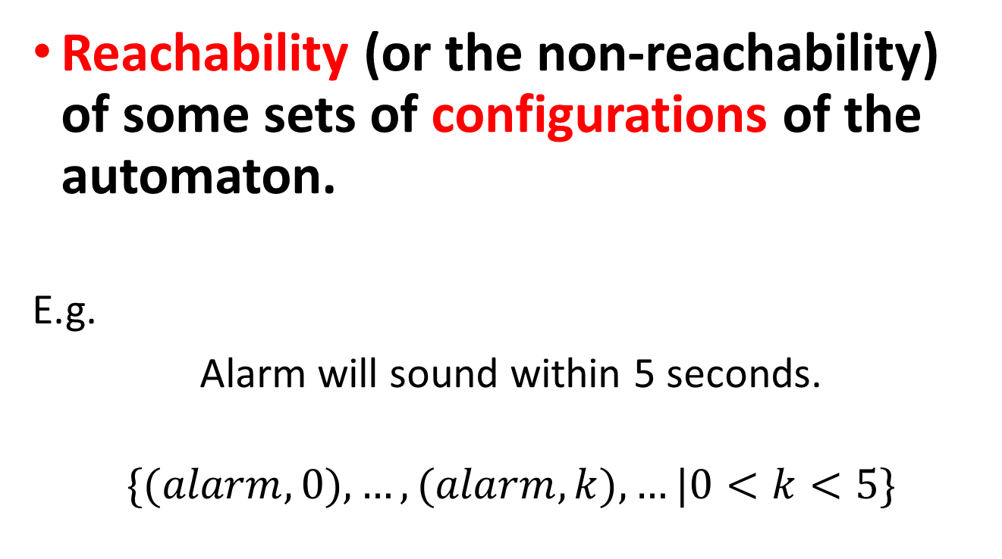
Method for simple properties
Reachability (or the non-reachability) of some sets of configurations of the automaton.
E.g.
Alarm will sound within 5 seconds.
$$\{(alarm, 0), …, (alarm, k), …|0<k<5\}$$
Notes:
To formally state such temporal and real-time properties, there exists some methods.
The simplest method is to express the property in terms of the reachability (or the non-reachability) of some sets of configurations of the automaton.
For example, suppose that we want to express property that alarm will sound within 5 seconds. Using this method, we could express by a set of configurations. (alarm, 0), (alarm, 1), (alarm, 2) and so on, as shown in the screen. This set can describe the property that alarm will sound within 5 seconds.

Slide 5
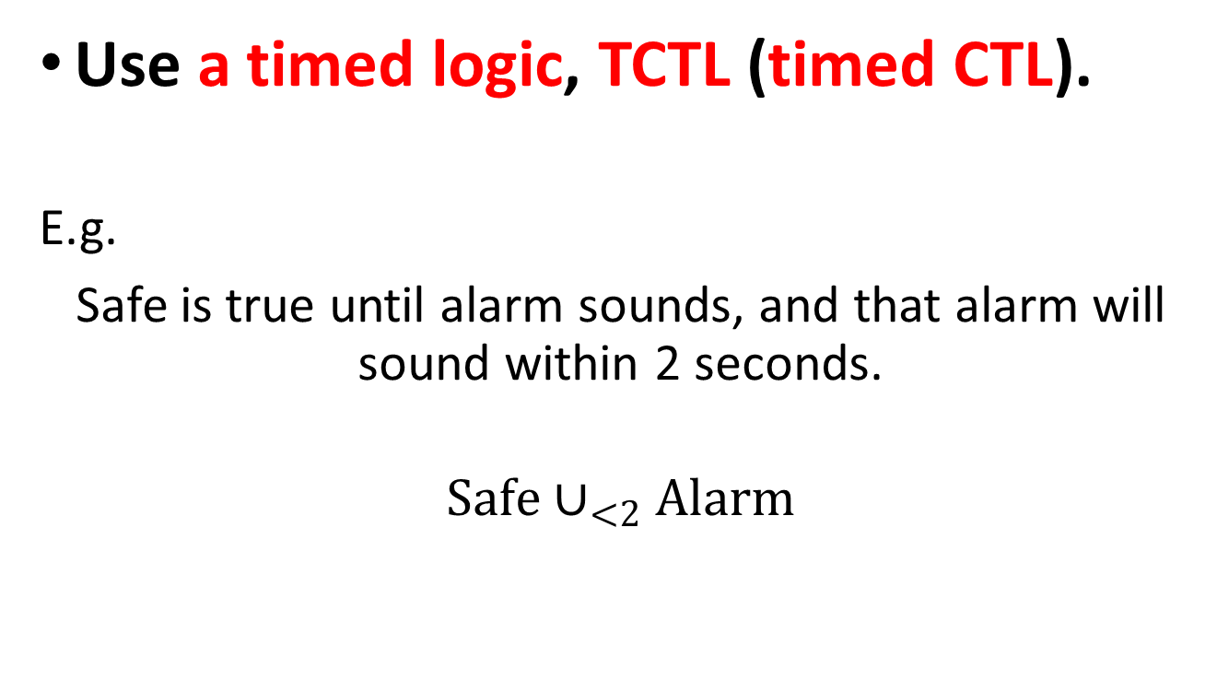
Method for complicated properties
Use a timed logic, TCTL (timed CTL).
E.g.
Safe is true until alarm sounds, and that alarm will sound within 2 seconds.
$$Safe∪_{<2}Alarm$$
Notes:
For more complicated properties, we use a timed logic, TCLT, namely timed CTL. This method is an extension of CTL by primitives expressing conditions on durations and dates.
For example, suppose that we want to express a property that safe is true until alarm sounds, and that alarm will sound within 2 seconds. Using TCTL, we could use a formula to express this property. Different from CTL, TCLT concerns the delay, and using comparison symbols to describe the condition, such as in this example, “less than 2” indicates “within 2 seconds”.
This is my part. Thanks for your listening.

