Slide 1

tES + visual attention
IEEE EMBC paper
Tianyi Zheng
Jimbo & Kotani Lab
D2

Slide 2
1. Experiment session
Time
Task
Task
tACS or Sham
EEG
EEG
tACS or Sham session
Intensity (peak-to-peak): 1.5mA
Frequency: 40Hz
Duration: 15 min
Electrode size: 3cm*3cm
Electrode location: Anode on P6, cathode on Cz
Safety note: [4mA, 60min)] is reported to be safe, and [1.5mA, 15min] is a much milder setting.
Antal A, et al. : Low intensity transcranial electric stimulation : safety, ethical, legal regulatory and application guidelines. Clin Neurophysiol, 128(9), pp. 1774-1809, 2017.
吉元 俊輔, 青山 一真, 梶本 裕之, 西川 敦: 人体通電の影響と安全基準. 生体医工学, 2020 年 58 巻 4-5 号 p. 147-159
12/18

Slide 3
2. Task
Stimulus
Endo Cue
Wait for Stimulus
Wait for Response
80%
Click!
50%
or
1s
0.5s or 1s
20%
No click
1.5 sec
Fixation
0.05s
Fixation
1.5s
1.5s
Stimulus
Exo Cue
Wait for Stimulus
Wait for Response
80%
Click!
50%
or
Flash twice 0.033s
0.5s or 1s
20%
No click
1.5 sec
0.05s
60 endogenous trials, 60 exogenous trials
Take about 9 min at all
12/18

Slide 4
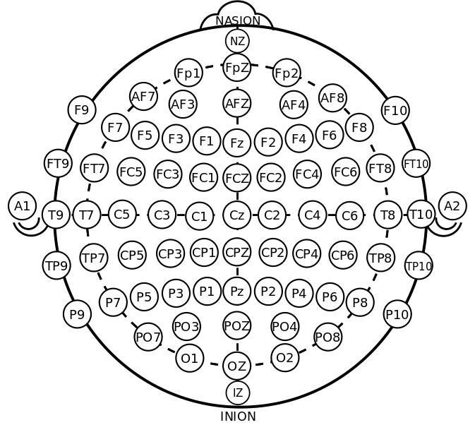
3. Electrode placement
EEG:
32 channels
GND - Fpz
REF - left ear
TRG – trigger from Arduino
tACS:
Anode: P6
Cathode: Cz
13/18

Slide 5
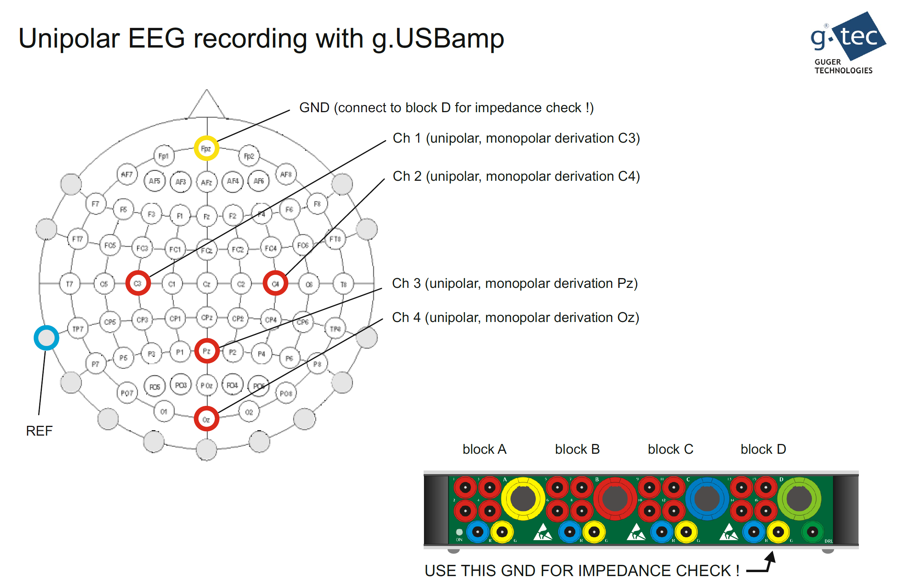
1
2
3
4
5
6
8
9
7
10
11
12
13
14
15
16
17
18
19
20
22
23
24
25
26
21
27
28
29
30
31
32

Slide 6
4. Behavior analysis
8 subjects at all.
4 receive sham stimulation and 3 of them achieve shorter reaction time after stimulation.
4 receive real stimulation and 3 of them achieve shorter reaciton time after stimulation.
13/18

Slide 7
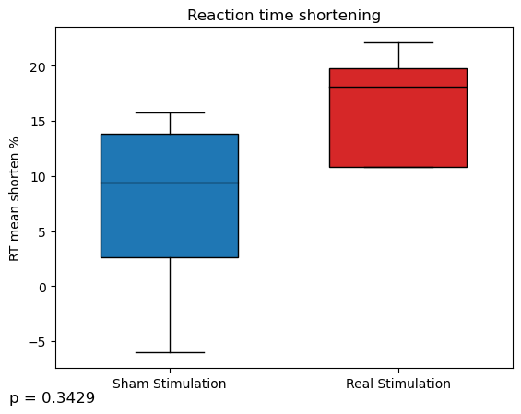
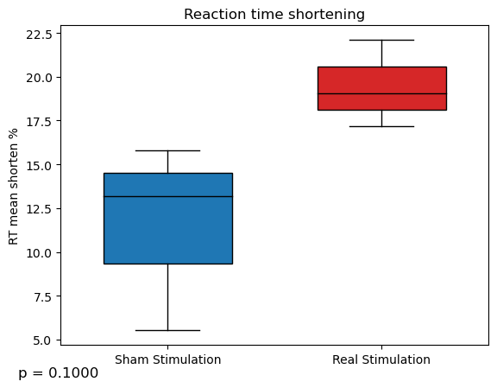
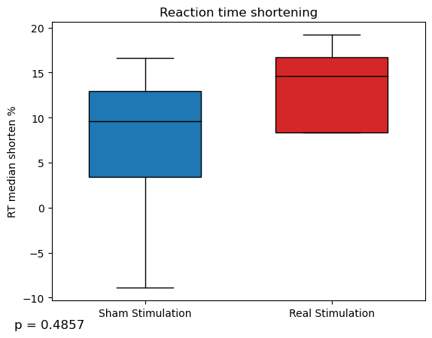
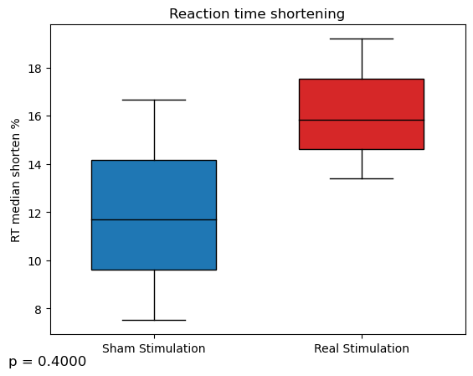
4. Behavior analysis (both endo and exo)
If do not drop reaction time worse case:
If drop reaction time worse case:
13/18

Slide 8
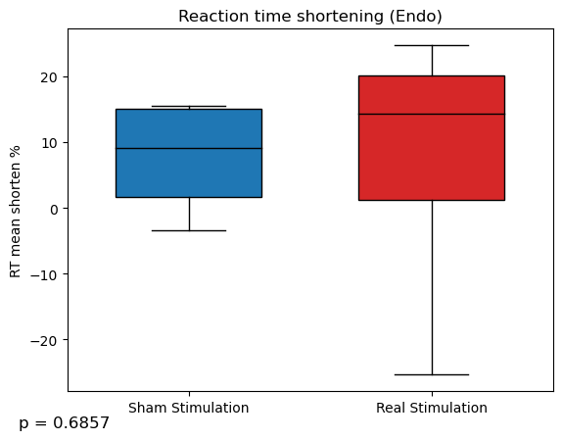
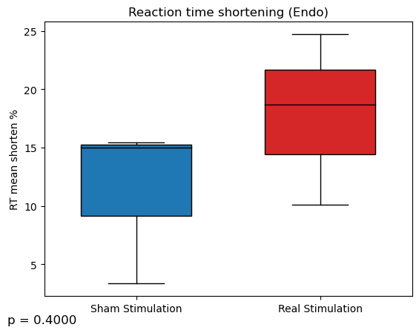
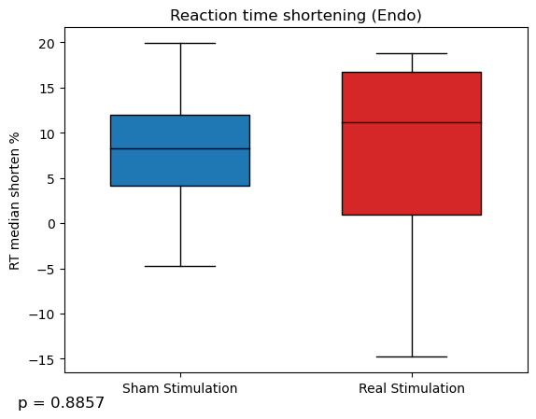
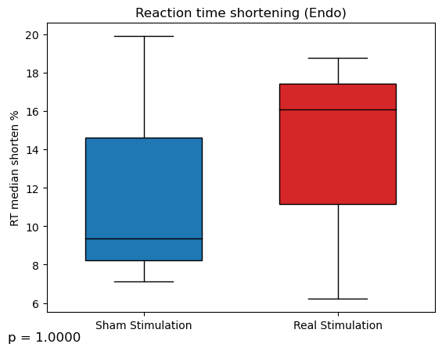
4. Behavior analysis (endo)
If do not drop reaction time worse case:
If drop reaction time worse case:
13/18

Slide 9
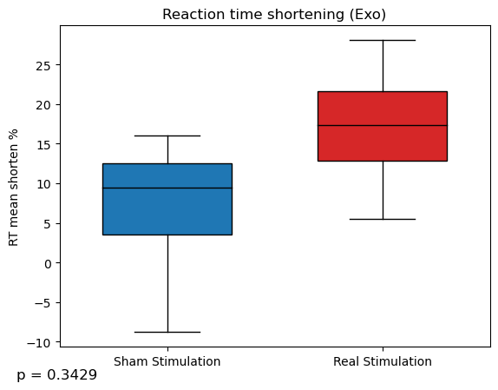
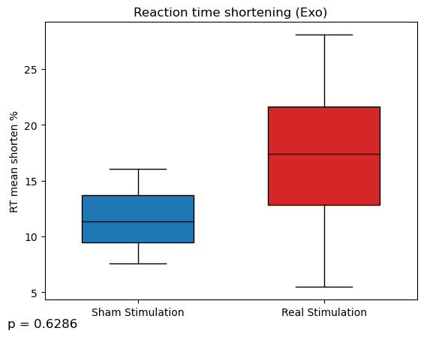
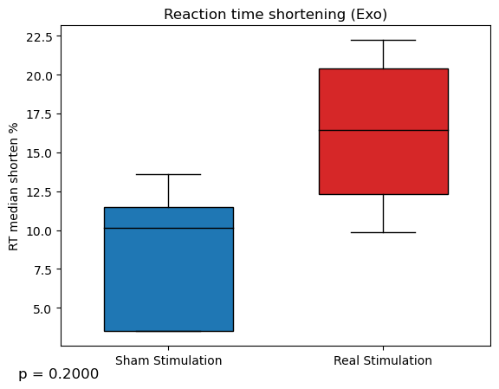
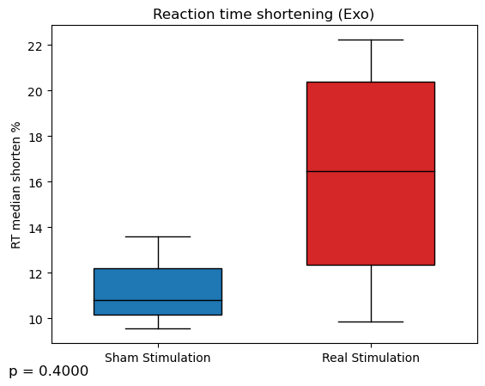
4. Behavior analysis (exo)
If do not drop reaction time worse case:
If drop reaction time worse case:
13/18

Slide 10
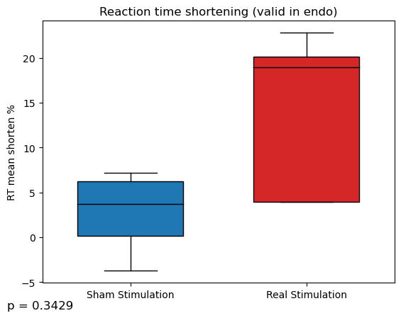
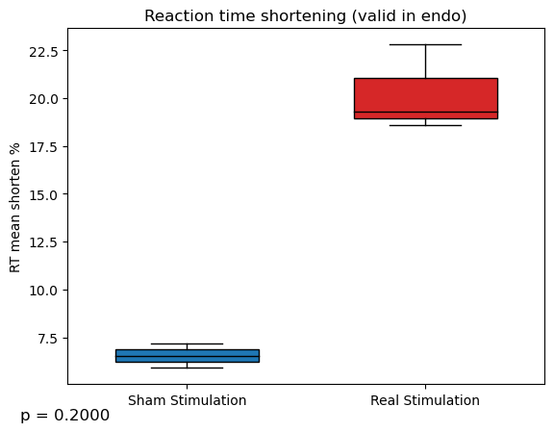
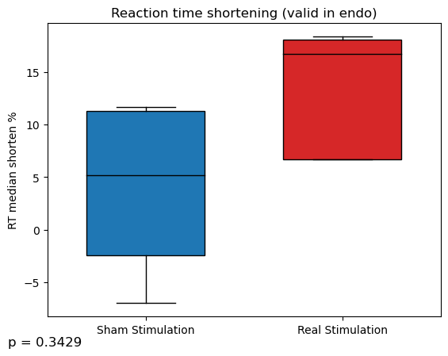
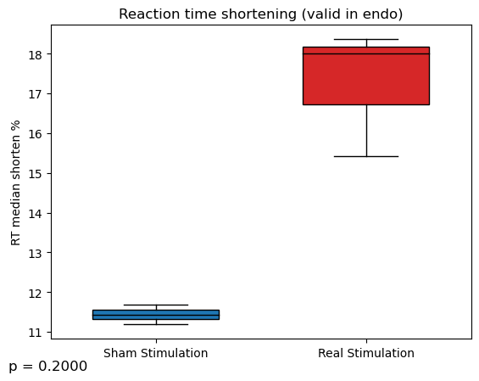
4. Behavior analysis (valid in endo)
If do not drop reaction time worse case:
If drop reaction time worse case:
13/18

Slide 11
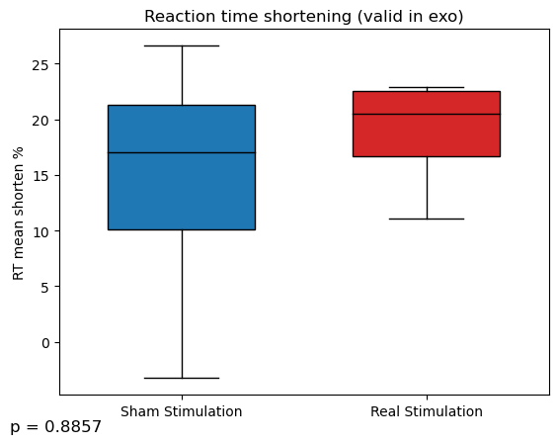
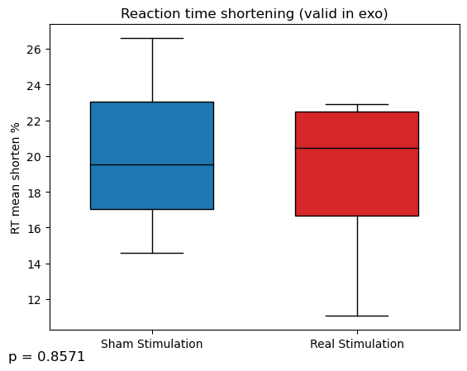
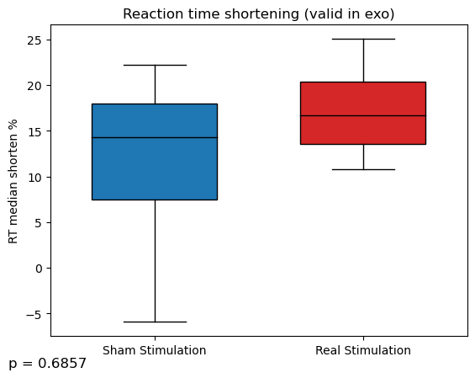
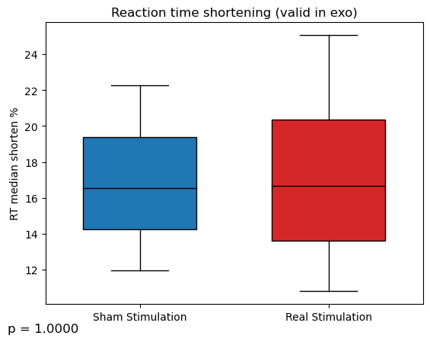
4. Behavior analysis (valid in exo)
If do not drop reaction time worse case:
If drop reaction time worse case:
13/18

Slide 12
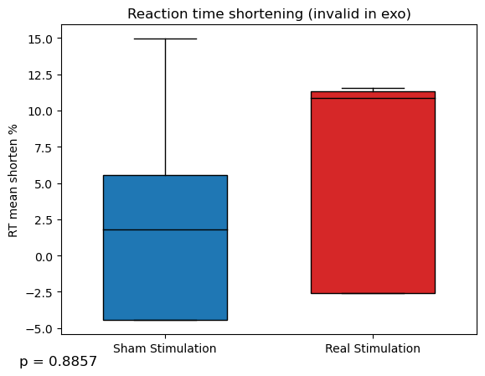
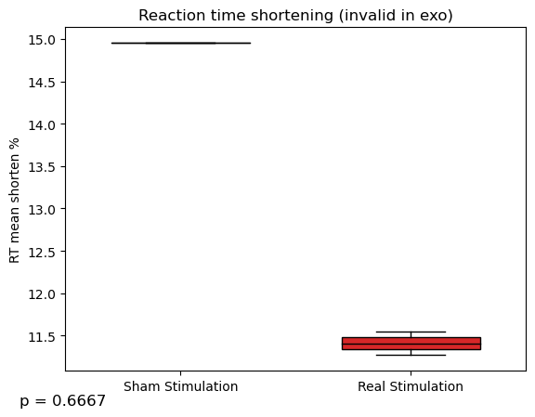
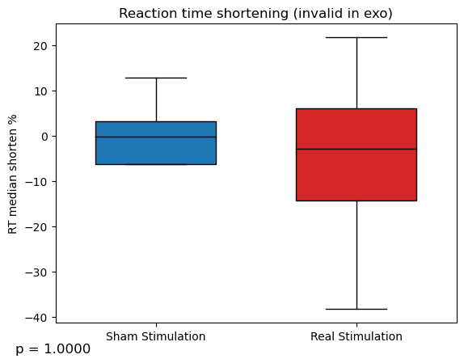
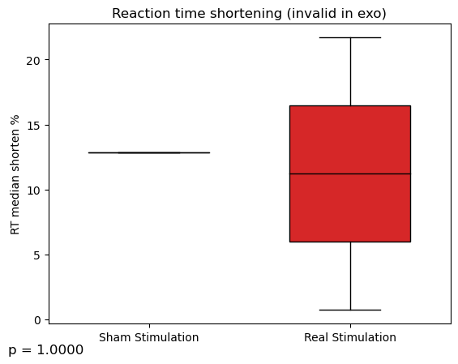
4. Behavior analysis (invalid in exo)
If do not drop reaction time worse case:
If drop reaction time worse case:
13/18

Slide 13
4. Behavior analysis (invalid in endo)
If do not drop reaction time worse case:
If drop reaction time worse case:
13/18

