Slide 1
Wait for Stimulus
Wait for Response
Endo Cue
Stimulus
Fixation
Fixation
Exo Cue
Wait for Stimulus
Stimulus
Wait for Response

Slide 2
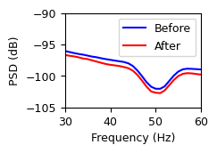
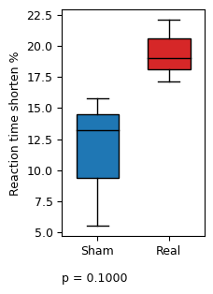
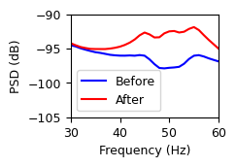
A
B
C

