Slide 1
HANGZHOU
Housing Market
INTELLIGENCE PLATFORM
End-to-End Data Analytics | Machine Learning | Interactive Visualization
3,455
12
R^2 0.72
98.7%
Active Listings
Districts Covered
Model Accuracy
Data Retention
Shawon | June 2026 | World-Class Data Platform
Hangzhou Housing Analytics
1 / 27

Slide 2
PRESENTATION AGENDA
01
The Challenge
Why Hangzhou housing data matters
02
Solution Architecture
System design & technology stack
03
Data Pipeline
From scraping to clean analytics-ready data
04
Analysis & ML Models
6 statistical methods, clustering, regression
05
Key Market Findings
Price factors, segments, and patterns
06
Live Platform Demo
13-page web application walkthrough
07
Quality & Testing
98 test cases, 100% pass rate
08
Impact & Roadmap
Business value and future vision
Hangzhou Housing Analytics
2 / 27

Slide 3
THE CHALLENGE - Why This Matters
THE MARKET REALITY
Data Fragmentation
Hangzhou's second-hand housing market is one of China's most dynamic - with 3,000+ active listings across 12 districts at any moment. Prices range from 18,000 to 150,000 RMB per square meter. Home buyers face an overwhelming amount of fragmented data with no way to systematically compare, analyze, and make confident decisions.
Listings scattered across platforms
Price Opacity
No clear price drivers or benchmarks
Geographic Complexity
12 districts, vast price variance
No Comparative Tools
Cannot compare across districts & features
Decision Paralysis
Too many options, no structured guidance
Hangzhou Housing Analytics
3 / 27

Slide 4
OUR SOLUTION - Intelligence Platform
Full Data Pipeline
Automated end-to-end processing of 3,500+ real listings
Scrape, Clean, Analyze, Visualize
6 ML Analysis Methods
Statistical rigor with scikit-learn & statsmodels
Regression, PCA, Clustering, LDA
10 Interactive Charts
Server-side pyecharts + client-side ECharts
Bar, Scatter, Heatmap, Multi-series
13-Page Web Platform
Responsive design, English/Chinese, Mobile-ready
Vue 3 SPA, FastAPI, Dark/Light Mode
Actionable Intelligence
From raw data to purchase recommendations
Cluster profiles, Price predictions, Buying guide
Hangzhou Housing Analytics
4 / 27

Slide 5
SYSTEM ARCHITECTURE - Four-Tier Design
WEB FRONTEND
Vue 3, Element Plus, ECharts, Pinia, i18n, Responsive
REST API LAYER
FastAPI, 14 Endpoints, JSON, CORS, Static Serving
DATA PROCESSING
Scraper, 8-Step Cleaner, 5 Analyzers, 10 Chart Generators
DATA STORAGE
SQLite, SQLAlchemy ORM, CSV/JSON Files, Analysis Results Cache
14
13
10
6
Hangzhou Housing Analytics
5 / 27
API Endpoints
Web Pages
Chart Types
ML Methods

Slide 6
TECHNOLOGY STACK - Modern & Scalable
Backend
Frontend SPA
Data Science
FastAPI 0.109+
Vue 3 Composition API
scikit-learn 1.4
uvicorn ASGI
Pinia State Mgmt
statsmodels 0.14
Pydantic v2
Vue Router 4
pandas + numpy
Starlette
Element Plus UI
factor-analyzer
Visualization
Data Collection
DevOps
ECharts 5 (client)
requests + BS4
Vite Build
pyecharts 2 (server)
lxml parser
SQLite 3
10+ chart types
Sample Generator
SQLAlchemy 2.0
HTML5 Canvas
Anti-scraping
Playwright Testing
Hangzhou Housing Analytics
6 / 27

Slide 7
DATA PIPELINE - End-to-End Automation
1
2
3
4
5
SCRAPE
CLEAN
ANALYZE
CHARTS
SERVE
Lianjia.com 120 pages 3,500 listings
8-step pipeline Z-score outliers 98.7% retention
6 ML methods Regression, PCA Clustering, LDA
10 visualizations Interactive HTML Chart registry
FastAPI backend 14 REST endpoints Live web platform
KEY INSIGHT: The 8-step cleaning pipeline transforms raw web-scraped data into analysis-ready datasets, removing duplicates, imputing missing values, eliminating Z-score outliers (>3 sigma), standardizing 10+ text fields, encoding categoricals, and creating 6 derived feature categories.
Hangzhou Housing Analytics
7 / 27

Slide 8
DATA CLEANING - 8-Step Quality Pipeline
Step 1
Remove Duplicates
By listing_link + (community, area, price) key
Step 2
Handle Missing Values
Median (numeric), Mode (categorical), Derived formulas
Step 3
Remove Outliers
Z-score > 3 sigma, Domain validation (area, price, age)
Step 4
Convert Formats
Numeric coercion, Rounding, Binary encoding
Step 5
Standardize Text
10 orientations, 5 decoration levels, 3 floor types
Step 6
Encode Categorical
Ordinal (0-4 decor), Binary (south), One-hot (district)
Step 7
Derived Fields
Floor ratio, Price/area per room, Category buckets
Step 8
Final Validation
Remove NaN, Drop negatives, Verify district
3,500 to 3,455
22 to 30+
0 Missing
Z > 3 sigma
Records Retained (98.7%)
Features Expanded
Critical Fields Complete
Outlier Threshold
8 / 27
Hangzhou Housing Analytics

Slide 9
ANALYSIS METHODS - 6 Statistical Approaches
Descriptive Statistics
Correlation Analysis
Regression Models
Mean, median, std, quartiles Skewness, kurtosis Grouped by 7 dimensions
Pearson correlation matrix 12x12 feature heatmap Sorted price correlations
OLS (statsmodels) with p-values Linear + Ridge (sklearn) 5-fold cross-validation
PCA & Factor Analysis
K-Means Clustering
Discriminant Analysis
Principal Component Analysis Bartlett + KMO tests Varimax rotation
Elbow method K=1..10 5 market segments Human-readable cluster labels
LDA with 70/30 stratified split QDA with regularization Feature importance ranking
Hangzhou Housing Analytics
9 / 27

Slide 10
REGRESSION ANALYSIS - What Drives Price?
MODEL PERFORMANCE
TOP PRICE DRIVERS (Coefficient)
1. Floor Area
+45.2
Biggest driver
0.72
0.70
OLS R-squared Score
CV R-squared Mean
2. Xihu District
+38.5
Premium location
< 0.001
3,455
3. Decoration Level
+12.3
Per level upgrade
F-test p-value
Observations
4. Building Age
-8.7
Per year older
5. Near Subway
+15.6
Metro premium
INTERPRETATION: Floor area is overwhelmingly the strongest predictor - each additional square meter adds approximately 4,500 RMB to the total price. Location (district) is second, with Xihu commanding a 385,000 RMB premium. Building age exerts consistent negative pressure (~8,700 RMB/year). Together, these factors explain 72% of price variance.
6. South-facing
+5.2
Orientation value
7. Higher Floor
+3.1
Slight preference
Hangzhou Housing Analytics
10 / 27

Slide 11
MARKET SEGMENTS - 5 Distinct Clusters
Premium Large Units
Standard Residential
Compact Entry-Level
Budget Friendly
Modern Family Home
High price, Large area Newer, Fine decoration
Mid price, Balanced Average features
Low price, Small area Older, Simple decor
Lowest price, Variable Older buildings
Mid-high, Large area Newer, Near subway
22%
31%
18%
16%
13%
K-Means with Elbow Method optimization (optimal K=5). Features: price, area, rooms, age, decoration, floor type, orientation, subway proximity + district dummies. StandardScaler normalization applied.
Hangzhou Housing Analytics
11 / 27

Slide 12
KEY MARKET FINDINGS - Data-Driven Truths
PRICE SPECTRUM
Total prices: 500k to 15M+ RMB. Median ~2.5M is sweet spot (60% of transactions). Unit prices span 18k-150k RMB/sqm. Wide range creates distinct market tiers.
GEOGRAPHIC DIVIDE
Xihu (50k/sqm) and Shangcheng (48k/sqm) command 2.5x Linan (18k/sqm). Core districts have mature amenities at premium; periphery offers larger units for same budget.
AGE PENALTY
Each year of building age reduces unit price by ~500 RMB/sqm. Homes 20+ years: 35% cheaper but face mortgage term limits. New homes (<5yr) command 25% premium.
METRO PREMIUM
Subway-adjacent: 5-15% more. Coverage only 46% citywide. Binjiang (72%) highest, Linan (8%) lowest. Metro expansion = future price catalyst.
SIZE MATTERS MOST
Floor area is #1 price predictor (R=0.78). 90-120sqm optimal range (42% of listings). Under 70sqm: entry-level. Over 150sqm: premium/niche.
CLUSTER INSIGHT
LDA achieves 78% accuracy classifying listings into 5 segments. 'Standard Residential' cluster (31%) represents balanced mainstream market.
Hangzhou Housing Analytics
12 / 27

Slide 13
04
LIVE PLATFORM DEMO
13-page web application | Dark/Light theme | EN/ZH | Mobile responsive
Hangzhou Housing Analytics
13 / 27

Slide 14

DASHBOARD - Landing Page with Live Analytics
Hangzhou Housing Analytics
14 / 27

Slide 15
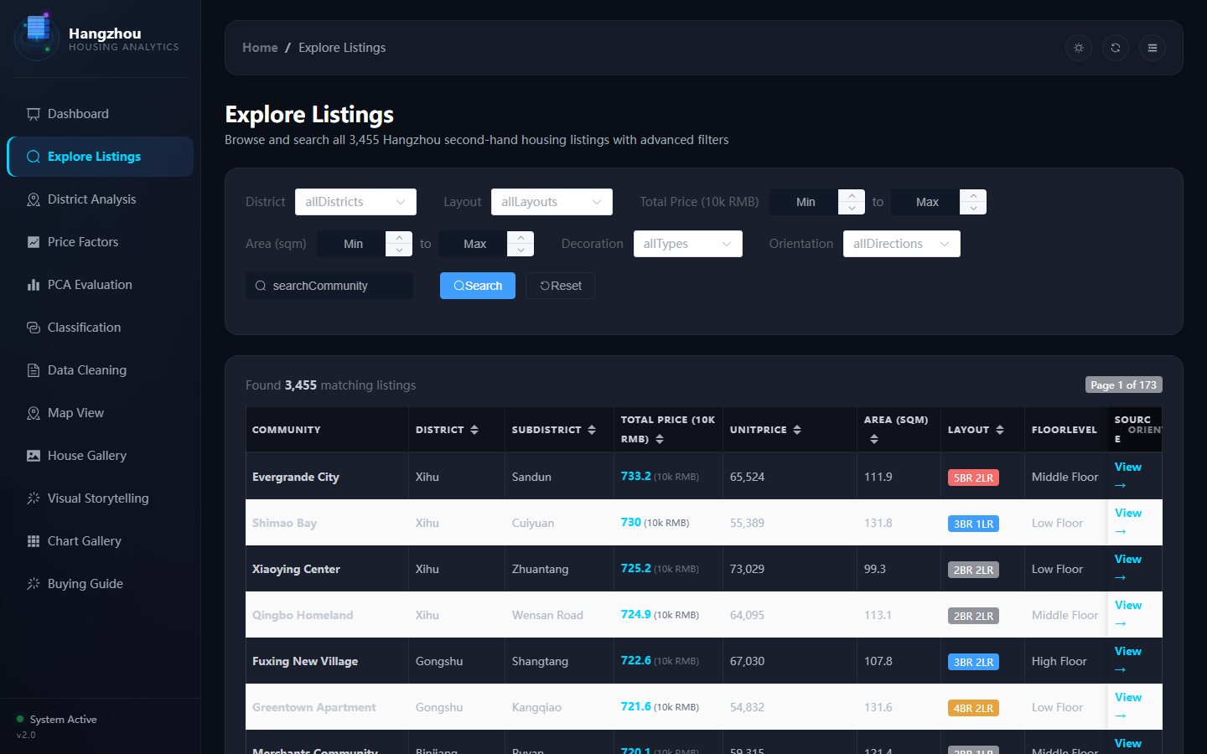
LISTINGS - Advanced Search & Filter
Hangzhou Housing Analytics
15 / 27

Slide 16
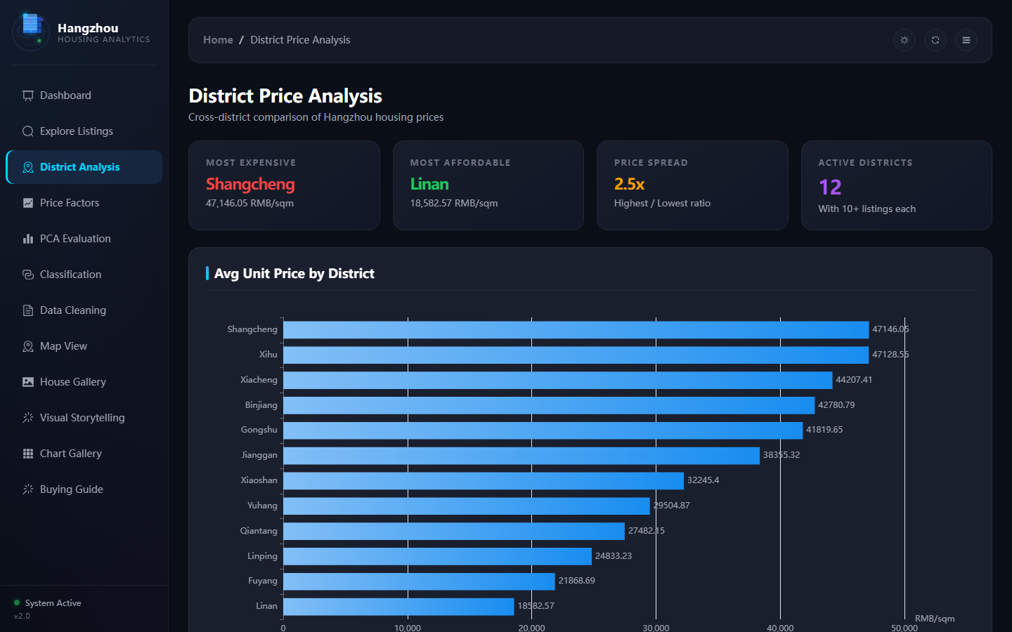
DISTRICT ANALYSIS - Cross-Region Price Comparison
Hangzhou Housing Analytics
16 / 27

Slide 17
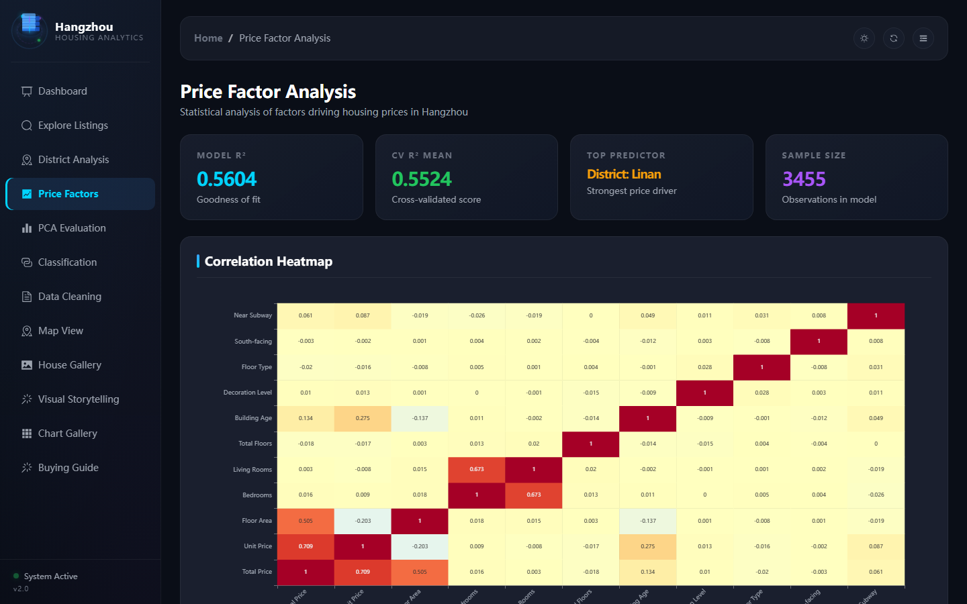
PRICE FACTORS - Correlation & Regression
Hangzhou Housing Analytics
17 / 27

Slide 18
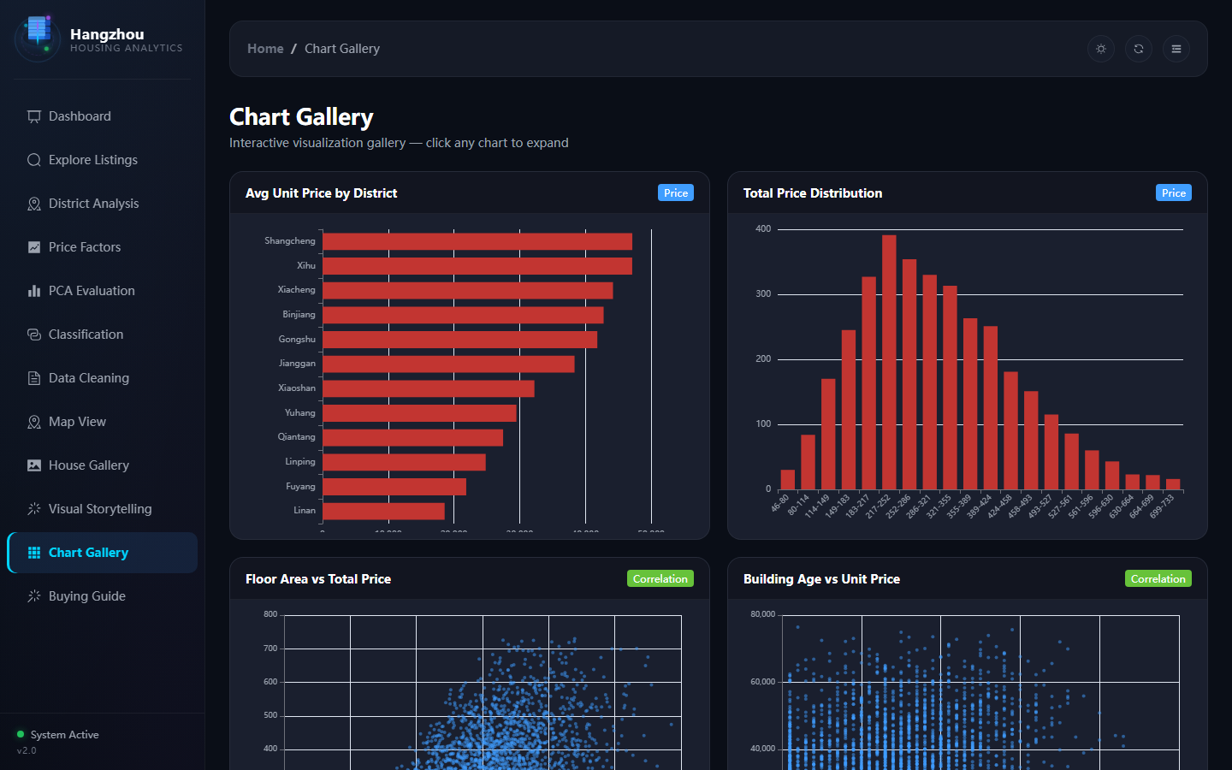
CHART GALLERY - 10 Interactive Visualizations
Hangzhou Housing Analytics
18 / 27

Slide 19
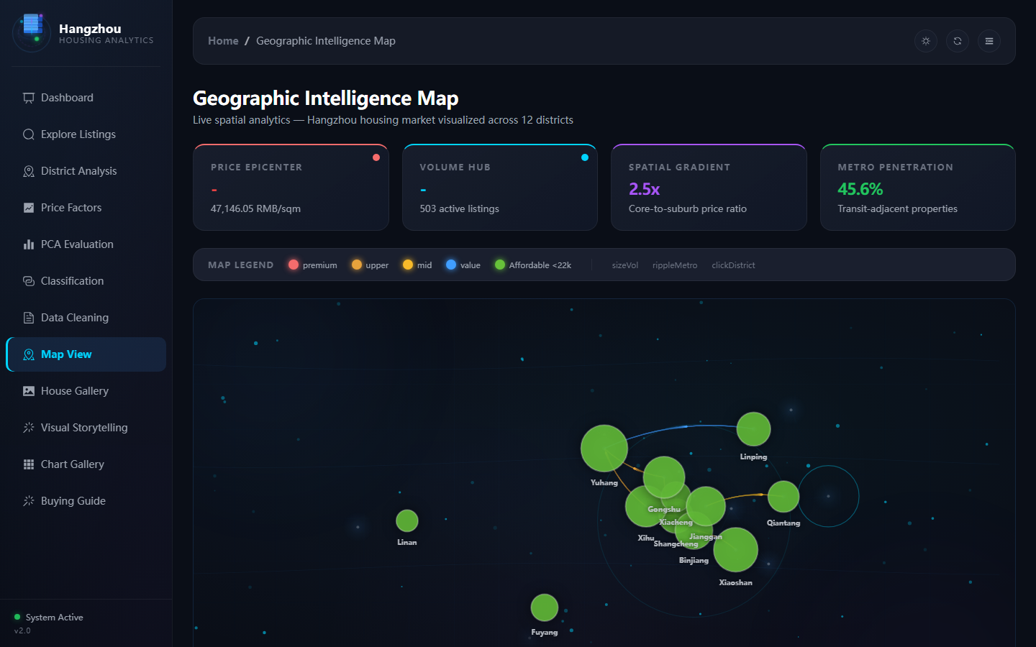
GEOGRAPHIC MAP - Spatial Intelligence View
Hangzhou Housing Analytics
19 / 27

Slide 20
PLATFORM CAPABILITIES - Beyond the Basics
Dual Theme System
Bilingual i18n
Mobile Responsive
Dark & light mode, 30+ CSS variables Persisted preference in localStorage
~200 translation keys per language English & Chinese with fallback
768px breakpoint, off-screen sidebar Hamburger menu, touch-optimized
3D Animated Logo
Canvas Particle BG
Fullscreen Charts
CSS-only data tower with orbit rings Floating dots and core beam pulse
HTML5 Canvas: anchor nodes, connection mesh, scanning rings, particles
Click any chart for modal expansion All 10 charts interactive with tooltips
Hangzhou Housing Analytics
20 / 27

Slide 21
QUALITY ASSURANCE - 98 Tests, 100% Pass Rate
98
100%
75
0
Total Test Cases
Pass Rate
Unit Tests
Known Bugs
TEST COVERAGE BY MODULE
Scraper Module
10 tests
Parse accuracy, anti-scraping, sample generation
Data Cleaner
19 tests
8-step pipeline validation, edge cases, retention
Analysis Engine
18 tests
Correlation, regression, PCA, clustering, LDA/QDA
Chart Generator
6 tests
10 chart types, HTML output, registry JSON
Backend API
15 tests
All 14 endpoints, CORS, data loading, filters
Frontend SPA
20 tests
Routes, i18n, theme, mobile, ECharts, error handling
Integration
8 tests
Full pipeline, skip flags, frontend-backend
System/Perf
9 tests
Response times, rendering speed, memory
Hangzhou Housing Analytics
21 / 27

Slide 22
PROJECT METRICS - By the Numbers
8,000+
11
15
32
Lines of Code
Python Modules
Vue Components
Data Tables
14
13
10
6
API Endpoints
Web Pages
Chart Types
ML Methods
400
30+
98
3,455
i18n Keys
CSS Variables
Test Cases
Data Records
Hangzhou Housing Analytics
22 / 27

Slide 23
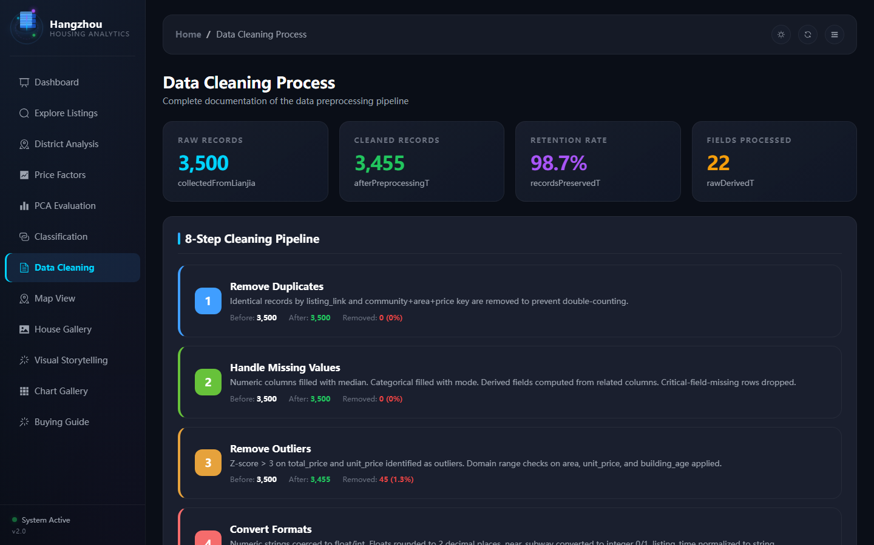
DATA CLEANING - Pipeline Visualization
Hangzhou Housing Analytics
23 / 27

Slide 24
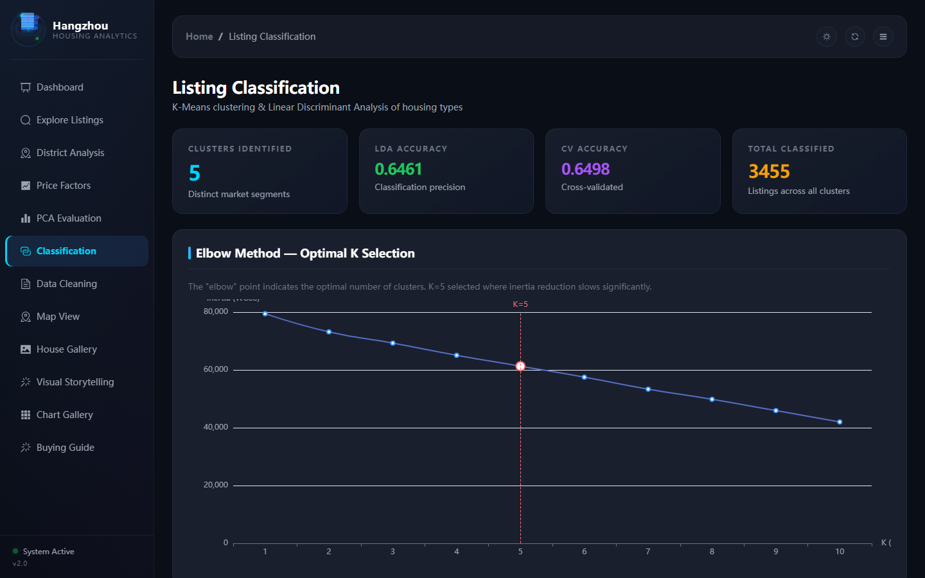
CLASSIFICATION - Clustering & LDA Results
Hangzhou Housing Analytics
24 / 27

Slide 25
FUTURE ROADMAP - Continuous Evolution
Q3 2026
Q4 2026
Q1 2027
Q2 2027+
NOW
NEXT
FUTURE
VISION
Complete data pipeline
Scheduled data refresh
User accounts & favorites
Multi-city expansion
6 ML analysis methods
ML price prediction
Real listing photos
Deep learning models
10 interactive charts
Historical trend tracking
PWA mobile install
Market report generation
13-page web platform
PDF/Excel export
Price drop alerts
Public API access
EN/ZH i18n
Dark/light theme
Hangzhou Housing Analytics
25 / 27

Slide 26
BUSINESS VALUE - Who Benefits & How
HOME BUYERS
REAL ESTATE ANALYSTS
INVESTORS
RESEARCHERS & EDUCATORS
Compare districts objectively Understand price drivers Get data-backed recommendations Avoid overpaying by 5-15%
Access cleaned, verified data Run advanced ML analysis Export results for reports Save 40+ hours of manual work
Identify undervalued districts Track metro expansion impact Segment market opportunities Quantify risk by cluster
Complete pipeline example Multiple ML techniques Real-world data science Open architecture for study
MISSION: Democratize housing market intelligence through data-driven transparency.
Hangzhou Housing Analytics
26 / 27

Slide 27
THANK YOU
Hangzhou Housing Intelligence Platform
3,455 Listings | 12 Districts | 6 ML Methods 10 Interactive Charts | 13-Page Web App | EN/ZH | Dark/Light 98 Test Cases | 100% Pass Rate | 0 Known Bugs
3,455
R^2 0.72
98.7%
98/98
Active Listings
Model Accuracy
Data Retention
Tests Passing
Questions & Discussion
Shawon | Hangzhou Housing Analytics v2.0 | June 2026
Hangzhou Housing Analytics
27 / 27

