Slide 1
SECURING HOME IOT SETUP AT NETWORK ARCHITECTURE LEVEL

Slide 2
INTRODUCTION
IoT revolutionizes home automation by enhancing convenience and control.
Smart homes consist of connected devices like thermostats and cameras.
IoT introduces efficiency but also cybersecurity risks.
Weak authentication, unencrypted communication, and bad access control are common vulnerabilities.
The goal is to secure IoT networks using WPA3 encryption, VLAN segmentation, and MAC filtering.
Notes:
The emergence of the Internet of Things (IoT) has greatly revolutionised home automation, providing convenience, efficiency and better control of household systems. Converged Smart homes, which consist of connected devices like thermostats, lights, cameras, and voice assistants, support convenient user experiences with the ability to monitor and control the home remotely. The increasing integration of IoT in houses has turned everyday life more intelligent and smarter. But such connectivity also poses a great cybersecurity threat. Poorly authored authentication and unencrypted communications, bad access control, and vulnerability to outsiders are common threats to IoT devices, which makes them a desirable target to attackers. These vulnerabilities may cause unauthorised access, data leak, and device malfunction. This study is aimed at modelling and simulating a secure architecture IoT network with the view to solving these vulnerabilities. Through using high-end security protocols like WPA3 encryption, VLAN segmentation, and MAC filtering, this research will help to strengthen the security of smart homes against cyberattacks.

Slide 3
LITERATURE REVIEW
IoT security remains a major issue due to device vulnerabilities.
Unauthorized access via weak or default passwords is common.
Lack of encryption exposes sensitive data to interception.
WPA3 encryption improves security against brute-force attacks.
VLAN segmentation and RBAC enhance network security and access control.
Notes:
The concept of IoT security is still a major issue because most devices and networks used are vulnerable. Unauthorised access to IoT devices is one of the most frequent problems, which can be achieved with the help of common and weak passwords or default ones. Most of the IoT devices are not very strong in security, which exposes them to susceptibility to brute-force attacks and unworthy manipulation. Furthermore, encryption has not been used in most cases of IoT communication, thus predisposing sensitive data to spying and information interception. These weaknesses ensure that there is a significant need to improve the security processes in IOT systems (Abiodun et al. 2021). To reduce such risks, the concept of “WPA3 encryption” has been developed, which serves to perform wireless network encryption with enhanced safety structures against brute-force attacks. Furthermore, network segmentation and “role-based access control (RBAC)” have emerged as solutions. Home automation has seen considerable growth with the influx of the “Internet of Things(IoT)”, which comes with ease of use and efficiency, and provides improved control over the systems in a household. With the help of interconnected gadgets, including thermostats, lights, cameras, and voice assistants, smart homes allow users to operate programmatically and create seamless experiences since one can monitor and manage them remotely. The increased use of IoT in homes has made everyday life more connected and smart.

Slide 4
RESEARCH METHODOLOGY
Two-phase approach: insecure network setup followed by security measures.
Phase 1: Connect devices to an unsecured router for initial testing.
Phase 2: Secure network with WPA3, VLANs, MAC filtering, and RBAC.
Simulation performed using Cisco Packet Tracer.
Test results help validate the security measures' effectiveness.
Notes:
The research approach to this paper is the process of developing a two-point network structure of the smart home IoT environment. The insecure IoT network is the first stage that starts with the connection between several devices, including a laptop, smart light, smart camera, and smartphone, and a router, but they are not secured. The said configuration mimics a typical unsecured smart home network, where one can detect the potential weaknesses, which include direct access, poor authentication, and plaintext-based communication (Ahmad et al. 2024). During the second step, the network will be made secure with the help of “WPA3 encryption” to secure wireless communication, “VLAN segmentation” of critical and non-critical devices, MAC address filtering, and “role-based access control (RBAC)” to prevent unauthorised access. Such security precautions will help to counter the risks pointed out at the initial stage. The Cisco Packet Tracer application is used to simulate a secure and vulnerable network setup. With the help of Packet Tracer, it will be possible to deploy devices virtually, cogitate over the setup of security attributes, and check network interactions in a controlled setting.

Slide 5
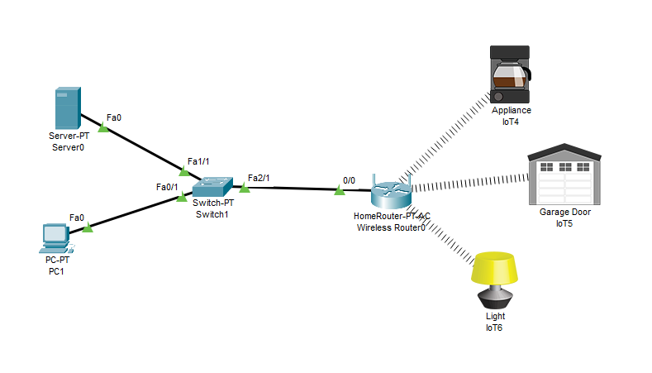
INSECURE NETWORK SETUP
Initial network setup involves devices like laptop, smart light, and camera.
Devices connected to an open router without any encryption.
DHCP is enabled for automatic IP assignment.
No security measures were implemented in this phase.
The network was vulnerable to unauthorized access and eavesdropping.
Notes:
The basic configuration is a non-secure IoT Wifi network consisting of three devices: a laptop, a smart light, and a smart camera, all relating to an open “WRT300N wireless router”. Such devices are set with DHCP so that the IP addresses are issued automatically by a router.
There are no security measures, as a result of which the equipment could freely exchange messages within the network (Latif et al. 2022). This arrangement exposed the network to various threats because unapproved devices could connect and access the network easily.

Slide 6
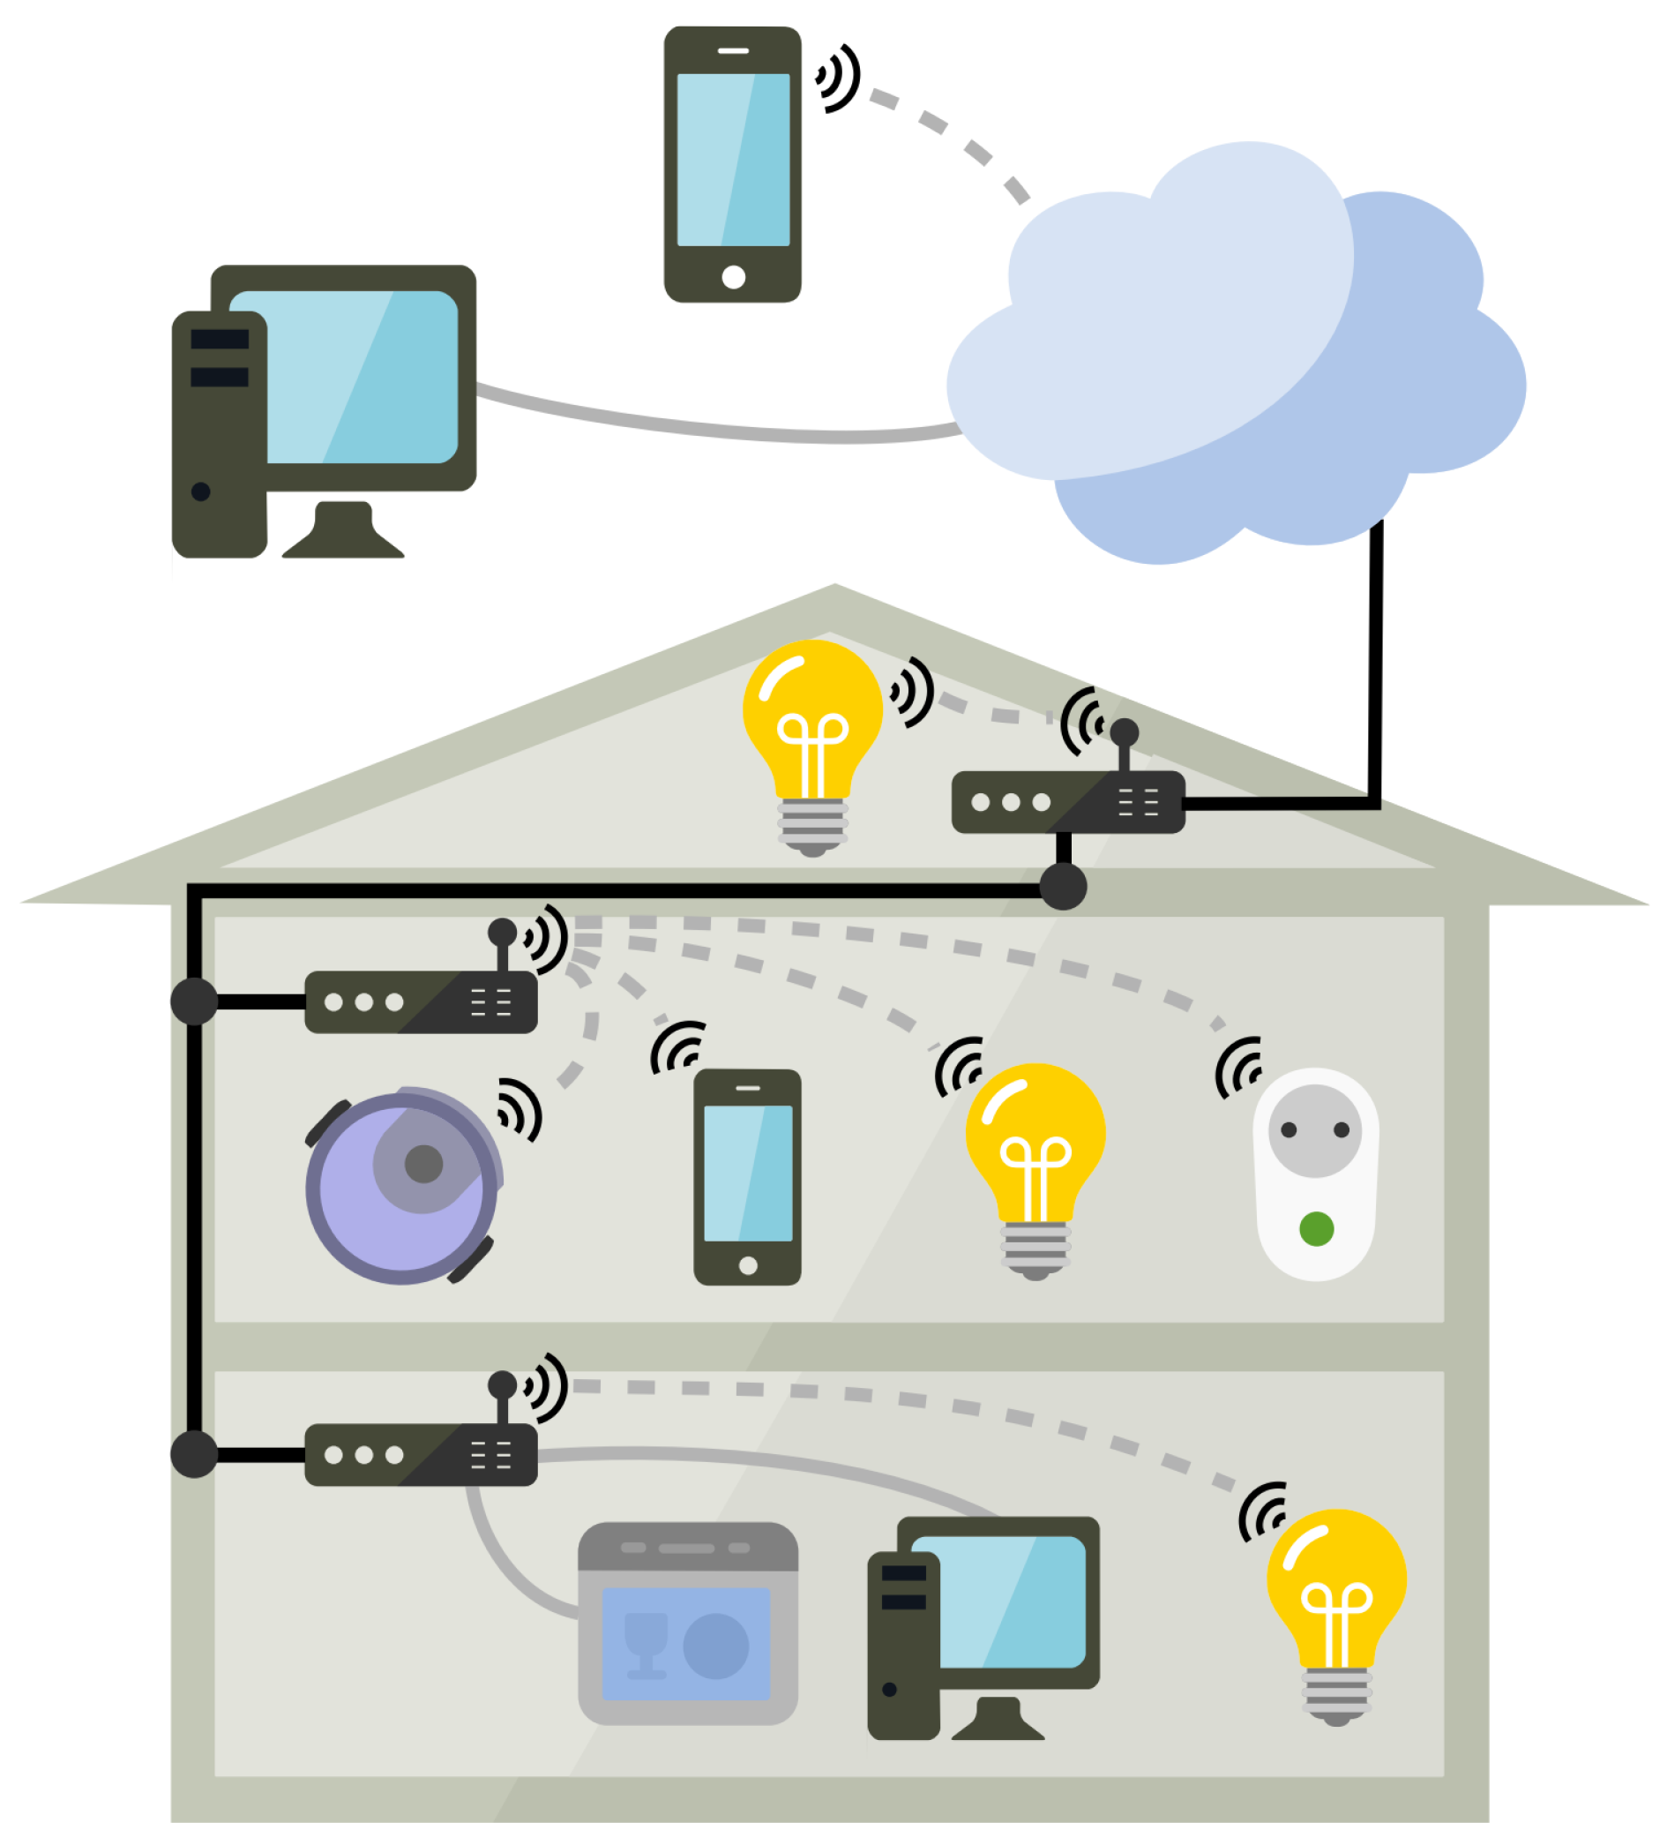
SECURING THE NETWORK
WPA3 encryption implemented to secure wireless communication.
VLAN segmentation isolated critical devices from non-critical ones.
MAC filtering allowed only authorized devices to connect.
Role-based access control (RBAC) ensured device-specific permissions.
These measures enhanced the network security, preventing unauthorized access.
Notes:
Several measures are taken to increase the security of the network:
The router is also encrypted using WPA3, a range of solid encryption on wireless communications.
VLAN Segmentation came into place to provide network division into remote units. When it came to critical devices like the smart camera, it is properly placed in a different VLAN compared to the less critical devices, like the smart light.

Slide 7
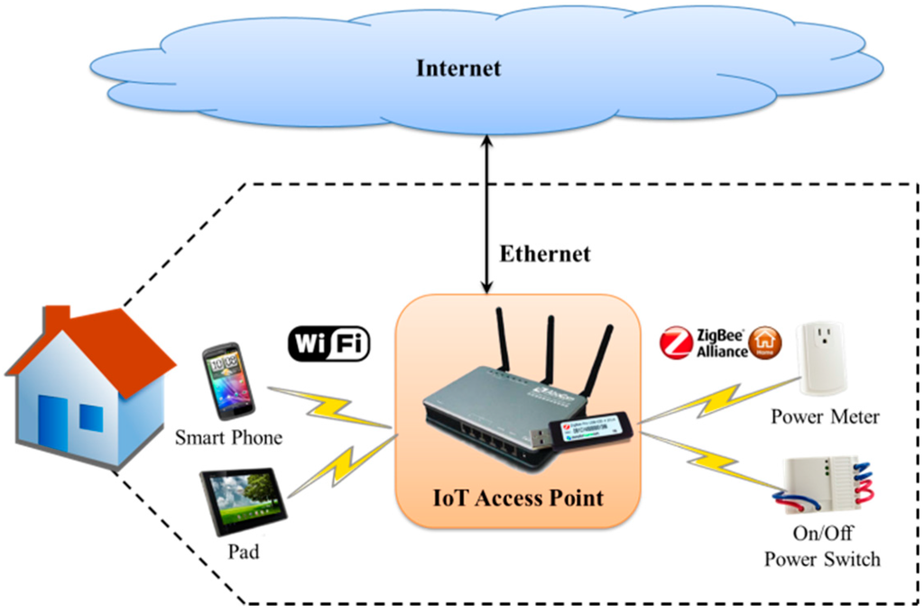
RESULTS - IMPROVEMENT IN SECURITY
Devices in separate VLANs showed improved isolation.
Only authorized devices could connect to the network.
Network segmentation restricted unnecessary cross-communication.
WPA3 encryption ensured encrypted communication between devices.
MAC filtering added an extra layer by blocking unauthorized devices.
Notes:
The MAC Filtering is also applied, and only the devices having previously agreed-upon addresses can connect to the network (Lata and Kumar, 2022). This gave an extra security measure whereby unauthorised devices are not allowed access.
Once these measures of security are implemented, communication between devices is less free, and unauthorised access is greatly limited. Each VLAN could interconnect its devices without limitation.

Slide 8
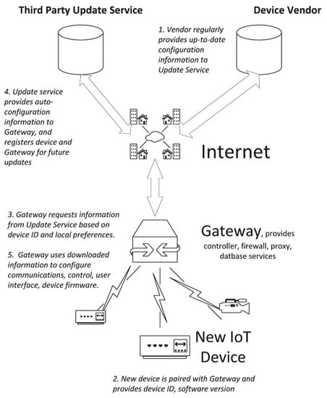
CHALLENGES ENCOUNTERED
Misconfiguration of VLANs initially blocked communication between devices.
VLAN issues resolved through proper VLAN settings.
MAC filtering caused devices to fail to connect initially.
Configuration errors in ACL and VLAN resulted in connectivity issues.
These challenges were addressed by carefully verifying settings.
Notes:
In the simulation, there are difficulties, including misconfigured VLANs that, in the first place, led to the inability of devices in the same segment to communicate with each other effectively (Rachit Bhatt and Ragiri, 2021). This is a problem that is solved using a close examination of VLAN settings. A MAC filtering misconfiguration occurred and which gave the device difficulties in connecting in the first place, but this is solved by checking the MAC address list through updating.

Slide 9
CONCLUSION
WPA3 encryption, VLAN segmentation, and MAC filtering enhanced security.
IoT networks are now better protected against unauthorized access.
Network structure optimization is crucial for smart home security.
Future work includes investigating additional security measures.
Automation of security controls could further enhance IoT protection.
Notes:
This paper has managed to show how IoT network security in smart homes can address the risks inherent in poorly authenticated devices, unsecured communications, and ill-organised access. The introduction of WPA3 encryption protocol, VLAN segmentation, and MAC filtering allowed for a substantial increase in the network security level and prevented unauthorised access to it, as well as secure communication between the devices. The study points to the significance of a well-defined network structure in smart homes that would ensure high security of sensitive information and the integrity of devices. Though we had encountered problems like VLAN misconfiguration, misconfiguration of the MAC filter, they have been resolved, and this has resulted in a more secure network environment. The potential questions that might be considered in future studies are the investigation of additional security measures and automated control tools to protect the IoT devices.

Slide 10
REFERENCES
Touqeer, H., Zaman, S., Amin, R., Hussain, M., Al-Turjman, F. and Bilal, M., 2021. Smart home security: challenges, issues and solutions at different IoT layers. The Journal of Supercomputing, 77(12), pp.14053-14089.
Lata, M. and Kumar, V., 2022. IoT network security in smart homes. Cybersecurity in smart homes: architectures, solutions and technologies, pp.155-176.
Sisavath, C. and Yu, L., 2021. Design and implementation of security system for smart home based on IOT technology. Procedia Computer Science, 183, pp.4-13.
Notes:
Simadiputra, V. and Surantha, N., 2021. Rasefiberry: Secure and efficient Raspberry-Pi based gateway for smarthome IoT architecture. Bulletin of Electrical Engineering and Informatics, 10(2), pp.1035-1045.
Latif, S.A., Wen, F.B.X., Iwendi, C., Wang, L.L.F., Mohsin, S.M., Han, Z. and Band, S.S., 2022. AI-empoared, blockchain and SDN integrated security architecture for IoT network of cyber physical systems. Computer communications, 181, pp.274-283.

Slide 11
THANK YOU!

