Slide 1
TEXT CLASSIFICATION
GROUP 17
SR NO | NAME | ROLL NUMBER
1 | KHUSHI PATEL | AU2040068
2 | AASTHA GAUDANI | AU2040032
3 | DEVYASH SHAH | AU2040152
4 | SIMRAN KHOJA | AU1910606

Slide 2
INTRODUCTION
This project aims to perform text category classification on a BBC news dataset using machine learning techniques. The goal is to develop a model that can accurately predict the category of a given article based on its text content. This projects is using variety of machine learning algorithms. Our data consist of 2225 rows and 2 columns. One column consist of the Text and the other column contains the corresponding category of the Text.

Slide 3
PROBLEM STATEMENT
Our goal is to develop a machine learning model that can accurately assign a label to each of the text from a predefined set of categories. To achieve our goal we have implemented two models using different methods of feature extraction.

Slide 4
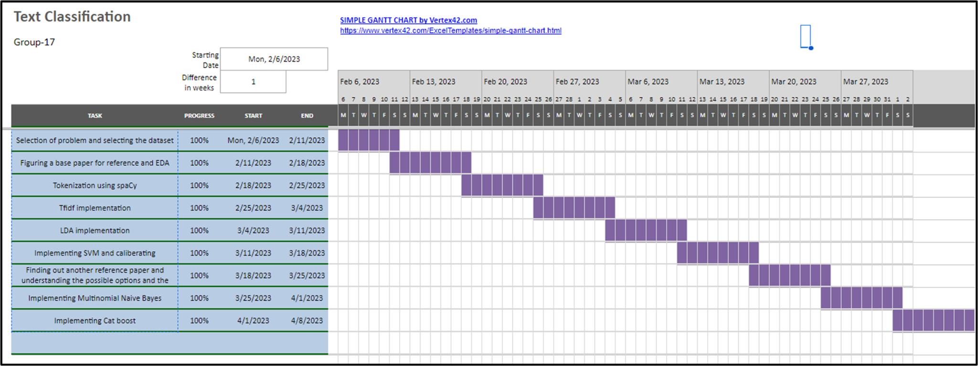
GANTT CHART

Slide 5
EXISTING BODY OF WORK
The base paper proposes an algorithm that is a combination of both LDA and SVM. The results observed from experiments on benchmark dataset showed how proposed model outperformed other models with VSM+SVM and LSI+SVM.

Slide 6
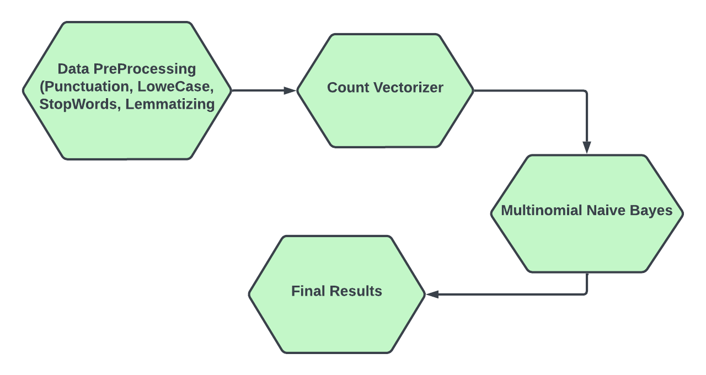
APPROACH - 1

Slide 7
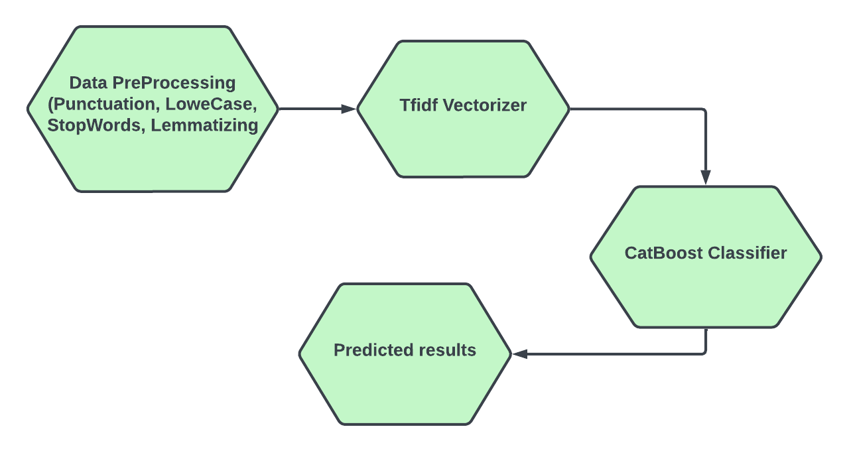
APPROACH - 2

Slide 8
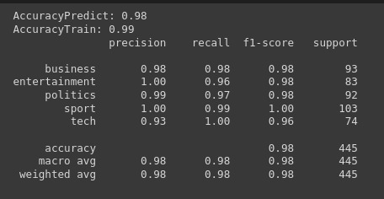
FINAL RESULTS
OVERFITTING EXPLANATION

Slide 9
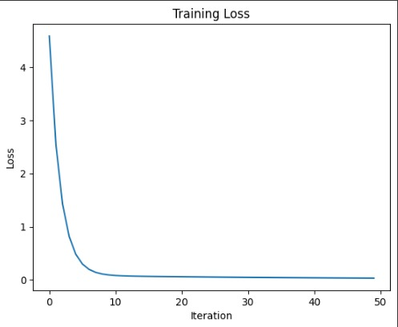
LOSS PER ITERATION

Slide 10
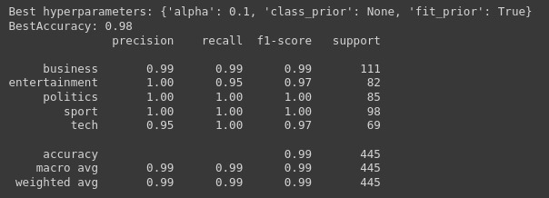
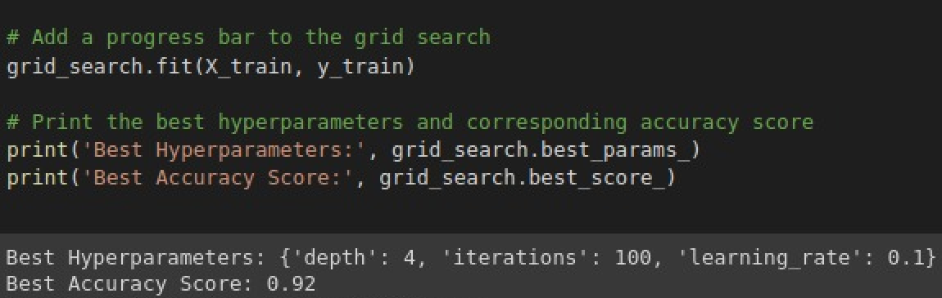
COMPARISON OF TWO END SEM MODELS
ACCURACY WITH MNB
ACCURACY WITH CATBOOST

Slide 11
CONCLUSION
We saw that MNB performs well when the dataset is relatively small as it requires less data to get trained. In the MNB model prediction were based on the probabilities. Hence we conclude that MNB model performed best out of four.

Slide 12
WORK DONE
NAME | WORK DONE
SIMRAN KHOJA | DATA CLEANING, CATBOOST
KHUSHI PATEL | MNB, TFIDF IMPLEMENTATION
AASTHA GAUDANI | MNB, LDA IMPLEMENTATION
DEVYASH SHAH | CATBOOST, LDA IMPLEMENTATION

Slide 13
REFERENCE
Z. Liu, M. Li, Y. Liu and M. Ponraj, "Performance evaluation of Latent Dirichlet Allocation in text mining," 2011 Eighth International Conference on Fuzzy Systems and Knowledge Discovery (FSKD), Shanghai, China, 2011, pp. 2695-2698, doi: 10.1109/FSKD.2011.6020066.
Support Vector Machine (SVM) algorithm - javatpoint. www.javatpoint.com. (n.d.). Retrieved March 11, 2023, from https://www.javatpoint.com/machine-learning-support-vector-machine-algorithm
Jain, P. (2021, June 1). Basics of countvectorizer. Medium. Retrieved March 11, 2023, from https://towardsdatascience.com/basics-of-countvectorizer-e26677900f9c
Sklearn.svm.SVC. scikit. (n.d.). Retrieved March 11, 2023, from https://scikit-learn.org/stable/modules/generated/sklearn.svm.SVC.html
Performance evaluation of latent Dirichlet allocation in text mining ... (n.d.). Retrieved March 11, 2023, from https://ieeexplore.ieee.org/abstract/document/6020066
Sklearn.naive_bayes.multinomialnb. scikit. (n.d.). Retrieved April 15, 2023, from https://scikit-learn.org/stable/modules/generated/sklearn.naive_bayes.MultinomialNB.html
Chepenko, D. (2022, August 10). Introduction to gradient boosting on decision trees with catboost. Medium. Retrieved April 15, 2023, from https://towardsdatascience.com/introduction-to-gradient-boosting-on-decision-trees-with-catboost-d511a9ccbd14

