Slide 1
CAPSTONE PROJECT
KEYLOGGERS AND IT’S SECURITY
Presented by
SHAM GANESH ..M – MADHA ENGINEERING COLLEGE – INFORMATION TECNOLOGY

Slide 2
OUTLINE
Problem Statement
Proposed System/Solution
System Development Approach
Algorithm and deployment
Results
Conclusion
Future Scope
Reference

Slide 3
PROBLEM STATEMENT
The proliferation of keyloggers poses a significant threat to information security, as they are capable of stealthily capturing and transmitting sensitive data, including passwords, financial information, and personal correspondence. Despite advancements in antivirus and cybersecurity measures, keyloggers continue to evolve, employing sophisticated techniques to evade detection and persist within systems.

Slide 4
PROPOSED SYSTEM/SOLUTION
Our proposed system entails the development of a keylogger using Python's Tkinter library for the GUI, alongside the pynput library for capturing keyboard inputs. The keylogger records keystrokes and saves them in both text and JSON formats for comprehensive analysis.

Slide 5
SYSTEM DEVELOPMENT APPROACH
The "System Approach" section outlines the overall strategy and methodology for developing and implementing the phishing attack. Here's a suggested structure for this section:
Python: For programming the keylogger functionality.
Tkinter: For building the graphical user interface (GUI).
pynput: For capturing keyboard inputs.
JSON: For storing keystroke data in a structured format.

Slide 6
ALGORITHM AND DEPLOYMENT
Below is an algorithm that outlines the functionality of the provided Python program, which is a basic keylogger implemented using the Tkinter GUI toolkit and the pynput library:
ALGORITHM:
1.Import Necessary Libraries:
2.Global Variables:
3.Define Functions:
4.Define `on_press` Function:
5.Define `on_release` Function:
6.Define `start_keylogger` Function:
7.Define `stop_keylogger` Function:
8. GUI Setup:

Slide 7
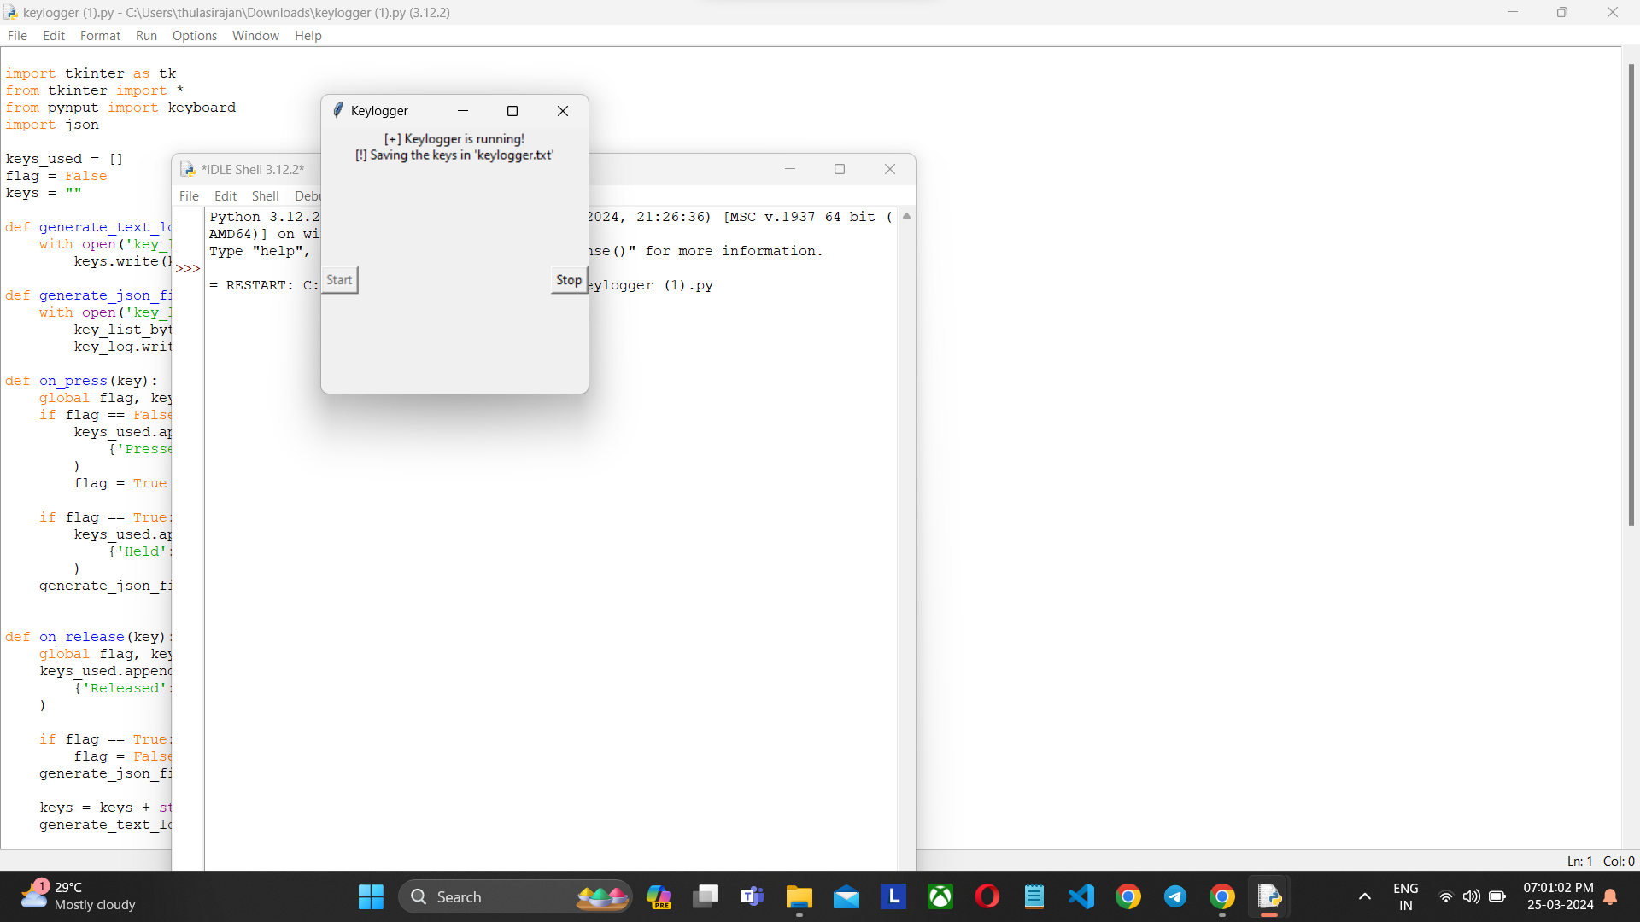
RESULT
The GUI presents "Start" and "Stop" buttons to control the keylogging process. Upon starting, the keylogger captures keystrokes and saves them in designated files. Stopping the keylogger halts the logging process.

Slide 8
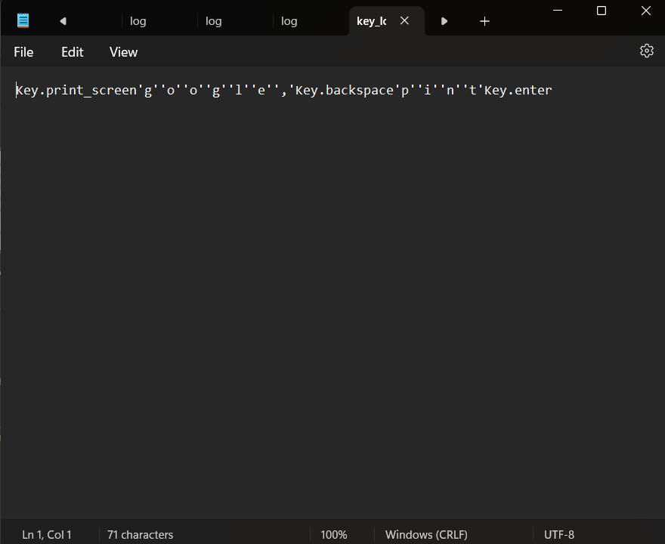

OUTPUT

Slide 9
CONCLUSION
Implementing a keylogger highlights the ease of capturing keyboard inputs and underscores the importance of robust security measures to prevent unauthorized access to sensitive information. Understanding keylogging techniques aids in fortifying systems against potential threats.

Slide 10
FUTURE SCOPE
Enhanced Stealth: Develop techniques to make the keylogger more covert and harder to detect by antivirus software and anti-malware programs.
Remote Monitoring: Implement features to allow remote access to the captured keystrokes and system logs.
Advanced Logging: Extend logging capabilities to capture more than just keystrokes.

Slide 11
REFERENCES
Nyang, DaeHun; Mohaisen, Aziz; Kang, Jeonil (2014-11-01). "Keylogging-Resistant Visual Authentication Protocols". IEEE Transactions on Mobile Computing. 13 (11): 2566–2579. doi:10.1109/TMC.2014.2307331. ISSN 1536-1233. S2CID 8161528.
^ Conijn, Rianne; Cook, Christine; van Zaanen, Menno; Van Waes, Luuk (2021-08-24). "Early prediction of writing quality using keystroke logging". International Journal of Artificial Intelligence in Education. 32 (4): 835–866. doi:10.1007/s40593-021-00268-w. hdl:10067/1801420151162165141. ISSN 1560-4292. S2CID 238703970.
^ Use of legal software products for computer monitoring, keylogger.org
^ "Keylogger". Oxford dictionaries. Archived from the original on 2013-09-11. Retrieved 2013-08-03.
^ Keyloggers: How they work and how to detect them (Part 1), Secure List, "Today, keyloggers are mainly used to steal user data relating to various online payment systems, and virus writers are constantly writing new keylogger Trojans for this very purpose."

Slide 12
THANK YOU

