Slide 1
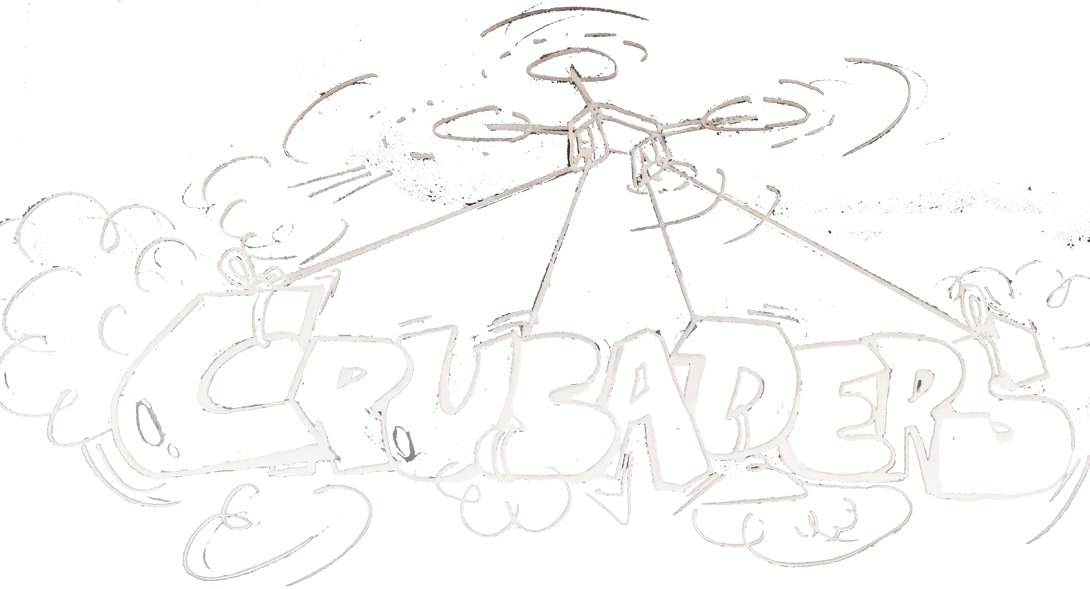

Slide 2
DRONE DELIVERY SYSTEM - ITSP 2020
Mentor- Vishwajeet Bhagyawan
Aman Jain
Ridayesh Parab
Shubham Gupta
Shyam Iyer

Slide 3
Motivation
This project aims to innovate a new system that will result in the added convenience of deliveries of parcels to the nearest proximity when human-based delivery is not allowed or not feasible.
An example of this is late night Swiggy/Uber Eats orders to the hostel.

Slide 4
Objective
Creating a Drone Delivery Framework which can be applied to real life scenarios.
Incorporating this framework into first one drone and subsequently multiple drones to set up a Drone Delivery System.
Setting up and hosting an interface (in this case, website) to relay information between the user and the system.

Slide 5
Project overview
ROS Node
PX 4 Firmware
Mission Control (Waypoint, Mode)
Launch Files
Location Input From Website
World & Drone Models
MAVROS
MAVLINK UAV Comm.
Gazebo Simulation

Slide 6
Technology Used
ROS
Gazebo Simulator
PX4
QGroundControl
Google Firebase
Web Development using HTML, CSS and JS.
Google Maps Javascript API

Slide 7
References
dev.px4.io
ERC ROS tutorials
wiki.ros.org
gazebosim.org
firebase.com/docs
theconstructsim.com
youtube.com- ROS, Gazebo and Google Maps implementation
w3schools.com - Website Development

