Slide 1
JavaScript
ES5 AND ES6

Slide 2
Content
Data Types
Arrays
Maps
Sets
Control Flows
Function
Hoisting
Closure
Objects
OOP
Promises
Event Loop

Slide 3
Javascript Datatypes
Data type
String // let color = "Yellow";
Number // let length = 16
Boolean // let x = true;
Null // let x = Null
Undefined // var name;
Bigint // var num = new Bigint(“5414894889”)
Symbol // const sym = Symbol(“description”)
Object // const obj = { }
Object data types [built-in objects, and user defined objects]
[objects, arrays, dates, maps, sets, intarrays, floatarrays, promises, and more

Slide 4
What is the difference Between (Null And Undefined)
Undefined
primitive type.
Indicate the variable has been declared but not yet been assigned to value.
Common Scenarios
Let a; console.log(a)
Function foo(x) { console.log(x) } → then call it → foo();
function foo(x) { return x } console.log(foo())
Null
Primitive type and it an Object // console.log(typeof null) → object
is explicitly assigned by the programmer to indicate "no value."
Common Scenarios
Let a = null; console.log(a)

Slide 5
Arrays
An array is a special variable, which can hold more than one value
const cars = ["Saab", "Volvo", "BMW"];
Arrays Methods:
Cars.length; // 3
Cars.join(“ “) ; // Saab Volvo BMW
Cars.at(2); // BMW
Cars.pop(); // BMW
Cars.push(“Nissan”); // ["Saab", "Volvo", “Nissan”]
Cars.shift(); // ["Volvo", “Nissan”]
Cars.unshift(“saab”); // ["Saab", "Volvo", “Nissan”]
Cars.splice(0, 2, “zzz”) // [“zzz”, “Nissan”]
Const x = Cars.slice(0, 2) // x = [“zzz”, “Nissan”]
Delete cars[0] // [“Nissan”]
indexOf(“c”), lastIndexOf(“c”) , includes(“c”) // search methods
Find(), filter(), map(), reduce(), every(), some(), forEach() // iteration methods or HOF

Slide 6
Maps
Create Map
const map = new Map();
const map = new Map( [ [1, ‘Ahmed’] , [2, ‘Mohamed’] ]); // with initial value
Map Methods
map.get(key)
map.set(key, value)
map.size
map.delete(key)
map.clear()
map.has(key)

Slide 7
Sets
Create Set
const set = new Set();
const set = new Set([1, 2, 3, 5, 6, 5, 8]); // with initial value
Map Methods
set.add(value)
set.has(key)

Slide 8
Control Flows (Loops)
For
For(let i =0; i < 10; i++) { …}
For-in
For(let x in object) { … }
For-of
For(let x of array/string) { … }
While
While(condition) { … }

Slide 9
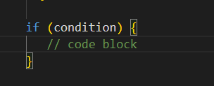
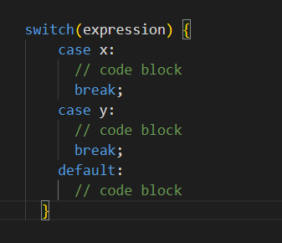
Control Flows (Conditions)
If
Switch – Case

Slide 10
Functions
Function Declarations function greet() {...}
Function Expressions greet = function() {...}
Arrow Functions const greet = () => {...}
Immediately Invoked Function Expressions (IIFE) (function great() {...}) ();
Constructor Functions function Person(name) {this.name = name;}
Async Functions async function fetchData() {}
Generator Functions
Methods (Object Methods and Class Methods)

Slide 11
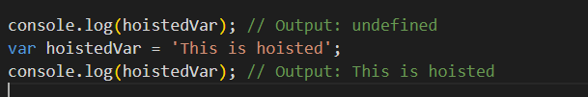
Hoisting
JavaScript hoisting refers to the process where the interpreter moves variable and function declarations to the top of their containing scope during the compile phase, before the code is executed.
This means that you can use variables and functions before they are declared in the code.
Variables hoisting
Let and const

Slide 12
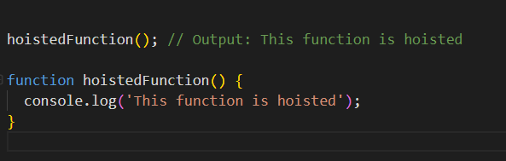
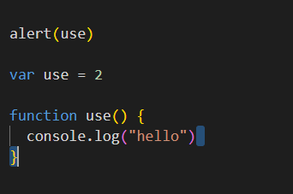
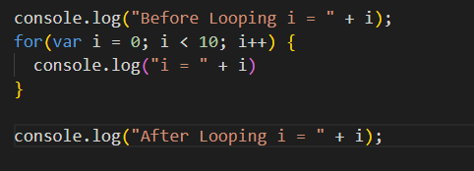
Hoisting
Functions Hoisting
What’s about the expression function?
Which one was hoisted first? Variable or function
Ex:

Slide 13
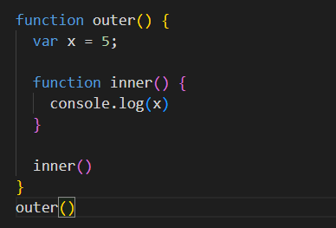
Closure
A closure in JavaScript is a feature where an inner function has access to the outer (enclosing) function's variables.
Closures are often used to create functions that can remember and access their own private data.

Slide 14
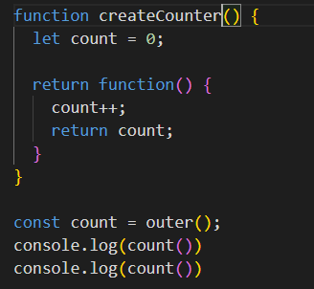
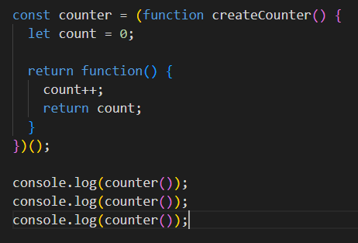
Closure
Practical Example: Counter
Practical Example: Using IIFE

Slide 15
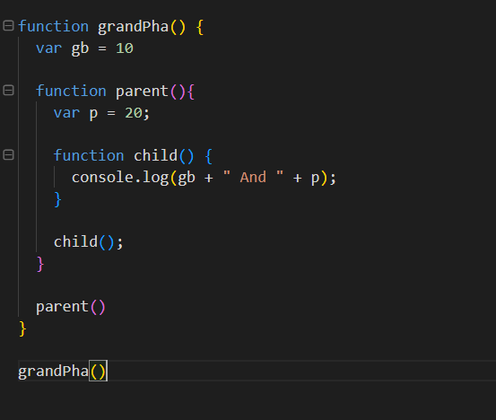
Examples

Slide 16
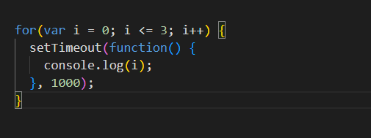
Example (more advanced)

Slide 17
Objects
Using Object Constructor
In real life, objects are things like: houses, cars, people, animals, or any other subjects.
defineProperty()
defineProperties()
Freeze()
Instance method and static method what is the diff
In JavaScript, there are several ways to create objects
Object Literals
Constructor Functions
Object.create()
ES6 Classes
Factory Functions
Using Object constructor
Singleton Pattern

Slide 18
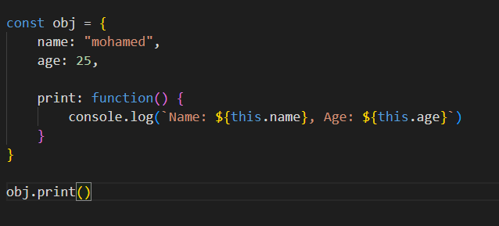
1. Object Literals

Slide 19
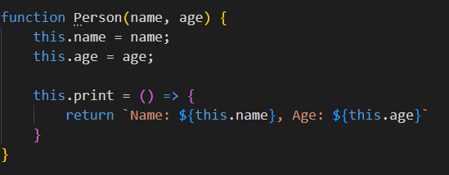
2. Constructor Functions

Slide 20
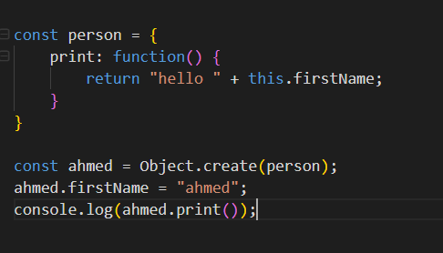
3. Object.create()

Slide 21
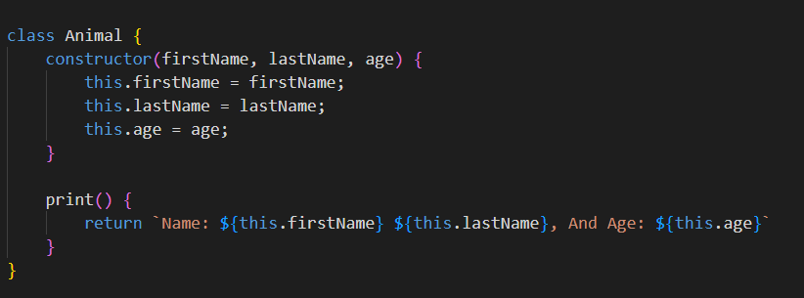
4. ES6 Classes

Slide 22
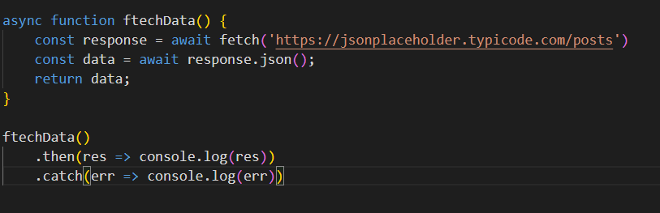
Async Function
Async/Await
are syntactic sugar built on top of promises to make asynchronous code look more like synchronous code
An Async function always returns a promise.

Slide 23
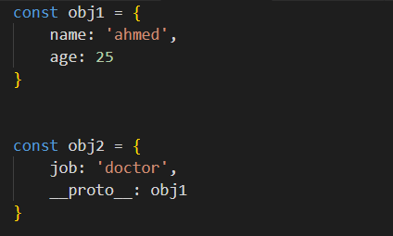
Object Oriented Programing (OOP)
Native

Slide 24
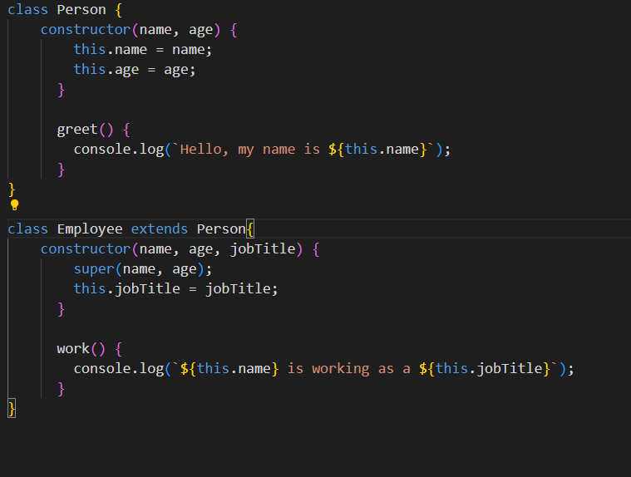
Inheritance

Slide 25
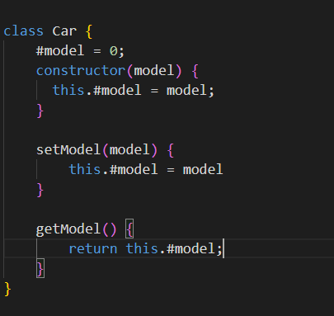
Encapsulation

Slide 26
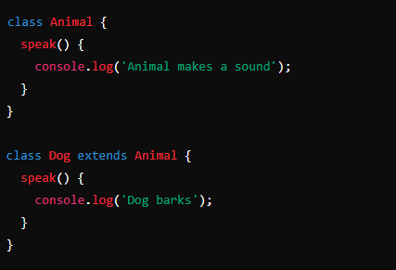
Polymorphism

Slide 27
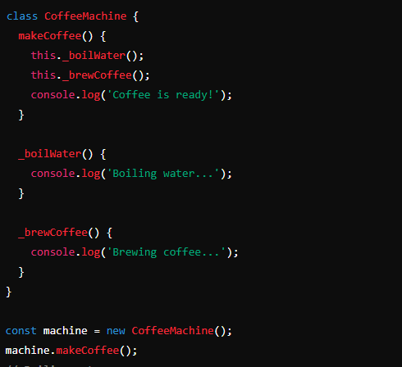
Abstraction

Slide 28
Promises
Promises
JavaScript promises are a way to handle asynchronous operations.
A promise represents a value that may be available now, or in the future, or never.
Promises allow you to write asynchronous code in a more synchronous fashion.
making your code more readable and easier to debug.
Basics of Promises
A promise can be in one of three states:
Pending: Initial state, neither fulfilled nor rejected.
Fulfilled: Operation completed successfully.
Rejected: Operation failed.

Slide 29
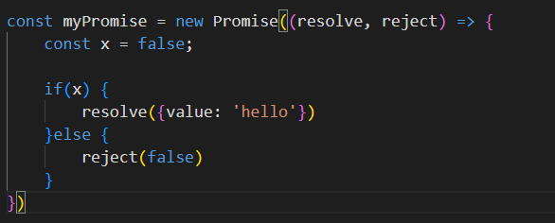
Promises
Create Promise
Consuming promise
.then() Used to handle a successful outcome.
.catch() Used to handle an error.
.finally() Executed regardless of the outcome.

Slide 30
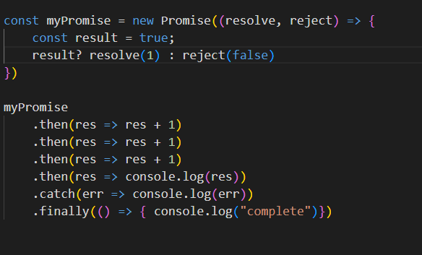
Promises
Chaining Promises

Slide 31
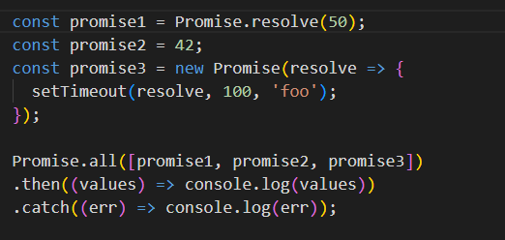
Promises
Promise.all()
Executes multiple promises in parallel and waits for all of them to resolve or any to reject.

Slide 32
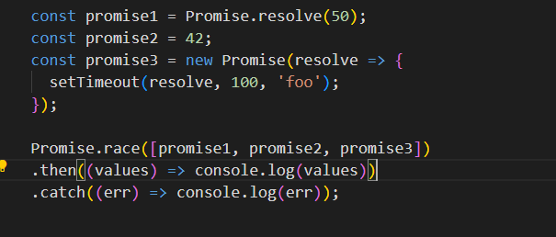
Promises
Promise.race()
Waits until any of the promises is resolved or rejected.

Slide 33
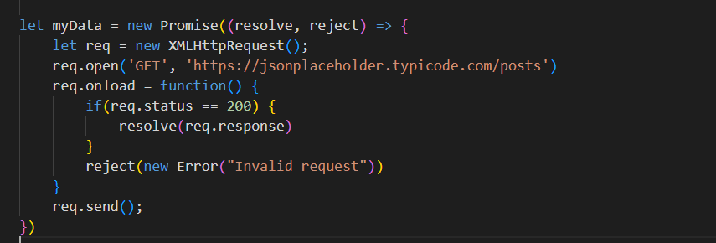
Example

Slide 34
Event Loop
The JavaScript event loop is a fundamental concept that explains how JavaScript handles asynchronous operations, such as callbacks, promises, and timers.
Event Loop Process
Call Stack: JavaScript has a single-threaded runtime, which means it executes one piece of code at a time.
Web APIs: These are provided by the browser and include things like ‘setTimeOut’, ‘Dom events’, and ajax calls (XMLHttpRequst). These are not part of the JavaScript language
Callback Queue (or Task Queue): When asynchronous operations complete, their callbacks are placed in the callback queue.
Event Loop: The event loop continuously checks the call stack to see if it is empty. If the call stack is empty, it takes the first callback from the callback queue and pushes it onto the call stack, effectively running it.

Slide 35
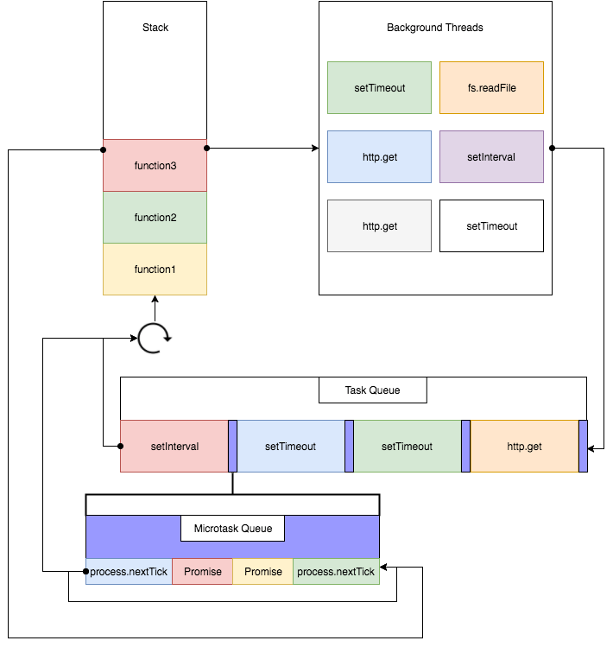

Slide 36
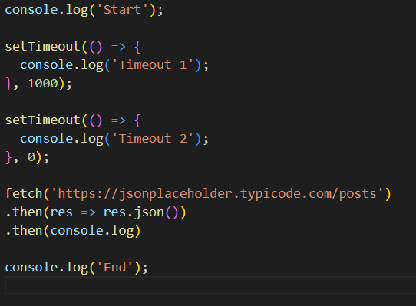
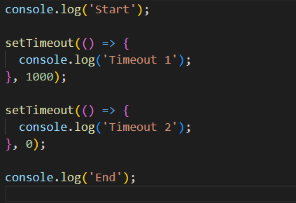
Examples

