Slide 1
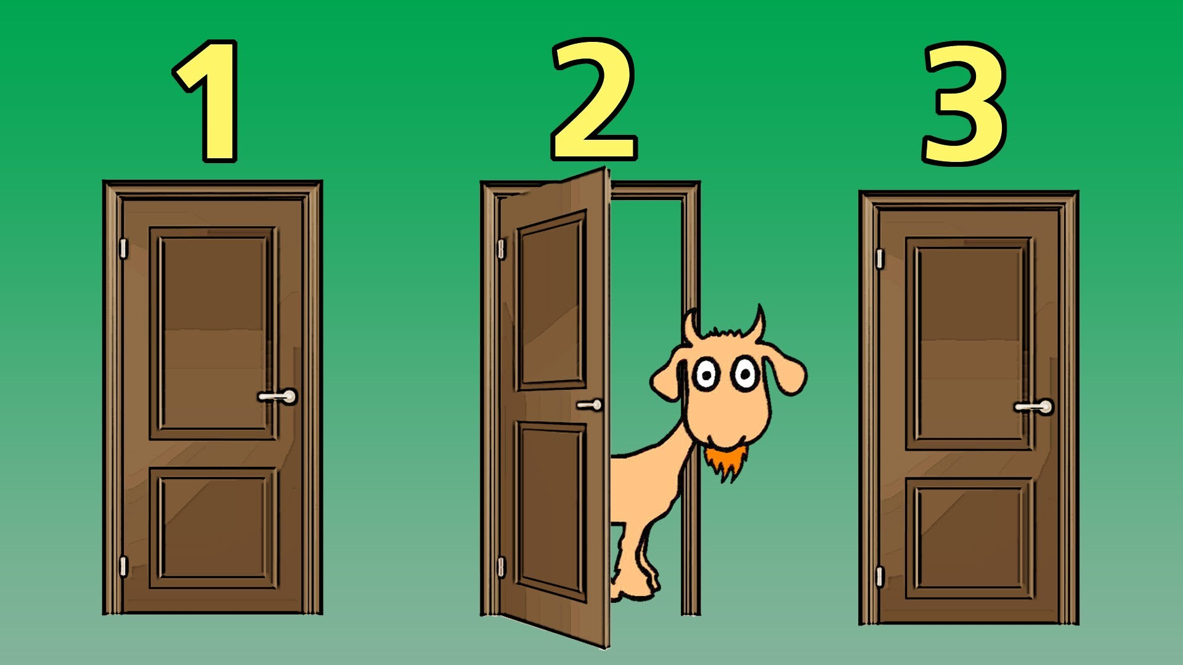
DOUGLAS RUBIN PhD
Complete Solutions Guide to Pishro-Nik’s:
Introduction to Probability, Statistics and Random Processes

