Slide 1

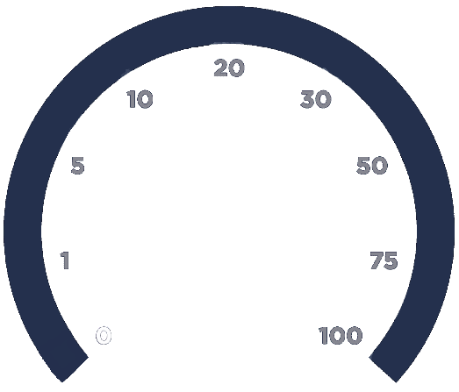
Color tester
USE
EXPORT
Hardware resource: GPU
IMPORT DATASET
BEGIN TRAINING

