Slide 1
CSS Grid Basics
Shay Nadav

Slide 2
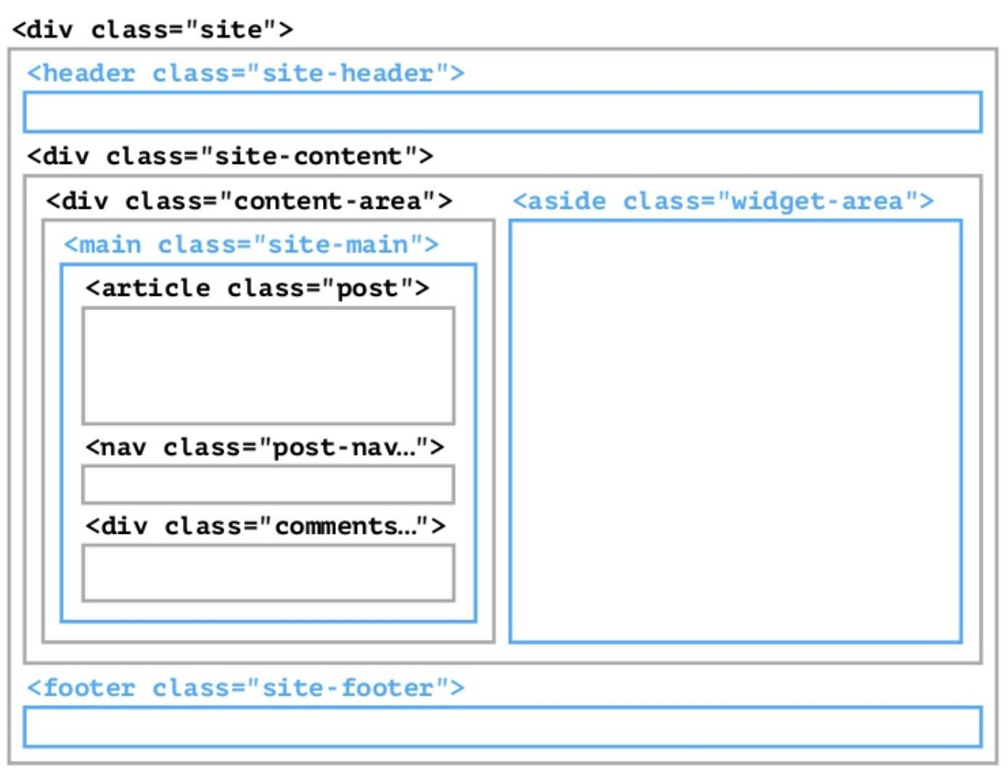
Before CSS Grid

Slide 3
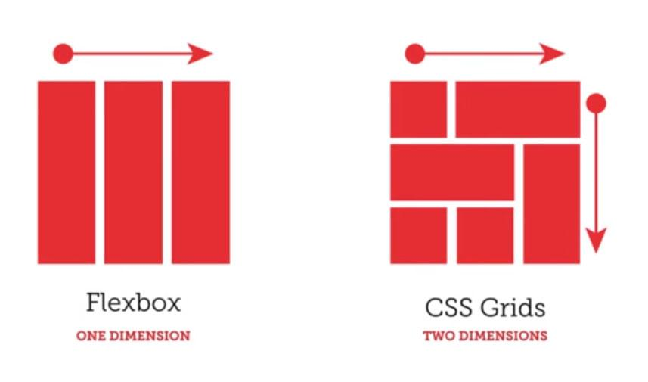
Advantages of CSS Grid
Has the advantages of flexbox, and works in 2 dimensions.

Slide 4
Grid Terminology

Slide 5
Grid Container
<div class=”site”>
<header class=”child”></header>
<main class=”child”></main>
<aside class=”child”>
<div class=”child-of-child”></div>
<!-- doesn’t get effected-->
</aside>
<footer class=”child”></footer>
</div>
CSS
.site{
display:grid;
}

Slide 6
Grid Item
Any element that is a direct descendant of the grid.
<div class=”site”>
<header class=”child”></header>
<main class=”child”></main>
<aside class=”child”>
<div class=”child-of-child”></div>
<!-- doesn’t get effected-->
</aside>
<footer class=”child”></footer>
</div>

Slide 7
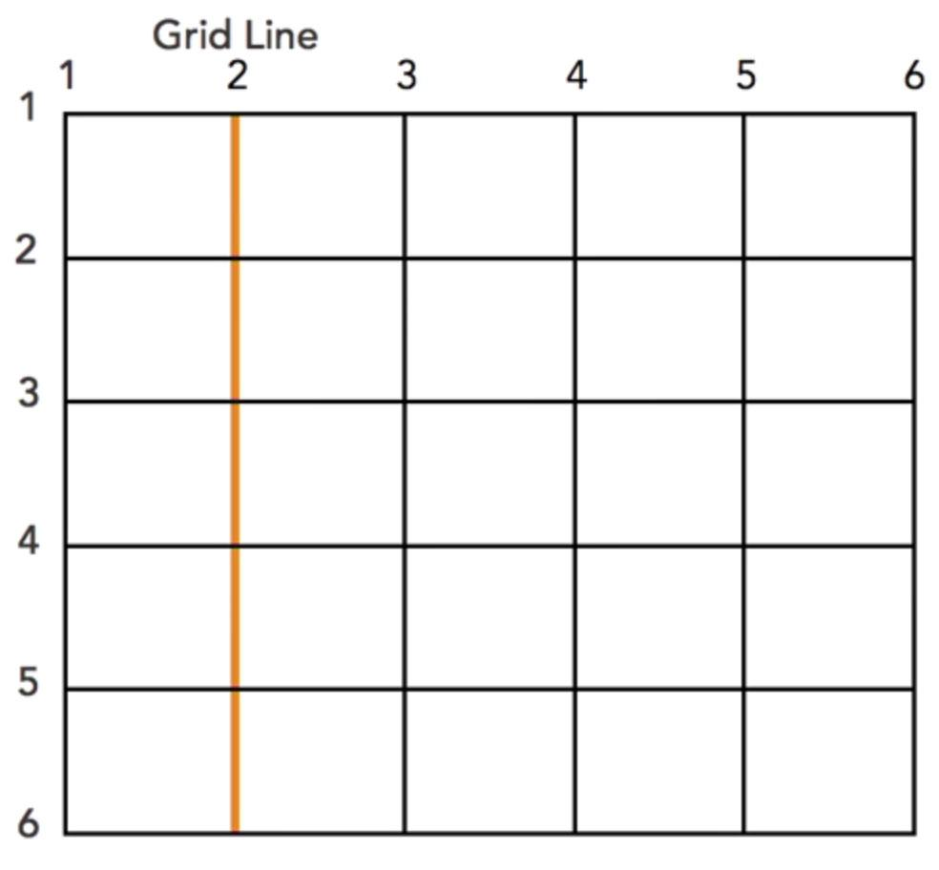
Grid Line
The horizontal and vertical lines that make up the grid.

Slide 8
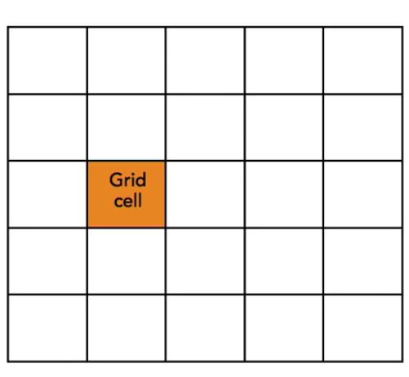
Grid Cell
The smallest space between four grid lines

Slide 9
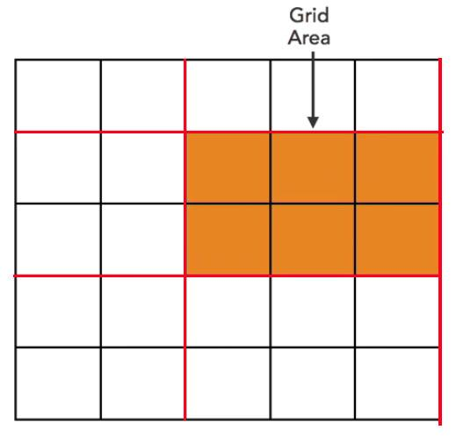
Grid Area
The area between four grid lines
That can contain multiple Grid Cells.

Slide 10
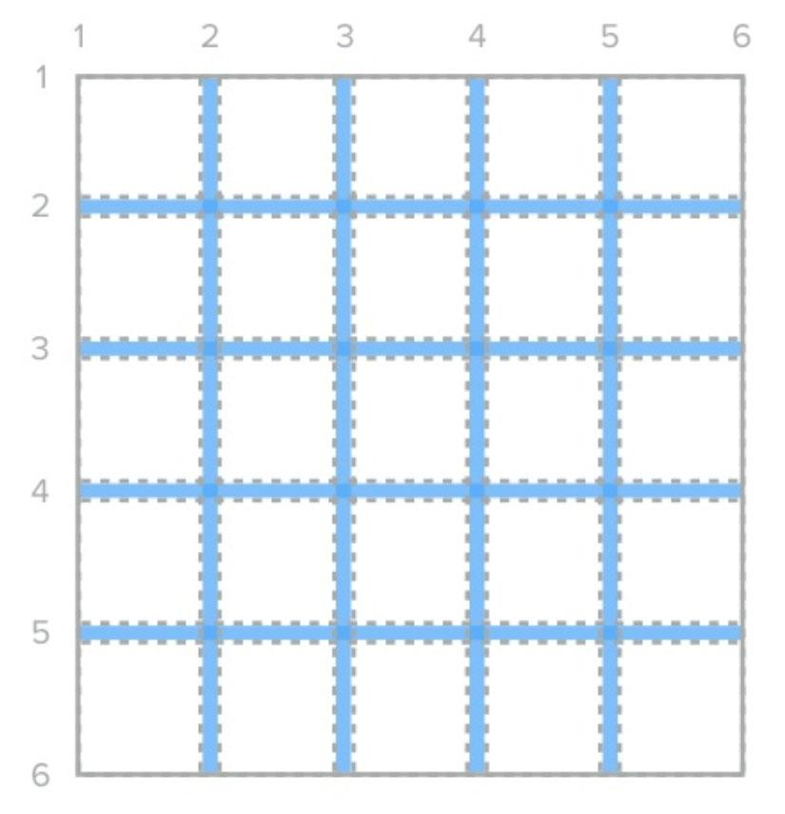
Grid Gap
Empty space between grid cells/areas
grid-column-gap:10px;
grid-row-gap:10px;
=
grid-gap:10px;

Slide 11
Grid Gap
Empty space between grid tracks
column-gap:10px;
row-gap:10px;
=
gap:10px;

Slide 12
Let’s Start Gridding

Slide 13
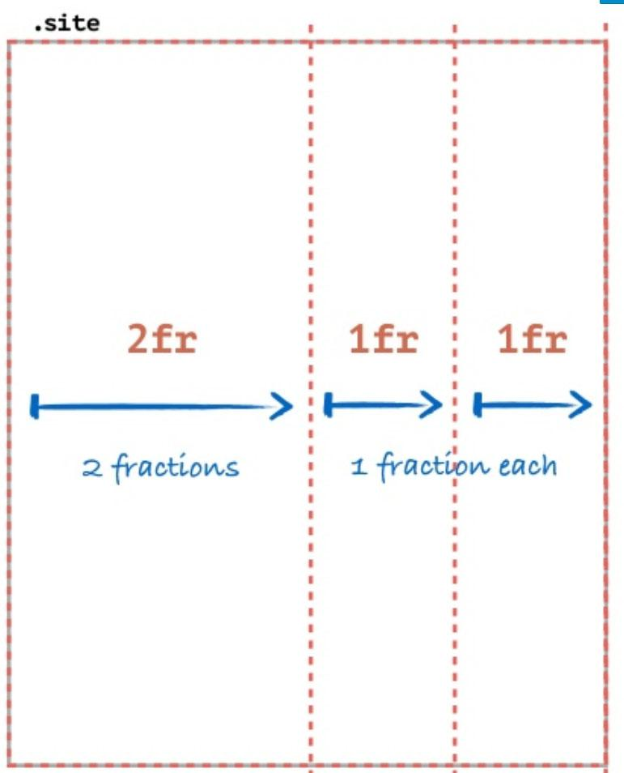
Grid-Template
.site {
display:grid;
grid-template-columns: 2fr 1fr 1fr;
}

Slide 14
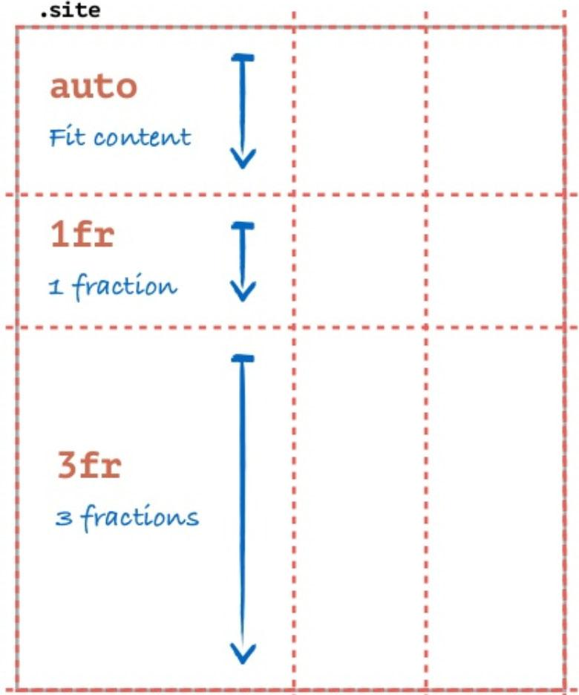
Grid-Template
.site {
display:grid;
grid-template-columns: 2fr 1fr 1fr;
grid-template-rows: auto 1fr 3fr;
}

Slide 15
CSS Grid Methods

Slide 16
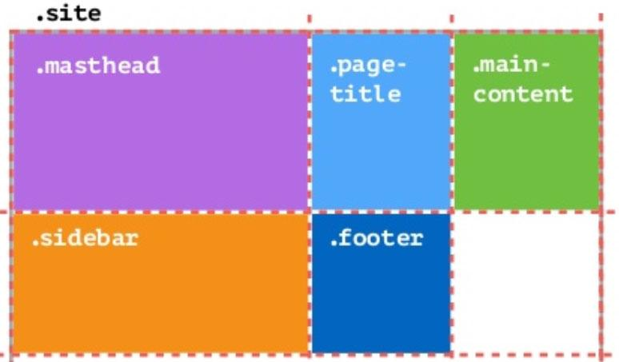
Base method
.site {
display:grid;
grid-template-columns: 2fr 1fr 1fr;
}
<div class=”site”>
<header class=”mastheader”></header>
<h1 class=”page-title”></h1>
<main class=”main-content”></main>
<aside class=”sidebar”></aside>
<footer class=”footer”></footer>
</div>
Example:
https://codepen.io/elad2412/pen/JrLeMG

Slide 17

Practice Time!
https://codepen.io/elad2412/pen/BayLwyq

Slide 18
Before we continue
Say hello to the
repeat function
grid-template-columns:1fr 1fr 1fr;
=
grid-template-columns:repeat(3 , 1fr);

Slide 19
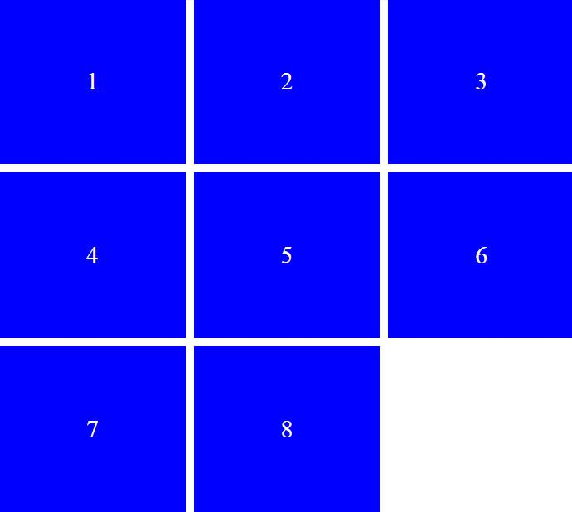
List Method
Using the “base method”and the “repeat function” we can easily achieve list sequence of items.
.site{
display:grid;
grid-template-columns: repeat(3, 1fr);
grid-gap:10px;
}
<ul class=”common-list”>
<li class=”common-list-item”>1</li>
<li class=”common-list-item”>2</li>
<li class=”common-list-item”>3</li>
…
</ul>
Example:
https://codepen.io/elad2412/pen/rGdomM

Slide 20
Practice Time!
https://codepen.io/elad2412/pen/NWPRaPo

Slide 21
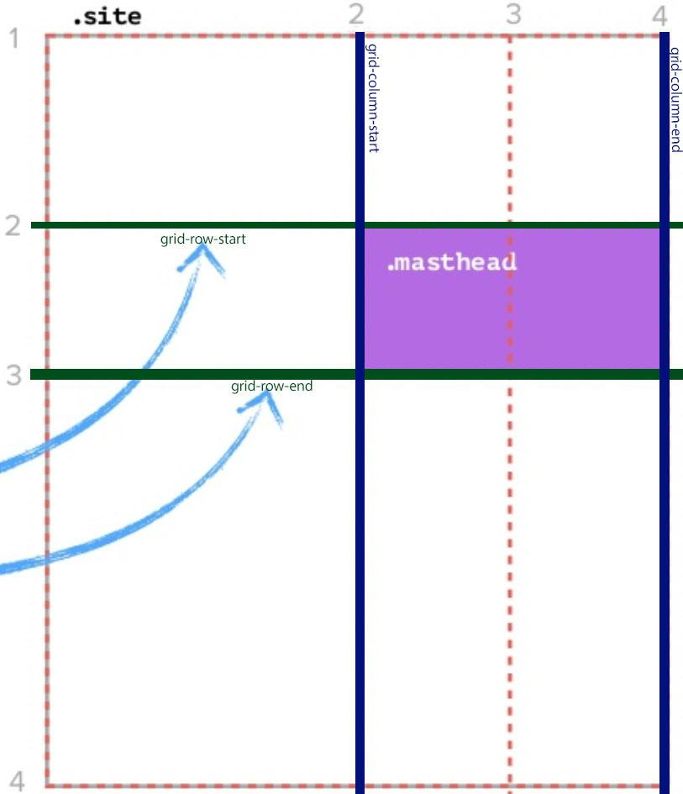
Positioning Method
Position grid item according the grid lines.
.site{
display:grid;
grid-template-columns: 2fr 1fr 1fr;
grid-template-rows: auto 1fr 3fr;
}
.masthead{
grid-column:2/4;
grid-row:2/3;
}
same as:
.masthead{
grid-column-start:2;
grid-column-end:4;
grid-row-start:2;
grid-row-end:3;
}
Example:
https://codepen.io/elad2412/pen/mBxagg

Slide 22
Positioning Method
More syntax options
grid-row:2/3;
=
grid-row:2; /*will take one cell*/
grid-column:2/4;
=
grid-column:2/span 2; /*will take two cells;
Example:
https://codepen.io/elad2412/pen/mBxagg

Slide 23
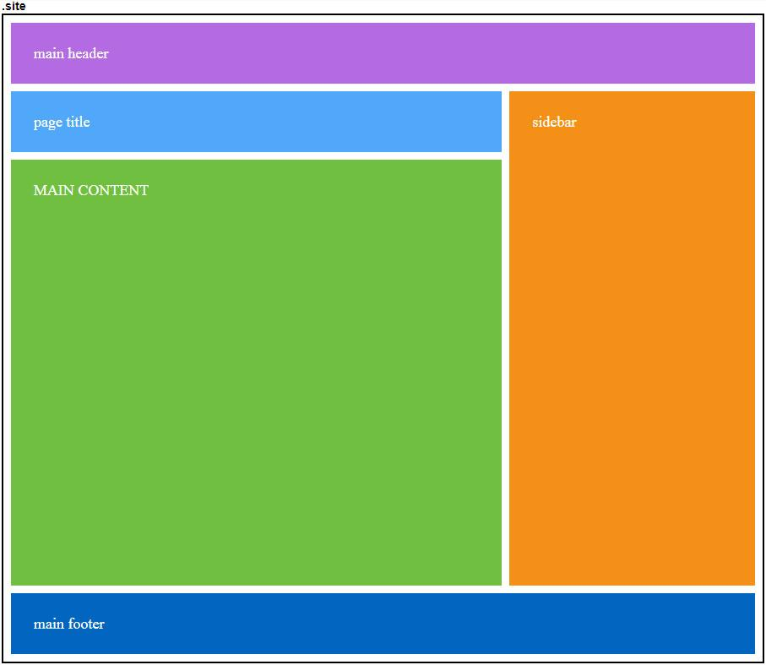
Areas Method
Positioning grid items according grid map.
<div class="site">
<header class="mastheader">main header</header>
<h1 class="page-title">page title</h1>
<main class="main-content">MAIN CONTENT</main>
<aside class="sidebar">sidebar</aside>
<footer class="footer">main footer</footer>
</div>
.site{
display:grid;
grid-template-columns:2fr 1fr; grid-gap:10px;
grid-template-areas:"header header"
"title sidebar"
"main sidebar"
"footer footer";
}
.mastheader{background:#b46ae3; grid-area:header;}
.page-title{background:#51a7fa; grid-area:title;}
.main-content{
background:#70bf40; grid-area:main; min-height:500px;
}
.sidebar{background:#f49018; grid-area:sidebar;}
.footer{background:#0265c0; grid-area:footer;}
Example: https://codepen.io/elad2412/pen/boMRaL

Slide 24
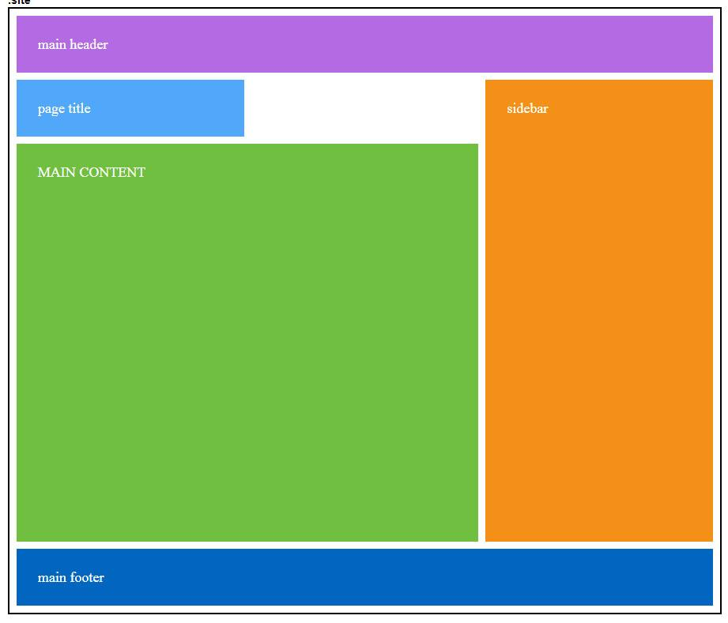
Areas Method
Saving EMPTY space with dot(.)
.site{
display:grid;
grid-template-columns:1fr 1fr 1fr; grid-gap:10px;
grid-template-areas:"header header header"
"title . sidebar"
"main main sidebar"
"footer footer footer";
}
Example: https://codepen.io/elad2412/pen/GMdxrN

Slide 25
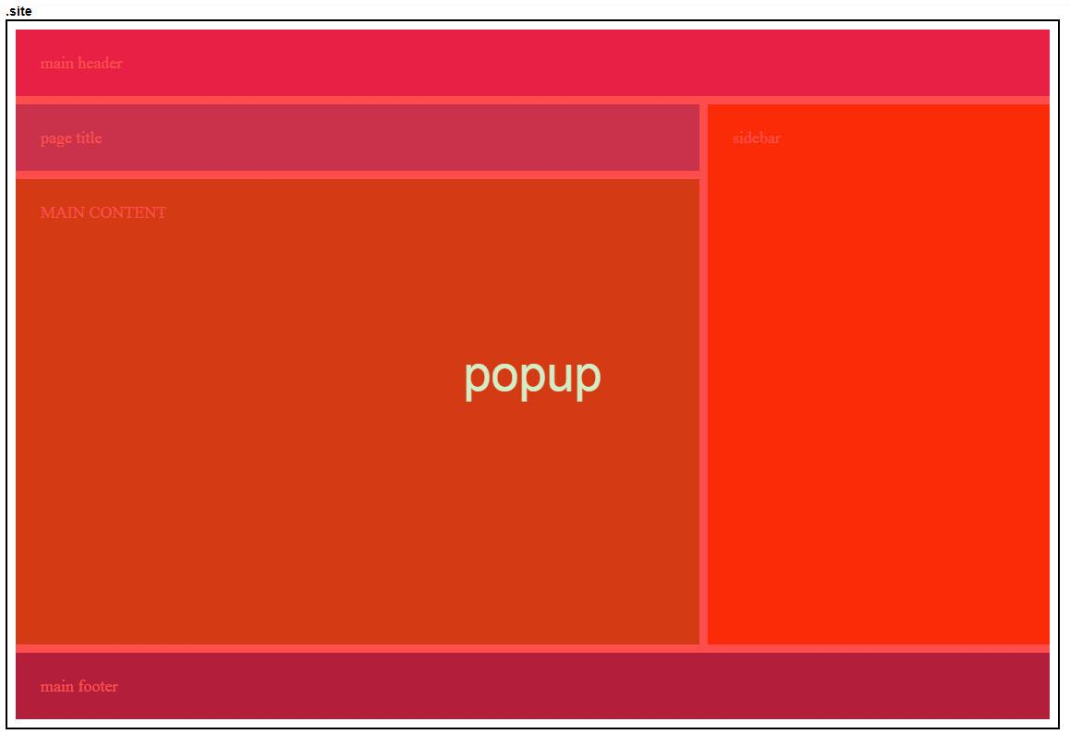
Overlapping Grid items
Grid items can be layered/stacked by properly positioning them and assigning z-index when necessary.
Example: https://codepen.io/elad2412/pen/yzjjyd

Slide 26
Practice Time!
https://codepen.io/elad2412/pen/yLyazNB

Slide 27
Finished the Basics

Slide 28
Some More Stuff

Slide 29
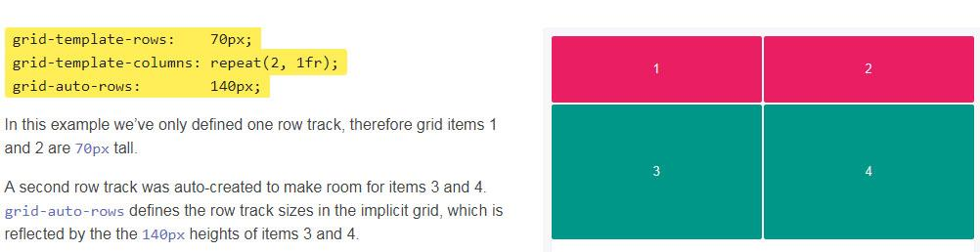
grid-auto-rows/columns
When columns or rows aren't declared you can use this property to declare fix height/width to undeclared columns or rows.

Slide 30
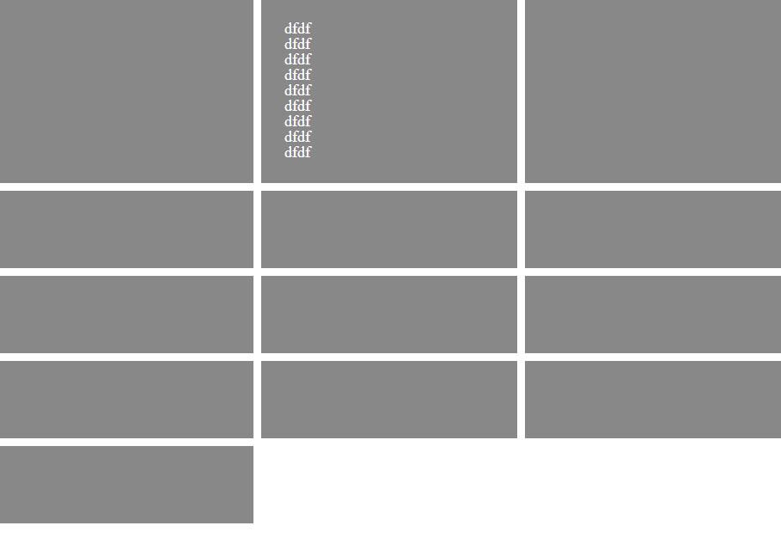
MinMax Function
.site{
display:grid; height: 100%;
grid-template-columns: 1fr 1fr 1fr;
grid-auto-rows: minmax(100px,auto);
grid-gap: 10px;
}
Minimum height of 100px
Example:
https://codepen.io/elad2412/pen/MEGQBr

Slide 31
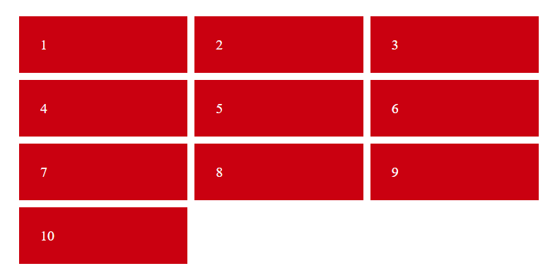
grid-auto-flow
The default flow (direction) of a grid is row, It means if there isn’t more space the left item will drop to new row. But like every definition it is changeable.
.site{
display:grid;
grid-template-columns:repeat(3,1fr);
grid-template-rows:repeat(3,1fr);
}
https://codepen.io/elad2412/pen/XoJrLO

Slide 32
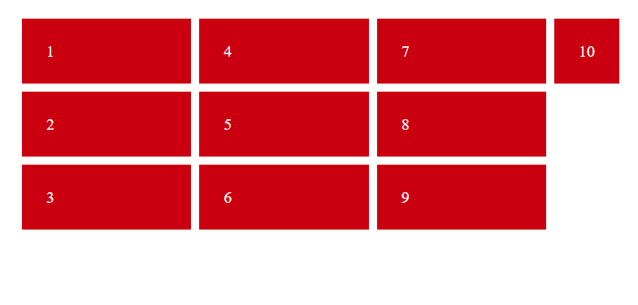
grid-auto-flow
The default flow (direction) of a grid is row, It means if there isn’t more space the left item will drop to new row. But like every definition it is changeable.
.site{
display:grid;
grid-template-columns:repeat(3,1fr);
grid-template-rows:repeat(3,1fr);
grid-auto-flow:column;
}
https://codepen.io/elad2412/pen/QqrqvK

Slide 33

Carousel with Grid ?
grid-auto-flow:column; without rows is the nowrap of grid.
.site{
display:grid;
grid-auto-flow:column;
}
<div class="site">
<div>1</div>
<div>2</div>
<div>3</div>
<div>4</div>
<div>5</div>
<div>6</div>
<div>7</div>
<div>8</div>
<div>9</div>
<div>10</div>
</div>
Example:
https://codepen.io/elad2412/pen/YrLErW

Slide 34
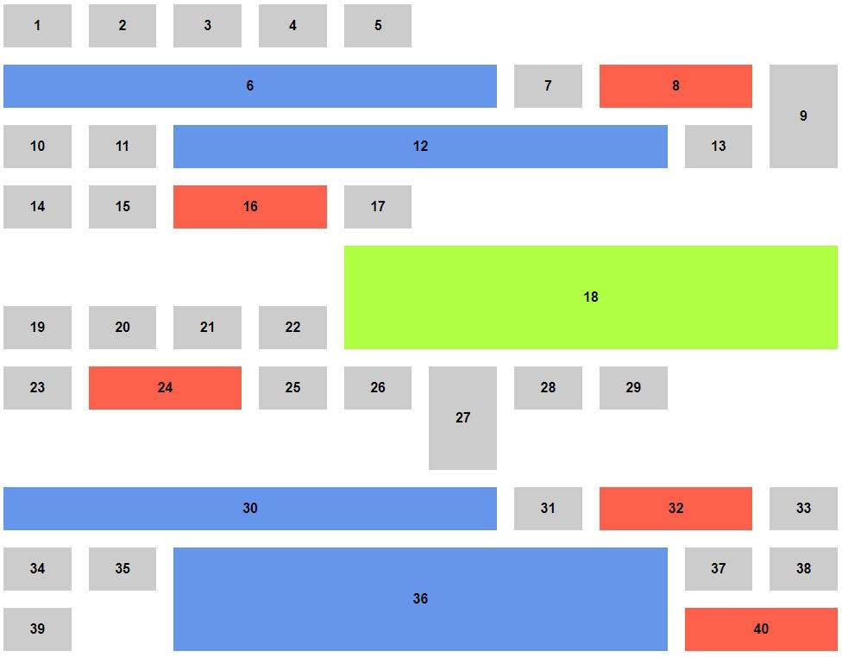
Galleries With CSS Grid - grid-auto-flow:dense;
.gallery{ display: grid; grid-gap: 20px; grid-template-columns: repeat(10, 1fr); }
.grid-item-6{ grid-column:span 6; }

Slide 35
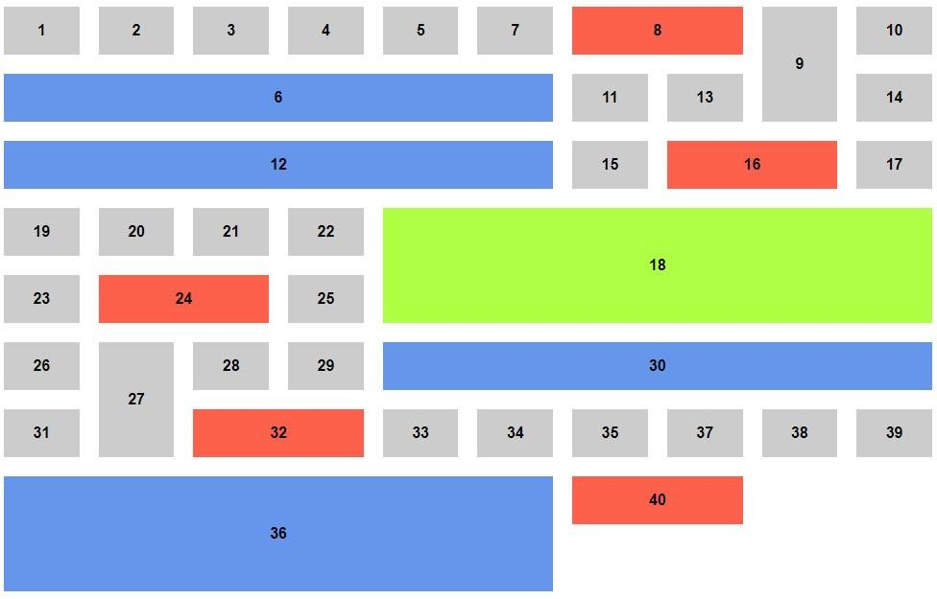
Galleries With CSS Grid - grid-auto-flow:dense;
.gallery{ display: grid; grid-gap: 20px; grid-template-columns: repeat(10, 1fr); grid-auto-flow: dense; }
.grid-item-6{ grid-column:span 6; }

Slide 36
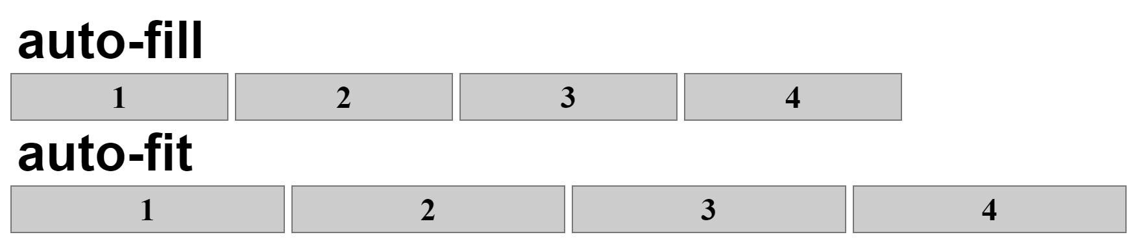
Auto-fill & auto-fit values
.container{ display: grid; grid-template-columns: repeat(auto-fill, minmax(300px , 1fr)); /* Not Equal*/ grid-template-columns: repeat(auto-fit, minmax(300px , 1fr)); }
Dynamic Number of Columns In a Row
https://codepen.io/elad2412/pen/mLqBwr

Slide 37
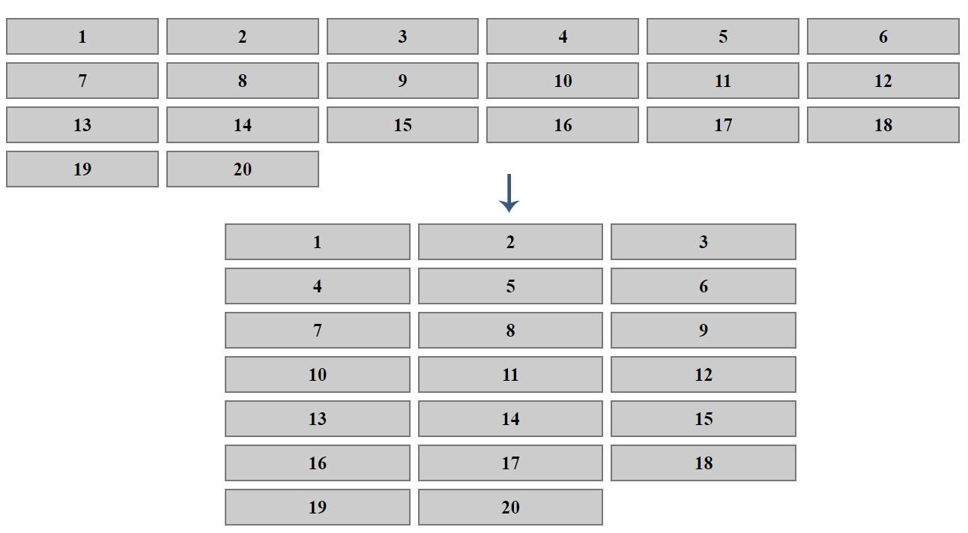
Auto-fill & auto-fit values
narrow screen
https://codepen.io/elad2412/pen/deZZvz

Slide 38
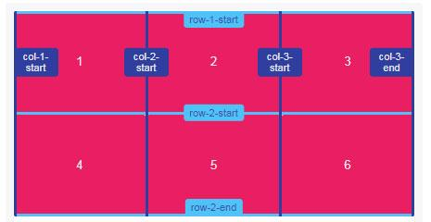
Naming Grid Lines
Grid lines can be named when defining the grid with the grid-template-rows and grid-template-columns properties. Line names can then be referenced to position grid items.
grid-template-rows: [row-1-start] 1fr [row-2-start] 1fr [row-2-end]; grid-template-columns: [col-1-start] 1fr [col-2-start] 1fr [col-3-start] 1fr [col-3-end];

Slide 39
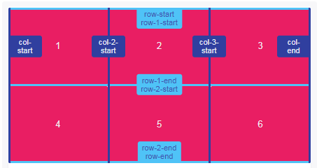
Naming Grid Lines - Multiple Names
Multiple names can be assigned to grid lines by adding names within square brackets and separating each with a whitespace.
Each line name can then be referenced when positioning grid items by line names.
grid-template-rows: [row-start row-1-start] 1fr [row-1-end row-2-start] 1fr [row-2-end row-end]; grid-template-columns: [col-start] 1fr [col-2-start] 1fr [col-3-start] 1fr [col-end];

Slide 40
Naming Grid Lines - Positioning Items by Line Names
grid-row: row-2-start / row-end; grid-column: col-2-start / col-end;

Slide 41
Finished?
Are you kidding me!

Slide 42
Remember flexbox aligning?
Justify-items, justify-self, align-items, align-self, justify-content, align-content….
All these rules are applying in CSS Grid and you can use them here.
You can learn them from my presentation of world of flexbox
https://www.slideshare.net/eladsc/world-of-flexbox
Or from this awesome website
http://learncssgrid.com/#aligning-grid-items
Order property of flexbox is working too.

Slide 43
Using In Real Life
https://www.investing.com/crypto/ico-listing-request
https://www.allrates.com/loans/personal-loans
https://play.walla.co.il/

Slide 44
References
Videos:
CSS Grid Changes EVERYTHING - https://www.youtube.com/watch?v=7kVeCqQCxlk&index=1&list=PL8rji95IPUUCcHS8_JCAVDpuX4-fuNrtG
CSS Grid Layout Crash Course - https://www.youtube.com/watch?v=jV8B24rSN5o
CSS Grid terminology (Lynda.com) - https://www.lynda.com/CSS-tutorials/CSS-grid-terminology/422835/477279-4.html
Websites:
http://learncssgrid.com
https://css-tricks.com/snippets/css/complete-guide-grid/
https://developer.mozilla.org/en-US/docs/Web/CSS/grid-auto-columns
https://www.w3.org/TR/css-grid-1/

