Slide 1
3D Trigonometry
LO: To apply knowledge of trigonometry in solving 3D problems.
Starter

Slide 2




Pythagoras Recap
In a right angle triangle,
$$a^{2}+b^{2}=c^{2}$$
$$c^{2}$$
Steps:
Square the side lengths you’re given.
Are you finding the hypotenuse or one of the shorter sides?
$$b^{2}$$
$$a^{2}$$
For the hypotenuse, add them
For a shorter side, add them
Square root

Slide 3
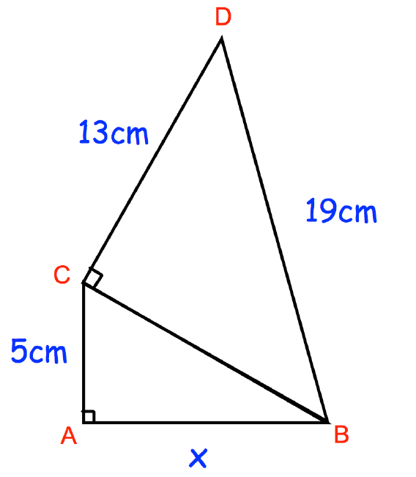


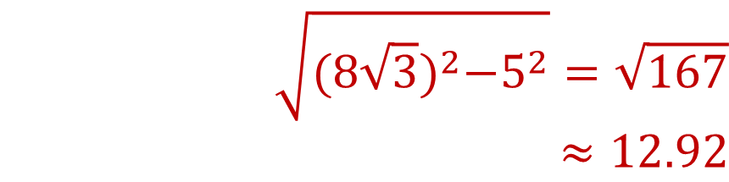
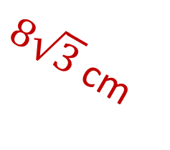
Multi-Step Pythagoras Problems
$$\sqrt{{{19}^{2}−13}^{2}}=8\sqrt{3}$$
$$\sqrt{{{(8\sqrt{3})}^{2}−5}^{2}}=\sqrt{167} \\ ≈12.92$$
$8\sqrt{3}$ cm
$$x=12.92$$

Slide 4
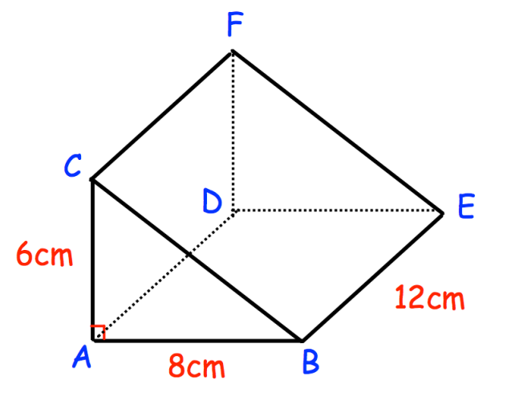



3D Pythagoras – Example #1
Find the length of BC.
Find the length of CD.
Find the length of BF
$$\sqrt{6^{2}+8^{2}} =10 cm$$
13.42cm
$$\sqrt{6^{2}+12^{2}} =13.42 cm$$
10cm
$$\sqrt{{10}^{2}+{12}^{2}} =15.62 cm$$

Slide 5
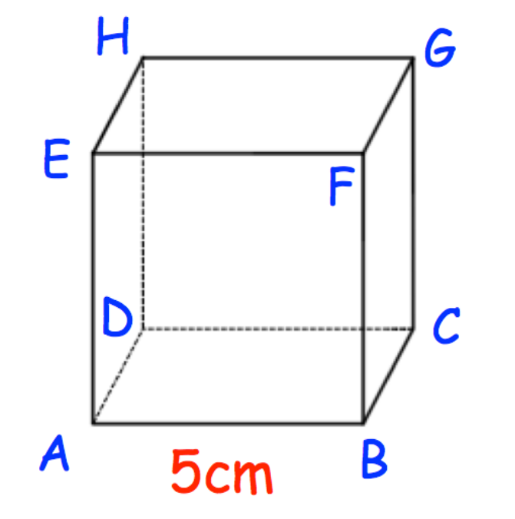


3D Pythagoras – Example #2
Find the length of AC.
Find the length of AG.
$$\sqrt{5^{2}+5^{2}} = 7.07 cm$$
5cm
$$\sqrt{5^{2}+{7.07}^{2}} =8.66 cm$$
7.07cm

Slide 6
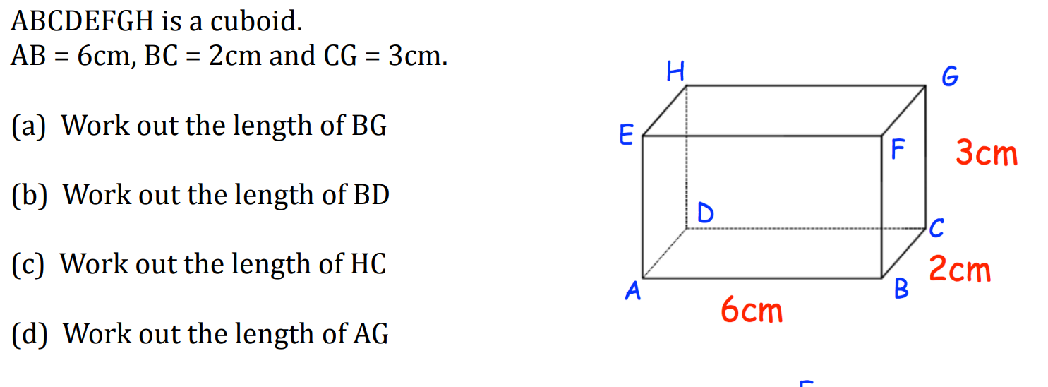




3D Pythagoras – Example #3
$$\sqrt{2^{2}+3^{2}}=3.61$$
6.71cm
$$\sqrt{2^{2}+6^{2}}=6.32$$
6.71cm
3.61cm
2cm
$$\sqrt{6^{2}+3^{2}}=6.71$$
6.32cm
$$\sqrt{2^{2}+{6.71}^{2}}=7 cm$$

Slide 7
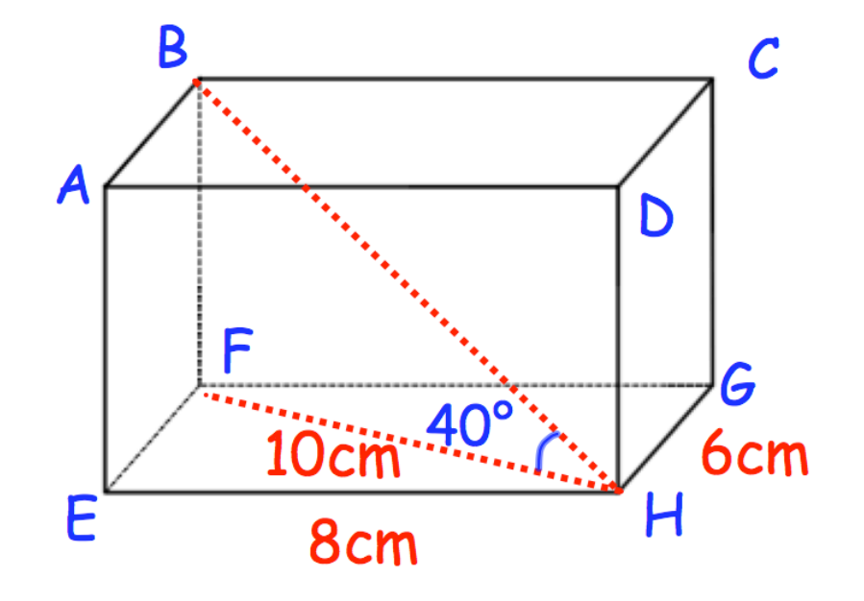

3D Trigonometry – Example #1
Find the length of BF.
Find the length of BH.
Find the angle FBH.
$$10×tan\left(40\right) = 8.39 cm$$
$$\sqrt{10^{2}+{8.39}^{2}} = 13.05 cm$$
$$50°$$

Slide 8
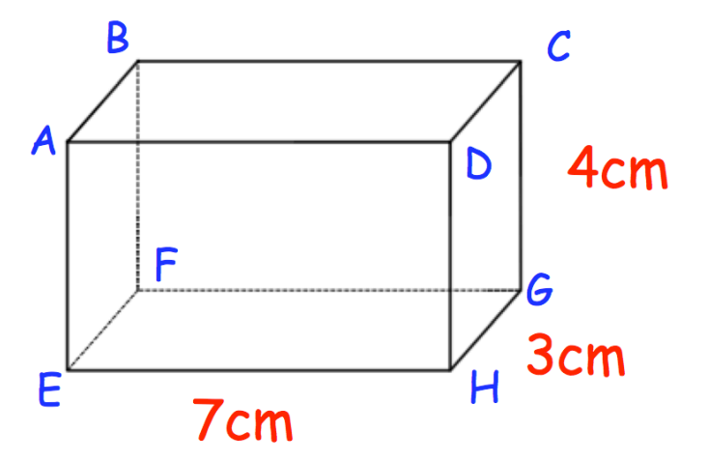



3D Trigonometry – Example #2
Find angle GEH.
Find angle CHG.
Find the length of EG.
$$θ =tan^{−1}\left(\frac{3}{7}\right) = 23.2°$$
$$θ =tan^{−1}\left(\frac{4}{3}\right) = 53.12°$$
$$\sqrt{7^{2}+3^{2}}= 7.62 cm$$

Slide 9
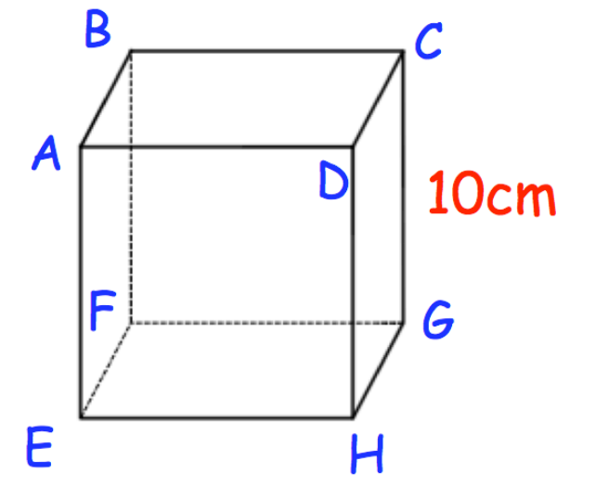


3D Trigonometry – Example #2
Find the length of FH.
Find angle DFH.
$$\sqrt{10^{2}+10^{2}} =14.14 cm$$
$$tan^{−1}\left(\frac{10}{14.14}\right) =35.27°$$
(Cube)

Slide 10
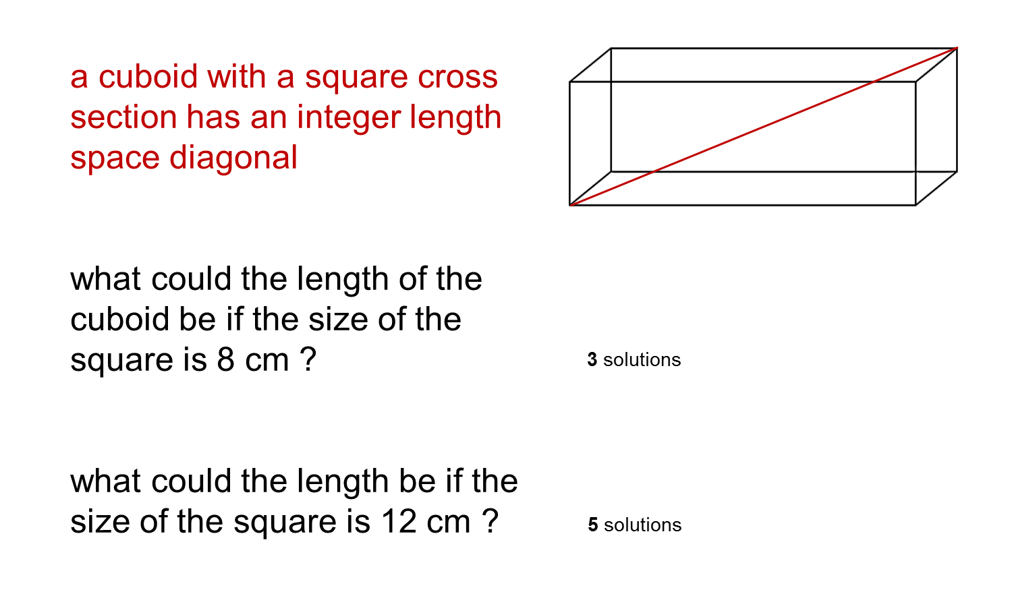
Extension

Slide 11
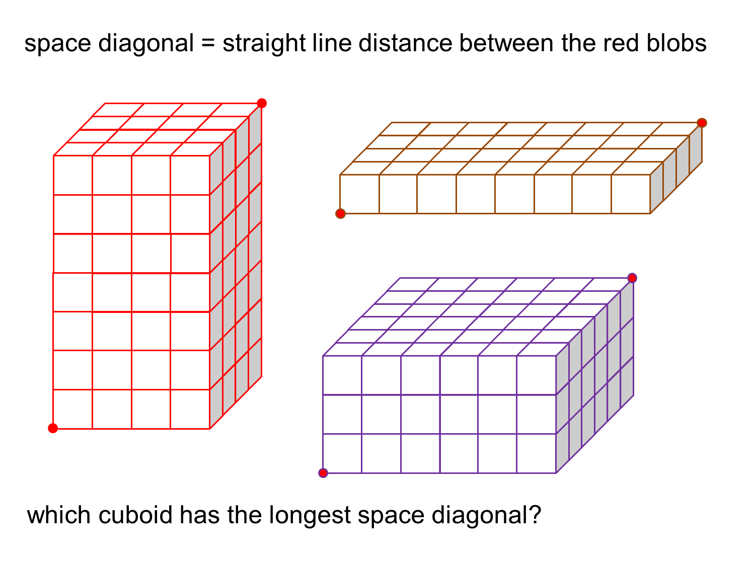
Plenary

