Slide 1
K.L.N. COLLEGE OF ENGINEERING, POTTAPALAYAM – 630 612
Department of Artificial Intelligence and Data Science
Knowledge Graph-Based Structural Context
for AI-Assisted Software Development
Code2Graph — a code-intelligence system built on Tree-sitter parsing, NetworkX graph analytics and MCP
Team No: 20 Academic Year: 2026 – 2027
Supervisor: Mrs. Ilamathi S., Assistant Professor / AI & DS
Team: Akshaya Kumar R S (910623108002) · Sachin J (910623108041) · Senthil Pandian G S (910623108044)
Notes:
Good morning. We are Team 20, and our project is 'Knowledge Graph-Based Structural Context for AI-Assisted Software Development' — implemented as a system called Code2Graph. The whole idea is that AI coding assistants need the *right* code context, and the right context is mostly about relationships between files and symbols, not more lines of text.

Slide 2
Index
Contents of the presentation
1
Abstract
6
Literature Review
2
Introduction
7
System Architecture
3
Problem Statement
8
List of Modules
4
Existing System
9
Module Description
5
Proposed System
10
Output Screenshots
Code2Graph · Knowledge Graph-Based Structural Context for AI-Assisted Software Development · Team 20
Notes:
These are the ten sections we will cover: abstract, introduction, problem statement, existing system, proposed system, literature review, system architecture, list of modules, module description and the output screenshots.

Slide 3
01
Abstract
What the project is, and what it delivers
▪ A persistent code-intelligence graph built from a software repository
▪ Tree-sitter parsing + language-specific extractors for nodes and edges
▪ Graph queries, shortest paths, community analysis, change impact
▪ Local, LLM-free indexing · live watcher · broken-reference healing · MCP access
Code2Graph · Knowledge Graph-Based Structural Context for AI-Assisted Software Development · Team 20
Notes:
Section 1 — Abstract. One line each: what the project is, what it builds, and what you will see.

Slide 4
Abstract — The Problem We Address
Section 01
01
▪ AI-assisted programming tools need relevant code context to understand a software project and reason about changes.
▪ Broad context retrieval and file-level search can overlook the relationships between components.
▪ They can equally include irrelevant information, wasting context and tokens.
▪ Result: assistants answer with partial or wrong mental models of the codebase.
What Code2Graph does
Builds a persistent graph from a software repository
Scans supported source and configuration files
Tree-sitter-based parsing + language-specific extractors
Represents files, modules, classes and functions as nodes
How the graph is used
Graph queries and shortest-path tracing
Component explanation and community analysis
Change-impact inspection before a refactor
Focused structural context handed to AI assistants
Code2Graph · Knowledge Graph-Based Structural Context for AI-Assisted Software Development · Team 20
Notes:
The problem: AI tools are given broad context or file-level context. They miss relationships between components and they also pull in irrelevant code. So the assistant gets an incomplete and noisy picture of the project.

Slide 5
Abstract — System Summary
Section 01
01
▪ Relationships such as imports, calls, inheritance and dependencies are represented as graph edges.
▪ Code-only indexing runs locally — no LLM API calls and no token consumption.
▪ Optional semantic workflows process supported documents and media when a model provider is configured.
▪ A file-system watcher incrementally updates the graph as files change.
▪ Missing-target references are recorded and reconciled during updates, so suitable relationships recover when their targets return.
▪ The graph is accessed through a CLI, IDE-specific agent skills, and an optional MCP server for compatible assistants.
▪ Goal: help developers and AI assistants navigate codebases and reason about cross-file changes more effectively.
▪ Limitation: static analysis may not resolve all dynamic or runtime-dependent behaviour.
Code2Graph · Knowledge Graph-Based Structural Context for AI-Assisted Software Development · Team 20
Notes:
Code2Graph builds a persistent graph from the repository: files, modules, classes and functions are nodes; imports, calls, inheritance and dependencies are edges. Code-only indexing is fully local — no API key, no tokens. A watcher keeps the graph current and missing-target references are recorded and later healed. The graph is served through a CLI, agent skills and an optional MCP server.

Slide 6
02
Introduction
Why a code graph matters for AI-assisted development
▪ A repository is more than a collection of files
▪ Relationships are the missing context — not more text
▪ Deterministic structure first, semantic inference second
▪ One graph, many surfaces: CLI, agent skills, MCP
Code2Graph · Knowledge Graph-Based Structural Context for AI-Assisted Software Development · Team 20
Notes:
Section 2 — Introduction.

Slide 7
Introduction — From Files to a Code Graph
Section 02
02
▪ Modern projects are large, multi-file and highly interconnected; a repository is more than a collection of files.
▪ Code2Graph models symbols, files, imports, calls, inheritance and other relationships as a graph that coding agents can query.
▪ This makes it easier to follow execution paths, understand dependencies, and identify the impact of a change.
▪ Instead of repeatedly re-scanning the entire project, an assistant asks a focused structural question.
▪ Turning a source tree into a navigable code-intelligence graph keeps AI context small and relevant.
The central idea
▪ Files and symbols become nodes; imports, calls, containment, inheritance and dependencies become edges.
▪ The graph is persisted (graph.json), so the expensive work happens once and is reused by every later question.
▪ A watcher keeps it current, and every extracted relationship carries a confidence label: EXTRACTED, INFERRED or AMBIGUOUS.
Code2Graph · Knowledge Graph-Based Structural Context for AI-Assisted Software Development · Team 20
Notes:
A repository is more than files. Code2Graph models symbols, files, imports, calls and inheritance as a graph that agents can query, so execution paths, dependencies and change impact become graph questions instead of guesswork.

Slide 8
Introduction — Capabilities at a Glance
Section 02
02
Understand a repo
Find entry points, symbols, modules, calls, imports and dependencies
Trace behaviour
Query relationships, neighbours, communities, shortest-path tracing
Assess a change
Inspect callers and other nodes affected by a refactor
Keep it current
Saves, deletes and renames trigger incremental updates and healing
▪ Usable three ways: an agent skill inside a coding assistant, a terminal CLI, or an MCP server with a live watcher.
▪ Code indexing needs no API key — a key is only required for optional document / media semantic workflows.
Code2Graph · Knowledge Graph-Based Structural Context for AI-Assisted Software Development · Team 20
Notes:
Five capability groups: understand a repo, trace behaviour, assess a change, keep references current, and optionally explore documents and media with a semantic provider. Everything structural is local and deterministic.

Slide 9
03
Problem Statement
What is missing in today's context pipelines
▪ File-level retrieval loses structure
▪ Irrelevant context inflates tokens and error rates
▪ Cross-file impact is hard to see
▪ Broken references are silently lost
Code2Graph · Knowledge Graph-Based Structural Context for AI-Assisted Software Development · Team 20
Notes:
Section 3 — Problem statement.

Slide 10
Problem Statement
Section 03
03
▪ AI assistants must be given the right context before they can reason about a change — but choosing that context is the hard part.
▪ Broad context retrieval and file-level search can overlook relationships between components.
▪ The same strategies pull in irrelevant information, which costs tokens and increases hallucination risk.
▪ Manual navigation across a large codebase is slow, and cross-file impact of a change is easy to miss.
▪ During refactors, renames and deletions, references break — and tooling rarely tracks what broke or why.
▪ There is no single, persistent, queryable structure that both developers and agents can share.
Requirement
A persistent structural context layer that is (a) focused, (b) locally computable, (c) incrementally updated, and (d) queryable by an AI assistant through a standard interface.
Code2Graph · Knowledge Graph-Based Structural Context for AI-Assisted Software Development · Team 20
Notes:
The assistant must be given the right context before it reasons about a change. Broad retrieval misses structure and adds noise; refactors break references and the tooling rarely tracks what broke.

Slide 11
Problem Statement — Consequences
Section 03
03
Gap | Consequence for the developer / assistant
No relationship model | The assistant sees files, not how components call, inherit from or depend on each other.
Whole-file or chunk retrieval | Context windows fill with unrelated code; answers drift from the real implementation.
Repeated full scans | Slow, token-heavy and repeated for every question asked about the repository.
No broken-reference tracking | Refactoring silently drops edges; the assistant then reasons on a stale mental model.
Tool-specific integrations | Every assistant needs a bespoke integration instead of one standard graph interface.
▪ These gaps motivate a locally-computed graph that is small enough to query but complete enough to trust.
Code2Graph · Knowledge Graph-Based Structural Context for AI-Assisted Software Development · Team 20
Notes:
The consequence table: each gap — no relationship model, whole-file retrieval, repeated scans, no broken-reference tracking, tool-specific integrations — translates into a practical failure for the developer or the assistant.

Slide 12
04
Existing System
How code context is handled today
▪ IDE search, grep and file trees
▪ Language Server Protocol (LSP) navigation
▪ RAG over code chunks and whole files
▪ Static analysers, docs generators and code-search platforms
Code2Graph · Knowledge Graph-Based Structural Context for AI-Assisted Software Development · Team 20
Notes:
Section 4 — Existing system.

Slide 13
Existing System
Section 04
04
Approach | What it gives you | What it does not give you
IDE search / grep, file tree | Fast lexical lookup; go-to-file navigation | No relationship model; misses indirect references
Language Server Protocol | Symbol-level go-to-definition and find-references | Per-workspace, IDE-bound; no persistent queryable graph
RAG over code chunks / whole files | Text similarity retrieval for an LLM | Structure-blind; pulls irrelevant code; no impact analysis
Docs generators / static analysers | Reports, coverage, dependency listings | Batch outputs; not queryable mid-task by an agent
Code-search platforms | Cross-repo search at organisation scale | Heavy infrastructure; not a local, self-updating graph
Code2Graph · Knowledge Graph-Based Structural Context for AI-Assisted Software Development · Team 20
Notes:
How code context is handled today: IDE search, LSP, RAG over chunks, static analysers and code-search platforms. Each is useful, and each misses something.

Slide 14
Existing System — Limitations
Section 04
04
▪ No unified, persistent relationship graph covering the whole repository.
▪ File-level or chunk-level retrieval misses structural links such as calls, inheritance and imports.
▪ Retrieved context is often irrelevant, raising token cost and hallucination risk.
▪ Updates are manual — there is no automatic incremental rebuild when a file changes on disk.
▪ Broken references after a rename or delete are neither recorded nor reconciled.
▪ Integration with assistants is ad hoc instead of using a standard protocol.
▪ Code indexing and semantic (document/media) extraction are not clearly separated.
Code2Graph · Knowledge Graph-Based Structural Context for AI-Assisted Software Development · Team 20
Notes:
The limitations that matter for our problem: no unified persistent graph, no structural links, irrelevant context, manual updates, no broken-reference handling, ad hoc integrations, and code vs semantic extraction not separated.

Slide 15
05
Proposed System
Code2Graph — design and advantages
▪ Persistent graph of nodes and relationships
▪ Local structural extraction, optional semantic layer
▪ Incremental watcher with broken-reference healing
▪ CLI, agent skills and MCP server access
Code2Graph · Knowledge Graph-Based Structural Context for AI-Assisted Software Development · Team 20
Notes:
Section 5 — Proposed system.

Slide 16
Proposed System — Code2Graph
Section 05
05
Design decision | How Code2Graph implements it
Graph as the single model | Files, modules, classes, functions and other symbols are nodes; imports, calls, inheritance and dependencies are edges.
Local deterministic parsing | Tree-sitter-backed extractors per language, plus language-specific resolvers; no code is sent to a model for structural indexing.
Confidence-labelled edges | EXTRACTED, INFERRED and AMBIGUOUS labels make the strength of every relationship explicit.
Incremental by default | A watchdog-based watcher debounces saves/renames and re-parses only the affected files.
Self-healing references | Edges whose endpoint disappears are stored as BROKEN metadata and restored (HEALED) when the target returns.
Many access surfaces | Terminal CLI, IDE/agent skill files, and optional MCP server exposing graph tools to assistants.
Code2Graph · Knowledge Graph-Based Structural Context for AI-Assisted Software Development · Team 20
Notes:
Our design decisions: the graph is the single model, parsing is local and deterministic, every edge carries a confidence label, updates are incremental, references heal themselves, and the graph is exposed through CLI, agent skills and MCP.

Slide 17
Proposed System — Features & Advantages
Section 05
05
Query
Natural-language questions resolved by BFS/DFS traversal of the graph
Paths
Shortest path between two symbols, with relation and confidence shown
Explain
Plain-language explanation of a node and its neighbours
Impact
Reverse traversal listing everything a change can break
Communities
Louvain clustering + god-node detection for architecture insight
Healing
Broken and healed reference diagnostics exposed to the agent
▪ Advantages: focused context instead of whole files · measurable token reduction · no API key for code · stays current while you type · survives refactors.
Code2Graph · Knowledge Graph-Based Structural Context for AI-Assisted Software Development · Team 20
Notes:
Six features: query, path, explain, impact, communities and healing. The advantage line summarises it: focused context instead of whole files, with measurable token reduction.

Slide 18
Proposed System — Existing vs Proposed
Section 05
05
Aspect | Existing approaches | Proposed — Code2Graph
Context unit | Whole files / text chunks | Graph nodes with their relationships
Relationships | Not modelled (or IDE-local only) | calls, imports, inherits, contains, method, uses …
Update model | Manual re-run / re-index | Debounced incremental watcher, atomic writes
Broken references | Silently dropped | Recorded as BROKEN, reconciled to HEALED
Assistant integration | Custom per-tool glue | Standard MCP tools and resources
Cost | Large prompts, repeated scans | Local AST pass; ~4.6× fewer tokens per query (sample run)
Code2Graph · Knowledge Graph-Based Structural Context for AI-Assisted Software Development · Team 20
Notes:
Side-by-side comparison. Notice the last row: on our sample repository the graph-based answers used about 4.6 times fewer tokens than sending the whole corpus.

Slide 19
06
Literature Review
Background areas and the technologies behind the design
▪ Knowledge graphs in software engineering
▪ Static analysis and incremental parsing (Tree-sitter)
▪ Graph analytics: communities, centrality, shortest paths
▪ Model Context Protocol for assistant integration
Code2Graph · Knowledge Graph-Based Structural Context for AI-Assisted Software Development · Team 20
Notes:
Section 6 — Literature review.

Slide 20
Literature Review — Background Areas
Section 06
06
Area | Key idea taken into this project
Knowledge graphs in software engineering | Represent files, symbols and relationships explicitly so navigation, tracing and impact analysis become graph queries.
Static analysis / AST parsing | Tree-sitter offers robust, incremental, error-tolerant parsing across many languages — the base of the extraction layer.
Code intelligence platforms & LSP | Symbol-level go-to-definition and find-references prove the value of a relationship model, but stay IDE/workspace bound.
Graph analytics | Community detection (Louvain), centrality and shortest paths expose architectural hubs and bridging components.
Incremental indexing | File-system watchers with debouncing keep derived artefacts fresh with minimal recomputation.
Model Context Protocol | A standard way to expose tools and resources so any compatible assistant can query the same graph.
Code2Graph · Knowledge Graph-Based Structural Context for AI-Assisted Software Development · Team 20
Notes:
The background areas we studied: knowledge graphs in software engineering, static analysis and Tree-sitter parsing, code-intelligence platforms and LSP, graph analytics, incremental indexing, and the Model Context Protocol.

Slide 21
Literature Review — Concepts & Scope
Section 06
06
▪ Relationship confidence: distinguishing EXTRACTED, INFERRED and AMBIGUOUS edges keeps deterministic parsing separate from semantic guessing.
▪ Broken-reference handling: retaining unresolved edges as metadata (with reason, missing node and source location) instead of dropping them.
▪ Refactoring support: reverse traversal over callers and dependents gives change-impact analysis before the edit lands.
▪ Deterministic vs. semantic extraction: structural indexing never depends on an LLM; semantic extraction is optional and flagged when unavailable.
▪ Repository hygiene: ignore rules, size caps, URL/path validation and label sanitisation protect the local corpus.
Code2Graph · Knowledge Graph-Based Structural Context for AI-Assisted Software Development · Team 20
Notes:
The concepts we adopted: confidence labels for relationships, keeping broken references as recoverable metadata, reverse traversal for change impact, and a strict separation between deterministic extraction and semantic inference.

Slide 22
Literature Review — Technology Stack
Section 06
06
Python 3.10+
Core language / runtime
Tree-sitter + grammars
Incremental multi-language parsing
NetworkX
Graph construction, path, centrality, Louvain
watchdog
File-system events with debouncing
MCP SDK (stdio/HTTP)
Assistant-facing tools and resources
rapidfuzz · numpy · tomli
Matching, numerics, configuration
▪ Output formats: graph.json · GRAPH_REPORT.md · interactive graph.html · SVG · GraphML · Obsidian vault · Cypher · call-flow HTML.
▪ Testing: pytest suites covering extraction, resolution, graph validation, caching, watching and healing.
Code2Graph · Knowledge Graph-Based Structural Context for AI-Assisted Software Development · Team 20
Notes:
Technology stack: Python 3.10+, Tree-sitter with per-language grammars, NetworkX, watchdog, the MCP SDK, and smaller helpers like rapidfuzz. Outputs range from graph.json to interactive HTML, SVG, GraphML, Obsidian and Cypher.

Slide 23
07
System Architecture
Pipeline, layers and data flow
▪ detect → extract → build → cluster → analyse → report/export
▪ Modular stages exchanging plain dicts and NetworkX graphs
▪ Persisted graph + cache + manifest for incremental work
▪ Watcher and MCP server as the live runtime
Code2Graph · Knowledge Graph-Based Structural Context for AI-Assisted Software Development · Team 20
Notes:
Section 7 — System architecture.

Slide 24
System Architecture — Pipeline
Section 07
07
detect()
extract()
build()
cluster()
analyse
report
export
▪ Each stage lives in its own module; stages communicate through plain Python dicts and NetworkX graphs.
▪ detect(root) → directory scan summary: files grouped by category, totals, warnings, scan root.
▪ extract(paths, *, root) → {nodes, edges}; collect_files(target) expands a directory into that list.
▪ build(extractions) → nx.Graph: deduplicates nodes, normalises relationships, refuses dangling endpoints.
▪ cluster(G) → {community_id: [node_id, …]} — the graph itself is not mutated.
▪ analyse helpers: god_nodes, surprising_connections, suggest_questions, find_import_cycles, graph_diff.
▪ report.generate(…) → GRAPH_REPORT.md string; export.to_*(G) → json / html / svg / graphml / cypher / obsidian …
Code2Graph · Knowledge Graph-Based Structural Context for AI-Assisted Software Development · Team 20
Notes:
The pipeline is detect, extract, build, cluster, analyse, report and export. Every stage is its own module and they exchange plain dictionaries and NetworkX graphs.

Slide 25
System Architecture — Layered View
Section 07
07
Access layer
Terminal CLI · IDE / agent skill files · MCP server (stdio + HTTP) · graph.html / call-flow HTML
Query & analysis layer
query · path · explain · affected · god-nodes · communities · graph_diff · benchmark · broken_references / heal_status
Graph store
graph.json (nodes, links, hyperedges, broken_references, healing_status) · in-memory NetworkX cache · manifest + cache for incremental work
data
flow
Extraction layer
Tree-sitter extractors per language · cross-file resolvers · config/manifest/schema ingesters · semantic (optional LLM) pass
Source layer
Repository files: source code, configuration, Markdown, documents, media
Code2Graph · Knowledge Graph-Based Structural Context for AI-Assisted Software Development · Team 20
Notes:
The same system as layers: an access layer of CLI/agent skills/MCP; a query and analysis layer; the graph store; the extraction layer; and the source files underneath.

Slide 26
System Architecture — Extraction & Graph Model
Section 07
07
▪ 1. Discover files — language, ignore and safety rules are applied before anything is parsed.
▪ 2. Parse code locally — Tree-sitter extractors build file and symbol nodes plus relationships (imports, calls, containment, inheritance).
▪ 3. Resolve relationships — cross-file resolvers use current parse results plus read-only symbol data from unchanged files.
▪ 4. Build and validate — the builder deduplicates nodes, normalises relationships and refuses dangling endpoints.
▪ 5. Persist outputs — graph.json is the queryable graph; cache and manifest files support incremental work.
Extraction schema
{ “nodes”: [ {id, label, source_file, source_location} ],
“edges”: [ {source, target, relation, confidence} ] }
validate.py enforces it before build() consumes it.
Edge direction & confidence
Arc order carries direction (source → target); _src/_tgt markers preserve it on reload.
EXTRACTED · INFERRED · AMBIGUOUS — ambiguous edges are flagged for review.
Code2Graph · Knowledge Graph-Based Structural Context for AI-Assisted Software Development · Team 20
Notes:
Extraction in five steps — discover files, parse locally with Tree-sitter, resolve relationships across files, build and validate the graph without dangling endpoints, then persist the outputs. The schema and the confidence labels are shown at the bottom.

Slide 27
System Architecture — Live Update & Healing
Section 07
07
▪ When the MCP server starts, a background watcher monitors the project that contains the configured graph.
▪ A short debounce (default 0.75 s) groups editor save events; a move event contributes both the old and the new path.
▪ Only changed, locally parseable files are re-parsed; stored AST data for unchanged files is reused as resolution context.
▪ Stale nodes from deleted or renamed-away files are removed, then nodes and edges are reconciled with the previous graph.
▪ If a relationship loses an endpoint it is kept out of the active graph and recorded under graph.broken_references as BROKEN (with reason, missing node, affected files, source location).
▪ On the next rebuild the healer compares the previous graph with the new node set: a returning target restores the edge and marks the record HEALED. A unique same-file, same-location match can heal a rename; ambiguous matches are never guessed.
▪ MCP tools broken_references and heal_status expose this state to the agent; updates are atomic and serialised per project.
Code2Graph · Knowledge Graph-Based Structural Context for AI-Assisted Software Development · Team 20
Notes:
Live behaviour: the watcher debounces events, re-parses only affected files, reconciles the graph, and records any relationship that lost its endpoint as BROKEN with a reason. On the next rebuild a returning target restores the edge and marks it HEALED. The MCP tools broken_references and heal_status expose this to the agent.

Slide 28
08
List of Modules
The building blocks of the implementation
▪ Core pipeline modules
▪ Extractor and ingester modules
▪ Runtime modules: watcher, server, healing
▪ Support modules: security, validation, caching
Code2Graph · Knowledge Graph-Based Structural Context for AI-Assisted Software Development · Team 20
Notes:
Section 8 — List of modules.

Slide 29
List of Modules — Core Pipeline
Section 08
08
# | Module | Responsibility
1 | detect.py | Scan a directory into a file summary grouped by category
2 | extract.py | Path list → {nodes, edges}; collect_files expands directories
3 | extractors/ | Language-specific Tree-sitter extractors and resolvers
4 | build.py | Extraction → NetworkX graph; dedup, normalise, validate
5 | cluster.py | Louvain community detection over the graph
6 | analyze.py | God nodes, surprises, suggested questions, cycles, diff
7 | report.py | Generate GRAPH_REPORT.md from graph + analysis
8 | export.py | JSON, HTML, SVG, GraphML, Obsidian, Canvas, Cypher
9 | wiki.py | One Markdown article per community + index
Code2Graph · Knowledge Graph-Based Structural Context for AI-Assisted Software Development · Team 20
Notes:
The core pipeline modules with their responsibilities: detect, extract, the language extractors, build, cluster, analyse, report, export and wiki.

Slide 30
List of Modules — Runtime & Support
Section 08
08
# | Module | Responsibility
10 | serve.py | MCP server over stdio or HTTP, with in-memory graph cache
11 | watch.py | Watch a directory and rebuild the graph on code changes
12 | healing.py / broken refs | Record BROKEN edges, reconcile them to HEALED
13 | cache.py | Semantic cache: nodes / edges / hyperedges + pending files
14 | manifest.py | Per-file stamps that drive incremental re-extraction
15 | security.py | URL, path and label validation before any external input
16 | validate.py | Enforce the extraction schema before build()
17 | ids.py · paths.py | Deterministic node ids and graph path handling
18 | benchmark.py | Corpus vs. subgraph token-cost comparison
19 | callflow_html.py | Mermaid architecture / call-flow HTML report
Code2Graph · Knowledge Graph-Based Structural Context for AI-Assisted Software Development · Team 20
Notes:
Runtime and support modules: the MCP server, the watcher, healing, the semantic cache, the manifest that drives incremental work, security validation, schema validation, id/path helpers and the benchmark.

Slide 31
09
Module Description
What each module does, and with what interface
▪ Verified entry points and data contracts
▪ Analysis, reporting and export behaviour
▪ Runtime, caching and healing mechanics
Code2Graph · Knowledge Graph-Based Structural Context for AI-Assisted Software Development · Team 20
Notes:
Section 9 — Module description.

Slide 32
Module Description — Extraction & Build
Section 09
09
Module · entry point | Input → Output
detect.detect(root) | Directory → scan summary dict (files by category, totals, warning, scan_root)
extract.extract(paths, *, root) | List of file paths → {nodes, edges} dict
extract.collect_files(target) | Directory → the file path list consumed by extract()
build.build(extractions) / build_from_json | Extraction dict(s) → nx.Graph
cluster.cluster(G) | Graph → {community_id: [node_id, …]} (graph not mutated)
validate.validate_extraction / assert_valid | Extraction dict → schema error list / raises on invalid
extractors.extract_<lang>(path) | One file → nodes and edges for that language
▪ extract() takes a list of paths and a keyword-only root — node ids and source_file values are derived relative to that root.
Code2Graph · Knowledge Graph-Based Structural Context for AI-Assisted Software Development · Team 20
Notes:
Real entry points and their contracts for extraction and build. Note that extract() takes a list of paths and a keyword-only root, because node ids are derived relative to that root.

Slide 33
Module Description — Analysis & Output
Section 09
09
Function | What it produces
analyze.god_nodes(G) | Most-connected nodes — the architectural hubs
analyze.surprising_connections(G) | Cross-community links worth a second look
analyze.suggest_questions(G, …) | Question candidates this graph is uniquely able to answer
analyze.find_import_cycles(G) | Detected import cycles
analyze.graph_diff(G_old, G_new) | Node/edge level difference between two graphs
report.generate(G, …) | GRAPH_REPORT.md: summary, hubs, surprises, communities, gaps
export.to_json / to_html / to_svg / to_graphml | Persisted graph and visual artefacts
export.to_obsidian / to_canvas / to_cypher | Obsidian vault + canvas, and Cypher for graph databases
wiki.to_wiki(G, communities, …) | One Markdown article per community plus index.md
Code2Graph · Knowledge Graph-Based Structural Context for AI-Assisted Software Development · Team 20
Notes:
Analysis and output functions: god nodes, surprising connections, suggested questions, import cycles, graph diff, the report generator, the exporters and the wiki writer.

Slide 34
Module Description — Runtime, Cache & Healing
Section 09
09
Function | Behaviour
serve.serve(graph_path) | MCP stdio server; loads the graph, starts the project watcher
serve.serve_http(graph_path, *, host, port) | HTTP transport for the same tool surface
watch.watch(path, debounce) | Rebuild the graph when watched files change
watch.check_update(path) | Report whether a re-extraction is still pending
cache.check_semantic_cache / save_semantic_cache | Reuse cached nodes / edges / hyperedges; list files still needing extraction
healing + graph.broken_references | Store unresolved edges with reason, missing node and affected files
graph.healing_status | Per-file summaries consumed by the heal_status MCP tool
security.validate_url / safe_fetch / validate_graph_path / sanitize_label | Guard every external input and every label written to the graph
▪ MCP tools: query_graph · shortest_path · get_node · get_neighbors · get_community · god_nodes · graph_stats · broken_references · heal_status · list_prs · get_pr_impact · triage_prs.
Code2Graph · Knowledge Graph-Based Structural Context for AI-Assisted Software Development · Team 20
Notes:
Runtime, cache and healing: the stdio/HTTP MCP server, the watcher and its update check, the semantic cache, broken-reference storage and healing status, and the security validators. The MCP tool list is at the bottom.

Slide 35
10
Output Screenshots
Real runs of Code2Graph on a 15-file sample repository
▪ Indexing and clustering from an empty output folder
▪ Queries, paths, explanations and impact
▪ Exports, MCP session, healing, graph views
Code2Graph · Knowledge Graph-Based Structural Context for AI-Assisted Software Development · Team 20
Notes:
Section 10 — Output screenshots. Every screenshot that follows is a real run of the tool on a 15-file sample repository; the same run gives 65 nodes, 110 edges and 9 communities.

Slide 36
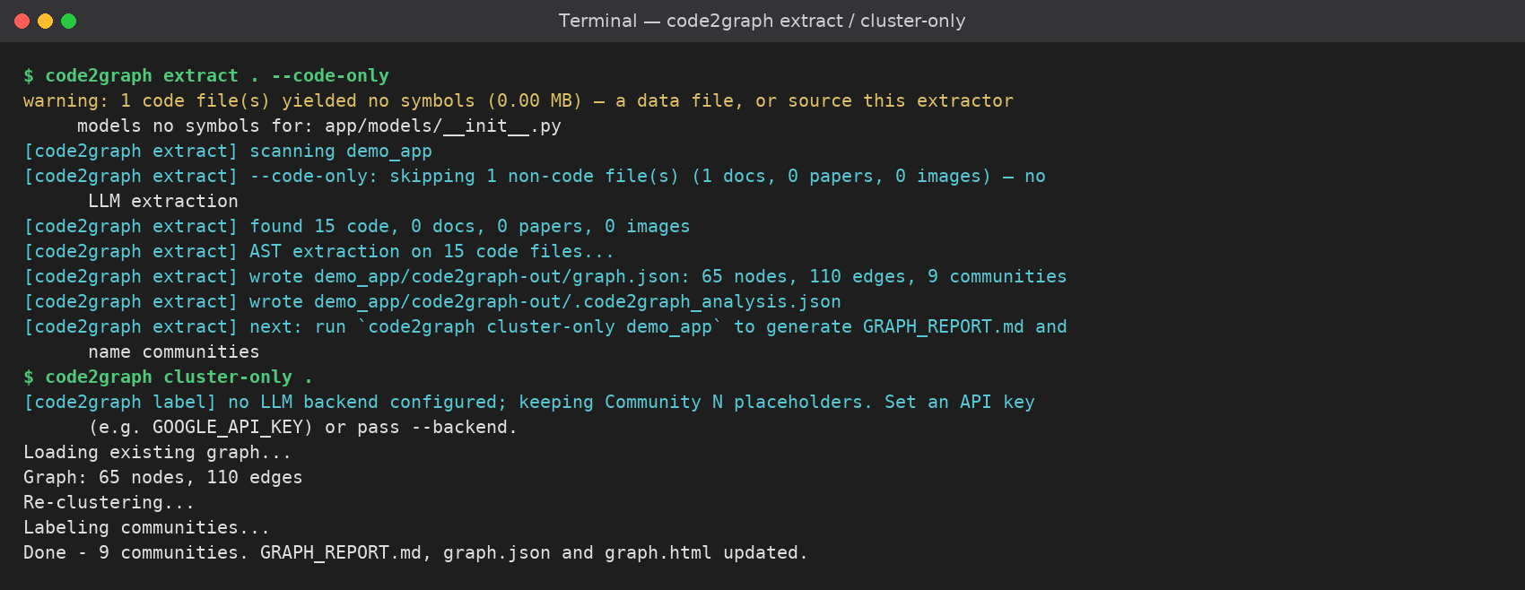
output/01 — Indexing a repository
Section 10
10
code2graph extract . --code-only parses 15 code files locally — no API key, no tokens — then cluster-only writes the graph, GRAPH_REPORT.md and graph.html.
Code2Graph · Knowledge Graph-Based Structural Context for AI-Assisted Software Development · Team 20
Notes:
First run: extracting the repository. Everything is local AST work — no API key and no tokens — and the graph is written to code2graph-out/graph.json.

Slide 37
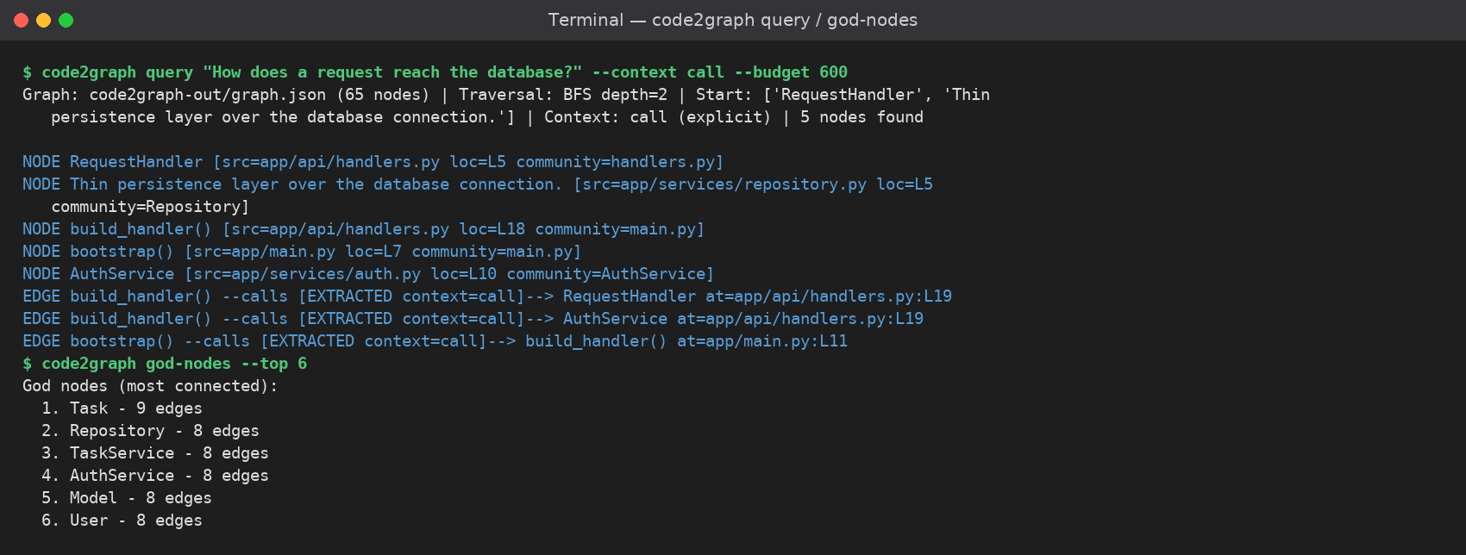
output/02 — Graph query and hubs
Section 10
10
A focused question is answered over the graph (BFS, context filtered to calls) and god-nodes lists the architectural hubs of the project.
Code2Graph · Knowledge Graph-Based Structural Context for AI-Assisted Software Development · Team 20
Notes:
A focused query, and the god-nodes command that lists the architectural hubs of the project.

Slide 38
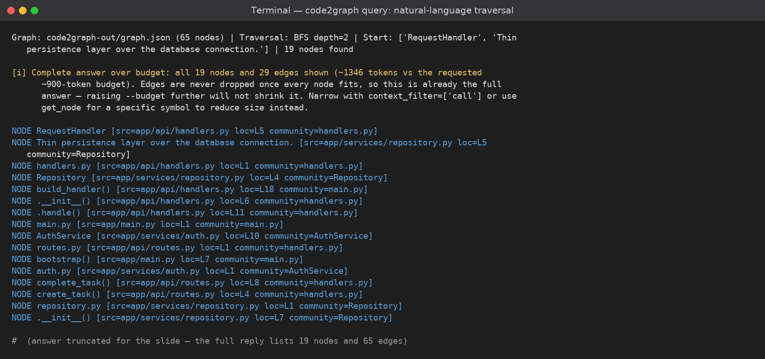
output/03 — Natural-language traversal
Section 10
10
The same question with a wider budget returns 19 nodes and 29 edges, each with source file, line and community — the assistant's view of the graph.
Code2Graph · Knowledge Graph-Based Structural Context for AI-Assisted Software Development · Team 20
Notes:
The same question with a wider budget: 19 nodes and 29 edges returned, each with its source file, line and community.

Slide 39
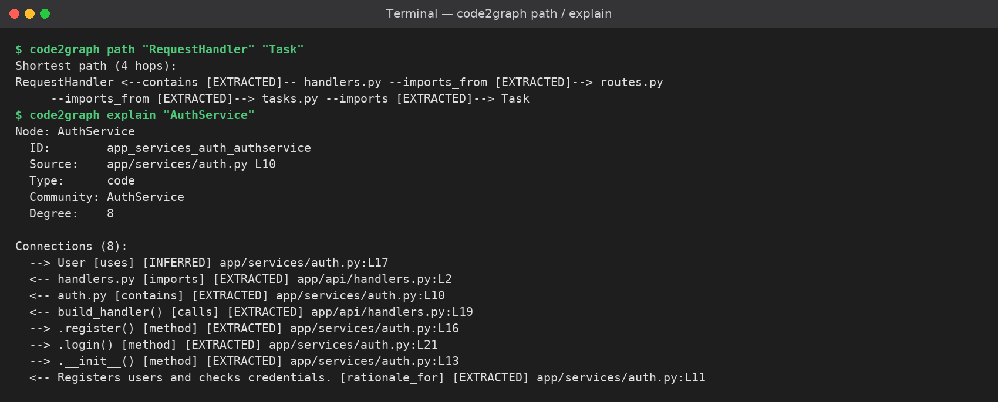
output/04 — Path tracing and explanation
Section 10
10
code2graph path "RequestHandler" "Task" returns a 4-hop route through the imports; code2graph explain "AuthService" lists all 8 relationships with relation type and confidence.
Code2Graph · Knowledge Graph-Based Structural Context for AI-Assisted Software Development · Team 20
Notes:
Path tracing and explanation: a four-hop route between RequestHandler and Task, and a full explanation of AuthService including inferred edges.

Slide 40
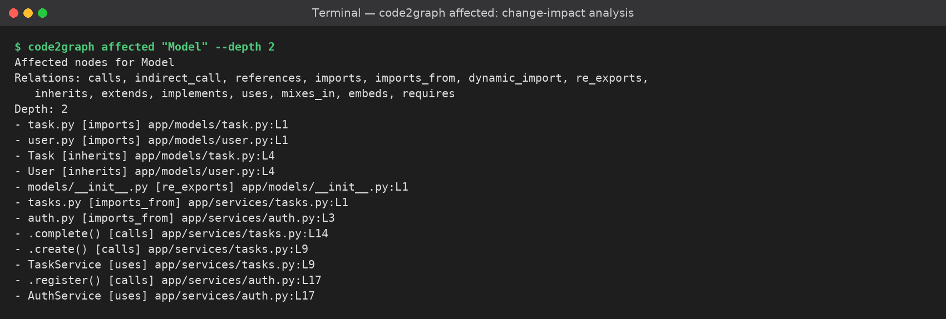
output/05 — Change-impact analysis
Section 10
10
code2graph affected "Model" performs a reverse traversal and lists every node a change to Model can reach — imports, inherits, calls and re-exports.
Code2Graph · Knowledge Graph-Based Structural Context for AI-Assisted Software Development · Team 20
Notes:
Change impact: a reverse traversal from Model shows everything a change could reach — imports, inherits, calls and re-exports.

Slide 41
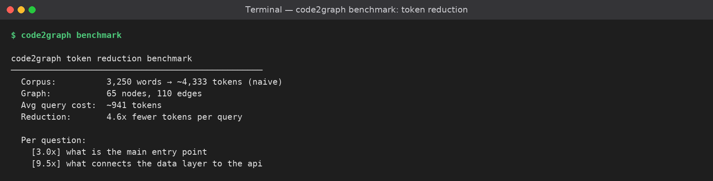
output/06 — Token-reduction benchmark
Section 10
10
code2graph benchmark compares the whole corpus against the subgraph an answer needs: ~4.6× fewer tokens per query on this sample repository.
Code2Graph · Knowledge Graph-Based Structural Context for AI-Assisted Software Development · Team 20
Notes:
The benchmark command quantifies the benefit: roughly 4.6 times fewer tokens per query than using the whole corpus.

Slide 42
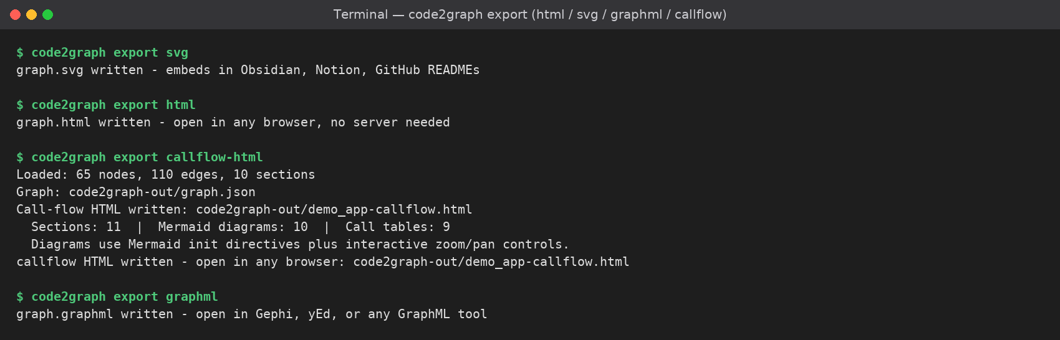
output/07 — Export formats
Section 10
10
The same graph is exported as interactive HTML, SVG, GraphML and a Mermaid call-flow report — one graph, many downstream views.
Code2Graph · Knowledge Graph-Based Structural Context for AI-Assisted Software Development · Team 20
Notes:
One graph, many exports: interactive HTML, SVG, GraphML and a Mermaid call-flow report.

Slide 43
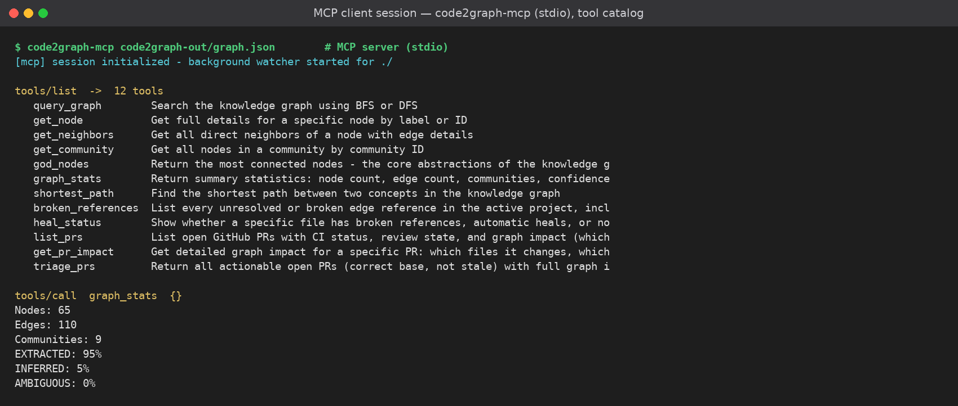
output/08 — MCP tool catalog
Section 10
10
code2graph-mcp serves 12 tools over stdio and starts the background watcher; graph_stats answers with node, edge, community and confidence counts.
Code2Graph · Knowledge Graph-Based Structural Context for AI-Assisted Software Development · Team 20
Notes:
The MCP server: 12 tools over stdio, a background watcher, and graph_stats reporting nodes, edges, communities and the confidence split.

Slide 44
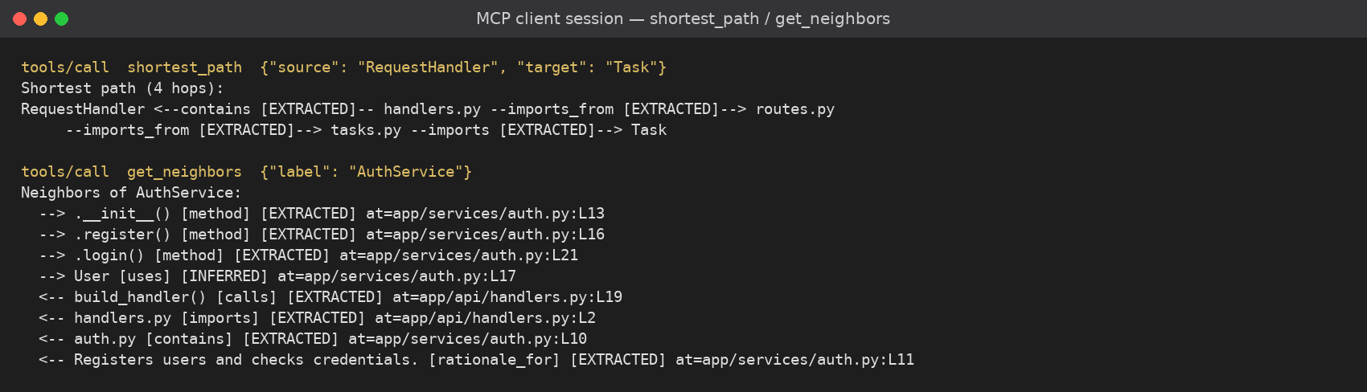
output/09 — MCP graph queries
Section 10
10
Inside a client session, shortest_path traces RequestHandler → Task in 4 hops and get_neighbors returns every relationship of AuthService with its confidence label.
Code2Graph · Knowledge Graph-Based Structural Context for AI-Assisted Software Development · Team 20
Notes:
Inside a client session: shortest_path and get_neighbors, with every relationship carrying its relation type and confidence label.

Slide 45
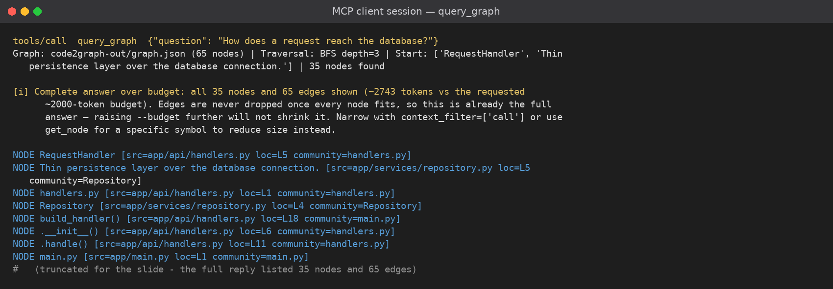
output/10 — MCP natural-language query
Section 10
10
query_graph answers a question in the assistant's own tool call; the reply reports the traversal, the node list and the token budget it respected.
Code2Graph · Knowledge Graph-Based Structural Context for AI-Assisted Software Development · Team 20
Notes:
A natural-language query answered through the MCP tool call, including the traversal details and the token budget the server respected.

Slide 46
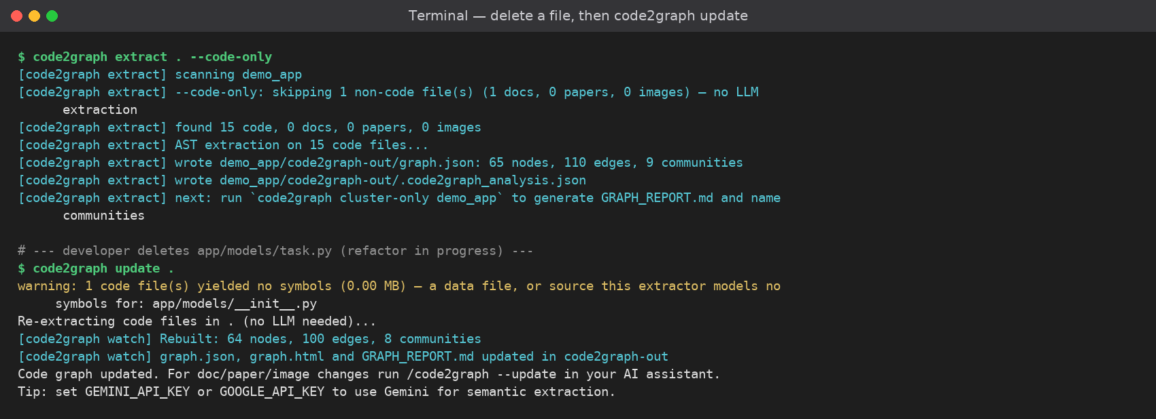
output/11 — Broken reference recorded
Section 10
10
After app/models/task.py is deleted, code2graph update rebuilds the graph to 64 nodes / 100 edges and records the lost relationships as BROKEN metadata.
Code2Graph · Knowledge Graph-Based Structural Context for AI-Assisted Software Development · Team 20
Notes:
Healing, part one: a source file is deleted and the update records the lost relationships as BROKEN metadata — no dangling edges and no phantom nodes.

Slide 47
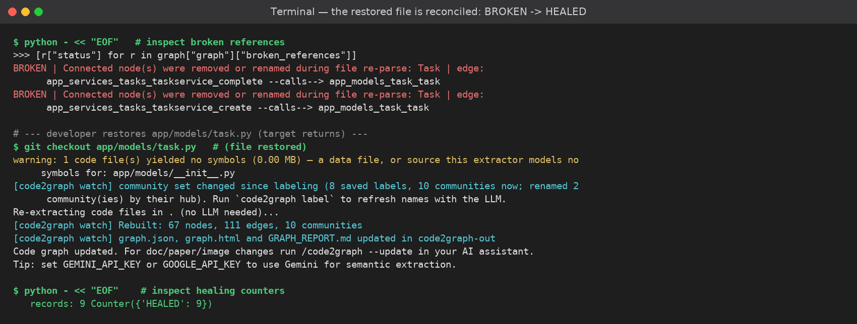
output/12 — Reference healed
Section 10
10
When the file returns, the next rebuild reconciles every record: all 9 edges are restored and marked HEALED instead of leaving dangling or phantom nodes.
Code2Graph · Knowledge Graph-Based Structural Context for AI-Assisted Software Development · Team 20
Notes:
Healing, part two: when the file returns, all nine records are reconciled and marked HEALED.

Slide 48
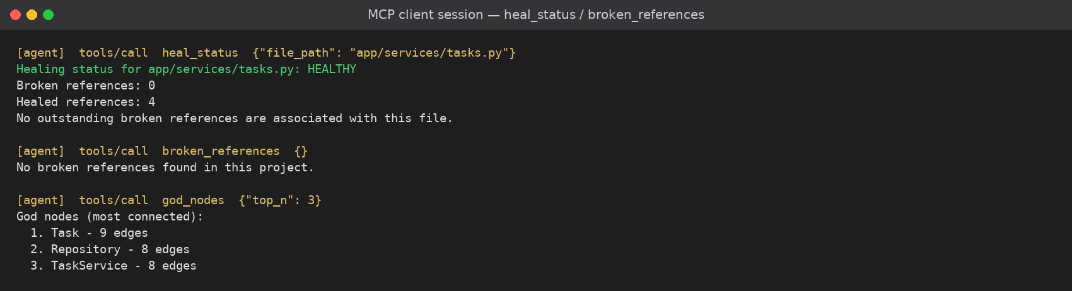
output/13 — Healing diagnostics over MCP
Section 10
10
heal_status reports the file as HEALTHY with 4 healed references and 0 broken; broken_references confirms the project has no unresolved edges left.
Code2Graph · Knowledge Graph-Based Structural Context for AI-Assisted Software Development · Team 20
Notes:
The agent-facing diagnostics: heal_status reports HEALTHY with four healed references, and broken_references confirms nothing is outstanding.

Slide 49
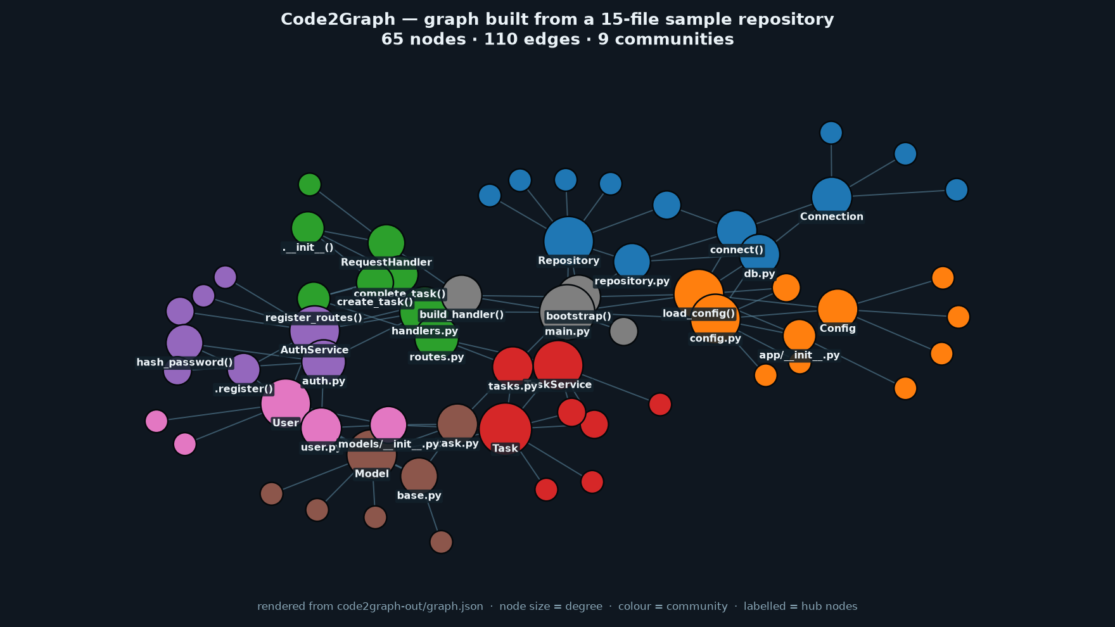
output/14 — Graph view (graph.json)
Section 10
10
The persisted graph rendered as a network: node size is degree, colour is community and hub nodes are labelled — the same data the interactive graph.html draws.
Code2Graph · Knowledge Graph-Based Structural Context for AI-Assisted Software Development · Team 20
Notes:
The persisted graph drawn as a network — node size is degree and colour is community.

Slide 50
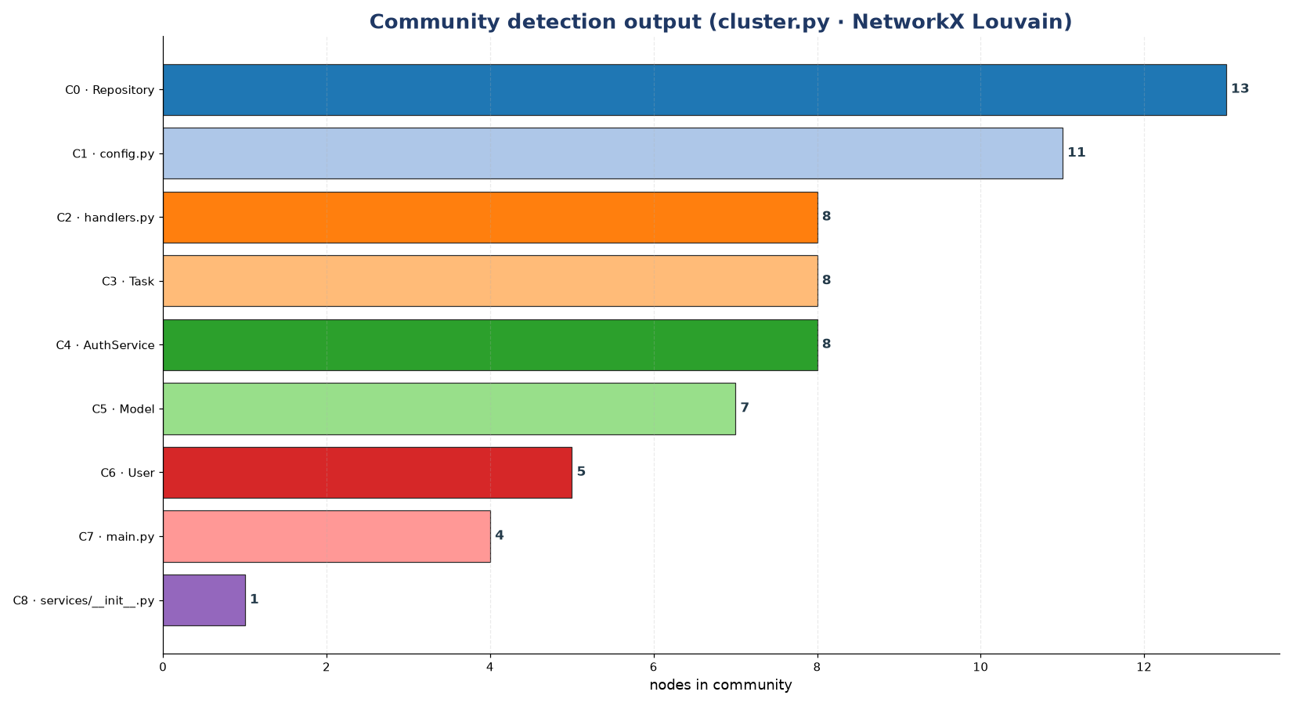
output/15 — Community detection
Section 10
10
Louvain clustering over the sample repository, with each community named after its highest-degree node.
Code2Graph · Knowledge Graph-Based Structural Context for AI-Assisted Software Development · Team 20
Notes:
Community detection output: nine communities for the sample repository, each named after its highest-degree node.

Slide 51
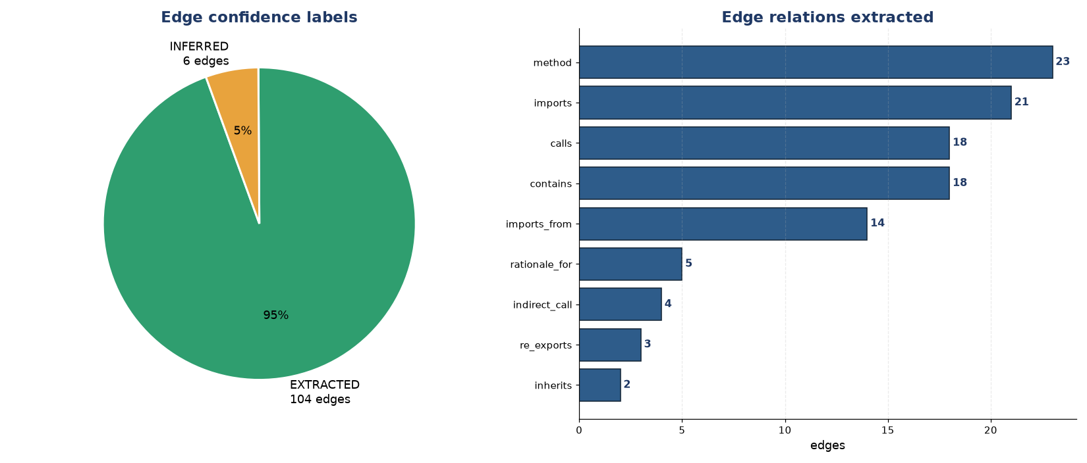
output/16 — Edge confidence and relations
Section 10
10
Every edge carries a confidence label (EXTRACTED / INFERRED / AMBIGUOUS) and a relation type such as calls, imports, imports_from, contains, method or rationale_for.
Code2Graph · Knowledge Graph-Based Structural Context for AI-Assisted Software Development · Team 20
Notes:
Every edge has a confidence label and a relation type, which is what makes the graph trustworthy for an assistant.

Slide 52
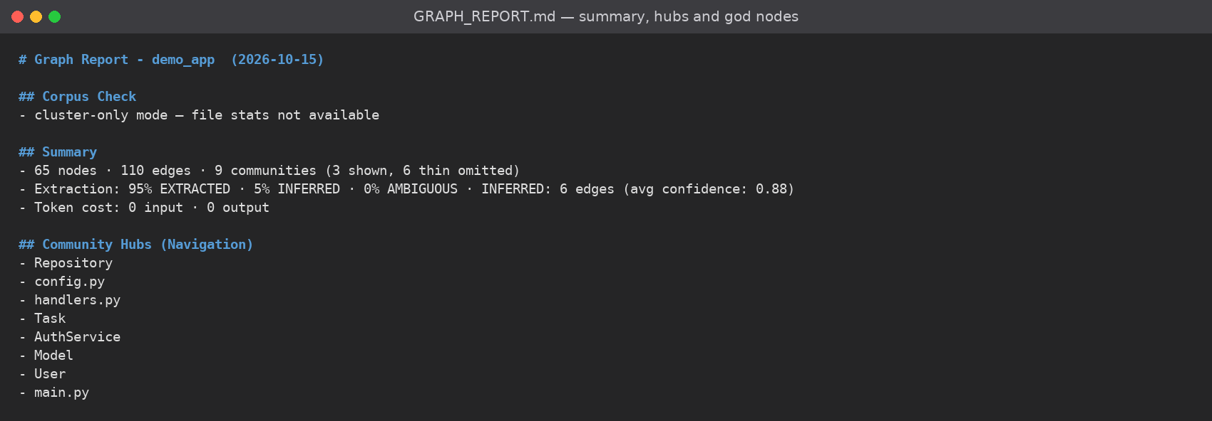
output/17 — GRAPH_REPORT.md (1 of 3)
Section 10
10
report.py writes a human-readable report: corpus summary, extraction confidence split, community hubs and the god nodes of the project.
Code2Graph · Knowledge Graph-Based Structural Context for AI-Assisted Software Development · Team 20
Notes:
The generated report, part one: corpus summary, confidence split, community hubs and god nodes.

Slide 53
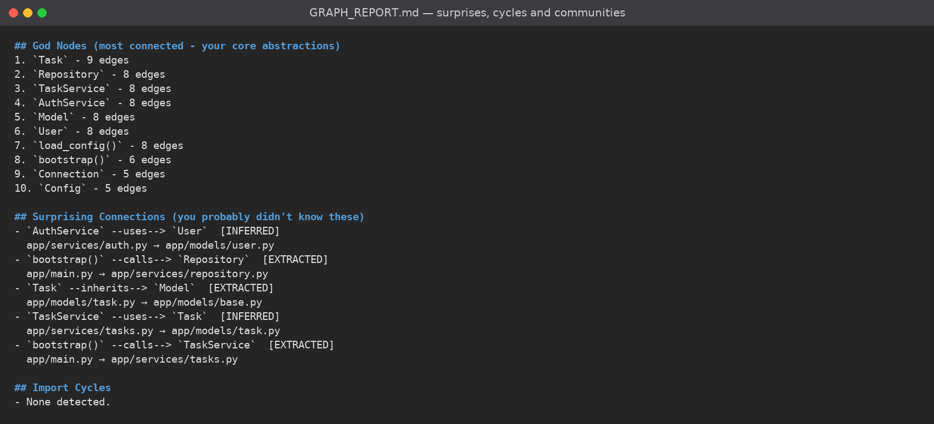
output/18 — GRAPH_REPORT.md (2 of 3)
Section 10
10
Surprising connections show cross-module links with their confidence, followed by import cycles and the detected communities with cohesion scores.
Code2Graph · Knowledge Graph-Based Structural Context for AI-Assisted Software Development · Team 20
Notes:
The generated report, part two: surprising cross-module connections, import cycles and the communities with their cohesion scores.

Slide 54
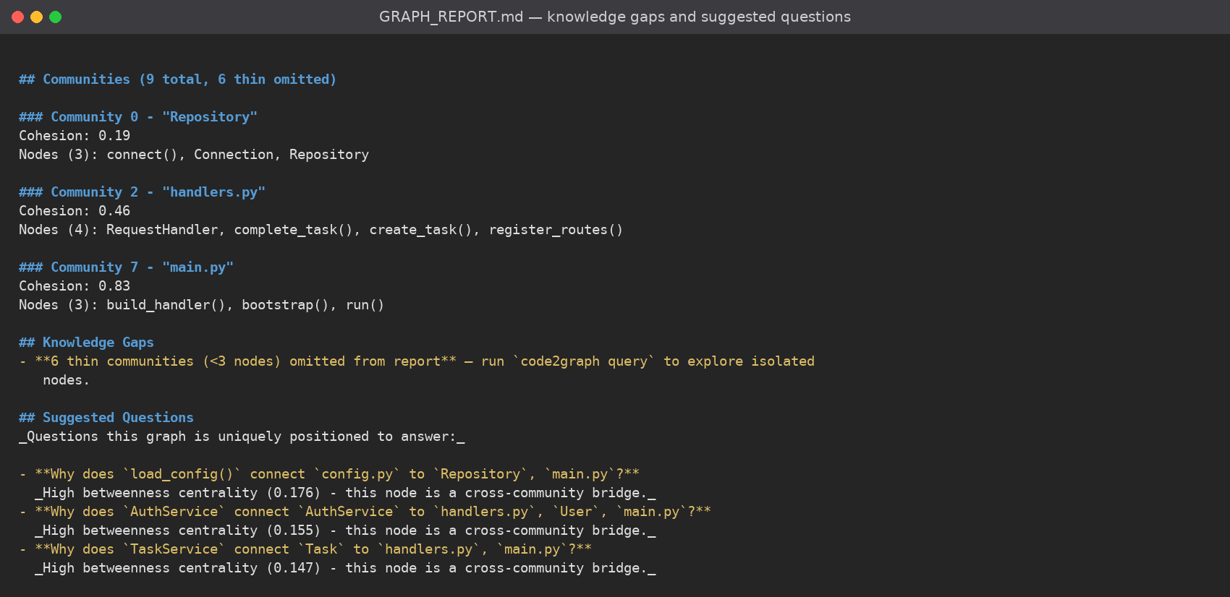
output/19 — GRAPH_REPORT.md (3 of 3)
Section 10
10
Knowledge gaps (thin communities) and suggested questions — each pointing at a bridge node the graph is uniquely positioned to explain.
Code2Graph · Knowledge Graph-Based Structural Context for AI-Assisted Software Development · Team 20
Notes:
The generated report, part three: knowledge gaps and the suggested questions the graph is uniquely able to answer.

Slide 55
Conclusion & Future Scope
Summary
▪ Code2Graph turns a source tree into a persistent, queryable knowledge graph of files, symbols and relationships.
▪ Structural extraction is local and deterministic — code-only indexing needs no API key and consumes no tokens.
▪ Incremental watching plus broken-reference healing keeps the graph trustworthy across edits, renames and deletions.
▪ One graph serves a terminal CLI, IDE/agent skills and an MCP server, so any compatible assistant can reuse the same context.
▪ Measured on the sample repository: 65 nodes, 110 edges across 15 files, ~4.6× fewer tokens per query than whole-corpus context.
Future scope
▪ Broaden dynamic/runtime analysis so behaviour that static parsing cannot resolve becomes visible in the graph.
▪ Expand the semantic layer for documents and media with configurable providers, and grow the language/grammar coverage.
▪ Deeper PR and cross-repository impact workflows, and richer human-facing exports (wiki, canvas, dashboards).
Code2Graph · Knowledge Graph-Based Structural Context for AI-Assisted Software Development · Team 20
Notes:
In conclusion: Code2Graph gives AI assistants and developers a focused, locally computed, self-healing structural context. Future work is broader dynamic analysis, a richer semantic layer for documents and media, and deeper PR / cross-repository workflows.

Slide 56
Thank You
Questions & Discussion
Team 20 · Akshaya Kumar R S · Sachin J · Senthil Pandian G S
Department of Artificial Intelligence and Data Science, K.L.N. College of Engineering
Supervisor: Mrs. Ilamathi S., AP / AI & DS
Code2Graph · Knowledge Graph-Based Structural Context for AI-Assisted Software Development · Team 20
Notes:
Thank you. We are happy to take questions.

