Slide 1
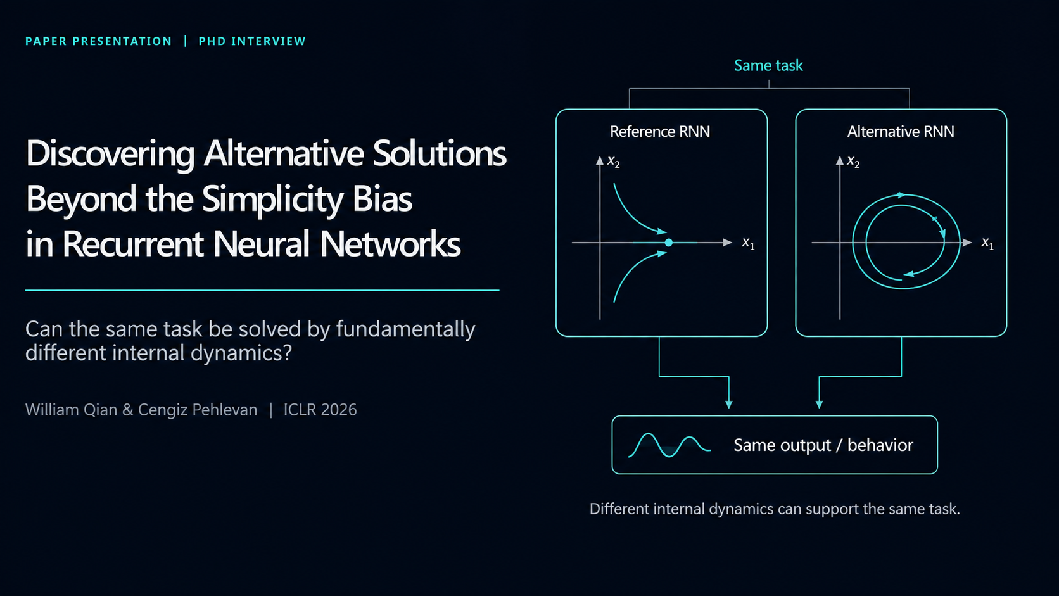
Qian & Pehlevan | ICLR 2026
Notes:
Open with the research question, not the result. Say that task-trained RNNs are often used as mechanistic hypotheses for neural computation. This paper asks whether the mechanism found by standard training is the only plausible mechanism, or just the easiest one for optimization to find. Emphasize that the presentation will be method-focused: the key contribution is not a new benchmark score, but a procedure for discovering alternative dynamical solutions.

Slide 2
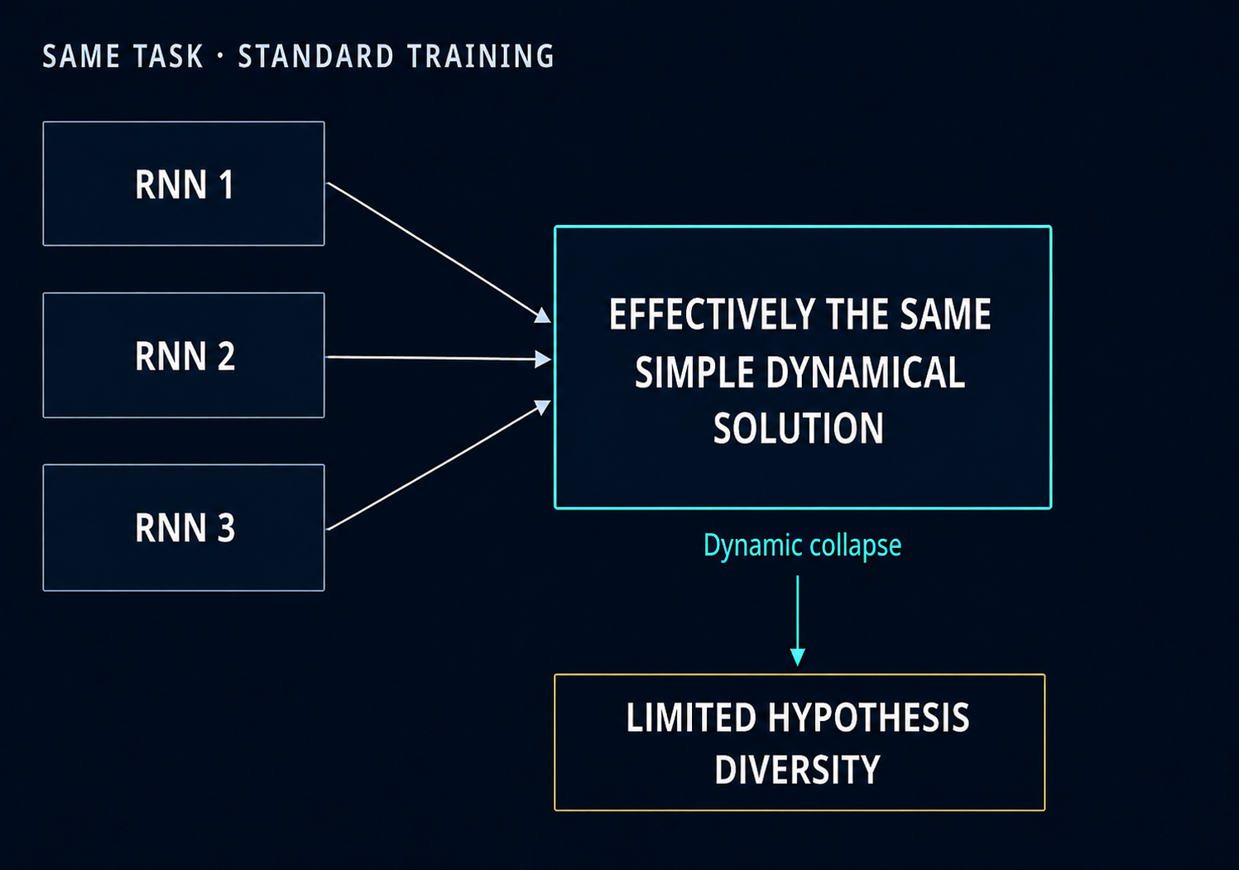
01 | PROBLEM
Why simplicity bias is a neuroscience problem?
Task-trained RNNs are useful if they yield multiple plausible mechanistic hypotheses.
Standard training favors simple, low-dimensional dynamics.
Different seeds or gains can converge to the same dynamical motif.
This creates dynamic collapse: many models, one mechanism.
Core failure mode:
parameter diversity does not imply mechanism diversity.
Qian & Pehlevan | ICLR 2026
Notes:
Explain why this matters scientifically. Task-trained RNNs are not just engineering models here; they are candidate mechanistic models of brain computation. Ideally, if we train many networks, we should obtain a set of competing hypotheses. The problem is that standard optimization often returns the same simple dynamical motif, such as fixed points or slow manifolds. Then a collection of trained networks only looks diverse at the parameter level, while the mechanism is effectively the same.

Slide 3
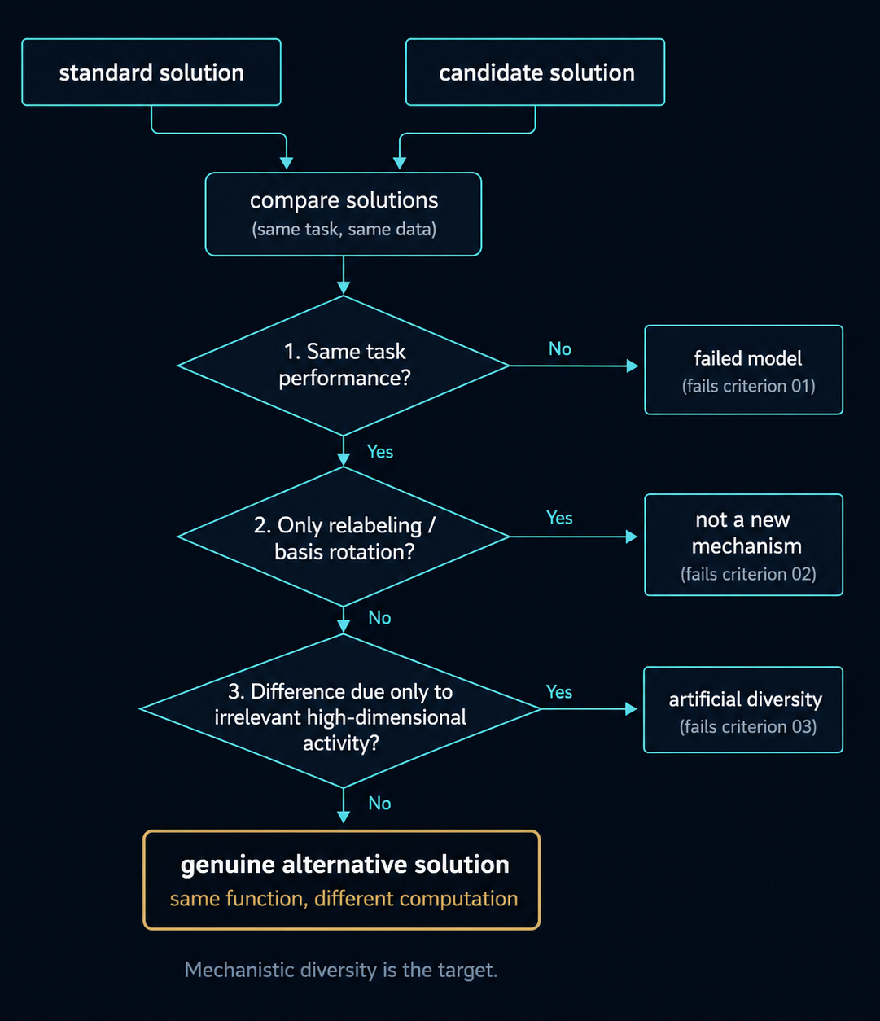
02 | DESIGN CRITERIA
What counts as a genuinely different solution?
A valid alternative must preserve task performance while changing the underlying computation.
01
Preserve function
Solve the same task equally well.
02
Reject superficial differences
Relabeling neurons or rotating the basis is not a new mechanism.
03
Reject trivial dissimilarity
Irrelevant high-dimensional activity must not fake dissimilarity.
Qian & Pehlevan | ICLR 2026
Notes:
Set up the design problem. A different solution must still solve the task. It must not be a trivial coordinate transformation, because neural axes in an artificial RNN are arbitrary. And it must not exploit the similarity metric by adding nuisance dynamics. These criteria explain why the authors do not just use standard RSA or a symmetric similarity score. They need an online penalty that targets reusable internal computations.

Slide 4
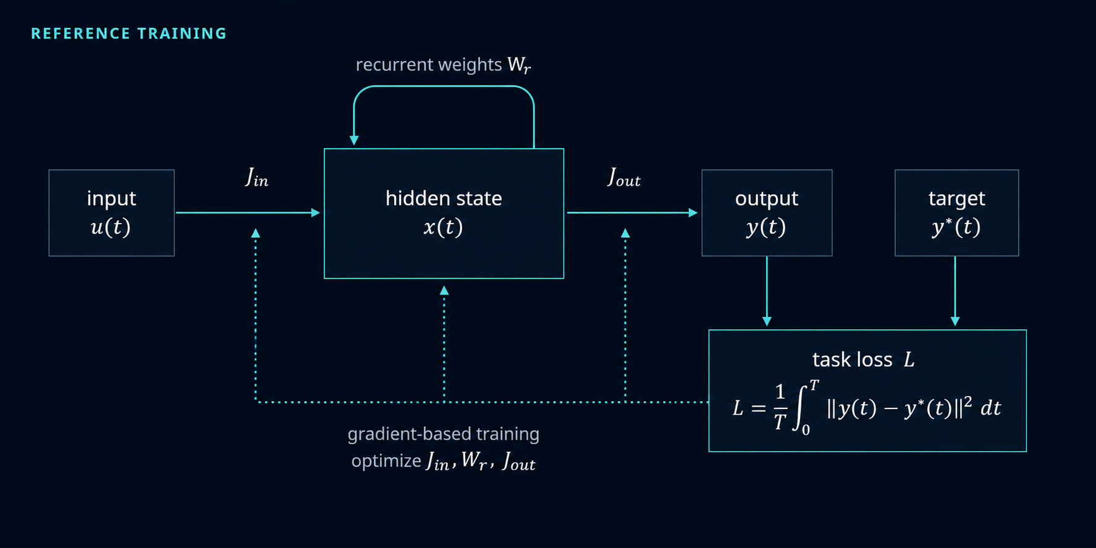



03 | BASELINE
Reference RNN and ordinary task training
Training a standard RNN
Continuous-time rate dynamics
$$\frac{dx}{dt}=−x+W_{r}r+J_{in}u\left(t\right)$$
$$r=\tanh\left(x\right), y\left(t\right)=J_{out}r\left(t\right)$$
Training objective
$$L=\frac{1}{T}\int_{0}^{T}{{\left\|y\left(t\right)−y^{∗}\left(t\right)\right\|}^{2}} dt$$
Standard comparison population
10 seeds for each initialization gain
g ∈ {0.01, 0.5, 1.0, 1.5}
Performance is optimized, but solution diversity is not.
Qian & Pehlevan | ICLR 2026
Notes:
This slide defines the baseline. The network dynamics are standard: the recurrent state evolves under decay, recurrent weights, and external input. The output is a linear readout from firing rates. The reference RNN minimizes only the task loss. The authors also train a standard comparison population across seeds and initialization gains. This lets them ask whether INSD finds solutions outside the range reached by ordinary training variations.

Slide 5
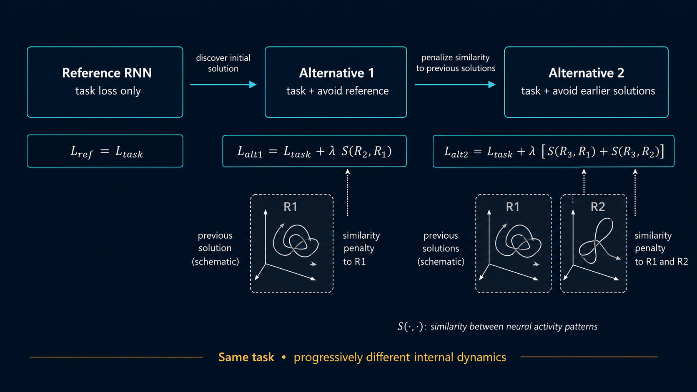
04 | PROPOSED METHOD
INSD: discover a new RNN solution by avoiding previous ones
Task performance is preserved; similarity to earlier neural dynamics is penalized
Qian & Pehlevan | ICLR 2026
Notes:
This is the core method. Train the reference normally. Then train alt-1 with the same task loss plus a penalty if its internal neural activity is linearly predictive of the reference activity. For alt-2, penalize similarity to both previous solutions. The point is iterative deflation: each time a solution is found, the next model is pushed away from it. Emphasize that the output target is unchanged; the method modifies the internal route to the output.

Slide 6
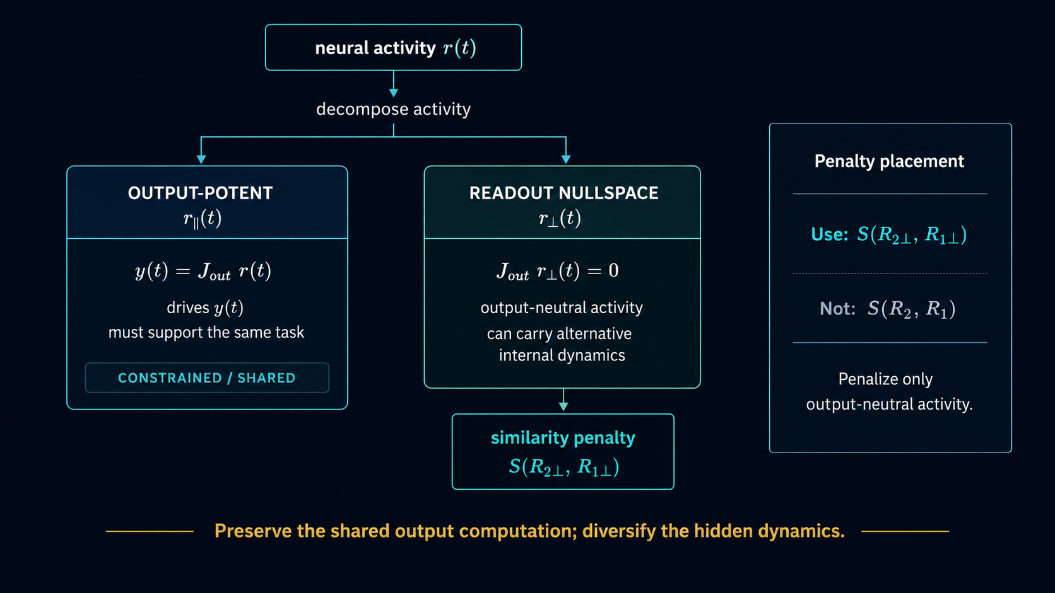
05 | CRITICAL DESIGN CHOICE
Why penalize the readout nullspace?
The output-constrained component must stay similar; INSD therefore penalizes only output-neutral activity.
Qian & Pehlevan | ICLR 2026
Notes:
This is the most important technical design choice after the loss itself. If two networks both match the target output, the activity components that drive that output must share information. Penalizing that component would directly conflict with task performance. Therefore, before computing the similarity penalty, the authors project firing rates into each network's readout nullspace. The penalty is then applied where alternative internal dynamics can exist without changing the output.

Slide 7
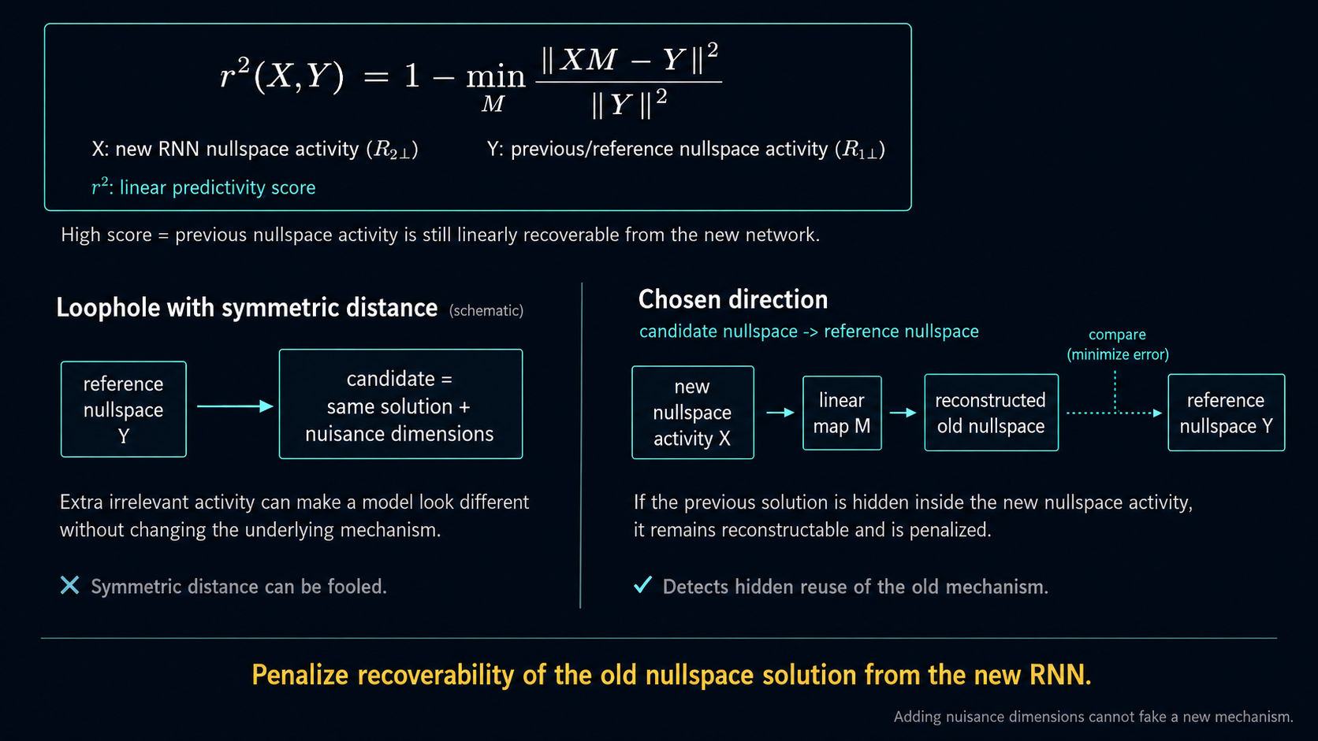
06 | SIMILARITY METRIC
Can the previous solution be linearly recovered from the new RNN?
Linear predictivity is asymmetric by design
Qian & Pehlevan | ICLR 2026
Notes:
Linear predictivity is used because it is efficient and invariant to simple rotations or relabeling of neural axes. The subtle point is that it must be used in the right direction. If the new model contains the reference solution plus many irrelevant dimensions, a wrong-direction or symmetric metric can be fooled. By asking whether the reference activity can be reconstructed from the penalized model, the method detects a hidden copy of the old representation and penalizes it. DSA is more directly dynamical, but too expensive to use as an online loss.

Slide 8
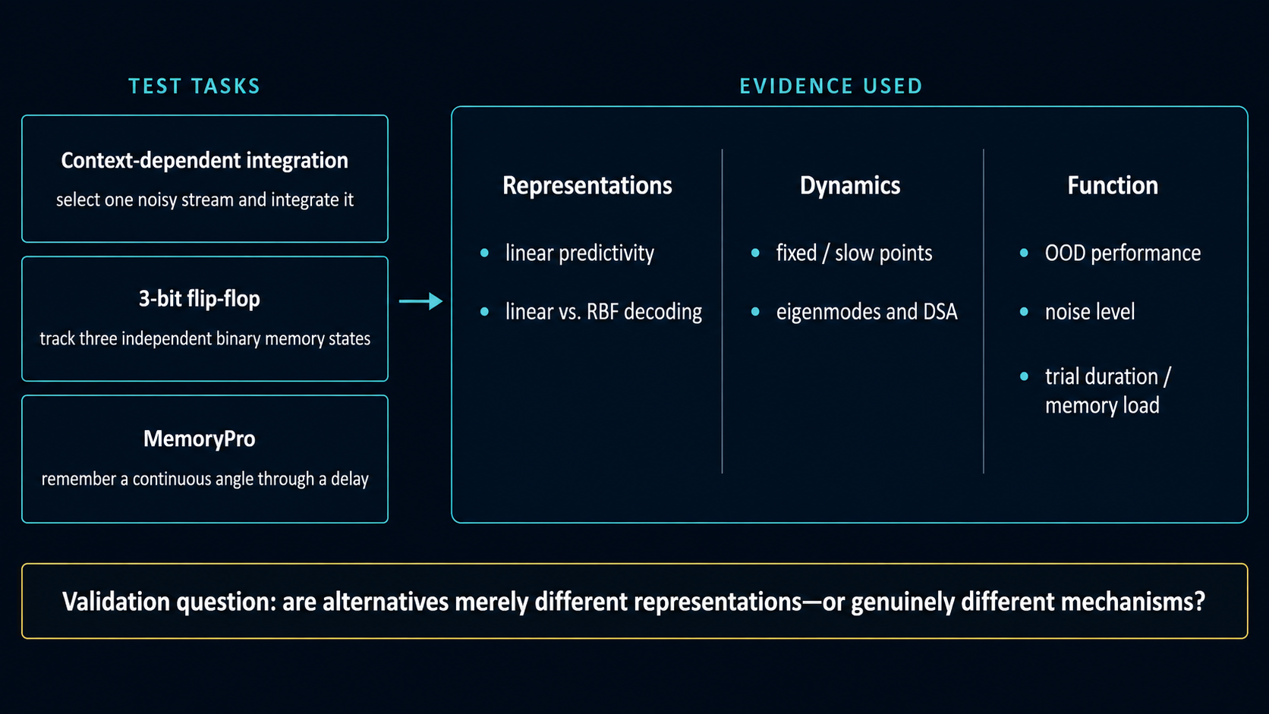
07 | VALIDATION
How the authors rule out cosmetic differences
The paper validates INSD alternatives at the representation, dynamical, and functional levels.
Qian & Pehlevan | ICLR 2026
Notes:
This slide explains why the paper's evidence is stronger than a simple figure comparison. The authors test three tasks: context-dependent integration, discrete 3-bit memory, and analog angle memory. They then assess alternatives at three levels: representational geometry, dynamical systems structure, and functional performance under out-of-distribution conditions. This directly addresses the concern that INSD might only change the coordinate system rather than the mechanism.

Slide 9
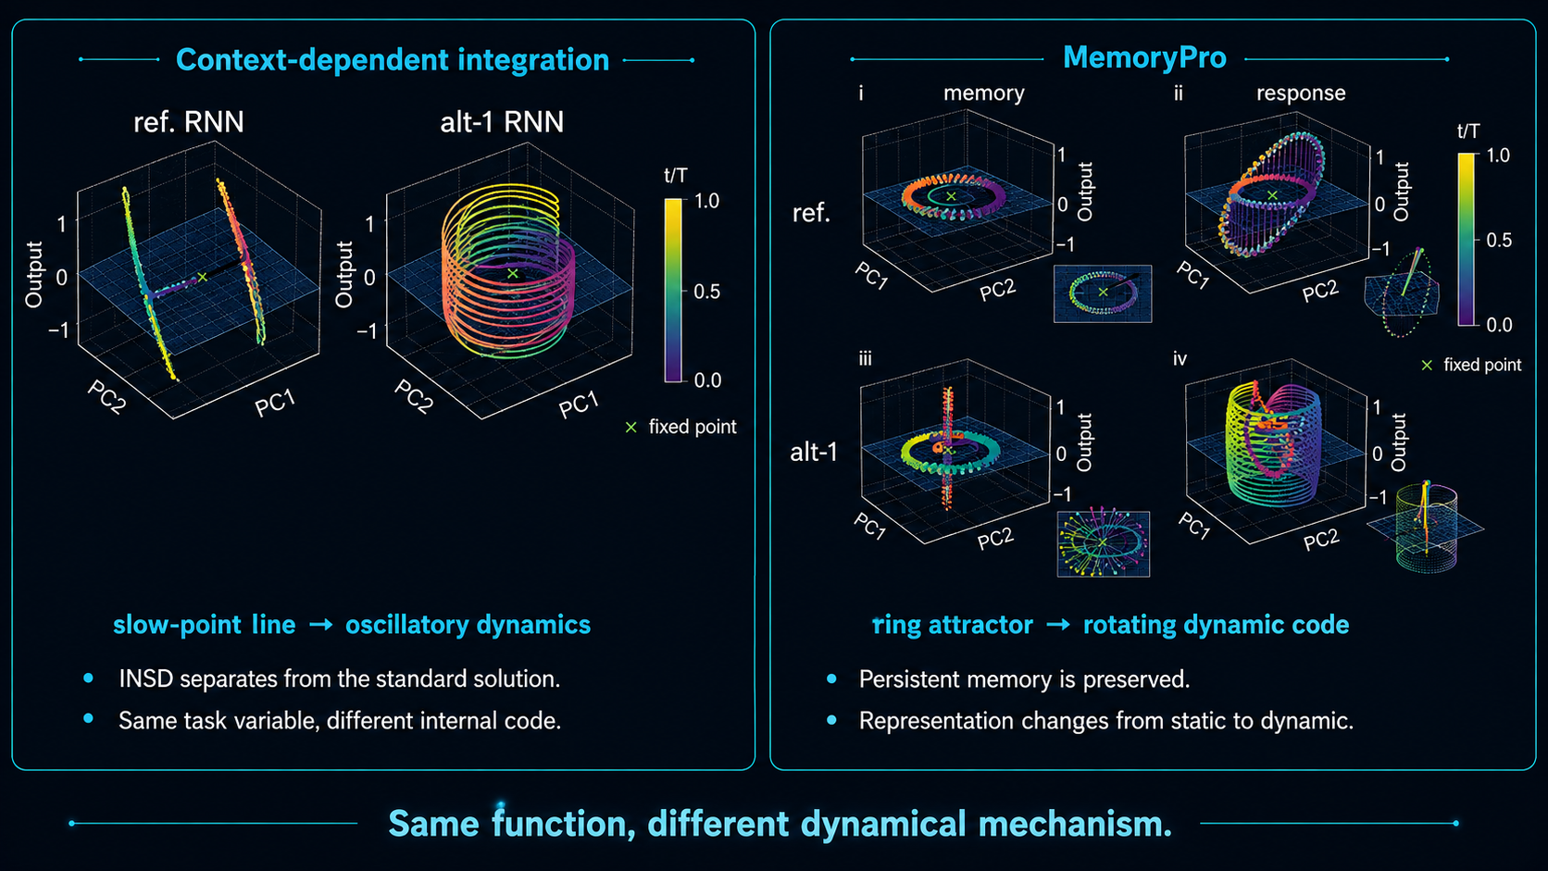
08 | RESULTS
INSD changes the dynamical mechanism, not just the plot
Qian & Pehlevan | ICLR 2026
Notes:
Summarize the main empirical result. In context-dependent integration, standard RNNs use line or slow-point attractor-like dynamics. INSD produces oscillatory, evolving trajectories. This is not merely cosmetic: the representations become less predictive of the standard population and the DSA embedding separates them dynamically. In MemoryPro, the reference network stores an angle in a persistent ring-like representation. The alternative preserves the remembered angle while activity rotates. Stress that the information is not lost; it is encoded more dynamically.

Slide 10
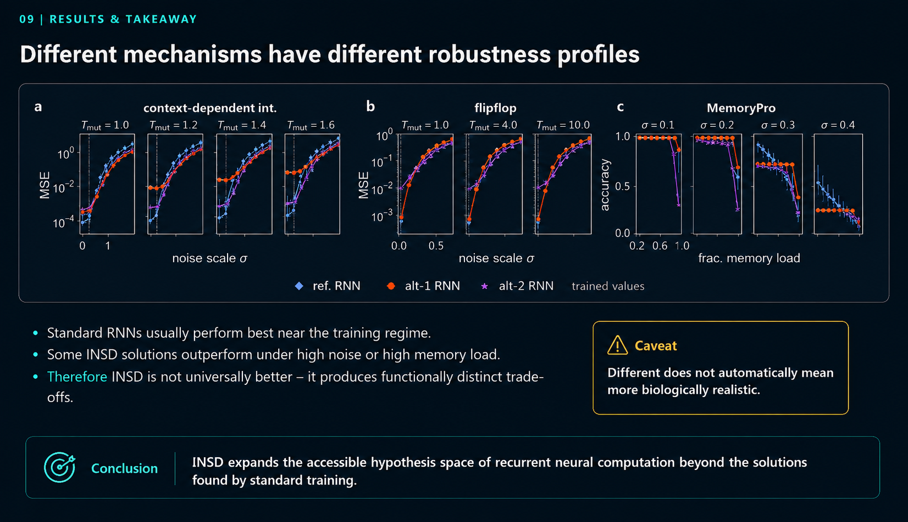
Qian & Pehlevan | ICLR 2026
Notes:
Close carefully. Do not claim that INSD is universally better. Standard RNNs often win near the training distribution. The important result is that alternatives have different robustness profiles: alt-2 helps in high-noise integration and flip-flop conditions, while alt-1 helps on the hardest MemoryPro trials. This supports the claim that the mechanisms are functionally distinct. End with the caveat: different does not automatically mean more biological. The value is expanding the hypothesis space for later comparison with neural data.

Slide 11


