Slide 1
Case Study
Blue Cross Blue Shield

Slide 2
Problem Statement
I will partner Closely with:
AI/Ml Scientists
Data Engineers
Platform Engineers
Architects
Governance Specialists
I will support:
Deployment
Availability
Monitoring of GenAI (LLM based) models
I should:
Model Management
Pipeline management
Performance Evaluation
Ethical guideline of models
Assisting in programming and storage solution

Slide 3
Deliverable
we have a collection of reports from industry experts covering a wide variety of relevant topics for our business and that this collection grows monthly
presume that a pilot GenAI solution has been developed such that our employees can leverage these reports to create insights and strategy recommendations for the leadership team
illustrative recommendation of an LLMOps solution to deploy this pilot solution to production that has safeguards around performance as time goes on

Slide 4
Plan
Terminology
w

Slide 5
LLM Model
presume that a pilot GenAI solution has been developed such that our employees can leverage these reports to create insights and strategy recommendations for the leadership team
Let’s see if I can find a model from Huggingface:
There is a python-based model, let’s see if we can deploy it

Slide 6
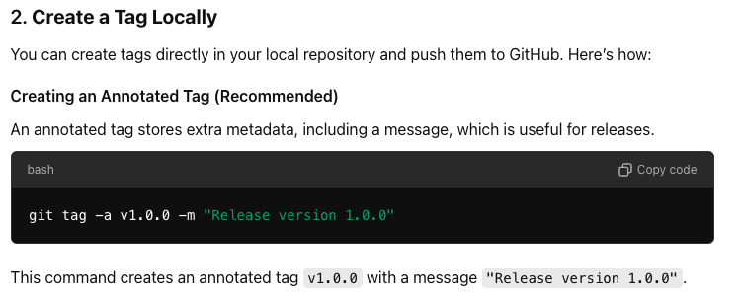
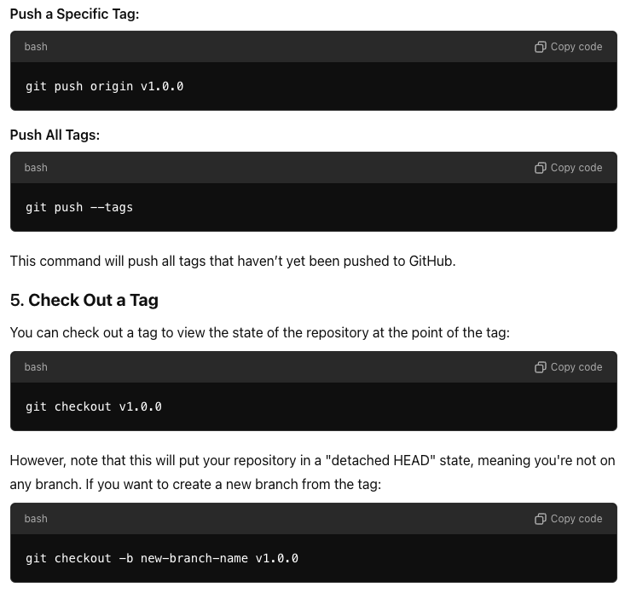
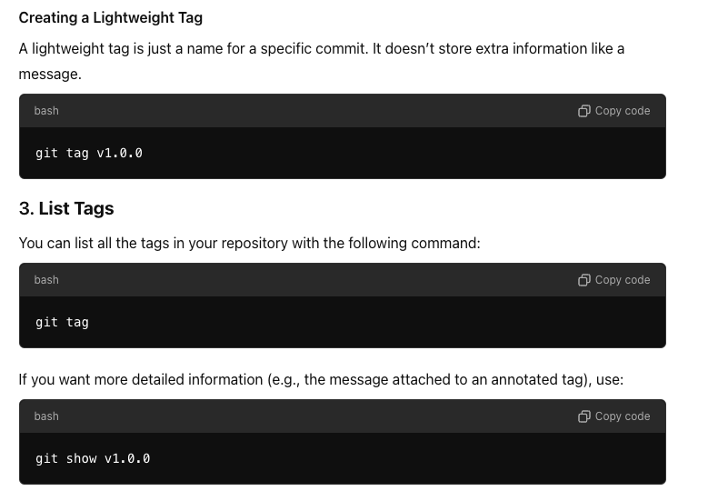
Steps (GitHub 1)
Create a Github Repo for the code: https://github.com/ShayanCanty/CaseStudy.git
Now we should put Restriction on main, to make sure no one can modify main directly
Repository Structure:
Have separate folders: src/, tests/, docs/, model/
Version Control with tags: Using Git tags in GitHub is a great way to mark specific points in your repository's history as important, typically used to denote releases or versions of your software. Tags are often used in conjunction with semantic versioning (e.g., v1.0.0, v2.0.1). Here’s how to use Git tags for version control effectively.

Slide 7
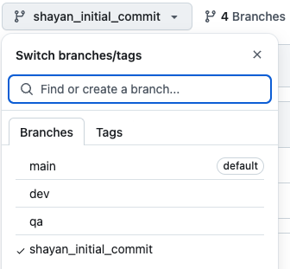
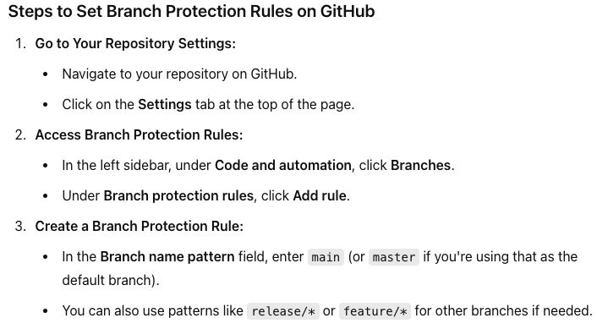
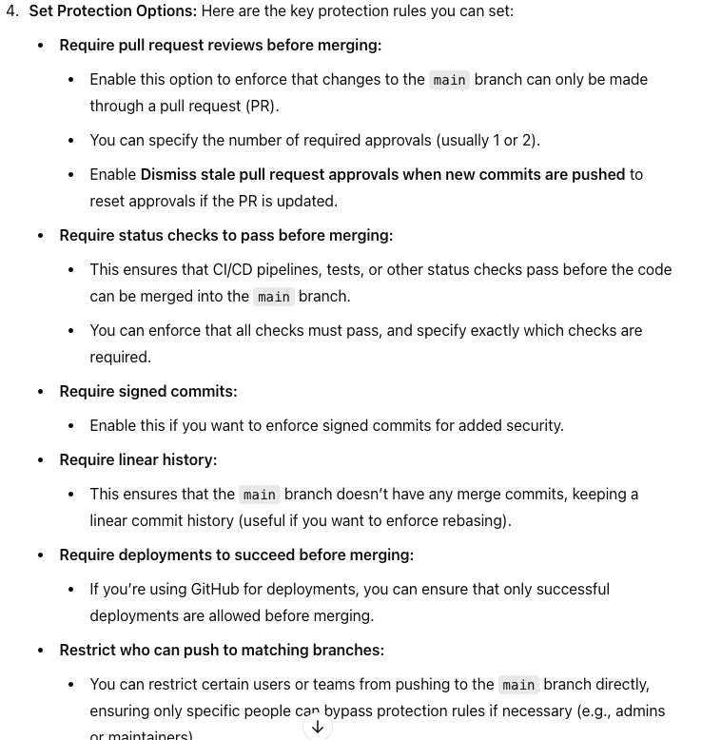
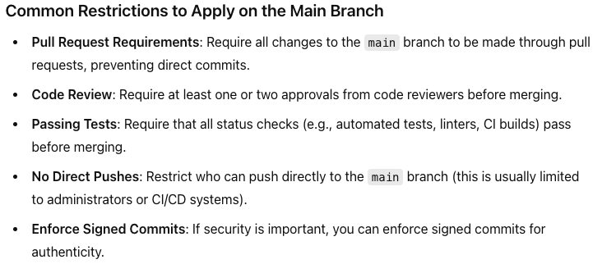
Steps (GitHub 2)
Create a Github Repo for the code: https://github.com/ShayanCanty/CaseStudy.git
Having different Branches:
Main: Always contains stable, production ready code
QA: Quality Assurance, code usually runs 2 weeks from Dev to production for any potential errors
Develop: For ongoing development and feature
Feature Branches: For indicidual features or changes.
Hotfix branches: For quick patches to production code
Regular merging: Keep branches up to date with the main branch to avoid large merge conflicts.

Slide 8
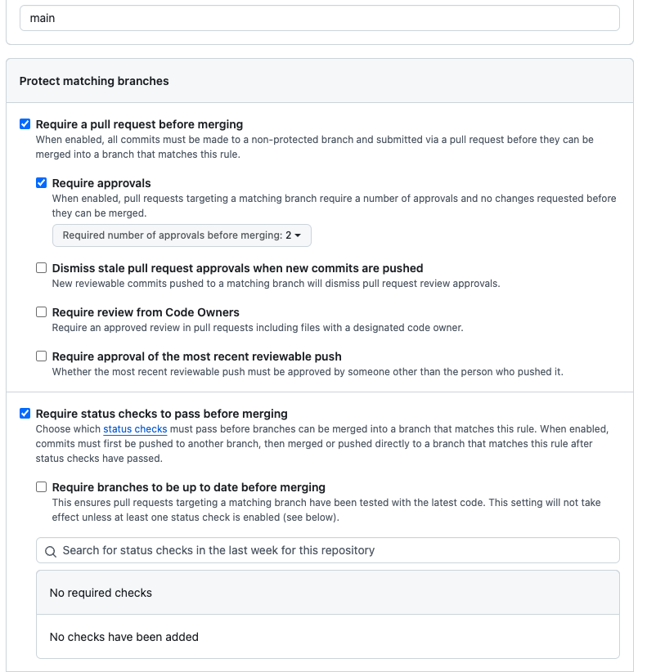
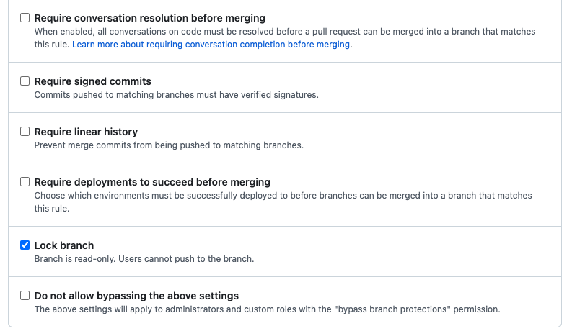
Steps (GitHub 3)
Create a Github Repo for the code: https://github.com/ShayanCanty/CaseStudy.git

Slide 9
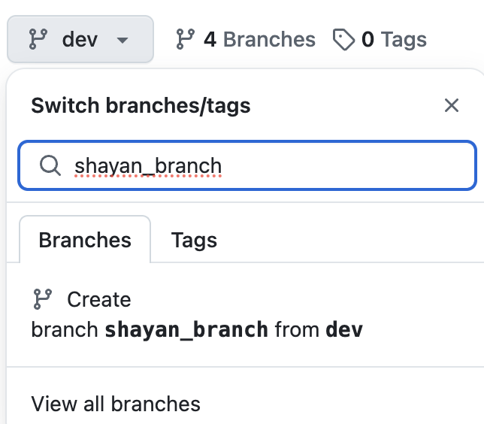
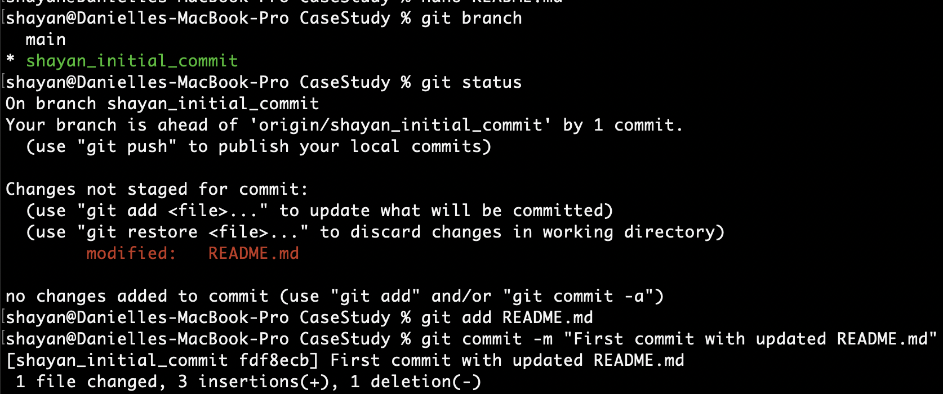
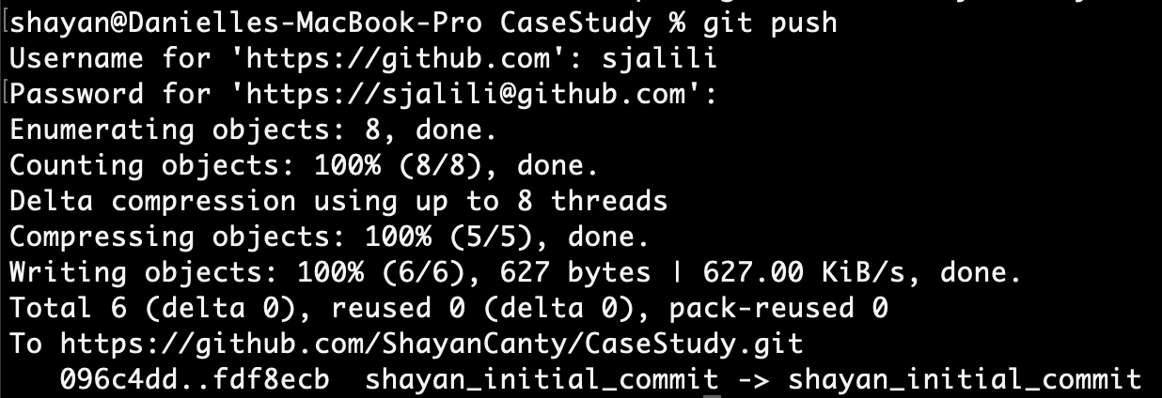
Steps (GitHub 4), How to Use code to Github
Do you have a feature Branch
Start Developing on your feature branch
Push the code to GitHub
Your local feature Branch to GitHub Feature Branch
Create a feature branch off Dev branch
No
Start here
Delete the feature branch
Wait for Approval
Create a pull request from feature branch to dev

Slide 10
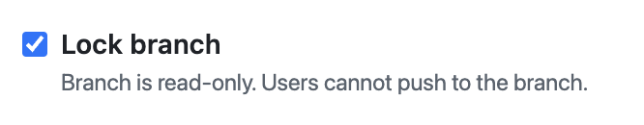
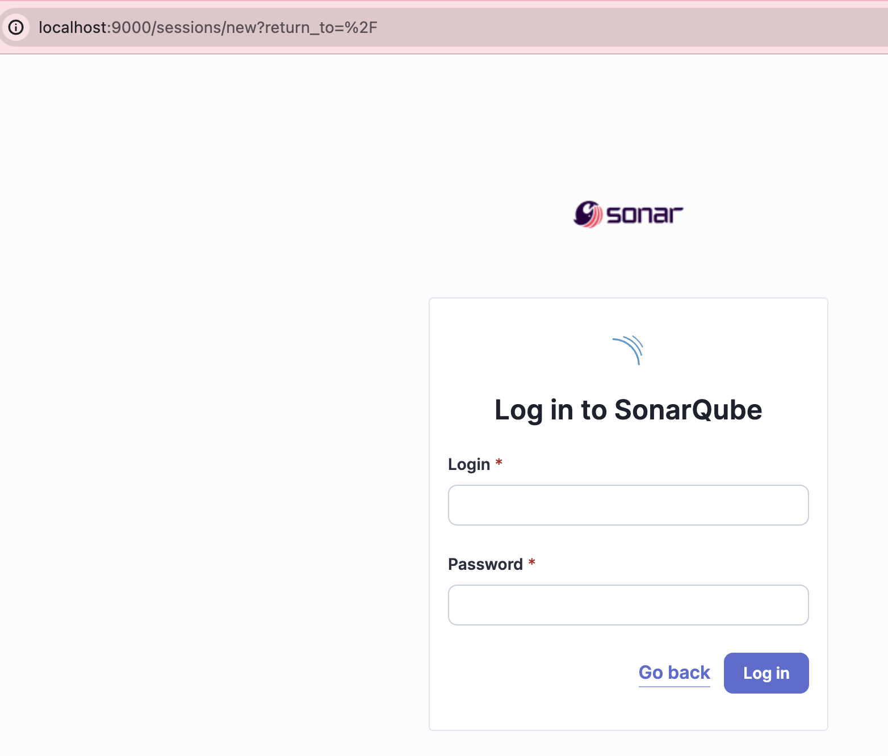
Steps (GitHub 5), Pull Requests (PRs) and Code Reviews
No Direct Commit to main branch
Code review with SonarQube: is an open-source platform for continuous inspection of code quality. It provides detailed insights into code by analyzing it for bugs, vulnerabilities, code smells, and other potential issues, focusing on improving maintainability, security, and overall quality. SonarQube supports multiple programming languages, including Java, C#, JavaScript, Python, and many more.
Code Analysis: SonarQube scans codebases for a wide range of potential issues, from coding standards to security vulnerabilities
Bugs and Vulnerabilities: Detects bugs and vulnerabilities to ensure your code is secure and less prone to errors.
Code Smells: Highlights areas of the code that may not be faulty but could lead to maintenance issues or inefficiency.
Maintainability and Technical Debt: Tracks "technical debt" by measuring how much time it would take to fix detected issues.
Integration: It integrates with popular build tools and CI/CD pipelines such as Jenkins, GitLab, GitHub, and others.
Installing SonarQube: https://docs.sonarsource.com/sonarqube/latest/try-out-sonarqube/
Intall Java17: https://adoptium.net/en-GB/installation/
Make sure Java version is 17.:
1. brew install --cask temurin17
2. export JAVA_HOME=$(/usr/libexec/java_home -v 17)
3. Java –version
Once installed, try in browser: http://localhost:9000
Credentials are admin/admin, try new password: casestudy

Slide 11
Steps Automated Testing with Github Actions

Slide 12
Model Creation
Data Ingestion & Preprocessing: Store data in S3 bucket and use NLP to remove irrelevant information, and split data into manageable sections for analysis.
Knowledge management: use a topic model algorithm mto categorize document into relevant themes
3. Insight Generation: Trend analysis, summarization,
Strategy Recommendation Engine
Context-Aware Recommendations: Build an LLM-based system (like GPT-4 or fine-tuned models) that synthesizes data and provides recommendations. For example, “Based on the increasing focus on telemedicine regulations, we recommend prioritizing digital healthcare solutions for our product portfolio.”
Customizable Filters: Allow leadership to filter recommendations by specific topics (e.g., cost control, innovation, patient engagement) or time frames.
Risk Assessment: Highlight areas of potential risk or uncertainty. For instance, “Reports suggest potential regulatory shifts in telehealth reimbursement models. A contingency strategy is advised.”
Actionable Insights: Use classification models to mark certain insights as "actionable," and provide suggestions such as "allocate resources to AI-based patient services" or "expand partnerships in telemedicine."
5. Dashboard for Leadership Team
Visual Insights: Develop a dashboard that displays key insights through visuals, such as trend graphs, word clouds for key terms, sentiment analysis over time, and strategic recommendations.
Interactive Reports: Allow leadership to drill down into specific reports or categories of interest, giving them a detailed view of the raw data behind the insights.
Notifications: Implement a system that sends alerts or periodic reports summarizing the latest findings and recommended actions.
6. AI-Driven Continuous Learning
Feedback Loop: Collect feedback from leadership on the usefulness of the insights and recommendations. Use this feedback to improve the model over time.
Continuous Updates: Regularly retrain the model as new reports are ingested and industry trends evolve, ensuring that insights and recommendations remain current.
7. Implementation Tools
Cloud Infrastructure: Leverage AWS or GCP for scalable data processing, storage, and model deployment.
LLM Framework: Use pre-trained transformer models (like GPT-4) fine-tuned on healthcare and insurance-specific data.
Data Visualization: Use platforms like Power BI, Tableau, or a custom-built dashboard with D3.js for creating visual insights.
APIs for Data Ingestion: Connect to external sources of industry reports via APIs to ensure reports are automatically fetched and processed.

Slide 13
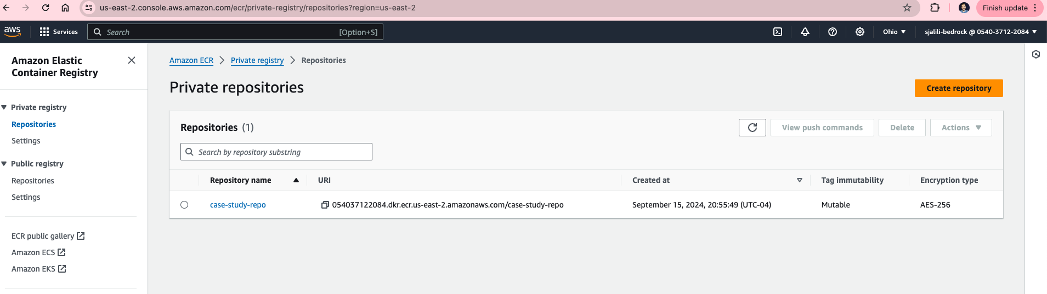
Create a Docker Image for Lambda Function
Create a Dockerfile
Install Docker: brew install docker
Run docker in mac using launchpad
Retrieve an authentication token and authenticate your Docker client to your registry. Use the AWS CLI:
aws ecr get-login-password --region us-east-2 | docker login --username AWS --password-stdin 054037122084.dkr.ecr.us-east-2.amazonaws.com
Note: If you receive an error using the AWS CLI, make sure that you have the latest version of the AWS CLI and Docker installed.
Build your Docker image using the following command. For information on building a Docker file from scratch see the instructions here . You can skip this step if your image is already built:
docker build -t case-study-repo .
After the build completes, tag your image so you can push the image to this repository:
docker tag case-study-repo:latest 054037122084.dkr.ecr.us-east-2.amazonaws.com/case-study-repo:latest
Run the following command to push this image to your newly created AWS repository:
docker push 054037122084.dkr.ecr.us-east-2.amazonaws.com/case-study-repo:latest

Slide 14
CI/CD for Unit Tests 1
To set up a pipeline that automatically runs unit tests when a pull request is made to the main branch, and prevents approval if the tests fail, you can use GitHub Actions. This is a common CI/CD workflow, and GitHub Actions makes it simple to trigger unit tests on pull requests and block merging if the tests fail.
Steps to Set Up the Pipeline:
Create a GitHub Actions Workflow that runs the unit tests when a pull request is made.
Configure branch protection rules in GitHub to ensure that pull requests cannot be merged if the tests fail.
Step 1: Create a GitHub Actions Workflow
In your repository, create a directory called .github/workflows/ if it doesn’t already exist.
Inside this directory, create a file named ci.yml (or any name you'd like for the workflow).
Add the following workflow configuration, which will trigger the tests on a pull request to the main branch:
Explanation:
Trigger: The workflow runs when there is a pull request targeting the main branch.
Jobs:
Checkout code: Retrieves the latest version of the repository's code.
Set up Python: Installs the specified version of Python.
Install dependencies: Installs dependencies from the requirements.txt file.
Run unit tests: Runs the unit tests using the unittest framework. Modify this step if you're using a different test framework (e.g., pytest).
Failure: If any tests fail, the workflow fails, and the pull request cannot be approved.

Slide 15
CI/CD for Unit Tests 2
Step 2: Configure Branch Protection Rules
To prevent the pull request from being merged if the tests fail, you need to set up branch protection rules in GitHub.
Go to your repository settings:
Navigate to your GitHub repository.
Click on the Settings tab.
Enable branch protection for main:
In the left-hand menu, click Branches under the Code and automation section.
Under Branch protection rules, click Add rule.
Configure the branch protection rule:
Set the branch name pattern to main.
Check Require status checks to pass before merging.
Under Status checks that are required, select the workflow (e.g., "Run Unit Tests") that you created in the .github/workflows/ci.yml file.
Optionally, check Require pull request reviews before merging if you want additional review requirements.
Save the branch protection rule.
Step 3: Test the Workflow
Create a pull request to the main branch.
The GitHub Actions workflow will automatically run the unit tests as part of the pull request process.
If the tests pass, the status check will succeed, and the pull request can be approved and merged.
If the tests fail, the status check will fail, and the pull request cannot be merged until the tests are fixed.

Slide 16
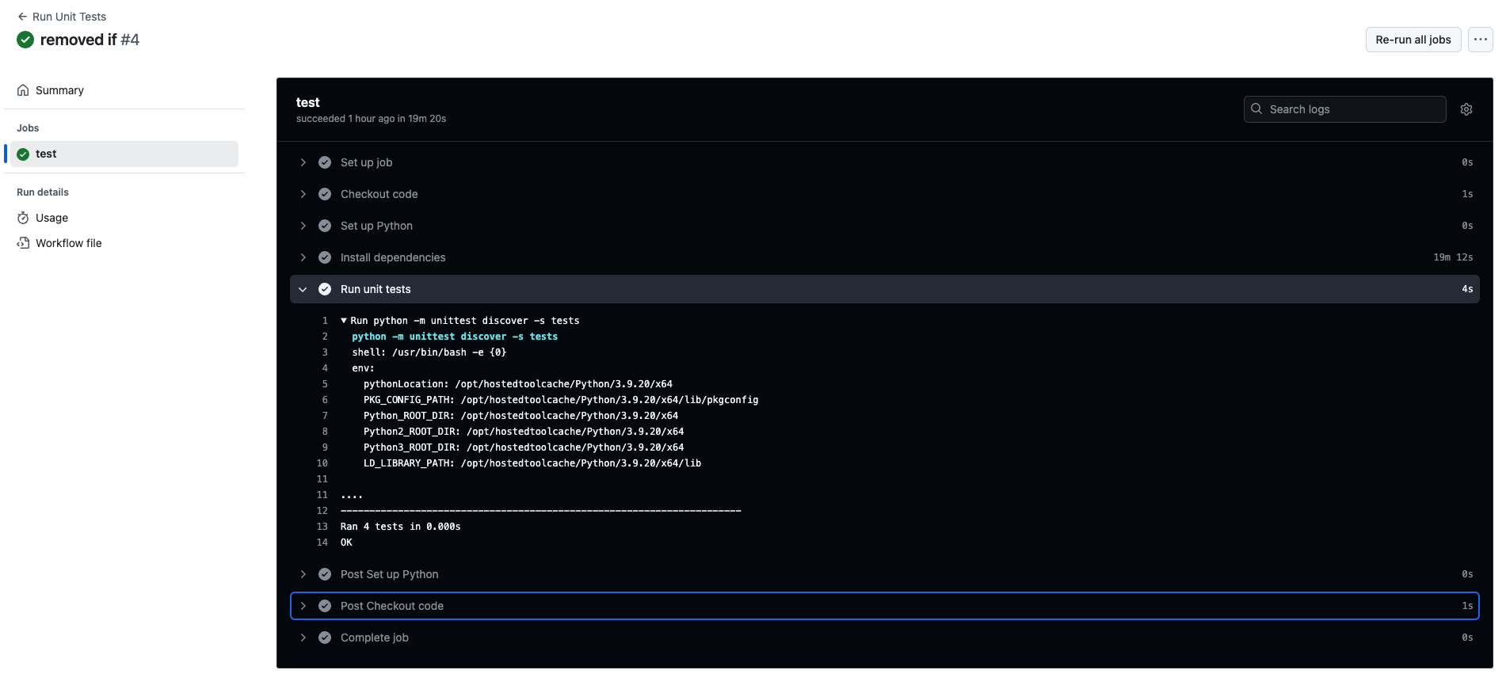
CI/CD for Unit Tests 3

Slide 17
CI/CD for Docker Image ECR 1
Now we have a docker image in artifact Registry, create a CI/CD pipeline for it.
Every time there is a pull request to main branch, create a docker image, and push it to ecr, amazon elastic container registry
There are several options:
Jenkins
Tekton
AWS CodePipeline and Code Build
Github Actions
We use GitHub Actions:
GitHub Actions is a powerful and flexible CI/CD (Continuous Integration/Continuous Deployment) platform provided by GitHub. It allows you to automate, build, test, and deploy your code directly from your GitHub repository. GitHub Actions uses workflows that can be triggered by various GitHub events like pushes, pull requests, releases, or even scheduled times.
Key Features of GitHub Actions:
Automation for CI/CD: Automate tasks such as building, testing, and deploying applications.
Event-Driven: Workflows can be triggered by GitHub events such as pushes, pull requests, issues, releases, and more.
Customizable Workflows: Define workflows with specific jobs and steps using YAML files that can run on different environments like Linux, macOS, and Windows.
Reusable Actions: Actions are reusable units of code that can be shared or used in different workflows. You can use pre-built actions from the GitHub Marketplace or create your own.
Matrix Builds: Run tests and builds in parallel on different environments and configurations (e.g., different versions of a programming language or OS).
Integration with GitHub: GitHub Actions is tightly integrated with GitHub repositories, making it easy to automate workflows and track their outcomes within the GitHub UI.

Slide 18
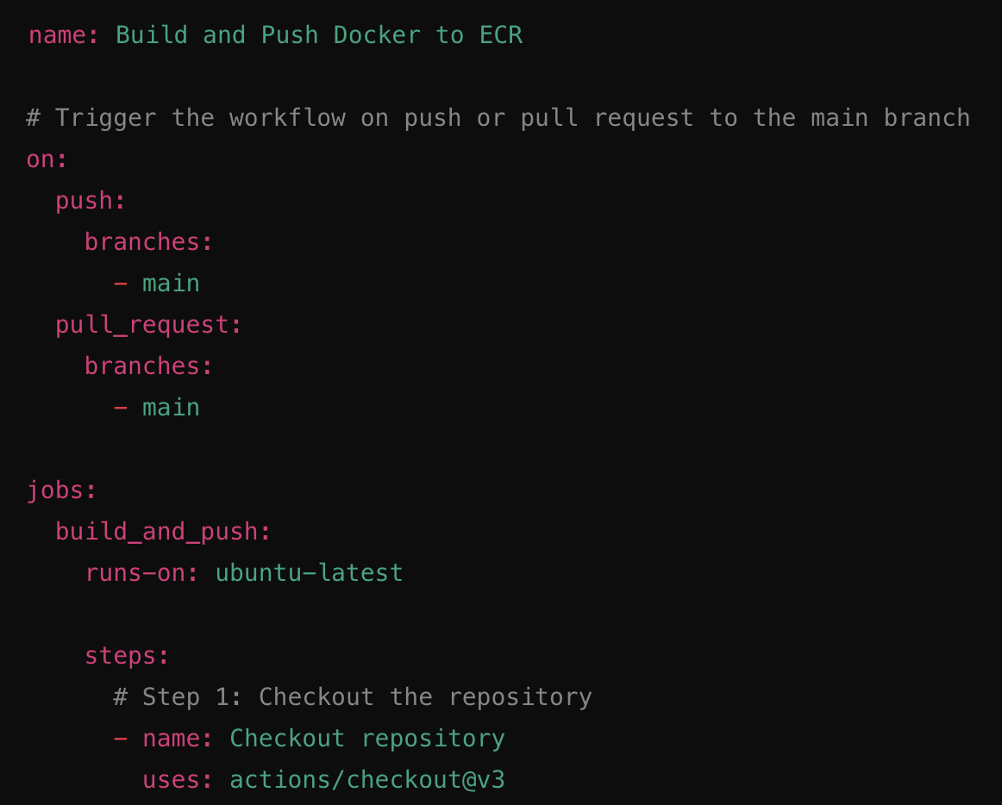
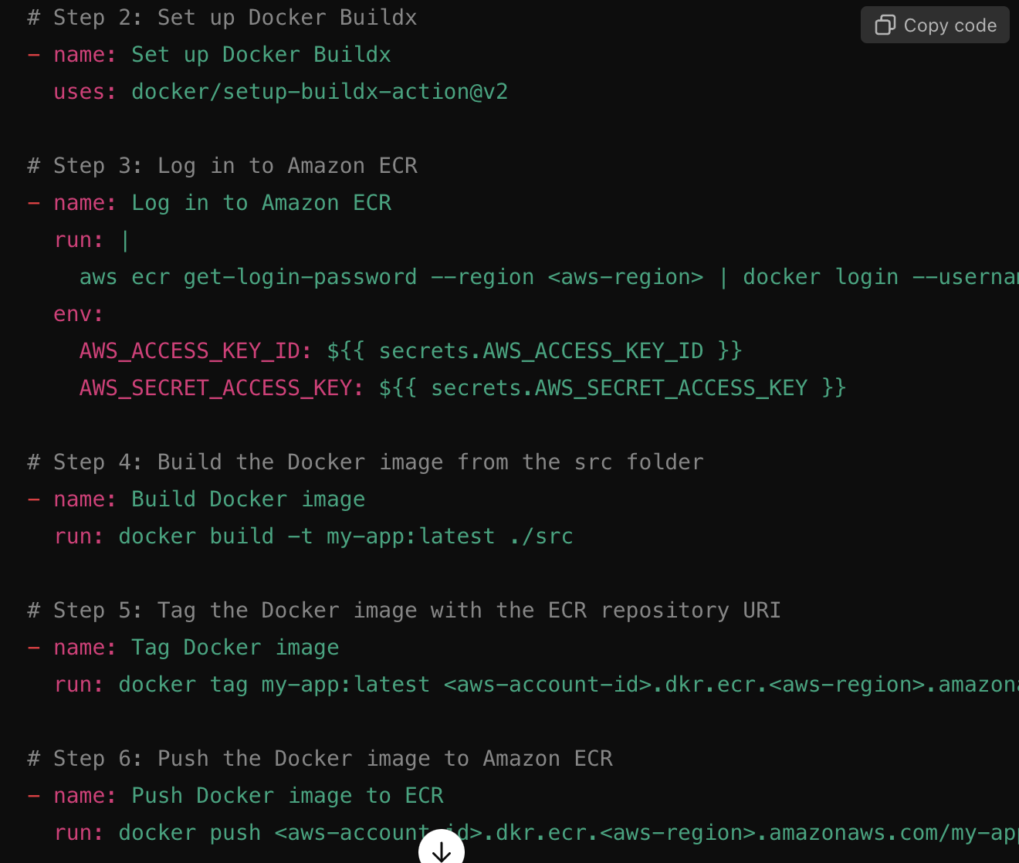
CI/CD for Docker Image ECR 2
Create a workflow file in .github/workflows directory in your repository.
Configure the workflow to:
Checkout your code.
Authenticate with AWS.
Build the Docker image from the src folder.
Tag the Docker image.
Push the Docker image to Amazon ECR.
Step 1: Create the GitHub Actions Workflow File
Create a new file in your repository:
Location: .github/workflows/docker-build.yml
The .github/workflows folder should exist at the root of your repository.
The following example workflow will:
Build a Docker image using the Dockerfile located in the src folder.
Push the Docker image to Amazon ECR.
Step 2: Configure AWS Secrets in GitHub
You need to store your AWS Access Key and Secret Key in GitHub as secrets to authenticate with AWS.
Go to your repository on GitHub.
Click on Settings.
On the left sidebar, click Secrets and variables > Actions.
Click the New repository secret button.
Add the following secrets:
AWS_ACCESS_KEY_ID: Your AWS Access Key ID.
AWS_SECRET_ACCESS_KEY: Your AWS Secret Access Key.
These secrets will be available to your workflow via the ${{ secrets.AWS_ACCESS_KEY_ID }} and ${{ secrets.AWS_SECRET_ACCESS_KEY }} environment variables.

Slide 19
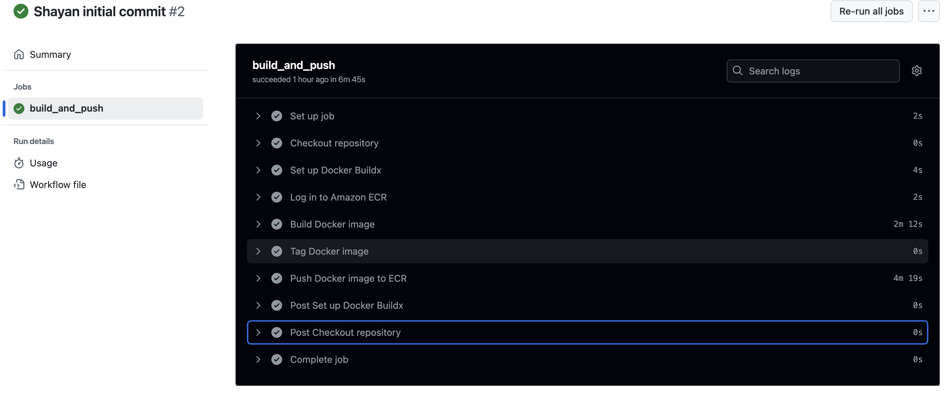
CI/CD for Docker Image ECR 3
Step 3: Update Workflow with Correct Information
Replace the following placeholders in the workflow file with actual values:
<aws-account-id>: Your AWS account ID (e.g., 123456789012).
<aws-region>: The AWS region where your ECR repository is located (e.g., us-east-1).
my-app: Replace this with your application name or the name of the Docker image you're building.
Step 5: Test the Workflow
After committing and pushing the .github/workflows/docker-build.yml file to your GitHub repository:
The workflow will automatically trigger on any push or pull request to the main branch.
You can monitor the workflow progress by going to the Actions tab in your GitHub repository.
Step 6: Verify the Docker Image in ECR
Once the workflow completes successfully, the Docker image should be pushed to your Amazon ECR repository. You can verify it by:
Going to the ECR section in the AWS Management Console.
Checking the repository for the pushed image and its associated tags.

Slide 20
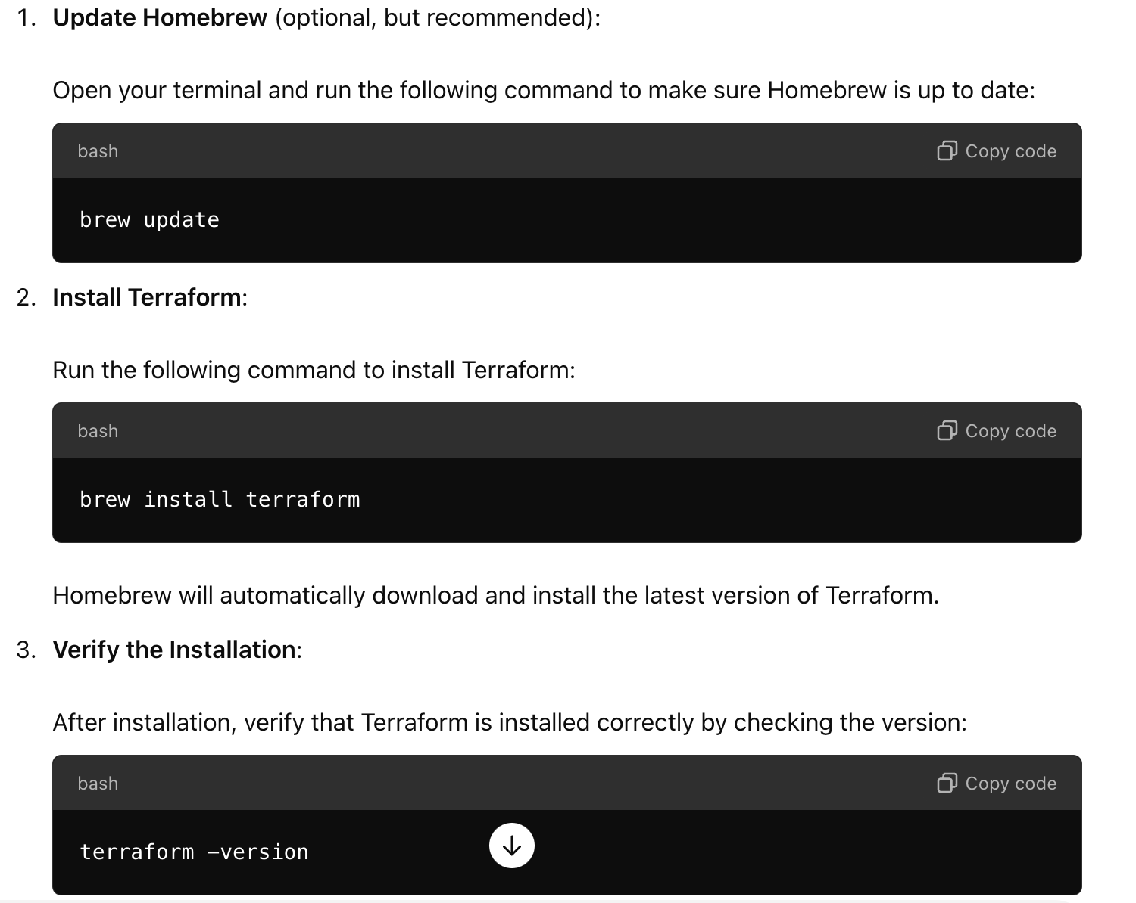
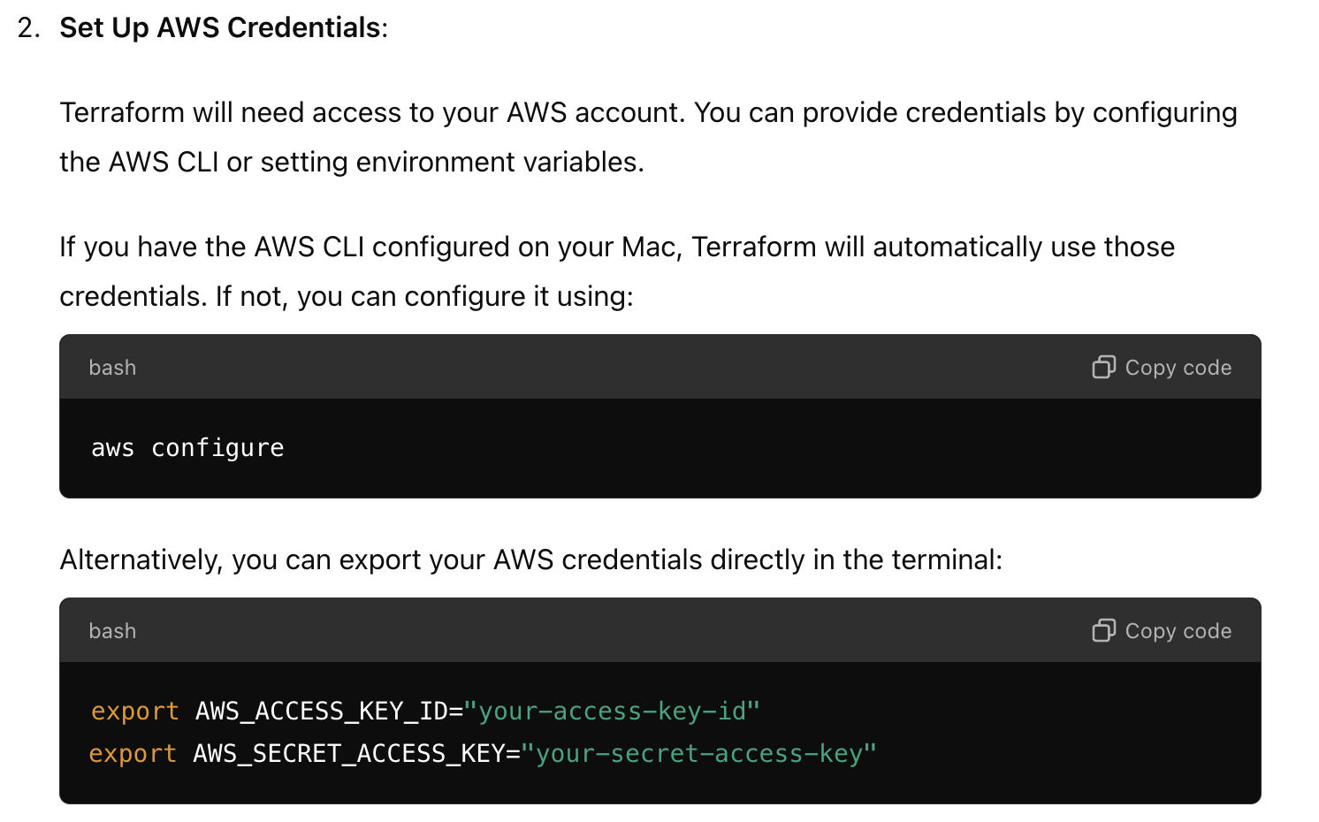
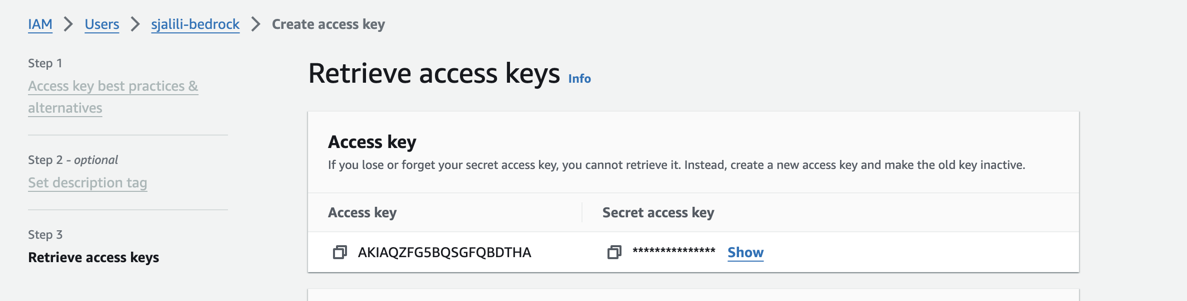
Deployment 1: Create a s3 bucket using terraform
Terraform installed: Ensure Terraform is installed on your local machine.
AWS CLI configured: You should have the AWS CLI set up with access credentials or Terraform should have access to your AWS credentials via environment variables or IAM roles.
Install aws-cli: brew install awscli
Aws configure
AWS account: You need an AWS account to create resources.

Slide 21
Deployment 2: s3 and lambda bucket using terraform
Use Modules: Organize resources into modules for reusability and modularity.
Version Control: Keep your Terraform files in a version control system like Git.
Environment Variables: Use variables for configuration, making your Terraform code flexible across different environments (e.g., development, production).
IAM Roles: Always assign minimal permissions to Lambda functions using IAM roles, ensuring least privilege.
Source Code Hashing: Use source_code_hash to force updates to the Lambda function when the source code changes.
Remote State: Store Terraform state remotely in an S3 bucket with locking enabled via DynamoDB to avoid concurrent modifications.

Slide 22
Monitoring
Amazon CloudWatch: Amazon CloudWatch is the primary monitoring tool in AWS. It provides real-time metrics, logs, alarms, and dashboards, allowing you to monitor various AWS services.
CloudWatch Metrics: Monitor CPU, memory, disk usage, network traffic, and other service-specific metrics (e.g., Lambda, EC2, ECS, EKS).
CloudWatch Logs: Aggregate logs from your LLM pipeline, including logs from AWS Lambda, ECS, EC2, or any other service your pipeline uses.
CloudWatch Alarms: Set thresholds on metrics to automatically trigger notifications when something is amiss.
CloudWatch Dashboards: Create custom dashboards to visualize key performance metrics of your pipeline.
Example: Monitoring Lambda invocation times, EC2 CPU utilization, or model performance metrics can help in understanding latency and performance bottlenecks.
2. AWS Cost Explorer: AWS Cost Explorer helps you track your AWS spending and optimize costs for your LLM pipeline.
Cost Monitoring: Visualize and analyze your AWS costs over time, including compute, storage, and network usage.
Budget Alarms: Set cost and usage alerts to avoid unexpected expenses.
Cost Optimization: Identify areas where you can save money, such as rightsizing EC2 instances or adjusting storage options.
Example: If you are running GPU-heavy workloads for training or inference, Cost Explorer can help you track GPU costs and identify potential savings.
3. Prometheus & Grafana (Self-Managed): If you need more granular control over your monitoring, you can set up a monitoring stack using Prometheus and Grafana. Prometheus collects metrics from your AWS resources and LLM pipeline, while Grafana provides advanced visualizations.
Prometheus: Collects time-series metrics from applications, services, and AWS resources.
Grafana: Visualizes data collected from Prometheus, CloudWatch, and other sources.
Custom Metrics: Define custom metrics for your LLM pipeline (e.g., model accuracy, throughput, inference latency).
Example: You can collect custom metrics like model response time, error rate, and request load in Prometheus and visualize them in Grafana.

