Slide 1

Illustrative Recommendation of an LLMOps Solution to Deploy GenAI to Production
Shayan Jalili
20 September 2024

Slide 2
Outline
Introduction and Problem Statement
Model Management
Automation
Monitoring,
Scalability,
Availability
Conclusion and Questions

Slide 3
Outline
Introduction and Problem Statement
Model Management
Automation
Monitoring,
Scalability,
Availability
Conclusion and Questions

Slide 4
Introduction and Problem Statement
Model Management
Automation
Monitoring,
Scalability,
Availability
Conclusion and Questions

Slide 5
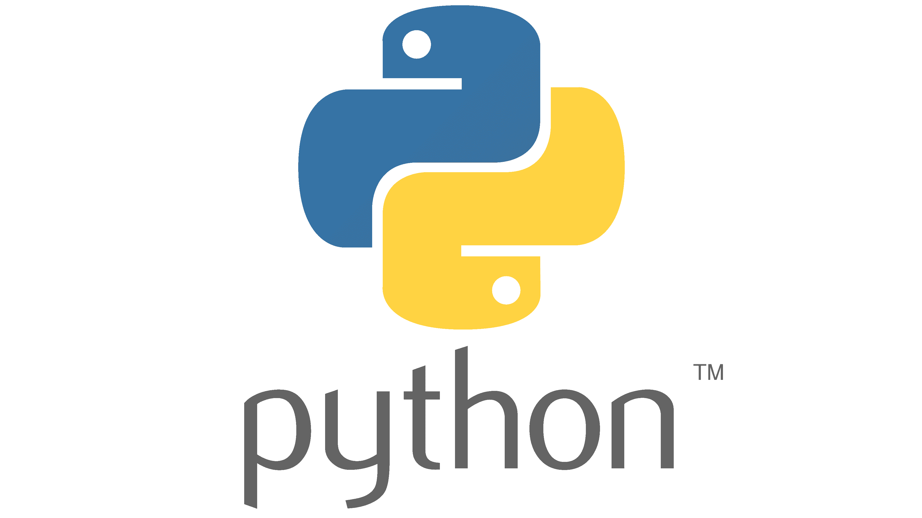

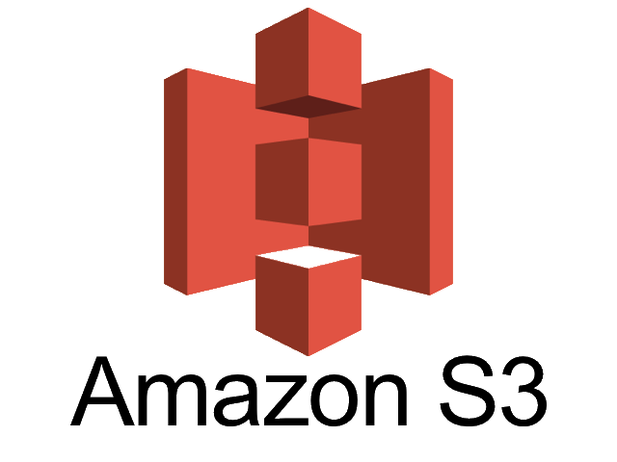



Problem Statement
AI/ML Center of Excellence team is developing LLM-based GenAI models
Deploy pilot GenAI solution that leverages industry report.
Provide insights and strategic Recommendation for the leadership team.

Slide 6
Terminology
Python is the go-to language for data analysis, machine learning, and artificial intelligence
pytest is a popular testing framework for Python
Amazon S3 (Simple Storage Service) is a scalable, high-performance object storage service offered by Amazon Web Services (AWS)
Amazon Lambda is a serverless compute service provided by Amazon Web Services (AWS) that allows you to run code without provisioning or managing servers
Amazon Kendra is an AI-powered enterprise search service from Amazon Web Services (AWS) that enables organizations to search across a wide range of internal documents and databases with natural language queries.
Amazon Textract is a machine learning service provided by AWS (Amazon Web Services) that automatically extracts text, handwriting, and data from scanned documents
Amazon Bedrock is an AWS service that provides access to foundational models (FMs) from leading AI providers via an API.

Slide 7

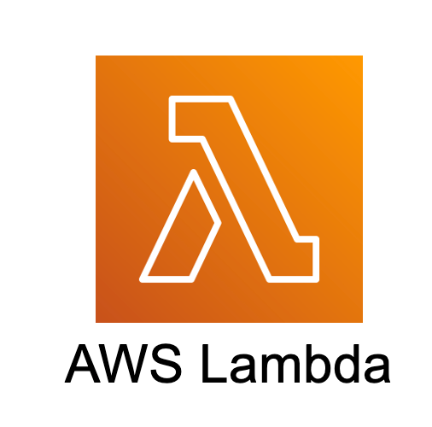

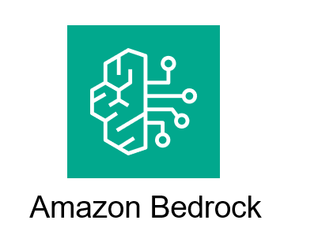

Pipeline Design
Textracts the text and structured data from the report. Send the report to S3
upload
Trigger
Runs
Trigger
To provide large language model (LLM) based insights and recommendations
To provide semantic search capabilities on the extracted data
Runs
Runs

Slide 8

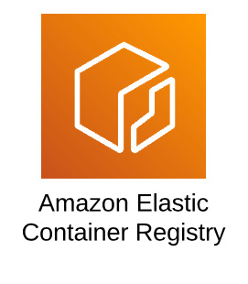
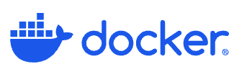
Leveraging Docker for Modularity and Scalability
Containers are lightweight, portable, and self-sufficient units that package everything needed to run a piece of software, including the code, runtime, system tools, libraries, and settings.
Portability: Run the same container across different environments without changes.
Isolation: Keep applications and their dependencies isolated from each other.
Efficiency: Containers are lightweight and start faster than virtual machines.
Scalability: Docker makes it easier to scale applications quickly and efficiently.
Consistency: Ensure the same environment in development, testing, and production.
CI/CD Integration: Simplify continuous integration and deployment workflows.
Notes:
Learning Curve: Requires time to learn and understand containerization concepts.
Performance Overhead: Resource contention and network performance can be impacted.
Security Challenges: Shared kernel and insecure images can pose security risks.
Data Persistence: Requires careful management of volumes for persistent data.
Orchestration Complexity: Managing large-scale container deployments can be challenging.
Storage and Networking: Large image sizes and complex networking setups can lead to inefficiencies.
Limited Cross-Platform Support: Not suitable for applications tightly tied to non-Linux operating systems.

Slide 9
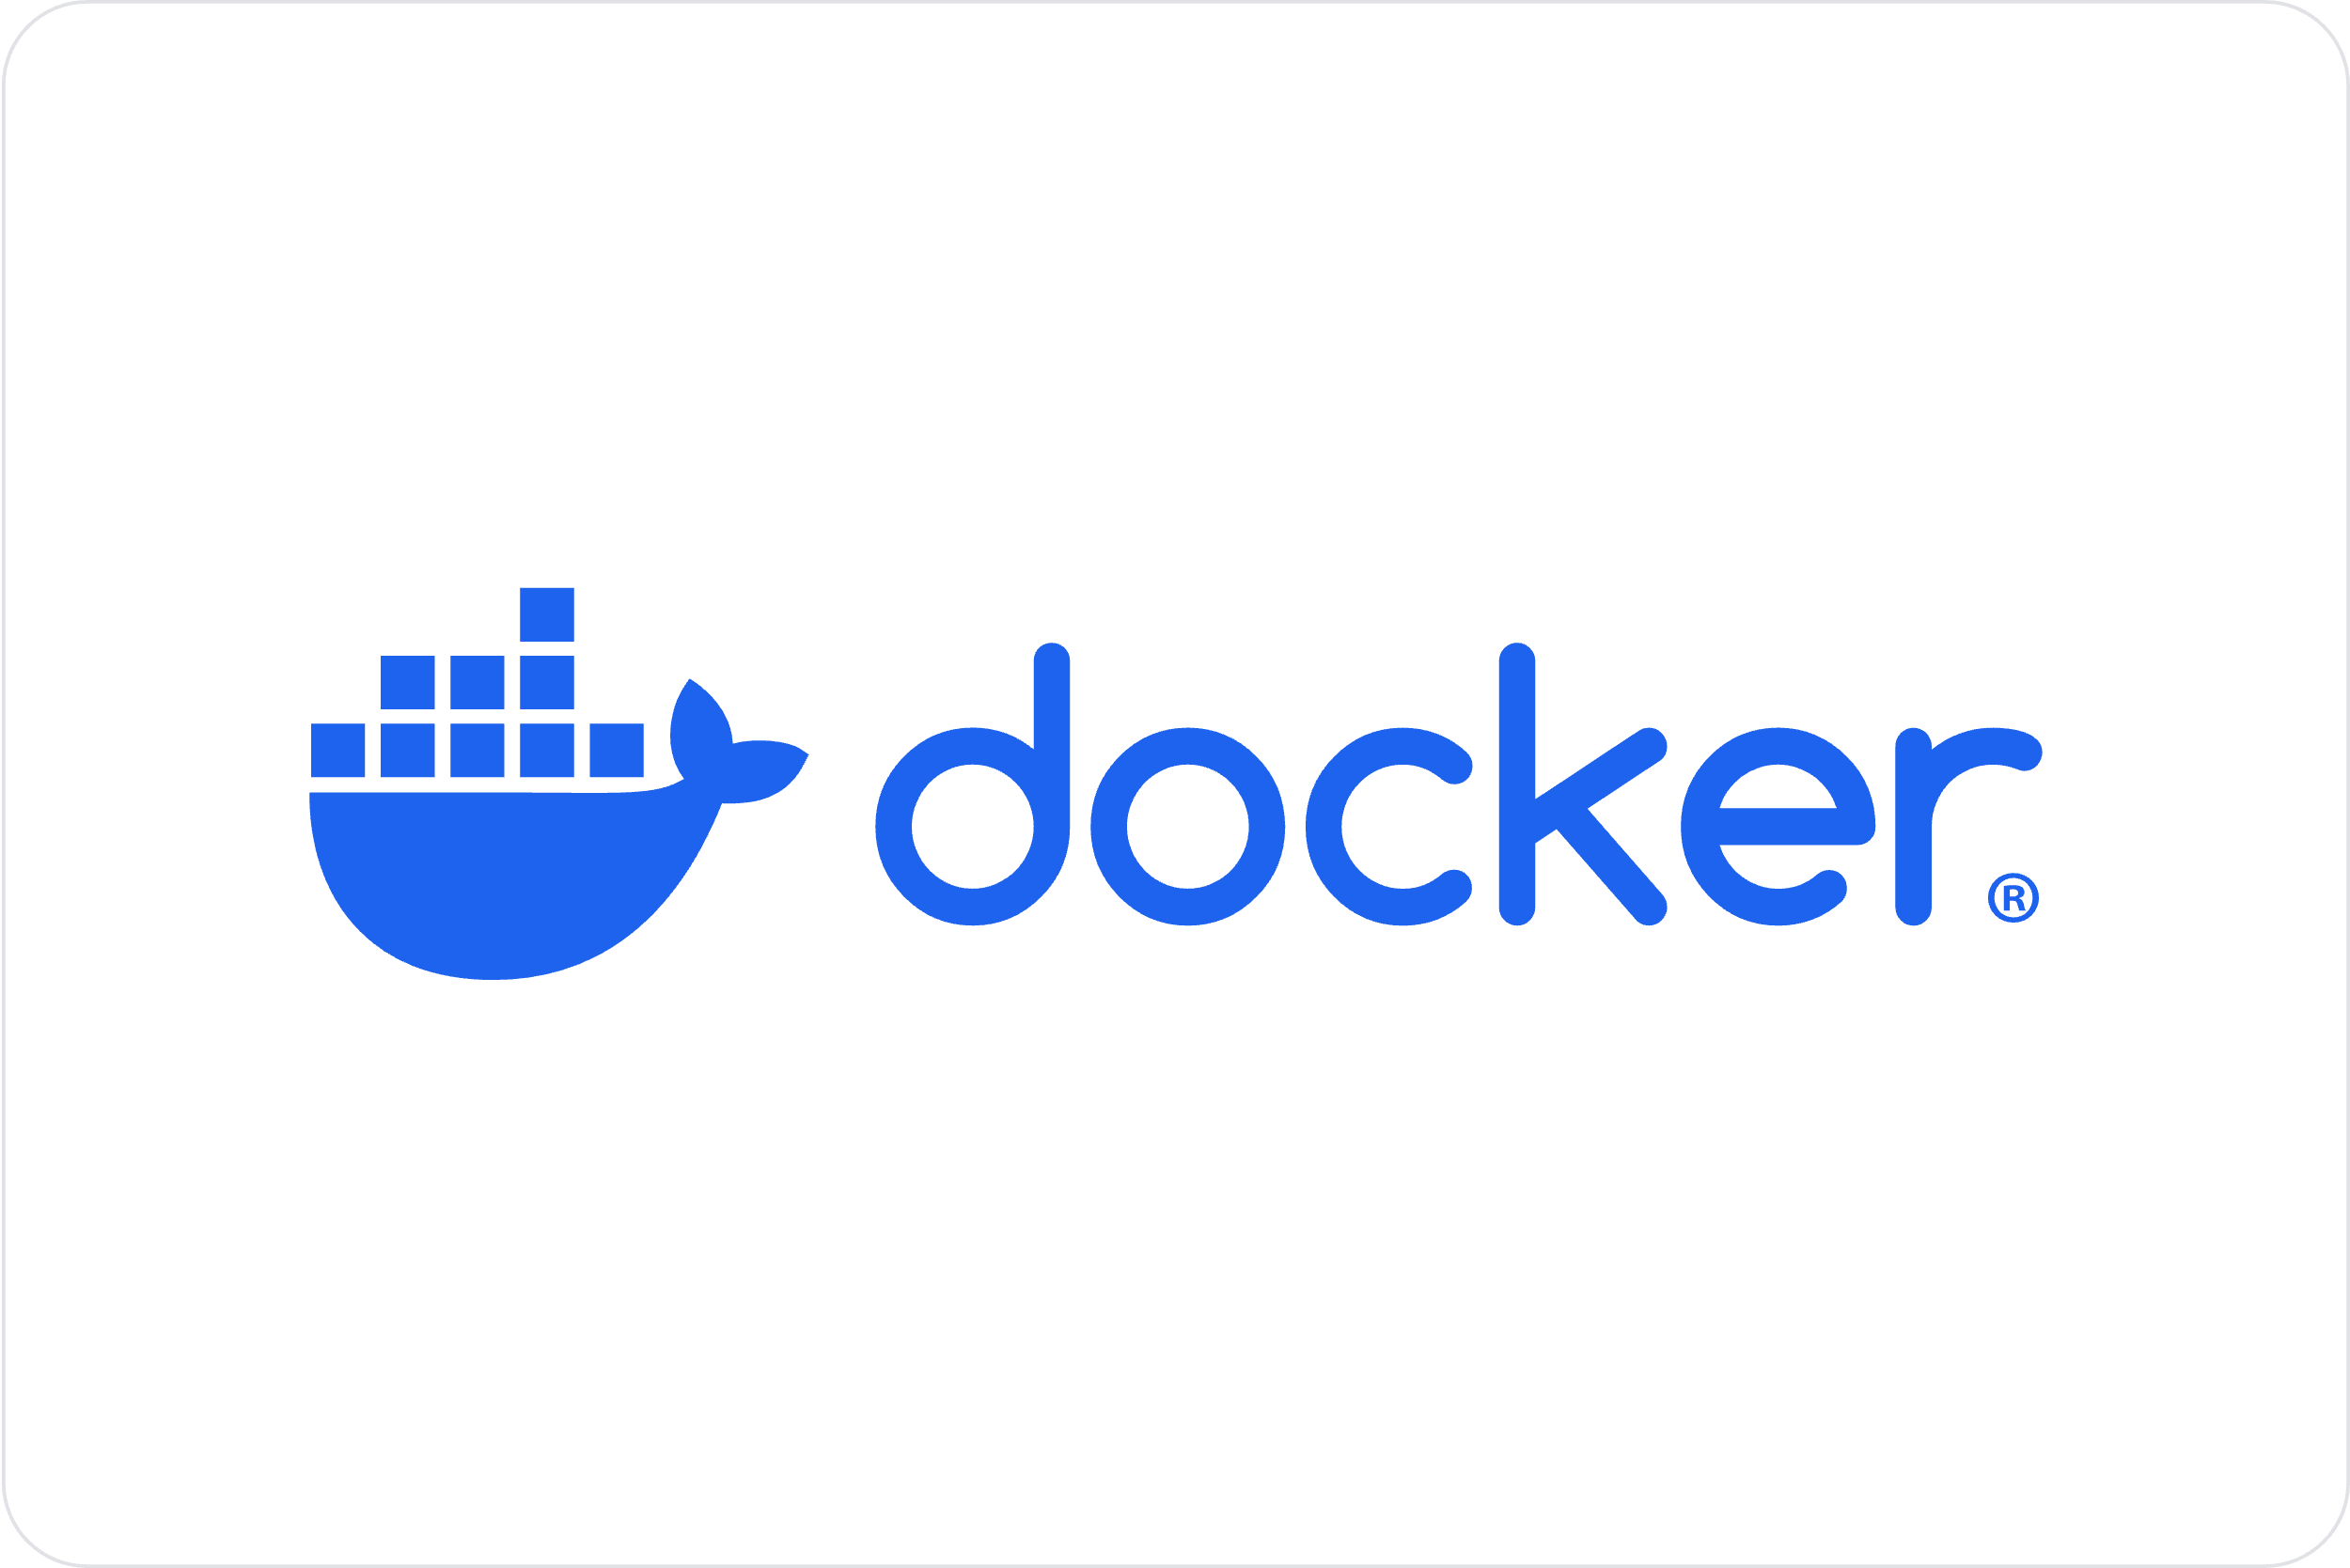
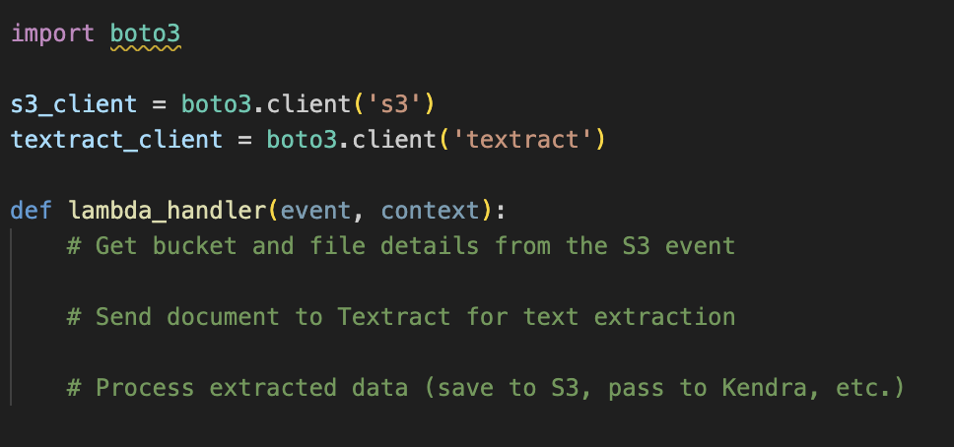
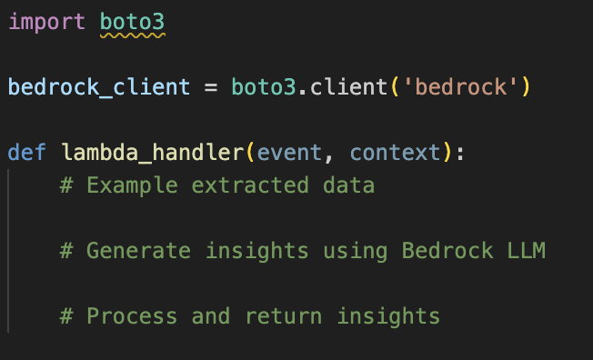
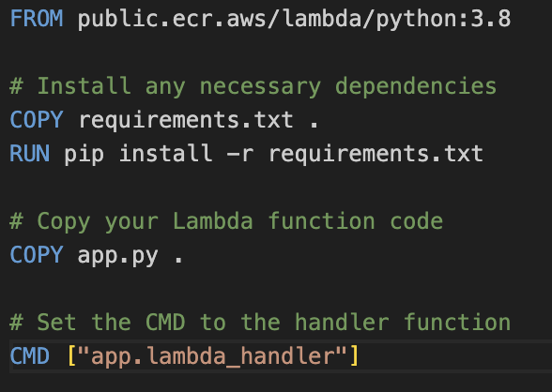
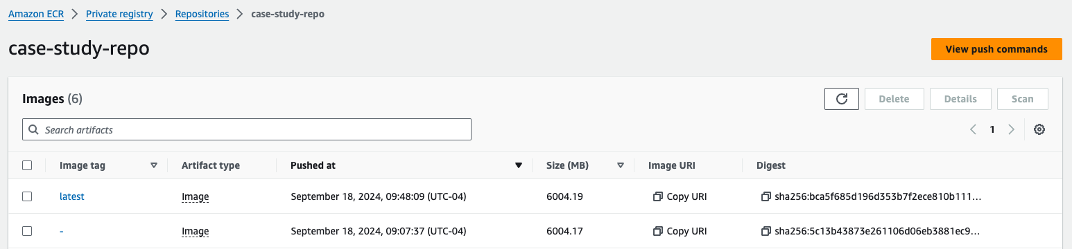
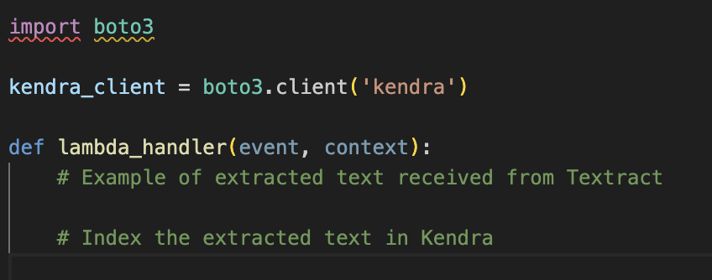
Package Your code

Slide 10

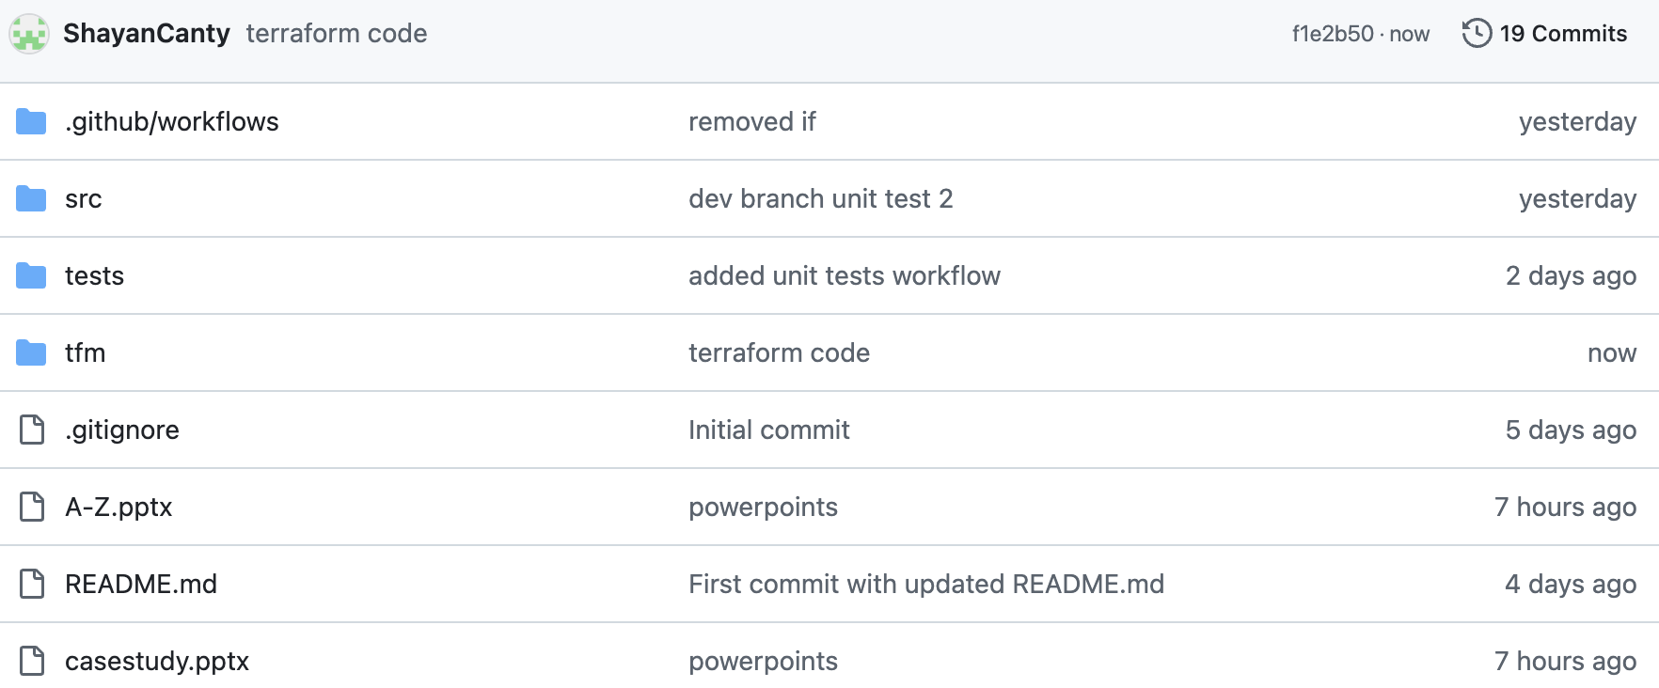
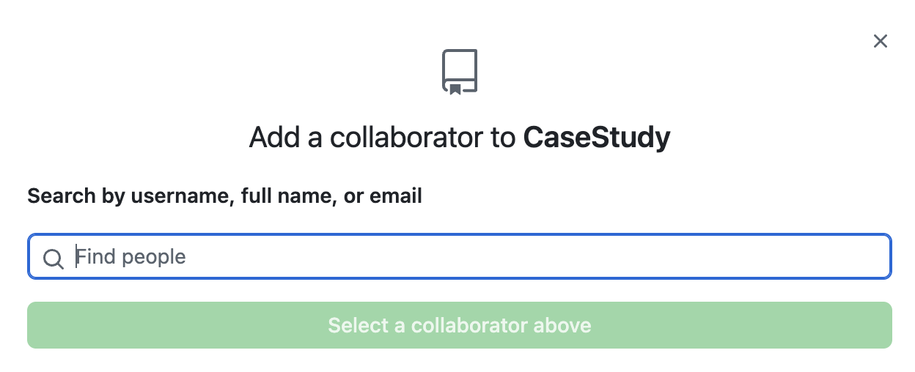
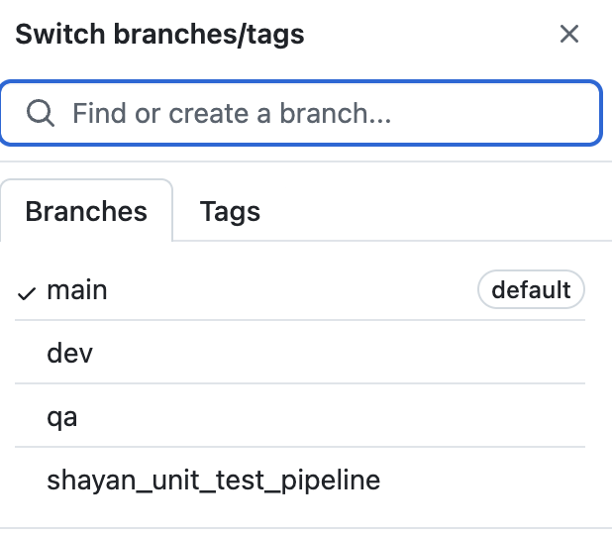
Leveraging GitHub for Efficient Model Management and Collaboration
Version Control:
Track Changes Over Time.
Revert to Previous Versions.
Collaboration:
Multiple Contributors.
Review and Feedback.
3. Experiment Tracking:
Model and Experiment Code Versioning.
Branching for Different Models.
4. CI/CD Integration (Continuous Integration/Continuous Deployment):
Automated Model Testing and Deployment.
Unit Tests for Code.
5. Documentation:
README Files and Wikis.
6. Issue Tracking and Collaboration:
Tracking Bugs and Improvements.
Collaboration on Model Performance.
7. Security and Access Control:
Role-Based Access:.
Audit Trail.

Slide 11
Protocol: How to Use GitHub for Version Control
Create a GitHub Repo for the code: https://github.com/ShayanCanty/CaseStudy.git
Now we should put Restriction on main, to make sure no one can modify main directly
Having different Branches:
Main: Always contains stable, production ready code.
QA: Quality Assurance, code usually runs 2 weeks from Dev to production for any potential errors.
Develop: For ongoing development and feature.
Feature Branches: For individual features or changes.
Hotfix branches: For quick patches to production code.
Delete the feature branch
Do you have a feature branch
Create a feature branch off dev branch
Merge from dev to feature branch
Push the code to GitHub
Your local feature Branch to GitHub Feature Branch
No
Start here
yes
Start developing on your feature branch
Pull From dev to have the latest code
Create a pull request from feature branch to dev
Wait for Approval

Slide 12

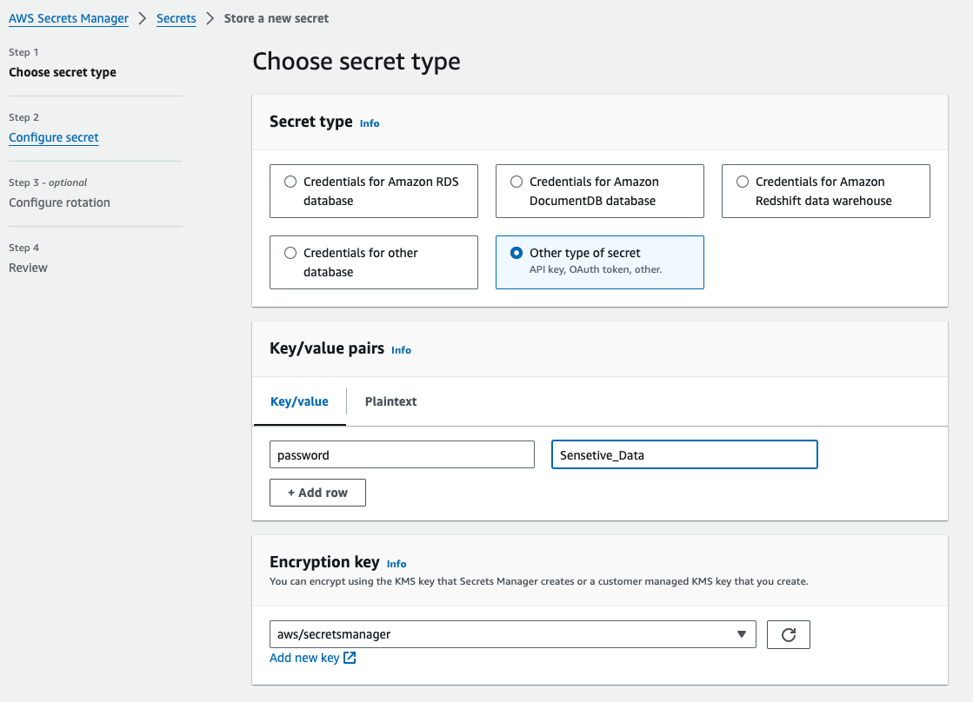
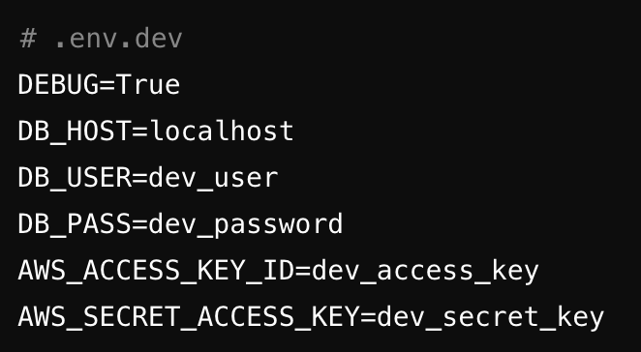
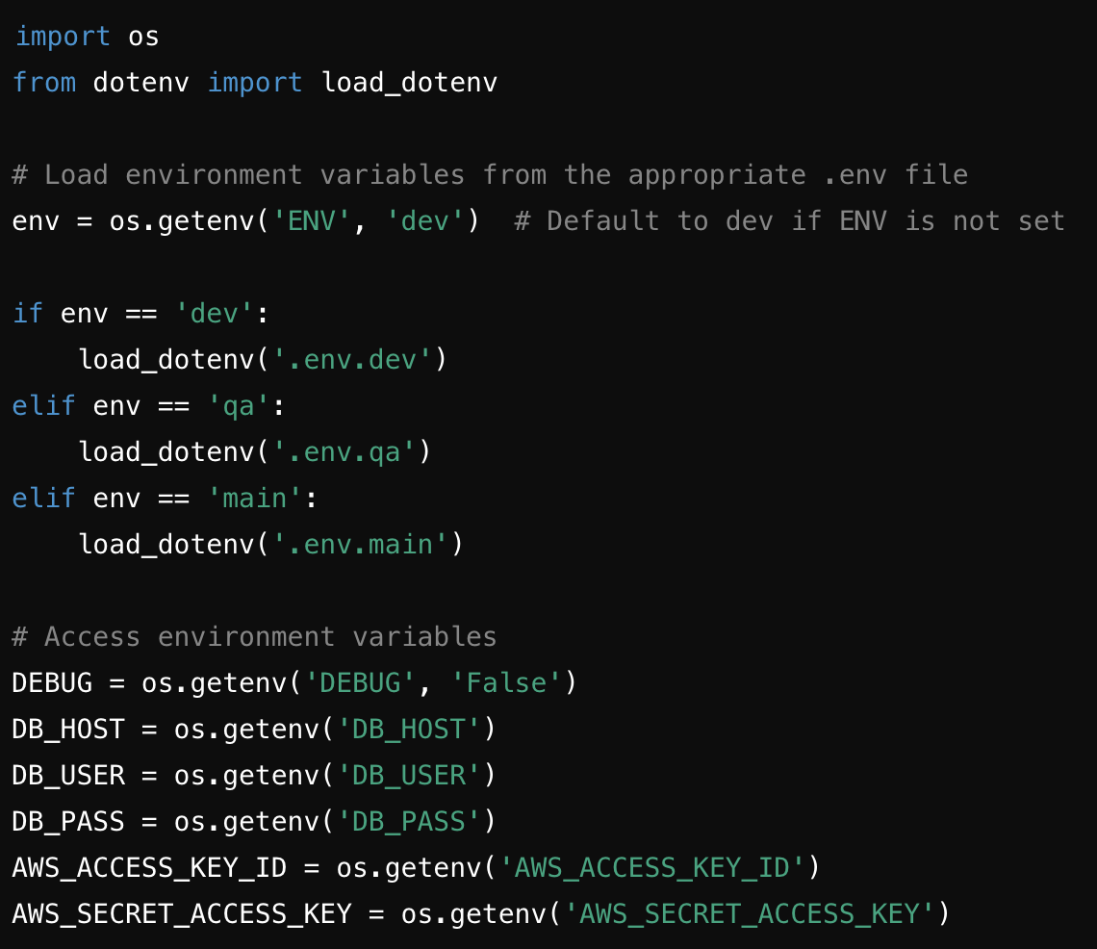
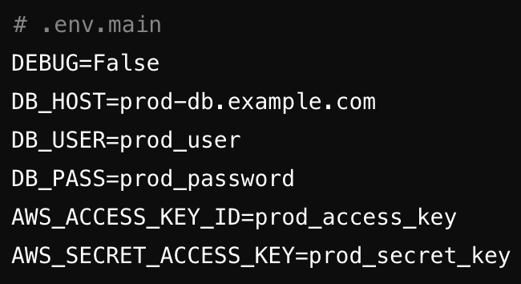
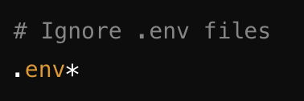
.env, .gitignore and Secret Managers
dev
s3
dev user
prod
s3

Slide 13
Introduction and Problem Statement
Model Management
Automation
Monitoring,
Scalability,
Availability
Conclusion and Questions

Slide 14

Infrastructure as Code with Terraform: Automating Cloud Provisioning
I created a s3 bucket, I can’t remember the name
Create 100 s3 buckets
200 Lambda function
500 tables in RDS
I need to delete all the services I created for my old project
My boss asked me to create a new lambda function with the exact same configuration as dev
Hi Joe, sorry to bother you, can you give me the name of s3 bucket you created for the project, I need to use it

Slide 15
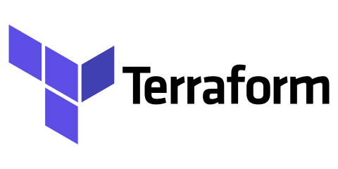

Infrastructure as Code with Terraform: Automating Cloud Provisioning

Slide 16
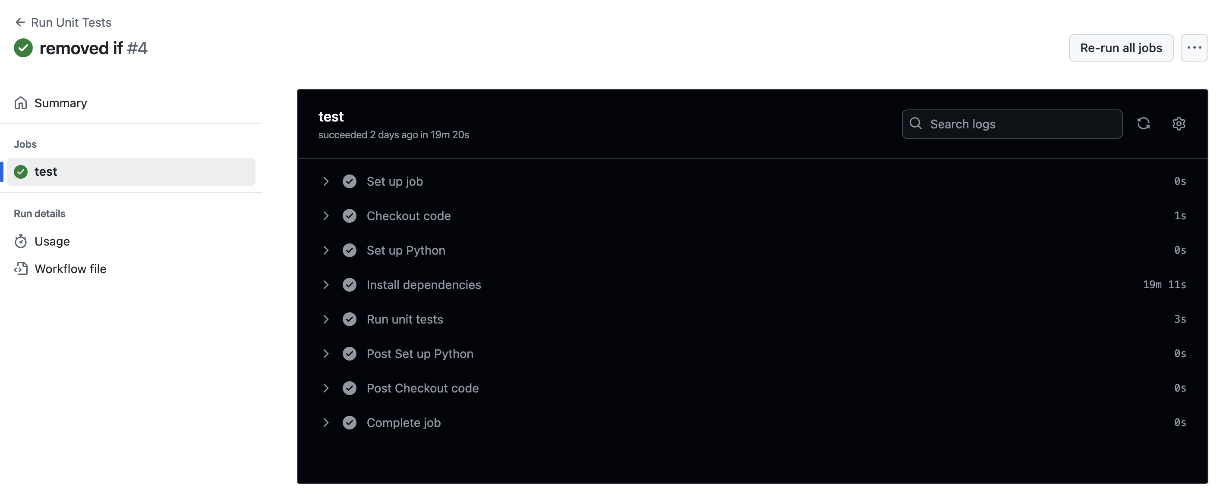
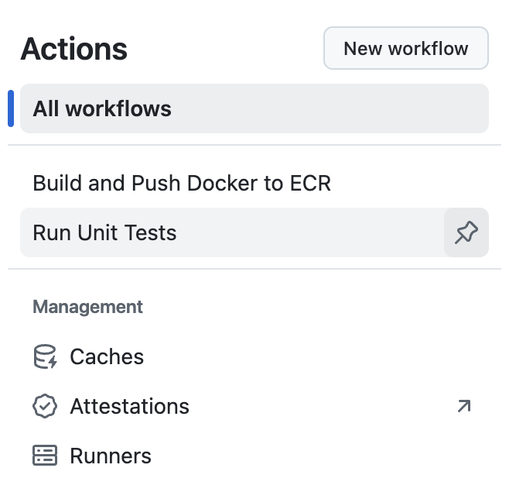
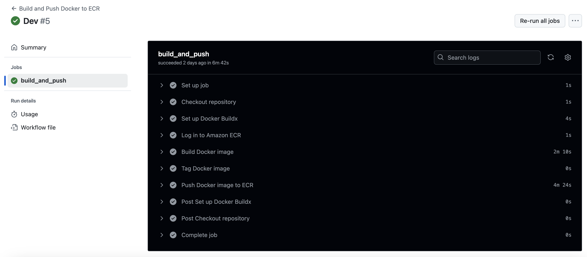
Automating Workflows with GitHub Actions
GitHub Actions is a CI/CD (Continuous Integration/Continuous Deployment) and automation tool built directly into GitHub, enabling developers to automate workflows related to their repositories. For example:
Run unit tests when there is a pull request to dev, if they fail, do not approve the pull request.
Create a docker image and push it to container registry when there is a pull request to main
Create a resource or modify it when there is a push to dev in tfm folder.

Slide 17
Introduction and Problem Statement
Model Management
Automation
Monitoring,
Scalability,
Availability
Conclusion and Questions

Slide 18
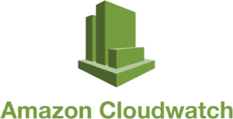



Monitoring, Logging and Alerts
Amazon CloudWatch: Amazon CloudWatch is the primary monitoring tool in AWS. It provides real-time metrics, logs, alarms, and dashboards, allowing you to monitor various AWS services.
CloudWatch Metrics: Monitor CPU, memory, disk usage, network traffic, and other service-specific metrics (e.g., Lambda, EC2, ECS, EKS).
CloudWatch Logs: Aggregate logs from your LLM pipeline, including logs from AWS Lambda, ECS, EC2, or any other service your pipeline uses.
CloudWatch Alarms: Set thresholds on metrics to automatically trigger notifications when something is amiss.
CloudWatch Dashboards: Create custom dashboards to visualize key performance metrics of your pipeline.
Example: Monitoring Lambda invocation times, EC2 CPU utilization, or model performance metrics can help in understanding latency and performance bottlenecks.
2. AWS Cost Explorer: AWS Cost Explorer helps you track your AWS spending and optimize costs for your LLM pipeline.
Cost Monitoring: Visualize and analyze your AWS costs over time, including compute, storage, and network usage.
Budget Alarms: Set cost and usage alerts to avoid unexpected expenses.
Cost Optimization: Identify areas where you can save money, such as rightsizing EC2 instances or adjusting storage options.
Example: If you are running GPU-heavy workloads for training or inference, Cost Explorer can help you track GPU costs and identify potential savings.
3. Prometheus & Grafana (Self-Managed): If you need more granular control over your monitoring, you can set up a monitoring stack using Prometheus and Grafana. Prometheus collects metrics from your AWS resources and LLM pipeline, while Grafana provides advanced visualizations.
Prometheus: Collects time-series metrics from applications, services, and AWS resources.
Grafana: Visualizes data collected from Prometheus, CloudWatch, and other sources.
Custom Metrics: Define custom metrics for your LLM pipeline (e.g., model accuracy, throughput, inference latency).
Example: You can collect custom metrics like model response time, error rate, and request load in Prometheus and visualize them in Grafana.

Slide 19
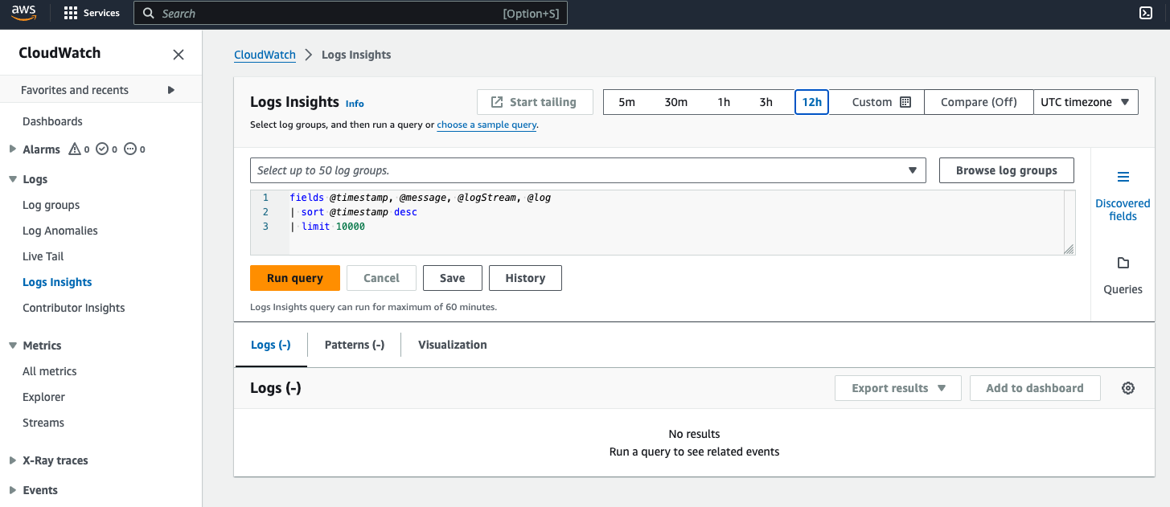
Monitoring an Alerting for LLM pipelines with CloudWatch
Some Services send logs to Cloud watch
We can create more logs for security, forexample S3 access logging to track who access the objects.
We can monitor variety of things using Cloud Watch:
Duration of Lambda function execution
Number of objects in S3 bucket
Query count in Kendra
…
We can set alerts, with conditions and thresholds, to send notifications to different channels, like Email, SMS, or a record in a relational database

Slide 20
Introduction and Problem Statement
Model Management
Automation
Monitoring,
Scalability,
Availability
Conclusion and Questions

Slide 21
.env, .gitignore and Secret Managers

Slide 22
.env, .gitignore and Secret Managers

Slide 23
.env, .gitignore and Secret Managers

Slide 24
.env, .gitignore and Secret Managers

Slide 25
.env, .gitignore and Secret Managers

Slide 26
.env, .gitignore and Secret Managers

Slide 27
.env, .gitignore and Secret Managers

Slide 28
.env, .gitignore and Secret Managers

Slide 29
.env, .gitignore and Secret Managers

Slide 30
.env, .gitignore and Secret Managers

Slide 31
.env, .gitignore and Secret Managers

