Slide 1
CAUSA
“Answers you can check”
Track 02: The Agent That Can Explain Why
Team MARS · GenAI Works Open Agent Hackathon 2026
Notes:
Open with the one-line pitch: Causa is an analyst agent that answers why questions and shows its work. Team MARS, Track 02: The Agent That Can Explain Why.

Slide 2
The problem: “why” has no audit trail
Questions analysts get
Why it is hard
“Why did Target’s revenue growth lag Walmart’s from FY2022 to FY2024?”
“Is Ford’s slowdown company-specific or sector-wide?”
Evidence is fragmented: SEC filings, industry classifications and macro statistics live in different places, and are stitched together by hand.
What they end up with
Target users
A slide with no audit trail. Nobody can check which numbers came from where.
Equity, credit and FP&A analysts who must explain movements across filings, peers and macro data.
Notes:
Analysts are asked why all day, for example why Target growth lagged Walmart, or whether Ford slowdown is company-specific or sector-wide. Evidence is fragmented across filings, industry codes and macro data. Today the result is a slide with no audit trail. Users: equity, credit and FP&A analysts.

Slide 3
The solution: an analyst agent that shows its work
1
2
3
4
5
Ground
Hypothesise
Test
Critique
Answer
Resolve companies to real CIK, ticker and SIC. Unknown names are refused, not invented.
Propose competing causes: company-specific, sector-wide or macro.
Read-only SQL through Zetaris across EDGAR, SIC and World Bank data.
A critic pass checks every number in every claim against the rows it cites.
Ranked causes with confidence, each linked to the exact query, rows and source.
Verified findings are remembered with provenance, so the next related question starts warm and can be audited.
Notes:
Walk the five steps: ground, hypothesise, test with read-only SQL through Zetaris, critic pass, ranked answer with provenance. Verified findings are remembered so the next question starts warm.

Slide 4
Agent workflow and architecture
Question
Scout Intent
World Model
H-MEM recall
a why-question
risk check, signed contract
grounds real CIK / SIC
prior verified findings
Zetaris SQL
retry with error fed back
Nemotron via Nightshift
catalog, describe, read-only SELECT
hypotheses, SQL, critic
Markovian: bounded carried context per step (flat cost)
H-MEM remember
Answer
Critic
derivedFrom evidence + query ids
ranked claims, evidence ids
second Nemotron pass + number check
Streams live to the web UI over Server-Sent Events
Notes:
Top row: question, Scout Intent (intent, risk check, signed execution contract), World Model (grounding), H-MEM recall. Middle: Nemotron served through Meterless Nightshift works with Zetaris tools (catalog, describe, read-only SQL), retries with errors fed back; Markovian keeps carried context bounded per step. Bottom row right to left: critic (second Nemotron pass plus deterministic number check), ranked answer, H-MEM remember with derivedFrom evidence and Zetaris query ids. Everything streams live over SSE.

Slide 5
Technical stack
Data
Power
Zetaris Lightning SQL over REST, federated sources + Unified Semantic Layer
Meterless Nightshift, OpenAI-compatible runtime (primary AI provider)
Model
Memory
NVIDIA Nemotron models, served through Nightshift
Meterless H-MEM
Grounding
Context
Meterless World Model
Meterless Markovian
Intent and safety
UI and API
Meterless Scout Intent
Vite + React + TypeScript; Node 22 + Hono, SSE
Built with Claude Code. Cursor was not used.
Notes:
Data via Zetaris Lightning SQL REST; power via Meterless Nightshift with Nemotron models; memory, grounding, context and intent via Meterless engines. H-MEM, World Model and Markovian are vendored reference engines under Apache-2.0; Scout Intent is implemented from its AGENTS.md spec. UI is Vite + React + TypeScript; API is Node 22 + Hono with SSE.

Slide 6
How Zetaris and Meterless were used
Technology | What it does in Causa
Zetaris | Every query: Lightning SQL over REST across EDGAR XBRL, SIC hierarchy, World Bank, plus a Unified Semantic Layer
Meterless Nightshift | Primary AI provider; the model that handled each call is recorded and shown
Meterless H-MEM | Remembers verified findings with provenance; recall, audit trail, feedback
Meterless World Model | Grounds companies to real CIK / ticker / SIC; refuses unknown names
Meterless Markovian | Keeps each reasoning step’s carried context bounded (flat cost per step)
Meterless Scout Intent | Intent, risk check, HMAC-signed contract with enforced tools and budgets
NVIDIA Nemotron | Planner, SQL investigator and critic, served through Nightshift
Cursor | Not used (built with Claude Code)
Notes:
Zetaris is the only source of facts: every query goes through its Lightning SQL REST API over EDGAR XBRL facts, the company_dns SIC hierarchy, World Bank indicators and the sic_edgar_usl Unified Semantic Layer. Meterless supplies Nightshift as the primary provider and four engines, each powering a feature. NVIDIA Nemotron is served through Nightshift. Cursor not used.

Slide 7
What was unique: a verification chain
1
Scout Intent
2
World Model
3
Zetaris
decides what the agent may do
decides what exists
the only source of facts
4
Nemotron
5
Critic
6
H-MEM
reasons over the evidence
refuses any number not in the evidence rows
remembers only what survived, with provenance
Each step constrains the next; nothing reaches memory unchecked.
Notes:
The sponsor technologies form a chain, not a feature list: Scout Intent decides what the agent may do, World Model decides what exists, Zetaris is the only source of facts, Nemotron reasons, the critic plus deterministic check refuses any number not in the evidence rows, H-MEM remembers only what survived, with provenance.

Slide 8
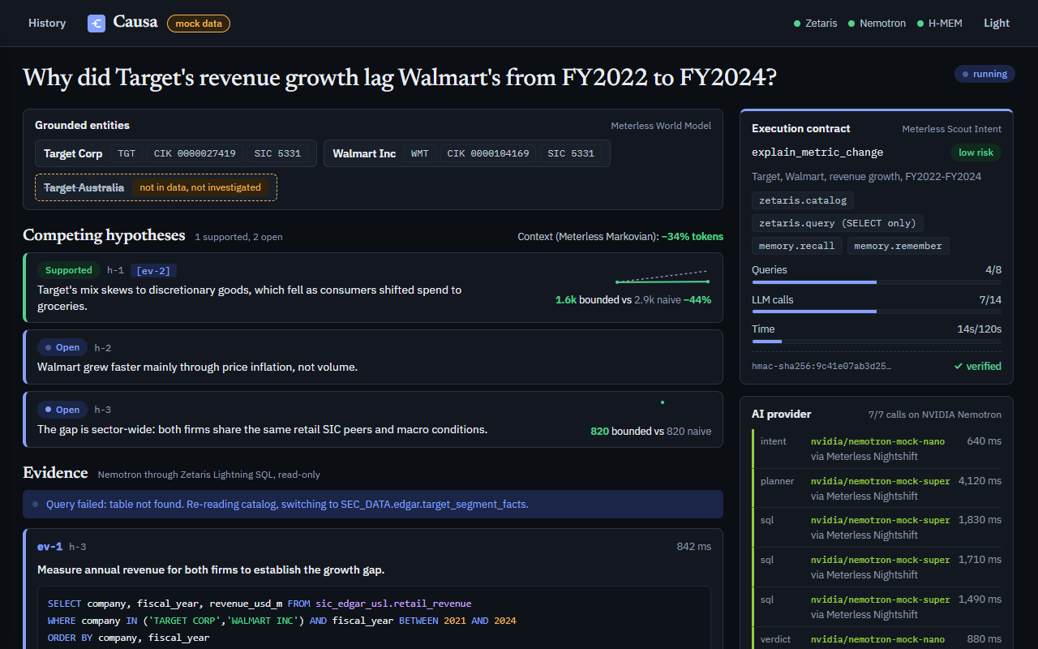
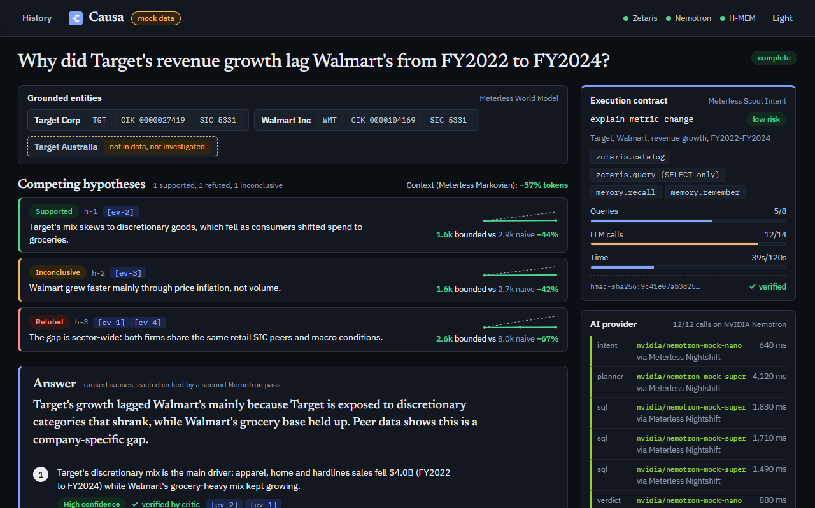
Product visuals: the investigation
Contract, entities, hypothesis board
Ranked answer, checked by a critic
UI preview
UI preview
Notes:
Left: live investigation with grounded entities, execution contract and budget meters, hypothesis board, AI provider log. Right: ranked answer with confidence and critic verification. Screenshots currently show MOCK data (mock data pill): replace with real-run screenshot.

Slide 9
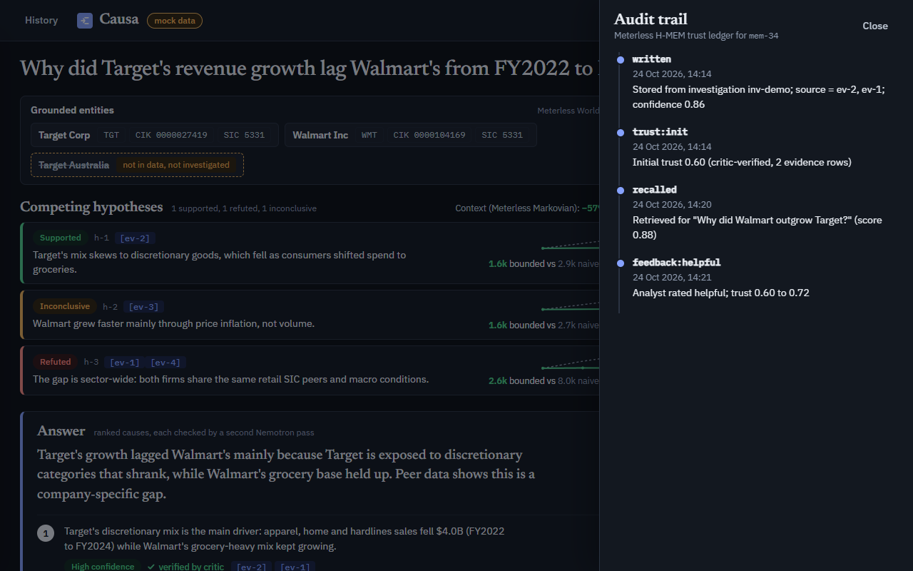
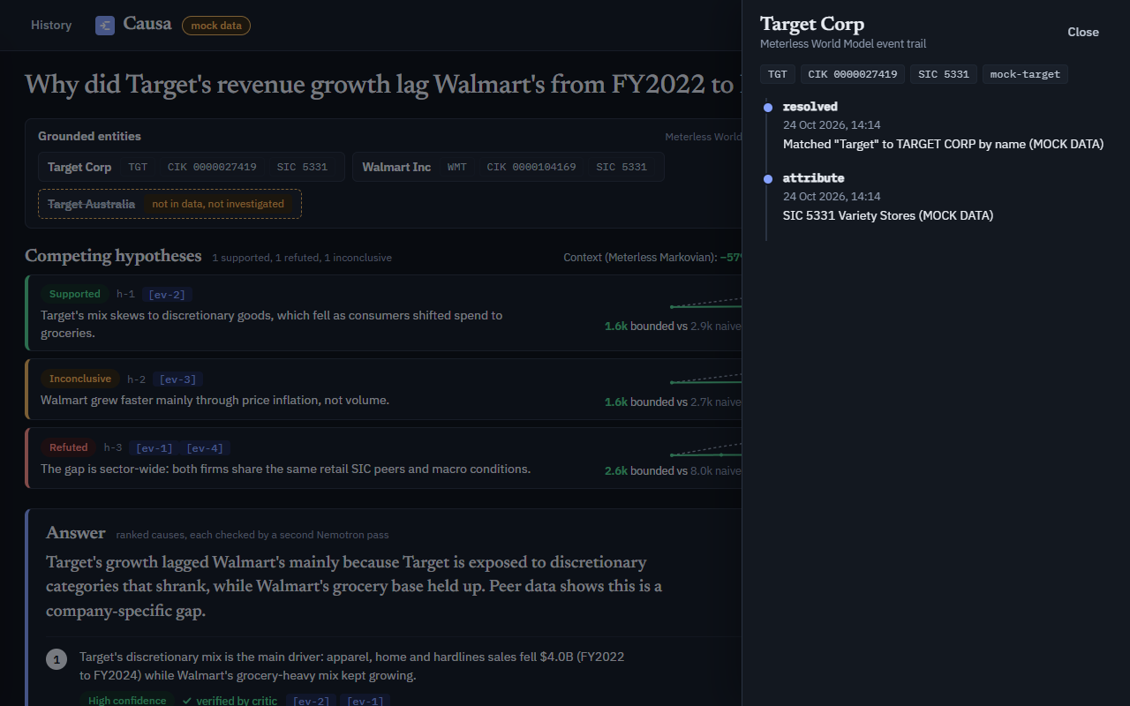
Product visuals: audit and entity trail
H-MEM audit trail
World Model entity trail
UI preview
UI preview
Notes:
Left: H-MEM trust-ledger audit drawer. Right: World Model entity-trail drawer. Screenshots currently show MOCK data (mock data pill): replace with real-run screenshot.

Slide 10
Future enhancements
More sources
FUTURE
Overnight investigations
FUTURE
Earnings-call transcripts and internal ERP, via Zetaris connectors
Scheduled Nightshift runs that pre-answer recurring questions
Analyst feedback loop
FUTURE
Team-shared memory
FUTURE
Analyst feedback written back into H-MEM
Verified findings shared across an analyst team
Evaluation set
FUTURE
Historical “why” questions with known answers to measure the agent
Notes:
All items on this slide are planned future work, not built.

Slide 11
Causa
“Answers you can check”
https://github.com/ShayanMuhammad-CS/causa
Track 02: The Agent That Can Explain Why · Team MARS
Notes:
Close on the tagline and point to the repo. Cursor was not used; built with Claude Code.

