Slide 1
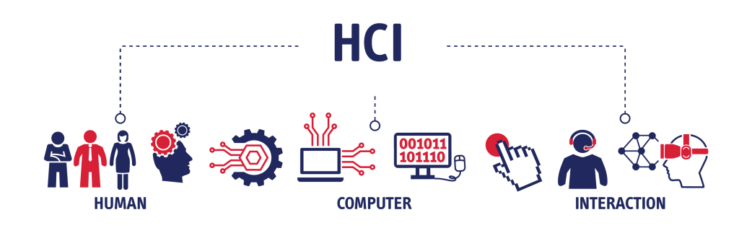
CS 522: Human-Computer Interaction
Lab: Formative Evaluation – 10/31
Notes:
https://debaleena.com/courses/uxmethods/

Slide 2
Formative Evaluation
Assessing a product during its development or early implementation.
Formative evaluation results should inform your high-fidelity prototyping or full-fledged implementation.

Slide 3
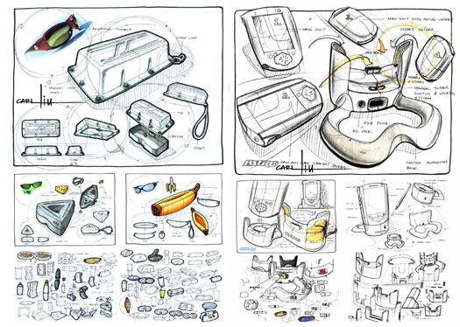
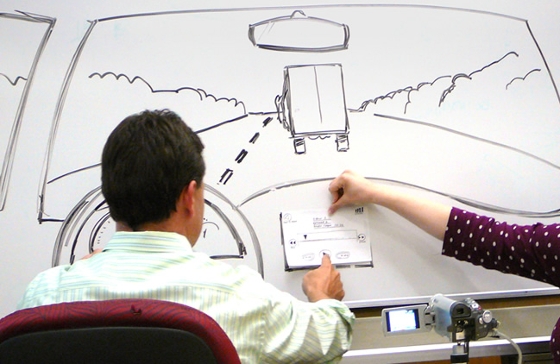
Getting the design right
Sketches using the elaboration-reduction method.
—Getting the right design (to meet the functional requirements)
Testing with users/ user representatives.
—Getting the design right (to meet usability goals and provide a user-friendly design solution.) still focusing on ideas, not system’s performance or visual design

Slide 4
Formative evaluation methods
Heuristic Inspection
Think aloud protocol
Cognitive Walkthrough
Pluralistic Walkthrough
GOMS (Goals, Operators, Methods, Selection)
Interviews
Observational task analysis
..... Many more
Notes:
Heuristic Inspection: This method involves experts reviewing a system to identify usability issues based on established usability principles (heuristics). It's quick and can uncover many problems.
Think Aloud Protocol: Here, users are asked to verbalize their thoughts while performing tasks with a system. This gives insights into their thought processes and helps identify usability issues.
Cognitive Walkthrough: Evaluators go through the user interface step-by-step, focusing on ease of learning. They consider if users can achieve their goals without difficulty and make sense of the interface.
Pluralistic Walkthrough: This method involves a group of users, developers, and usability experts. They all walk through the interface together, discussing potential issues from multiple perspectives.
GOMS (Goals, Operators, Methods, Selection): A model to analyze user interactions by breaking down tasks into Goals, Operators (actions), Methods (procedures), and Selection rules. It's used to predict and evaluate user performance and efficiency.
Interviews: Conducting structured or semi-structured interviews to get detailed feedback from users about their experiences, needs, and pain points.
Observational Task Analysis: Observing users as they perform tasks in their natural environment. This helps in understanding actual usage patterns and identifying real-world usability issues.

Slide 5
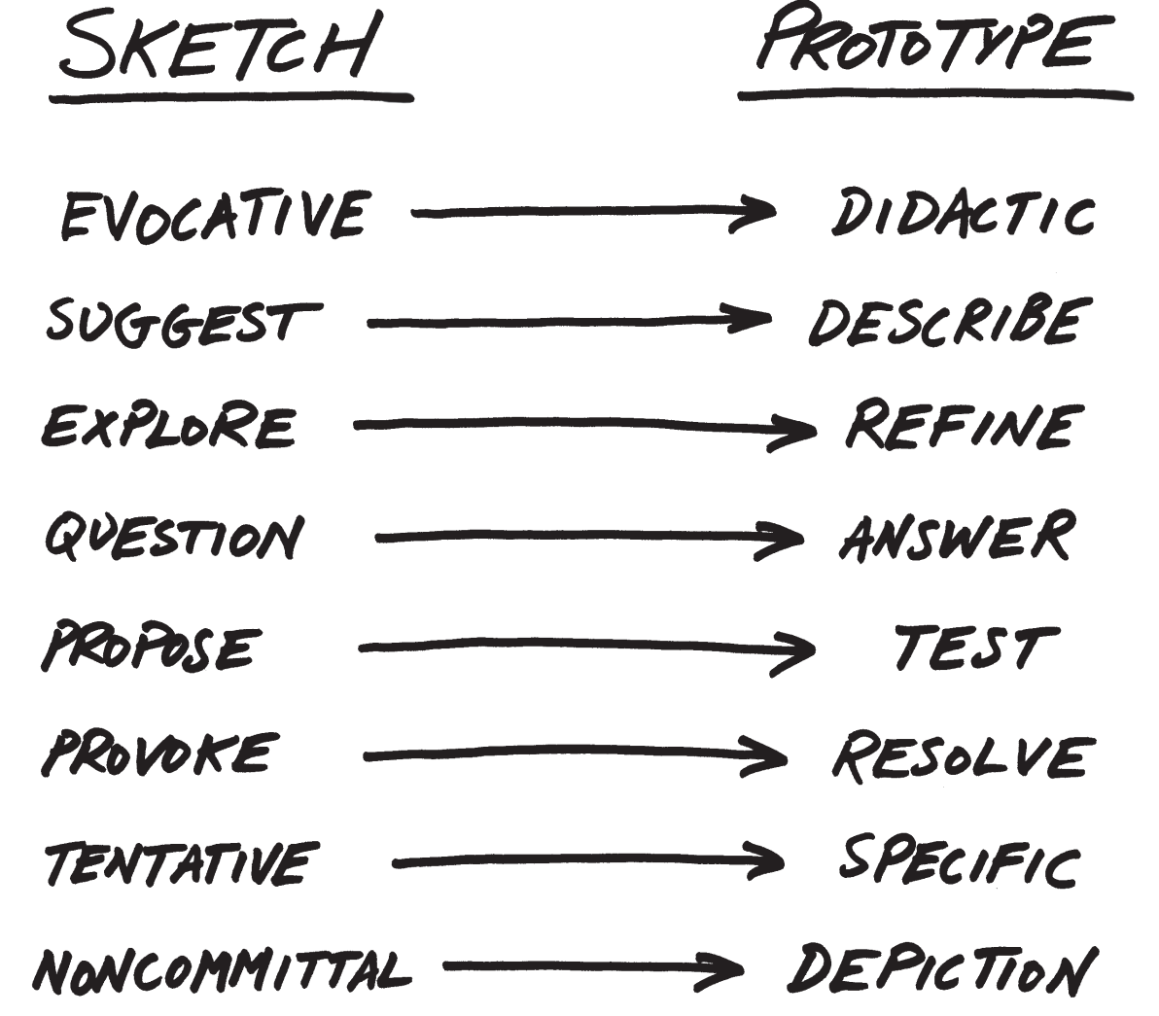
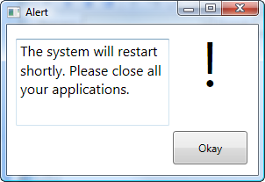
Before Evaluation
You need prototypes
Notes:
Sketching: This is all about quick, rough drawings that capture basic ideas and concepts. It's more about brainstorming and visualizing thoughts. Think of it as doodling your ideas on paper to explore various possibilities without going into detail.
Prototyping: This is about creating a more refined, functional model of your idea. Prototypes can range from low-fidelity (like paper models) to high-fidelity (like interactive digital versions). They help test and validate concepts with users, identifying issues and areas for improvement before final production.

Slide 6
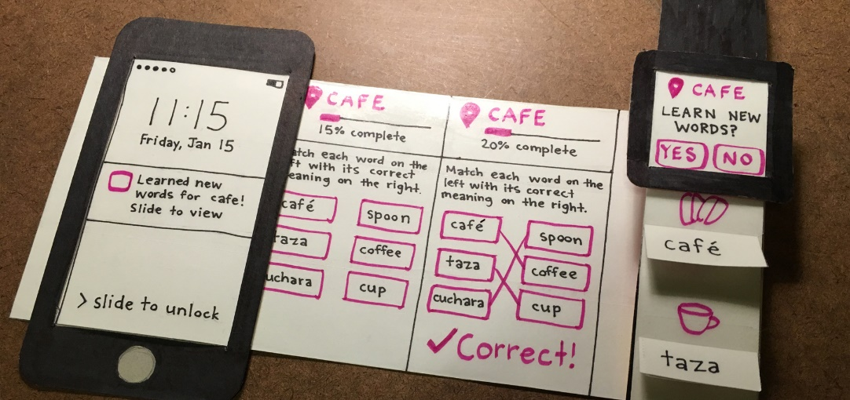
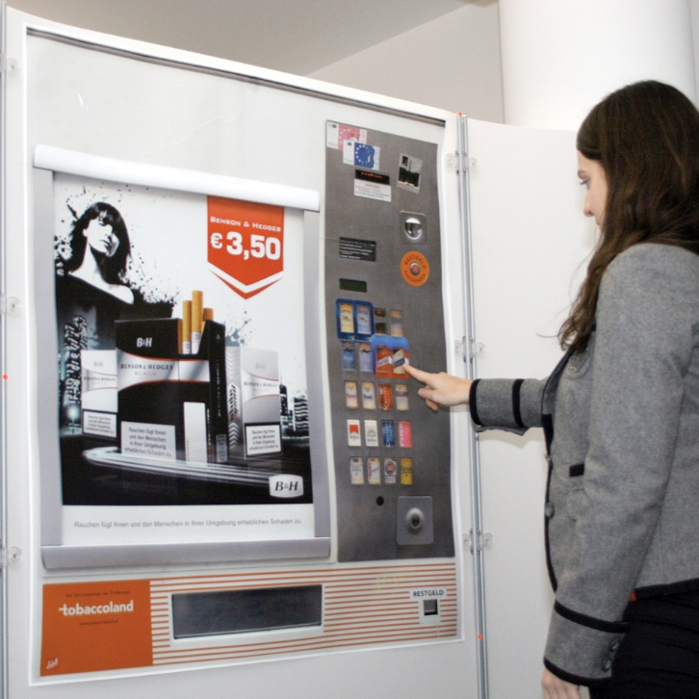
Low-fidelity Prototypes
Paper prototypes
Wizard-Of-Oz prototypes
Notes:
Paper Prototypes: These are low-fidelity, hand-drawn sketches or mockups of a user interface. They're quick and cheap to make, allowing designers to rapidly iterate on ideas. Users interact with these static sketches as if they were real interfaces, and designers can get immediate feedback on layout, functionality, and flow.
Wizard-of-Oz Prototypes: These are interactive prototypes where users believe they are interacting with a fully functional system, but behind the scenes, a person (the "wizard") is actually controlling the system manually. This method is useful for testing complex interactions and functionalities without needing to build a fully operational system.

Slide 7
The Method we will use in class
Cognitive walkthrough (CW)
A cognitive walkthrough describes the process of putting yourself (or members of your team or organization) in the shoes of a first-time user of the interface you are designing.
Prior to beginning the walkthrough, you should have on-hand clear documentation of the user’s ideal path that the user should follow to achieve their goal, already prototyped.
The ideal path can be divided into steps, starting with the user’s intention to complete the step, and ending with any feedback that your interface supplies to the user indicating that the step is complete.
Notes:
https://xd.adobe.com/ideas/process/user-testing/cognitive-walkthrough-improve-ux/

Slide 8
Materials Needed for CW
A low-fidelity prototype of the user interface
A user scenario
A task list that includes all the tasks that you will use in the walkthrough, as well as an action sequence that details the specific task flow from beginning to end.
A problem reporting form and cards for listing design ideas for later use
Notes:
https://www.usabilitybok.org/cognitive-walkthrough#:~:text=The%20cognitive%20walkthrough%20is%20a,for%20new%20or%20infrequent%20users.
https://www.interaction-design.org/literature/article/how-to-conduct-a-cognitive-walkthrough

Slide 9
During evaluation
Assign roles to your design team: Computer, Facilitator, and Observer.
Revisit your user scenarios and define 3 to 5 tasks. Tasks should be real, complete, independent, and representative.
A complete, written list of the actions needed to complete each task.
Notes:
Computer:
Simulates prototype
Doesn’t give any feedback that the computer wouldn’t
Facilitator:
Presents interface and tasks to the user
Encourages user to think aloud by asking questions
Keeps user test from getting off track
Observer
Keeps mouth shut, sits on hands if necessary
Takes copious notes

Slide 10
When evaluating an application:
During the process, you have to answer 4 questions.
Before each step, ask these 3 questions in the following order:
Will the user try to achieve the right effect?
Will the user notice that the correct action is available?
Will the user associate the correct action with the effect that the user is trying to achieve?
Ask this question after each step in the user's flow.
Will the user see that progress is being made toward the solution of the task?
Notes:
https://uxdesign.cc/assessing-interfaces-with-cognitive-walkthrough-9f92eae4321f

Slide 11
Lab
Create tasks
Plan your evaluation
Use your sketches to practice testing with your peers

