Slide 1
Query Dependent Prompt System

Slide 2
Prompt Content
Prompt 18:
First, assess if the news topic could interest a wide Persian-speaking audience. Then, determine if it aligns with significant themes such as major economic, political, or social events. If the news is relevant to many people, it is 'important' (1); if it targets a specific or small group, it is 'not important' (0).
Conclude your analysis of these scenarios by presenting the final classification in the following format:
Final Classification: [1 or 0]

Slide 3
Prompt Content
Prompt 18:
First, assess if the news topic could interest a wide Persian-speaking audience. Then, determine if it aligns with significant themes such as major economic, political, or social events. If the news is relevant to many people, it is 'important' (1); if it targets a specific or small group, it is 'not important' (0).
Conclude your analysis of these scenarios by presenting the final classification in the following format:
Final Classification: [1 or 0]

Slide 4
Prompt Content
Prompt 19: (Chain-of-thought)
The goal is to classify news items into 'important' (1) or 'not important' (0). To classify accurately, follow these steps:
1. Identify if the news topic could be relevant to a large Persian-speaking audience.
2. Assess if it pertains to significant economic events (currency or inflation changes, housing updates, etc.), critical political events (government actions, international relations), or socially impactful themes that could affect many people.
3. Finally, determine if the story has widespread appeal or is only relevant to a niche audience.
If the news is of broad interest and covers the themes above, label it as '1'. Otherwise, label it as '0'. Upon completing the scenario analysis, output the final classification using the format below:
Final Classification: [1 or 0]

Slide 5
Prompt Content
Prompt 21: (Tree-of-thought)
For this classification task, follow these branches of thought to decide if the news item is 'important' (1) or 'not important' (0):
1. First, examine if the topic could affect a large portion of Persian-speaking users, considering its potential reach.
2. Next, break down the topic's content into economic, political, and social relevance.
- For economic news: Consider factors like inflation, housing, and stock trends relevant to everyday users.
- For political news: Evaluate if the content relates to Iran’s major policies, high-profile government changes, or global interactions.
- For social relevance: Check if it covers popular sports or events with a broad appeal.
3. Assess if the story’s appeal is universal or niche.
Assign '1' if the story is broadly significant or '0' if it appeals mainly to a niche audience. Once you’ve reviewed these scenarios, provide the final classification formatted as follows:
Final Classification: [1 or 0]

Slide 6
Prompt Content
Prompt 24: (Chain-of-thought)
هدف این است که اخبار را به دو دسته «مهم» (۱) و «غیر مهم» (۰) طبقه‌بندی کنیم. برای طبقه‌بندی دقیق، مراحل زیر را دنبال کنید:
۱. بررسی کنید که آیا موضوع خبر می‌تواند برای جمعیت زیادی از فارسی‌زبانان مرتبط باشد یا خیر.
۲. ارزیابی کنید که آیا خبر به رویدادهای مهم اقتصادی (تغییرات ارز یا تورم، به‌روزرسانی‌های مسکن و غیره)، رویدادهای سیاسی حیاتی (اقدامات دولت، روابط بین‌الملل) یا موضوعات اجتماعی تاثیرگذار که ممکن است افراد زیادی را تحت تاثیر قرار دهد، مربوط می‌شود.
۳. در نهایت، مشخص کنید که آیا خبر جذابیت عمومی دارد یا تنها برای مخاطبان خاصی قابل توجه است.
اگر خبر به موضوعات ذکر شده مربوط باشد و علاقه‌مندی گسترده‌ای را به خود جلب کند، آن را با «۱» برچسب بزنید. در غیر این صورت، «۰» را انتخاب کنید. پس از بررسی این سناریوها، طبقه‌بندی نهایی را در قالب زیر ارائه کنید:
طبقه بندی نهایی: «۰ یا ۱»

Slide 7
Prompt Content
Prompt 25: (Tree-of-thought)
برای این وظیفه‌ی طبقه‌بندی، از شاخه‌های فکری زیر استفاده کنید تا تصمیم بگیرید که آیا خبر «مهم» (۱) است یا «غیر مهم» (۰):
۱. ابتدا بررسی کنید که آیا موضوع خبر می‌تواند بخش بزرگی از کاربران فارسی‌زبان را تحت تأثیر قرار دهد و به گستردگی احتمالی آن توجه کنید.
۲. سپس محتوای موضوع را از نظر اهمیت اقتصادی، سیاسی و اجتماعی تحلیل کنید.
برای اخبار اقتصادی: عواملی مانند تورم، وضعیت مسکن و روندهای بورس که برای کاربران عادی اهمیت دارند را مدنظر قرار دهید.
برای اخبار سیاسی: ارزیابی کنید که آیا محتوا به سیاست‌های کلان ایران، تغییرات مهم در دولت، یا تعاملات جهانی مربوط می‌شود.
برای اهمیت اجتماعی: بررسی کنید که آیا خبر شامل رویدادهای ورزشی محبوب یا موضوعاتی با جذابیت گسترده است.
۳. بررسی کنید که آیا جذابیت خبر عمومی است یا فقط برای مخاطبان خاصی جذابیت دارد.
اگر خبر از نظر گسترده‌ای مهم است، آن را با «۱» برچسب بزنید. در غیر این صورت، اگر بیشتر برای مخاطبان خاص جذاب است، «۰» را انتخاب کنید. تحلیل این سناریوها را به پایان رسانده و طبقه‌بندی نهایی را به‌صورت زیر ارائه دهید:
طبقه بندی نهایی: «۰ یا ۱»

Slide 8
Zero-shot Train Dataset Results
Title Only | Accuracy | Precision | Recall | F1-Score | F1-Score(‘1’) | F1-Score(‘0’)
Prompt 18 | 54% | 57% | 60% | 51% | 40% | 63%
Prompt 19 | 68% | 59% | 62% | 59% | 40% | 78%
Prompt 21 | 48% | 57% | 59% | 47% | 40% | 55%
Prompt 24 | 74% | 58% | 56% | 57% | 29% | 84%
Prompt 25 | 71% | 56% | 56% | 56% | 31% | 82%

Slide 9
Zero-shot Train Dataset Results
Title Only | Sports | Political | Economic | Global | Social | Cultural | Scientific | Health
Prompt 18 | 56% | 43% | 59% | 43% | 49% | 41% | 49% | 52%
Prompt 19 | 59% | 54% | 62% | 48% | 57% | 49% | 54% | 58%
Prompt 21 | 52% | 41% | 51% | 40% | 44% | 37% | 47% | 49%
Prompt 24 | 55% | 56% | 54% | 56% | 55% | 48% | 52% | 49%
Prompt 25 | 55% | 54% | 54% | 56% | 58% | 49% | 58% | 49%

Slide 10
Zero-shot Eval Dataset Results
Title Only | Accuracy | Precision | Recall | F1-Score | F1-Score(‘1’) | F1-Score(‘0’)
Prompt 18 | 51% | 56% | 59% | 48% | 36% | 61%
Prompt 19 | 66% | 57% | 60% | 56% | 36% | 77%
Prompt 21 | 45% | 56% | 58% | 44% | 36% | 52%
Prompt 24 | 76% | 58% | 57% | 57% | 30% | 85%
Prompt 25 | 72% | 57% | 57% | 57% | 31% | 83%

Slide 11
Zero-shot Eval Dataset Results
Title Only | Sports | Social | Political | Health | Cultural | Scientific | Economic | Global
Prompt 18 | 47% | 47% | 42% | 20% | 46% | 49% | 54% | 42%
Prompt 19 | 52% | 59% | 52% | 23% | 61% | 47% | 57% | 46%
Prompt 21 | 42% | 41% | 39% | 29% | 44% | 42% | 47% | 38%
Prompt 24 | 57% | 62% | 56% | 37% | 47% | 57% | 54% | 49%
Prompt 25 | 58% | 57% | 57% | 28% | 52% | 58% | 55% | 47%

Slide 12
Zero-shot Test Dataset Results
Title Only | Accuracy | Precision | Recall | F1-Score | F1-Score(‘1’) | F1-Score(‘0’)
Prompt 18 | 53% | 57% | 63% | 49% | 35% | 63%
Prompt 19 | 72% | 62% | 68% | 63% | 44% | 81%
Prompt 21 | 46% | 57% | 61% | 44% | 34% | 54%
Prompt 24 | 77% | 55% | 54% | 54% | 22% | 86%
Prompt 25 | 74% | 54% | 54% | 54% | 24% | 84%

Slide 13
Zero-shot Test Dataset Results
Title Only | Social | Sports | Political | Cultural | Global | Economic | Scientific | Health
Prompt 18 | 45% | 55% | 40% | 41% | 35% | 59% | 58% | 63%
Prompt 19 | 56% | 61% | 49% | 49% | 41% | 62% | 58% | 80%
Prompt 21 | 45% | 49% | 35% | 35% | 34% | 48% | 49% | 63%
Prompt 24 | 48% | 50% | 58% | 47% | 46% | 51% | 56% | 69%
Prompt 25 | 54% | 51% | 54% | 60% | 43% | 52% | 46% | 69%

Slide 14
Zero-shot Query Dependent Results
Query Dependent Prompt System Result:
Compared to best zero-shot prompt results:
Title Only | Accuracy | Precision | Recall | F1-Score | F1-Score(‘1’) | F1-Score(‘0’)
Q-Dependent | 86% | 75% | 72% | 73% | 55% | 92%
Title Only | Accuracy | Precision | Recall | F1-Score | F1-Score(‘1’) | F1-Score(‘0’)
Prompt 19 | 72% | 62% | 68% | 63% | 44% | 81%

Slide 15
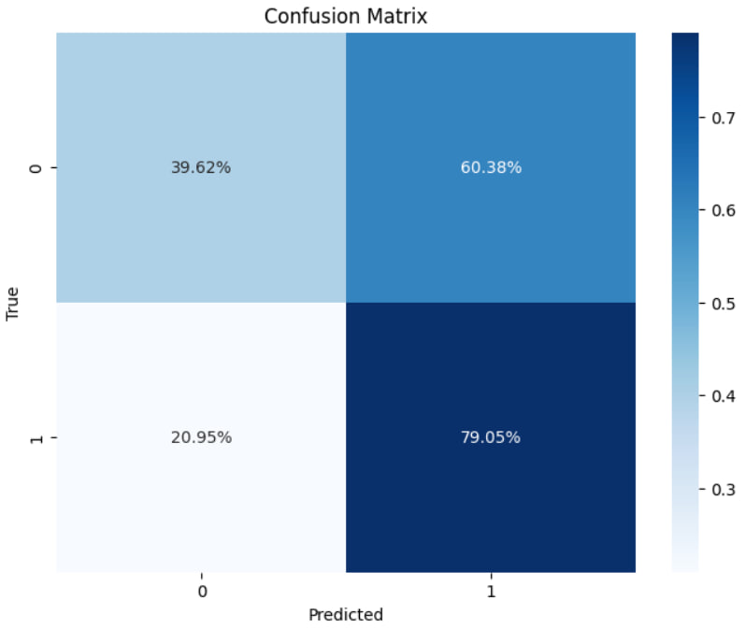
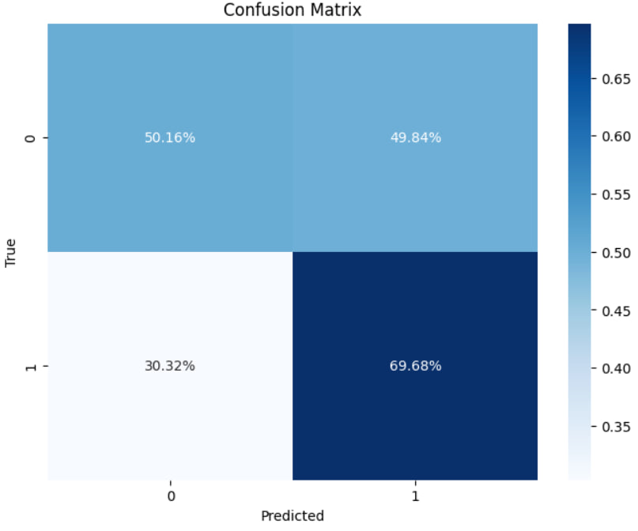
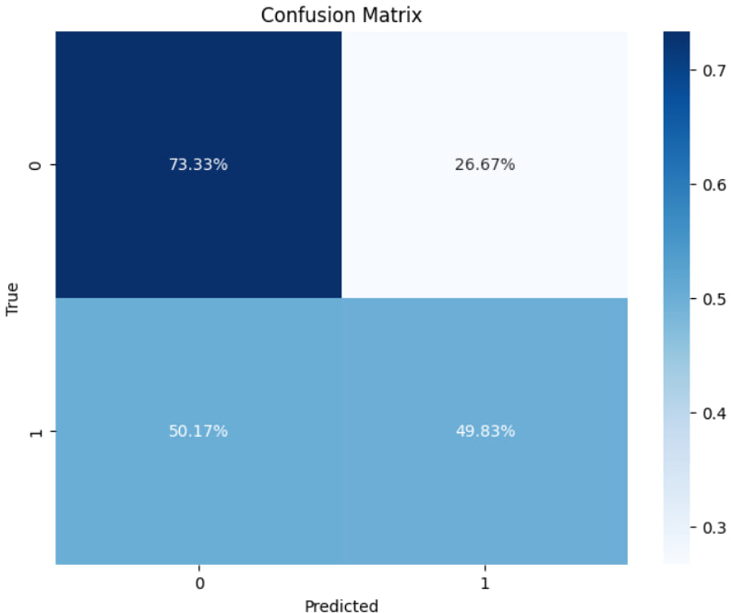
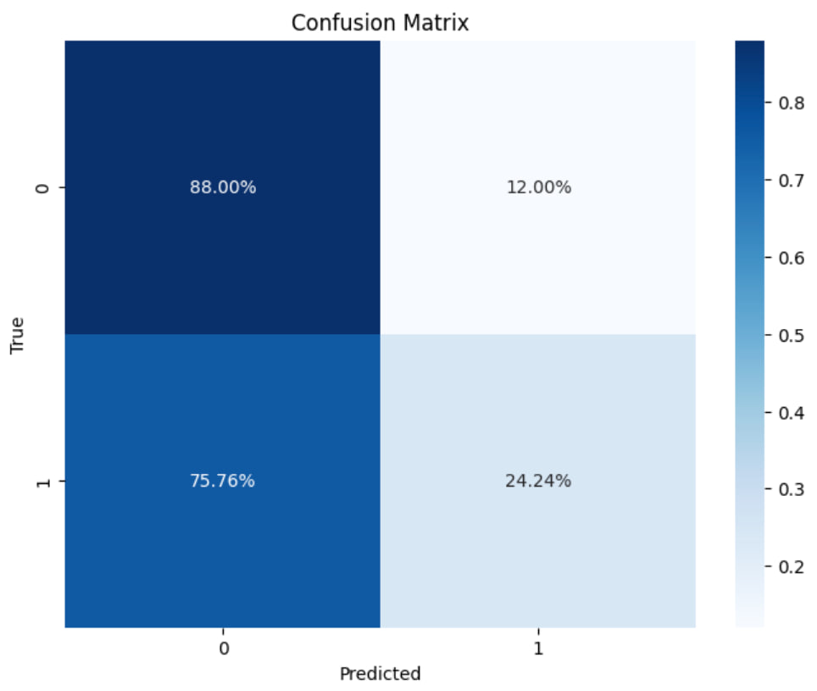
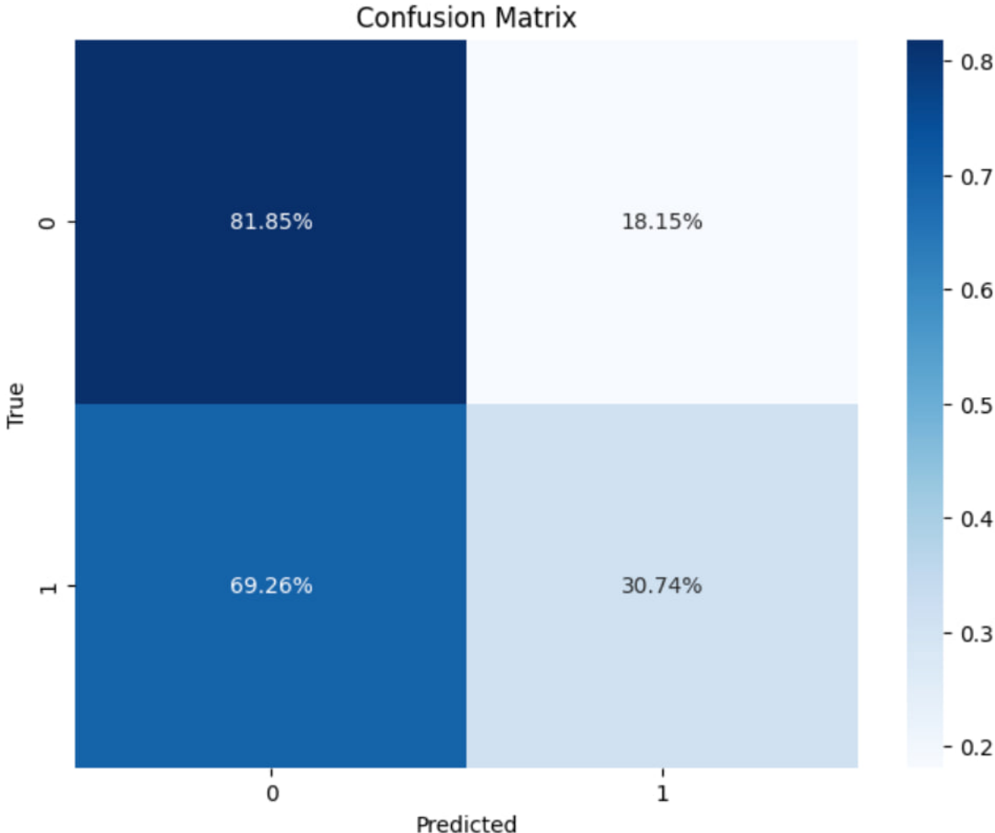
Zero-shot Query Dependent Results
This is because of different behaviors of prompts in terms of confusion matrix:

Slide 16
Few-shot Test Dataset Results
All of these results conducted in k=20 setting.
Title Only | Accuracy | Precision | Recall | F1-Score | F1-Score(‘1’) | F1-Score(‘0’)
Prompt 18 | 66% | 62% | 71% | 60% | 43% | 76%
Prompt 19 | 76% | 64% | 72% | 65% | 47% | 83%
Prompt 21 | 70% | 63% | 72% | 62% | 45% | 79%
Prompt 24 | 82% | 68% | 70% | 69% | 49% | 89%
Prompt 25 | 82% | 68% | 69% | 69% | 48% | 89%

Slide 17
Few-shot Test Dataset Results
All of these results conducted in k=20 setting.
Title Only | Social | Sports | Political | Cultural | Global | Economic | Scientific | Health
Prompt 18 | 66% | 57% | 48% | 61% | 48% | 64% | 58% | 71%
Prompt 19 | 65% | 62% | 56% | 76% | 55% | 69% | 62% | 89%
Prompt 21 | 63% | 56% | 53% | 67% | 52% | 67% | 60% | 80%
Prompt 24 | 66% | 68% | 66% | 68% | 68% | 70% | 57% | 42%
Prompt 25 | 69% | 65% | 66% | 66% | 63% | 72% | 50% | 68%

Slide 18
Few-shot Test Dataset Results
Query Dependent Prompt System Result on zero-shot setting:
Best few-shot prompt results:
Best zero-shot prompt results:
Title Only | Accuracy | Precision | Recall | F1-Score | F1-Score(‘1’) | F1-Score(‘0’)
Q-Dependent | 86% | 75% | 72% | 73% | 55% | 92%
Title Only | Accuracy | Precision | Recall | F1-Score | F1-Score(‘1’) | F1-Score(‘0’)
Prompt 24 | 82% | 68% | 70% | 69% | 49% | 89%
Title Only | Accuracy | Precision | Recall | F1-Score | F1-Score(‘1’) | F1-Score(‘0’)
Prompt 19 | 72% | 62% | 68% | 63% | 44% | 81%

Slide 19
Few-shot Train Dataset Results
All of these results conducted in k=20 setting.
The problem here is that the target title is include in examples provided in few-shot prompt!
Title Only | Accuracy | Precision | Recall | F1-Score | F1-Score(‘1’) | F1-Score(‘0’)
Prompt 18 | 99% | 97% | 99% | 98% | 97% | 99%
Prompt 19 | 99% | 98% | 99% | 99% | 98% | 99%
Prompt 21
Prompt 24
Prompt 25

