Slide 1
Group - 03
Proposed Project : Financial Management System
Project Name: finTECH
Members:
1705006 – Saiful Islam
1705011 – Md. Salman Farsi
1705012 – Jamilus Sheium
1705017 – Towhidul Islam
1705022 – Solaiman Ahmed

Slide 2
Motivation:
The Problem:
Confused Individuals who don’t know what to do with their hard earned money.
Why us?:
Our solution provides an in-depth view of their entire monetary scene by taking in their personal data like earnings and spending habits and determining where they want to end up when they retire.
We provide Graphs and charts to increase accessibility to their complex financial data.
Target Demographic :
People ranging from the young adults who just entered the job market to the people who are the end of their careers

Slide 3
Goal Achievements
Full Financial Day to Day Tracking
Retirement Planning
Investment Opportunities
Spending History
MAJOR FEATURES

Slide 4
Modules and Sub-Modules:
Account
Login, Logout
Personal Info
Menu
Day to Day track
Time Based Goal Achievement
Financial Info
Retirement Planning
History
Categorized Earning History
Categorized Spending History
Investments
Bank Details
Suggestions

Slide 5
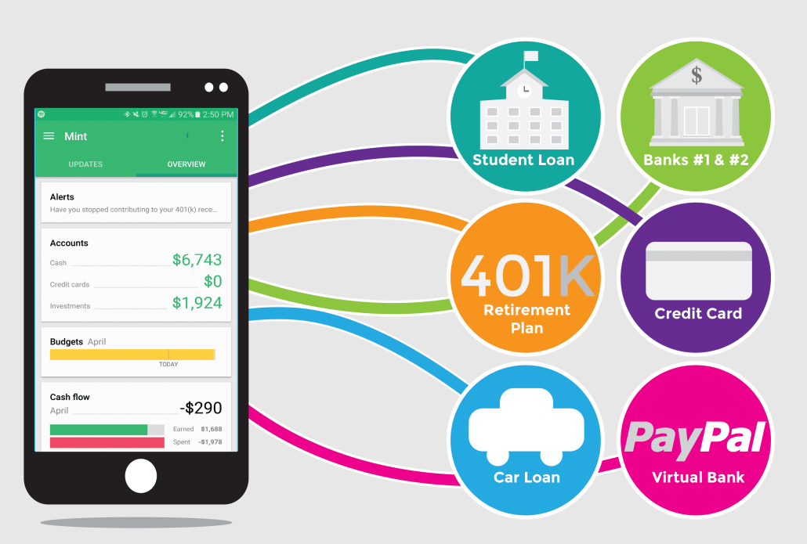
Related Examples and Existing Models:
Mint brings together everything from spending, balances, and budgets to your credit score and more. Access your financial life in one powerful app.
MINT
https://mint.intuit.com/

Slide 6
Data Collection & Generation :
Data Gathering From UI
Store in Database
Generate In-depth Analysis by pulling data from database
Show Infographic materials onto the UI

Slide 7
Presentation Assignment :
- BPMN: Solaiman (1705022)
- Mock UI: Salman(1705011), Towhid (1705017)
- Class diagram / ER diagram:
- Interaction / State: Sheium(1705012), Saiful(1705006)

