Slide 1
BPMN Diagram
Group - 03
Proposed Project : Financial Management System
Project Name: finTECH
Members:
1705006 – Saiful Islam
1705009 – Shayekh Bin Islam
1705011 – Md. Salman Farsi
1705012 – Jamilus Sheium
1705017 – Towhidul Islam
1705022 – Solaiman Ahmed

Slide 2
Modules and Sub-Modules:
Account
Login, Logout
Personal Info
Menu
Day to Day track
Time Based Goal Achievement
Financial Info
Retirement Planning
History
Categorized Earning History
Categorized Spending History
Investments
Bank Details
Suggestions

Slide 3
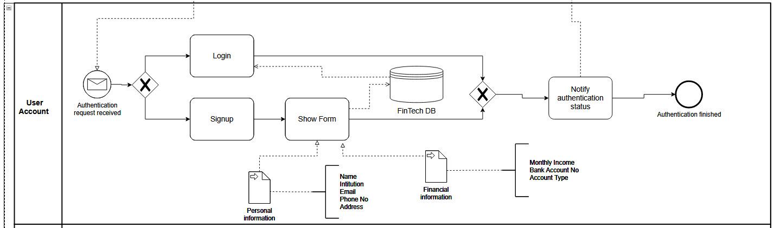
Module: User Account

Slide 4
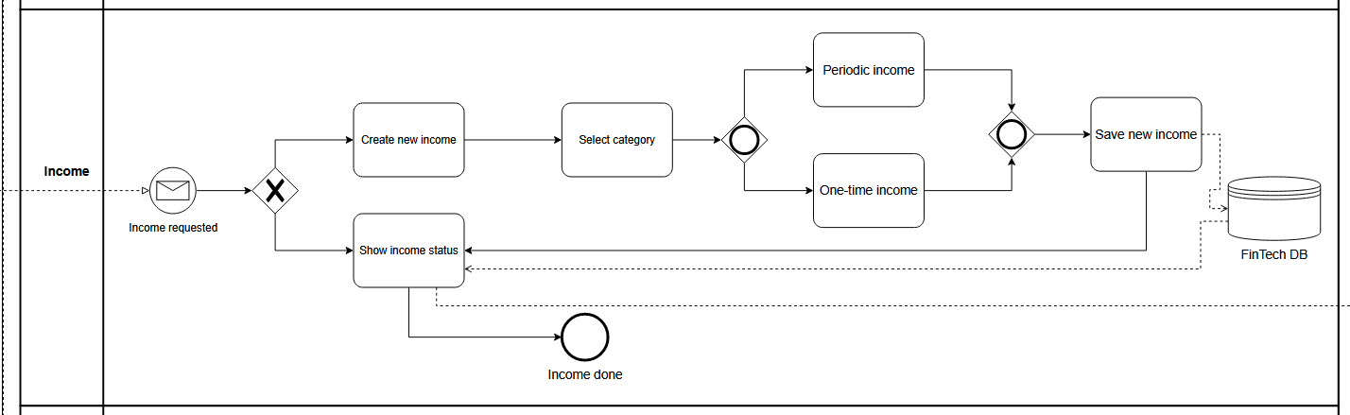
Module: Income

Slide 5
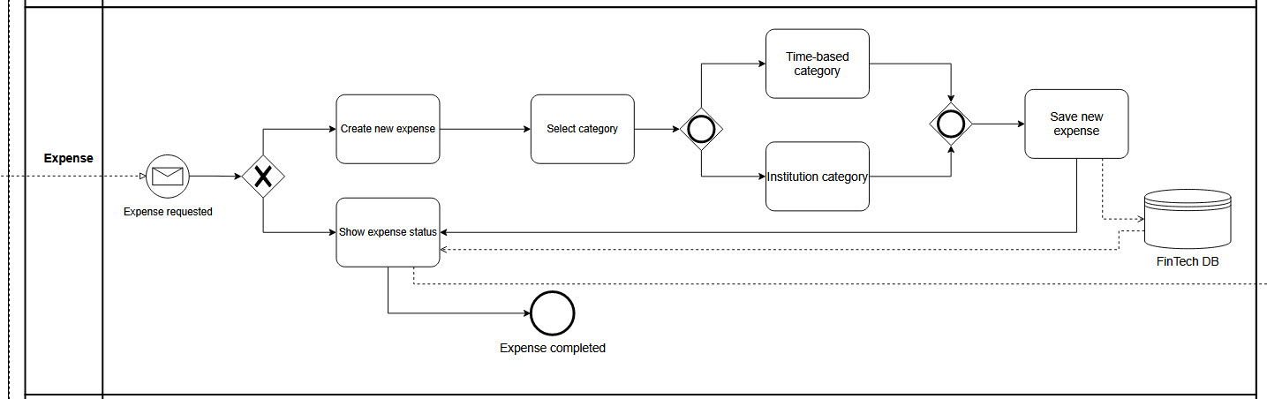
Module: Expense

Slide 6
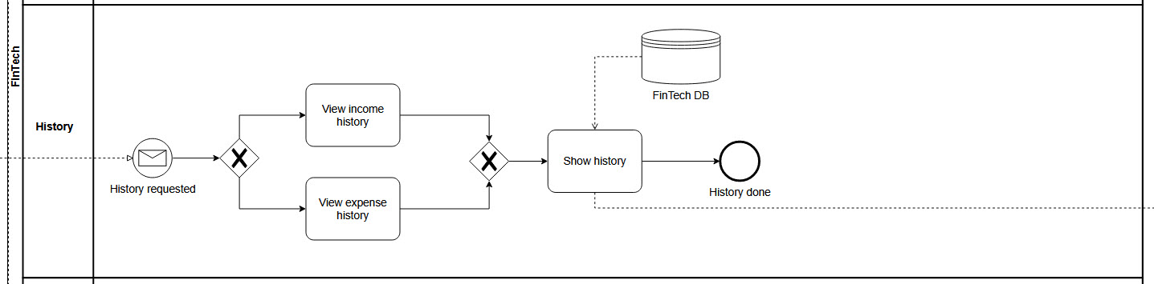
Module: History

Slide 7
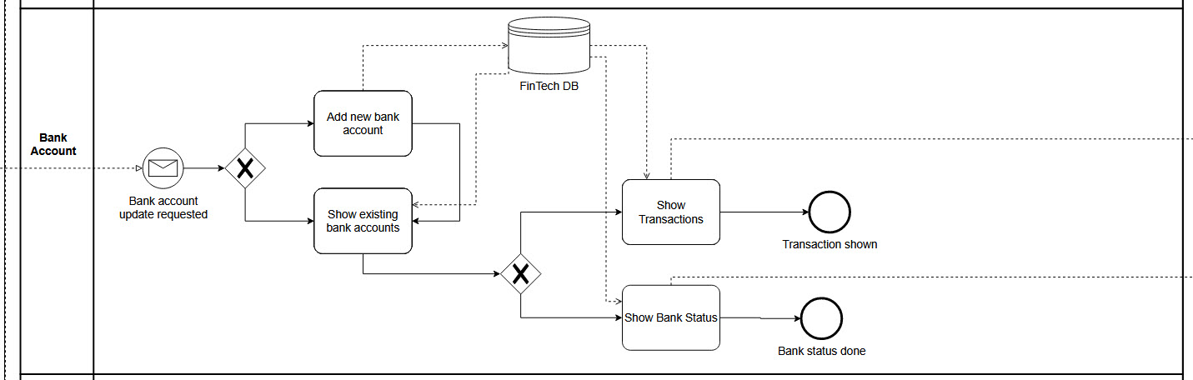
Module: Bank Account

Slide 8
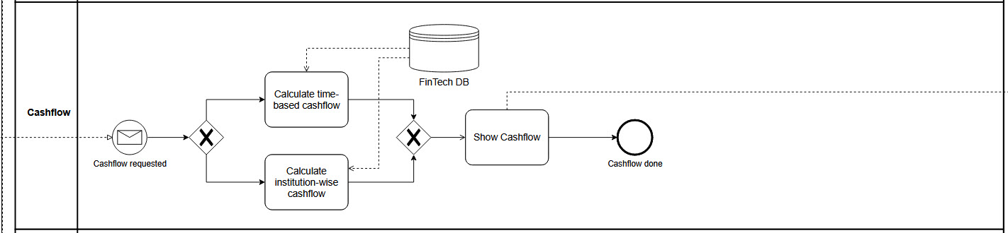
Module: Cashflow

Slide 9
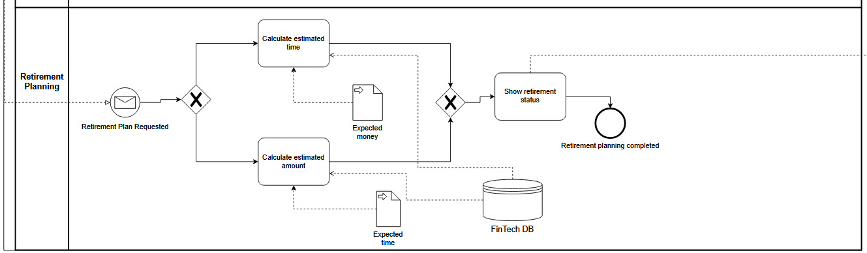
Module: Retirement Planning

Slide 10
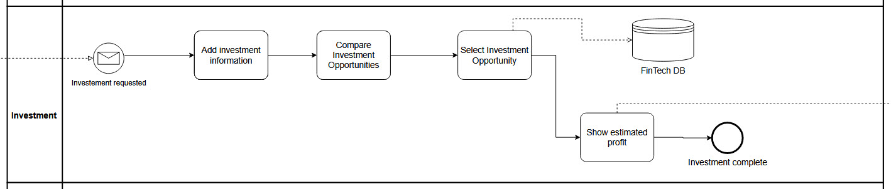
Module: Investment

Slide 11
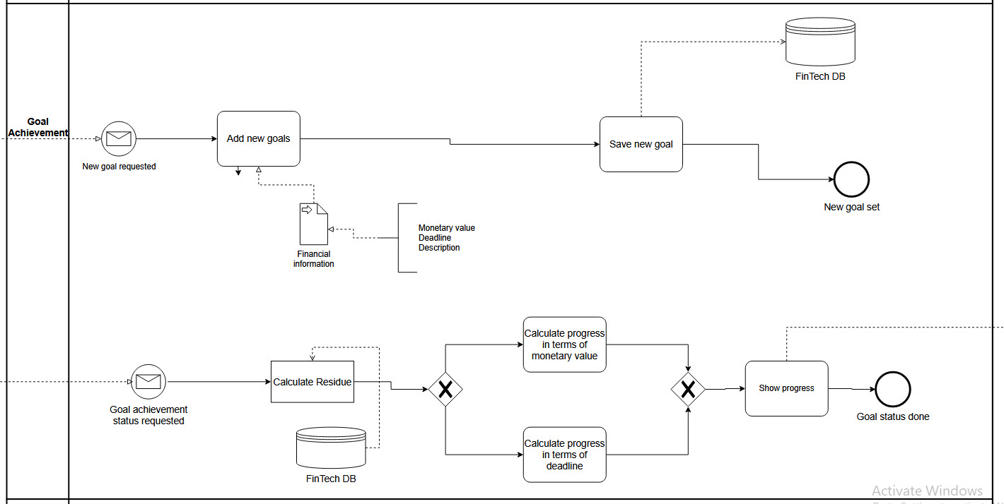
Module: Goal Achievement

Slide 12
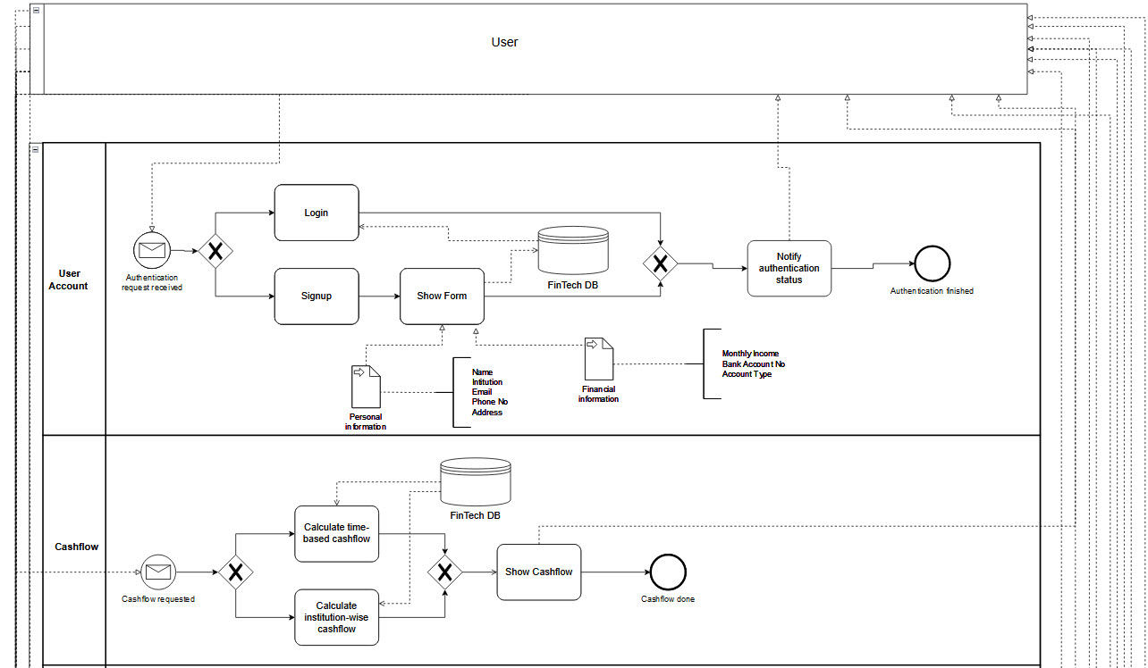
Big Picture of BPMN

Slide 13
Thank You

