Slide 1

BPMN Diagram for Study Mate
GROUP MEMBERS
1705064 - MD. TANVIR RAIHAN
1705068 - SAADMAN AHMED
1705070 – AL ARAFAT TANIN
1705071 – PRANTIK PAUL
1705075 – OVI PODDER
0905081 – ZAHIDUL ISLAM

Slide 2
Proposed modules of studymate
Authentication
Channel
Public Query Forum
Library
Collaboration
Contents

Slide 3
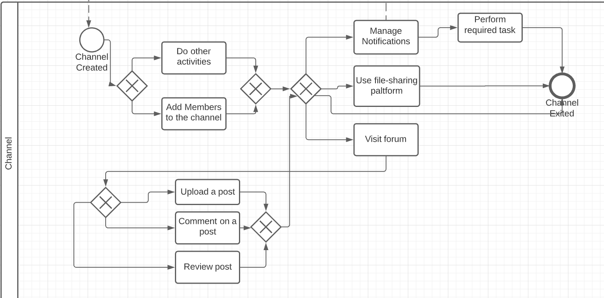
Module: channel

Slide 4
Module: channel(COntd.)
Manage Notifications
Comment on a post
Urgent Request
Timed Notifications
Question Review Notifications

Slide 5
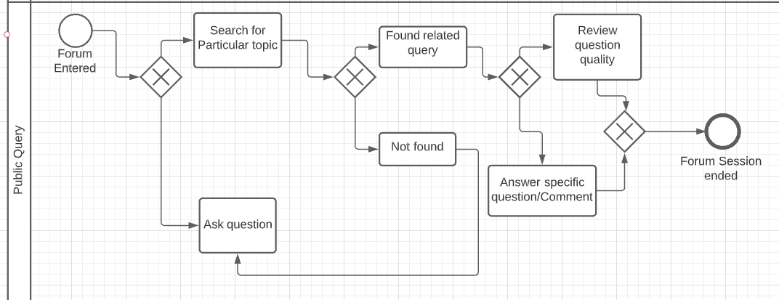
Module: Public query forum

Slide 6
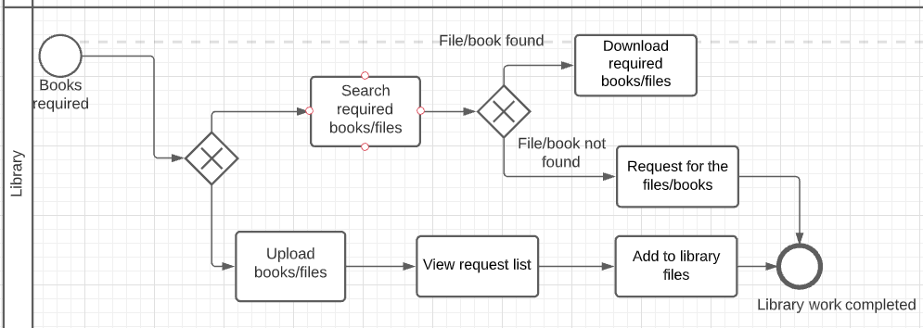
Module: Library

Slide 7
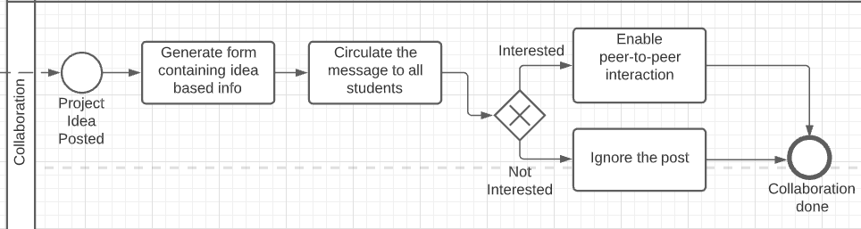
Module: Collaboration

Slide 8
Module: Collaboration(COntd.)
Generating Forms
Create Form
Add idea/project details/competition details
Add Expertise Requirement
Add Person Requirement
Post

Slide 9
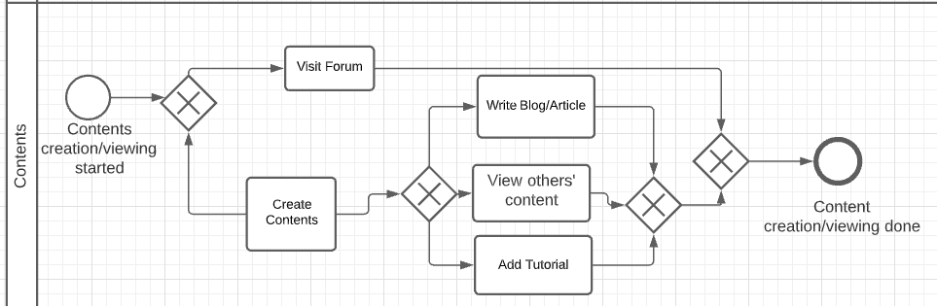
Module: Contents

Slide 10
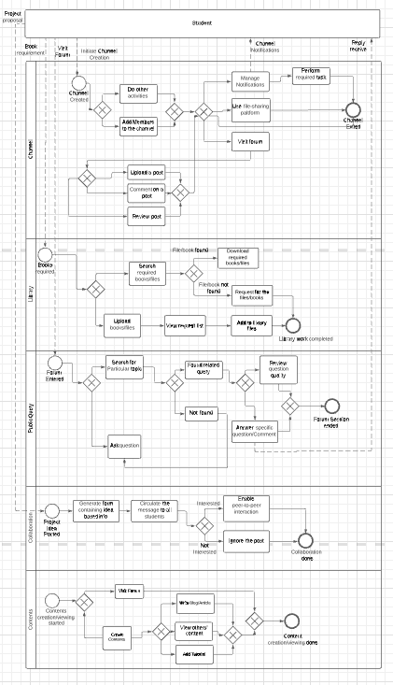
Studymate as a whole
Student Pool Interacts with all other modules.
Student initiates different events and participates in the activities.

Slide 11

Thank You
Feel free to ask any questions

