Slide 1
OpenGL and GLUT Basics

Slide 2
Outline
OpenGL & GLUT basics
  Grpahics Pipeline
  2-D drawing
  User interaction

Slide 3
What is Open GL
A software interface to graphics hardware
Graphics rendering API (Low Level)
  High-quality color images composed of geometric and image primitives
  Window system independent
  Operating system independent

Slide 4
OpenGL philosophy
Platform independent
Window system independent
Rendering only
Aims to be real-time
Takes advantage of graphics hardware where it exists
State system
Client-server system
Standard supported by major companies

Slide 5

OpenGL Basics
Rendering
  Typically execution of OpenGL commands
  Converting geometric/mathematical object descriptions into frame buffer values
OpenGL can render:
  Geometric primitives
    Lines, points, polygons, etc…
  Bitmaps and Images
    Images and geometry linked through
    texture mapping
Graphics Pipeline

Slide 6
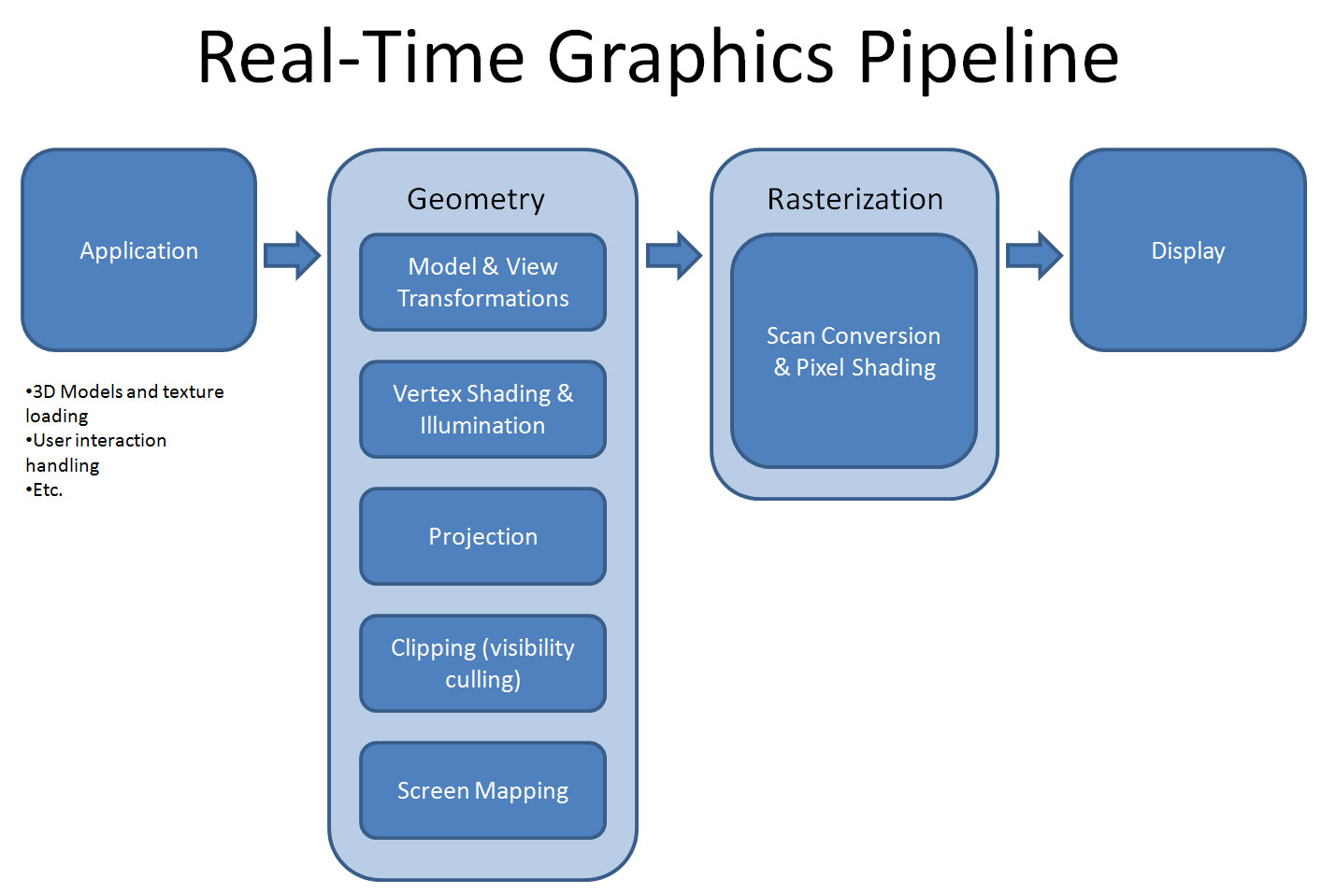
Graphics Pipeline

Slide 7
OpenGL – What is It?
GL (Graphics Library): Library of 2-D, 3-D drawing primitives and operations
  API for 3-D hardware acceleration
GLU (GL Utilities): Miscellaneous functions dealing with camera set-up and higher-level shape descriptions
GLUT (GL Utility Toolkit): Window-system independent toolkit with numerous utility functions, mostly dealing with user interface

Slide 8
OpenGL and GLUT
GLUT (OpenGL Utility Toolkit)
  An auxiliary library
    A portable windowing API
    Easier to show the output of your OpenGL application
    Not officially part of OpenGL
  Handles:
    Window creation,
    OS system calls
      Mouse buttons, movement, keyboard, etc…
    Callbacks

Slide 9
Event-driven GLUT program structure
1. Configure and open window
2. Initialize OpenGL state, program variables
3. Register callback functions
• Display (where rendering occurs)
• Resize
• User input: keyboard, mouse clicks, motion, etc.
4. Enter event processing loop

Slide 10
Simple OpenGL program
#include <stdio.h>
#include <GL/glut.h>
void main(int argc, char** argv)
{
  glutInit(&argc, argv); // configure and open window
  glutInitDisplayMode(GLUT_RGB | GLUT_DOUBLE);
  glutInitWindowSize(100, 100);
  glutCreateWindow(“hello”);
  init(); // set OpenGL states, variables
  glutDisplayFunc(display); // register callback routines
  glutKeyboardFunc(keyboard);
  glutMainLoop(); // enter event-driven loop
}

Slide 11
Configure and open window
• glutInit: Pass command-line flags on to GLUT
• glutInitDisplayMode: OR together bit masks to set modes on pixel type (indexed vs. true color), buffering, etc.
• glutInitWindowSize, glutCreateWindow: Set drawing window attributes, then make it

Slide 12
Initialize OpenGL state
• init(): Set OpenGL state, program variables
– Use GL types/typedefs GLfloat, GLint, GL_TRUE, GL_FALSE, etc. for
cross-platform compatibility
void init() {
  glClearColor(0.0, 0.0, 0.0, 0.0);
  glMatrixMode(GL_PROJECTION);
  glLoadIdentity();
  gluOrtho2D(0, right, 0, top);
}
sets “units” of subsequent draw commands

Slide 13
OpenGL screen coordinates
• Bottom left corner is origin
• gluOrtho2D() sets the units of the screen
coordinate system
•gluOrtho2D(0, w, 0, h) means the
coordinates are in units of pixels
•gluOrtho2D(0, 1, 0, 1) means the
coordinates are in units of “fractions of window
size” (regardless of actual window size)

Slide 14
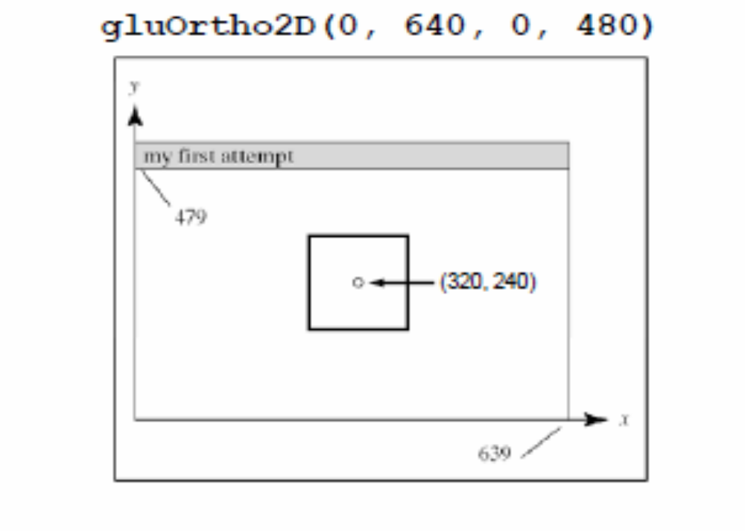
Example: Specifying the center of a square

Slide 15
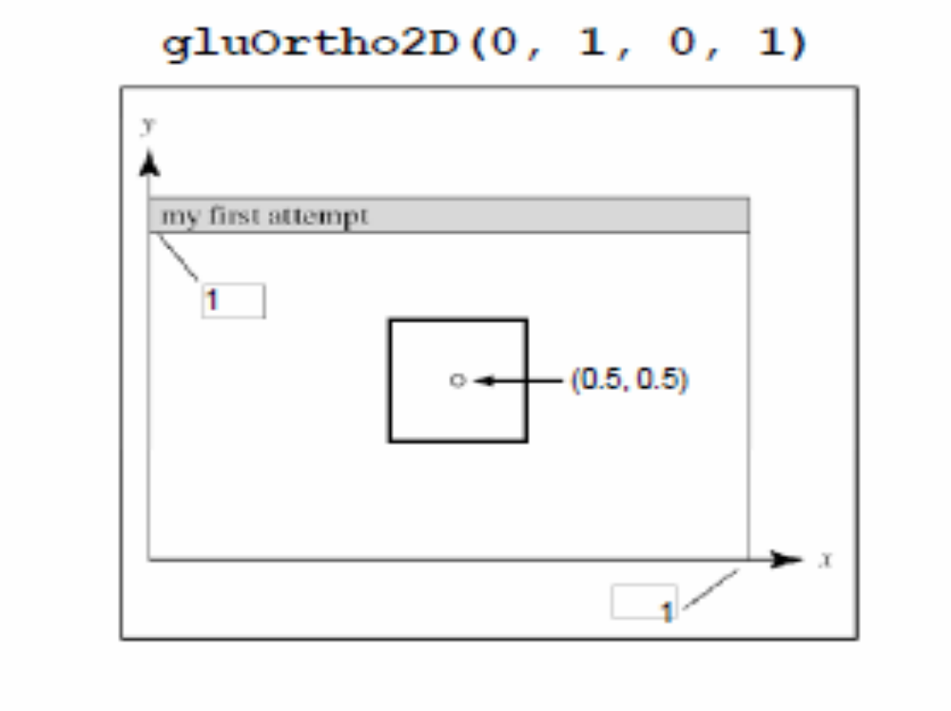
Example: Specifying the center of a square

Slide 16
A complete OpenGL program
#include <stdio.h>
#include <GL/glut.h>
void main(int argc, char** argv)
{
  glutInit(&argc, argv);
  glutInitDisplayMode (GLUT_SINGLE | GLUT_RGB);
  glutInitWindowSize (640, 480);
  glutInitWindowPosition (100, 150);
  glutCreateWindow ("my first attempt");
  glutDisplayFunc(myDisplay);
  myInit ();
  glutMainLoop();
}

Slide 17
A complete OpenGL program (cont.)
void myDisplay(void)
{
  glClear (GL_COLOR_BUFFER_BIT);
  glColor3f (0.0, 0.0, 0.0);
  glPointSize(4.0);
  glBegin(GL_POINTS);
  glVertex2i(100, 50);
  glVertex2i(100, 130);
  glVertex2i(150, 130);
  glEnd();
  glFlush ();
}

Slide 18
A complete OpenGL program (cont.)
void myInit (void)
{
  glClearColor(1.0, 1.0, 1.0, 0.0);
  glColor3f(0.0f, 0.0f, 0.0f);
  glPointSize(4.0);
  glMatrixMode(GL_PROJECTION);
  glLoadIdentity();
  gluOrtho2D(0.0, 640.0, 0.0, 480.0);
}

Slide 19
Rendering Steps
In function registered with glutDisplayFunc():
1. Clear window
• glClear(GL_COLOR_BUFFER_BIT);
2. Draw shapes
• Set colors, patterns, point/line sizes
• Specify type of geometric primitive(s) and list vertices
3. Swap buffers if display mode is GLUT_DOUBLE
4. Force all operations to complete with glFlush()

Slide 20
Single- vs. double-buffering
• Single-buffering: Draw directly to screen buffer
• Double-buffering: Draw to offscreen
buffer, then make that the screen buffer when done
• For animation, double-buffering is better because it eliminates flickering

Slide 21
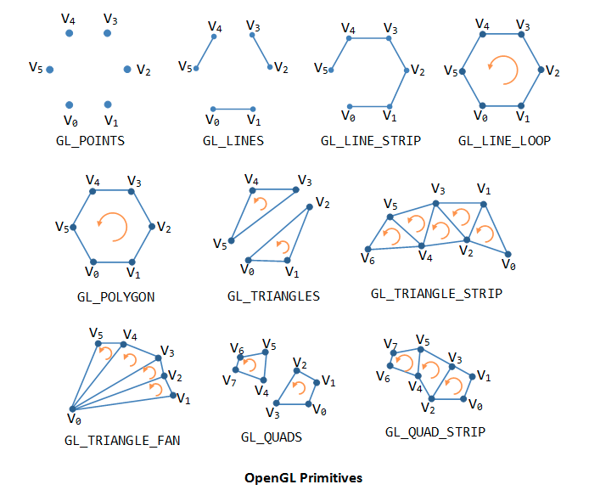
OpenGL Geometric Primitives

Slide 22
Specifying Geometric Primitives
Primitives are specified using
glBegin(primType);
...
glEnd();
– primType determines how vertices are combined
GLfloat red, green, blue;
GLfloat x, y;
glBegin(primType);
for (i = 0; i < nVerts; i++) {
glColor3f(red, green, blue);
glVertex2f(x, y);
... // change coord. values
}
glEnd();

Slide 23
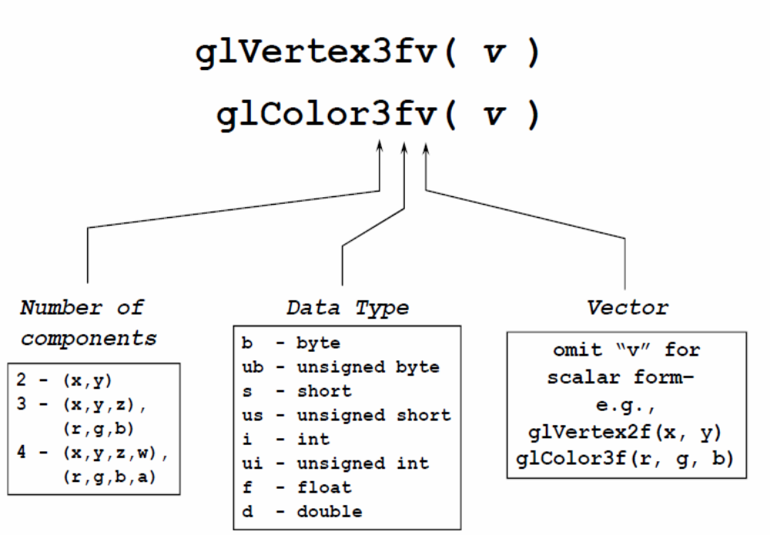
OpenGL Command Formats

Slide 24
Ubuntu Config: Freeglut
0. install build-essential (sudo apt-get install build-essential)
1. install freeglut3-dbg, freeglut3-dev, freeglut3
2. install libglewmx-dev, glew-utils, libgle-dbg, libglewmx-dbg, libglew-dev, libglewmx1.10, libglew1.10
3. go to /usr/lib/x86_64-linux-gnu [64bit] or /usr/lib/i386-linux-gnu [32bit]

Slide 25
Ubuntu Config: Freeglut
4. copy libglut.a, libglut.so, libglut.so.3, libglut.so.3.9.0 to /usr/lib [own this directory if you have any permission issue; with chown]
5. install codeblocks from ubuntu software center
6. create glut projects and just use "/usr" as glut location

Slide 26
Ubuntu Config: Freeglut
** if any problems with glu copy the libGLU.a, libGLU.so, libGLU.so.1, libGLU.so.1.3.1 files from the same location to same location.

Slide 27
Windows Config: glut
Unzip glut-3.7.6-bin.zip and you will get
1. glut.h
2. glut32.dll
3. glut32.lib

Slide 28
Windows Config: glut
Visual Studio 2010
Windows (7/8)
====================
On 32bit versions of windows:
  copy glut.h in include/GL folder to C:\Program Files\Microsoft SDKs\Windows\v7.0A\Include\gl
  copy glut32.lib in lib folder to C:\Program Files\Microsoft SDKs\Windows\v7.0A\Lib
  copy glut32.dll to C:\windows\system32
On 64bit versions of windows:
  copy glut.h in include/GL folder to C:\Program Files(x86)\Microsoft SDKs\Windows\v7.0A\Include\gl
  copy glut32.lib in lib folder to C:\Program Files(x86)\Microsoft SDKs\Windows\v7.0A\Lib
  copy glut32.dll to C:\windows\SysWOW64

Slide 29
Windows Config: glut
Visual Studio 2012
Windows (7/8)
====================
On 32bit versions of windows:
  copy glut.h in include/GL folder to C:\Program Files\Microsoft Visual Studio 11.0\VC\include\gl
  copy glut32.lib in lib folder to C:\Program Files\Microsoft Visual Studio 11.0\VC\lib
  copy glut32.dll to C:\windows\system32
On 64bit versions of windows:
  copy glut.h in include/GL folder to C:\Program Files (x86)\Microsoft Visual Studio 11.0\VC\include\gl
  copy glut32.lib in lib folder to C:\Program Files (x86)\Microsoft Visual Studio 11.0\VC\lib\amd64
  copy glut32.lib in lib folder to C:\Program Files (x86)\Microsoft Visual Studio 11.0\VC\lib
  copy glut32.dll to C:\windows\SysWOW64

