Slide 1




Conquering Class Imbalance: Strategic Sampling for High-Recall Credit Card Fraud Detection
A Machine Learning Approach
Presenter: Shayma Remy
Springboard | Data Science Track – Capstone | June 2025

Slide 2
Executive Summary - The Challenge & Our Solution
The Problem: Credit card fraud costs billions annually; 3.5% of transactions in our dataset, but high cost of missed fraud.
Our Goal: Develop a ML pipeline prioritizing recall (detecting fraud) while maintaining acceptable precision.
Core Strategy: Addressed extreme class imbalance (20k fraud vs. 570k legitimate) and large data volume (1.9 GB).
Key Approach: 2:1 undersampled subset + SMOTE for balanced training.
Result: Random Forest model with 73.34% recall, 85.02% precision (after threshold tuning), 0.9176 ROC AUC.

Slide 3
Introduction - The Scale of Credit Card Fraud
Why Fraud Detection Matters: Billions in annual losses, customer trust erosion, regulatory scrutiny.
The Data Landscape:
Merged IEEE-CIS dataset: 590,540 transactions, 144,233 identity records.
Extreme Class Imbalance: Only 3.5% (20,663) fraudulent transactions.
High Data Volume: Approx. 1.9 GB in memory, demanding efficient processing.
The Core Problem: Naive models fail; predicting "legitimate" yields high accuracy but misses virtually all fraud (near zero recall).

Slide 4
Data Overview & Preprocessing Steps
Dataset Merging: Joined train_transaction.csv (394 cols) and train_identity.csv (41 cols) on TransactionID, resulting in 590,540 rows and 434 columns.
Initial Assessment: Identified high missing rates in features like dist2, D7, DeviceInfo.
Memory Management: Reduced RAM usage from 1.9 GB to 1.8 GB via dtype optimization.
Preprocessing Pipeline:
Missing Value Imputation: Numeric (median), Categorical ("Unknown").
Feature Engineering: Extracted temporal features (hour, weekday) from TransactionDT.
Encoding & Scaling: RobustScaler for numeric, Label/One-Hot Encoding for categorical features.

Slide 5
Strategic Training: Undersampling & SMOTE
The Challenge with Full Dataset Training:
Hours of training time required.
Sophisticated imbalance handling needed.
Typically, low recall due to overwhelming legitimate transactions.
Our Chosen Approach: 2:1 Undersampled + SMOTE:
Retained all 20,663 fraud cases.
Randomly sampled 41,326 legitimate cases (2:1 ratio).
Resulted in 61,989 rows (33.3% fraud).
Applied SMOTE to training set to achieve 50/50 class balance (66,122 rows).
Benefits: 90% faster training time, dramatically improved recall.
Trade-off & Mitigation: Discarded ~528,000 legitimate transactions. Mitigated by rotating fresh samples during monthly retraining.

Slide 6
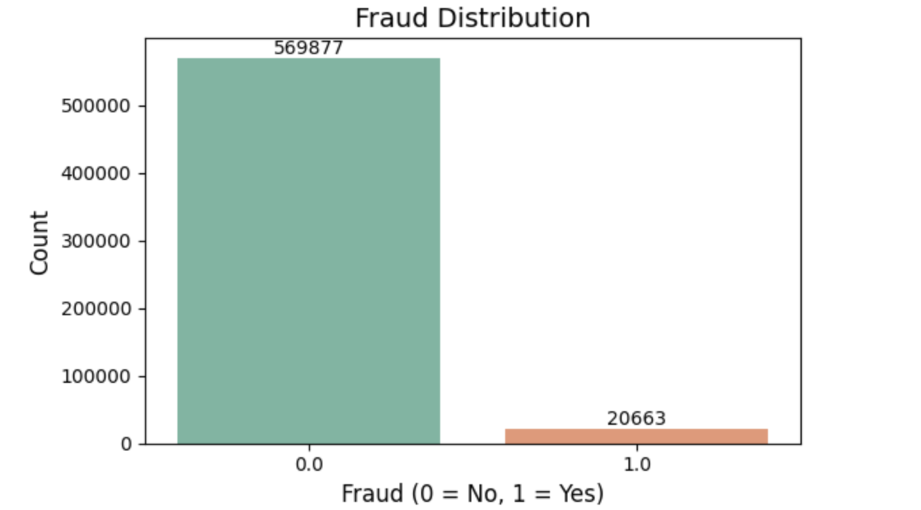
Fraud Patterns - Temporal Insights & Class Distribution
Source: Exploratory Data Analysis (EDA) on the full dataset.
Class Imbalance:
Fraudulent cases: 20,663 (3.5%)
Legitimate cases: 569,877 (96.5%)

Slide 7
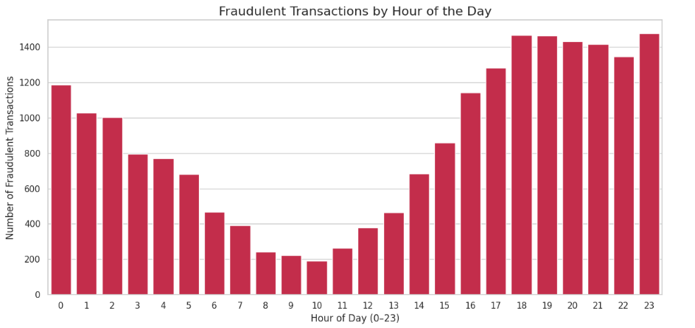
Key Fraud Patterns - Temporal Insights & Class Distribution
Hourly Distribution:
Fraudulent activity spikes during evening hours (4 PM to 11 PM).
Peak fraud at 11 PM (>1,300 transactions/hour).
Significant activity (20-25%) between midnight and 4 AM, indicating exploitation of reduced monitoring.

Slide 8
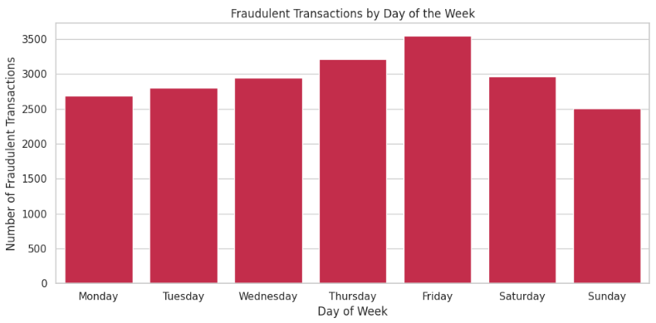
Key Fraud Patterns - Temporal Insights & Class Distribution
Weekday Distribution:
Fridays account for nearly 18% of fraudulent activity (disproportionate to total transactions).
Suggests opportunistic behavior exploiting end-of-week vulnerabilities.

Slide 9
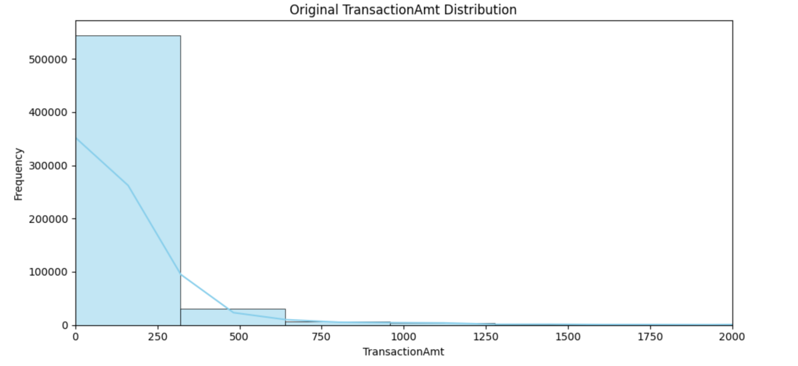
Key Fraud Patterns - Transaction & Network Characteristics
Transaction Amount: Most fraudulent transactions cluster between $0 and $200. Suggests small "test" charges.

Slide 10
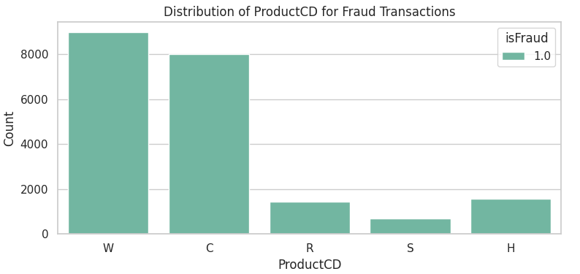
Key Fraud Patterns - Transaction & Network Characteristics
Product Code (ProductCD): Codes "W" and "C" are overrepresented in fraud cases (e.g., "W" is 5% of transactions but 12% of fraud).

Slide 11
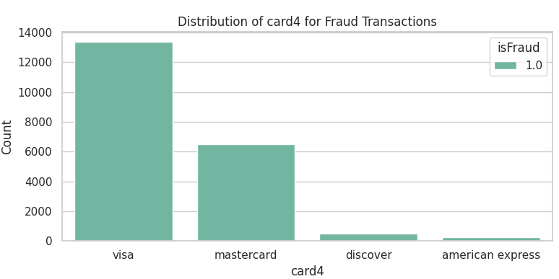
Key Fraud Patterns - Transaction & Network Characteristics
Card Network (card4):
Discover & MasterCard show disproportionately higher fraud rates.
Example: Discover processes 18% of transactions but accounts for 28% of fraud.

Slide 12
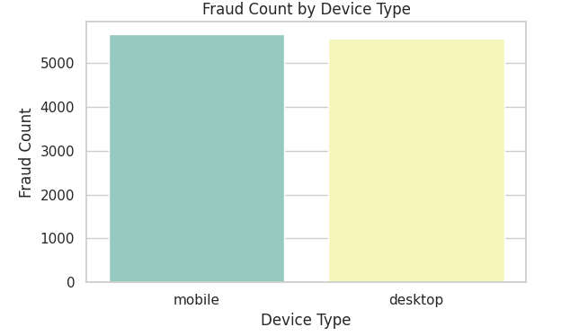
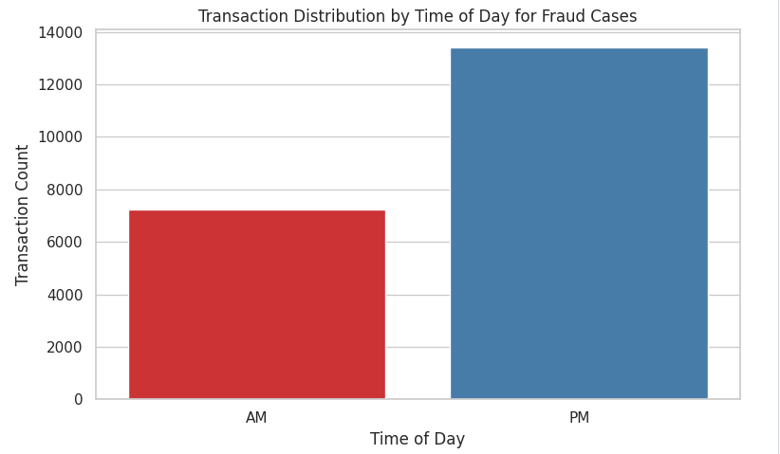
Key Fraud Patterns - Device, and Behavioral Signals
Device Type: Nearly 55% of fraud originates from mobile devices.
Time of Day (AM vs. PM): PM period (afternoon/evening) sees ~1.4x more fraud than AM.

Slide 13
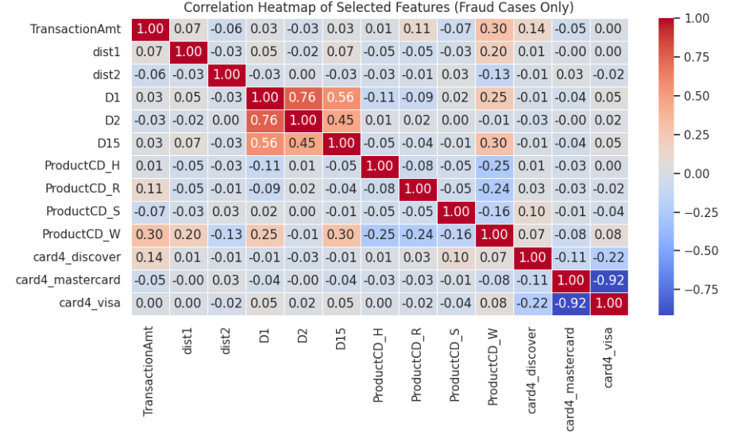
Key Fraud Patterns - Device, and Behavioral Signals
Distance & Time-Difference Correlations:
Strong correlation (0.76) between D1 and D2 suggests rapid successive transactions.
Moderate correlation (0.30) between TransactionAmt and D15 implies higher fraud amounts follow previous transactions quickly.

Slide 14
Model Selection - Overview of Classifiers
Goal: Build a robust fraud detection system balancing performance, efficiency, and scalability.
Classifiers Evaluated:
Logistic Regression: Transparent baseline, high recall (99.27%) but impractical due to ~99% false positives.
Random Forest: Ensemble of decision trees.
XGBoost: Gradient-boosted decision trees.
LightGBM: Optimized gradient-boosting framework.
Evaluation Focus: Prioritized high recall, balanced with acceptable precision, F1 score, and ROC AUC.
Training Data: All models trained on SMOTE-balanced training set (66,122 rows, 50/50 fraud/non-fraud).

Slide 15
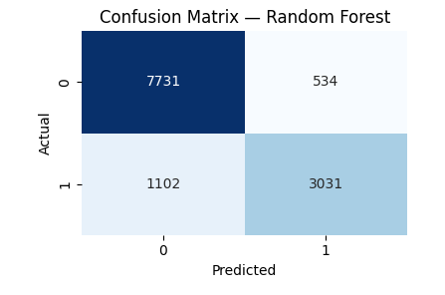
Random Forest - The Chosen Model's Performance
Metrics (Test Set, default 0.50 threshold):
Accuracy: 86.80%
Precision (Fraud): 85.02%
Recall (Fraud): 73.34%
F1 Score (Fraud): 78.75%
ROC AUC: 0.9176
Impact:
Correctly detected 3,031 of 4,133 fraud cases (1,102 false negatives).
Misclassified only 534 of 8,265 legitimate transactions as fraud (false positives).
Why Chosen: Offers the optimal balance between detecting fraud (recall) and minimizing false alarms (precision), strong class separation, and interpretability through feature importance.

Slide 16
Performance Comparison Across Models
Model | ROC AUC | Accuracy (%) | Precision(Fraud)(%) | Recall (Fraud)(%) | F1 Score (Fraud)(%) | False Positives | False Negatives
Logistic Regression | 0.4990 | 33.45 | 33.29 | 99.27 | 49.86 | 8,182 | 28
Random Forest | 0.9176 | 86.80 | 85.02 | 73.34 | 78.75 | 534 | 1,102
XGBoost | 0.9146 | 86.44 | 85.13 | 71.37 | 77.64 | 501 | 1,183
LightGBM | 0.9141 | 86.30 | 84.94 | 70.95 | 76.88 | 478 | 1,200
Random Forest: Strong balance of recall (73.34%) and precision (85.02%), highest ROC AUC (0.9176).
XGBoost: Very competitive, slightly lower recall (71.38%) but similar precision (85.48%), strong ROC AUC (0.9137).
LightGBM: Fastest training, lowest false positives (478), but slightly lower recall (70.97%).
Logistic Regression: Unacceptable false positives despite high recall.

Slide 17
Crucial Impact of Threshold Optimization
Default 0.50 Threshold: For Random Forest, this would lead to ~6,240 false positives daily (assuming 100k daily transactions), overwhelming manual review.
Optimized Threshold: 0.69:
Crucial for operational feasibility.
Maintains ~73% fraud recall.
Reduces false positives to under 1,000 daily.
Business Impact: Projected annual savings of over $104,000 by balancing missed fraud costs and false alert overhead.

Slide 18
Recommendation 1: Real-Time Deployment
Model: Random Forest (300 estimators, max_depth=15, min_samples_split=5).
Deployment: Integrated into real-time transaction pipeline for immediate scoring.
Flagging Criteria: Transactions with fraud probability ≥ 0.69 flagged for manual review.
Monitoring: Daily precision, recall, and false positive counts. Log key features for flagged cases.
Expected Outcome: ~73% fraud detection with fewer than 1,000 false positives daily, making manual review sustainable.

Slide 19
Recommendation 2: Three-Tier Review Workflow
Tier | Probability Range | Actions
1 | 0.69 ≤ p < 0.80 | Queue for hourly batch review; send automated email alerts to the fraud operations team.
2 | 0.80 ≤ p < 0.90 | Temporarily hold transactions; trigger real-time phone/SMS One-Time Password (OTP) verification for user authentication.
3 | p ≥ 0.90 | Immediately suspend/decline the transaction; escalate the case for overnight manual investigation.
Purpose: Optimize resource allocation based on predicted fraud probability.
Benefit: Real-time intervention for highest-risk cases, efficient batch processing for moderate-risk.

Slide 20
Recommendation 3: Continuous Monitoring & Adaptive Retraining
Monthly Retraining Pipeline:
Collect 60 days of recent labeled transactions.
Create new 2:1 undersampled subsets.
Apply preprocessing and SMOTE.
Retrain Random Forest, validate on holdout sets.
Recalibrate thresholds; deploy if performance meets/exceeds standards.
Real-time Monitoring Dashboard:
Track 7-day/30-day rolling averages of key metrics.
Monitor feature distributions for drift (e.g., >10%).
Alert on performance degradation (>2 percentage points).
Ensure review team capacity matches flagged volumes.
Goal: Maintain model effectiveness against evolving fraud tactics and preserve operational efficiency.

Slide 21
Current Limitations
Information Loss from Undersampling: Discarded ~528,000 legitimate transactions; may obscure rare valid patterns, potentially increasing false positives in production.
1
SMOTE Bias: Synthetic oversampling may not reflect emerging fraud schemes.
2
Feature Drift Vulnerability: Fraud patterns evolve, requiring vigilant monitoring to prevent performance degradation.
3
Limited Network Analysis: Current approach examines individual transactions; misses coordinated fraud rings.
4
Reduced Interpretability for "V" Features: Anonymized features limit understanding of model decisions.
5

Slide 22
Future Research Directions
Ensemble Methods: Combine Random Forest, XGBoost, LightGBM for enhanced performance and robustness.
Graph-Based Anomaly Detection: Leverage transaction-entity networks to identify coordinated fraud rings.
Streaming Learning Implementation: Enable near-real-time model updates for faster adaptation to evolving tactics.
Behavioral Biometrics Incorporation: Add user interaction patterns (mouse movements, typing dynamics) for richer fraud scoring.
Cost-Sensitive Optimization: Develop models that directly optimize business impact, balancing false negative costs against false positive burdens.
Advanced Feature Engineering: Explore temporal sequence modeling, peer-group comparisons, velocity-based features.

Slide 23
Conclusion - A Robust & Evolving Defense
Objective Achieved: Balanced high recall with acceptable precision in credit card fraud detection.
Key Achievements:
Optimized Random Forest performance (73.34% recall, 85.02% precision, 0.9176 ROC AUC).
Enhanced operational efficiency through 0.69 threshold (reduces false positives to <1,000 daily).
Critical pattern discovery (temporal spikes, low amounts, mobile device risk).
Established a scalable framework (monthly retraining, continuous monitoring).
Strategic Impact: Provides financial institutions with a robust, evolving defense against sophisticated fraud, safeguarding assets and customer trust.

Slide 24



Questions & Discussion
Thank you!

