Slide 1
Customer Churn Analysis – Key Drivers & Predictive Insights
Shayma Remy
Springboard – Capstone 3
August 2025

Slide 2
Agenda
01 | Executive Summary
02 | Problem Statement & Business Context
03 | Data Overview & Methodology
04 | Key Findings
05 | Predictive Model Development & Performance
06 | Interactive Dashboard Demo
07 | Business Impact & Recommendations
08 | Future Research Directions
09 | Conclusion & Next Steps
10 | Q&A/ Feedback

Slide 3
Executive Summary
Subscription churn impacts revenue more than new‐acquisition spend
Analysis on 7,043 Telco customers to pinpoint attrition drivers
Contract type accounts for ~80% of predictive power
Logistic Regression model AUC = 0.836
Actionable levers: contract incentives, auto-pay, service quality

Slide 4
Problem Statement & Business Context
Monthly churn rates erode subscription revenues by millions
Manual retention campaigns miss high-risk segments, waste budget
Need shift from reactive to proactive, data-driven retention
Goal: Identify at-risk customers and root causes of churn

Slide 5
Data Overview & Methodology
Telco Customer Churn Dataset (Kaggle): 7,043 records, 21 features - Demographics, service usage, account details, financials
Workflow: Clean & engineer features (tenure buckets, charges ratios)
Models: Logistic Regression (interpretability) & Decision Tree (non-linear)
Tools: Python (Pandas, NumPy, scikit-learn), Tableau, Matplotlib, Seaborn

Slide 6
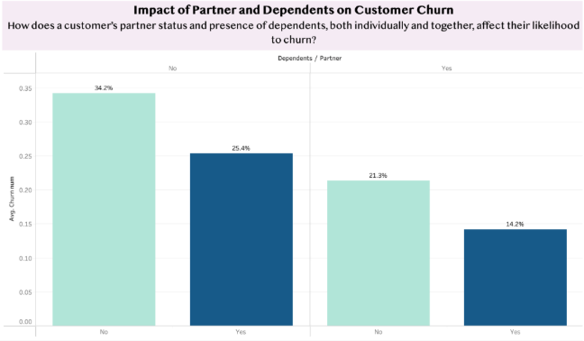
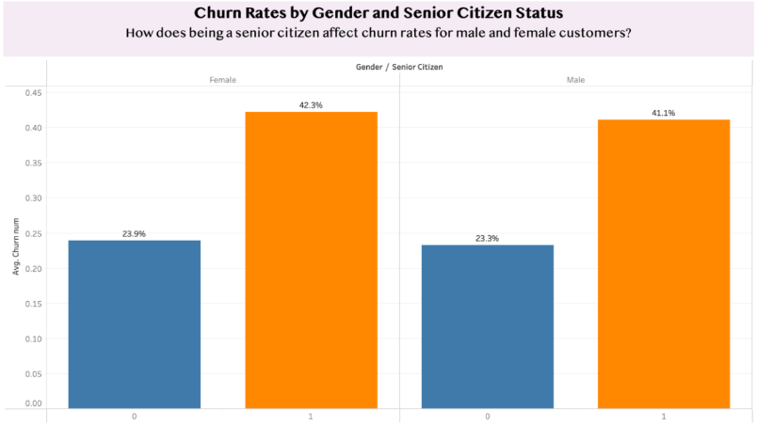
Demographic & Relationship Factors
Customers with no partner/dependents churn at 34.2%; both = 14.2%
Presence of family ties reduces churn by ~20 percentage points
Seniors churn ~42% vs. non-seniors ~24%; gender effect negligible

Slide 7
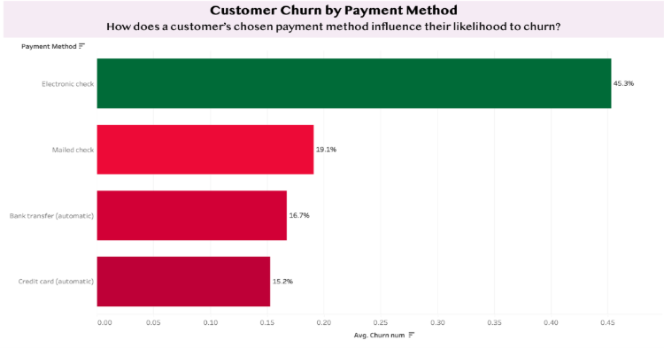
Financial & Payment Behavior
Electronic check users churn 45.3%; auto-pay users churn ~16%
Automatic payments indicate higher commitment and reduce attrition
Suggested levers: migrate to bank-transfer or credit-card auto-pay

Slide 8
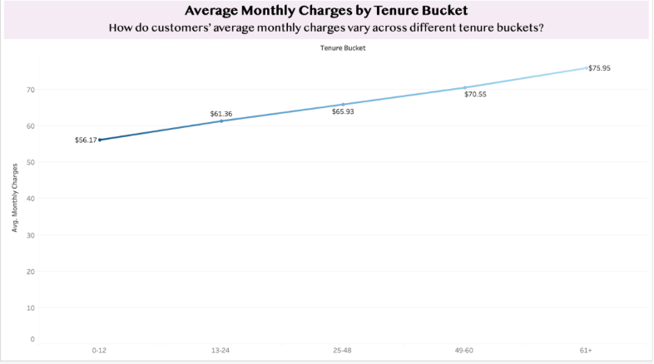
Tenure & Pricing Paradox
Early-tenure customers (0-12 months) pay avg. $56.17; long-tenure (61+ months) pay $75.95
Loyal customers accept higher-rates – possibly due to upgrade or price hikes
Key insight: price isn’t sole driver; service expectations matter

Slide 9
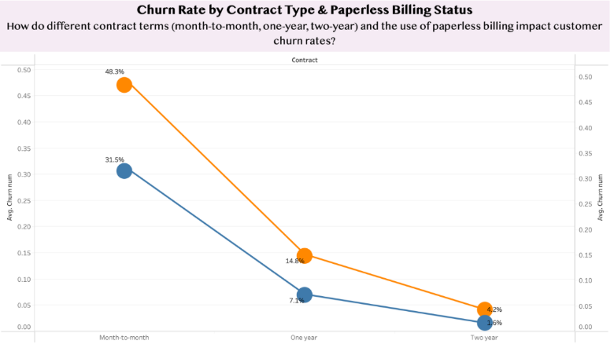
Contract & Service Factors
Months-to-month churn: 31.5-48.3%; one-year: 7.1-14.8%; two-year: 1.6-4.2%
Paperless billing correlates with ~1.5x higher churn across all contracts
Contract incentives are the single biggest retention lever

Slide 10
Predictive Model Development
Why these models?
Logistic Regression: clear coefficients → actionable risk scores
Decision Tree: uncovers non-linear interactions
Feature engineering: one-hot encoding, scaling, tenure brackets, charges ratios
AIM: balance interpretability & predictive power for real-world deployment

Slide 11
Model Performance Comparison
Logistic Regression
AUC = 0.836, recall = 91.0%, precision trade-offs
Confusion matrix: 739 TN, 301 TP, 296 FP, 73 FN
Decision Tree
Recall = 92.9%, but 444 FP vs. 45 FN → more false alarms

Slide 12
Model Performance Comparison (cont)
Logistic Regression Confusion Matrix
Actual/LogReg Predicted | 0 (No Churn) | 1 (Churn)
0 (No Churn) | 739 | 296
1 (Churn) | 73 | 301
Decision Tree Confusion Matrix
Actual/ Tree Predicted | 0 (No Churn) | 1 (Churn)
0 (No Churn) | 591 | 444
1 (Churn) | 45 | 329

Slide 13
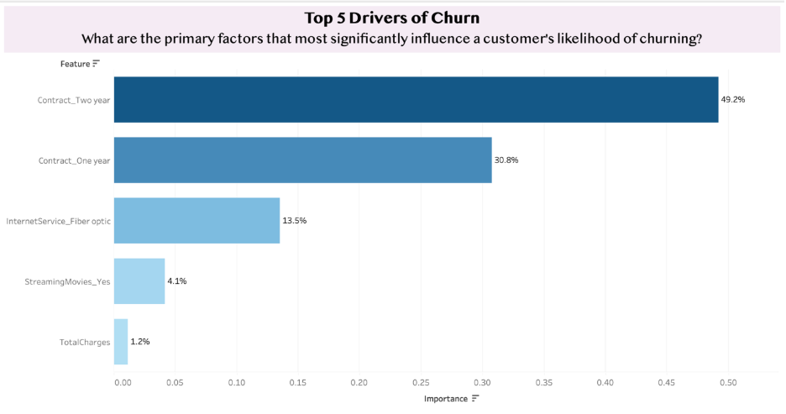
Feature Importance Analysis
Contract_Two year: 49.2% of model power
Contract_One year: 30.8%
InternetService_Fiber optics: 13.5% (signals potential quality issues)
StreamingMovies: 4.1%; TotalCharges: 1.2%

Slide 14
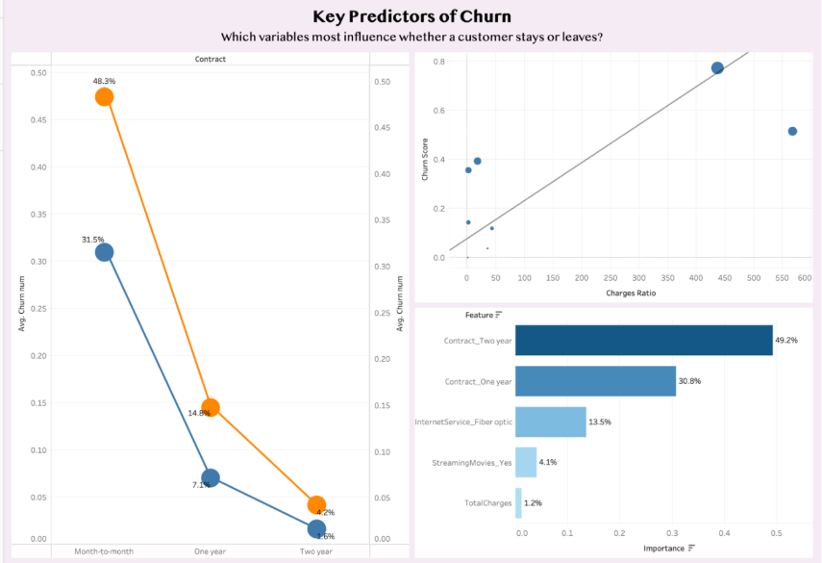
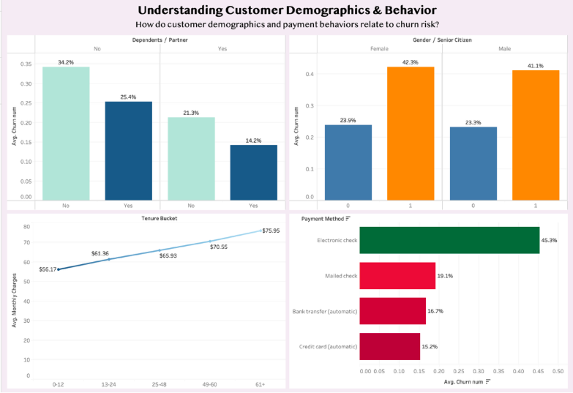
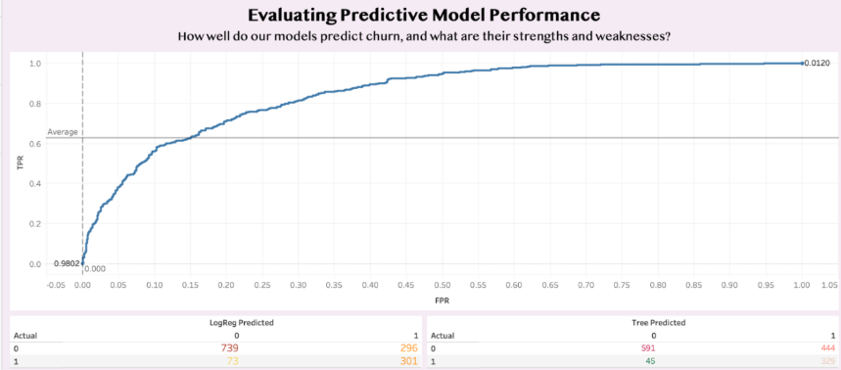
Interactive Dashboard Highlights
Dynamic filters: churn risk score, tenure, contract, payment method
High-risk cohort: month-to-month + fiber + electronic check + tenure <12 mo → 45–50% churn

Slide 15
Limitations
Data Constraints
Simulated dataset may not mirror real‑world complexity
Excludes external drivers such as seasonality, competitive activity, and macroeconomic trends
Modeling Challenges
Decision Tree exhibited overfitting (high false positives)
Narrow feature set — lacking behavioral metrics and customer service interactions
Scope Boundaries
Focus limited to churn prediction; no analysis of upsell/downgrade patterns
Assumes customer preferences remain constant over time

Slide 16
Recommendations for Implementation
Immediate Actions:
Tiered contract incentives (10–20% discounts + perks)
Auto-payment migration program with $5–10 credits + signup bonus
Embed churn-risk scoring in CRM for real-time alerts
Strategic Initiative: Fiber service satisfaction program: surveys, ticket analysis, infrastructure upgrades

Slide 17
Business Impact & Strategic Implications
Financial:
Contract incentives can slash churn from 40% to <15%
Auto-pay migration could cut churn among check users by 60%
Operational:
Investigate fiber service quality (high churn despite premium pricing)
Tailor retention for senior demographic & paperless billing users

Slide 18
Future Research Directions
Ensemble models (Random Forest, GBM), neural networks for deeper patterns
Time-series analytics to capture seasonality and churn timing
Integrate Customer Lifetime Value into retention prioritization
Enrich dataset: support tickets, usage logs, competitive intelligence
A/B test framework for retention tactics and pricing experiments

Slide 19
Conclusion & Next Steps
Data-driven insights transform churn from reactive pain into strategic advantage
Contract terms dominate churn decisions; payment & service quality follow
Next: pilot recommended interventions, deploy logistic model in CRM

Slide 20
Q&A / Feedback
What resonates most with your current retention challenges?
Any concerns on data assumptions or model deployment?
Suggestions for additional analyses or focus areas?
Thank you—your feedback will refine our next steps!

