Slide 1
IBM University Engagement Project Submission
“Exploring the Power of Agentic AI with IBM Granite and IBM Bob”

Slide 2

Project Tile – [Interview Trainer Agent]
Domain of Project – [Education + Artificial Intelligence]
Student Name | Recent Passport Photo | Email ID | Mobile number [WhatsApp]
Shayna Sharma |  | sharmashayna687@gmail.com | 7018332404

Slide 3
Problem Statement -
Problem Statement : AI Interview Trainer
The Challenge
Preparing for technical interviews can be difficult due to limited personalized practice, generic question banks, and lack of immediate feedback. Candidates often struggle to identify weaknesses in their answers and improve their interview performance without proper guidance.
The Objective
Build an AI-powered Interview Trainer that provides personalized interview practice, intelligent question generation, and automated feedback based on the candidate's selected role. The solution should:
• Role-Based Questions – Generate relevant interview questions based on the selected job role and difficulty level.
• AI Question Generation – Use IBM Granite to dynamically generate contextual and role-specific interview questions.
• Answer Evaluation & Scoring – Analyze candidate answers and provide scores, strengths, feedback, and areas for improvement.
• Adaptive Interview Flow – Generate the next relevant question based on the ongoing interview and selected role.
• Performance Report – Provide an overall summary of interview performance and highlight areas that require improvement.

Slide 4
Proposed Solution -
Proposed Solution: AI-Powered Interview Trainer
The proposed solution is an AI-powered Interview Trainer designed to provide personalized and interactive interview practice. The system helps candidates prepare for interviews through intelligent question generation, automated evaluation, and continuous feedback.
Core Features
Personalized Interview Practice – Allows candidates to select their desired job role and difficulty level for targeted preparation.
Interview Question Generation – Generates relevant and contextual interview questions based on the selected role and interview requirements.
Answer Evaluation & Scoring – Analyzes candidate responses and provides scores, strengths, weaknesses, and actionable feedback.
Adaptive Interview Flow – Generates the next relevant question according to the selected role and ongoing interview context.
Continuous Feedback – Helps candidates understand their mistakes and identify areas requiring improvement throughout the interview.
Performance Report – Provides an overall summary of the candidate's interview performance and improvement areas.
Overall Outcome
The solution provides an end-to-end AI interview practice experience, helping candidates improve their technical preparation, answer quality, and interview performance through personalized practice and feedback.

Slide 5
Technology Used
• IBM Bob Platform – Used for AI-assisted application development, code generation, debugging, and refinement of the project.
• IBM Granite Model – Used for natural language understanding, question generation, reasoning, and answer evaluation.
• Flask / Python – Used to build the backend APIs and application logic, handling communication between the frontend and AI services.
• React.js – Used to develop the interactive and user-friendly frontend for conducting interview sessions and displaying results.
• IBM Cloud / IBM AI Services – Used to provide access to the IBM Granite AI capabilities required for intelligent interview processing.
• REST APIs – Used for communication between the React frontend and Flask backend.
• Environment Configuration (.env) – Used to securely manage API credentials and sensitive configuration without exposing them in the application code.

Slide 6
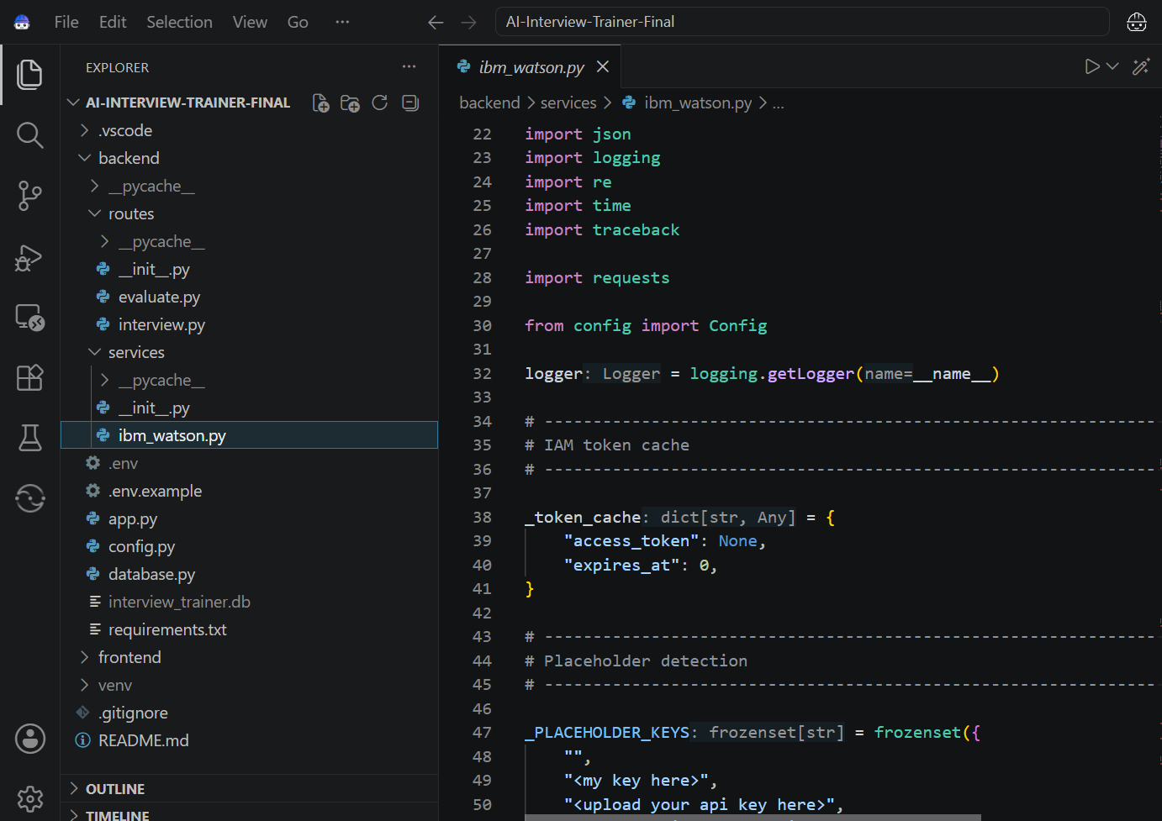
Required Files created using IBM bob -

Slide 7
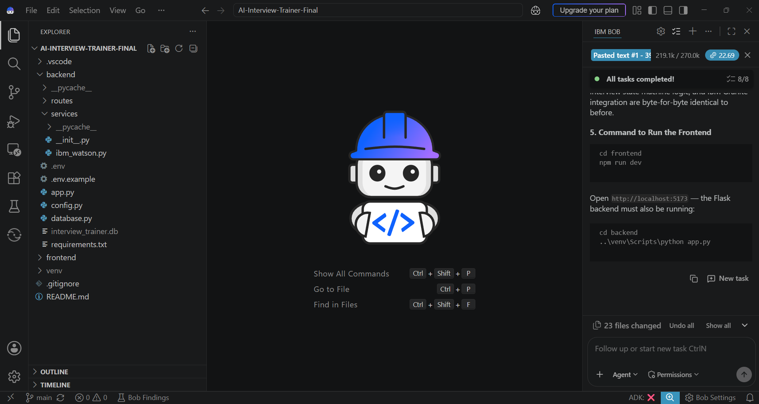
IBM Bob Screenshots:

Slide 8
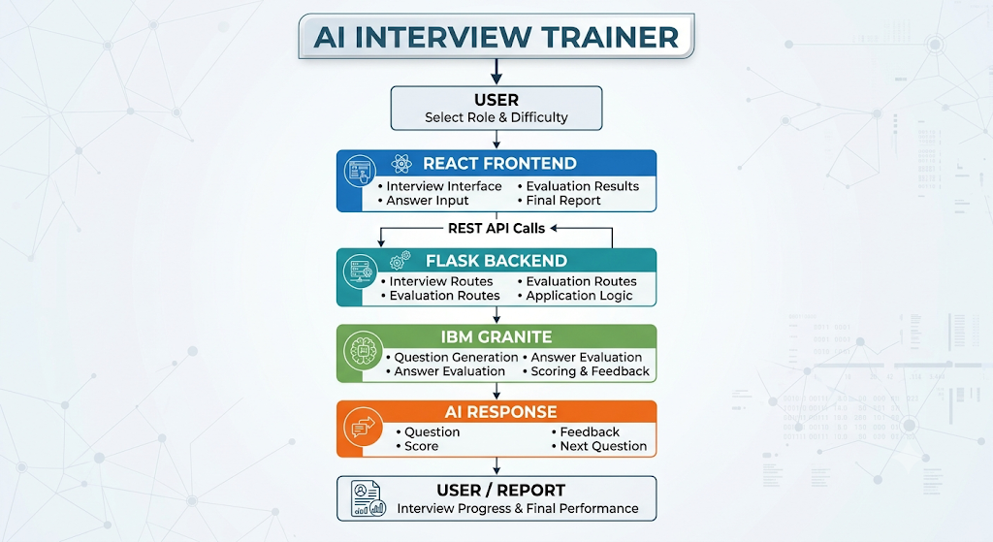
How my system work:-

Slide 9
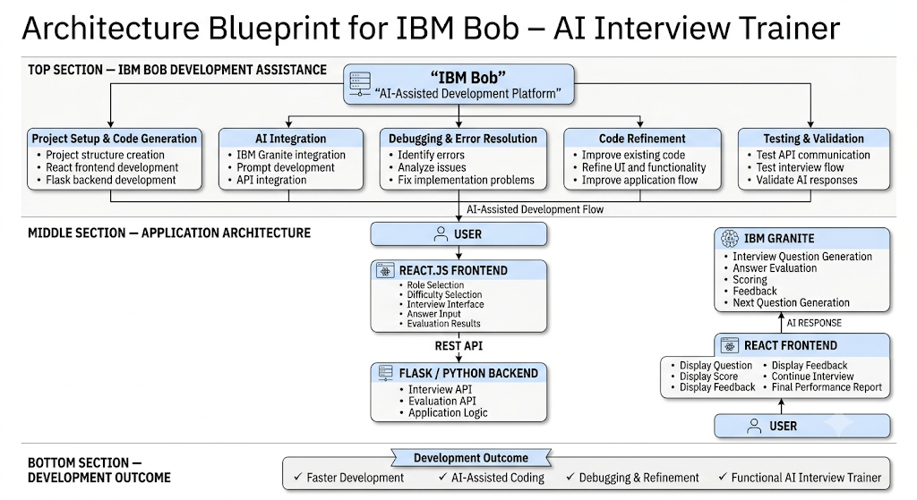

Slide 10

Role of Agentic AI in the solution
Role of Agentic AI in AI Interview Trainer
Agentic AI enables the AI Interview Trainer to function as an intelligent and interactive interview system rather than a simple question-answer application. Using IBM Granite models, the system can understand the selected job role and interview context to generate relevant questions and evaluate candidate responses.
The AI performs multiple tasks throughout the interview—such as generating interview questions, analyzing answers, assigning scores, providing feedback, and generating the next relevant question. These tasks work together to create a continuous and personalized interview experience.
Agentic AI also provides context awareness, allowing the system to consider factors such as the candidate's selected role, difficulty level, previous questions, and answers while continuing the interview.
It supports dynamic adaptation, where the next question can be generated according to the ongoing interview context instead of following a fixed set of questions.
Overall, Agentic AI makes the Interview Trainer more interactive, adaptive, personalized, and goal-driven, helping candidates practice realistic interviews and understand their strengths and areas for improvement through AI-powered feedback.

Slide 11
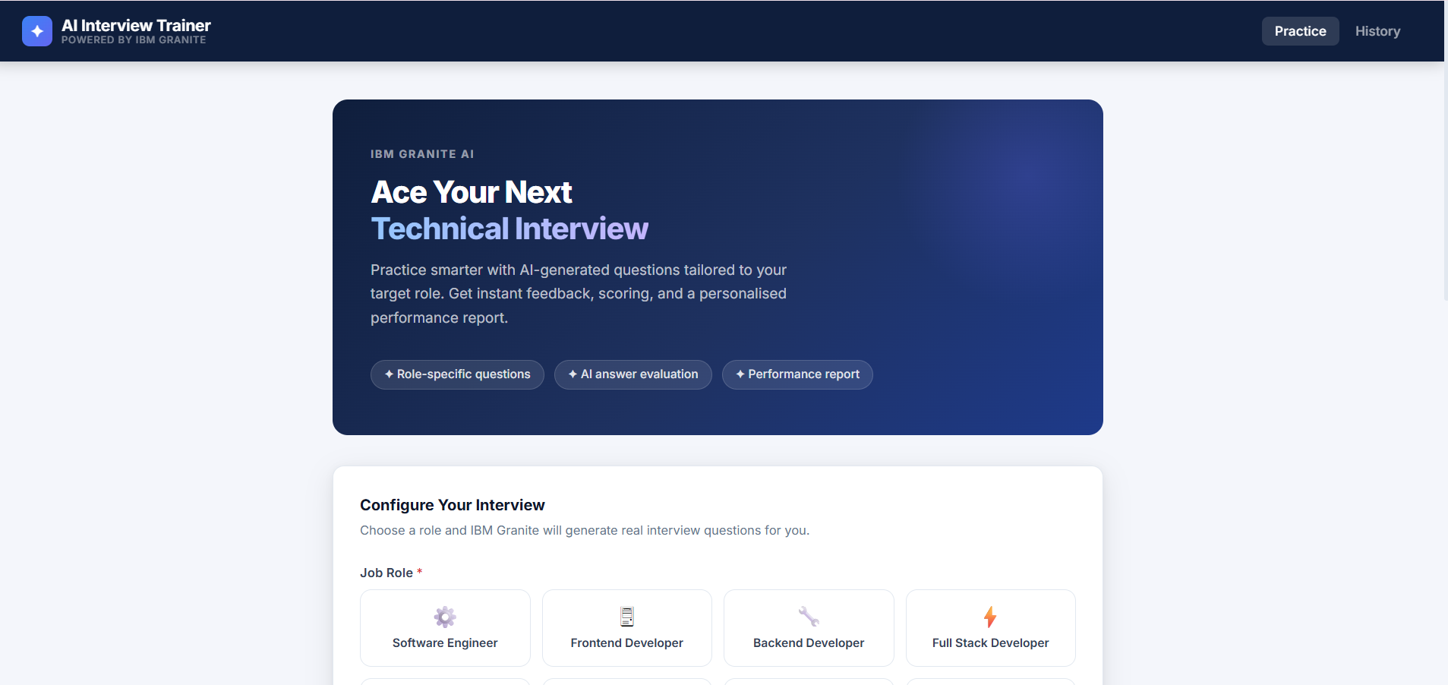
Project Output Screenshot
·
·
·

Slide 12
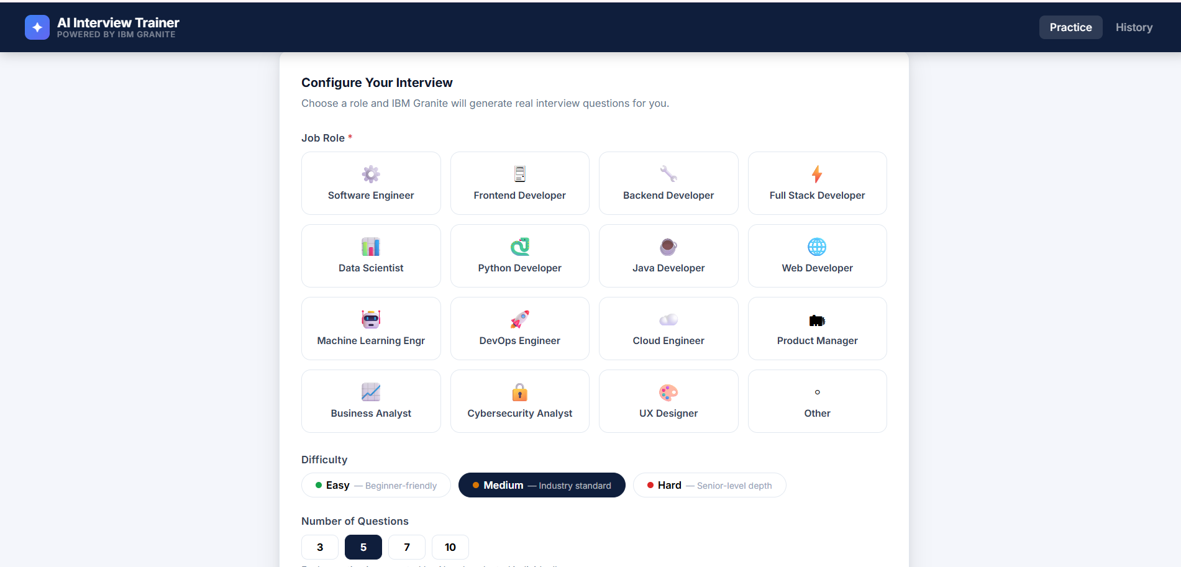

Slide 13
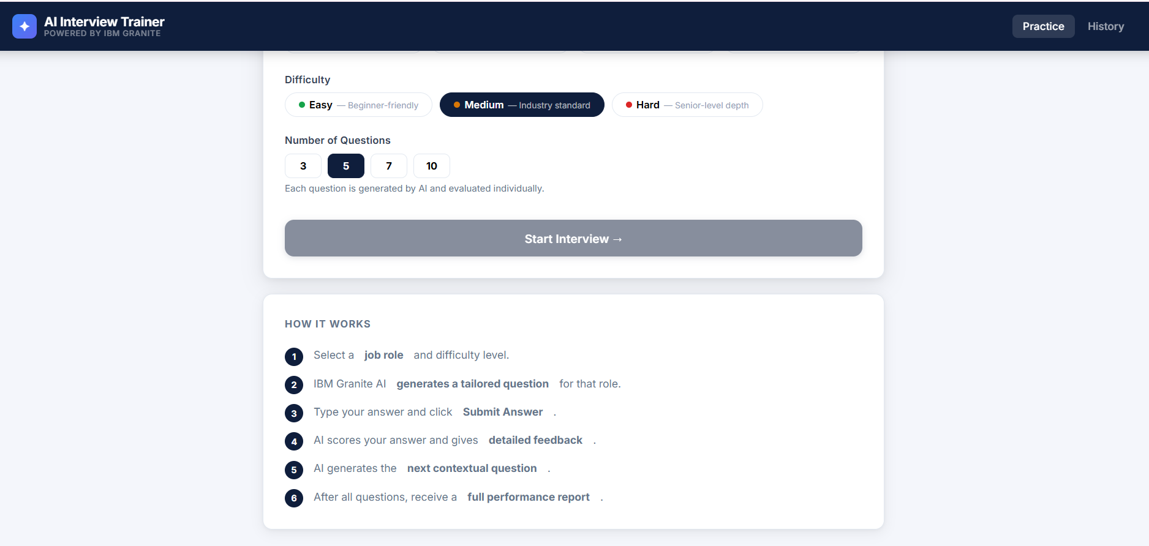

Slide 14
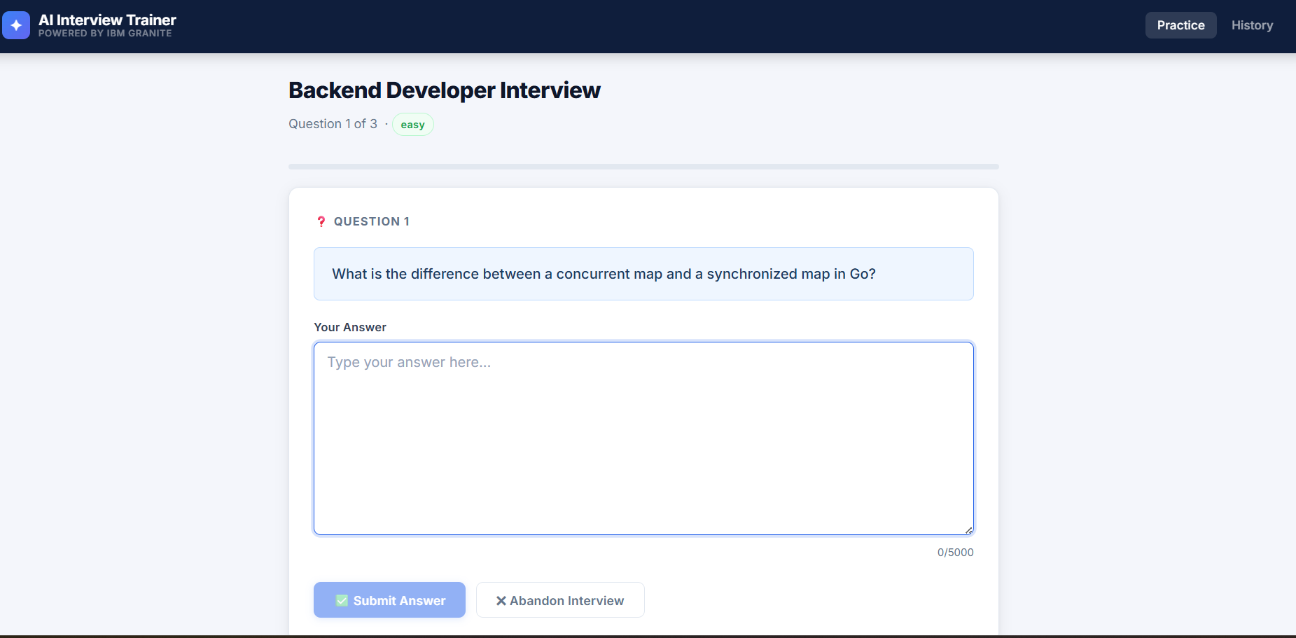

Slide 15
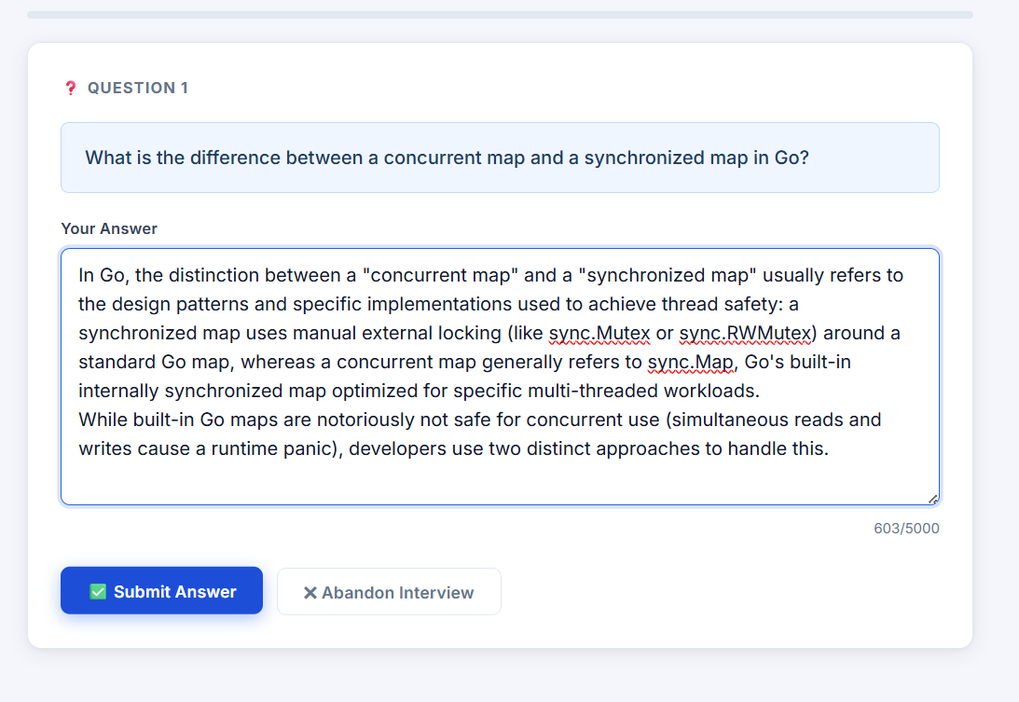

Slide 16
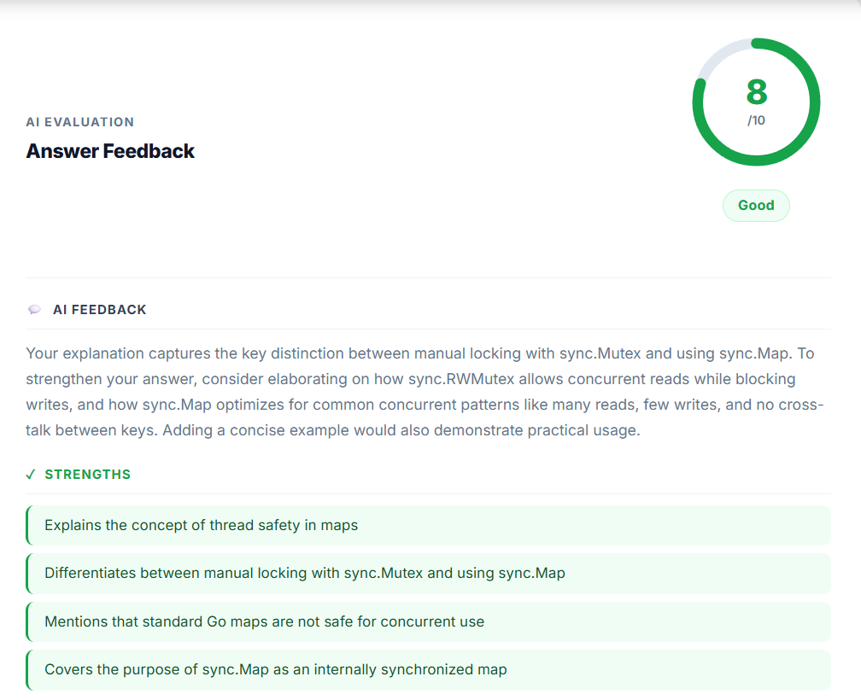

Slide 17
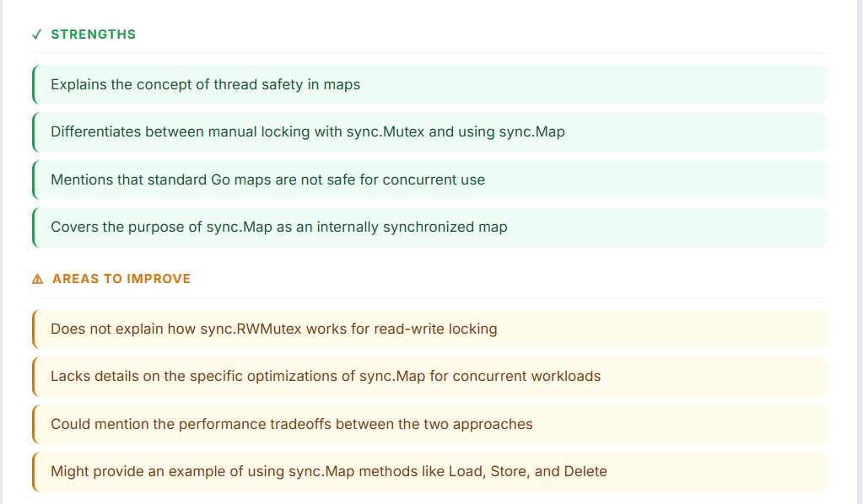

Slide 18
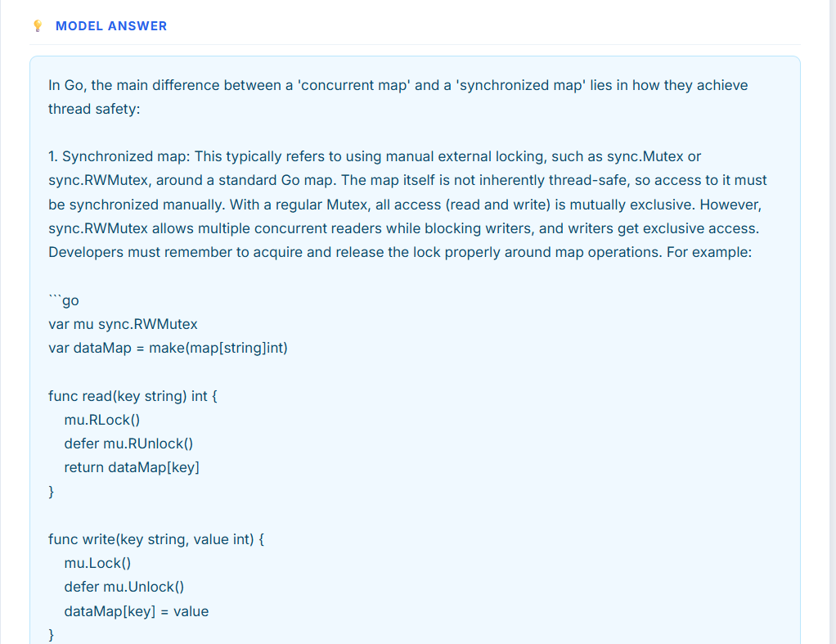

Slide 19
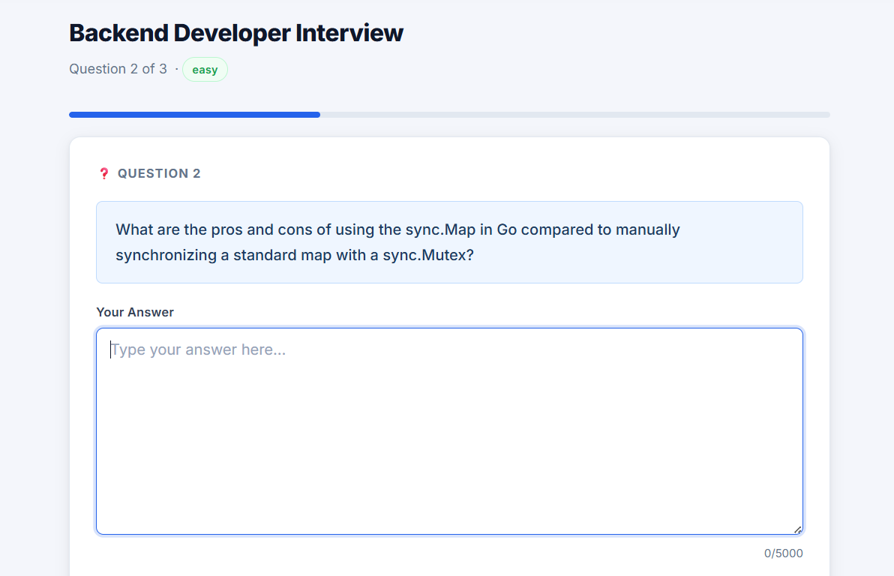

Slide 20
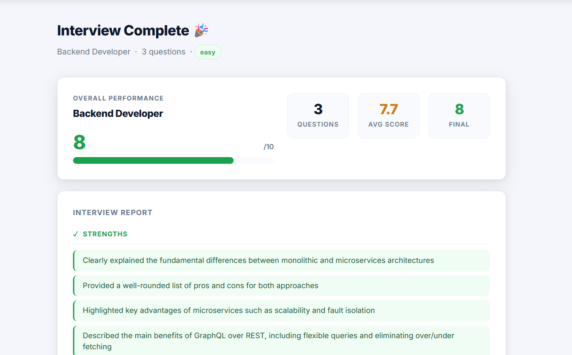
Final Result:

Slide 21
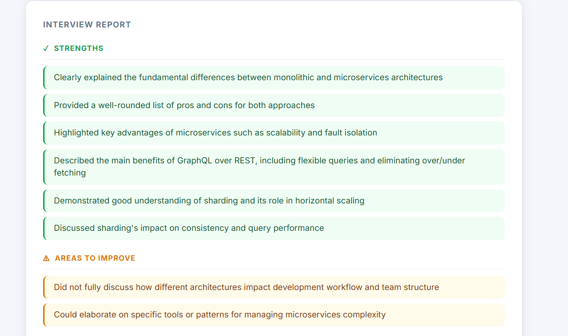

Slide 22
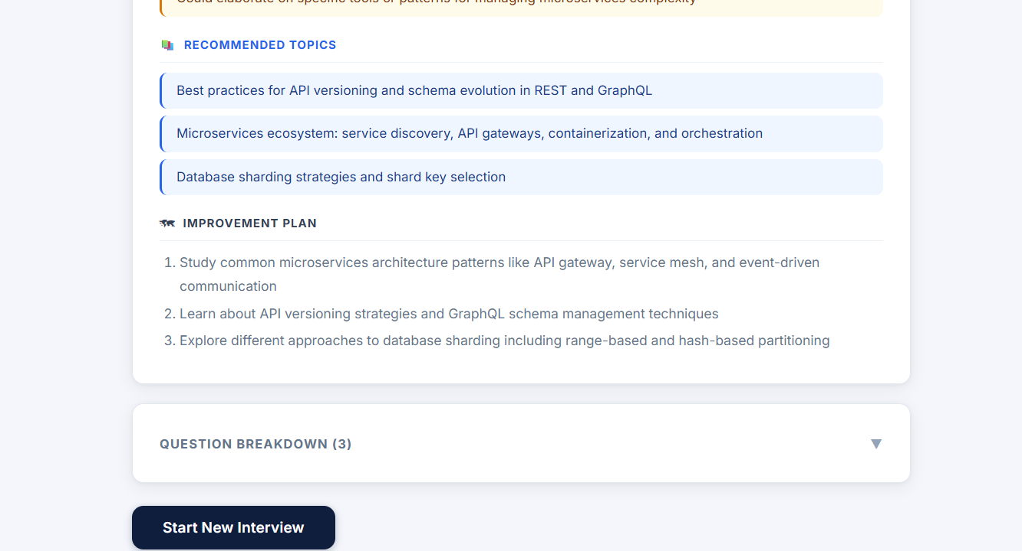

Slide 23
Novelty and Uniqueness
The proposed AI Interview Trainer stands out by combining Agentic AI, contextual understanding, and personalized interview evaluation into a single intelligent system.
Role-Based Intelligence – Generates interview questions according to the candidate’s selected job role and difficulty level, ensuring relevant and targeted practice.
AI-Powered Question Generation – Uses IBM Granite to dynamically generate interview questions instead of relying only on a fixed question bank.
Intelligent Answer Evaluation – Analyzes candidate responses and provides scores, strengths, weaknesses, and actionable feedback to help improve answer quality.
Context-Aware Interview Flow – Uses the ongoing interview context, including the role, previous questions, and candidate responses, to maintain a relevant interview experience.
Adaptive Questioning – Dynamically generates the next relevant question based on the ongoing interview rather than following a completely predefined sequence.
Personalized Feedback – Provides candidate-specific feedback that highlights areas of improvement and interview performance.
End-to-End Interview Experience – Combines question generation, answer evaluation, scoring, feedback, and final performance reporting into one continuous workflow.
AI-Assisted Development with IBM Bob – IBM Bob supports the development process through code generation, debugging, refinement, and application improvement.
This makes the solution a smart, adaptive, and personalized AI interview coach, rather than a static question-and-answer practice tool.

Slide 24
Git Hub Link
https://github.com/Shayna-Sharma/AI-Interview-Trainer
·
·
·

Slide 25
Future Scope
1. Voice-Based Interview & Speech Analysis – The system can be enhanced with voice-based interview interaction, allowing candidates to answer questions verbally instead of only through text. Future versions can analyze speech characteristics such as clarity, fluency, and confidence, providing additional feedback to improve overall interview communication.
2. Advanced Personalized & Adaptive Interviews – The system can be extended to provide more deeply personalized interview sessions by considering the candidate’s previous performance, strengths, weaknesses, and selected job role. The AI can dynamically adjust question difficulty and topics based on the candidate’s responses, creating a more realistic and adaptive interview experience.
·
·
·

Slide 26
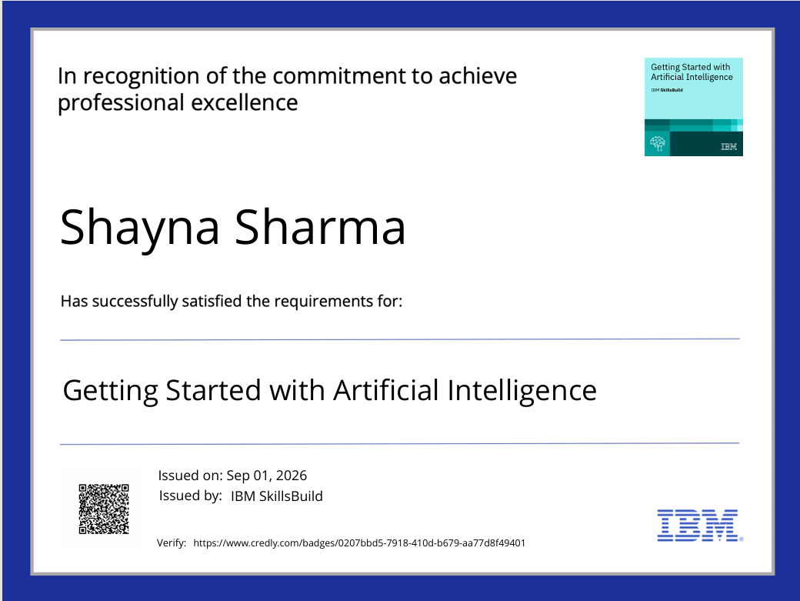
Certificates Earned:
Getting Started with Artificial Intelligence

Slide 27

Certificates Earned: Getting Started with Cybersecurity

Slide 28
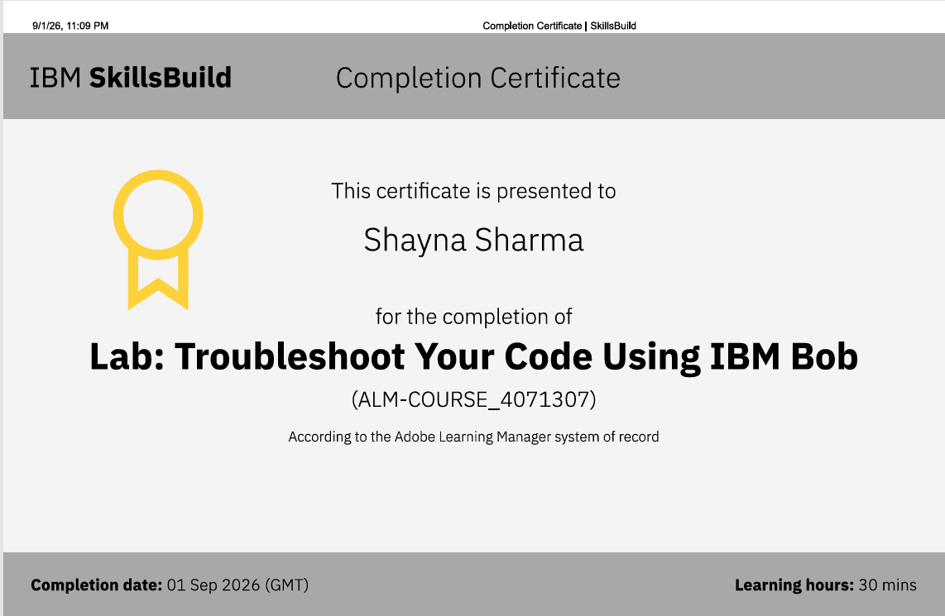
Certificates Earned:​
IBM BOB Certificate

Slide 29


