Slide 1
SIGCompete Session 3
Recursion and Basic Data Types

Slide 2
Session Outline
Teaching Session 14:00-15:00
Recursion, backtracking and brute force
Stack
Queue
List
Map
Set
Mini Contest 15:00-16:30
Contest Solutions 16:30-17:00

Slide 3
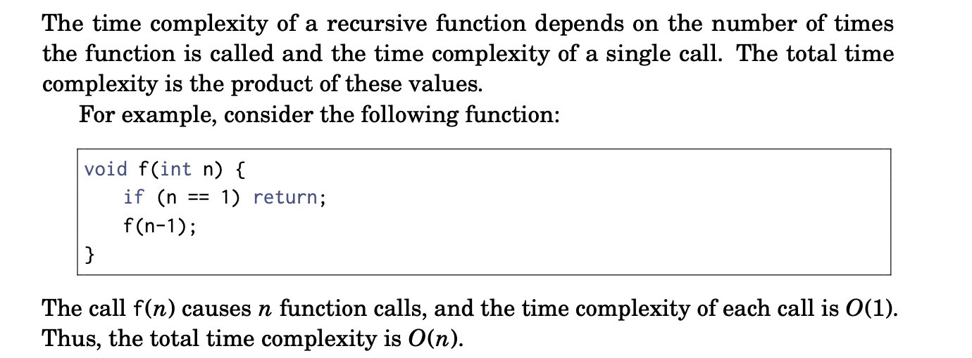
Recursion

Slide 4
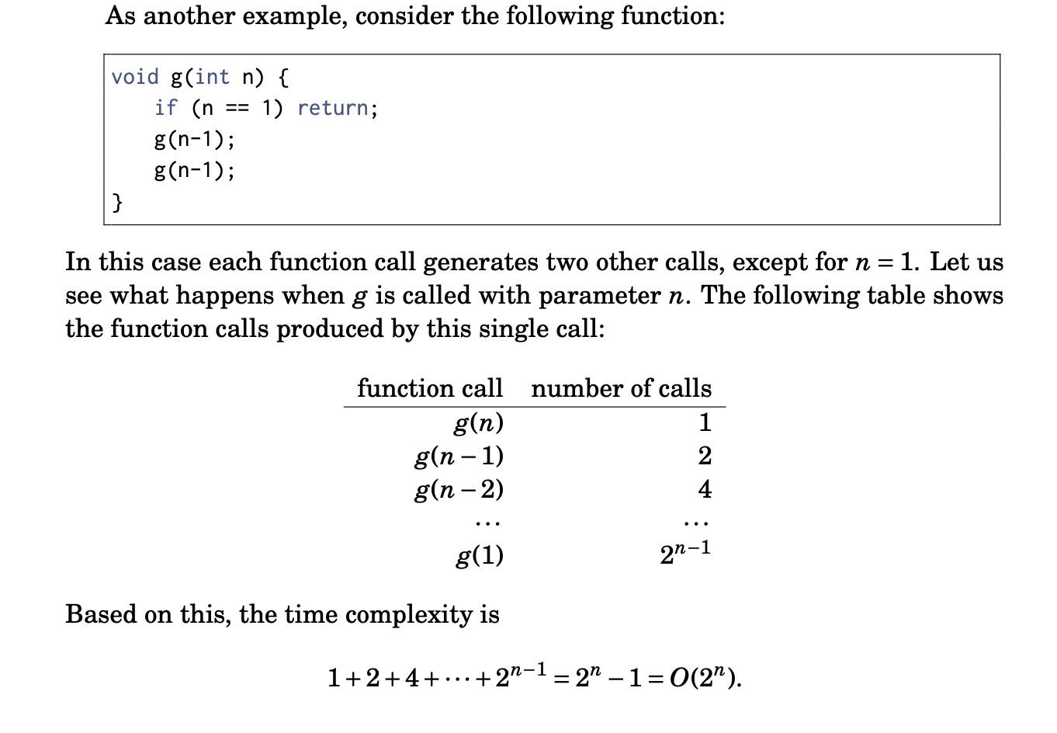

Slide 5
Brute Force
Attempts to try out every possible solution or option in order to arrive at a correct solution
Example:
Trying out all possible values of variables to satisfy a system of equations
Finding a combination of values in an array that add up to a sum by trying out all permutations
Linear search through an array
In theory, always works, BUT
Has the worst time complexity and only works for small inputs
I.e. to be able to finish within the given time limit

Slide 6
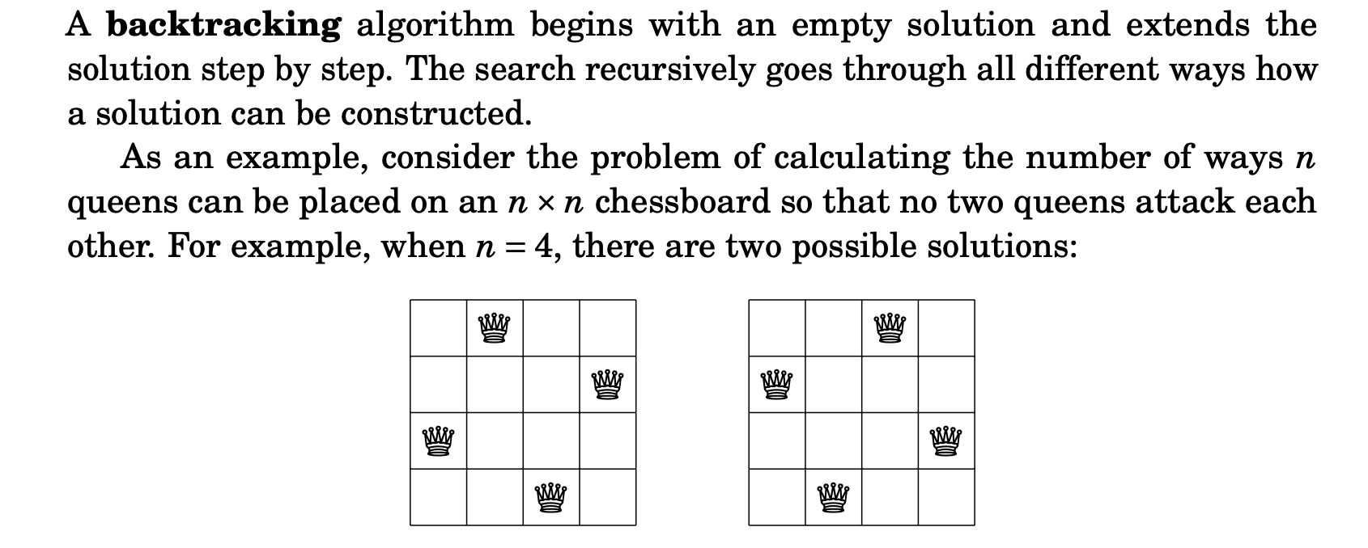
Backtracking
Notes:
The problem can be solved using backtracking by placing queens to the board row by row. More precisely, exactly one queen will be placed on each row so that no queen attacks any of the queens placed before. A solution has been found when all n queens have been placed on the board.

Slide 7
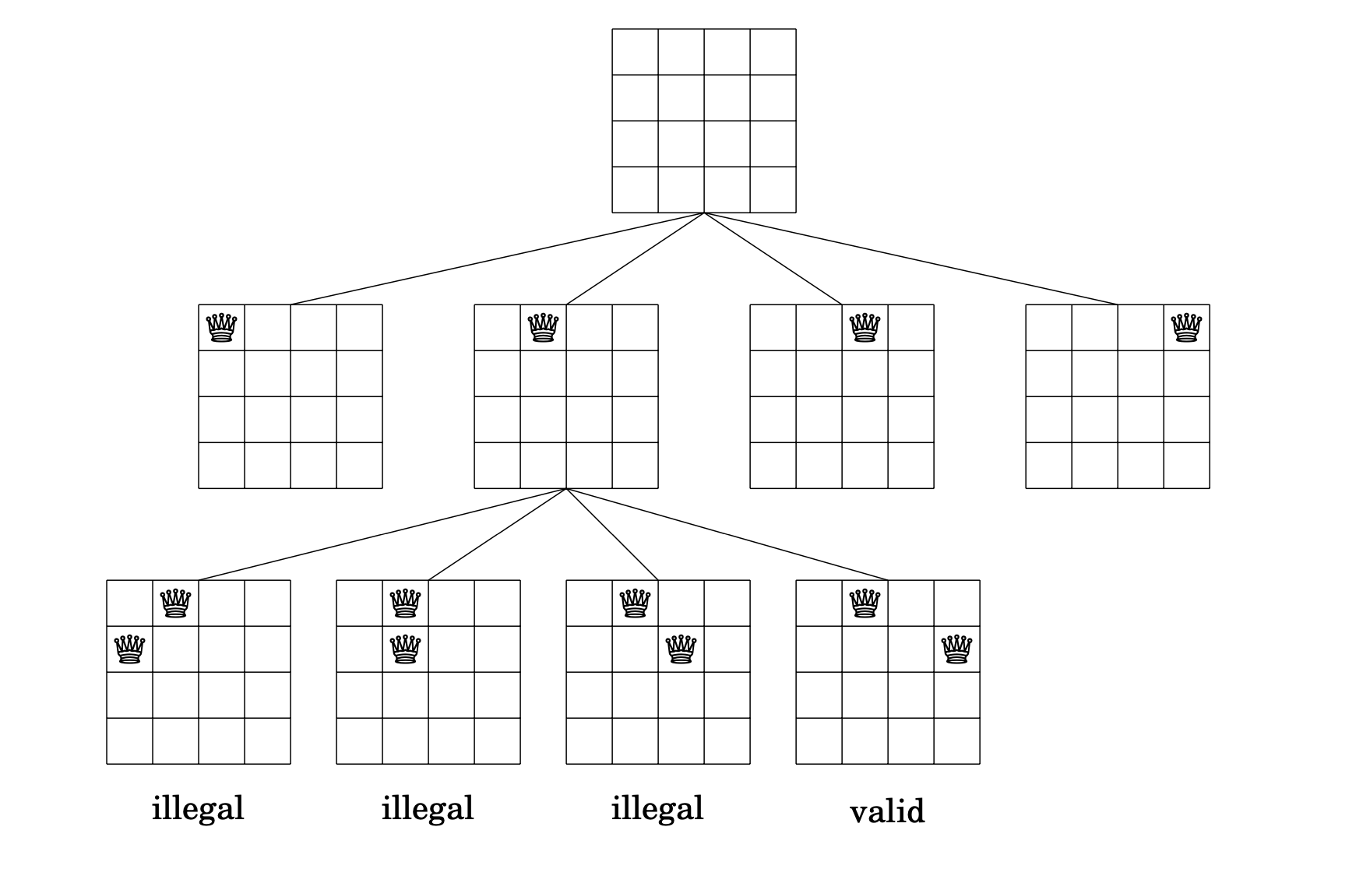
Notes:
At the bottom level, the three first configurations are illegal, because the queens attack each other. However, the fourth configuration is valid and it can be extended to a complete solution by placing two more queens to the board. There is only one way to place the two remaining queens.

Slide 8
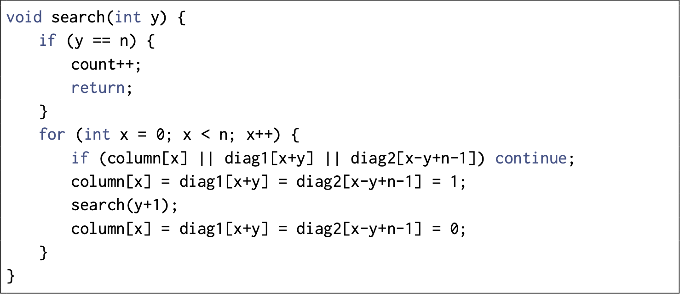
Sample Solution Using Backtracking (C++)

Slide 9
Other Problems Solvable by Backtracking & Recursion
Sudoku
Permutations of a String/Array
Subset Sum

Slide 10
Brute Force vs Backtracking
Brute force explores all possible options, without any regard for optimization
There are optimizations that can be used for backtracking (will cover later)
Backtracking typically involves recursion
Brute force is best suited for small input sizes or problems where a solution is easy to verify but difficult to compute.
Backtracking is suited for constraint satisfaction problems and situations where we need to explore multiple possibilities but can identify invalid solutions early.

Slide 11
Stackoverflow Error
Occurs when a recursive function keeps on calling itself and never returns
Indicates a logical error in your code
Could also be triggered by memory constraints
Each function call creates a stack frame, when number of created stacks frames exceed the memory designated to stack frames, this error is triggered
That is why even if a recursive algorithm has the same runtime complexity as a linear algorithm, the latter is usually preferred

Slide 12
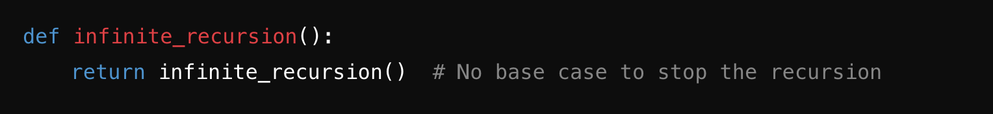
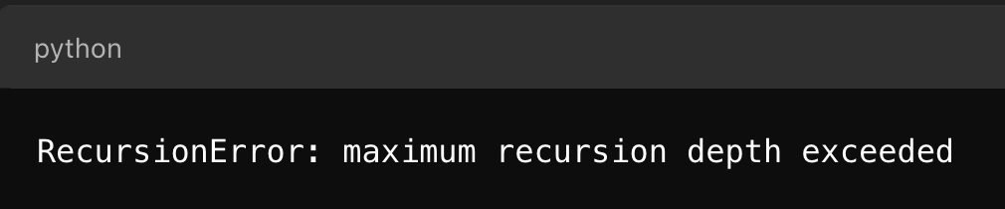
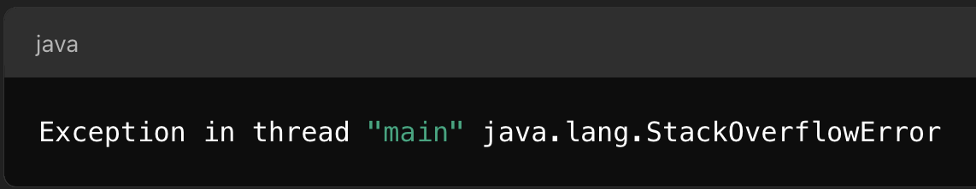
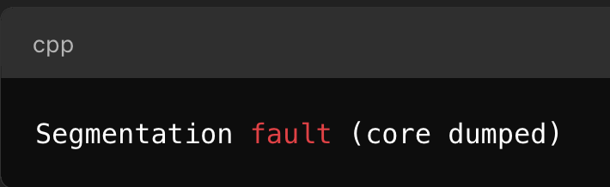
StackOverflow Error

Slide 13
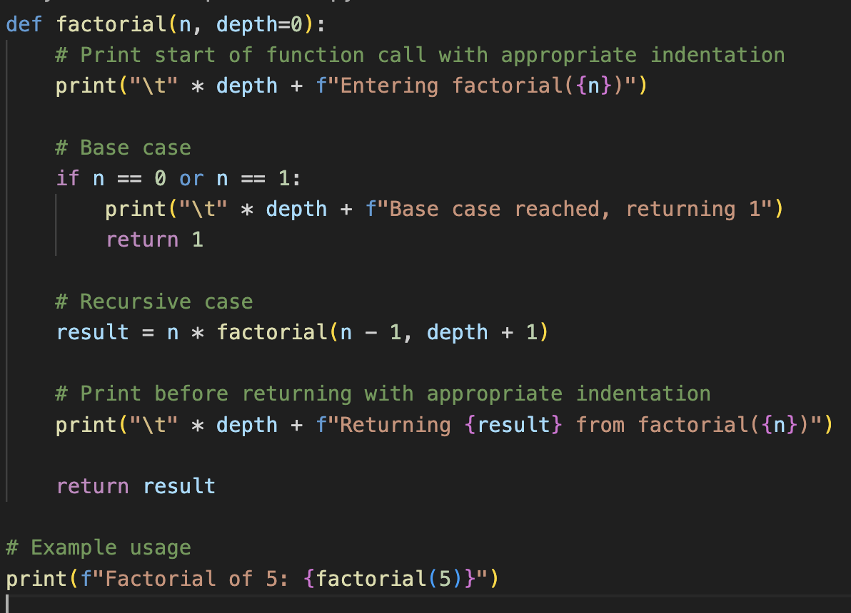
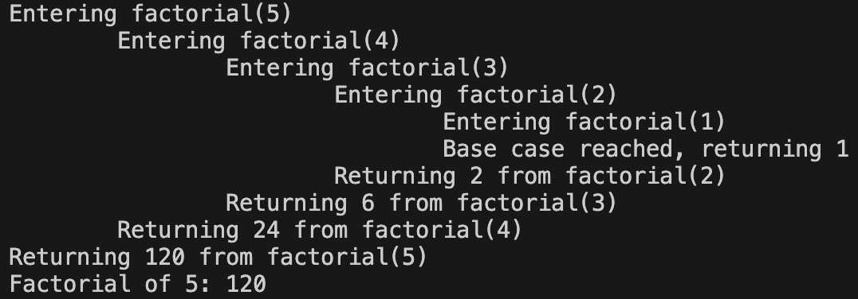
Debugging Recursion
It’s often useful to print stack trace in recursive calls to help analyze/debug your algorithm

Slide 14
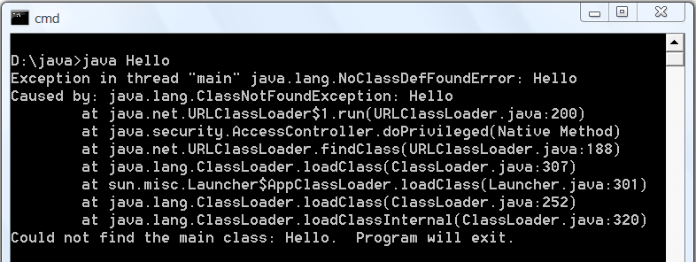
Stack
you’ve probably seen it before!
example stack trace

Slide 15
Stack and Queue
In a stack, the element deleted from the set is the one most recently inserted: the stack implements a last-in, first-out, or LIFO, policy.
In a queue, the element deleted is always the one that has been in the set for the longest time: the queue implements a first-in, first-out, or FIFO, policy.
Both of them can be implemented to have O(n) space complexity and O(1) speed for element insertion and removal.

Slide 16
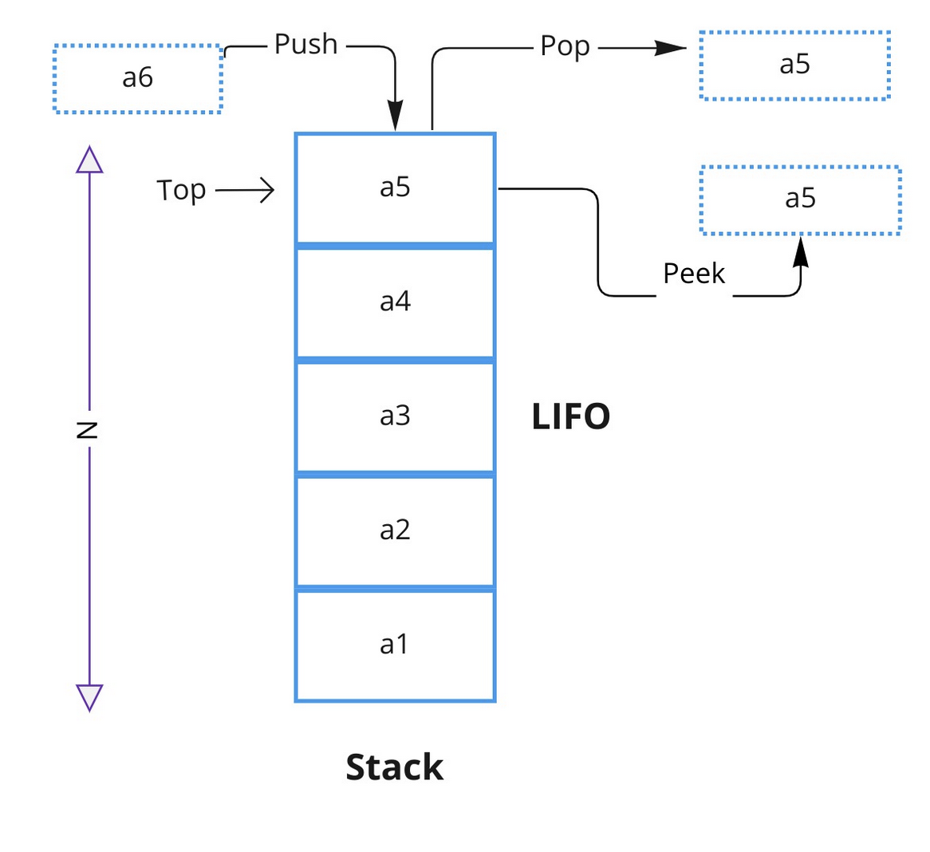
Stack
Last in, first out (LIFO)
Push, pop, peek, size
Matching parenthesis
Function calls
Backtracking
Reversing a list
Expression evaluation

Slide 17
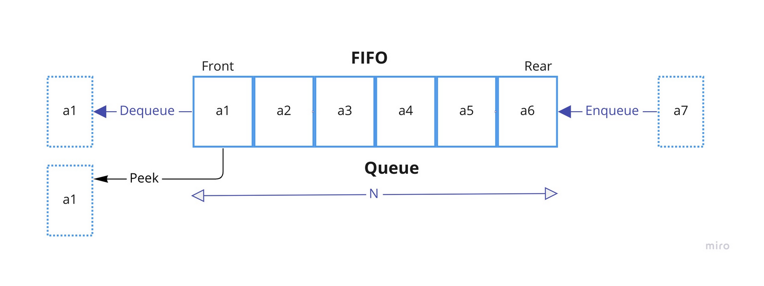
Queue
First in, first out (FIFO)
Has a head and tail
Elements get added to the tail
Enqueue, dequeue, size
Task scheduling
Waiting list for shared resources
BFS, Sliding window min/max, Topological Sort

Slide 18
Dynamic List
Implemented using static arrays
Added ability to grow and shrink in size
Supports all array operations and insert, delete, append
Access: O(1) supports random access
Append: O(1) amortized, O(n) worst case
Insertion/Deletion at position k has amortized time complexity of O(n - k), worst case O(n)
Generally static arrays are preferred over dynamic list for performance reasons

Slide 19
Dynamic List
C++: std::vector
Java: ArrayList
Python: list
It’s generally helpful to declare the size of the array when initializing it, as subsequent append operations will trigger resizing the array to twice the size each time the size capacity is reached.

Slide 20
Linked List
A list like structure
Does not support reference by index(random access)
Each element is stored in a node object
A chain of nodes with reference to the next node form the linked list
Traversal takes O(n) time, however, insertion and deletion can be faster than a dynamic list

Slide 21
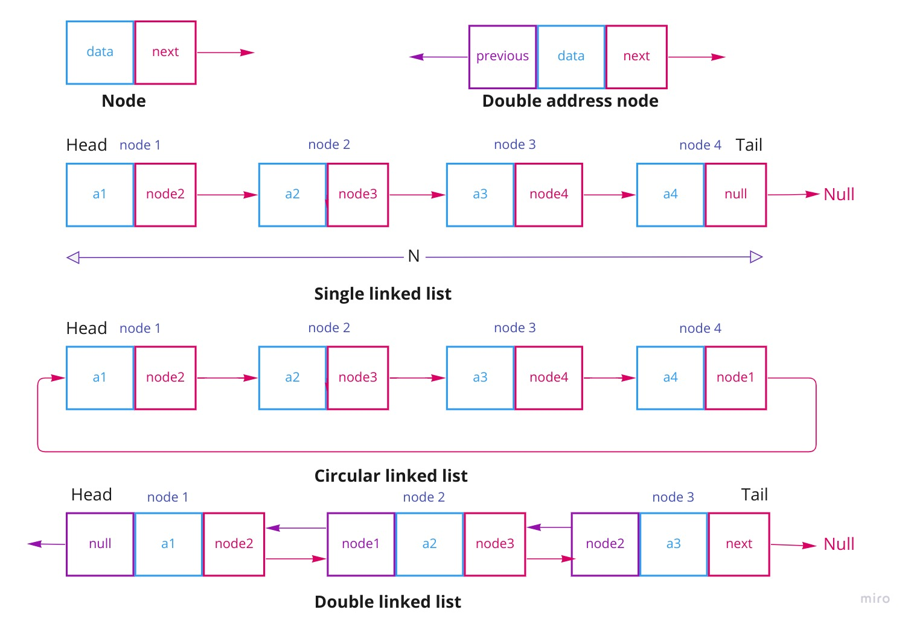
Linked List

Slide 22
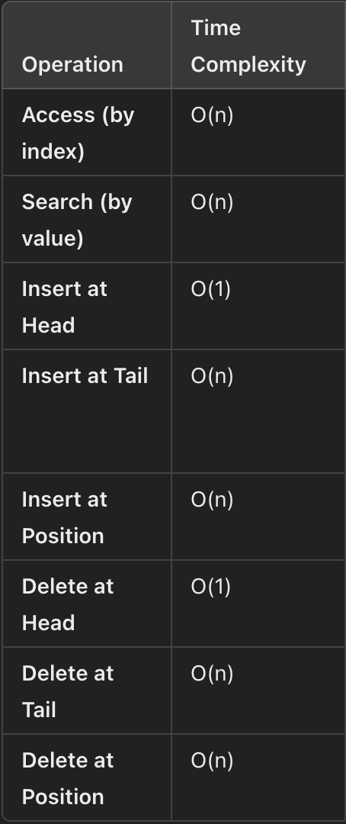
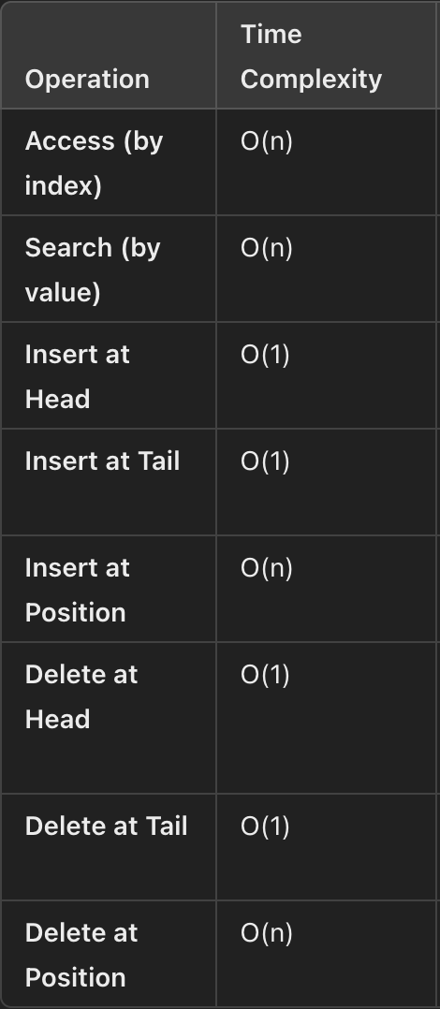
Linked List
singly linked list
doubly linked list

Slide 23
Map
Abstract data type
Common implementation is hash table
A “dictionary” of key-value pairs
Supports add, remove, edit, and get operations on key-value pairs
Usually supports iteration over all key-value pairs, with no guarantee on its order

Slide 24
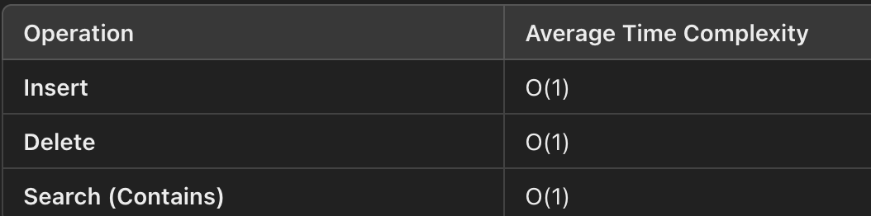
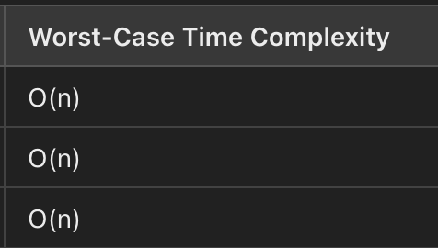
HashTable
Can be implemented using a static array of dynamic lists
Important factors are the hashing function, table size, bucket size, load factor
Hash collision will affect its efficiency

Slide 25
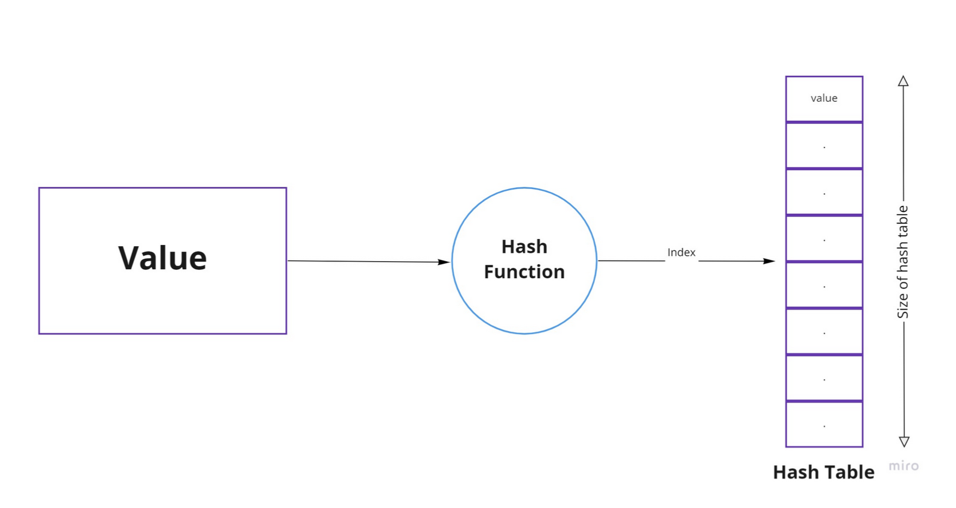
HashTable

Slide 26
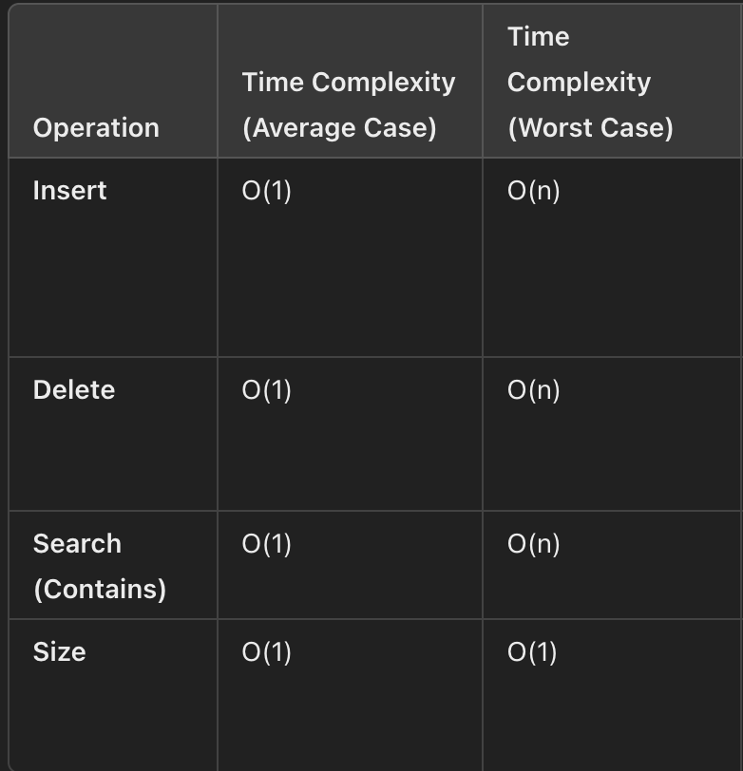
Set
Abstract data type with many different implementations
Only allows addition of unique elements
Useful for keeping track of presence of elements
Insert, delete, search/contains, size

Slide 27

Contest
7 problems
1h30min
On Virtual Judge

