Slide 1


Session 6: Intro to greedy algorithms
November 13th

Slide 2

Introducing greedy algorithms
Core principle of greedy algorithms
Common greedy algorithms problems
Online contest

Slide 3

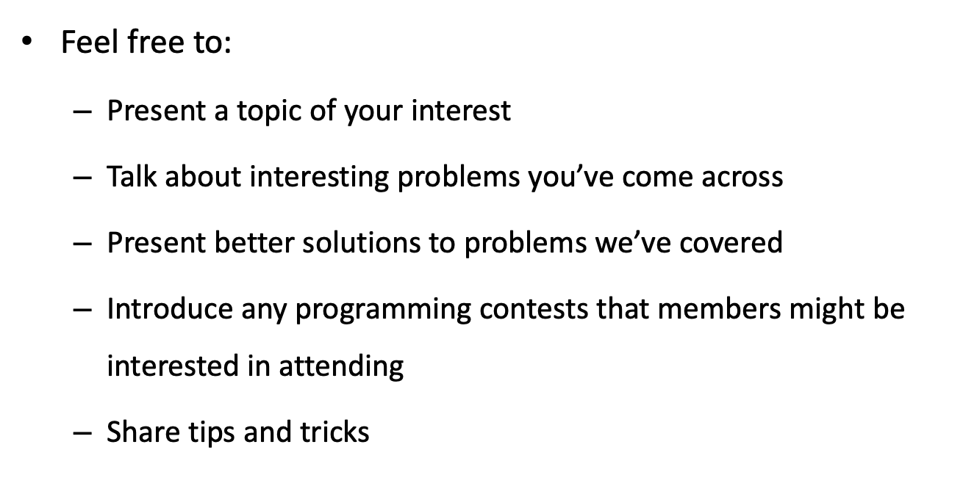

Slide 4
Greedy algorithms
A greedy algorithm constructs a solution to the problem by always making a choice that looks the best at the moment. A greedy algorithm never takes back its choices, but directly constructs the final solution. For this reason, greedy algorithms are usually very efficient.
Greedy does not refer to a single algorithm, but rather a way of thinking that is applied to problems; there's no one way to do greedy algorithms. Hence, we use a selection of well-known examples to help you understand the greedy paradigm.

Slide 5
Example problem (Coin problem)
Given a set of coins and our task is to form a sum of money n using the coins. The values of the coins are coins = {c₁, c₂,..., c_{k}}, and each coin can be used as many times as we want. What is the minimum number of coins needed.

Slide 6
Solution
A simple greedy algorithm to the problem always selects the largest possible coin, until the required sum of money has been constructed.
For example, if the coins are the euro coins (in cents) {1,2,5,10,20,50,100,200} and n = 520
we first select two 200 cent coins, then one 100 cent coin and finally one 20 cent coin

Slide 7
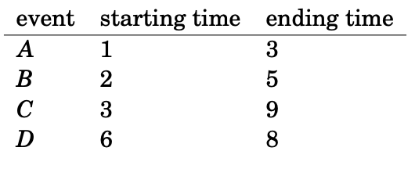
Scheduling problems
Many scheduling problems can be solved using greedy algorithms. A classic problem is as follows: Given n events with their starting and ending times, find a schedule that includes as many events as possible. It is not possible to select an event partially.

Slide 8
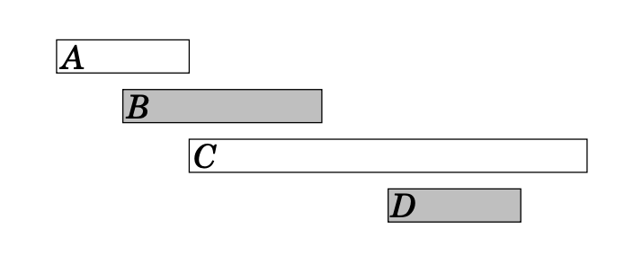
In this case the maximum number of events is two. For example, we can select events B and D as follows:

Slide 9
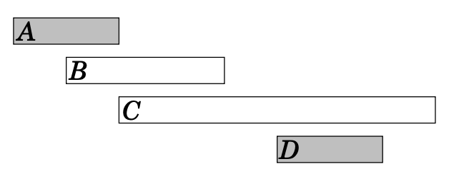
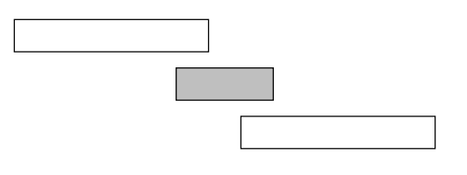
Algorithm 1
The first idea is to select as short events as possible. In the example case this algorithm selects the following events:
However, selecting short events is not always a correct strategy. For example, the algorithm fails in the following case:

Slide 10
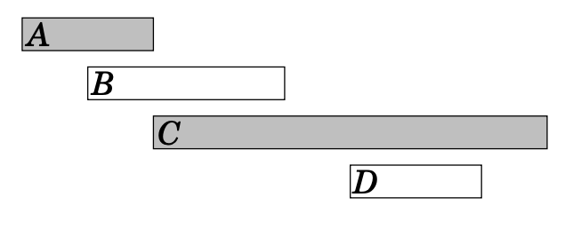
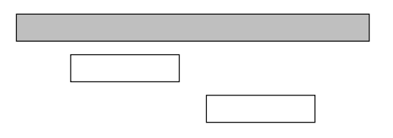
Algorithm 2
Another idea is to always select the next possible event that begins as early as possible. This algorithm selects the following events:
However, we can find a counterexample also for this algorithm. For example, in the following case, the algorithm only selects one event:

Slide 11
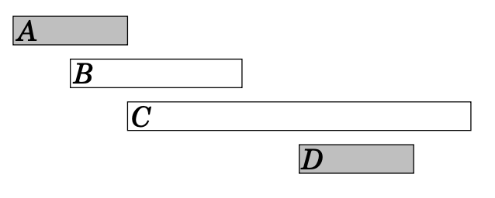
Algorithm 3 (Optimal)
The third idea is to always select the next possible event that ends as early as possible. This algorithm selects the following events:
It turns out that this algorithm always produces an optimal solution

Slide 12
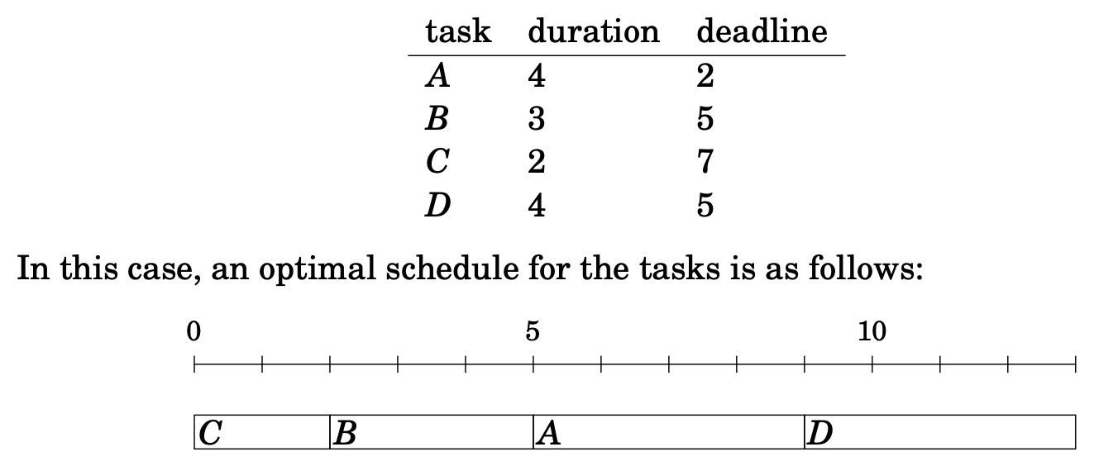
Tasks and deadlines
given n tasks with durations and deadlines and our task is to choose an order to perform the tasks. For each task, we earn d − x points where d is the task’s deadline and x is the moment when we finish the task. What is the largest possible total score we can obtain?

Slide 13

Minimizing sums
Given n numbers a₁,a₂,...,a_{n} and our task is to find a value x that minimizes the sum:
We focus on the cases c = 1 and c = 2

Slide 14

Case c = 1:
In this case, we should minimize the sum:
In the general case, the best choice for x is the median of the numbers.
The median is an optimal choice, because if x is smaller than the median, the sum becomes smaller by increasing x, and if x is larger than the median, the sum becomes smaller by decreasing x.
If n is even and there are two medians, both medians and all values between them are optimal choices.

Slide 15

Case c = 2:
In this case, we should minimize the sum:
By presenting the sum as follows:
This is a parabola opening upwards with roots x = 0 and x = 2s/n, and the minimum value is the average of the roots x = s/n, i.e., the average of the numbers a1,a2,...,an.

Slide 16
Problem
Farmer John ordered a specific sequence of cows (Holsteins 'H' and Guernseys 'G') represented by string A, but they arrived in a different order, represented by string B. To resolve this, his cousin Ben, a mad scientist, invented the multi-cow-breed-flipinator 3000. This device can take any substring of cows and toggle their breeds (H becomes G and G becomes H).
Goal: Determine the minimum number of flips needed using this device to transform B into A.

Slide 17
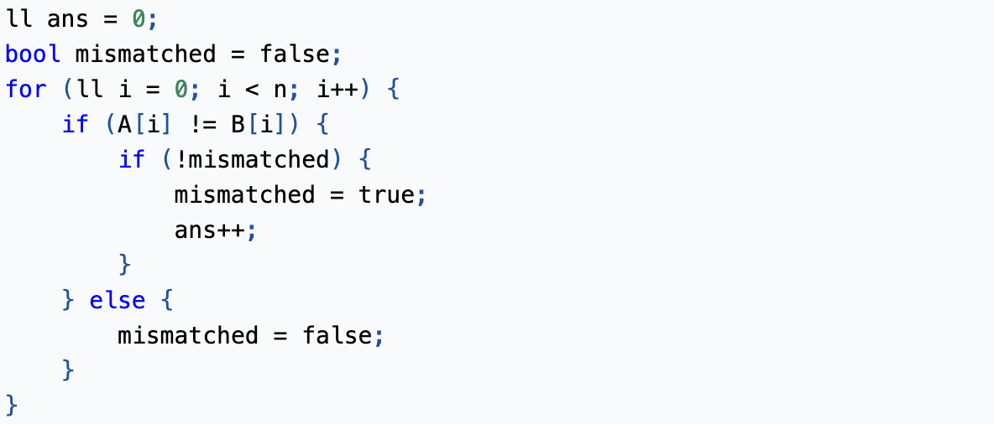

Slide 18
Knapsack problem (Fractional)
Given the weights and profits of N items, in the form of {profit, weight} put these items in a knapsack of capacity W to get the maximum total profit in the knapsack. In Fractional Knapsack, we can break items for maximizing the total value of the knapsack.
Input: arr[] = {{60, 10}, {100, 20}, {120, 30}}, W = 50 Output: 240 Explanation: By taking items of weight 10 and 20 kg and 2/3 fraction of 30 kg. Hence total price will be 60+100+(2/3)(120) = 240
Input: arr[] = {{500, 30}}, W = 10 Output: 166.667

Slide 19
Solution
The basic idea of the greedy approach is to calculate the ratio profit/weight for each item and sort the item on the basis of this ratio. Then take the item with the highest ratio and add them as much as we can (can be the whole element or a fraction of it).
This will always give the maximum profit because, in each step it adds an element such that this is the maximum possible profit for that much weight.

Slide 20
Sorting: Initially sort the array based on the profit/weight ratio. The sorted array will be {{60, 10}, {100, 20}, {120, 30}}.
Iteration:
For i = 0, weight = 10 which is less than W. So add this element in the knapsack. profit = 60 and remaining W = 50 – 10 = 40.
For i = 1, weight = 20 which is less than W. So add this element too. profit = 60 + 100 = 160 and remaining W = 40 – 20 = 20.
For i = 2, weight = 30 is greater than W. So add 20/30 fraction = 2/3 fraction of the element. Therefore profit = 2/3 * 120 + 160 = 80 + 160 = 240 and remaining W becomes 0.
So the final profit becomes 240 for W = 50.

Slide 21
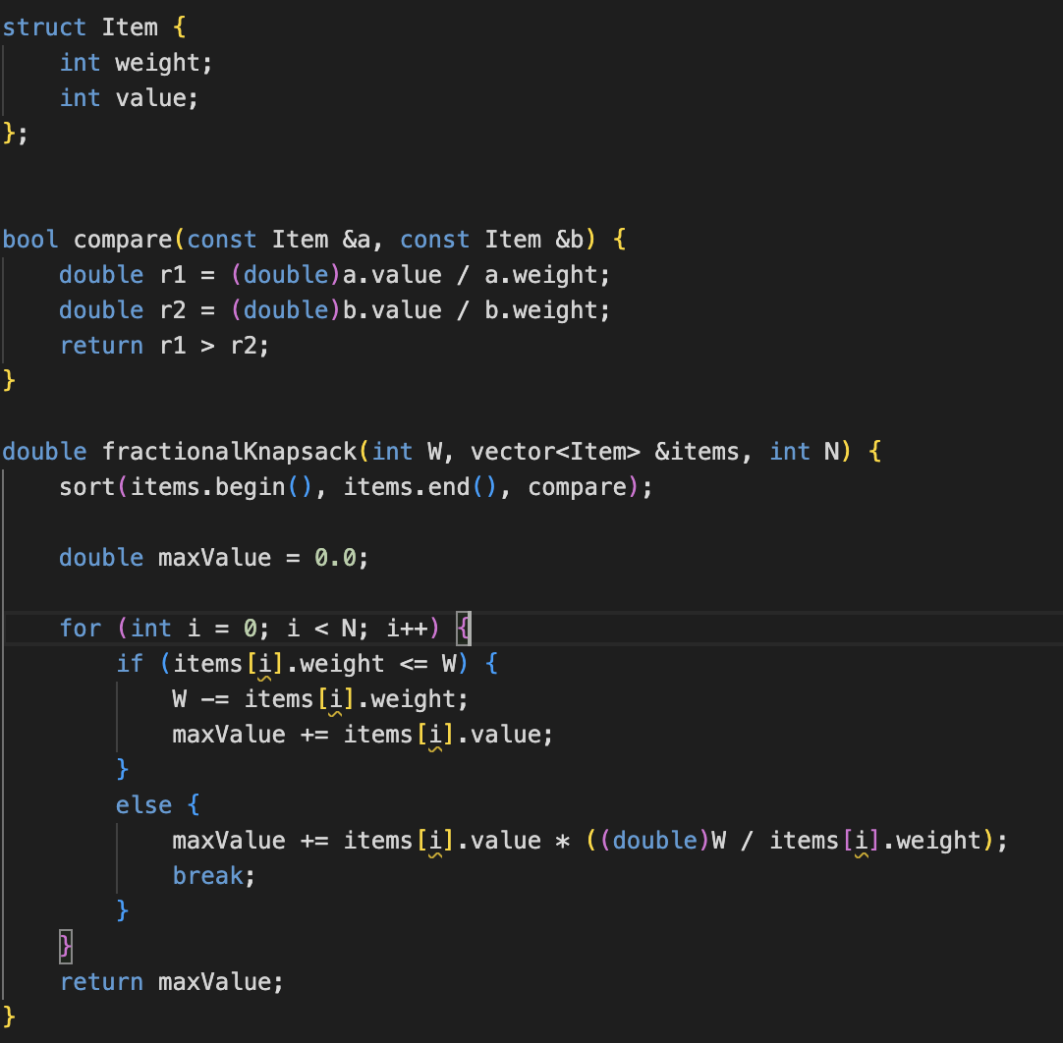

Slide 22
Thank you for attending our session!

