Slide 1

Welcome to SIGCompete
Special Interest Group for Competitive Programming

Slide 2
Session Outline
Intro & ICPC
Guided questions
CP Contest Taster
Vevox Poll
Icebreaking
Committee member meetup

Slide 3
What is Competitive Programming?
“Given well-known CS problems, solve them as quickly as possible!”
We deal with solved CS problems and produce working code that passes the author's test cases within a given time and memory limit.
Skills needed:
Programming Skills
Data structures and algorithms
Maths

Slide 4
What is SIGCompete?
foster and develop skills in competitive programming
a supportive environment
members can brainstorm, challenge each other, and continuously improve.
We aim to build a community that thrives on both individual growth and teamwork.

Slide 5
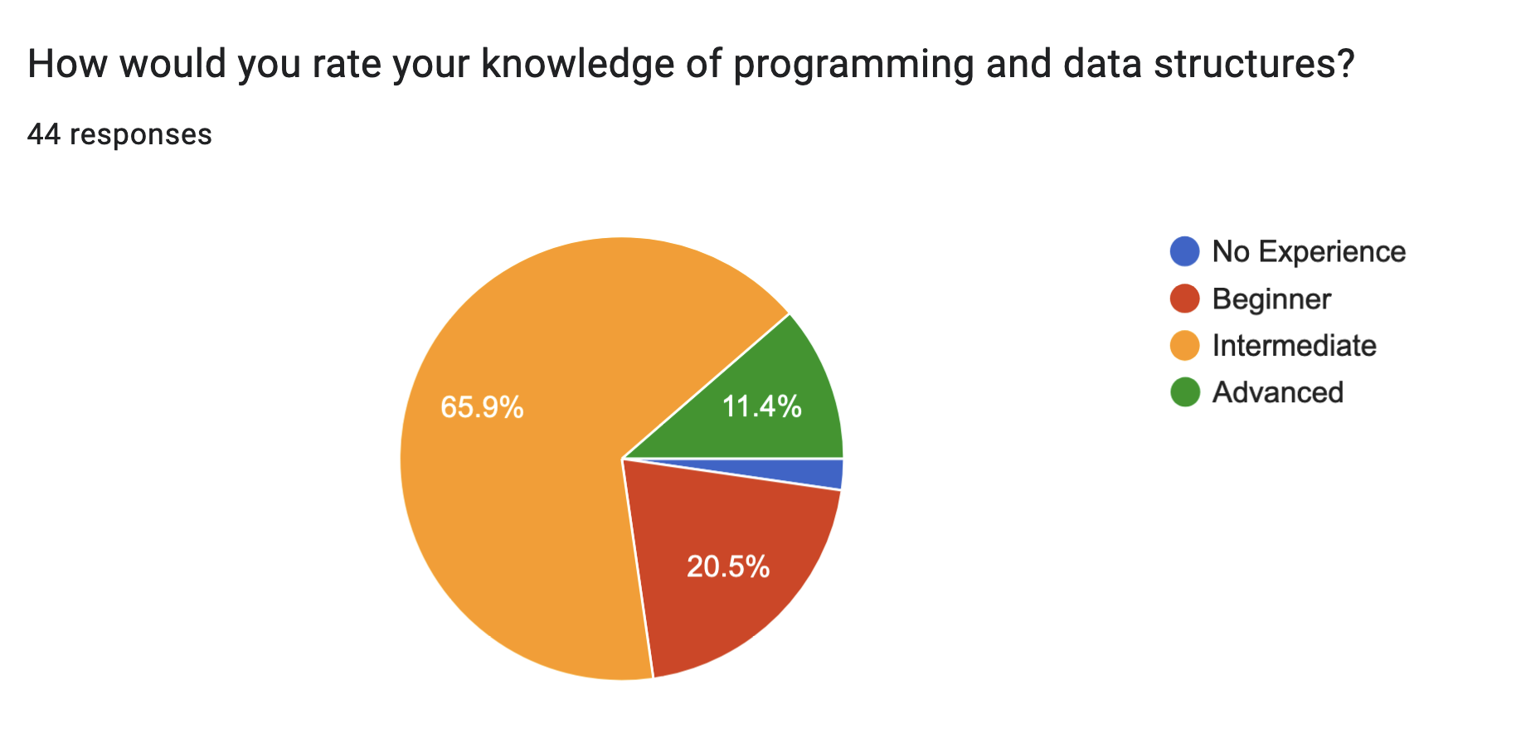
Who is it for?
Requires basic knowledge of coding and data structures and algorithms.
Minimum requirement is to be able to code in a programming language, deal with input/output, use arrays and manipulate strings
Notes:
In wich you can easily learn in a week or two if you are new to programming.
Beginners: If you have no prior knowledge of programming, you’ll need to study a programming language independently to fully participate in society events.
Advanced Members: For those with experience, we will offer challenging pr
oblems that push your limits.
We aim to be as inclusive as possible, ensuring beginners can understand and improve, while also providing difficult problems for more advanced members to solve.

Slide 6
We Learn Together
I’m not an expert on competitive programming—many questions are designed to be very hard.
We are here to brainstorm, share ideas, and improve together as a community.
Notes:
Welcome to SIGCompete!

Slide 7
Society Activities
We plan to have regular biweekly/weekly in person training sessions
We plan to have biweekly/weekly online internal contests
There will be occasional in person team contests
Potential Daily challenge questions on Discord
There will be socials in the future

Slide 8
Training Sessions
Each training session will introduce you to a topic in competitive programming
share solutions from last session
introduce a new topic
guided questions in the topic
try it yourself competition focused on the topic
Optional take home exercises (answers released next session)

Slide 9

What is ICPC?
ICPC is a team-based programming competition.
Teams of 3 work together to solve algorithmic problems.
Contest Duration: 5 hours, approximately 14 problems.
Teams use 1 computer to collaborate and solve problems.
Languages allowed: Java, Python, C++, C
For more information, visit https://ukiepc.info/
Notes:
Well known in the world
We will mainly be using Java, Python, and C++ for internal contests in this society
We will demonstrate solutions with pseudocode

Slide 10
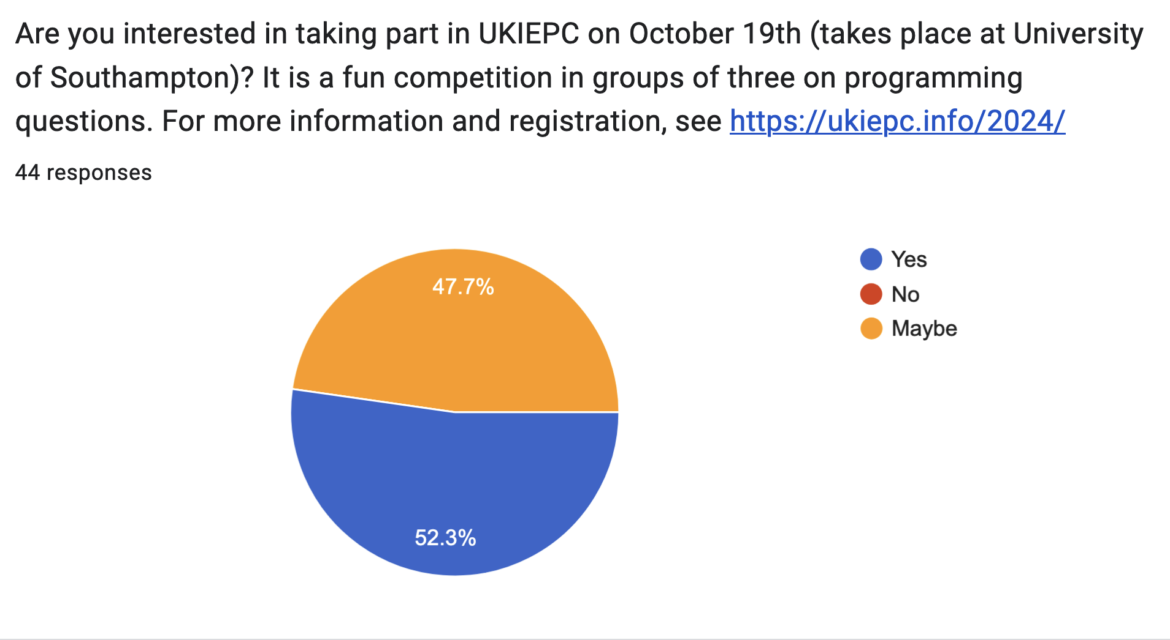
ICPC Participation
The University of Southampton will be participating in the ICPC each year in October.
This year, the contest will be held on Saturday 19th October 9am-5pm.
Notes:
We will hold training sessions assuming most members of the society will attend the contest.

Slide 11
ICPC Registration
Registration Deadline is 15 Oct
You need to form a team of 3
You can use the discord #icpc-team-finding channel to look for teammates
Register an account with your university email and form a team on https://ukiepc.info/
Team Registration navigation path:
Europe Contests > Northwestern Europe Regional Contest > ICPC UK & Ireland Programming Contest > Uni of Southampton
For more details and questions about the registration, email m.s.jameel@southampton.ac.uk

Slide 12
QUESTIONS?
Notes:
Let’s jump into solving actual problems!

Slide 13
Tips to Improve in Competitive Programming
Master your preferred programming language and libraries
Practice algorithms and data structures
Solve problems quickly and analyze algorithms for speed/memory limits
Develop a strong set of test cases
Team practice for ICPC is key to success!

Slide 14
General Approach to Solving a Problem
Understand the Problem:
What is the input?
What is the expected output?
What constraints or limits are given?
Recognize the Pattern:
Is this problem similar to a previous one?
What algorithms/data structures are applicable?
Break It Down:
Divide the problem into smaller parts.
Simplify the logic where possible.
Test Cases:
How can we test edge cases?
Are there any corner cases?
Notes:
Let’s proceed to solving 2 easy past ICPC problems to get an idea of the problem-solving process.

Slide 15
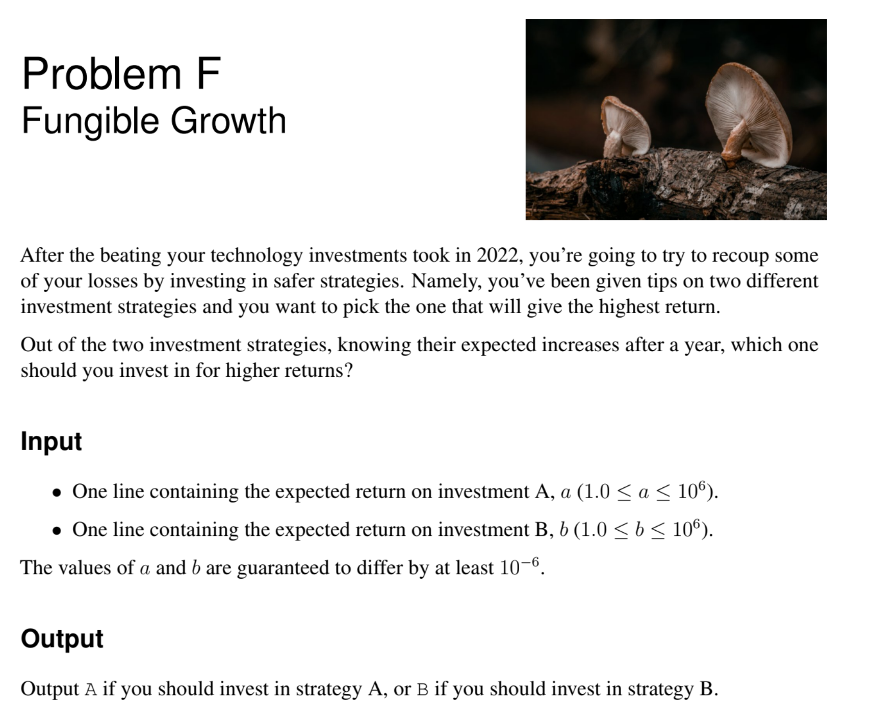
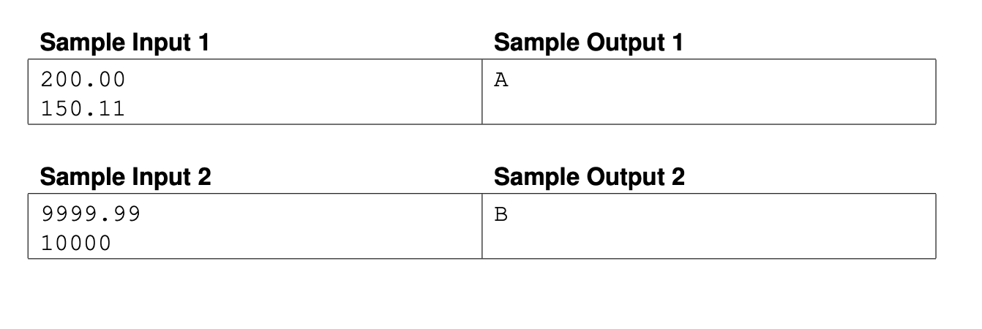
Example Problem 1
Problem taken from 2022 UKIEPC
Notes:
Here we have a past UKIEPC problem—UKIEPC is the UK round of ICPC.
Disguised behind fancy descriptions is a very easy problem. Every year, UKIEPC includes some easy problems designed to be solvable by most participants.
One strategy for UKIEPC: Quickly read through a problem, decide its difficulty, and solve the easy ones first.
I’ll give you about 2 minutes to read this problem.
Let’s work together to understand this problem. It may not be stated plainly in programming terms, so let’s break it down.
Here’s the task: We’ll compare two inputs A and B and print the larger one. Sounds simple, right? But let’s dig deeper.
1. Who can tell me: What’s the input we’ll be working with? [Pause for responses] (1.9 <= a <= 10^6)
2. And what’s the expected output? [Pause for responses] (A String)
Now, let’s brainstorm. What could be some test cases to check if we understand this problem correctly? [Encourage a few people to share ideas on possible input/output combinations]
Are there any edge cases? How should we deal with those?
Once we’ve identified those, the next step is figuring out the logic.
"Would anyone like to come up and write a pseudo code for this problem on the board?"
Variations:
Multiple Comparisons: What if there are three inputs, A, B, and C?
How do we handle that?
Edge Cases: How should we handle inputs like negative numbers, zeros, or even equal values?
Efficiency Discussion: “How would this scale with a large number of comparisons?" This could open a discussion about efficiency, big-O notation, and sorting algorithms.
Techniques
● Input/Output
Algorithm
● Check whether A > B
○ If A > B, print A
○ If B > A, print B
○ It will never be the case that A = B, but in case it does, throw an exception like a good software engineer.

Slide 16
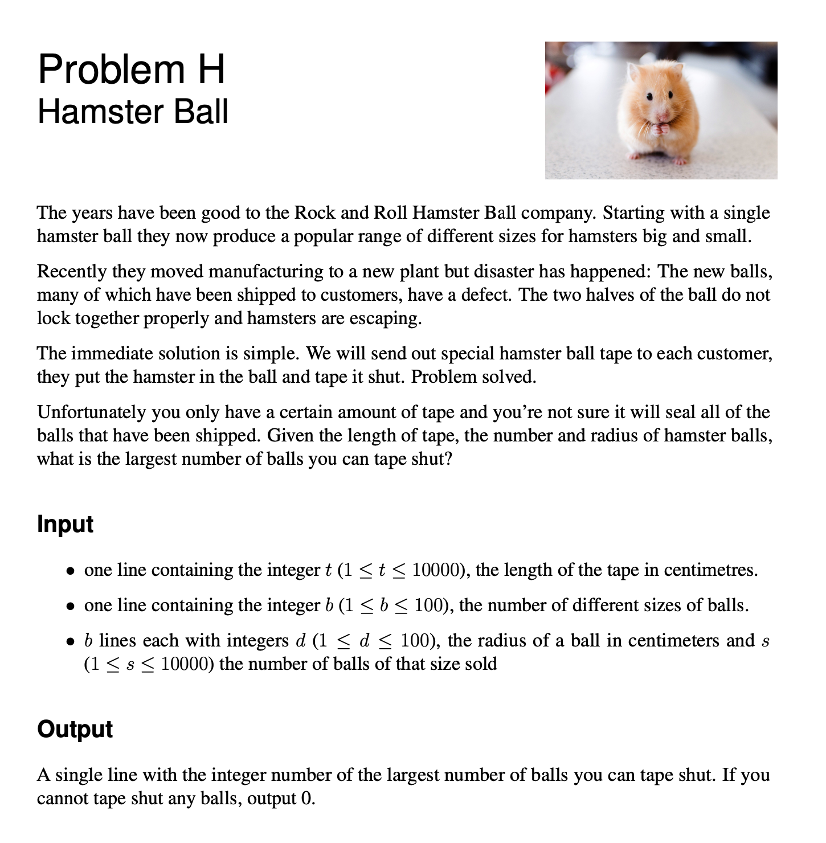
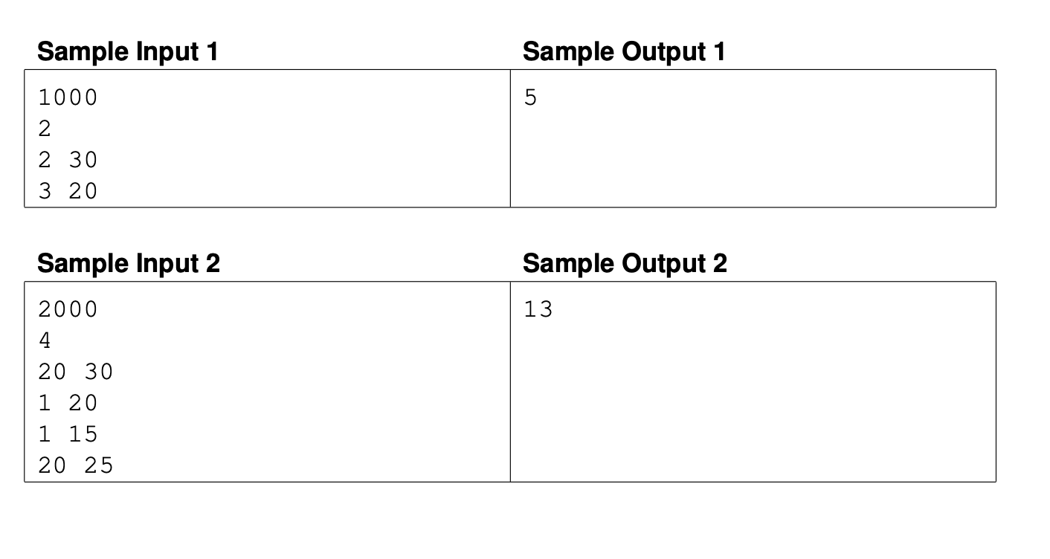
Example Problem 2
Problem taken from 2018 UKIEPC
Notes:
I’ll give you about 3 minutes to read and think about it.
"We have various hamster balls of different sizes, and a limited amount of tape. We need to figure out how many hamster balls we can seal shut using the tape.”
"A ball is sealed by taping around its diameter. So, for each ball, we need enough tape to wrap around its diameter once.”
Ask the group: "What information do we need to calculate this?”
Expected answers: diameter of the balls, amount of tape.
Ask: "How would you calculate how much tape is needed to seal one ball?
"Expected answers: diameter x π (circumference).
Introduce the techniques that will be useful for solving the problem:
Sorting the balls by size (smallest first).
Greedy approach (taking as many small balls as possible to maximize the number of balls sealed).
Greedy: for each step, make the locally optimal solution hoping to achieve a globally optimal solution
Don’t worry, we will formally introduce these topics in future training sessions. Today is just a taster.
Ask: "Why do you think sorting by size might be helpful here?”
Expected answers: smaller balls use less tape, so we can seal more of them before using larger balls.
"Does everyone see how sorting and the greedy approach helps us maximize the number of balls sealed?”
Break down the algorithm:
Tape usage per ball: Divide the length of the tape by π to easily work with diameters.
Sorting: Sort the ball sizes (smallest first) to maximize the number of balls sealed.
Greedy selection: For each size, seal as many balls as possible until the tape runs out.
Ask: "How would you track how many balls we’ve sealed?”
Expected answers: keep a count or loop through the sorted list.
("Let’s walk through Sample Input 1.
We have 1000 cm of tape,
2 sizes of balls (30 cm and 20 cm in diameter),
and the number of balls of each size is provided. How would we start?”)
"Would anyone like to come up and write a pseudo code for this problem on the board?"
Overview
A large number of hamster balls of varying sizes
An amount of tape
Calculate the largest number of hamster
balls than can be sealed shut with the tape.
The question isn’t very clear of how the tape seals a ball, I can tell you that a ball can be sealed but taping arounds its diameter.
Techniques
● Sorting ● Greedy Algorithm
Algorithm
● Divide the length of the tape by Pi, then we can use the hamster ball diameter easily.
● Sort the ball sizes smallest first, keeping track of how many of each.
● Starting with the smallest ball size, greedily take away as many balls as we can from the tape until there isn’t enough tape left for the next ball or we run out of balls that size, then look at the next size up.

Slide 17
Try it yourself!
Create a hackerrank account at https://www.hackerrank.com/
Sign up to the SIGCompete mini contest https://www.hackerrank.com/sigcompete-taster-session
Contest Details
6 problems (easy to medium difficulty)
Duration: 30 minutes
Goal: Solve as many problems as you can!
Earn points for each problem solved and follow the real-time leaderboard!
Prize: Top scoring person wins a box of cookies from me!
Allergens: nuts, egg, milk, soybean
Notes:
Now that you’ve gotten a hang of how competitive programming and ICPC works, let’s put that into practice by an internal mini competition.
I’ll make sure everyone has registered an account before starting the contest.

Slide 18
Society Events Poll
Go to: https://vevox.app
Enter the Session ID: 123-456-789

Slide 19
We welcome any Feedback
If you have any feedback or suggestions, feel free to post in the discord #suggestions channel!
Notes:
Thank you for attending our first session.

Slide 20
Icebreaker – Human Bingo
Mingle and Ask Different People
One Square Per Person
No Asking All Questions at Once
First to Complete a Row/Column/Diagonal Wins
Time limit of 15 minutes
First person to get a Bingo wins a box of cookies
Allergens: nuts, egg, milk, soybean
Notes:
Hope you’ve enjoyed the competition.
Let’s do something more casual to get to know each other better by doing an icebreaker of human bingo.

Slide 21
Committee Member Meetup
Arqam Qeisi
Ryan Scott
Matthew Botten
Rudrrayan Mana
Arjun Juneja
Notes:
17 of you have applied for committee positions and unfortunately there are only 6 positions available. I had to select candidates based on the responses of the google forms.

Slide 22


Thank You For Coming!
Hope to See You Soon
Discord:
Member Registration:

