Slide 1

Session 1: Time Complexity and Basic Data Types
October 9

Slide 2
Session Outline
Time Complexity
Basic Data Types
ICPC Team Finding

Slide 3
Updates
Github Repo: Can find it under #welcome-and-rules channel of discord server https://github.com/Shayna003/sigcompete
Currently we are planning to host a 2h training session every Wednesday 2-4pm.
The society training sessions will start from simple topics to more advanced topics.
Currently there are no daily challenges/weekly problem sets regular online contests yet. We will introduce them later-on.
Notes:
Just message me on discord!
Question: do we want to have tutorials on C++, or just stick to using a language of your choice for programming problems?

Slide 4
We Welcome Your Input
Feel free to:
Present a topic of your interest
Talk about interesting problems you’ve come across
Present better solutions to problems we’ve covered
Introduce any programming contests that members might be interested in attending
Share tips and tricks

Slide 5
Time Complexity
Time Complexity estimates how much time an algorithm will take to run for a given input, expressed as a function of the size of the input.
Memory Complexity estimates how much memory an algorithm will use for a given input, also expressed as a function of the size of the input.

Slide 6
Big-O Notation
Big-O Notation is a standard for measuring how the time or space required by an algorithm grows as the size of the input data increases.
Lower magnitude (e.g., O(log n) vs. O(n²)) indicates a more efficient algorithm in terms of time or memory usage.
O(···) expresses the upper bound of an algorithm's time/memory complexity.
Notes:
The time complexity of an algorithm is denoted O(···) where the three dots represent some function. Usually, the variable n denotes the input size. For example, if the input is an array of numbers, n will be the size of the array, and if the input is a string, n will be the length of the string.

Slide 7
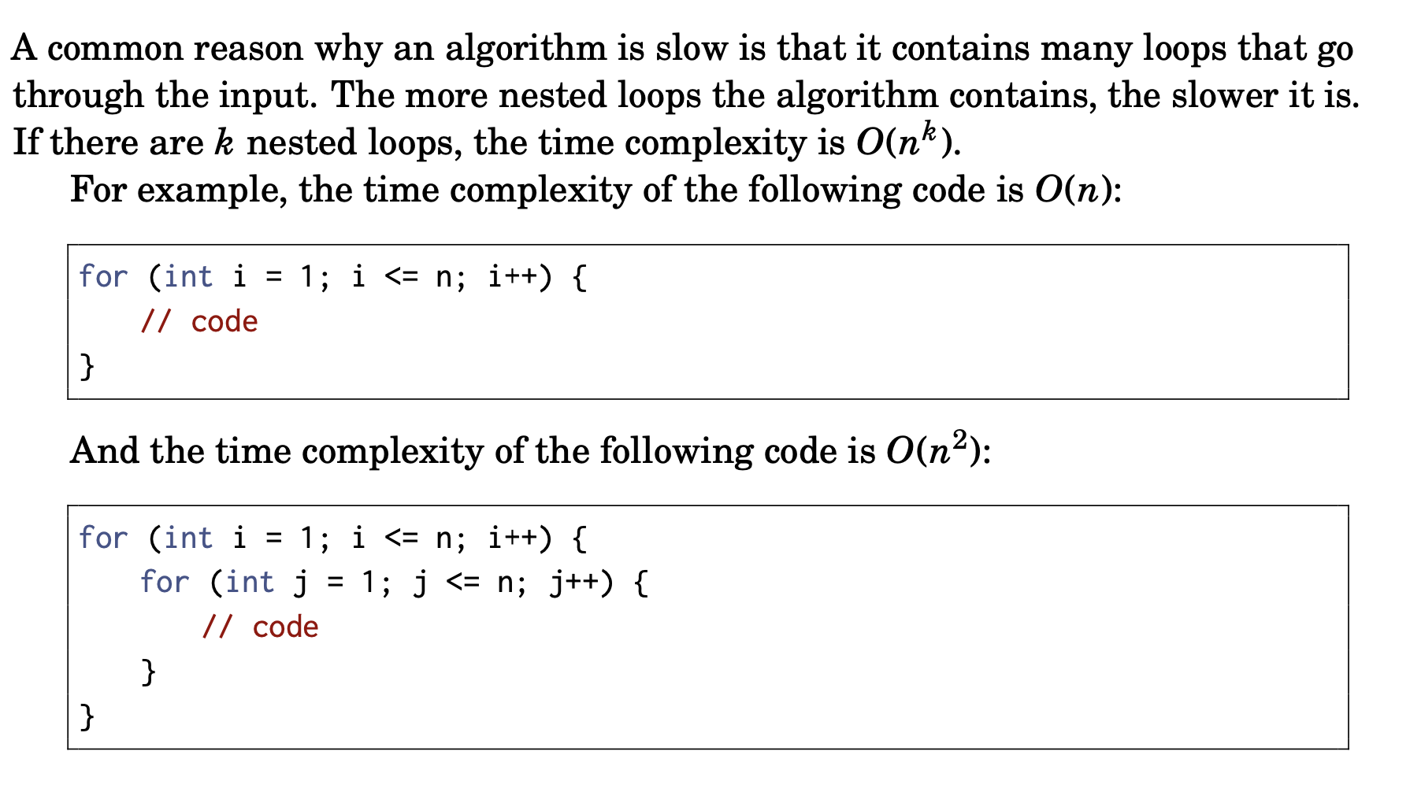
Time Complexity

Slide 8
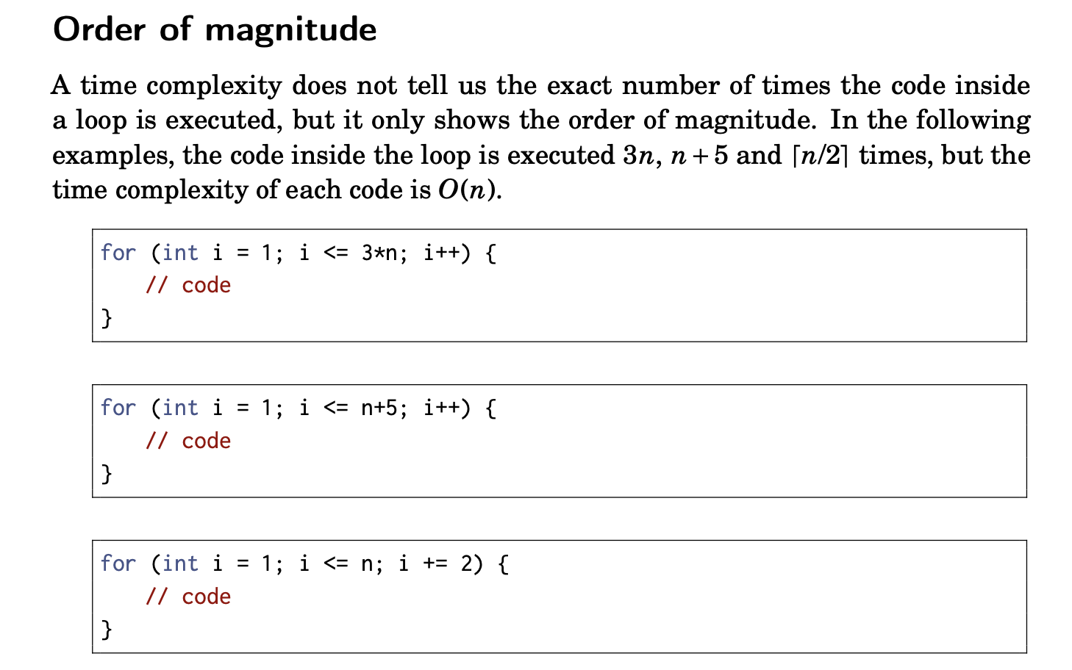
Time Complexity

Slide 9
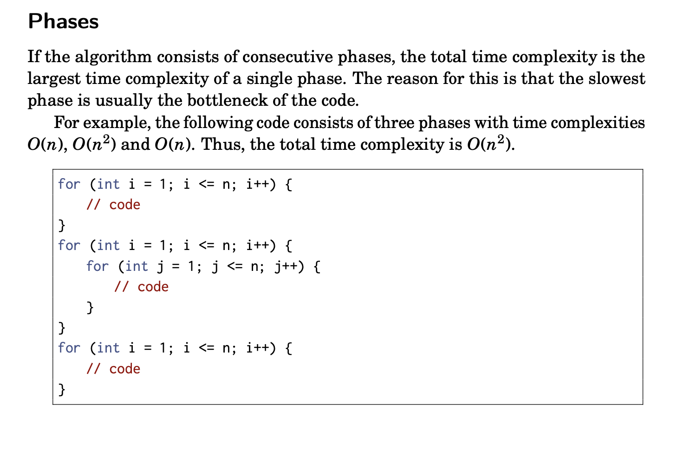
Time Complexity

Slide 10
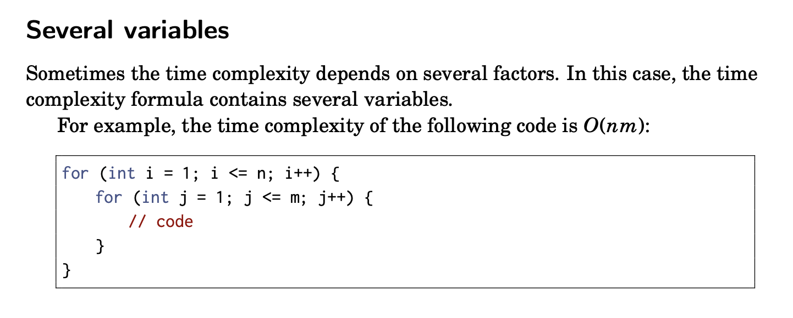
Time Complexity

Slide 11









Common Complexity Classes

Slide 12
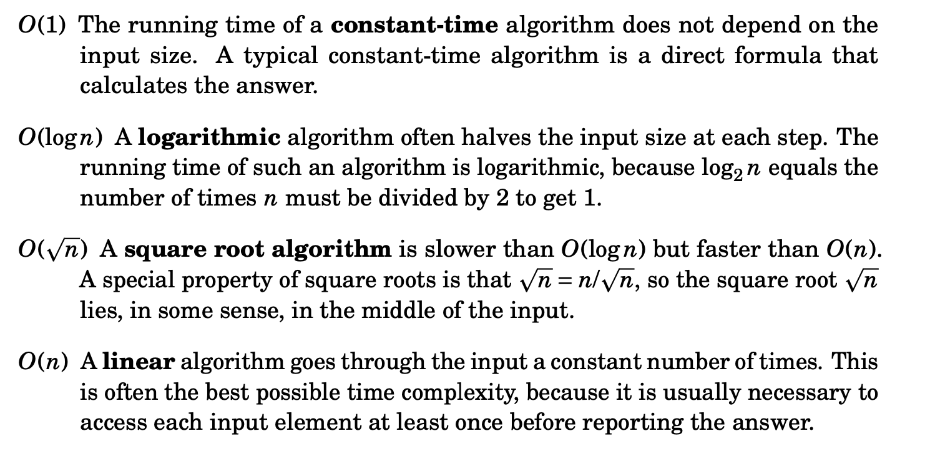
Complexity Classes

Slide 13
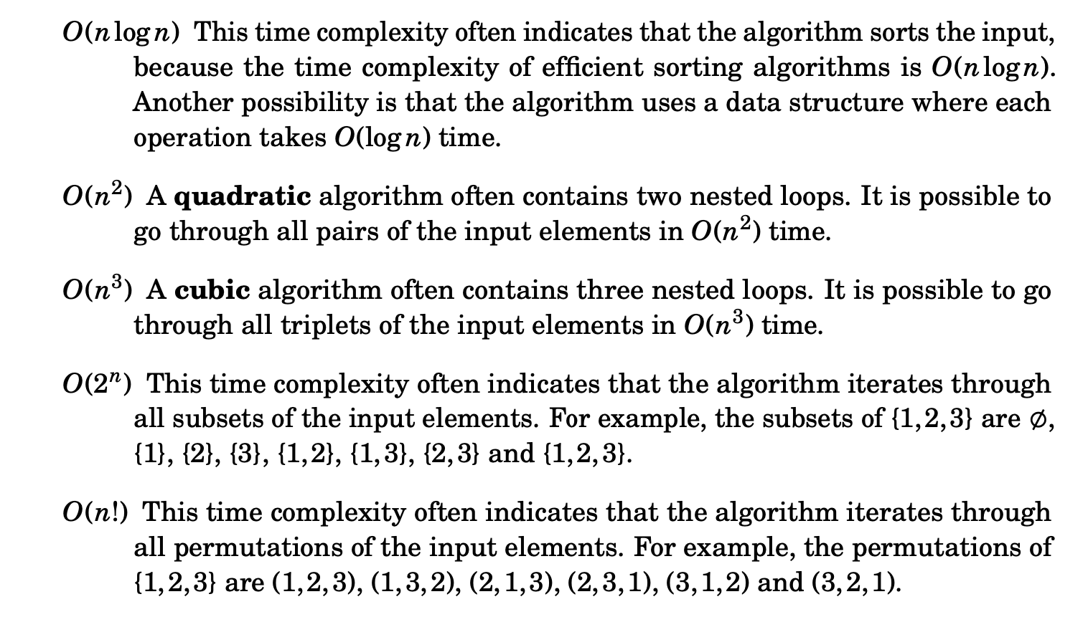
Complexity Classes

Slide 14
Test Your Knowledge
ahaslides.com/3H9U8

Slide 15
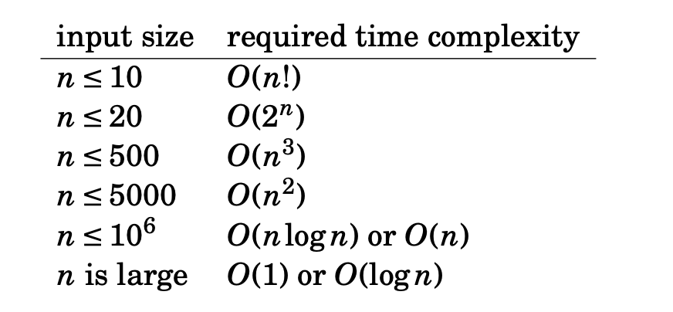
Time Limit
Assuming a time limit of 1 second:

Slide 16
Basic/Primitive Data Types
Numbers
Characters and Strings
Booleans
Static Arrays
Notes:
Choosing the right data types is crucial in competitive programming. It’s important to get familiar with working with them, as well as knowing how much space they occupy and the allowed precision.
I’m talking about these data types in the context of java/c++/python
Most high level programming languages should have these primitive data types

Slide 17
Common Numeric Data Types
Int/Long
Float/Double

Slide 18
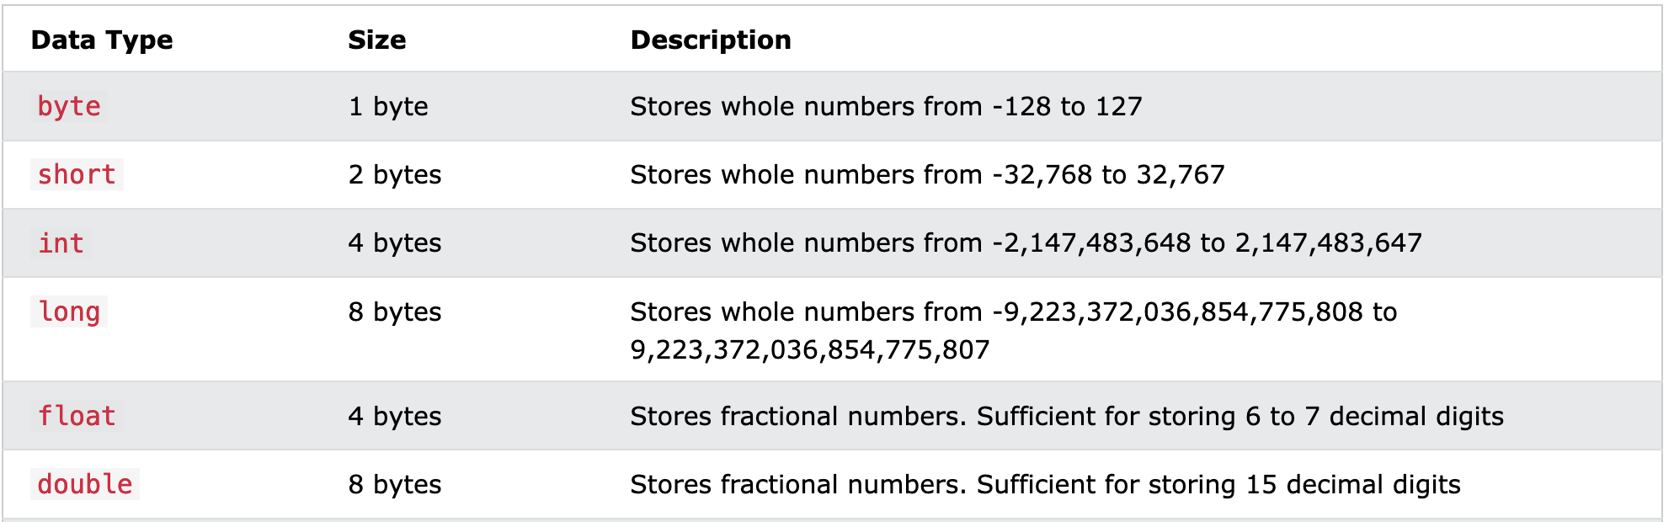
Java
Big Integer for Java for larger numbers
https://www.w3schools.com/java/java_data_types.asp

Slide 19
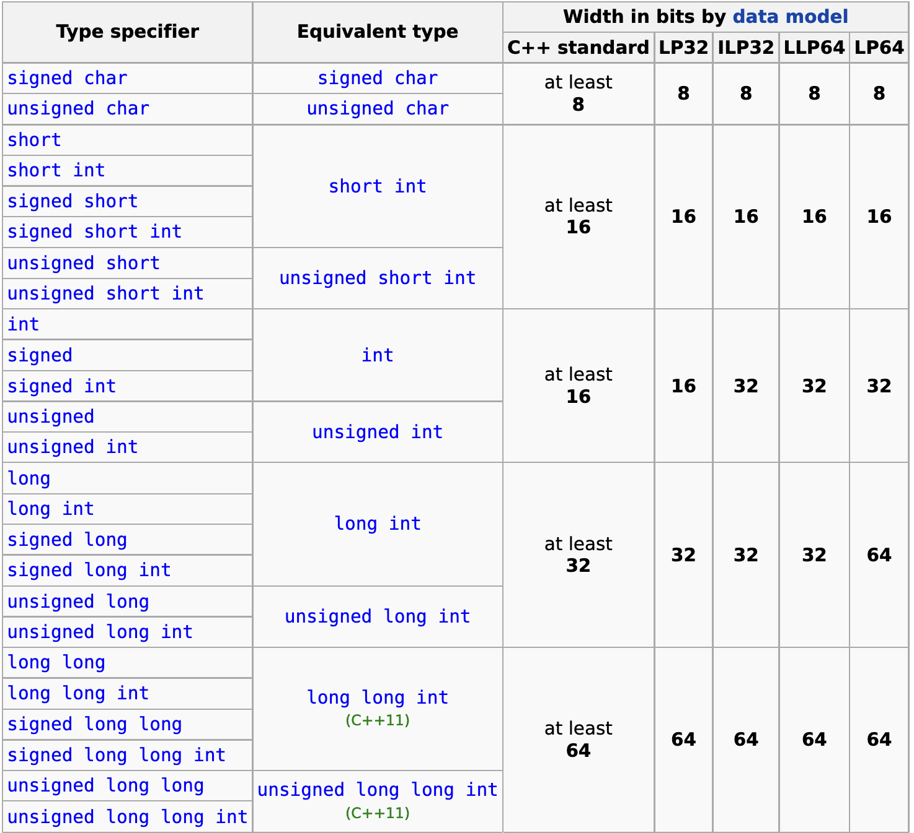
C++
https://en.cppreference.com/w/cpp/language/types

Slide 20
Python
Int: Integers have unlimited precision
Float: Floating-point numbers are usually implemented using double in C
Complex: Complex numbers have a real and imaginary part, which are each a floating-point number
The standard library includes the additional numeric types fractions.Fraction for rationals
decimal.Decimal for floating-point numbers with user-definable precision.

Slide 21
Division By Zero
Java/C++: Throws runtime exceptions (e.g., ArithmeticException in Java) or undefined behavior in C++.
Python: Raises a ZeroDivisionError.
Always validate the denominator before performing division operations.

Slide 22
Division with int precision
C++/Java: result = 5 / 2 # result will be 2
Python: result = 5 / 2 # result will be 2
C++/Java: double result = (double) a / b; // result will be 2.5
Python: result = 5 // 2 # result will be 2
Notes:
In Java and C++, if both operands of a division are integers (int or long), the result will be an integer. Any fractional part will be discarded (i.e., the result is truncated toward zero).
To handle this, you can explicitly cast one of the operands to double to get a floating-point result:
If you want integer division in Python 3, you use the // operator:

Slide 23
Floating Point Precision
Floating-point numbers (e.g., float, double) are stored in binary, which leads to precision errors in certain cases (e.g., 0.1 + 0.2 ≠ 0.3).
For critical calculations, consider using higher-precision libraries like BigDecimal in Java or Decimal in Python.
Problems involving double and float calculations typically specify an acceptable margin of error (e.g., 1e-9 or 1e-6).

Slide 24
Taking Large Logarithms
When dealing with very large numbers, ensure you use custom functions or libraries that handle precision errors and prevent overflow.
Avoid using standard logarithmic functions in languages like C++/Java for extremely large values without careful consideration.

Slide 25
Characters
Supports mathematical addition and subtraction
Supports == comparison
'a' + 1 == 'b'
Lower case and upper case are !=
Manipulating between lower case and capital case
‘a’ - 32 == ‘A'
Notes:
Manipulating Between Lowercase and Uppercase:
Convert between lower and upper case using built-in functions:
C/C++/Java: Use toupper() and tolower() functions.
Python: Use upper() and lower() methods.

Slide 26
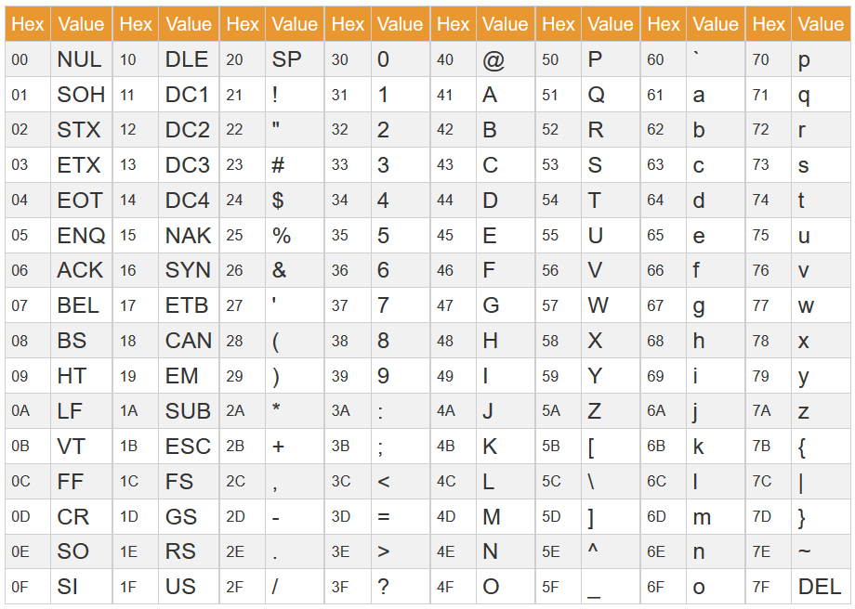
Ascii Table
‘a’==97
‘A’==65

Slide 27
Strings
Conceptually a List of Characters, enclosed in “”
Treated differently in Java/C++/Python
Common functions:
Length
Iterating over a string
Turning to and from characters
Replacing character(s)
Concatenation: “he” + “llo” -> “hello”
Substring
String comparison (e.g. lexical ordering)
Converting to/from Lower case and upper case

Slide 28
Booleans
Takes a value from true, false
Conditional Operator
!= Not Equal
== Equals
> Bigger Than
< Smaller Than
>= Bigger than or equals to
<= Smaller than or equals to
Common uses:
if statements
for loops
while loops
record if a condition has been met

Slide 29
Static Arrays
One of the Most Important Data Types in Competitive Programming (CP)
Efficient for storing collections of elements of the same type
Commonly used to solve problems involving lists or grids (2D, 3D, etc.)
Fixed Size: Must declare the size of the array at compile time.
Same Type: All elements in the array must be of the same type (e.g., all int, all char).
Multi-Dimensional Arrays:
2D arrays for grids
3D and higher dimensions are also possible
Keep in mind of memory limits
Arrays can quickly use large amounts of memory, especially in high dimensions.
If n = 10^6, an int[n][n] array would occupy around 4 terabytes of memory, which will certainly exceed the memory limits of most competitive programming environments.

Slide 30
Choosing the correct data type
Prompt: Given a range of integers from 1 to N, count how many numbers within this range have an odd number of 1s in their binary representation.
Using a boolean[] array instead of an int[] can reduce memory usage since you only need to store true/false values. You can further optimize to using an int variable to take up constant space.
Notes:
Solution: Implement efficient bit manipulation techniques to count 1s in binary.
This question can actually be solved in O(1) time using mathematic equations and advanced bit manipulation.

Slide 31
Choosing the correct data type
Prompt: Given two integers A and B, calculate their sum. However, A and B can be as large as 10^18, so you must ensure that your solution can handle these large numbers without overflowing.
If you use a typical int type in languages like C++, it may not be sufficient to handle such large numbers.
Solution: Use long long int in C++ or BigInteger in Java to ensure that the sum can fit within memory constraints.
Notes:
That’s it for time complexity and primitive data types.

Slide 32
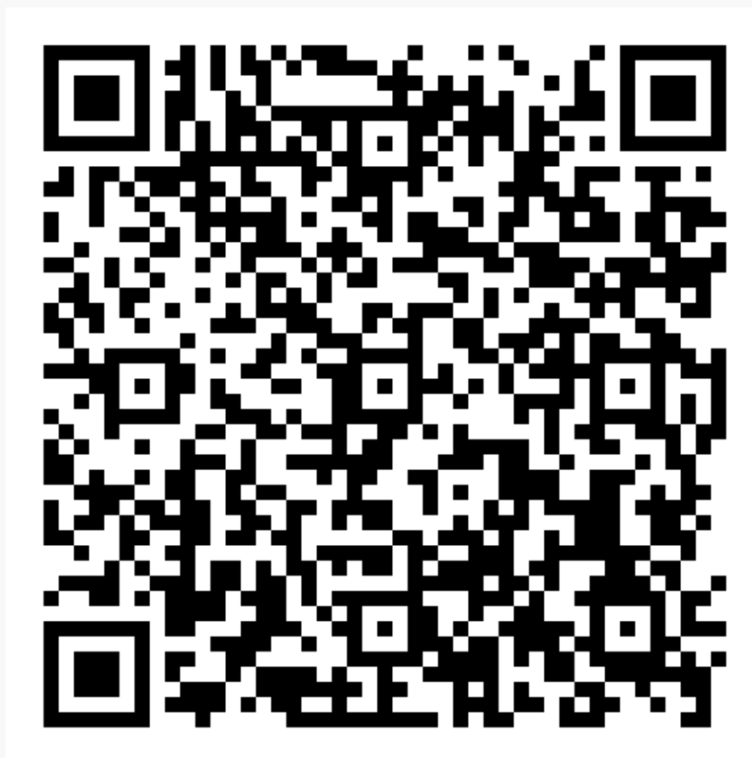
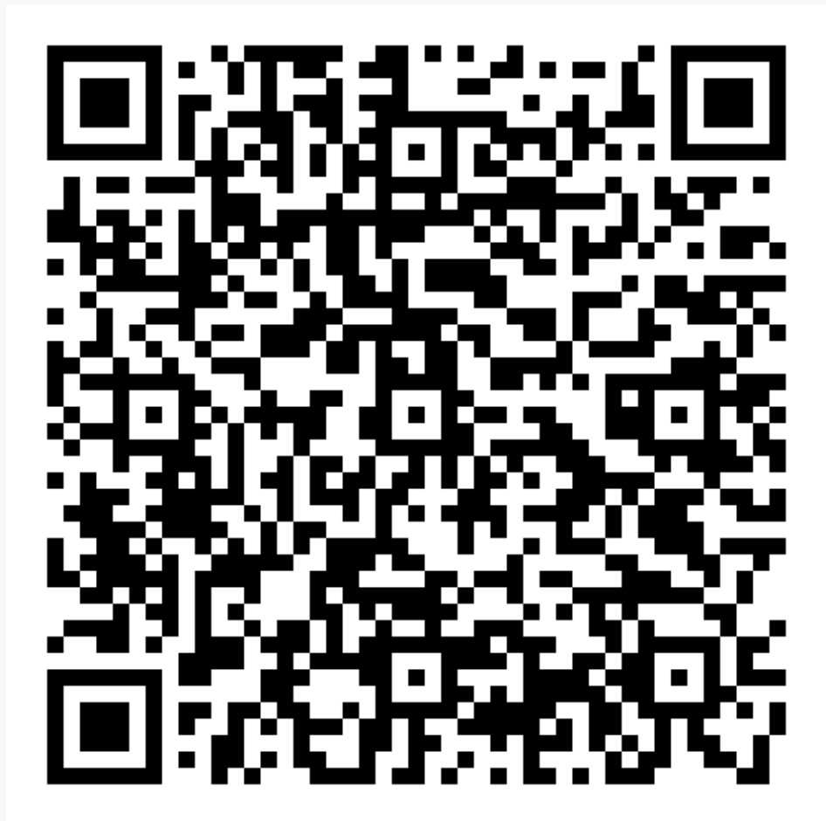
ICPC Team Finding
Google form
Google Sheet

Slide 33
Thank You For Coming!
Hope to See You Soon

