Slide 1


Session 5: Subsets and permutations
November 6th

Slide 2

Hand out participation rewards for last week's contest
Solutions to selected problems from last weeks' contest
Recap on Recursion and Backtracking
Pruning the search
Subsets
Permutations
Start this week's online contest

Slide 3

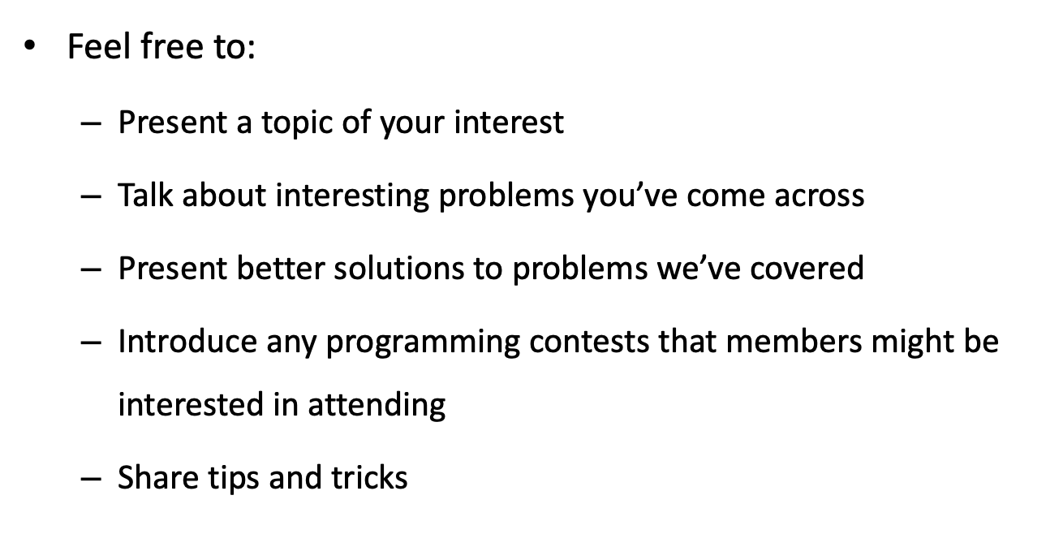

Slide 4
Pruning the search
Pruning the search is the process of eliminating irrelevant or unnecessary data from a search query to improve efficiency.
This can involve various techniques, including:
Filtering Results: Applying filters to exclude results that do not meet specified conditions, thereby enhancing the quality of the results returned.
Optimizing Algorithms: Refining algorithms to focus on more promising areas of the search space, reducing the time and resources needed to find relevant results.

Slide 5
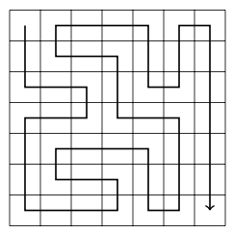
We can often optimize backtracking by pruning the search tree. Such optimizations can have a tremendous effect on the efficiency of the search.
Let us consider the problem of calculating the number of paths in an n × n grid from the upper-left corner to the lower-right corner such that the path visits each square exactly once. For example, in a 7 × 7 grid, there are 111712 such paths. One of the paths is as follows:

Slide 6
Basic Algorithm
The first version of the algorithm does not contain any optimizations. We simply use backtracking to generate all possible paths from the upper-left corner to the lower-right corner and count the number of such paths.
Running time: 483 seconds
Number of recursive calls: 76 billion

Slide 7
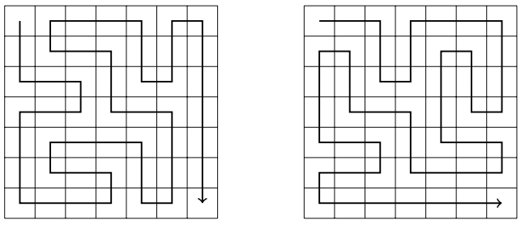
Optimization 1
In any solution, we first move one step down or right. There are always two paths that are symmetric about the diagonal of the grid after the first step. For example, the following paths are symmetric:
Hence, we can decide that we always first move one step down (or right), and finally multiply the number of solutions by two.
• running time: 244 seconds • number of recursive calls: 38 billion

Slide 8
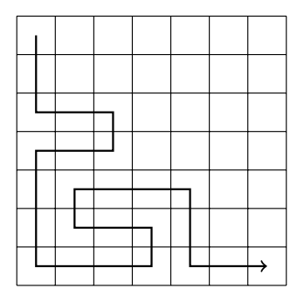
Optimization 2
If the path reaches the lower-right square before it has visited all other squares of the grid, it is clear that it will not be possible to complete the solution. An example of this is the following path:
Using this observation, we can terminate the search immediately if we reach the lower-right square too early.
• running time: 119 seconds • number of recursive calls: 20 billion

Slide 9
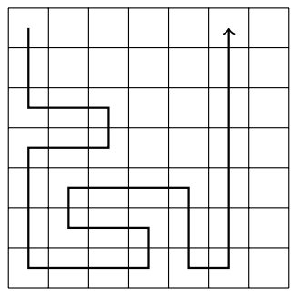
Optimization 3
If the path touches a wall and can turn either left or right, the grid splits into two parts that contain unvisited squares. For example, in the following situation, the path can turn either left or right:
In this case, we cannot visit all squares anymore, so we can terminate the search. This optimization is very useful:
• running time: 1.8 seconds • number of recursive calls: 221 million

Slide 10
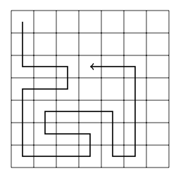
Optimization 4
The idea of Optimization 3 can be generalized: if the path cannot continue forward but can turn either left or right, the grid splits into two parts that both contain unvisited squares. For example, consider the following path:
It is clear that we cannot visit all squares anymore, so we can terminate the search. After this optimization, the search is very efficient:
• running time: 0.6 seconds • number of recursive calls: 69 million

Slide 11
The running time of the original algorithm was 483 seconds, and now after the optimizations, the running time is only 0.6 seconds. Thus, the algorithm became nearly 1000 times faster after the optimizations!
This is a usual phenomenon in backtracking, because the search tree is usually large and even simple observations can effectively prune the search. Especially useful are optimizations that occur during the first steps of the algorithm, i.e., at the top of the search tree.

Slide 12
Generating subsets
We first consider the problem of generating all subsets of a set of n elements. For example, the subsets of {0,1,2} are ; {0}, {1}, {2}, {0,1}, {0,2}, {1,2} and {0,1,2}. There are two common methods to generate subsets: we can either perform a recursive search or exploit the bit representation of integers.

Slide 13
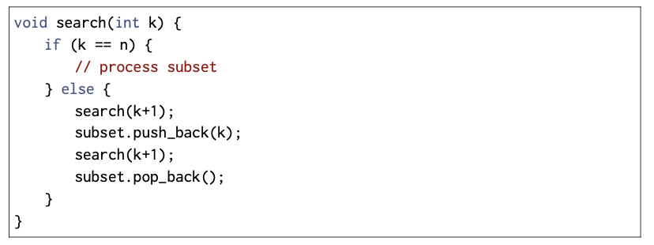
Method 1
An elegant way to go through all subsets of a set is to use recursion. The following function search generates the subsets of the set {0,1,...,n−1}. The function maintains a vector subset that will contain the elements of each subset. The search begins when the function is called with parameter 0.
Number of elements in the original set.

Slide 14
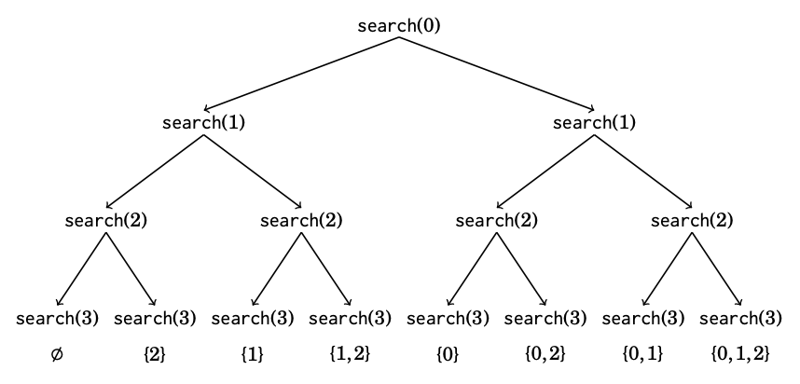
When the function search is called with parameter k, it decides whether to include the element k in the subset or not, and in both cases, then calls itself with parameter k + 1 However, if k = n, the function notices that all elements have been processed and a subset has been generated. The following tree illustrates the function calls when n = 3. We can always choose either the left branch (k is not included in the subset) or the right branch (k is included in the subset).

Slide 15
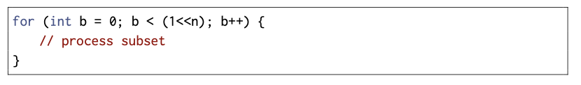
Method 2 (Bitmask)
Another way to generate subsets is based on the bit representation of integers. Each subset of a set of n elements can be represented as a sequence of n bits, which corresponds to an integer between 0...2n −1. The ones in the bit sequence indicate which elements are included in the subset.
The usual convention is that the last bit corresponds to element 0, the second last bit corresponds to element 1, and so on. For example, the bit representation of 25 is 11001, which corresponds to the subset {0,3,4}.
The following code goes through the subsets of a set of n elements

Slide 16
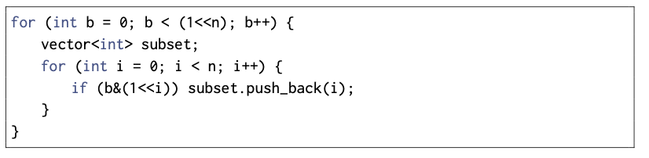
The following code shows how we can find the elements of a subset that corresponds to a bit sequence. When processing each subset, the code builds a vector that contains the elements in the subset.

Slide 17
Q: There are n apples with known weights. Your task is to divide the apples into two groups so that the difference between the weights of the groups is minimal.
Constraints
1 ≤ n ≤ 20
1 ≤ p_{i} ≤ 10⁹
Example
Input:
5 3 2 7 4 1
Output:
1 Explanation: Group 1 has weights 2, 3 and 4 (total weight 9), and group 2 has weights 1 and 7 (total weight 8).

Slide 18
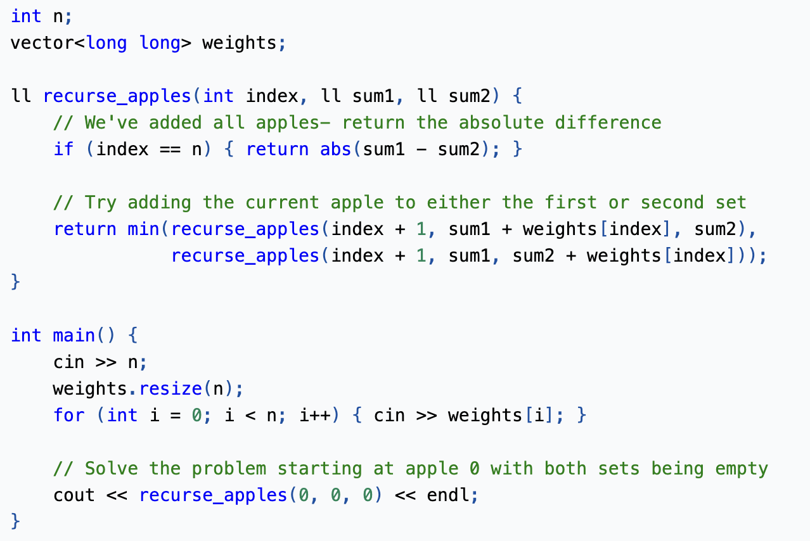
Since n <= 20, we can solve this by trying all possible divisions of n apples into two sets and finding the one with the minimum difference in weights.

Slide 19
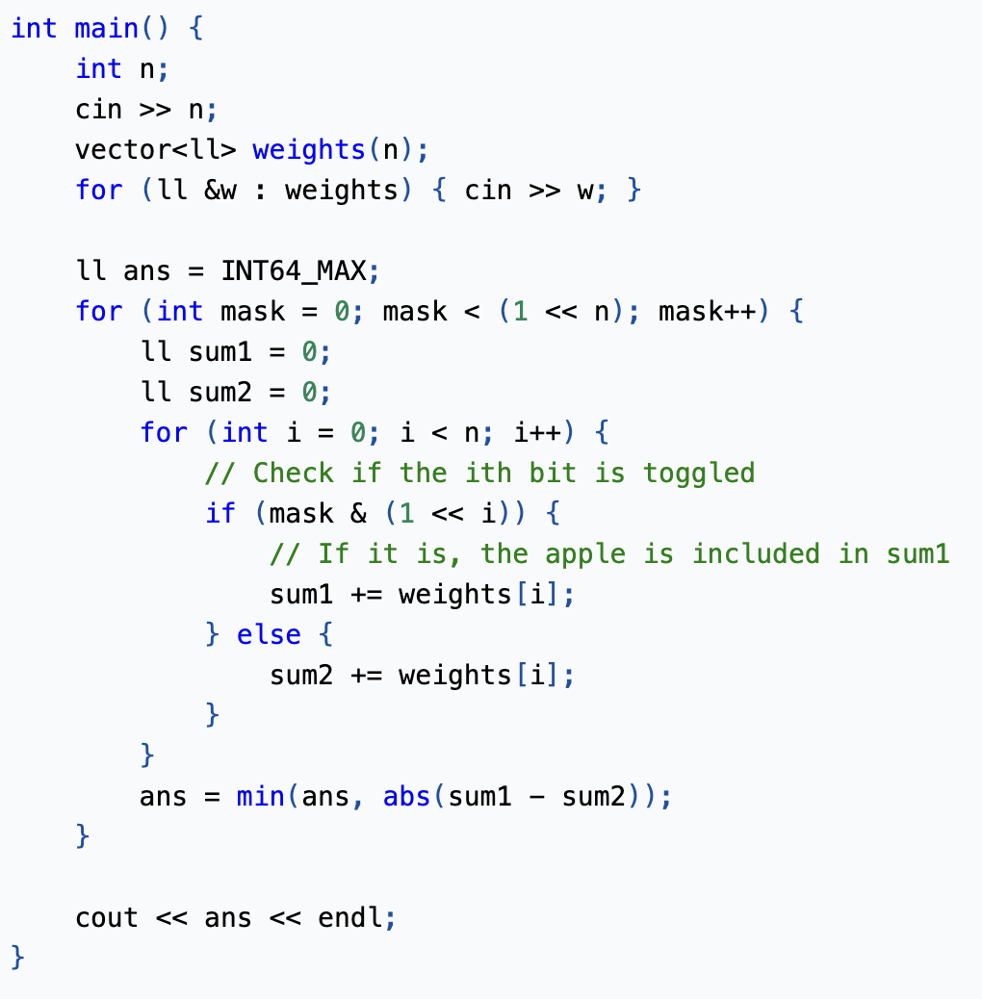
Using Bitmask:
Remember:

Slide 20
Generating Permutations (Lexicographical Order):
Think about how are words ordered in a dictionary. (In fact, this is where the term "lexicographical" comes from.)
In dictionaries, you will see that words beginning with the letter a appears at the very beginning, followed by words beginning with b, and so on. If two words have the same starting letter, the second letter is used to compare them;

Slide 21
Permutations can be placed into lexicographical order in almost the same way. We first group permutations by their first element; if the first element of two permutations are equal, then we compare them by the second element; if the second element is also equal, then we compare by the third element, and so on.
For example, the permutations of 3 elements, in lexicographical order, are:
[1,2,3] , [1,3,2] , [2,1,3] , [2,3,1] , [3,1,2] , [3,2,1]
Some problems will ask for an ordering of elements that satisfies certain conditions. In these problems, if N <= 10, we can just iterate through all N! permutations and check each permutation for validity.

Slide 22
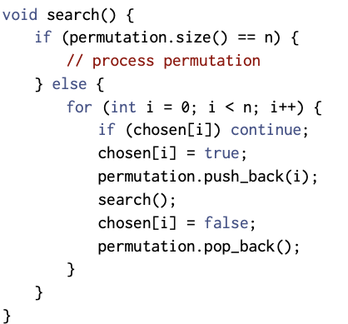
Method 1
Like subsets, permutations can be generated using recursion. The following function search goes through the permutations of the set {0,1,...,n−1}. The function builds a vector permutation that contains the permutation, and the search begins when the function is called without parameters.
Each function call adds a new element to permutation. The array chosen indicates which elements are already included in the permutation. If the size of permutation equals the size of the set, a permutation has been generated.

Slide 23
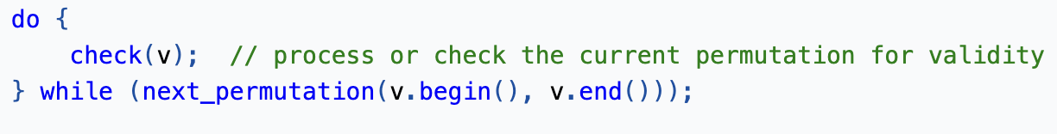
Alternatively, we can just use the next_permutation() function. This function takes in a range and modifies it to the next greater permutation. If there is no greater permutation, it returns false. To iterate through all permutations, place it inside a do-while loop. We are using a do-while loop here instead of a typical while loop because a while loop would modify the smallest permutation before we got a chance to process it.
What's going to be in the check function depends on the problem, but it should verify whether the current permutation satisfies the constraints given in the problem.

Slide 24
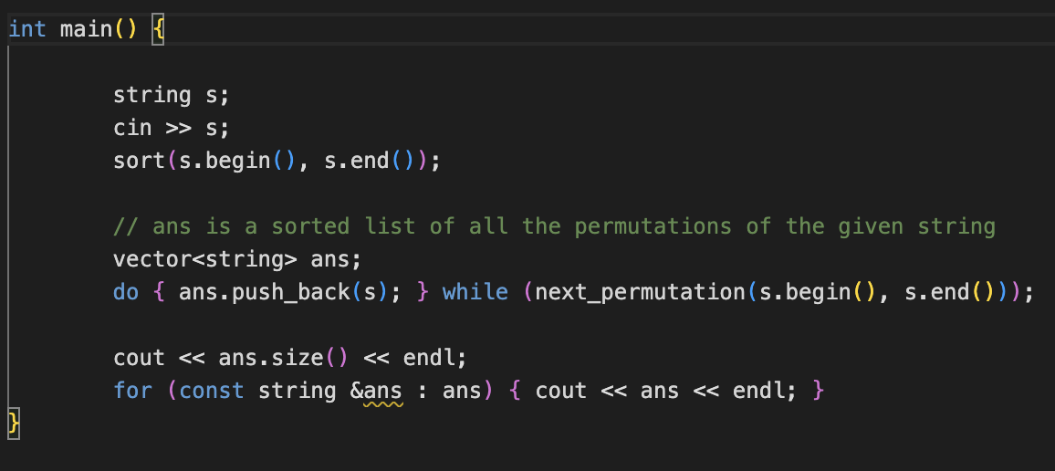
The following code generates all permutations unique of a string s:

Slide 25
Thank you for attending our session!

