Slide 1


Session 8: Number theory and modular arithmetic 2
November 27th

Slide 2

Introducing Euler’s totient function
Core principle of Fermat’s little theorem
Idea behind Binary exponentiation

Slide 3

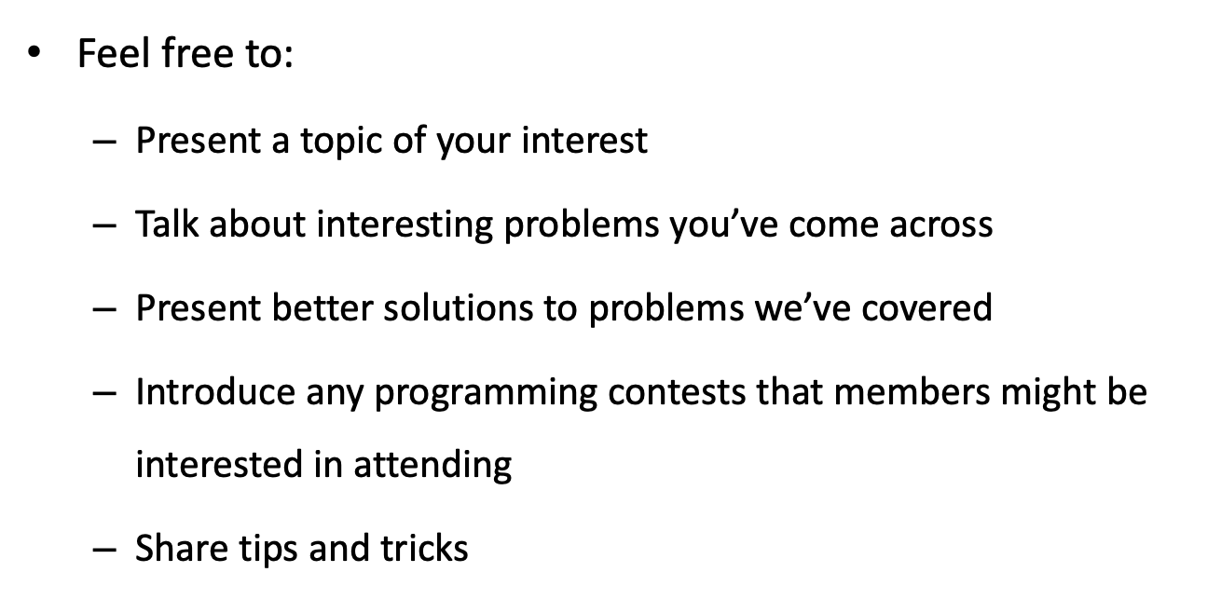

Slide 4
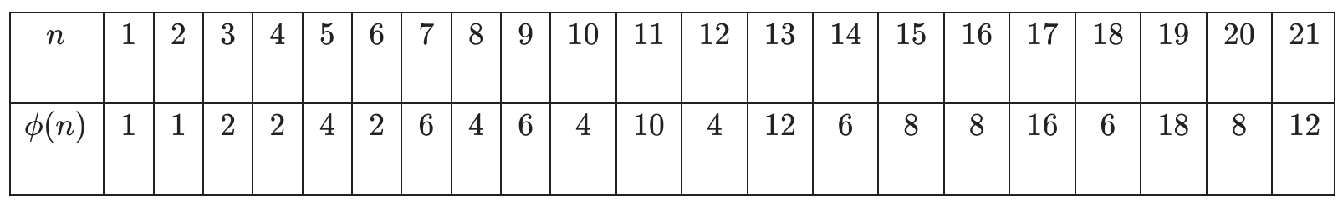
Euler totient function
Euler's phi function (which may be also called Euler's totient function) is a function that gives us the number of positive integers less or equal to a given integer 𝑛 that are coprime to 𝑛.
It is usually denoted by the Greek letter 𝜙. For instance, if we consider the number 6, there are exactly 2 integers that are not greater than 6 and coprime to it. These integers are 1 and 5. Therefore 𝜙(6) = 2. Similarly, 𝜙(9) = 6. The numbers that are not greater than 9 and coprime to it are 1, 2, 4, 5, 7 and 8. Note that according to the definition 𝜙(1)=1

Slide 5


The properties of Euler's phi function
If p is a prime number, then gcd(p, q) = 1 for all Therefore. we have:

Slide 6
Let 𝑝 be a prime number and 𝑘 a positive integer. Then:
𝜙(𝑝^{𝑘}) = 𝑝^{𝑘} - 𝑝^{𝑘-1}.
The proof of this property is quite straightforward. Consider all positive integers that are not greater than 𝑝^{𝑘}. Let us count those which are not coprime to 𝑝^{𝑘}. An integer is not coprime to 𝑝^{𝑘} if and only if it is a multiple of 𝑝. We see that there are 𝑝^{k-1} multiples of p in the interval of integers [1,𝑝^{𝑘}]. Therefore, there are 𝑝^{𝑘}−𝑝^{𝑘−1} integers which are not multiples of 𝑝 in this interval. Thus, 𝜙(𝑝^{𝑘}) = 𝑝^{𝑘} − 𝑝^{𝑘−1}.

Slide 7

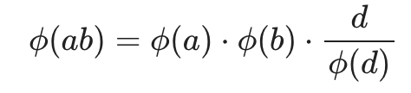
Let 𝑎 and 𝑏 be two coprime positive integers. Then:
In general, for not coprime a and b, the equation with d = gcd(a, b) holds:

Slide 8

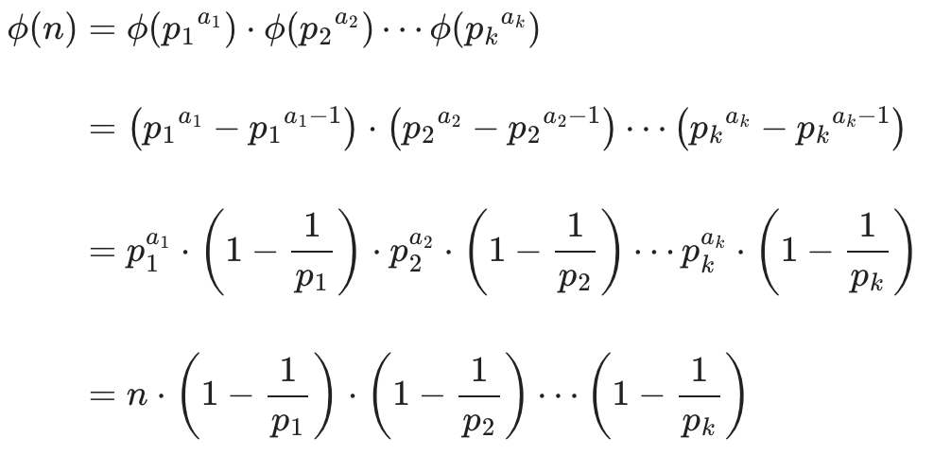
Thus, using the first three properties, we can compute 𝜙(n) through the factorization of n (decomposition of n into a product of its prime factors).
If

Slide 9
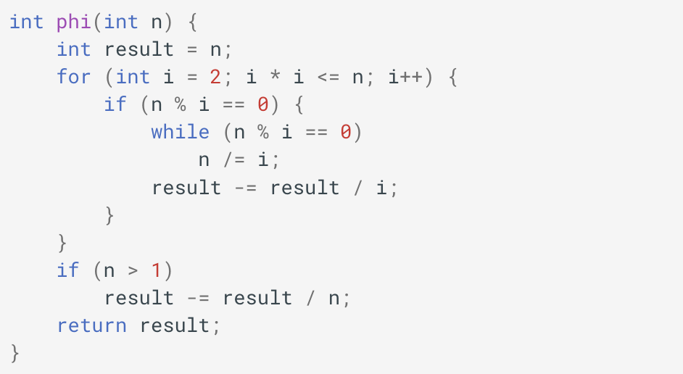
Implementation
Here is an implementation using factorization in O(sqrt(n)):

Slide 10
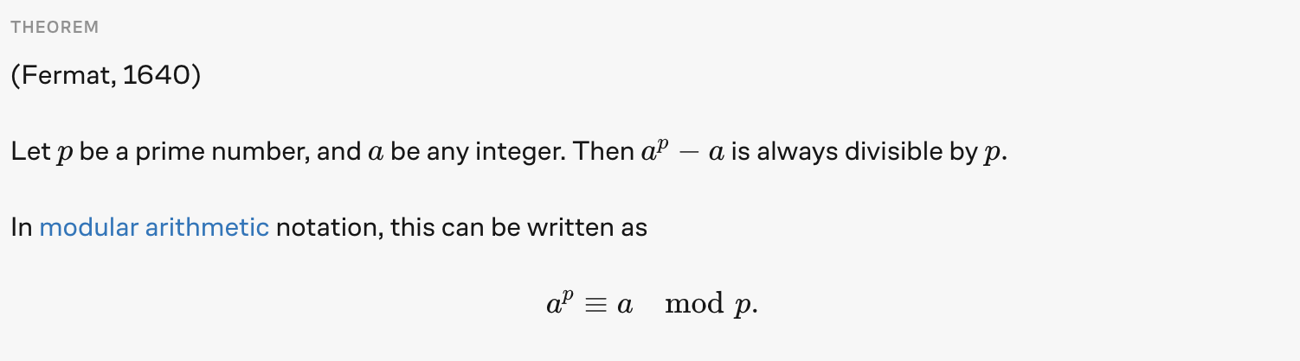
Fermat's little theorem is a fundamental theorem in elementary number theory, which helps compute powers of integers modulo prime numbers.
The result is called Fermat's "little theorem" in order to distinguish it from Fermat's last theorem.
11 is prime, so 2¹¹ – 2 = 2046 is divisible by 11.

Slide 11
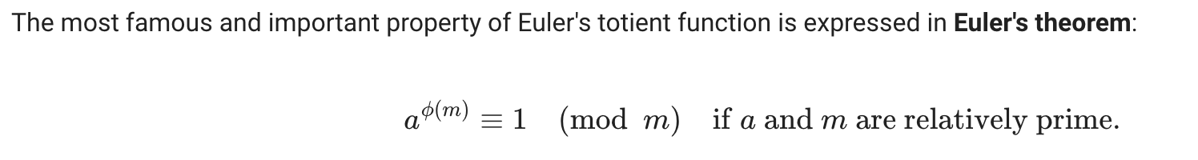
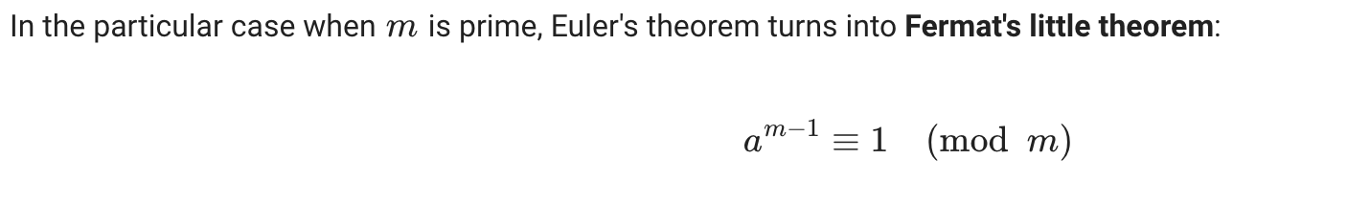
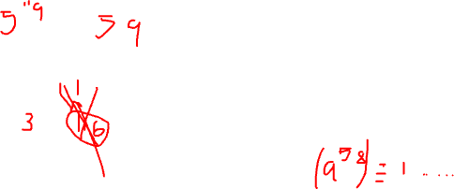
Euler’s generalization of Fermat’s little theorem.

Slide 12
Example 1
What is the remainder if 5¹¹⁹ upon division by 59?

Slide 13
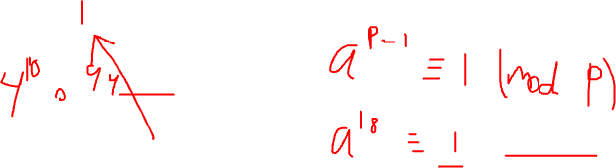
Example 2
What is the remainder of 4¹⁰⁰⁰⁰⁰ upon division by 19?

Slide 14
Example 3
What is the remainder obtained when 2⁷⁰+3⁷⁰ is divided by 13?

Slide 15
Binary exponentiation
It is an algorithm that quickly calculates the power of a number.
For a^{b} , Instead of applying O(b) algorithm, we do O(log(b)).
The idea behind binary exponentiation is extremely simple.
3⁴ = 3 . 3 . 3 . 3 = 81
3⁸ = 3 . 3 . 3 . 3 . 3 . 3 . 3 . 3 = ?

Slide 16
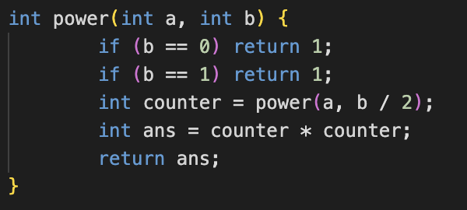
In general,
a^{b} = (a^{b/2})²

Slide 17
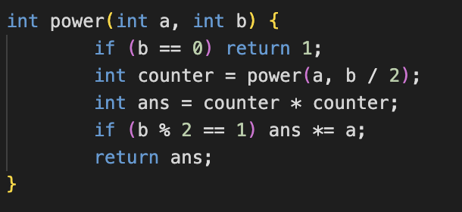
Odd numbers ?

Slide 18
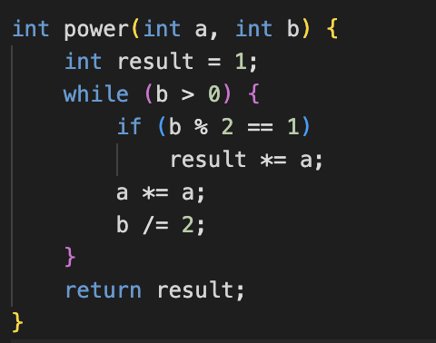
Other method

Slide 19
In binary b = 1011₍₂₎
In the recursive solution, the result variable was multiplied by a only if b is odd. That depends on the last bit of 1011.
Then it will be removed by the recursive step
The same will happen to the second last bit
This process happens recursively.
The result from 101 will be squared.
Which means each bit will contribute some result.
a, a², a⁴ , a⁸ , …

Slide 20
So, by calculating the powers of a base a. (either recursively or iteratively).
Whenever you are asked to compute any power for example, 3⁴⁶
Using 3, 3², 3⁴, 3⁸, 3¹⁶, …
3⁴⁶ = 3³² . 3⁸ . 3⁴ . 3²
Therefore, using the binary representation of the power and an array holding the powers of the base, you can choose which numbers to take. (which the iterative solution will do it for you).

Slide 21
Thank you for attending our session!

