Slide 1





Slide 2

A small review of last week's contest problems
Introduction to Sorting – Overview with example problems
Introduction to Binary Search – Explanation and example problems

Slide 3

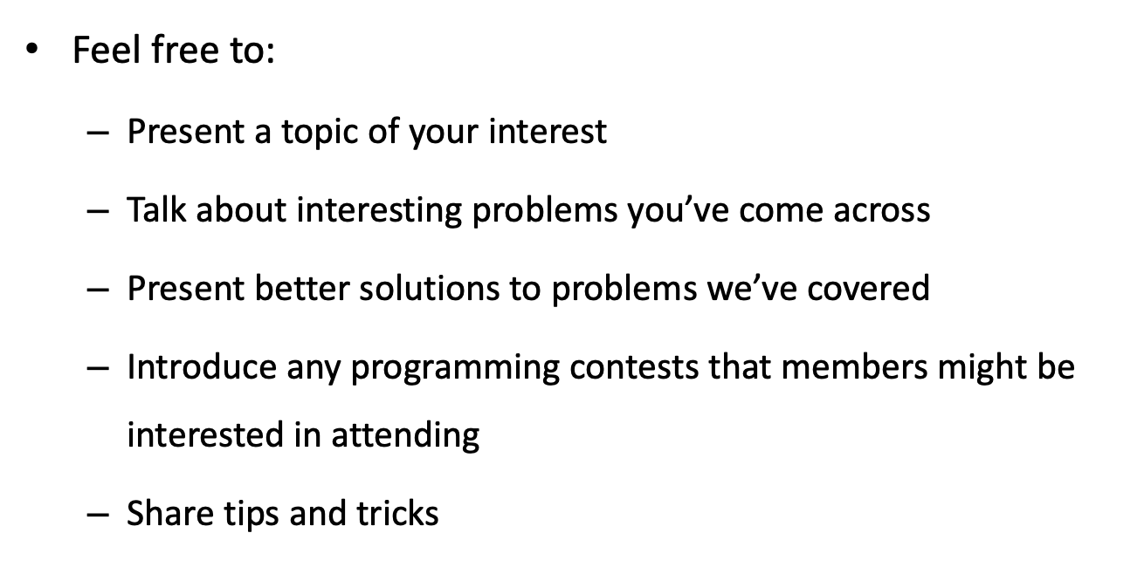

Slide 4
Sorting
A Sorting Algorithm is used to rearrange a given array or list of elements in an order
Many efficient algorithms use sorting as a subroutine, because it is often easier to process data if the elements are in a sorted order.
”does an array contain two equal elements?”
”what is the most frequent element in an array?”

Slide 5
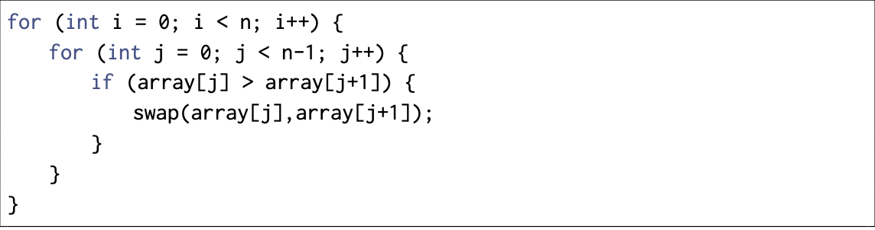
O(n²) algorithms
A famous O(n²) sorting algorithm is Bubble sort.
Bubble sort consists of n rounds. On each round, the algorithm iterates through the elements of the array. Whenever two consecutive elements are found that are not in correct order, the algorithm swaps them

Slide 6

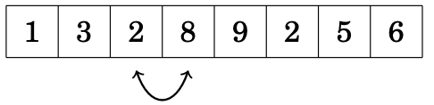
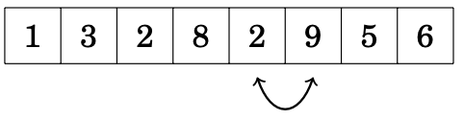
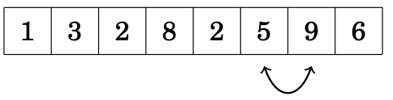
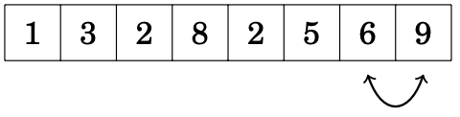

Slide 7
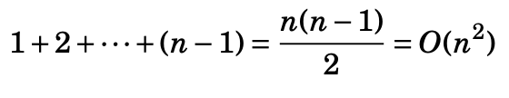
Time-complexity
In the worst case scenario, the area will be sorted in descending order. Therefore, the last element (index i) will need (n - 1) steps to be in the correct position, the element at index (i - 1) will need (n - 1) and so on…
Mathematically:

Slide 8
O(nlogn) algorithms
It is possible to sort an array efficiently in O(nlogn) time using algorithms that are not limited to swapping consecutive elements. One such algorithm is merge sort.
Merge sort is an efficient algorithm, because it halves the size of the subarray at each step. The recursion consists of O(log n) levels, and processing each level takes O(n) time.
Merge sort can be done with or without recursive

Slide 9
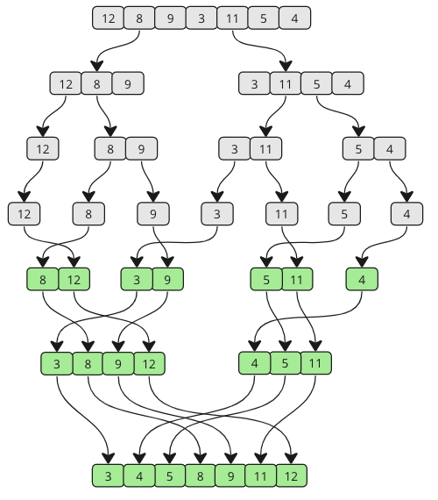

Slide 10
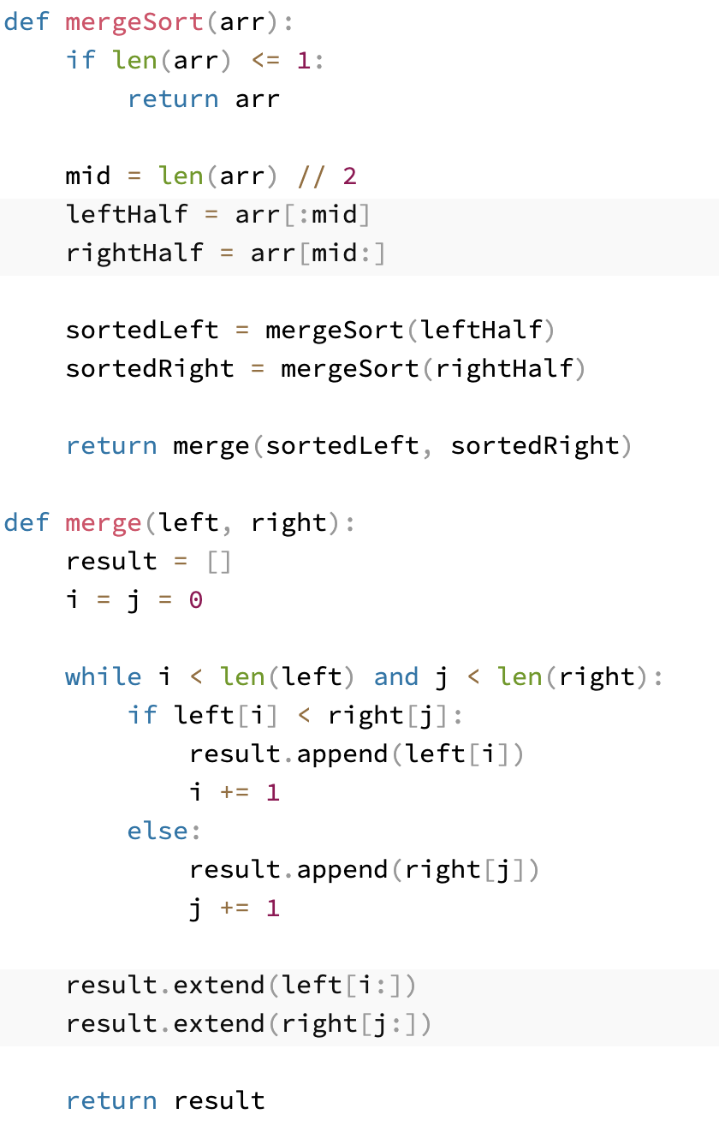

Slide 11
Best time complexity
It can be proven mathematically that the best we can do regarding sorting algoritms is O(nlogn).

Slide 12
Other algorithms
Insertion sort
Quick sort
Counter sort
…

Slide 13
Q: What would the array [7, 2, 6, 3, 1] be after 1 pass of bubble sort?
[2, 6, 3, 1, 7]
[1, 2, 7, 6, 3]
[1, 2, 3, 6, 7]

Slide 14
Q: What is the time-complexity of merge sort?
O(nlogn)
O(n²)
O(logn)

Slide 15
Q: How many steps does it take to sort the following array (ascending order) using merge sort. [6, 5, 4, 3, 2, 1]?

Slide 16
Sorting in C++
Static arrays
Dynamic arrays
(Dynamic) arrays of pairs and tuples

Slide 17
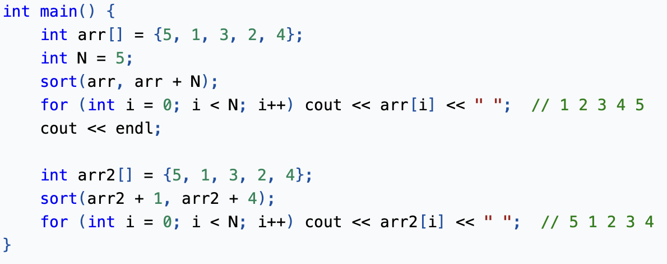
Static Arrays
To sort static arrays, use sort(arr, arr + N), where N is the number of elements to be sorted.
The range can also be specified by replacing arrandarr + Nwith the intended range. For example, sort(arr + 1, arr + 4) sorts indices [1, 4).

Slide 18
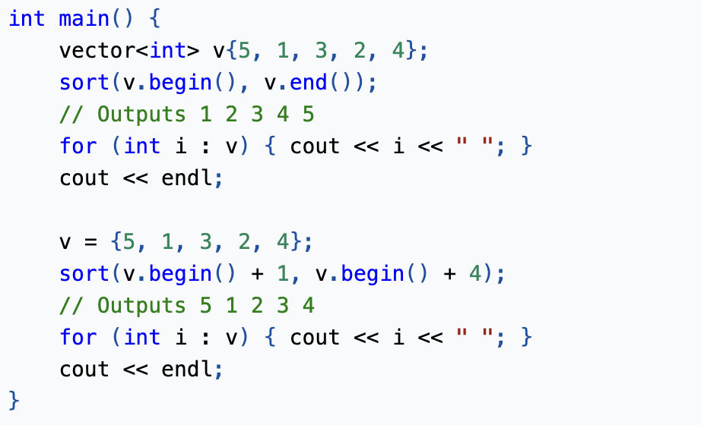
Dynamic Arrays
In order to sort a dynamic array, use sort(v.begin(), v.end()) or sort(begin(v),end(v)).
The default sort function sorts the array in ascending order. Similarly, we can specify the range. For example, sort(v.begin() + 1, v.begin() + 4) sorts indices [1, 4).
.

Slide 19
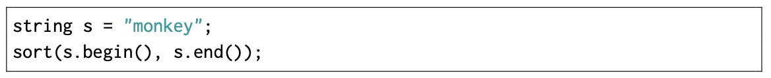
A reverse order is possible as follows:
Strings can also be sorted as follows:

Slide 20
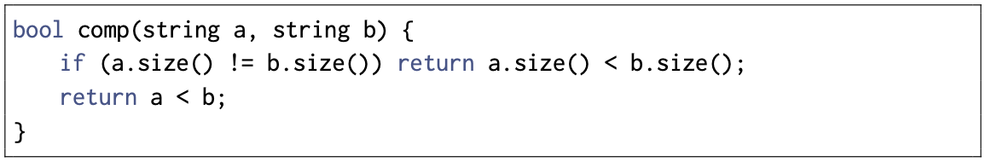
What if we need a specific sorting rule?
We can use comparison tools!
For example, the following comparison function comp sorts strings primarily by length and secondarily by alphabetical order:
Now, a vector of strings can be sorted as follows:

Slide 21
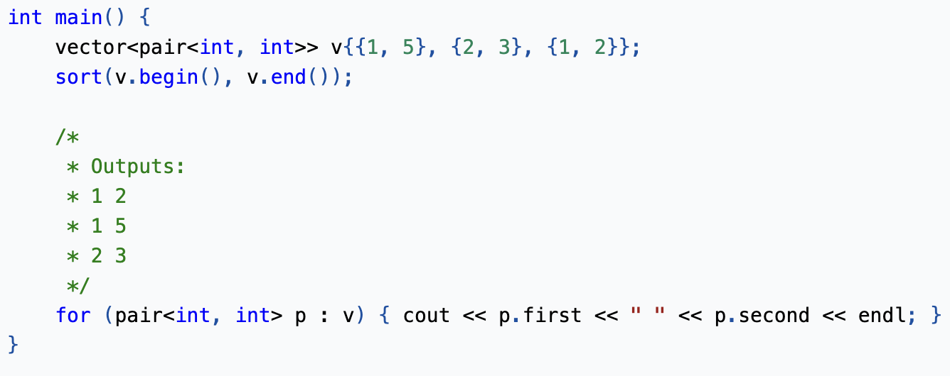
(Dynamic) Arrays of pairs or tuples
By default, C++ pairs are sorted by first element and then second element in case of a tie.

Slide 22
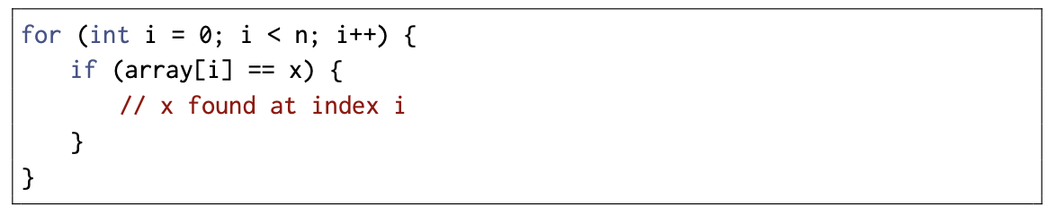
Binary Search
A general method for searching for an element in an array is to use a for loop that iterates through the elements of the array. For example, the following code searches for an element x in an array:
If the array is sorted, the situation is different. In this case it is possible to perform the search much faster, because the order of the elements in the array guides the search. Binary search algorithm efficiently searches for an element in a sorted array in O(log n) time

Slide 23
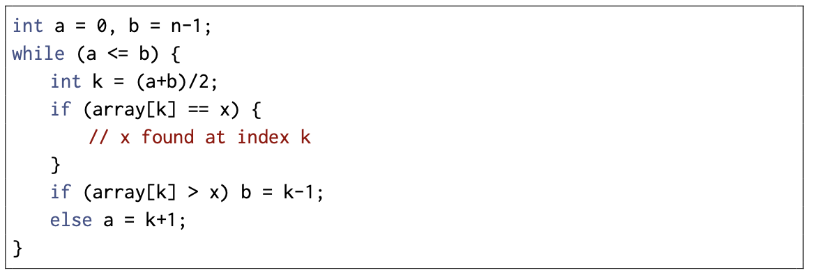
Method 1
At each step, the search checks the middle element of the active region. If the middle element is the target element, the search terminates. Otherwise, the search recursively continues to the left or right half of the region, depending on the value of the middle element.
The algorithm halves the size of the region at each step, so the time complexity is O(log n).

Slide 24
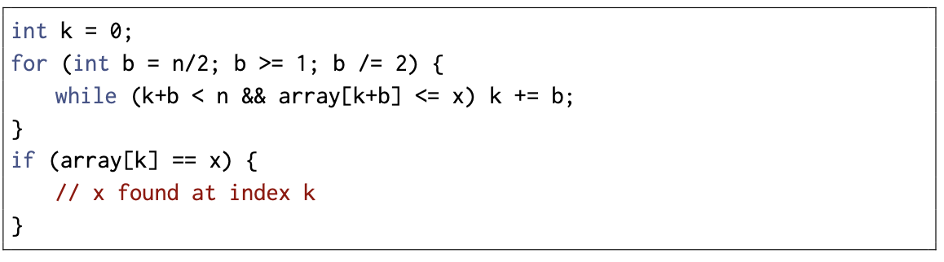
Method 2
The search goes through the array from left to right, and the initial jump length is n/2. At each step, the jump length will be halved: first n/4, then n/8, n/16, etc., until finally the length is 1. After the jumps, either the target element has been found or we know that it does not appear in the array.

Slide 25
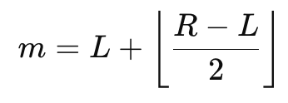
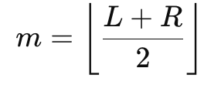
Middle element
Might overflow!

Slide 26
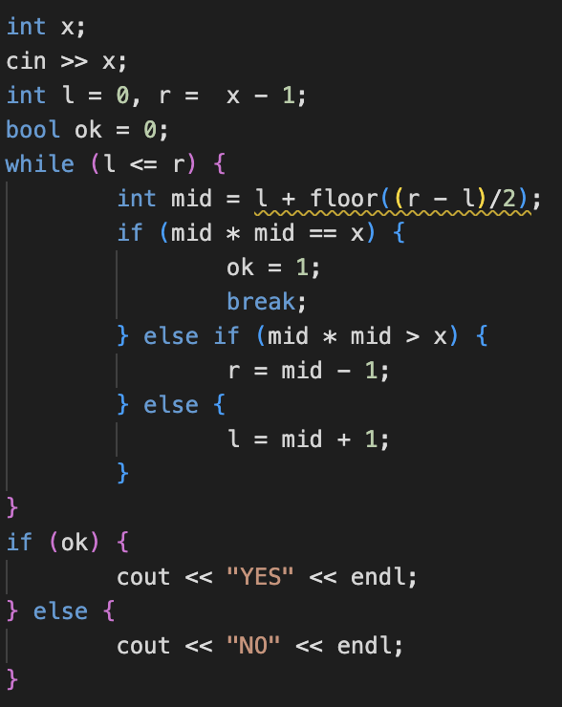
Problem
Q: Is x a square?

Slide 27

Abstract idea
An important use for binary search is to find the position where the value of a function changes. Suppose that we wish to find the smallest value k that is a valid solution for a problem. We are given a function ok(x) that returns true if x is a valid solution and false otherwise. In addition, we know that ok(x) is false when x < k and true when x ≥ k. The situation looks as follows:

Slide 28
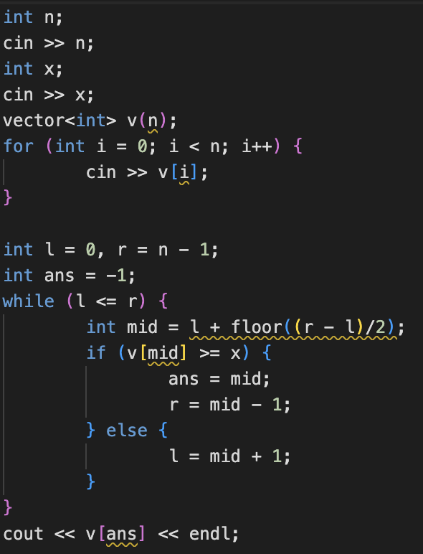
Problem
Q: Find the first value greater than or equal to x.

Slide 29
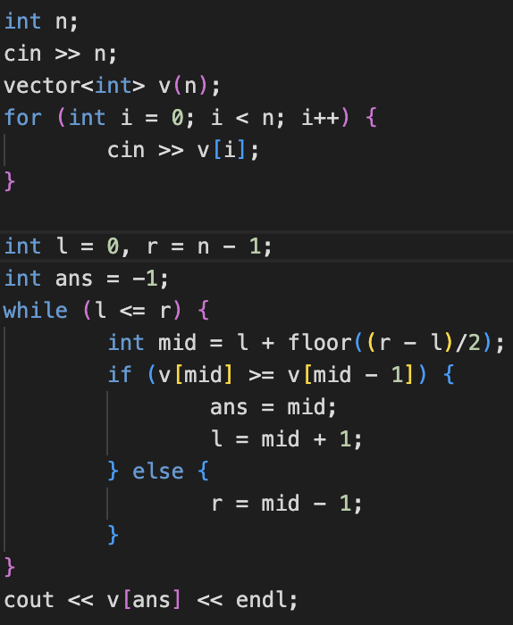
Problem
Q: An array of length n increases and then decreases, find the maximum element.

Slide 30
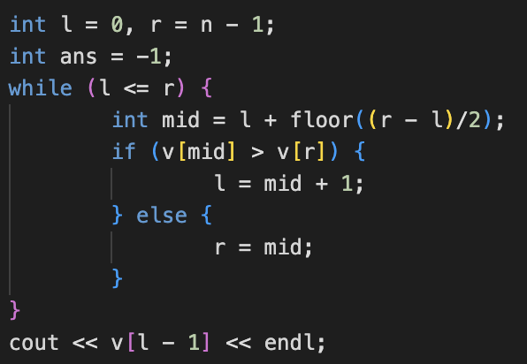
Problem
Q: An array was rotated (shifted) a sorted array (ascending order), find the smallest element.

Slide 31
Thank you for attending our session!

