Slide 1


Session 9: Prefix sum
December 4th

Slide 2

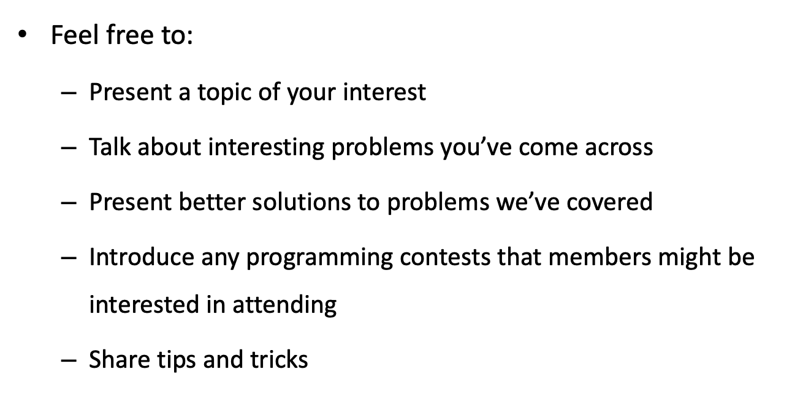

Slide 3
Introduction to prefix sum
Computing range sum queries in constant time over a fixed 1D array.
1 + 2 + 3 + 4 + 5 + 6 + 7 + 8 + 9 + 10 = 55
3 + 4 + 5 + 6 + 7 + 8 + 9 + 10 = ?

Slide 4
Prefix sums
0
3 5 6 9 10 14 16
a = [3, 2, 1, 3, 1, 4, 2]
“Prefix of length k” = “The first k elements”

Slide 5
We need to be careful with indices:
pref[k] = sum of the first k elements
pref[i] = pref[i – 1] + a[i – 1]
pref[i + 1] = pref[i] + a[i]
i | 0 | 1 | 2 | 3 | 4 | 5 | 6 | 7
a[i] | 3 | 2 | 1 | 3 | 1 | 4 | 2
pref[i] | 0 | 3 | 5 | 6 | . | . | . | .

Slide 6
Therefore, we can get the sum of elements in the range [a, b]:
a = [3, 2, 1, 3, 1, 4, 2]
sum(L..R) = pref[R + 1] + pref[L]
2 5
pref[] = 0 3 5 6 9 10 14 16

Slide 7
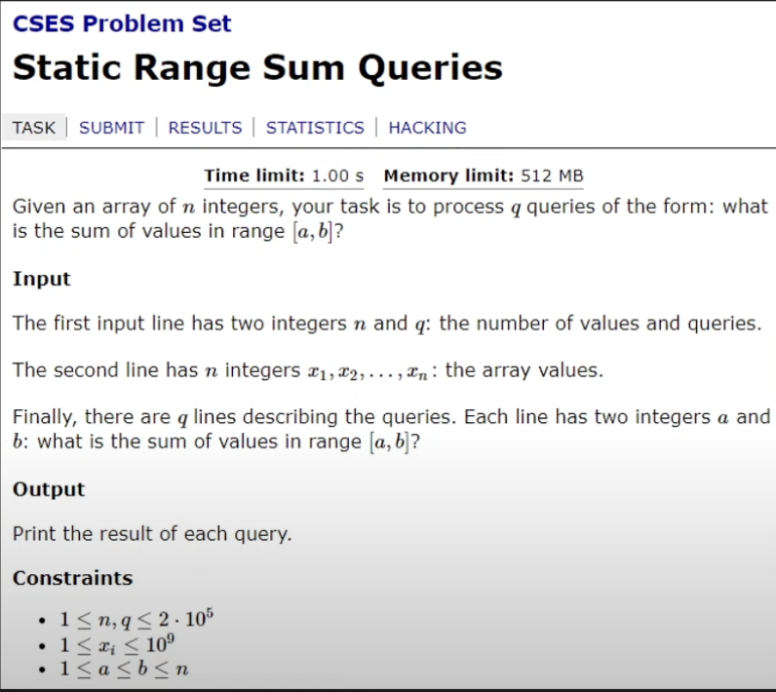
BRUTE FORCE:
For every query [a, b]:
sum = 0
for i in [a,b]
sum += x[i]
print(sum)
Time complexity?
O(q x n)

Slide 8
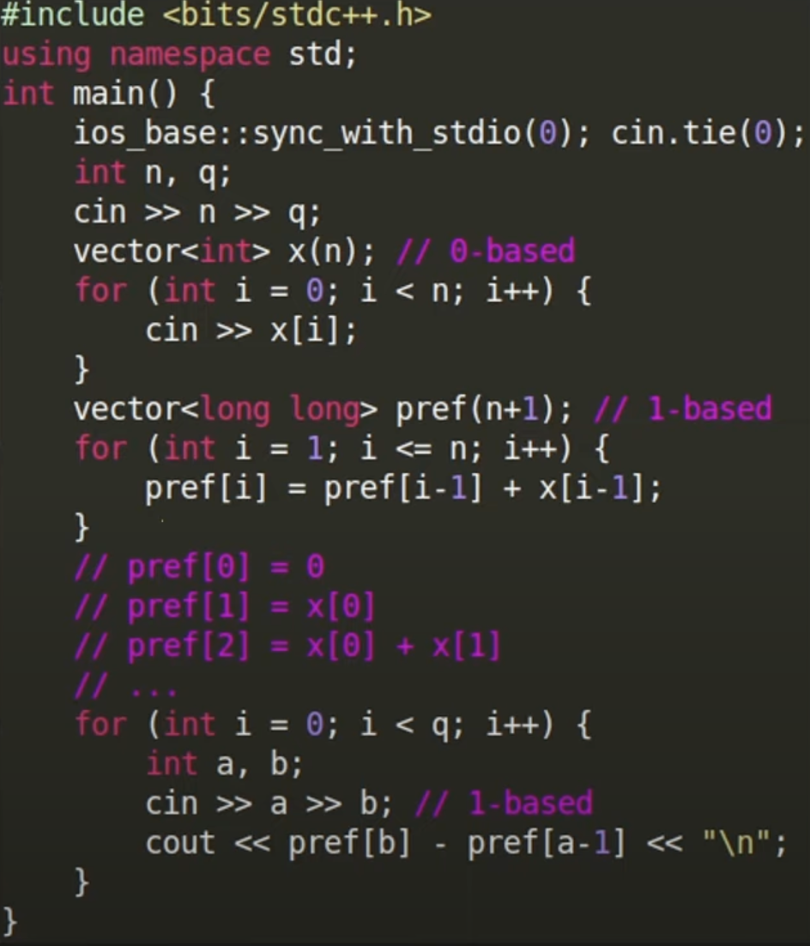
Solution Time complexity?

Slide 9
You are given a string S of length N. Answer Q queries: Given L and R: find the most common character in the substring S[L..R].
S = “abcccabaaabb”

Slide 10
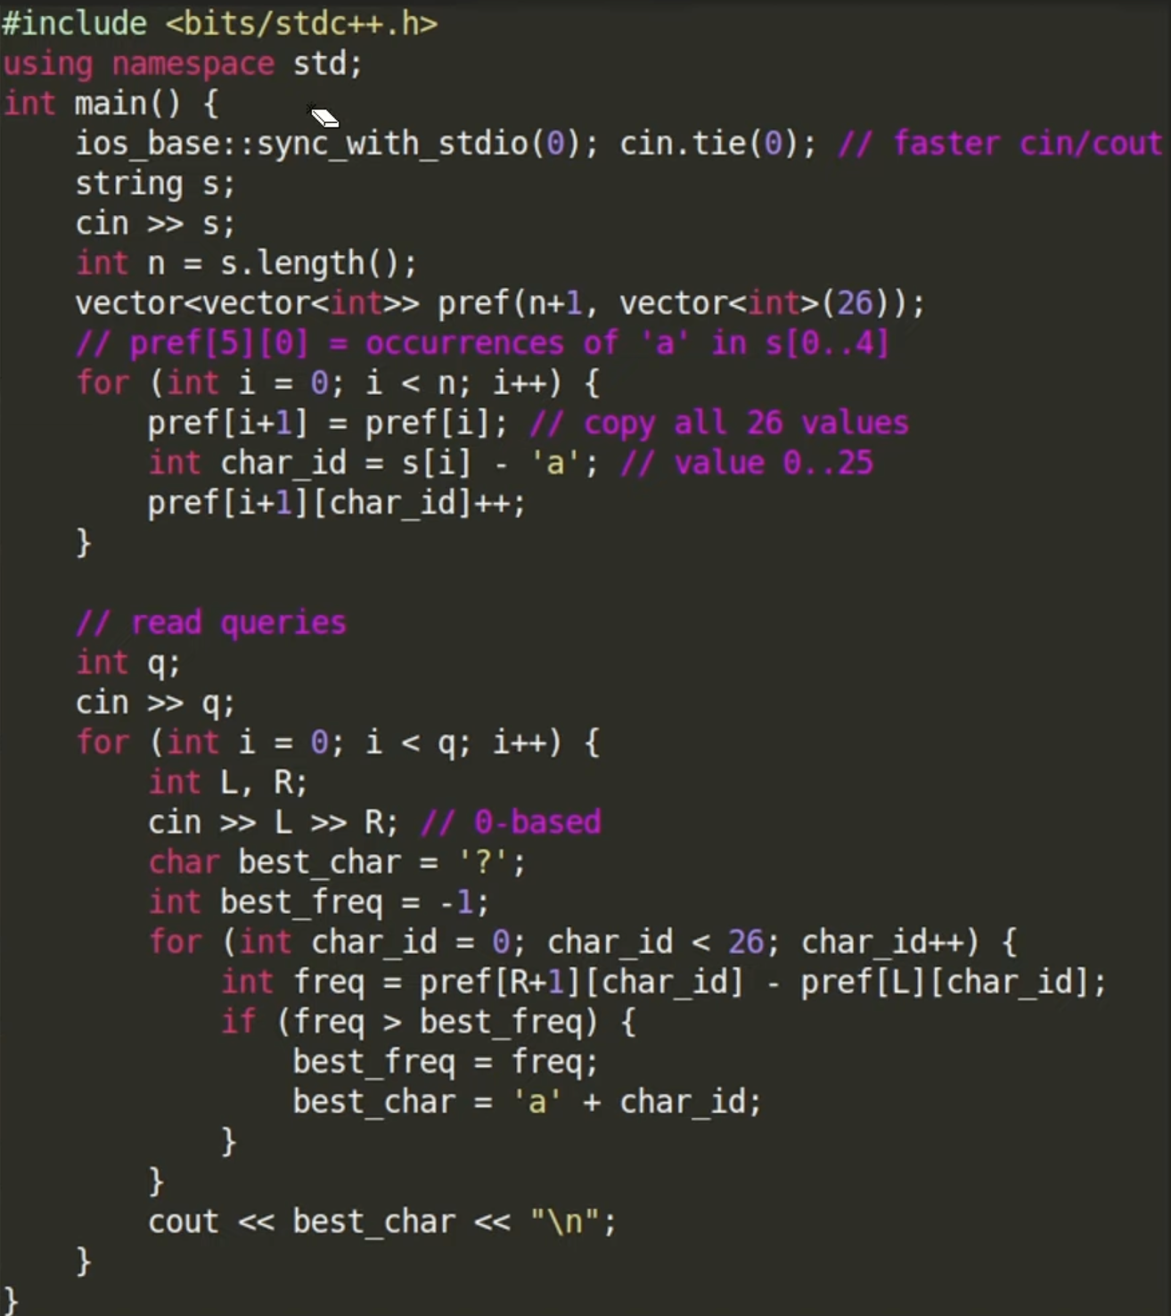
Solution Time complexity?
For the pre-processing part, O(26 x N), and for each query, O(q x 26)
Therefore, O(26xN + qx26)
More generally,
O(AxN + qxA), where A is a constant, and represents the number of possible characters in the string.

Slide 11
Prefix sum does not work with all operations For any array (length = 9): ___ ___ ___ ___ ___ ___ ___ ___ ___ if pref[8] = 20 and pref[3] is also 20, then there is not way of knowing what is the max in the range with indices [3, 7]

Slide 12
You are given an array a[N] and Q updates. An update consists of three numbers L, R, X. You need to increase all elements at indices [L..R] by +X. Print the final sequence. N, Q <= 100,000

Slide 13
Solution
For an array a: (we want to add x to the region highlighted)
___ ___ ___ ___ ___ ___ ___ ___ ___
We can add five to the first element in that region and then do prefix sums:
___ ___ _+5_ ___ ___ ___ ___ ___ ___
This +5 will propagate everywhere to the end of the array though, so we need to cancel the effect of the +5. We can add -5:
___ ___ _+5_ ___ ___ ___ _-5_ ___ ___
Therefore, we need to add 5 at index L, and subtract 5 at index R + 1, and run prefix sums at the end.

Slide 14
Pseudocode
pref = [array of N+1 zeros]
for every query (L, R, X):
pref[L] += x
pref[R+1] -= x
for every i:
pref[i] += pref[i-1]
for every i:
print(a[i] + pref[i])

Slide 15
Thank you for attending our session!

