Slide 1

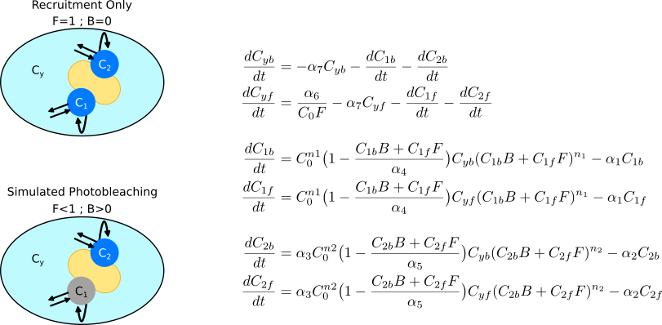
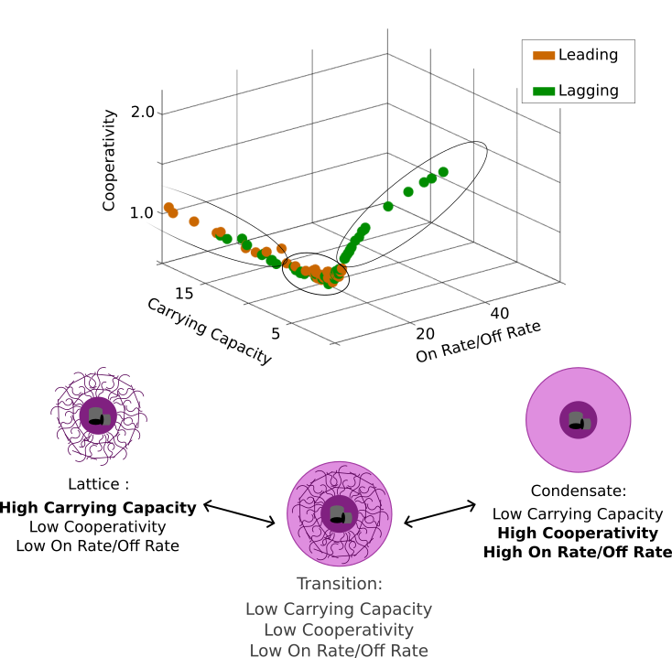
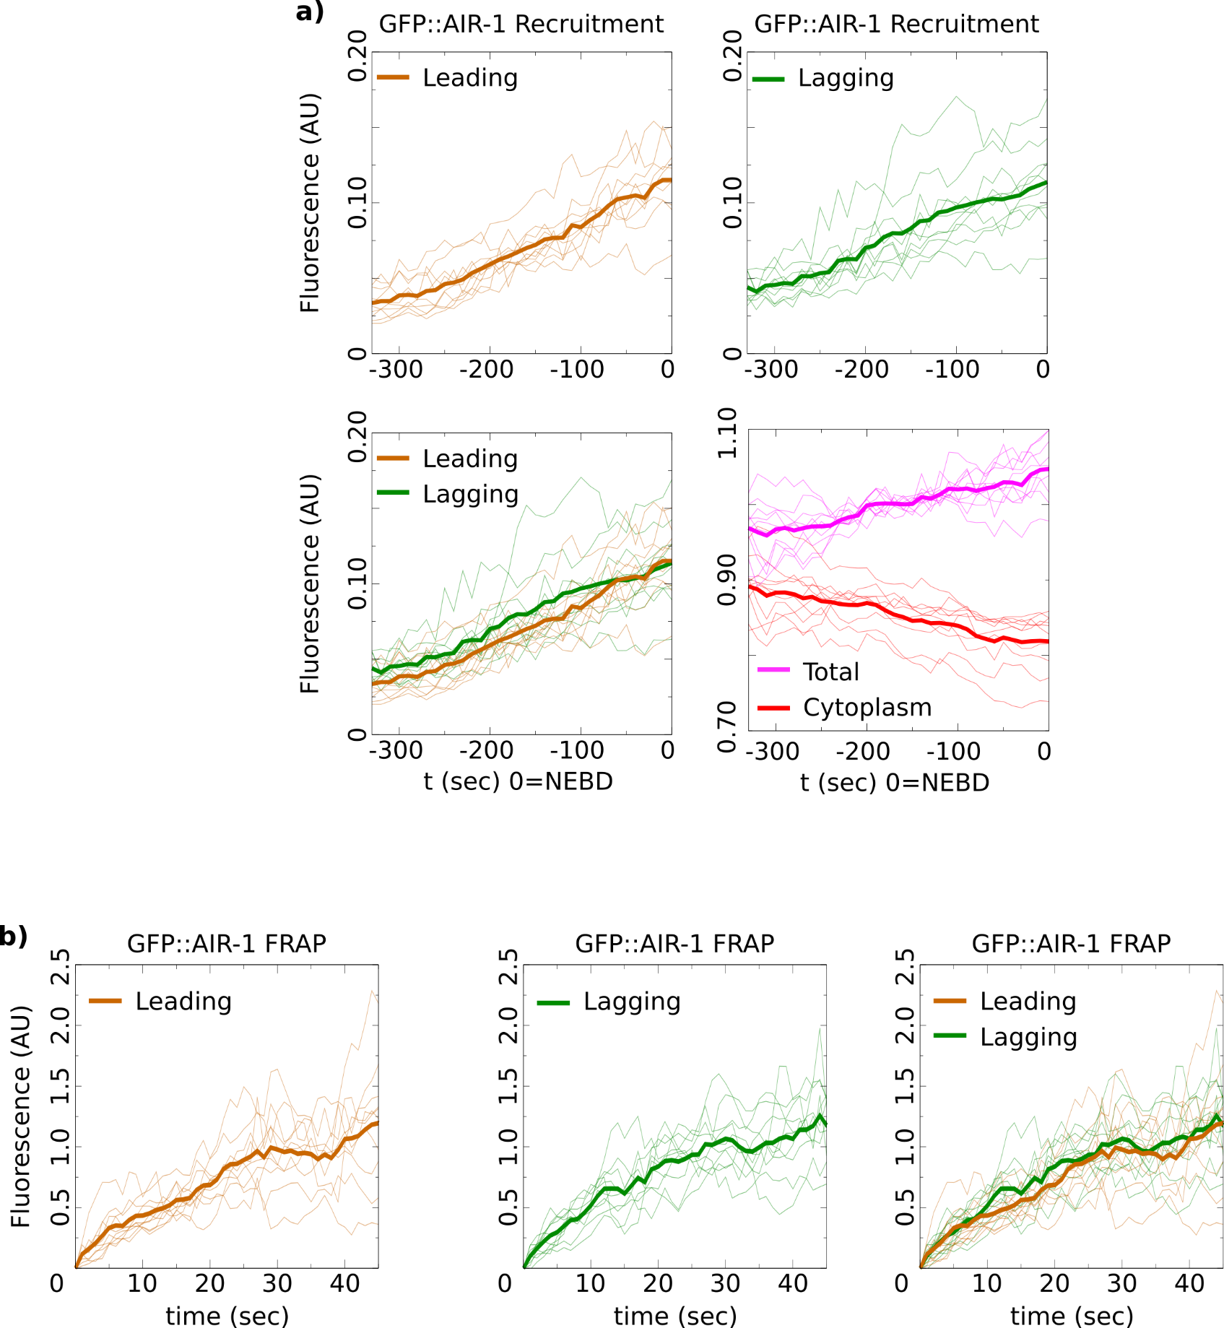
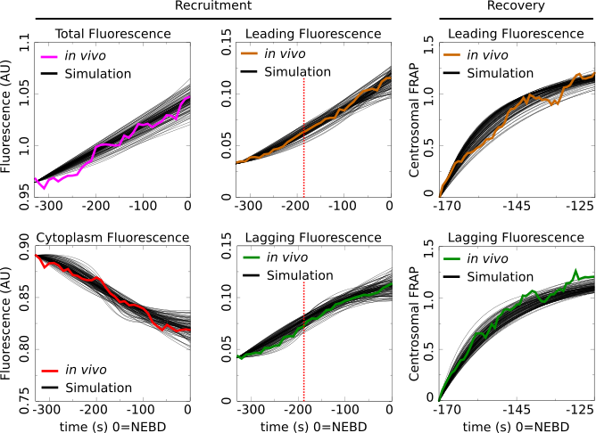
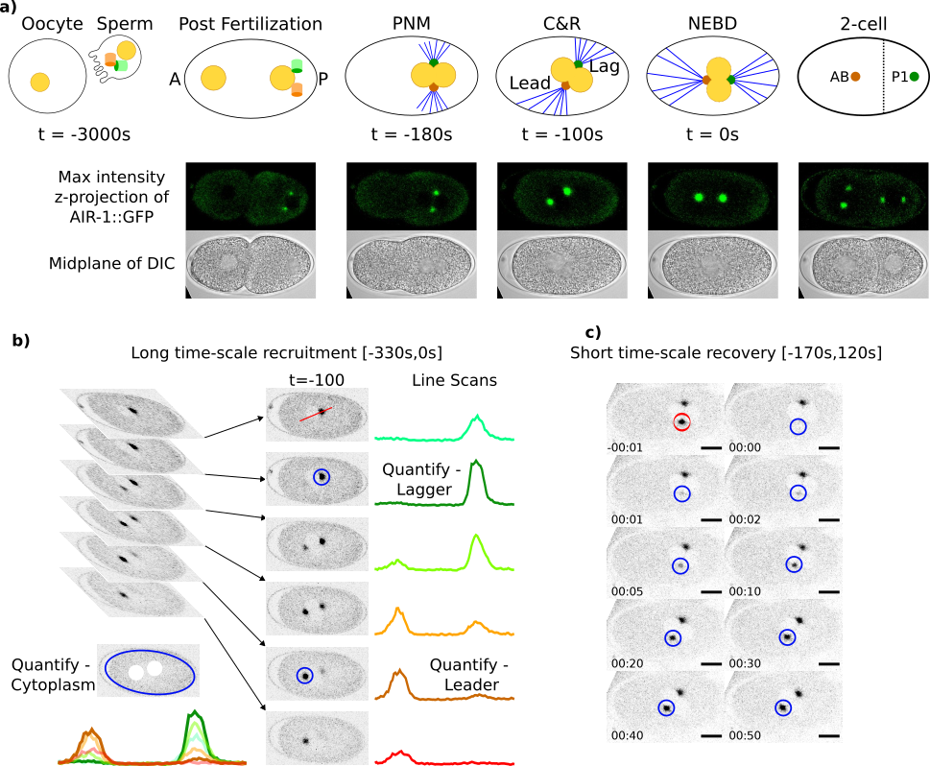
Asymmetric Centrosome Maturation in the Early C. elegans Embryo Revealed by Multi-scale Microscopy and Mathematical Modeling Shayne M. Plourde¹, Natalia Kravtsova², Adriana Dawes^{1,2} ¹ The Ohio State University, Department of Molecular Genetics, Columbus, Ohio ² The Ohio State University, Department of Mathematics, Columbus, Ohio
`
My personal website:
shayne-falco.github.io
INTRODUCTION
The process with which cells position their centrosomes is critically important for proper cell divisions. Centrosomes are the main microtubule organizing centers of the cell and abnormal positioning during cell division is one potential cause leading to cancer metastasis.
Microtubule (MT) Array Asymmetry
Our lab previously reported an asymmetry in the size and density of the MT arrays from the two centrosomes during the first cellular division of the C. elegans embryo. The source of this asymmetry is currently unknown.
We use c. elegans as a model for asymmetric cell division and centrosome placement because the steps leading up to the first asymmetric cell division are tightly regulated (Fig. 1a). We analyze the fluorescence intensity of a GFP tagged AIR-1, a factor found in the centrosome that is required for microtubule nucleation in both centrosomes.
Leading centrosome found in the anterior (larger) cell.
Lagging centrosome found in the posterior (smaller) cell.
RESULTS
Figure 3. A 3 Compartment Model of Centrosome Recruitment and Recovery After Photobleaching
Figure 5. Parameter Space Shows Asymmetry in Centrosome Structural Composition
Figure 2. Asymmetric Centrosome Recruitment and Recovery Revealed by a Precise Quantification
3 compartment mathematical model of a maturation factor that can localize to the simulated cytoplasm (C_{y}), or the two centrosome compartments (C₁, C₂). To incorporate the ability to photobleach the model factor we track both a fluorescent version (f) and a bleached version (b) of the maturation factor. Dynamics for the system accounted for both version of the factor to be as biologically relevant as possible. b) Model equations with a dynamic cytoplasm and centrosome compartment that have a carrying capacity, cooperativity, and basal gain and loss terms.
The centrosome compartment parameters represent the overall structural composition of the centrosomes. To visualize the possibilities revealed by our parameter search we plotted all parameter sets on 3D plot with axis for cooperativity, carrying capacity, and the ratio of the on rate to the off rate. We saw that the parameters were confined to a well-defined region of this parameter space. This region is defined by two arms reaching out to high levels of carrying capacity and also to high cooperativity and on rate to off rate ratio. There is a region connecting these two arms where all 3 parameter values are relatively low.
a) Leading centrosome, lagging centrosome, cytoplasmic, ad the total cell fluorescence intensities of GFP::AIR-1 were precisely quantified and then normalized. The average intensity of the lagging centrosome was observed to be higher than that of the leading centrosome. b) Fluorescence recovery after photobleaching (FRAP) was recorded for 10 leading and 10 lagging centrosomes and normalized as per standard protocols. The final concentrations of the recovery curves were similar for both compartments.
Figure 4. Parameter Sets that Recapitulate in vivo Recruitment & Recovery Data
Figure 1. Imaging Fluorescent Centrosomes in the First Division of C. elegans Development
DISCUSSION
C. Elegans Centrosomes are asymmetric in the early embryo.
By combining a precise quantification of a factor required for proper MT nucleation and mathematical modeling we found that the leading and the lagging centrosomes have different dynamics and possibly different structural compositions.
Emergent Centrosome Structural Asymmetry
The two extremes of the parameter space coincide with previously published biological hypotheses of centrosome structure (Fig. 5b). Our model gives these three structures a common model and may explain the recently reported progression of centrosomes from a liquid condensate state to a more ridged lattice state.
Statistical Analysis Shows Asymmetries
Our newly publish Gromov-Wasserstein based distance metric was used to identify any potential differences between the shapes of the calculated recruitment and recovery curves.
The recruitment did not show a difference between leading and lagging centrosomes. The recruitment on the long time-scale shows that the average fluorescence in the lagging centrosomes is greater than the leading centrosome (Fig. 2a).
The FRAP curves show similar final recovery amounts, however analysis shows distinct recovery dynamics between the two centrosomes (Fig. 2b).
Using a parameter search based on our MCMC method we were found 112 parameter sets that fit the model’s maturation factor to the observed AIR-1::GFP data. These parameter sets all independently fit to the 6 data curves with a low error as calculated by the sum of absolute differences.
MATHEMATICAL MODELING
To uncover potential mechanisms responsible for the reported centrosomal dynamics, we turned to mathematical modeling. A 3-compartment model representing the two centrosomes as well as the cytoplasm was constructed to simulate a maturation factor’s recruitment and recovery in a one-cell embryo (Fig. 3).
Parameter Space of the Model Reveals Structural Features of the Centrosomes
There are three features that define the structural dynamics of the centrosome compartments in the model. The cooperativity, carrying capacity, and the ratio of the on rate to the off rate. Plotting all 112 parameter sets on a 3D plot with these features as the axis and differentiating the leading from the lagging centrosome revealed a high level of restriction to the location of possible parameters (Fig. 5).
REFERENCES
a) The steps leading up to first division are fertilization, pronuclear meeting (PNM), centration and rotation (C&R), and Nuclear envelope breakdown (NEBD). NEBD is used to mark a time of 0 as it coincides with when the centrosomes have been properly placed for cell division. C) Recruitment was quantified every 10 seconds from 330 seconds before NEBD to 0 seconds. Blue circles represent the quantified regions representing the middle of the centrosome and the average of all stacks with centrosomes masked out representing the cytoplasmic fluorescence intensity. c) Recovery was quantified immediately after pronuclear meeting (PNM) every second for 50 seconds.
References style should be: Authors Names, Year Published, Name of Journal, Volume(Issue):Pages.
Grebmeier et al., 2006, Science, 311(5766):1461-1664.
Golubova et al., 2009, Journal of Marine Biology, 35(7):593-608.
Flint, 2003, Marine Biology, 160(1):59-65.
Mizobata et al., 2010, Journal of Oceanography, 66(3):405-424.
You need at least 10 references total for your poster. 6 of these need to be journal articles (these are also called primary sources), the remaining 4 references can be secondary sources (e.g., newspaper, magazine, documentary) or primary sources.
Of these 10 total references, you will want to find 2-3 for the introduction section, 2-3 for the methods section, 2-3 for the results section and 2-3 for the discussion section. You need a
Johns and Arnot, 2019, Environmental Science & Technology, 53(1):113-117.
Sorrykumar et al., 2012, Infection & Immunity, 213(12):11456-11461.
Yang and Brown, 2018, Journal of Biological Chemistry, 347(18):1450-1459.
ACKNOWLEDGEMENTS
Here is where you acknowledge collaborators and funding agencies, either with text or with thei logos.

