Slide 1

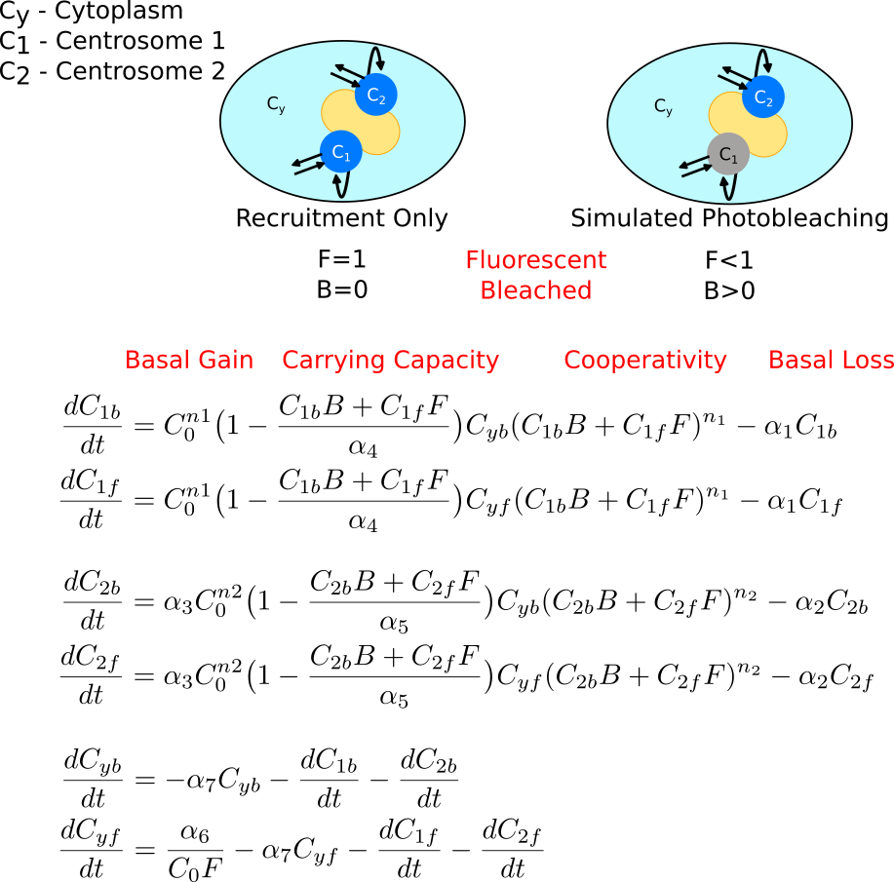
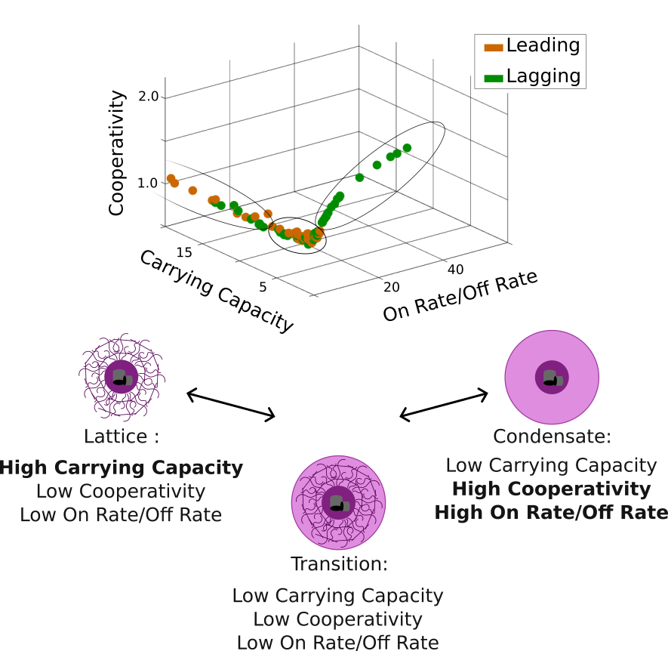
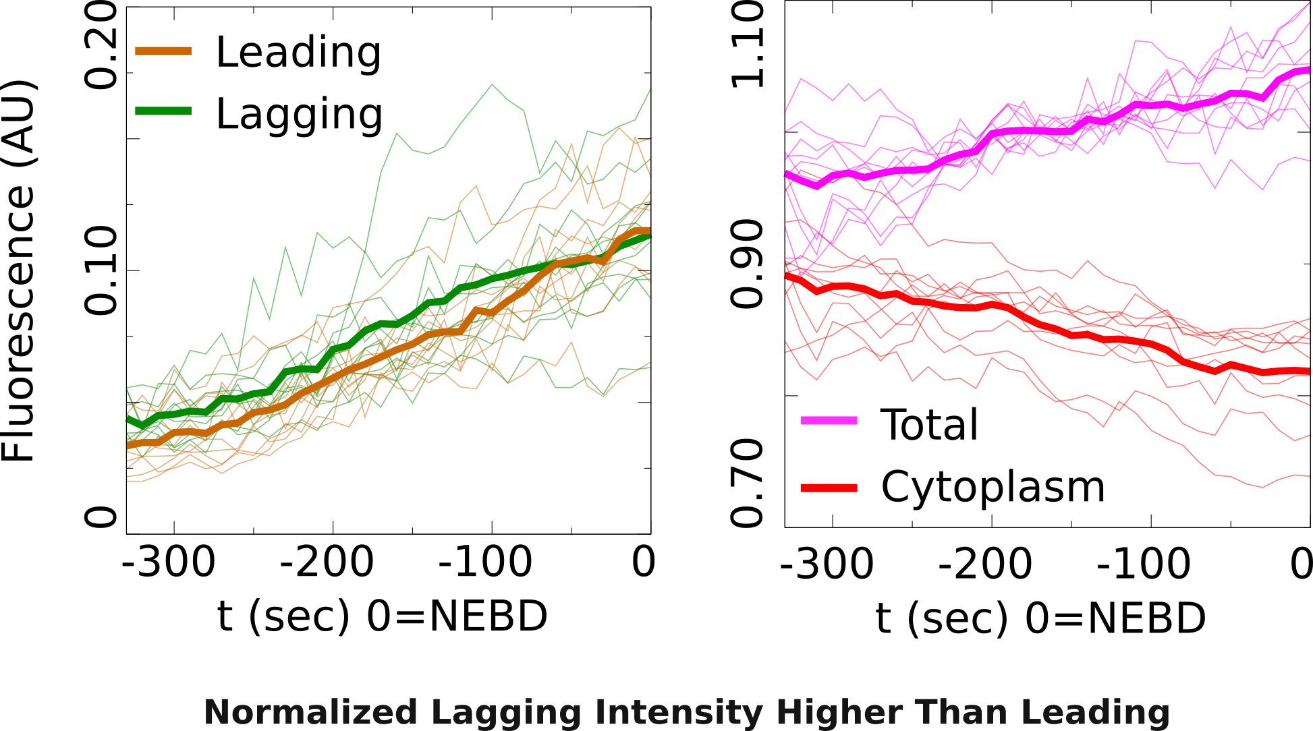
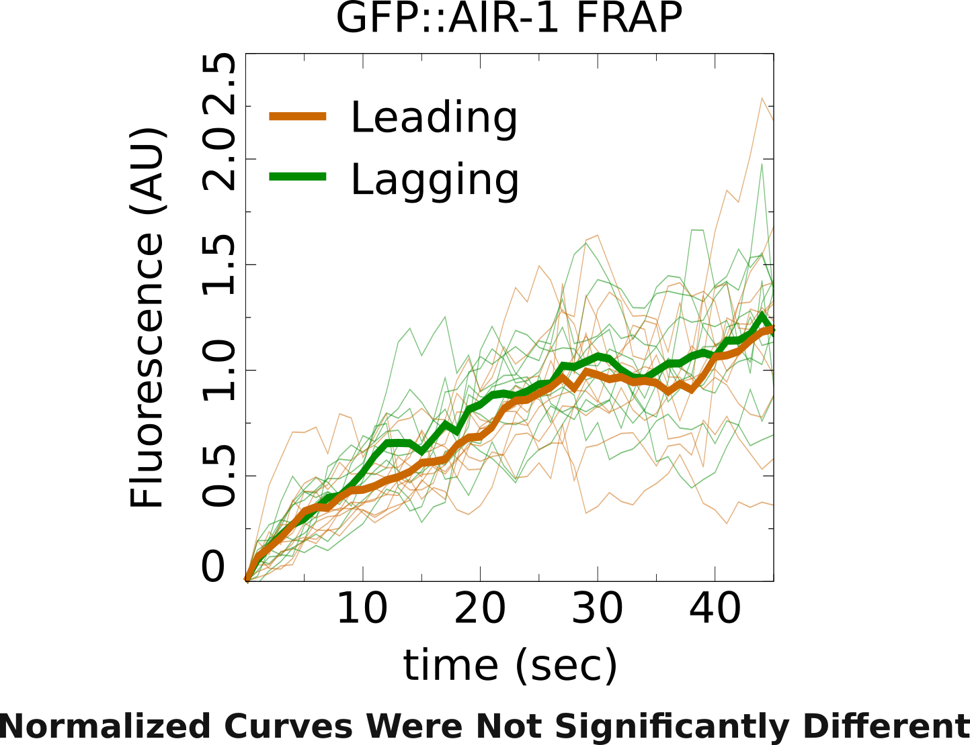
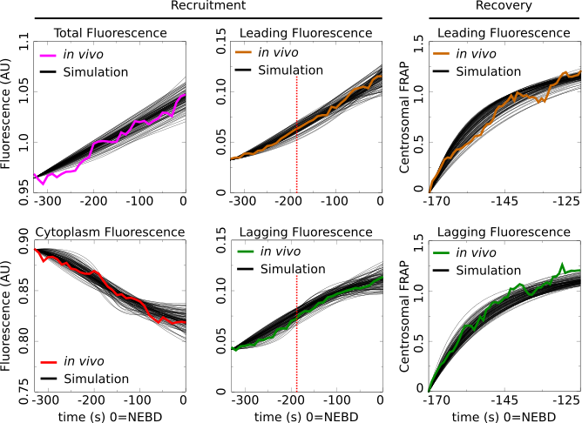
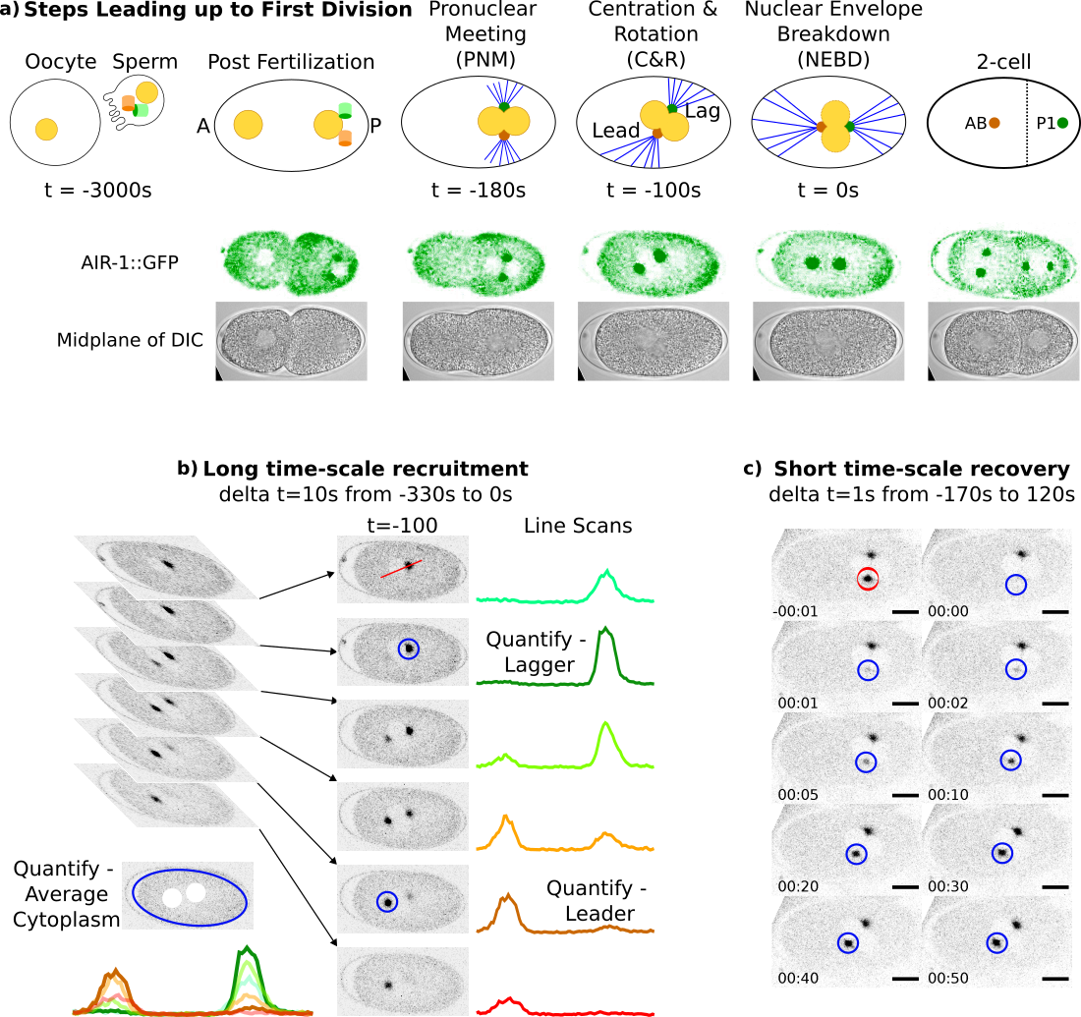


Asymmetric Centrosome Maturation in the Early C. elegans Embryo Revealed by Multi-scale Microscopy and Mathematical Modeling Shayne M. Plourde¹, Natalia Kravtsova², Adriana Dawes^{1,2} ¹ The Ohio State University, Department of Molecular Genetics, Columbus, Ohio ² The Ohio State University, Department of Mathematics, Columbus, Ohio
`
My personal website:
shayne-falco.github.io
INTRODUCTION
The process by which cells position their centrosomes is critically important for proper cell divisions^{1,2}. Centrosomes are the main microtubule organizing centers of the cell and abnormal positioning during cell division is one potential cause leading to cancer metastasis³.
Microtubule (MT) Array Asymmetry in C. elegans
We use C. elegans as a model for asymmetric cell division and centrosome placement because the steps leading up to the first asymmetric cell division are tightly regulated⁴ (Fig. 1a).
Our lab previously reported an asymmetry in the size and density of the MT arrays from the two centrosomes during the first cellular division of the C. elegans embryo⁵. The source of this asymmetry is currently unknown.
We analyze the fluorescence intensity of a GFP tagged AIR-1, a factor found in the centrosome that is required for microtubule nucleation in both centrosomes.
Leading centrosome found in the anterior (larger) cell.
Lagging centrosome found in the posterior (smaller) cell.
RESULTS
Figure 3. 3-Compartment Model of Centrosome Recruitment & Recovery After Photobleaching
Figure 5. Parameter Space Shows Asymmetry in Centrosome Structural Composition
Figure 2. Asymmetric Centrosome Recruitment & Recovery Revealed by Precise Quantification
Figure 1. Imaging Fluorescent Centrosomes Leading up to the First Division of C. elegans
Figure 4. 112 Parameter Sets that Recapitulate in vivo Recruitment & Recovery Data
DISCUSSION
Early embryo C. elegans Centrosomes are asymmetric.
Combining a precise quantification of a factor required for MT nucleation and mathematical modeling we found that the leading and the lagging centrosomes have different dynamics.
Emergent Centrosome Structural Asymmetry
The two extremes of the parameter space coincide with previously published biological hypotheses of centrosome structure (Fig. 5b). Our model gives these three structures a common model and may explain the recently reported progression of centrosomes from a condensate to a lattice⁹.
FUTURE DIRECTIONS
Expanding in vivo & in silico Work to New Factors
We will investigate the recruitment, recovery, and maturation of more centrosomal factors. Of particular interest will be factors granting the centrosome its strength.
With a larger data set we will also be able to expand our mathematical model to include more terms and more dynamic interactions.
Statistical Analysis Shows Asymmetries
Our recently published Gromov-Wasserstein based distance metric was used to identify any potential differences between the shapes of the calculated recruitment and recovery curves⁷.
The recruitment did not show a difference between leading and lagging centrosomes indicating that their dynamics were overall similar. However, the recruitment in the lagging centrosomes is greater than the leading centrosome until ~-50s which would not be captured by this analysis (Fig. 2).
The FRAP curve analysis identified distinct recovery dynamics between the two centrosomes even though the curves recovered to the same final amount (Fig. 2).
Using a parameter search based on our MCMC method⁸ we were found 112 parameter sets that fit the model’s maturation factor to the observed AIR-1::GFP data.
Parameter Space of the Model Reveals Structural Features of the Centrosomes
Three features define the structural dynamics of the centrosome compartments in the model. The cooperativity, carrying capacity, and the ratio of the on rate to the off rate.
Plotting all 112 parameter sets on a 3D plot with these features as the axis and differentiating the leading from the lagging centrosome revealed a high level of restriction to the location of possible parameters (Fig. 5).
MATHEMATICAL MODELING
A 3-compartment model representing the two centrosomes as well as the cytoplasm was constructed to simulate a maturation factor’s recruitment and recovery in a one-cell embryo (Fig. 3).
REFERENCES
Meraldi et al., 2016, Chromosome Res. 24:19-34
Yamashita et al., 2009, Frontiers in Bioscience, (14):3003
Pancione et al., 2021, Biomolecules, 11(5): 629
Rose et al., 2014, WormBook, Dec 30:1-43.
Coffman et al., 2016, MBOC, 27(22):3550–3562.
Kress et al., 2013, JCB, 201(4):559-575
Kravtsova et al. 2023, Bulletin of Mathematical Biology 85(8)
Kravtsova et al. 2023, Scientific reports 13(1), 16285.
Woodruff 2021, Curr Opin Strruct Biol. 66:139-147
AKNOWLEDGMENTS
We would like to thank our funding agencies, NSF & NIH, as well as The Ohio State University and the MCDB graduate program

