Slide 2
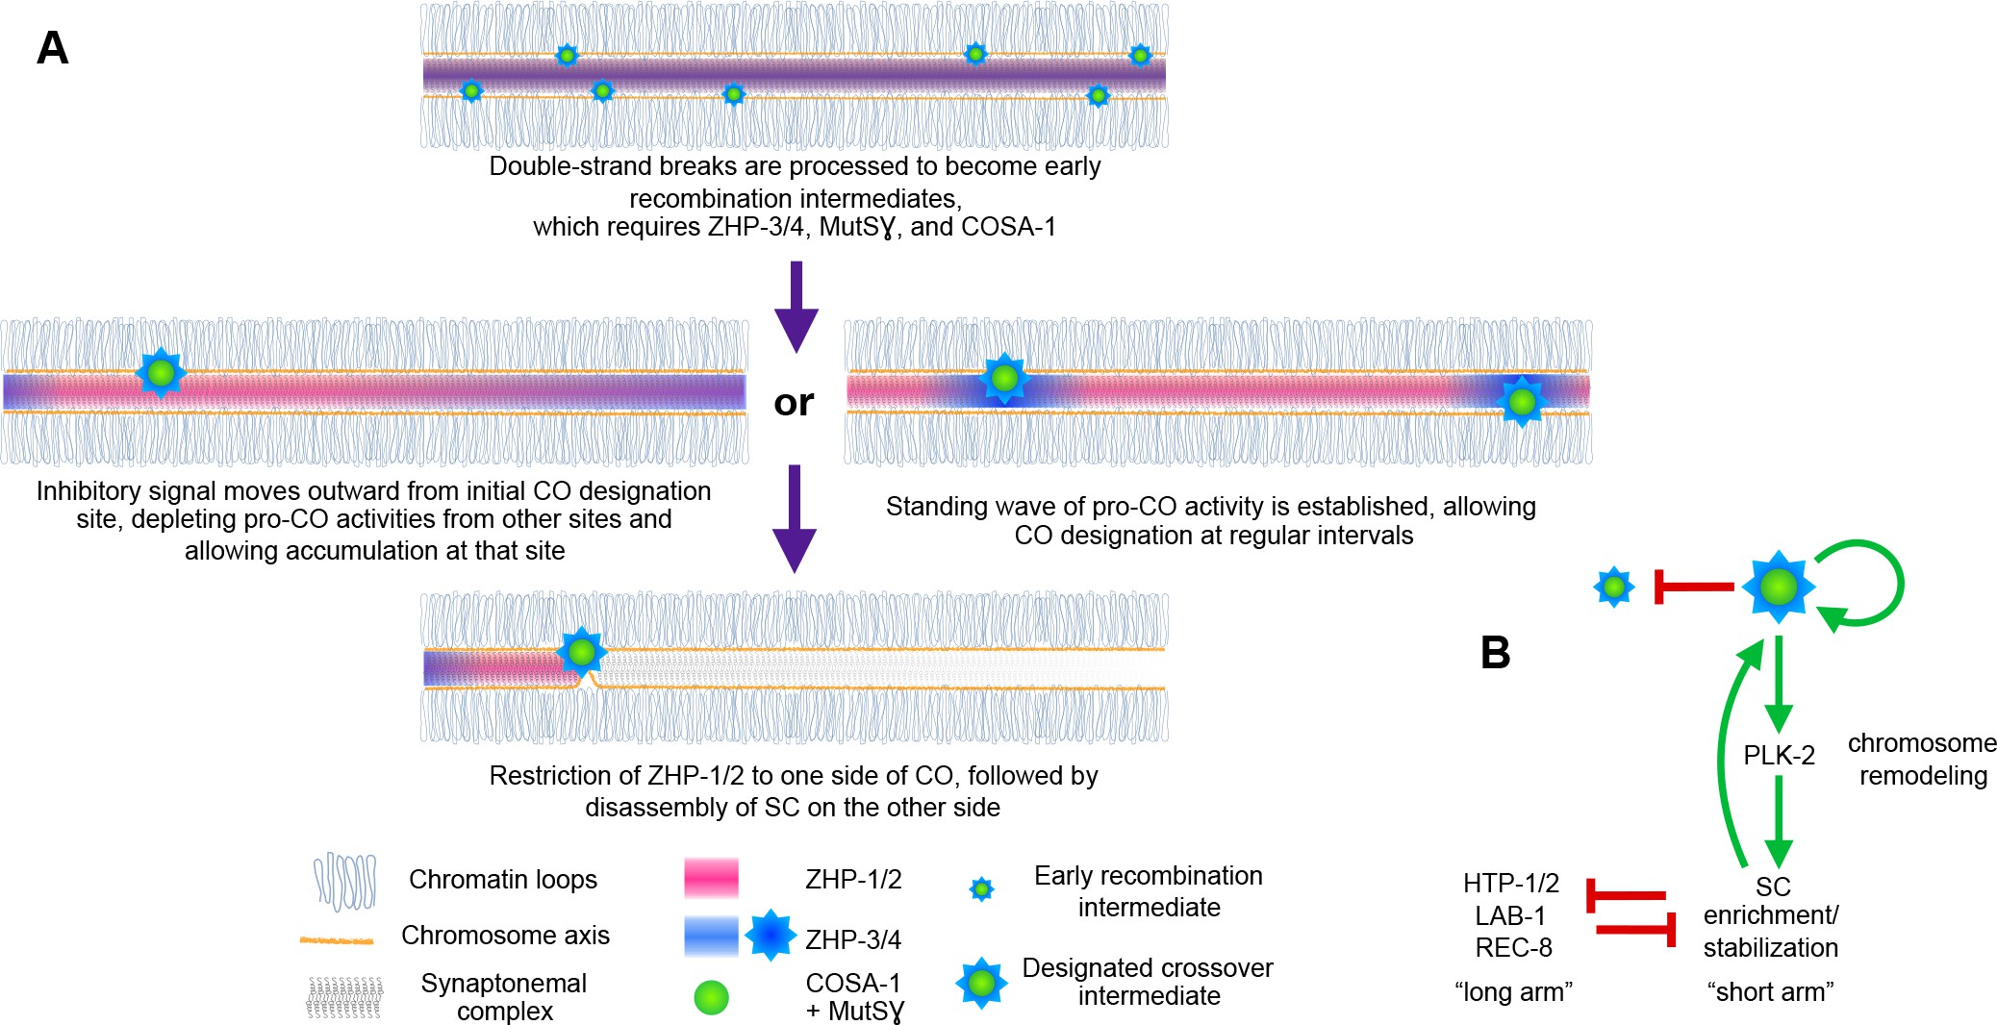
Axial Elements
Transverse Filament

