Slide 1

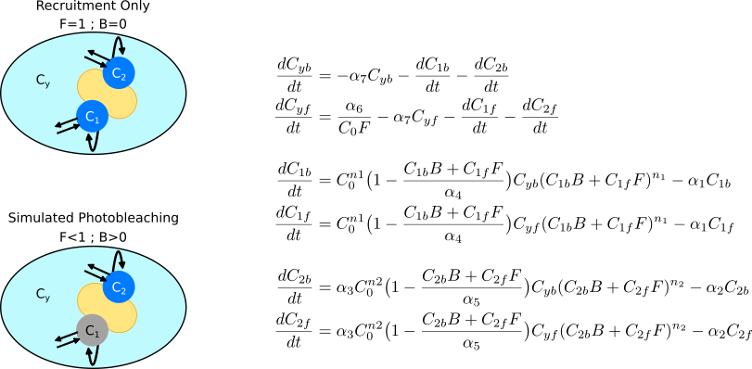
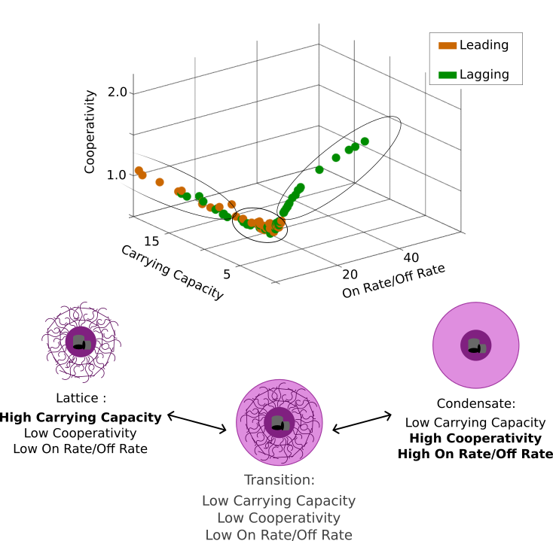
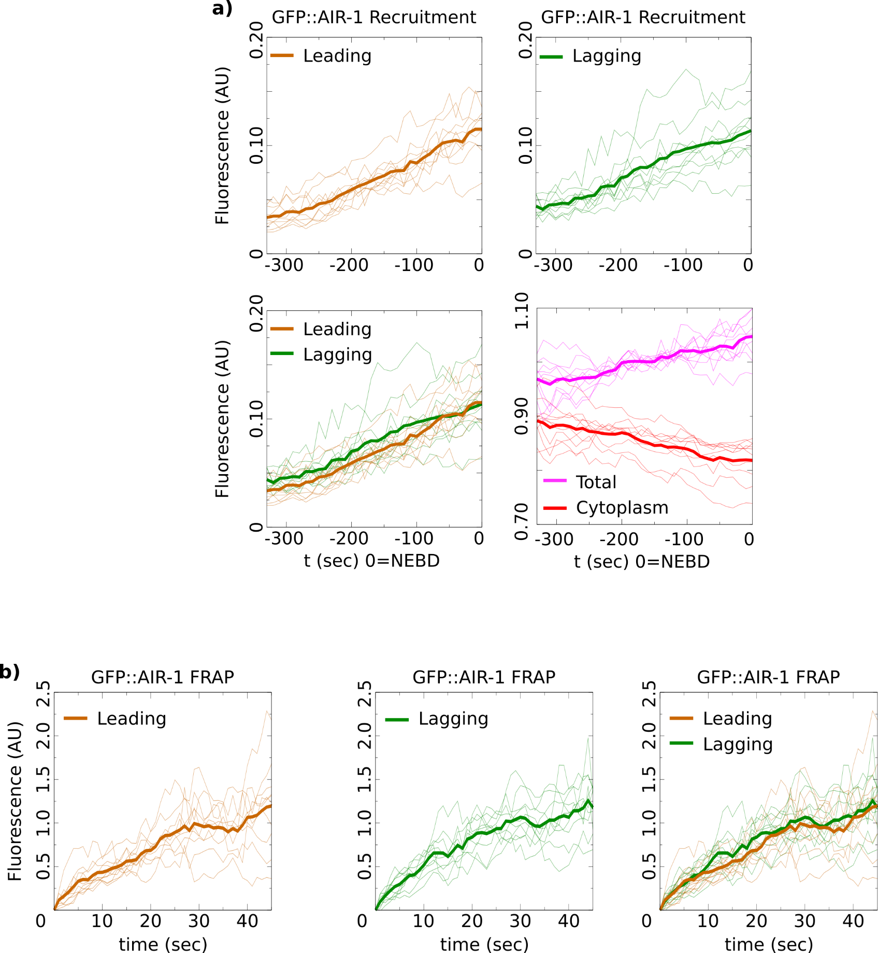
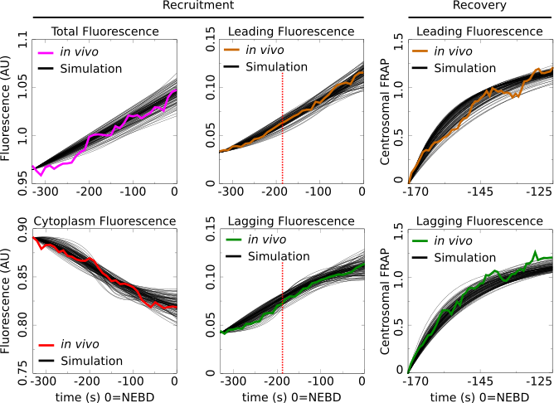
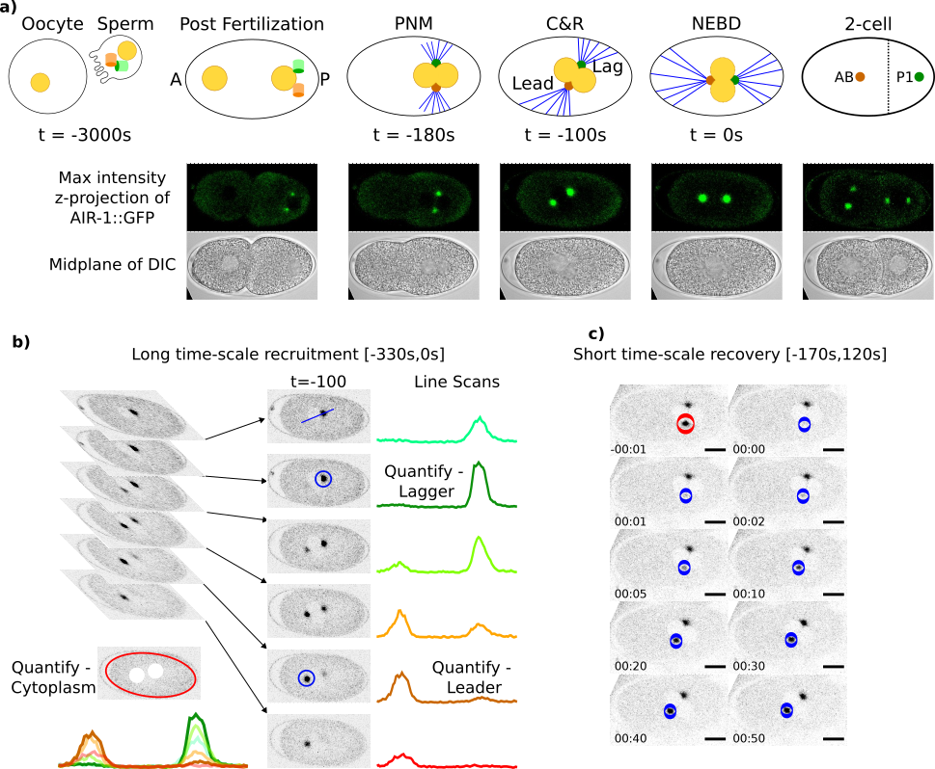
Asymmetric Centrosome Maturation in the Early C. elegans Embryo Revealed by Multi-scale Microscopy and Mathematical Modeling Shayne M. Plourde¹, Natalia Kravtsova¹, Adriana Dawes^{1,2} ¹The Ohio State University, Department of Molecular Genetics, Columbus, Ohio ²The Ohio State University, Department of Mathematics, Columbus, Ohio
My personal website:
shayne-falco.github.io
INTRODUCTION
The process with which cells position their centrosomes is critically important for proper cell divisions. Centrosomes are the main microtubule organizing centers of the cell and abnormal positioning during cell division is one potential cause leading to cancer metastasis.
Using c. elegans as a model for asymmetric cell division and centrosome placement
Our lab has previously discovered an asymmetry in the size and density of the microtubule arrays that emanate from the two centrosomes during the first cellular division of the C. elegans embryo. We analyze AIR-1, a factor found in the centrosome that is required for microtubule nucleation. We precisely quantify the long time-scale of recruitment and the short time-scale of recovery after photobleaching. Then we build and fit a mathematical model to this data.
Taken together our results reveals the kinetics and dynamics required for proper centrosome maturation and further the uncover a novel understanding of the structure of the two asymmetric centrosomes during the first division of the C. elegans embryo.
RESULTS
Nuclear envelope breakdown (NEBD) is used to mark a time of 0 as it coincides with when the centrosomes have been properly placed for cell division. Recruitment was quantified every 10 seconds from 330 seconds before NEBD to 0 seconds (Fig. 1b). Recovery was quantified immediately after pronuclear meeting (PNM) every second for 50 seconds (Fig. 1c).
The recruitment on the long time-scale shows that the average fluorescence in the lagging centrosomes is greater than the leading centrosome (Fig. 2a).
The recovery after photobleaching shows similar final recovery amounts, however analysis of the recovery curves shows distinct recovery dynamics between the two centrosomes (Fig. 2b)
A 3 Compartment Model of Centrosome Recruitment and Recovery After Photobleaching
Parameter Space Shows Asymmetry in Centrosome Structural Composition
Figure 3 caption. A figure captions should accompany each figure. Captions should be clear, concise and explain everything that is contained in the figure. A figure caption is 50-100 words in length. Figure and caption should stand alone, meaning that if figure and caption were removed from the poster, the audience would still be able to read and understand the figure without the need to see the rest of the poster. Cite sources.⁶
Asymmetric Centrosome Recruitment and Recovery Revealed by a Precise Quantification
112 Parameter Sets That Recapitulate in vivo Dynamics
Using a parameter search based on our MCMC method we were able to find 112 parameter sets that fit the model’s maturation factor to the observed AIR-1::GFP data (Fig. 4).
Figure 5 caption. A figure captions should accompany each figure. Captions should be clear, concise and explain everything that is contained in the figure. A figure caption is 50-100 words in length. Figure and caption should stand alone, meaning that if figure and caption were removed from the poster, the audience would still be able to read and understand the figure without the need to see the rest of the poster. Cite sources. ⁷⁻⁹
Parameter Sets that Recapitulate in vivo Recruitment & Recovery Data
DISCUSSION
By combining a precise quianti
Imaging Fluorescent Centrosomes in the First Division of C. elegans Development
Figure 2 or Table II caption. A figure captions should accompany each figure. Captions should be clear, concise and explain everything that is contained in the figure. A figure caption is 50-100 words in length. Figure and caption should stand alone, meaning that if figure and caption were removed from the poster, the audience would still be able to read and understand the figure without the need to see the rest of the poster. Cite sources. ⁴
Figure 4 caption. A figure captions should accompany each figure. Captions should be clear, concise and explain everything that is contained in the figure. A figure caption is 50-100 words in length. Figure and caption should stand alone, meaning that if figure and caption were removed from the poster, the audience would still be able to read and understand the figure without the need to see the rest of the poster. Cite sources.⁶
Statistical Analysis Shows Asymmetries
Our newly publish Gromov-Wasserstein based distance metric was used to identify any potential differences between the shapes of the calculated recruitment and recovery curves. The recruitment did not show a difference between leading and lagging centrosomes. However, the leading and lagging centrosomes did have different shaped recovery curves indicating that their recovery dynamics were different.
Parameter Space of the Model Reveals Structural Features of the Centrosomes
There are three features that define the structural dynamics of the centrosome compartments in the model. The cooperativity, carrying capacity, and the ratio of the on rate to the off rate. Plotting all 112 parameter sets on a 3D plot with these features as the axis and differentiating the leading from the lagging centrosome revealed a high level of restriction to the location of possible parameters (Fig. 5).
REFERENCES
References style should be: Authors Names, Year Published, Name of Journal, Volume(Issue):Pages.
Grebmeier et al., 2006, Science, 311(5766):1461-1664.
Golubova et al., 2009, Journal of Marine Biology, 35(7):593-608.
Flint, 2003, Marine Biology, 160(1):59-65.
Mizobata et al., 2010, Journal of Oceanography, 66(3):405-424.
You need at least 10 references total for your poster. 6 of these need to be journal articles (these are also called primary sources), the remaining 4 references can be secondary sources (e.g., newspaper, magazine, documentary) or primary sources.
Of these 10 total references, you will want to find 2-3 for the introduction section, 2-3 for the methods section, 2-3 for the results section and 2-3 for the discussion section. You need a
Johns and Arnot, 2019, Environmental Science & Technology, 53(1):113-117.
Sorrykumar et al., 2012, Infection & Immunity, 213(12):11456-11461.
Yang and Brown, 2018, Journal of Biological Chemistry, 347(18):1450-1459.
Figure 1 or Table I caption. A figure captions should accompany each figure. Captions should be clear, concise and explain everything that is contained in the figure. A figure caption is 50-100 words in length. Figure and caption should stand alone, meaning that if figure and caption were removed from the poster, the audience would still be able to read and understand the figure without the need to see the rest of the poster. Cite sources.^{1,2}
MATHEMATICAL MODELING
To help uncover potential mechanisms responsible for the reported centrosomal dynamics, we turned to mathematical modeling. A 3-compartment model representing the two centrosomes as well as the cytoplasm was constructed to simulate a maturation factor’s recruitment and recovery in a one-cell embryo (Fig. 3).
ACKNOWLEDGEMENTS
Here is where you acknowledge collaborators and funding agencies, either with text or with thei logos.

