Slide 1

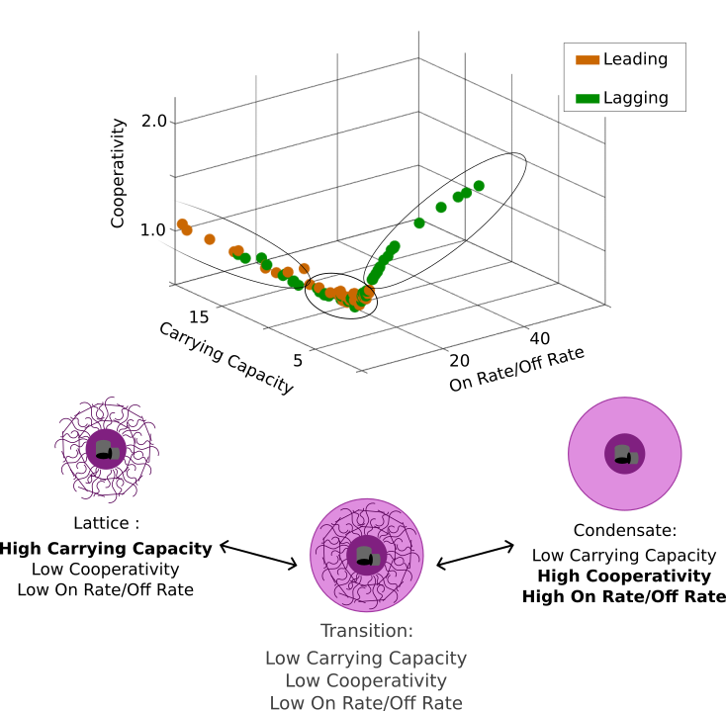
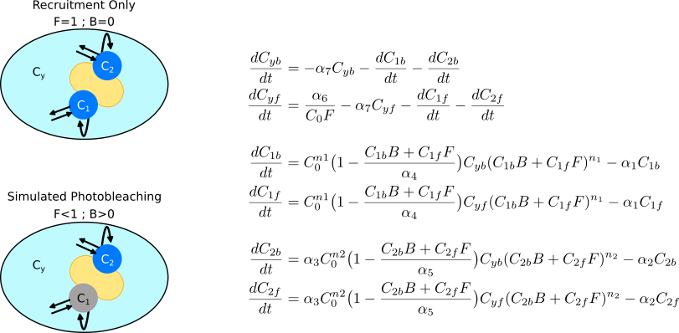
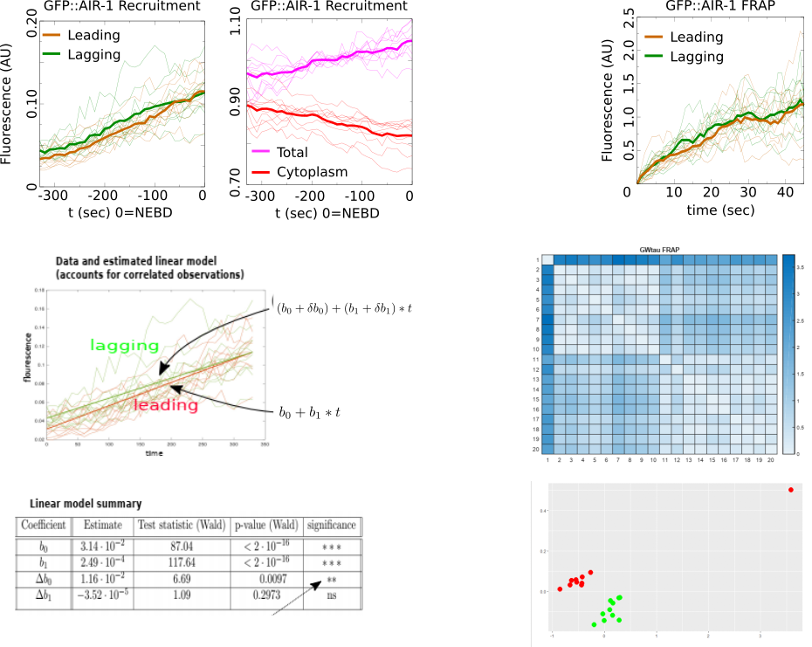
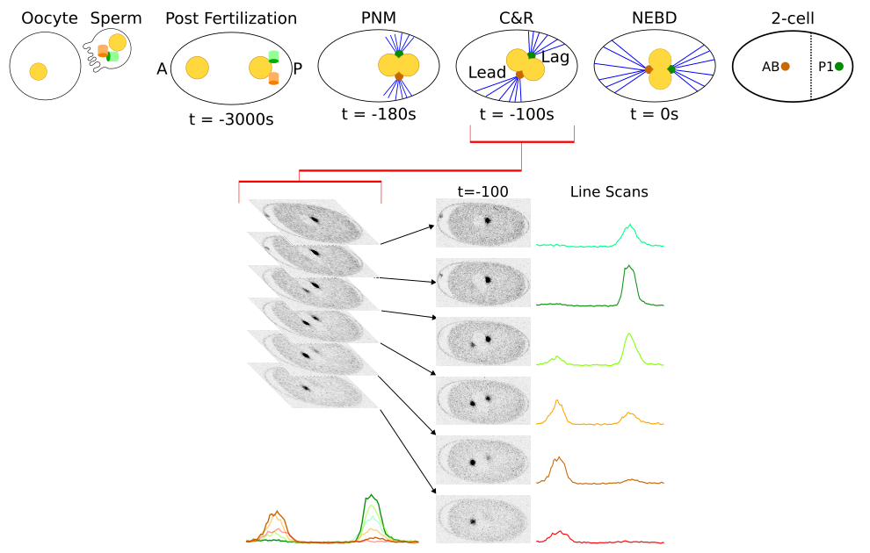
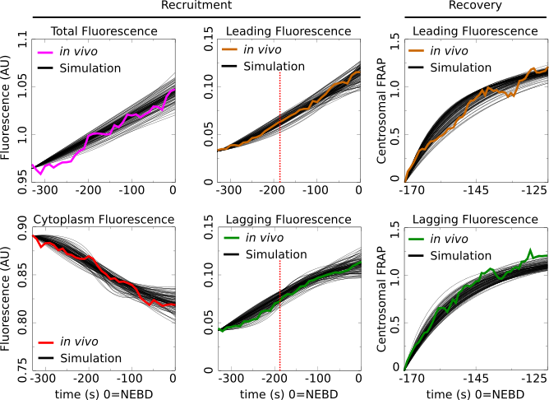
Asymmetric Centrosome Maturation in the Early C. elegans Embryo Revealed by Multi-scale Microscopy and Mathematical Modeling Shayne M. Plourde¹, Natalia ______, Adriana Dawes^{1,2} ¹The Ohio State University, Department of Molecular Genetics, Columbus, Ohio ²The Ohio State University, Department of Mathematics, Columbus, Ohio
My personal website:
shayne-falco.github.io
INTRODUCTION
The process with which cells position their centrosomes is critically important for proper cell divisions. Centrosomes are the main microtubule organizing centers of the cell and abnormal positioning of them during cell division is one potential cause leading to cancer metastasis.
Our lab has previously discovered an asymmetry in the size and density of the microtubule arrays that emanate from the two MTOCs during the first cellular division of the C. elegans embryo. Here we verify those results with EBP-2 which marks the ends of growing MTs. We also extend the analysis to Air-1, a factor found in the PCM that is required for spindle assembly and recruitment of other MT-nucleating factors
RESULTS
Text
Be sure to spell check all text and have trusted colleagues proofread the poster. In general, authors should:
Use the active tense
Simplify text by using bullet points
Use colored graphs and charts
Use bold to provide emphasis; avoid capitals and underlining
Avoid long numerical tables
MATHEMATICAL MODELING
Images
Images must be 72 to 100 dpi in their final size, or use a rule of thumb of 2 to 4 megabytes of uncompressed .tif file per square foot of image. For instance, a 3x5 photo that will be 6x10 in size on the final poster should be scanned at 200 dpi.
Parameter Space Shows Asymmetry in Centrosome Structural Composition
Modeling Centrosome Recruitment & Recovery
Asymmetric Recruitment and Recovery
Figure 5 caption. A figure captions should accompany each figure. Captions should be clear, concise and explain everything that is contained in the figure. A figure caption is 50-100 words in length. Figure and caption should stand alone, meaning that if figure and caption were removed from the poster, the audience would still be able to read and understand the figure without the need to see the rest of the poster. Cite sources. ⁷⁻⁹
Imaging Fluorescent Centrosomes in the First Division of C. elegans Development
Figure 3 caption. A figure captions should accompany each figure. Captions should be clear, concise and explain everything that is contained in the figure. A figure caption is 50-100 words in length. Figure and caption should stand alone, meaning that if figure and caption were removed from the poster, the audience would still be able to read and understand the figure without the need to see the rest of the poster. Cite sources.⁶
DISCUSSION
You need 4-6 figures (or tables) in your poster. Figures can be illustrations, images, diagrams, maps, graphs, photographs, and charts.
You should have at least 1 graph and/or 1 table on your poster.
Figures should be high quality (at least 300 dpi). Zoom in to view poster at 100%, if figure looks blurry then it will be blurry when you print it and you should use a new figure.
The audience will focus on figures and tables and so it is important to provide high-quality and informative figures and tables.
Figure 2 or Table II caption. A figure captions should accompany each figure. Captions should be clear, concise and explain everything that is contained in the figure. A figure caption is 50-100 words in length. Figure and caption should stand alone, meaning that if figure and caption were removed from the poster, the audience would still be able to read and understand the figure without the need to see the rest of the poster. Cite sources. ⁴
Parameter Sets that Recapitulate in vivo Recruitment & Recovery Data
Figure 1 or Table I caption. A figure captions should accompany each figure. Captions should be clear, concise and explain everything that is contained in the figure. A figure caption is 50-100 words in length. Figure and caption should stand alone, meaning that if figure and caption were removed from the poster, the audience would still be able to read and understand the figure without the need to see the rest of the poster. Cite sources.^{1,2}
REFERENCES
AIM
Using a combination of time-lapse microscopy and novel mathematical modeling we will investigate the origins of the asymmetry observed in the MT arrays. We will be able to quantify the spatial and temporal localization of tagged proteins and this data will serve as the basis of an interaction based mathematical model which can further uncover any mechanisms that could lead to the observed localization patterns.
Printing your Poster
There is a handful of cost-effective places with poster printing capabilities at the university. Plan ahead as one poster can take 30 minutes or longer to print.
A list of places at Ohio State where you can print posters can be found here: go.osu.edu/osuposter
References style should be: Authors Names, Year Published, Name of Journal, Volume(Issue):Pages.
Grebmeier et al., 2006, Science, 311(5766):1461-1664.
Golubova et al., 2009, Journal of Marine Biology, 35(7):593-608.
Flint, 2003, Marine Biology, 160(1):59-65.
Mizobata et al., 2010, Journal of Oceanography, 66(3):405-424.
You need at least 10 references total for your poster. 6 of these need to be journal articles (these are also called primary sources), the remaining 4 references can be secondary sources (e.g., newspaper, magazine, documentary) or primary sources.
Of these 10 total references, you will want to find 2-3 for the introduction section, 2-3 for the methods section, 2-3 for the results section and 2-3 for the discussion section. You need a
Johns and Arnot, 2019, Environmental Science & Technology, 53(1):113-117.
Sorrykumar et al., 2012, Infection & Immunity, 213(12):11456-11461.
Yang and Brown, 2018, Journal of Biological Chemistry, 347(18):1450-1459.
Authors should re-write their paper so that it is suitable for the brevity of the poster format. Respect your audience. As a general rule, less is more. Use a generous amount of white space to separate elements and avoid data overkill. Refer to Web sites or other sources to provide a more in- depth understanding of the research.
ACKNOWLEDGEMENTS
Here is where you acknowledge collaborators and funding agencies, either with text or with thei logos.
Figure 4 caption. A figure captions should accompany each figure. Captions should be clear, concise and explain everything that is contained in the figure. A figure caption is 50-100 words in length. Figure and caption should stand alone, meaning that if figure and caption were removed from the poster, the audience would still be able to read and understand the figure without the need to see the rest of the poster. Cite sources.⁶

