Slide 1

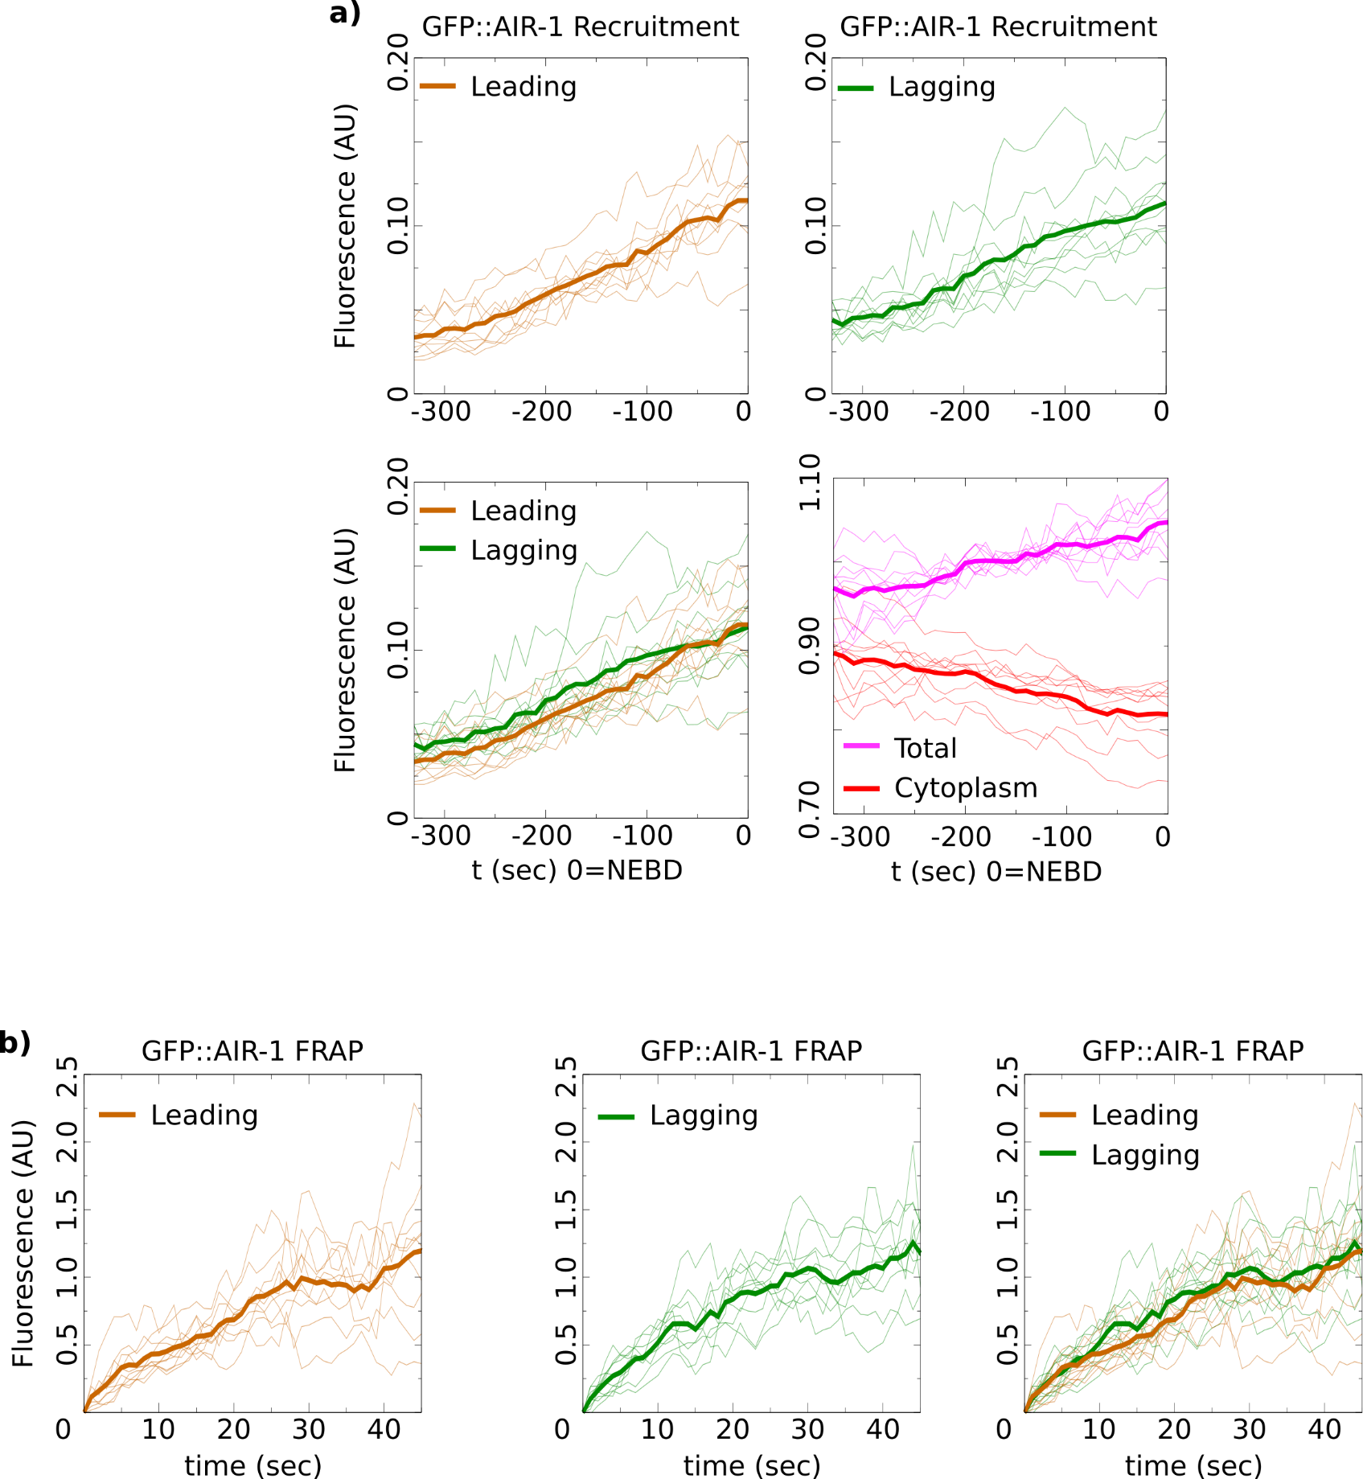
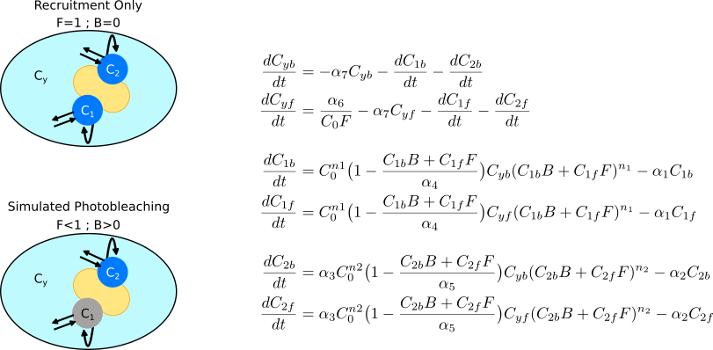
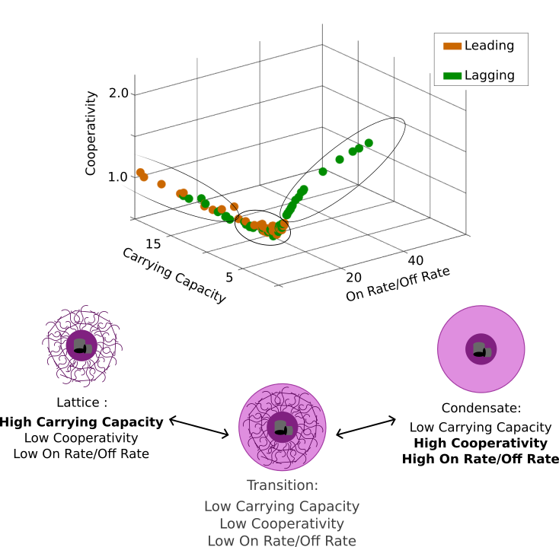
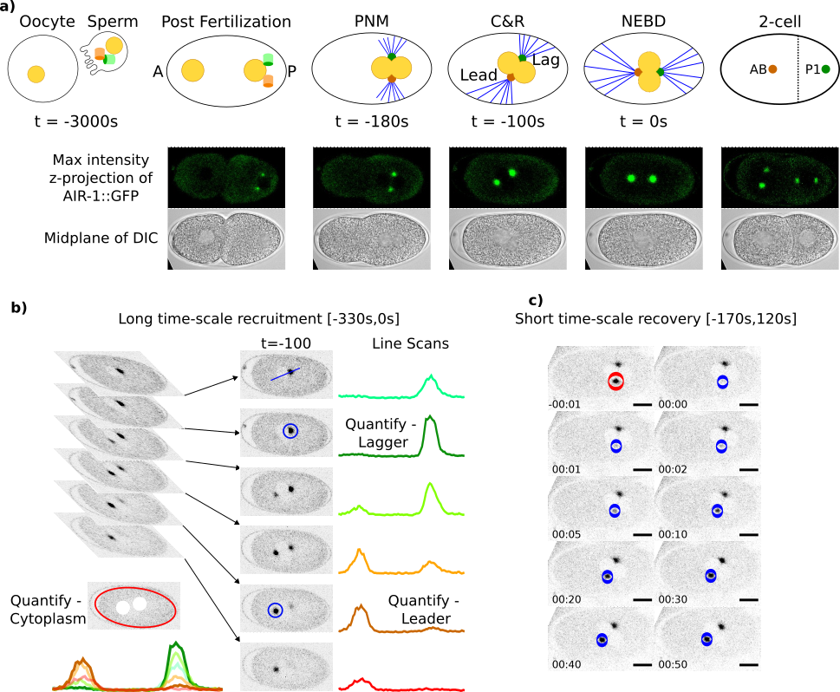
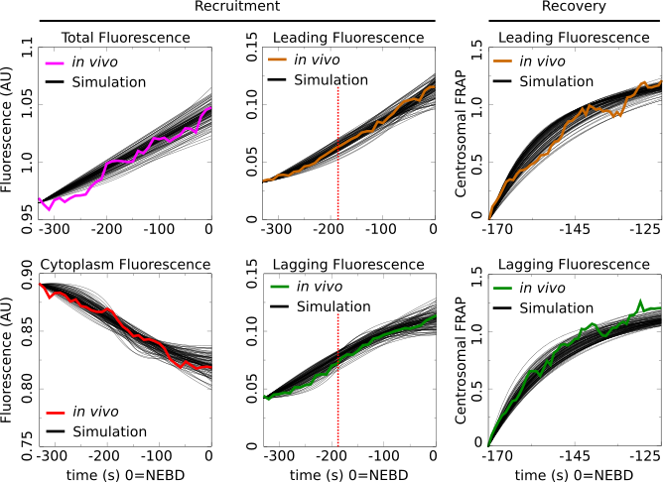
Asymmetric Centrosome Maturation in the Early C. elegans Embryo Revealed by Multi-scale Microscopy and Mathematical Modeling Shayne M. Plourde¹, Natalia Kravtsova², Adriana Dawes^{1,2} ¹ The Ohio State University, Department of Molecular Genetics, Columbus, Ohio ² The Ohio State University, Department of Mathematics, Columbus, Ohio
`
My personal website:
shayne-falco.github.io
INTRODUCTION
The process with which cells position their centrosomes is critically important for proper cell divisions. Centrosomes are the main microtubule organizing centers of the cell and abnormal positioning during cell division is one potential cause leading to cancer metastasis.
Our lab has previously discovered an asymmetry in the size and density of the microtubule arrays that emanate from the two centrosomes during the first cellular division of the C. elegans embryo. The source of this asymmetry is currently unknown.
Using c. elegans as a model for asymmetric cell division and centrosome placement leading up to the first asymmetric cell division (Fig. 1a). We analyze AIR-1, a factor found in the centrosome that is required for microtubule nucleation. We differentiate the centrosomes by their location after first division:
Leading centrosome in the anterior (larger) cell.
Lagging centrosome in the posterior (smaller) cell.
Asymmetric Centrosome Recruitment and Recovery Revealed by a Precise Quantification
Figure 3) A 3 Compartment Model of Centrosome Recruitment and Recovery After Photobleaching
Parameter Space Shows Asymmetry in Centrosome Structural Composition
Figure 3 Mathematical Model of Centrosome Maturation. A figure captions should accompany each figure. Captions should be clear, concise and explain everything that is contained in the figure. A figure caption is 50-100 words in length. Figure and caption should stand alone, meaning that if figure and caption were removed from the poster, the audience would still be able to read and understand the figure without the need to see the rest of the poster. Cite sources.⁶
Imaging Fluorescent Centrosomes in the First Division of C. elegans Development
Figure 2 or Table II caption. A figure captions should accompany each figure. Captions should be clear, concise and explain everything that is contained in the figure. A figure caption is 50-100 words in length. Figure and caption should stand alone, meaning that if figure and caption were removed from the poster, the audience would still be able to read and understand the figure without the need to see the rest of the poster. Cite sources. ⁴
Figure 4) Parameter Sets that Recapitulate in vivo Recruitment & Recovery Data
Figure 5 caption. A figure captions should accompany each figure. Captions should be clear, concise and explain everything that is contained in the figure. A figure caption is 50-100 words in length. Figure and caption should stand alone, meaning that if figure and caption were removed from the poster, the audience would still be able to read and understand the figure without the need to see the rest of the poster. Cite sources. ⁷⁻⁹
Statistical Analysis Shows Asymmetries
Our newly publish Gromov-Wasserstein based distance metric was used to identify any potential differences between the shapes of the calculated recruitment and recovery curves.
The recruitment did not show a difference between leading and lagging centrosomes. The recruitment on the long time-scale shows that the average fluorescence in the lagging centrosomes is greater than the leading centrosome (Fig. 2a).
The recovery after photobleaching shows similar final recovery amounts, however analysis of the recovery curves shows distinct recovery dynamics between the two centrosomes (Fig. 2b).
DISCUSSION
C. Elegans Centrosomes are asymmetric in the early embryo.
By combining a precise quantification of a factor required for proper MT nucleation and mathematical modeling we found that the leading and the lagging centrosomes have different dynamics and possibly different structural compositions.
Emergent Centrosome Structural Asymmetry
The two extremes of the parameter space coincide with previously published biological hypotheses of centrosome structure (Fig. 5b). Our model gives these three structures a common model and may explain the recently reported progression of centrosomes from a liquid condensate state to a more ridged lattice state.
Figure 1 or Table I caption. A figure captions should accompany each figure. Captions should be clear, concise and explain everything that is contained in the figure. A figure caption is 50-100 words in length. Figure and caption should stand alone, meaning that if figure and caption were removed from the poster, the audience would still be able to read and understand the figure without the need to see the rest of the poster. Cite sources.^{1,2}
Using a parameter search based on our MCMC method we were able to find 112 parameter sets that fit the model’s maturation factor to the observed AIR-1::GFP data. These parameter sets all independently fit to the 6 data curves with a low error as calculated by the sum of absolute differences.
MATHEMATICAL MODELING
To help uncover potential mechanisms responsible for the reported centrosomal dynamics, we turned to mathematical modeling. A 3-compartment model representing the two centrosomes as well as the cytoplasm was constructed to simulate a maturation factor’s recruitment and recovery in a one-cell embryo (Fig. 3).
RESULTS
Nuclear envelope breakdown (NEBD) is used to mark a time of 0 as it coincides with when the centrosomes have been properly placed for cell division. Recruitment was quantified every 10 seconds from 330 seconds before NEBD to 0 seconds (Fig. 1b). Recovery was quantified immediately after pronuclear meeting (PNM) every second for 50 seconds (Fig. 1c).
Parameter Space of the Model Reveals Structural Features of the Centrosomes
There are three features that define the structural dynamics of the centrosome compartments in the model. The cooperativity, carrying capacity, and the ratio of the on rate to the off rate. Plotting all 112 parameter sets on a 3D plot with these features as the axis and differentiating the leading from the lagging centrosome revealed a high level of restriction to the location of possible parameters (Fig. 5).
REFERENCES
References style should be: Authors Names, Year Published, Name of Journal, Volume(Issue):Pages.
Grebmeier et al., 2006, Science, 311(5766):1461-1664.
Golubova et al., 2009, Journal of Marine Biology, 35(7):593-608.
Flint, 2003, Marine Biology, 160(1):59-65.
Mizobata et al., 2010, Journal of Oceanography, 66(3):405-424.
You need at least 10 references total for your poster. 6 of these need to be journal articles (these are also called primary sources), the remaining 4 references can be secondary sources (e.g., newspaper, magazine, documentary) or primary sources.
Of these 10 total references, you will want to find 2-3 for the introduction section, 2-3 for the methods section, 2-3 for the results section and 2-3 for the discussion section. You need a
Johns and Arnot, 2019, Environmental Science & Technology, 53(1):113-117.
Sorrykumar et al., 2012, Infection & Immunity, 213(12):11456-11461.
Yang and Brown, 2018, Journal of Biological Chemistry, 347(18):1450-1459.
ACKNOWLEDGEMENTS
Here is where you acknowledge collaborators and funding agencies, either with text or with thei logos.

