Slide 1

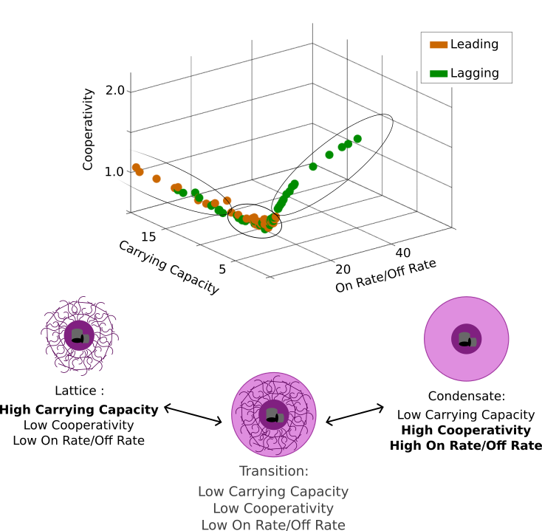
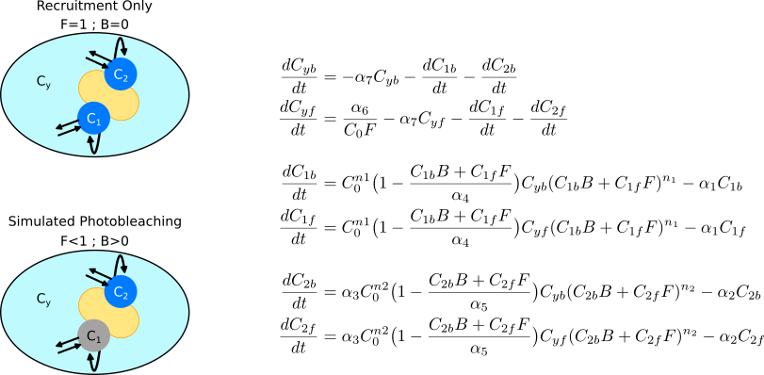
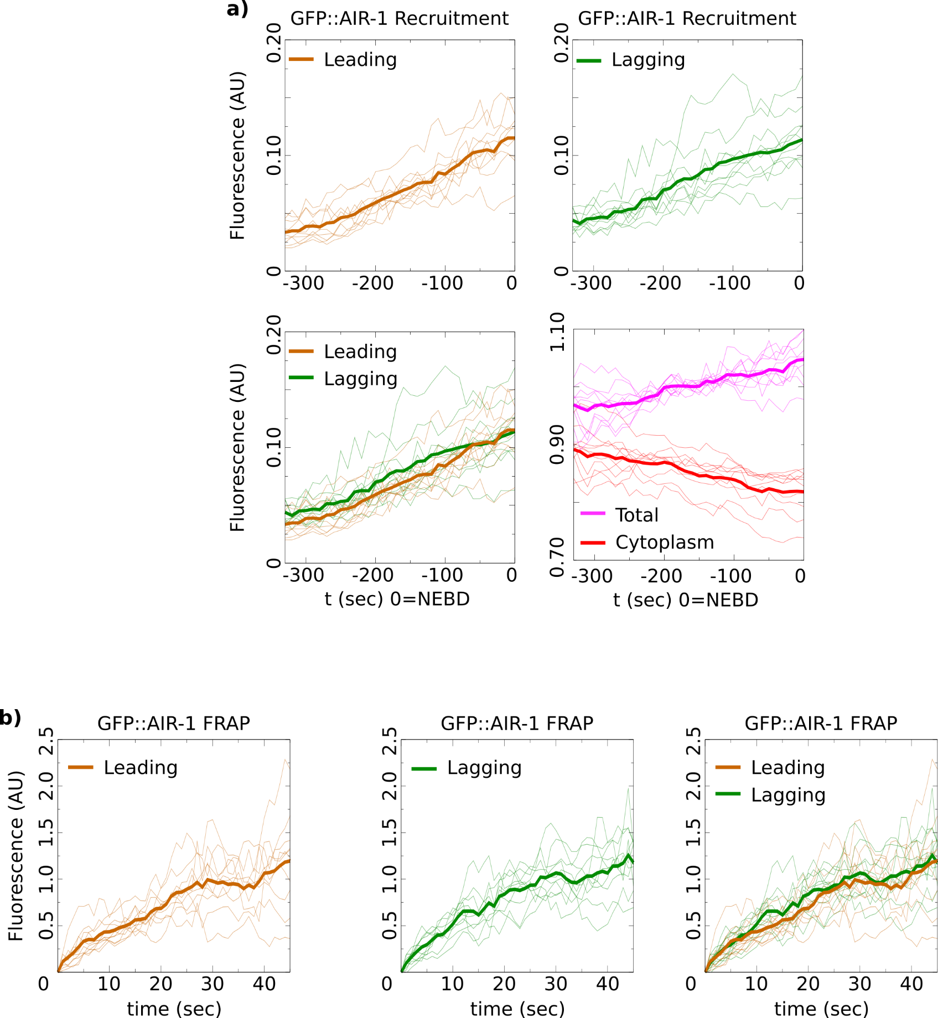
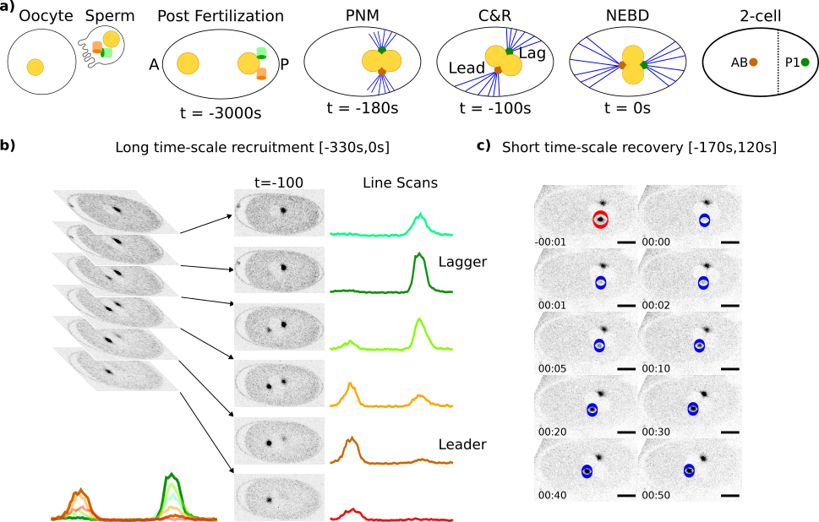
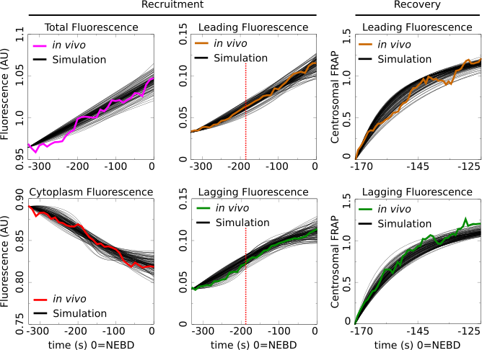
Asymmetric Centrosome Maturation in the Early C. elegans Embryo Revealed by Multi-scale Microscopy and Mathematical Modeling Shayne M. Plourde¹, Natalia Kractsova¹, Adriana Dawes^{1,2} ¹The Ohio State University, Department of Molecular Genetics, Columbus, Ohio ²The Ohio State University, Department of Mathematics, Columbus, Ohio
My personal website:
shayne-falco.github.io
INTRODUCTION
The process with which cells position their centrosomes is critically important for proper cell divisions. Centrosomes are the main microtubule organizing centers of the cell and abnormal positioning during cell division is one potential cause leading to cancer metastasis.
Using c. elegans as a model for asymmetric cell division and centrosome placement
Our lab has previously discovered an asymmetry in the size and density of the microtubule arrays that emanate from the two centrosomes during the first cellular division of the C. elegans embryo. We analyze AIR-1, a factor found in the centrosome that is required for microtubule nucleation. We precisely quantify the long time-scale of recruitment and the short time-scale of recovery after photobleaching. Then we build and fit a mathematical model to this data.
Taken together our results reveals the kinetics and dynamics required for proper centrosome maturation and further the uncover a novel understanding of the structure of the two asymmetric centrosomes during the first division of the C. elegans embryo.
RESULTS
Text
Nuclear envelope breakdown (NEBD) is used to mark a time of 0 as it coincides with when the centrosomes have been properly placed for cell division. Recruitment was quantified every 10 seconds from 330 seconds before NEBD to 0 seconds (Fig. 1b). Recovery was quantified immediately after pronuclear meeting (PNM) every second for 50 seconds (Fig. 1c).
The recruitment on the long time-scale shows that the average fluorescence in the lagging centrosomes is greater than the leading centrosome (Fig. 2a).
The recovery after photobleaching shows similar final recovery amounts, however analysis of the recovery curves shows distinct recovery dynamics between the two centrosomes (Fig. 2b)
MATHEMATICAL MODELING
Images
Images must be 72 to 100 dpi in their final size, or use a rule of thumb of 2 to 4 megabytes of uncompressed .tif file per square foot of image. For instance, a 3x5 photo that will be 6x10 in size on the final poster should be scanned at 200 dpi.
Parameter Space Shows Asymmetry in Centrosome Structural Composition
A 3 Compartment Model of Centrosome Recruitment and Recovery After Photobleaching
Asymmetric Centrosome Recruitment and Recovery Revealed by a Precise Quantification
Figure 5 caption. A figure captions should accompany each figure. Captions should be clear, concise and explain everything that is contained in the figure. A figure caption is 50-100 words in length. Figure and caption should stand alone, meaning that if figure and caption were removed from the poster, the audience would still be able to read and understand the figure without the need to see the rest of the poster. Cite sources. ⁷⁻⁹
Figure 3 caption. A figure captions should accompany each figure. Captions should be clear, concise and explain everything that is contained in the figure. A figure caption is 50-100 words in length. Figure and caption should stand alone, meaning that if figure and caption were removed from the poster, the audience would still be able to read and understand the figure without the need to see the rest of the poster. Cite sources.⁶
DISCUSSION
You need 4-6 figures (or tables) in your poster. Figures can be illustrations, images, diagrams, maps, graphs, photographs, and charts.
You should have at least 1 graph and/or 1 table on your poster.
Figures should be high quality (at least 300 dpi). Zoom in to view poster at 100%, if figure looks blurry then it will be blurry when you print it and you should use a new figure.
The audience will focus on figures and tables and so it is important to provide high-quality and informative figures and tables.
Imaging Fluorescent Centrosomes in the First Division of C. elegans Development
Parameter Sets that Recapitulate in vivo Recruitment & Recovery Data
Figure 2 or Table II caption. A figure captions should accompany each figure. Captions should be clear, concise and explain everything that is contained in the figure. A figure caption is 50-100 words in length. Figure and caption should stand alone, meaning that if figure and caption were removed from the poster, the audience would still be able to read and understand the figure without the need to see the rest of the poster. Cite sources. ⁴
REFERENCES
Printing your Poster
There is a handful of cost-effective places with poster printing capabilities at the university. Plan ahead as one poster can take 30 minutes or longer to print.
A list of places at Ohio State where you can print posters can be found here: go.osu.edu/osuposter
References style should be: Authors Names, Year Published, Name of Journal, Volume(Issue):Pages.
Grebmeier et al., 2006, Science, 311(5766):1461-1664.
Golubova et al., 2009, Journal of Marine Biology, 35(7):593-608.
Flint, 2003, Marine Biology, 160(1):59-65.
Mizobata et al., 2010, Journal of Oceanography, 66(3):405-424.
You need at least 10 references total for your poster. 6 of these need to be journal articles (these are also called primary sources), the remaining 4 references can be secondary sources (e.g., newspaper, magazine, documentary) or primary sources.
Of these 10 total references, you will want to find 2-3 for the introduction section, 2-3 for the methods section, 2-3 for the results section and 2-3 for the discussion section. You need a
Johns and Arnot, 2019, Environmental Science & Technology, 53(1):113-117.
Sorrykumar et al., 2012, Infection & Immunity, 213(12):11456-11461.
Yang and Brown, 2018, Journal of Biological Chemistry, 347(18):1450-1459.
Figure 1 or Table I caption. A figure captions should accompany each figure. Captions should be clear, concise and explain everything that is contained in the figure. A figure caption is 50-100 words in length. Figure and caption should stand alone, meaning that if figure and caption were removed from the poster, the audience would still be able to read and understand the figure without the need to see the rest of the poster. Cite sources.^{1,2}
Authors should re-write their paper so that it is suitable for the brevity of the poster format. Respect your audience. As a general rule, less is more. Use a generous amount of white space to separate elements and avoid data overkill. Refer to Web sites or other sources to provide a more in- depth understanding of the research.
ACKNOWLEDGEMENTS
Here is where you acknowledge collaborators and funding agencies, either with text or with thei logos.
Figure 4 caption. A figure captions should accompany each figure. Captions should be clear, concise and explain everything that is contained in the figure. A figure caption is 50-100 words in length. Figure and caption should stand alone, meaning that if figure and caption were removed from the poster, the audience would still be able to read and understand the figure without the need to see the rest of the poster. Cite sources.⁶

