Slide 1
Instructor Content v1

Slide 2
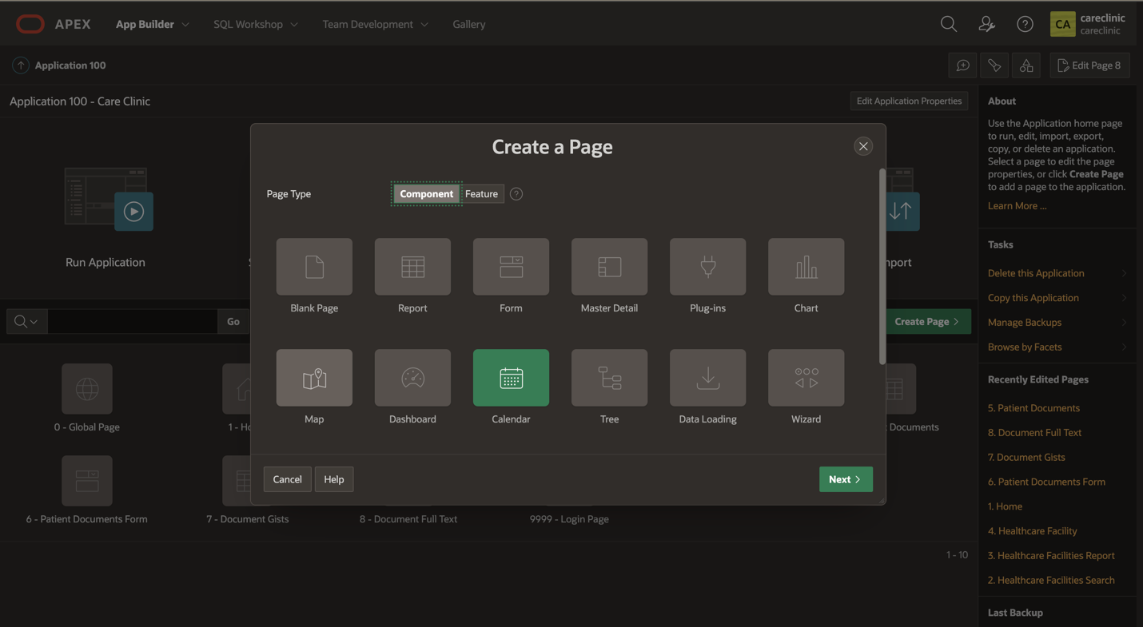
Click Edit App 100 down in the development tool bar. Let’s create one more page for our patients' appointments. This time we will create a Calendar page

Slide 3
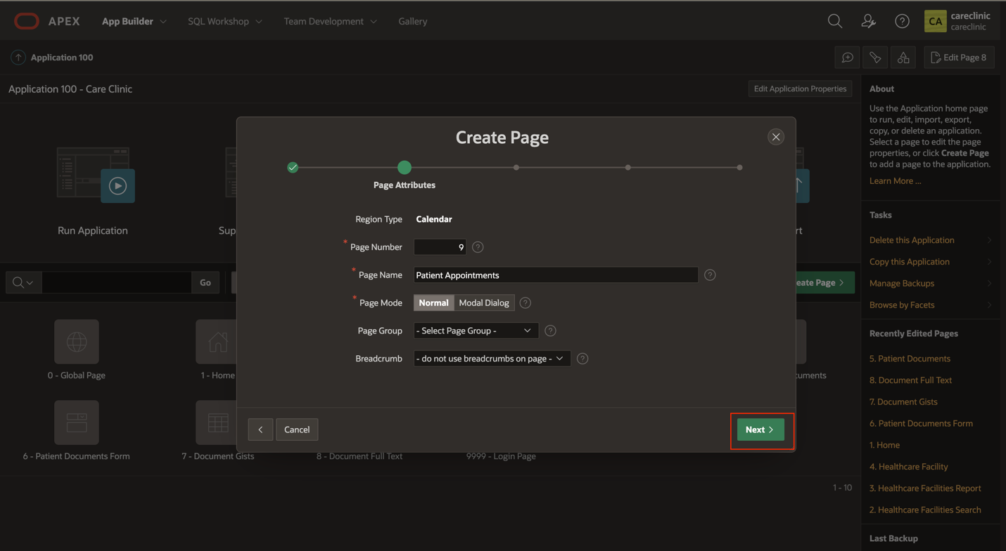
Give the new page a name and select Next.

Slide 4
Select “Create a new navigation menu entry” and enter a navigation menu entry name

Slide 5
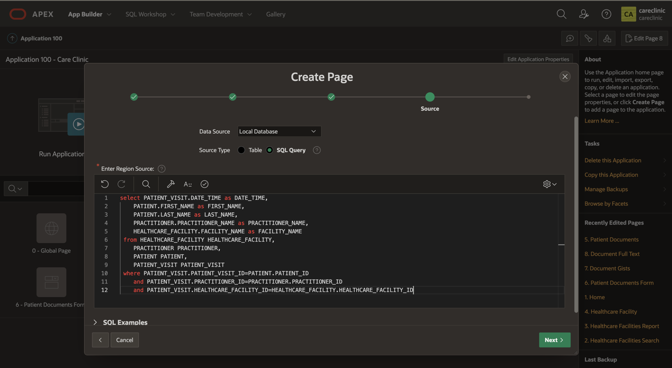
Enter the source and a SQL Query and paste the code provided. Click Next.

Slide 6
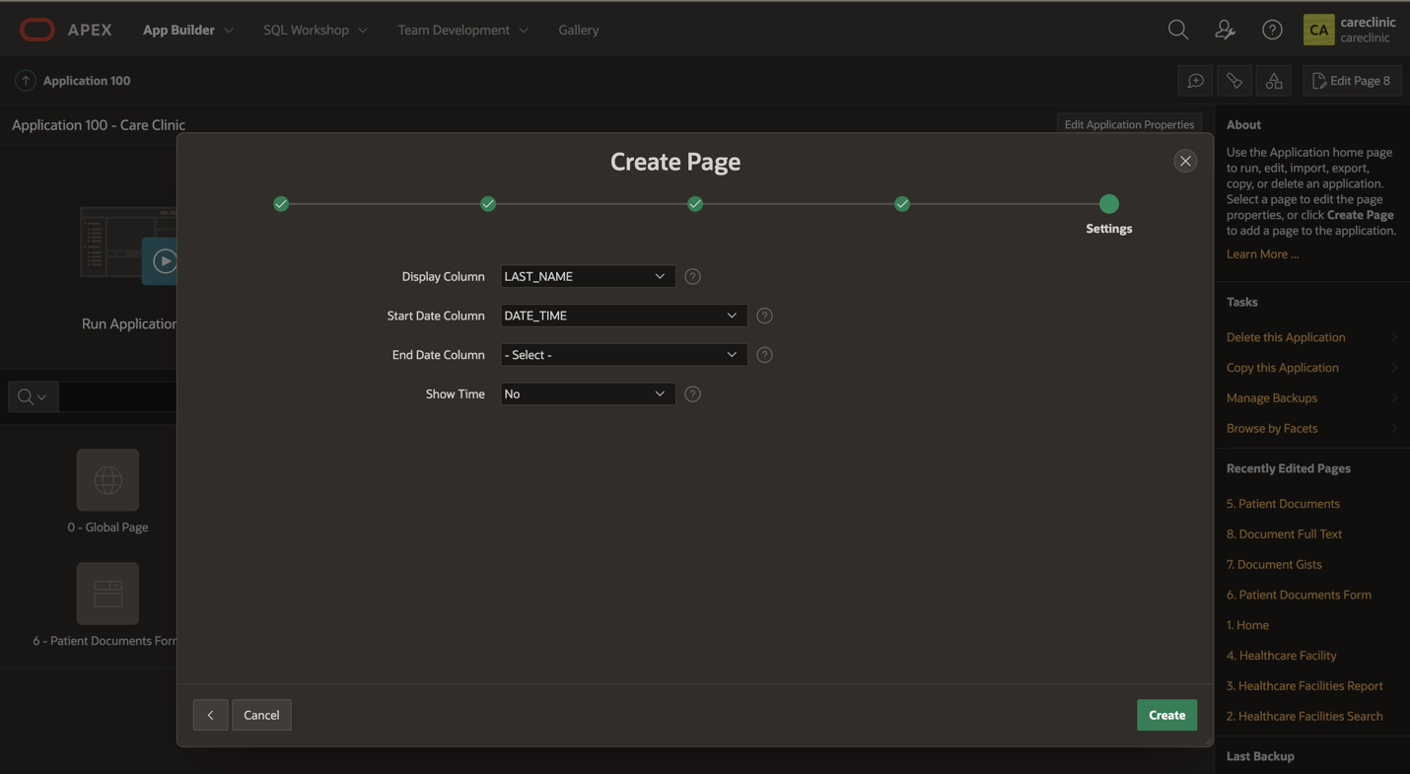
For Display Column select Last_Name, and for Start Data Column select Date_Time

Slide 7
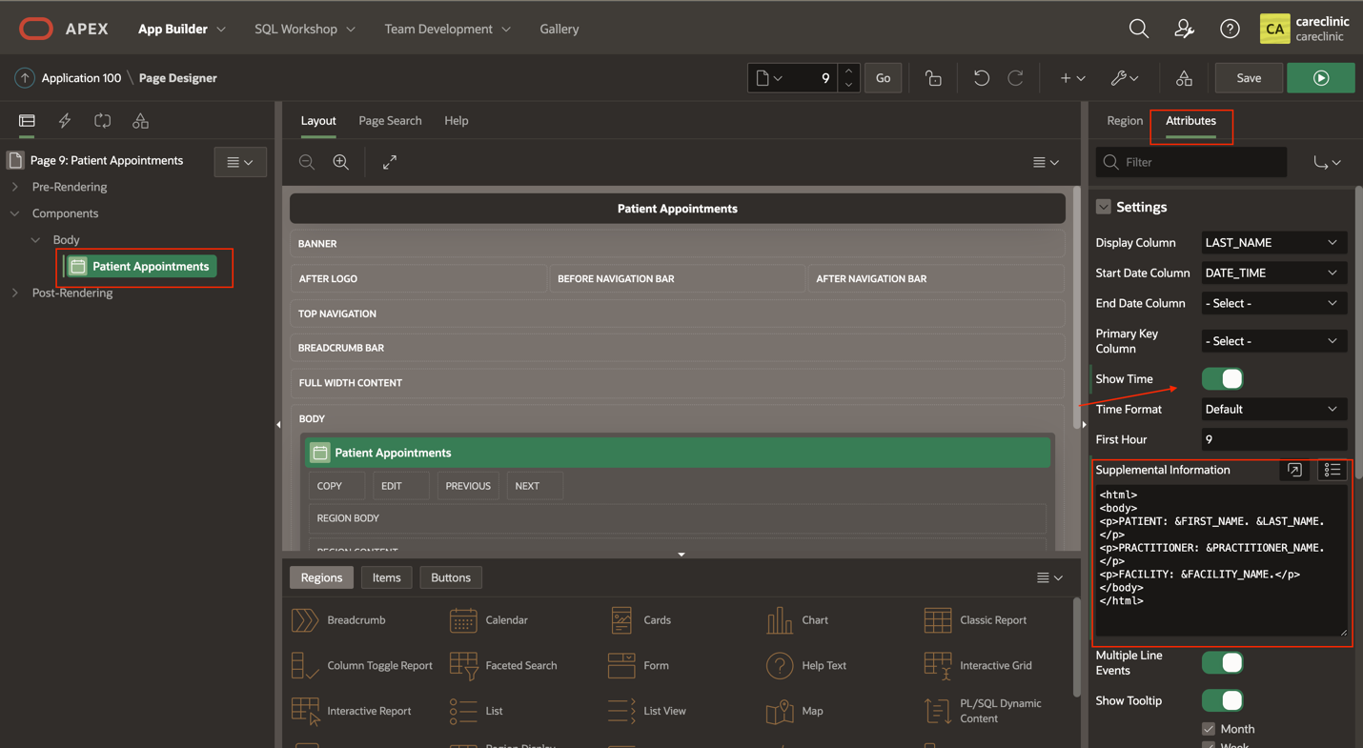
Lastly under attributed for the Patient Appointments Region. Activate Show time, and add some supplemental information for each of the events on the calendar.Save and Run.

Slide 8
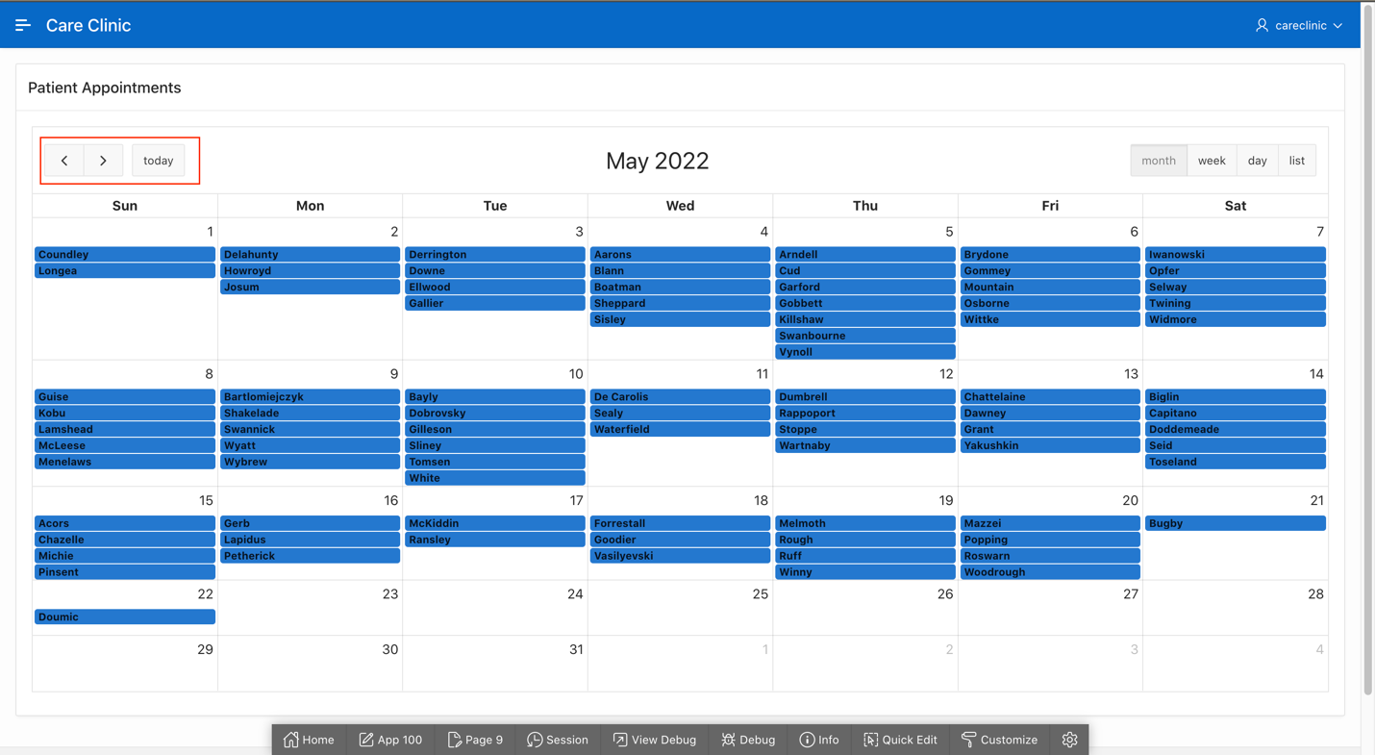
Use this navigation to return to the end of 2021/start of 2022 where data is present in out tables. Note you can hover over the appointments to view the supplemental information about each one.

