Slide 1
Poem Generation
By Shayne Kaiser

Slide 2
A look at the data

Slide 3
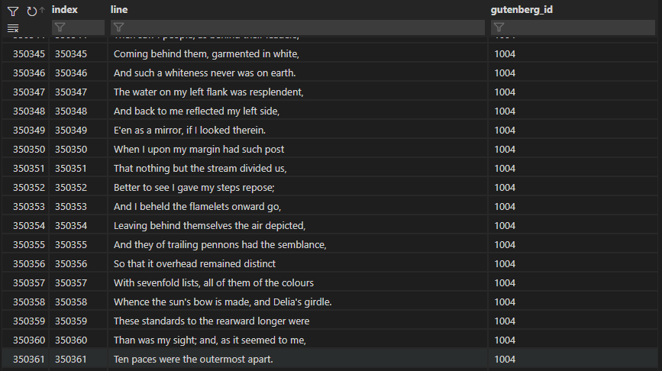
Gutenberg Poetry Corpus
3,085,117 observations
Lines and ID
1,191 unique IDs

Slide 4
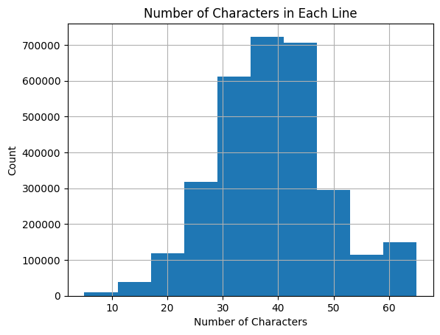
Character and word counts

Slide 5
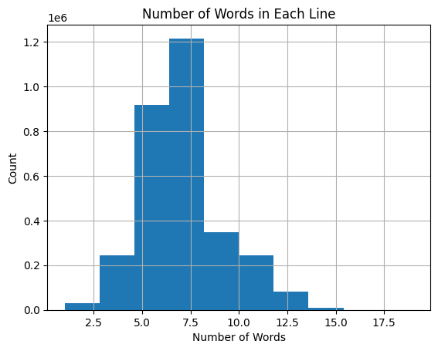

Slide 6
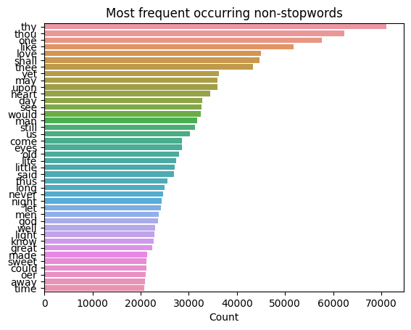
Frequencies

Slide 7
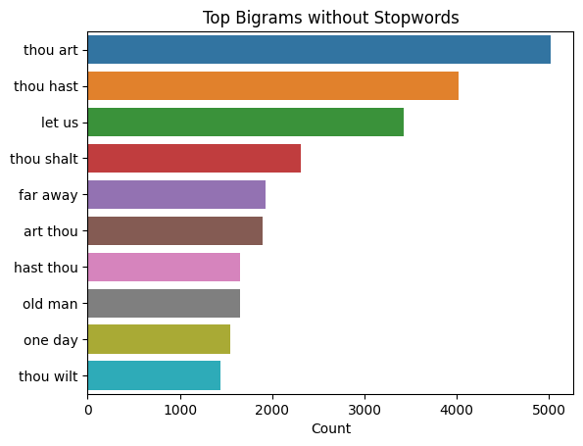

Slide 8
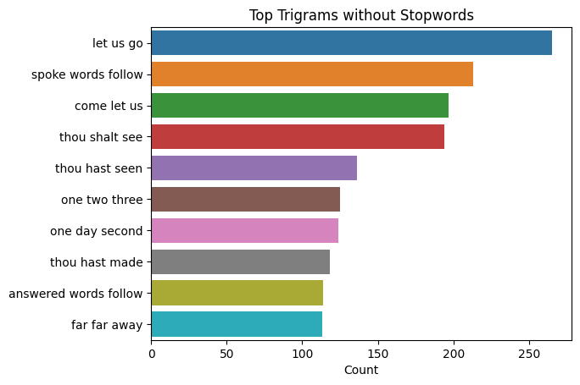

Slide 9
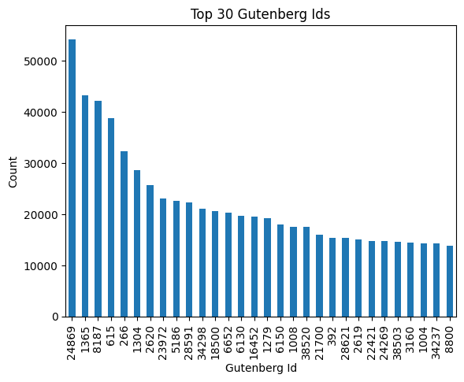
Gutenberg Ids

Slide 10
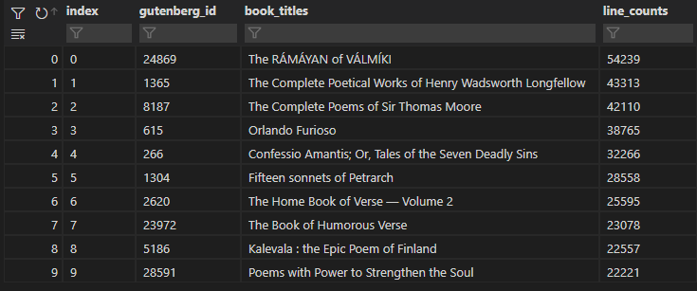

Slide 11
Untrained Models

Slide 12
Distilgpt2
Smallest version of GPT2
Text Generation
82 million parameters
Same Tokenizer as GPT-2

Slide 13
GPT-Neo 1.3B
EleutherAI
Replication of GPT-3 architecture
1.3 billion parameters
Trained with Pile

Slide 14
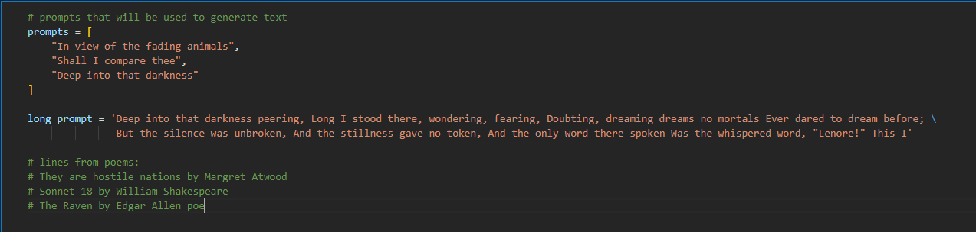
Prompts

Slide 15
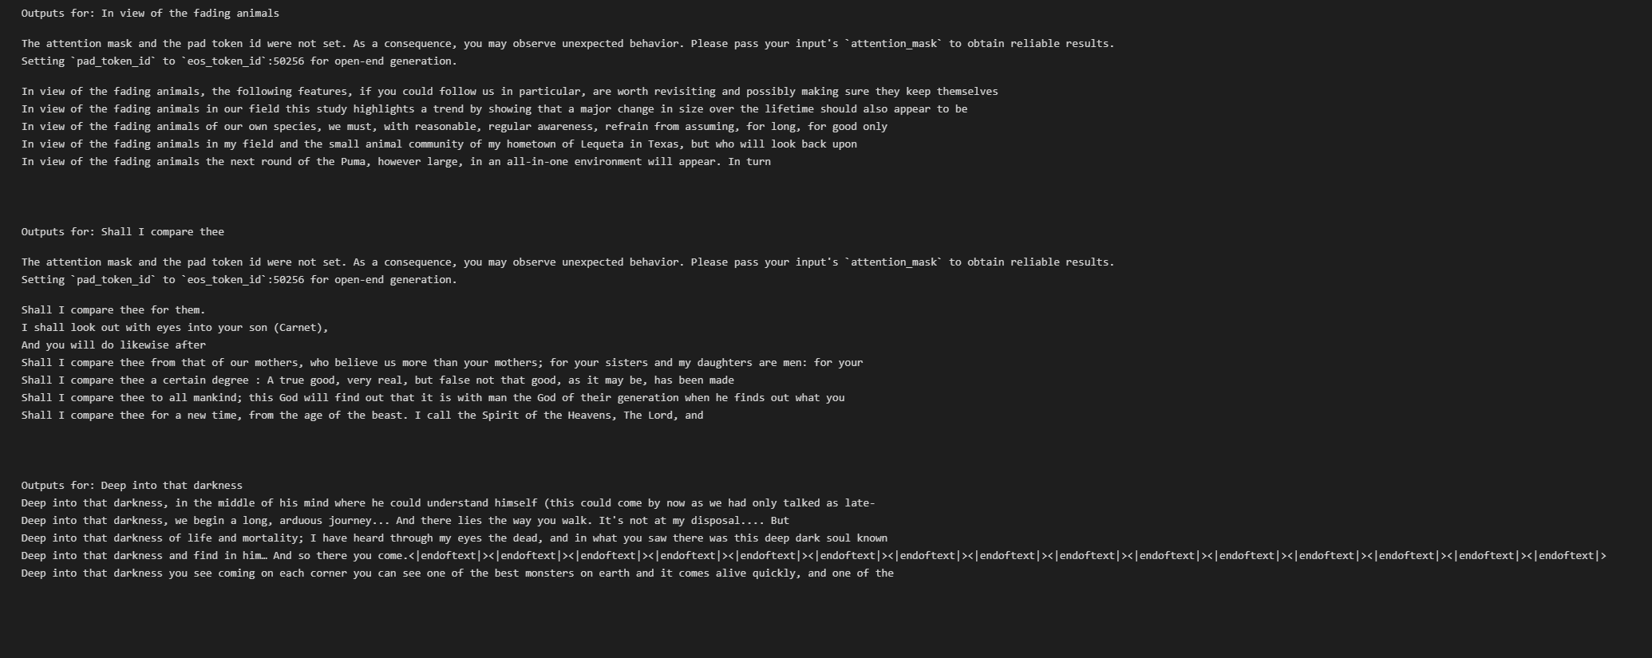
DistilGPT output

Slide 16
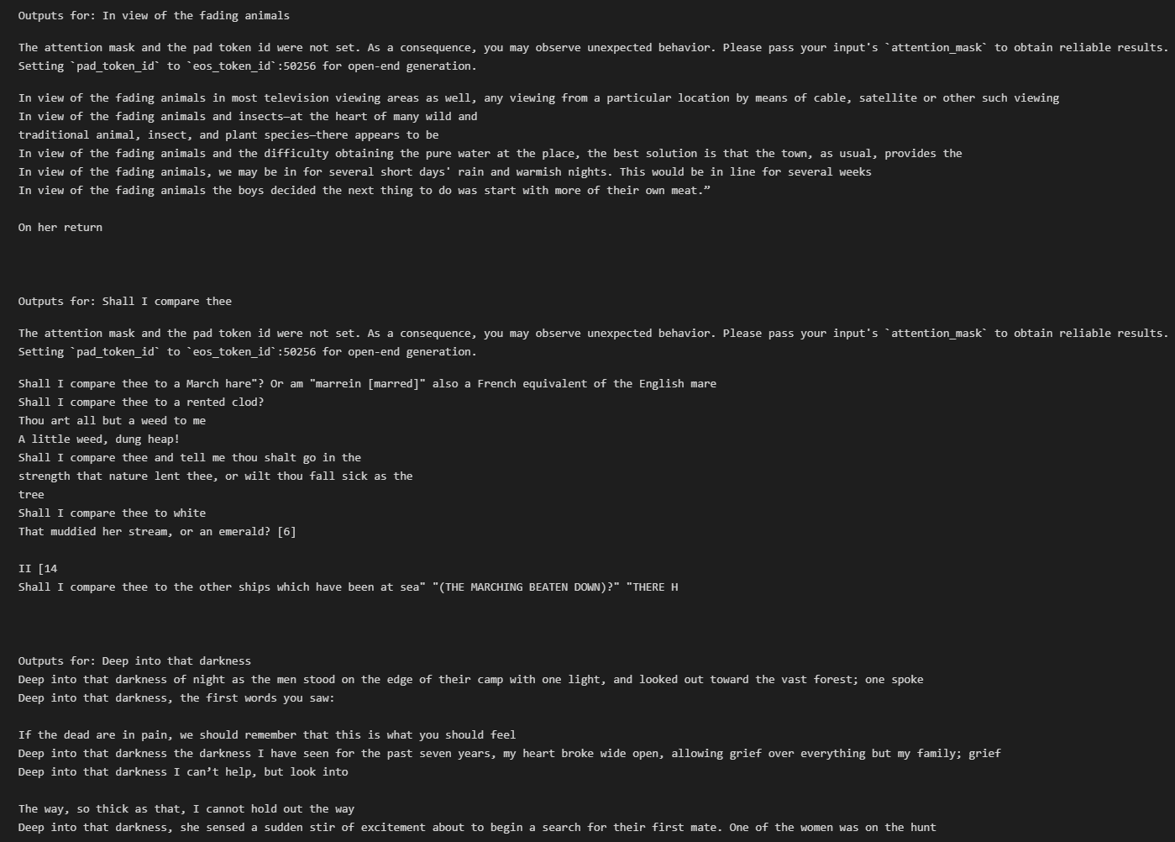
GPT-NE0 1.3B Output

Slide 17
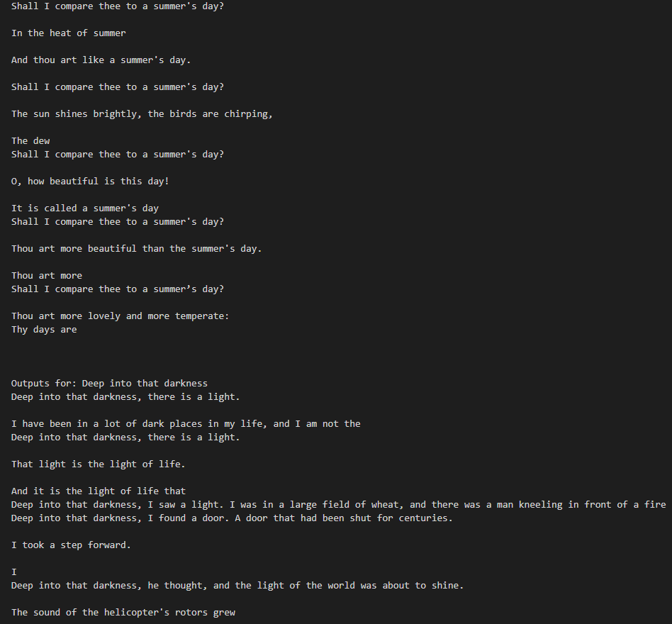
Temperature 0.6

Slide 18
Train MY models

Slide 19
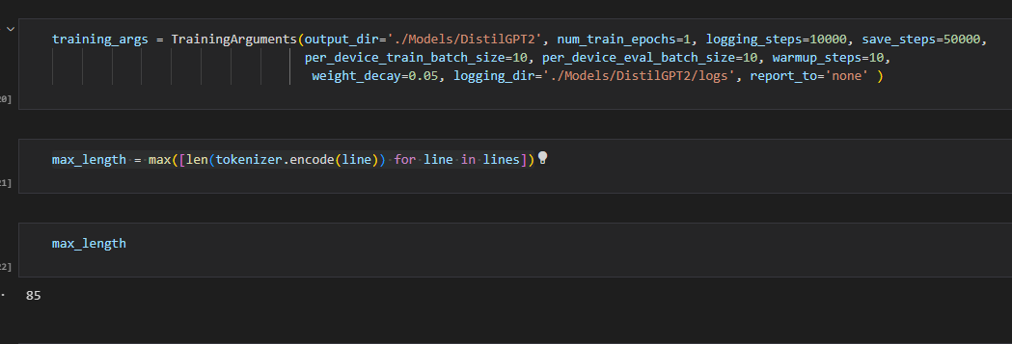
Training Arguments

Slide 20
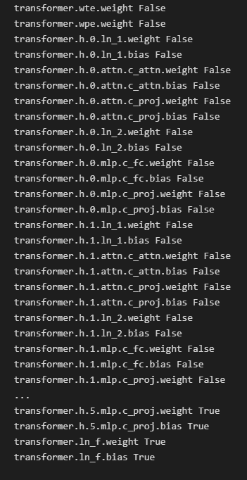
Distilgpt Freezing Layers

Slide 21
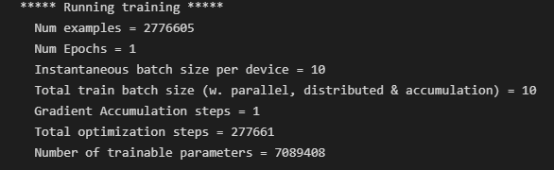
Training distilgpt

Slide 22
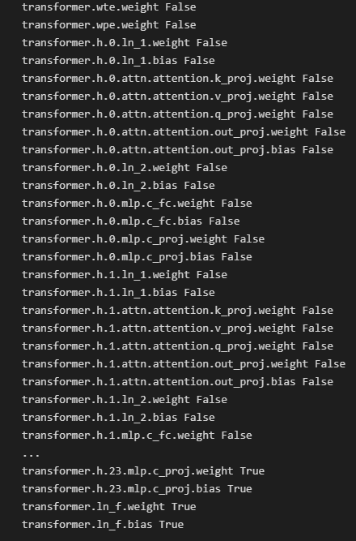
Gpt-Neo freezing layers

Slide 23
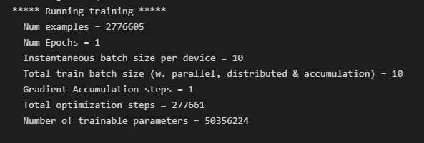
Training Gpt-neo

Slide 24
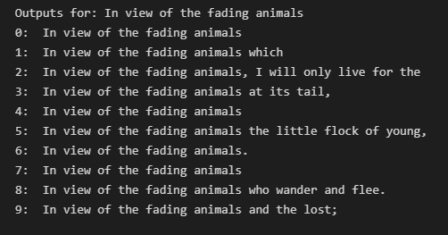
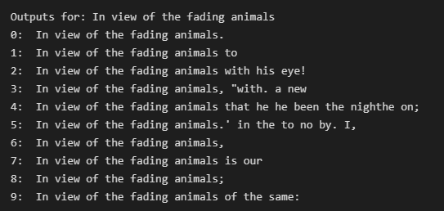
Comparing outputs
DistilGPT
GPT-Neo

Slide 25
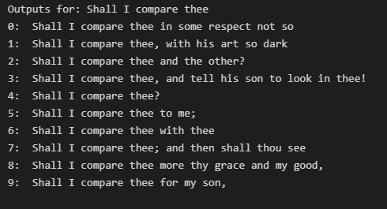
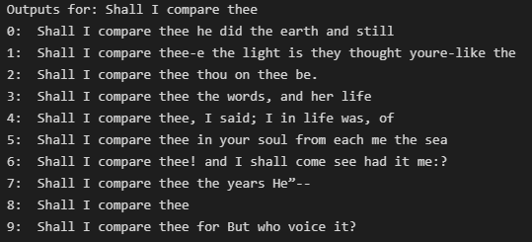
Comparing outputs
DistilGPT
GPT-Neo

Slide 26
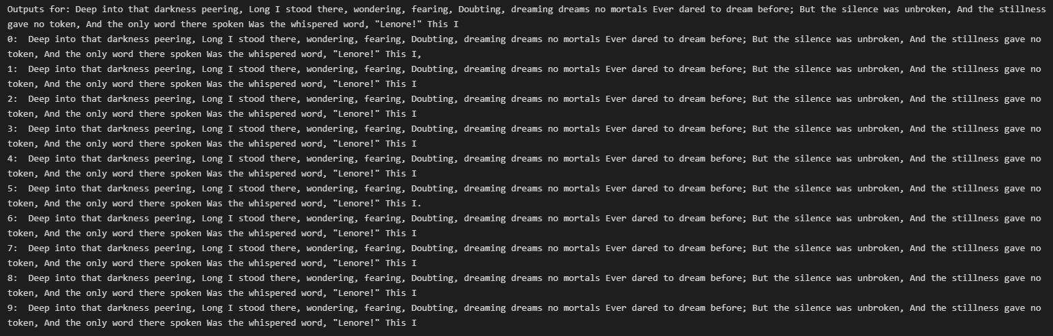
Longer Prompts

Slide 27
Changing the data

Slide 28
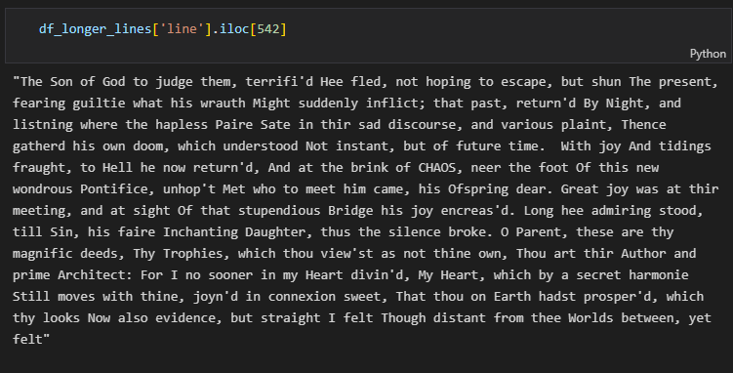

Slide 29
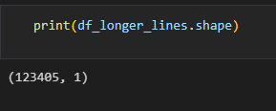
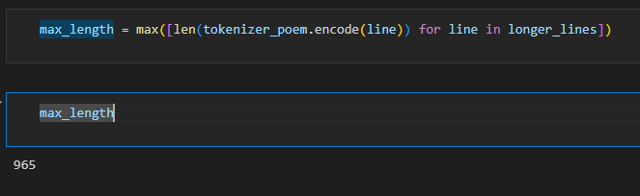

Slide 30
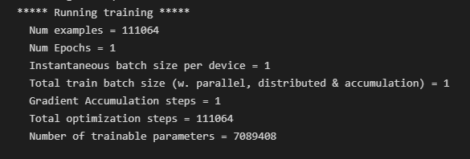
Training distilgpt again

Slide 31
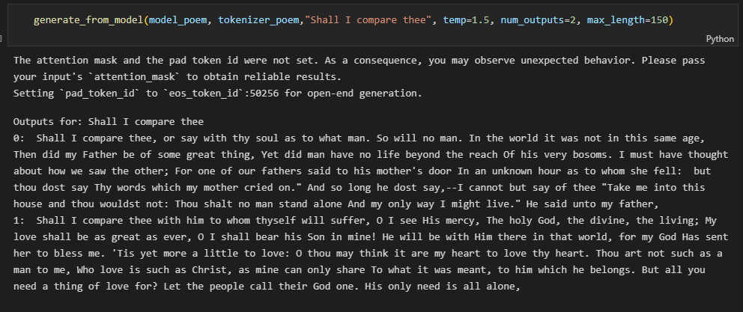
New outputs

Slide 32
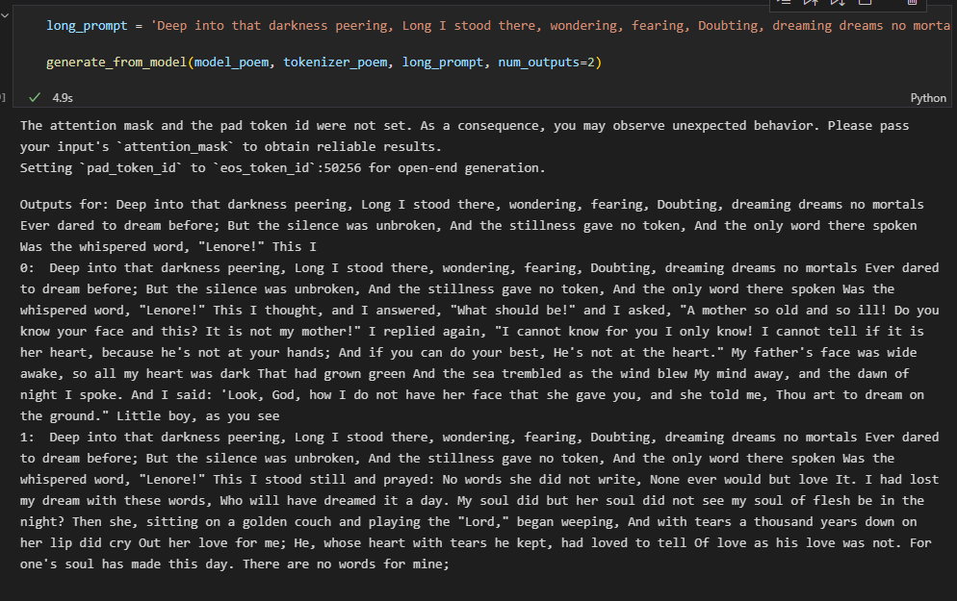
New outputs

Slide 33
Final outputs

Slide 34
In view of the fading animals heark to the earth That, in which each life itself hath found, Is not too much to learn or can live in, But for we, so close unto life, Have seen or saw our selves, Who look or look through what nature hath done.

Slide 35
Takeaways and improvements
Use GPU and SAVE!!!
Better data
More time for optimization

Slide 36
Thank you

