Slide 1

Developing hypotheses based on public databases
Shaimar R. González Morales

Slide 2
Overview
Analyzing data from NCBI Geo database
-Cleaning data in Excel
-Building graphs
-statistical analysis

Slide 3
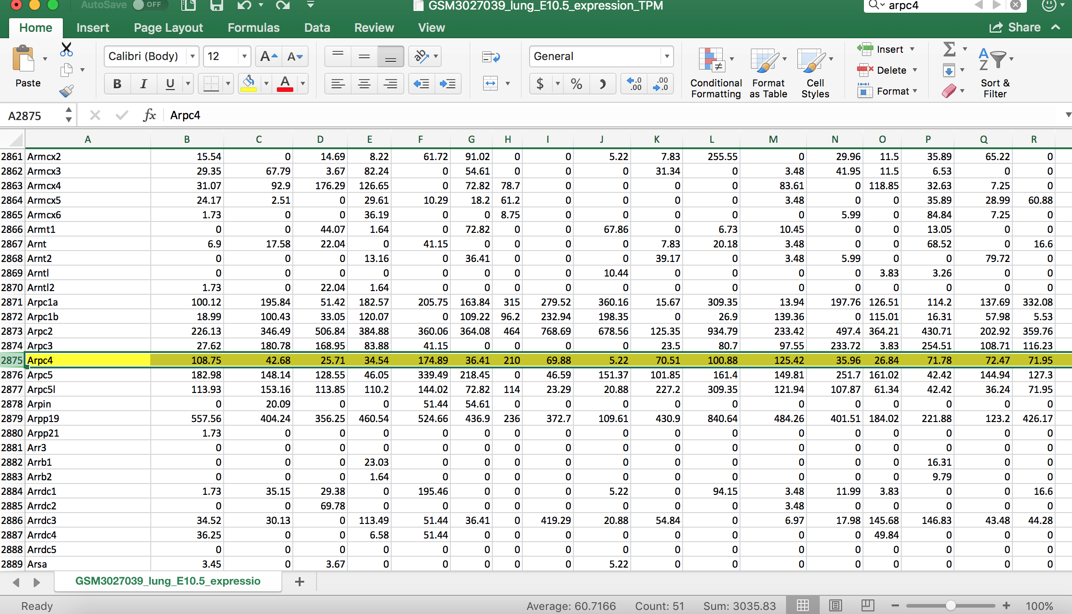
Cleaning data in Excel
Delete the row that you are not interested and compare between columns

Slide 4
Creating arrays from the data
import numpy as np
from scipy import stats
E2E=np.array([108.75, 42.68, 25.71, 174.89, 100.88, 35.96, 71.95, 27.93, 31.39, 20.33, 15.15])
E1E=np.array([65.16, 38.05, 50.79, 12.2, 70.31])
E2M=np.array([34.54, 36.41, 209.91, 69.88, 5.22, 70.51, 125.42, 26.84, 71.78,72.47, 41.47, 64.31, 6.74, 12.18])
E1M=np.array([123.85, 66.88, 14.28, 67.61, 17.77, 118.53, 92.6, 58.04, 9.05, 7.54, 87.78, 113.42, 23.64, 68.55, 83.58, 33.12, 49.72, 48.07])
#Combine the arrays from the different measurements into one array
Epi=np.concatenate([E1E] + [E2E])
Mes=np.concatenate([E1M] + [E2M])

Slide 5
Creating the error bars
#Calculate the mean
Epi_mean=np.mean(Epi)
Mes_mean=np.mean(Mes)
#Calculate Standard deviation
Epi_std=np.std(Epi)
Mes_std=np.std(Mes)
# Error bars
Cell_types=[‘Epi', 'Mes']
x_pos=np.arange(len(Cell_types))
meanbars=[Epi_mean, Mes_mean]
error=[Epi_std, Mes_std]

Slide 6
Customizing the graphs
import matplotlib.pyplot as plt
# Build the plot
fig, ax = plt.subplots()
ax.bar(x_pos, meanbars, color=['pink', 'blue'], yerr=error, align='center', alpha=0.5, ecolor='black', capsize=10)
ax.set_ylabel('mRNA Expression')
ax.set_xticks(x_pos)
ax.set_xticklabels(Cell_types)
ax.set_title('Aprc4 expression in epithelial and mesenchymal cells')
ax.yaxis.grid(True)
# Save the figure and show
plt.tight_layout()
plt.savefig('Aprc4_mRNAexpression_E10.5.png')
plt.show()
#t-test and p-value
t, p = stats.ttest_ind(Mes,Epi, equal_var=False)
print("t = " + str(t))
print("p = " + str(p))

Slide 7
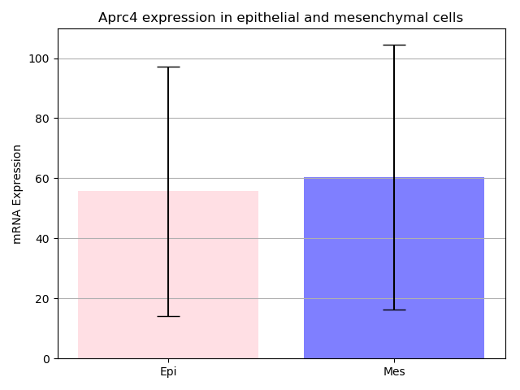
Graph= GSM3027039_lung_E10.5
I choose blue and pink but you can change the colors by just changing color=[‘’] to your favorite colors

