Slide 1
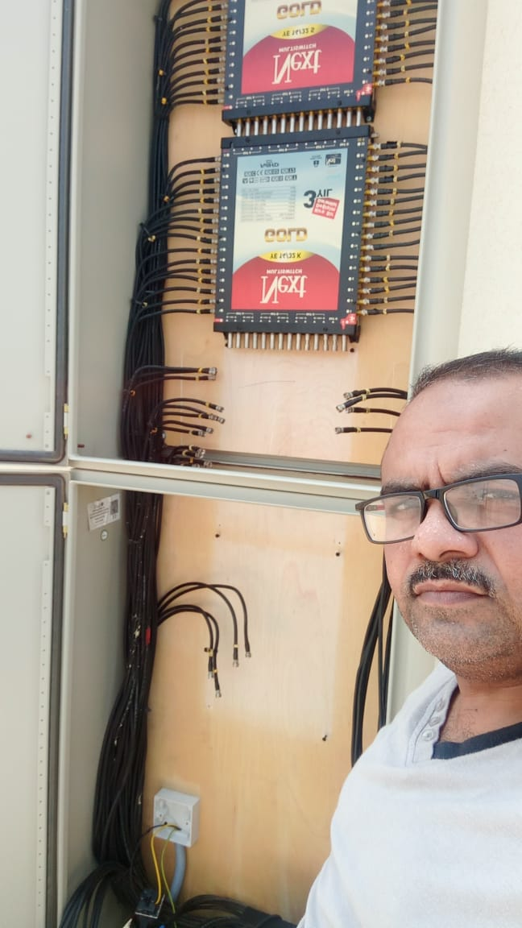
Aqmar al-raWdah
General maint.. & cont
plumbing
Electric & electronics
Installation dish & Anteenas

