Slide 1
Xchange
Shared memory
for coding agents
MongoDB NYC Hackathon
Recursive Harnessing
Notes:
0:00–0:25 (25 seconds)
Your coding agent solves a hard bug. Tomorrow, another agent on your team hits the same problem and starts from scratch. The fix is in the code, but the lesson is buried in a conversation. We built Xchange: shared memory for coding agents, so what one agent learns can become context for the next.
Delivery cue: Pause after “buried in a conversation.” Look up before introducing Xchange.
Sources and factual context:
Product purpose: README.md. Shipped scope: https://mongo-db-hackathon-xchange.vercel.app/?item=observation%3A7c1e9a52-3b4d-4f6e-8a1b-2c3d4e5f6c01. The opening is a hypothetical problem scenario, not a measured time-saving claim.

Slide 2
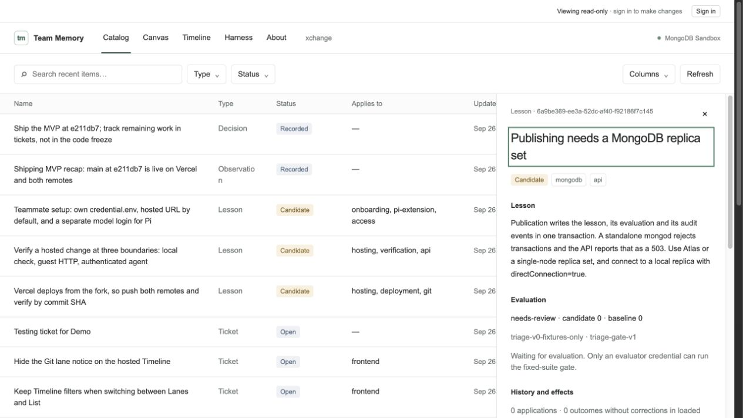
We used Xchange to document Xchange
Publishing needs
a MongoDB
replica set
We captured the discovery
with a commit and a test.
Current status: candidate
2 / 6
Notes:
0:25–0:55 (30 seconds)
We used Xchange while building Xchange. Here’s an actual lesson we captured: our publication workflow needs a MongoDB replica set because it uses transactions. The record keeps the explanation, scope, commit and test together. It’s still a candidate, and the interface says so. The team can inspect what was learned and the evidence behind it before treating it as trusted guidance.
Delivery cue: Point once to the candidate status in the screenshot, then return to the audience.
Sources and factual context:
Live candidate and original screenshot, read 26 September 2026: https://mongo-db-hackathon-xchange.vercel.app/?item=lesson%3A6a9be369-ee3a-52dc-af40-f92186f7c145. Evidence: commit 939742a and apps/api/src/mongo-gate.test.ts. This candidate is needs-review and has no recorded applications or measured outcomes.

Slide 3
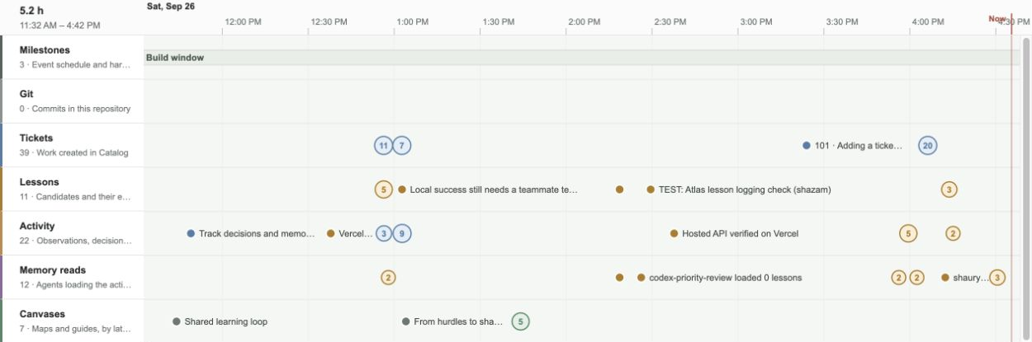
Lessons reach the next agent
Pi and MCP connect independent sessions to the same active memory.
Verified locally: two Pi processes shared and retrieved a lesson.
3 / 6
Notes:
0:55–1:35 (40 seconds)
An agent records a finding. It can propose a candidate for evaluation, or explicitly share a lesson through Pi. Published lessons become part of a versioned set of instructions that another session can retrieve through Pi or MCP. People see the same records in the Catalog, Canvas and Timeline. We verified the handoff between two real Pi processes, and separately confirmed a model could identify its injected memory. Those checks show that the context reaches the agent.
Delivery cue: Give “two real Pi processes” a beat. The transfer check used synthetic content; the separate model check verified injected context.
Sources and factual context:
Current README.md; docs/demo.md; packages/pi-extension/src/index.ts; apps/api/src/repository.ts. Public Timeline screenshot captured 26 September 2026: https://mongo-db-hackathon-xchange.vercel.app/?view=timeline. The fixed suite scores lesson text with no model calls. Pi share_ lesson uses immediate publication. Hosted harness was v0 in the recorded shipping report. Do not imply the visible candidates have passed the gate. Two-process transfer and separate Pi/Sonnet memory identification: docs/local-verification-2026-09-26.md. Transport used a synthetic lesson without a model; the separate model response correctly identified injected memory. Neither establishes improved behavior.

Slide 4
MongoDB holds the shared state
One
transaction
Lesson
Evaluation
Harness version
Audit event
Version checks protect updates. Rollback changes active memory.
Atlas Vector Search support for ticket relevance
4 / 6
Notes:
1:35–2:05 (30 seconds)
MongoDB makes that shared state reliable. For evaluated publication, the lesson, evaluation, harness version and audit event commit in one transaction. Version checks protect against competing updates. Rollback removes a lesson from active memory. We also implemented Atlas Vector Search for ticket relevance, with a recency fallback. Each agent keeps its own conversation.
Delivery cue: Emphasize “one transaction.” Keep the architecture explanation to these four records.
Sources and factual context:
apps/api/src/repository.ts: MongoLessonRepository, session.withTransaction, expectedVersion handling, rollbackLesson and $vectorSearch. infra/mongodb/README.md. Stress evidence: https://mongo-db-hackathon-xchange.vercel.app/?item=observation%3A72d75e8b-ff2e-4a0d-a55c-18fc115e7d52. Vector retrieval is implemented, but the local verification used fallback and does not establish Atlas retrieval quality.

Slide 5
Shared memory survives competing writes
40
simultaneous shares
40 consecutive versions. No lesson lost.
1
winner from 30 competing evaluations
29 conflicts. One evaluation record.
50
identical retries
One record created.
Recorded tests against a local MongoDB replica set, 26 September 2026
5 / 6
Notes:
2:05–2:40 (35 seconds)
Then we put the system under contention. Forty simultaneous shares produced forty consecutive versions, with no lessons lost. Thirty competing evaluations produced one winner and twenty-nine conflicts. Fifty identical retries created one record. These are recorded tests against a local MongoDB replica set. We also have a working hosted workspace, where you can inspect the lessons and the evidence.
Delivery cue: Pause briefly after each result. These are recorded local tests, not production scale claims.
Sources and factual context:
Shipping recap: https://mongo-db-hackathon-xchange.vercel.app/?item=observation%3A7c1e9a52-3b4d-4f6e-8a1b-2c3d4e5f6c01. Local concurrency report: https://mongo-db-hackathon-xchange.vercel.app/?item=observation%3A72d75e8b-ff2e-4a0d-a55c-18fc115e7d52, recorded at revisions 901c59e and 2210e16. Local MongoDB 7 replica set through api/index.ts: 40 concurrent shares, 30 evaluations (1 success, 29 HTTP 409), and 50 identical retries per record type yielding one record each. Pi transport: docs/local-verification-2026-09-26.md, two real Pi RPC processes, synthetic lesson, no model. These tests were recorded earlier; this presentation task did not rerun them. Public stress-report details were read again in the hosted UI during this presentation revision, 26 September 2026.

Slide 6
Xchange
What one agent learns,
the team can reuse
Next: measure the benefit
on unseen tickets
mongo-db-hackathon-xchange.vercel.app
Notes:
2:40–3:00 (20 seconds)
Next, we’ll measure whether shared lessons reduce mistakes on unseen tickets. Today, we have working agent integrations and shared memory that we can inspect, version and roll back. Xchange: what one agent learns, the team can reuse.
Delivery cue: Slow down for the last sentence. Leave the final slide up.
Sources and factual context:
Delivered scope and remaining model trials: https://mongo-db-hackathon-xchange.vercel.app/?item=observation%3A7c1e9a52-3b4d-4f6e-8a1b-2c3d4e5f6c01; docs/local-verification-2026-09-26.md; README.md. No claim of improved model behavior or reduced error rates. Live public workspace verified visually on 26 September 2026.

