Slide 1


Insights to Management in Consumer Goods Domain
By
Shaziya Shaikh

Slide 2
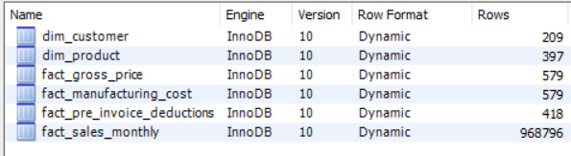
Data set

Slide 3
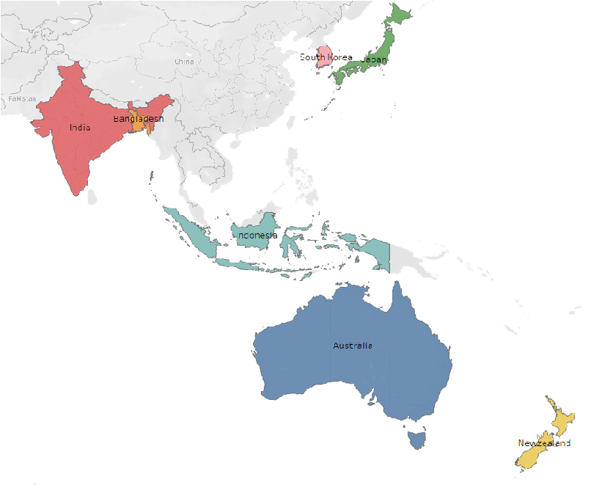
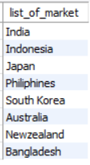
Market Analysis for “Atliq Exclusive”
1. Provide the list of markets in which customer "Atliq Exclusive" operates its business in the APAC region.
Output:

Slide 4
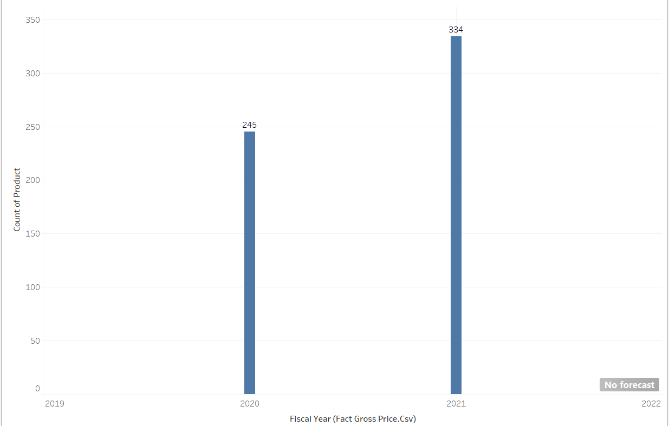

Difference of unique product 2022 vs. 2021
2. What is the percentage of unique product increase in 2021 vs. 2020? The final output contains these fields,unique_products_2020,unique_products_2021,percentage_chg
Output:
Insight: demand and production both increased.
Which is healthy and positive sigh for business.

Slide 5
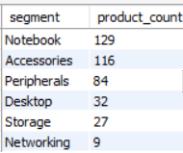
Segment wise unique products
3. Provide a report with all the unique product counts for each segment and sort them in descending order of product counts. The final output contains 2 fields, segment, product_count.
Output:
Insight:
segments like Notebook, Accessories, peripherals are performing well.
Were as desktop, storage Networking is having slow progress.

Slide 6
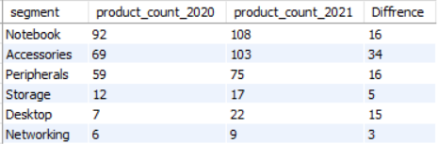
Segment wise Product count difference
4. Follow-up: Which segment had the most increase in unique products in 2021 vs 2020?
Output:

Slide 7

Highest and Lowest manufacturing cost
5. Get the products that have the highest and lowest manufacturing costs. The final output should contain these fields, product_code, product, manufacturing_cost
Output:
Insight:
AQ Home Allin Gen 2 (A6120110206) is a personal desktop with 240.5364$ hight manufacturing cost
where as AQ Master wired x1 Ms is a mouse with 0.8920$ lowest manufacturing cost.

Slide 8
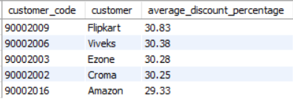
Top 5 customers with average high discount for fiscal year 2021
6. Generate a report which contains the top 5 customers who received an average high pre_invoice_discount_pct for the fiscal year 2021 and in the Indian market.
Output:
Insight:
Highest average discount percentage is given to Flipkart.
Least average discount is given to Amazon.

Slide 9
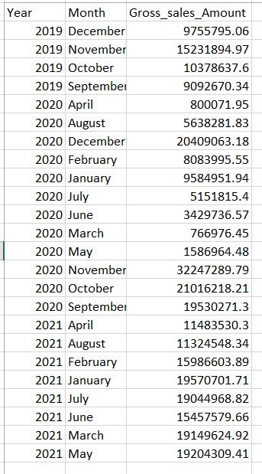
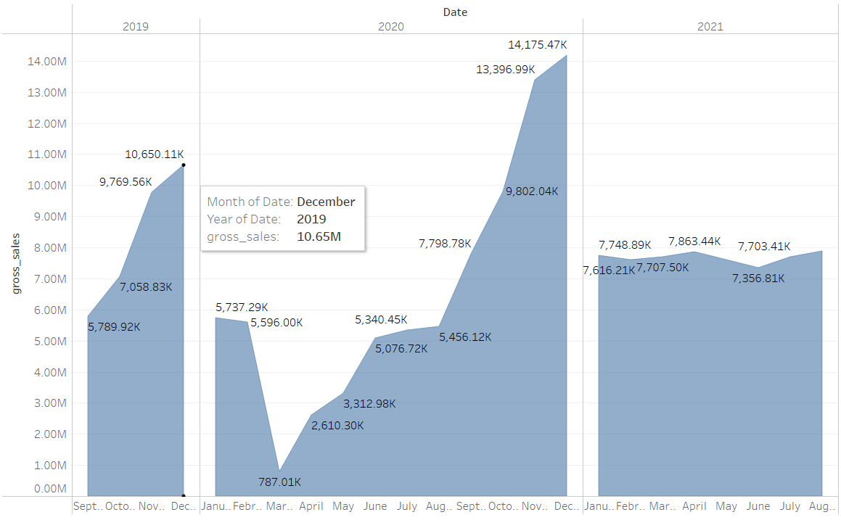
7. Get the complete report of the Gross sales amount for the customer “Atliq Exclusive” for each month.
Insight: Form Feb 2020 to Aug 2020 there is very less gross sales.

Slide 10
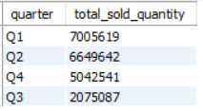
Quarter wise sold Quantity
8. In which quarter of 2020, got the maximum total_sold_quantity? The final output contains these fields sorted by the total_sold_quantity.
Insight: As we can see from above graph there is less quantity sold in quarter3.

Slide 11
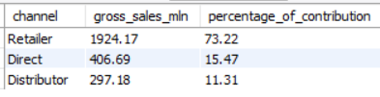
Channel contribution:
9. Which channel helped to bring more gross sales in the fiscal year 2021 and #the percentage of contribution?
Output:
Insight: Maximum contribution to gross sales is done by Retailer which is 73%.

Slide 12
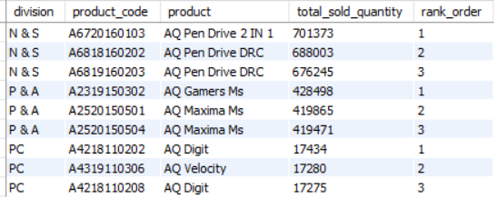
To 3 product In each division
10. Get the Top 3 products in each division that have a high total_sold_quantity in the fiscal_year 2021?

