Slide 1
Ecommerce Platform
Academic Viva Presentation | Professional Edition
College Project Demonstration
College: Mohamed Sathak College of Arts & Science
Student: Shalini | Roll No: 24MCAG001
Department: MCA

Slide 2
Presentation Outline
1. Problem Statement & Objectives
2. Technology Architecture & Design
3. Frontend Implementation Details
4. Backend & API Design
5. Database Schema & Models
6. Security & Authentication
7. Checkout & COD Flow
8. Testing, Results & Deployment

Slide 3
Problem Statement
Learning Need: A complete, production-style full-stack implementation for academic evaluation
Architecture Need: Clear separation of concerns across frontend, admin, and backend
Operational Need: Stable COD-first checkout for reliable demonstrations
Documentation Need: Structured technical report and viva-ready presentation
Scalability Need: Foundation that can evolve toward payment gateways and analytics

Slide 4
Project Objectives
Functional Goals:
• Build responsive customer interface
• Implement admin panel
• Design secure backend APIs
• Enable complete order pipeline
Quality Goals:
• Professional architecture
• Comprehensive documentation
• Security best practices
• Ready for deployment

Slide 5
Frontend Technology Stack
Framework & Build:
• React 18+ (Hooks-based)
• Vite (Fast HMR/bundling)
• Tailwind CSS (Utility-first)
• React Router v6 (Client navigation)
Libraries & Tools:
• Axios (HTTP client)
• Context API (State mgmt)
• React Toastify (Notifications)
• npm/yarn (Package manager)

Slide 6
Backend & Database Stack
Backend Runtime:
• Node.js 18+ LTS
• Express.js (Minimal framework)
• Mongoose ODM (Schema validation)
• JWT (Token-based auth)
Infrastructure:
• MongoDB (Document database)
• Multer (File uploads)
• bcrypt (Password hashing)
• Environment variables (.env)

Slide 7
System Architecture
Three-Tier Separation: Customer Frontend | Admin Panel | Shared Backend
API-First Design: Both clients communicate via REST endpoints
Stateless Authentication: JWT tokens for session management
Database Layer: MongoDB with schema validation via Mongoose
Scalability Path: Ready for microservices, caching, and load balancing

Slide 8
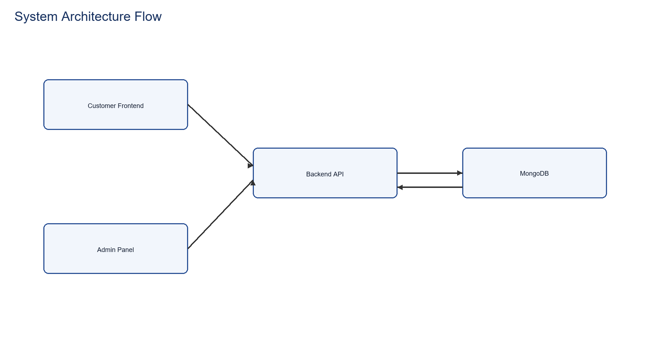
System Architecture Flowchart
Client-Service-Database model: Frontend and Admin clients consume unified backend API

Slide 9
Frontend Module Features
Product Discovery: Search, filter by category, price range sorting
Product Details: Full specs, images, size/color variants
Shopping Cart: Add/remove, quantity management, persistent storage
Checkout: Address entry, order review, COD confirmation
Order Tracking: History view, status updates, delivery confirmation

Slide 10
Admin Module Capabilities
Product Management:
• Add new products
• Edit product details
• Remove/archive
• Bulk operations
Order Management:
• View all orders
• Update status
• Track fulfillment
• Generate reports

Slide 11
Backend API Organization
User Routes: /api/user (register, login, admin login)
Product Routes: /api/product (add, list, remove, single)
Cart Routes: /api/cart (add, get, update)
Order Routes: /api/order (place, list, status, userorders)
Route-level middleware enforces auth and admin access controls

Slide 12
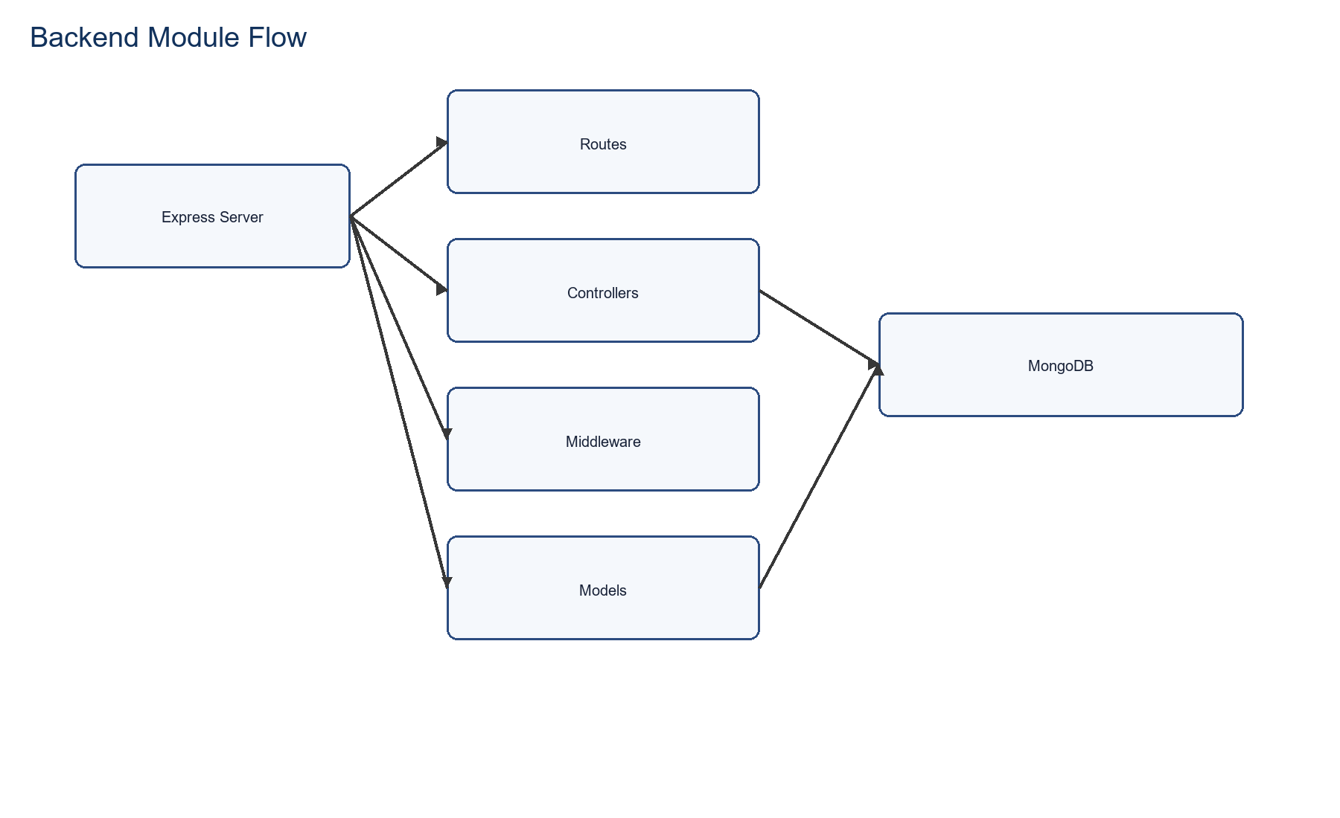
Backend Module Flow
Express route -> controller -> middleware -> model pipeline with MongoDB persistence

Slide 13
MongoDB Collections
User Schema:
• ID, Email, Password Hash
• Name, Address, Phone
• Cart Array (Items)
• Auth Tokens, Timestamps
Product Schema:
• ID, Name, Category
• Price, Description
• Images Array
• Sizes, Stock Level

Slide 14
Order & Payment Models
Order Schema:
• User Reference
• Items Array
• Delivery Address
• Order Date & Status
Payment Flow:
• Payment Method: COD
• Status Transitions
• Date Tracking
• Admin Updates

Slide 15
Authentication & Security
JWT Implementation: Secure token generation and verification
Password Security: bcrypt hashing with salt rounds
Role-Based Access: Customer vs Admin vs Public routes
Middleware Protection: Auth middleware on protected endpoints
Environment Secrets: Credentials via .env files, never hardcoded

Slide 16
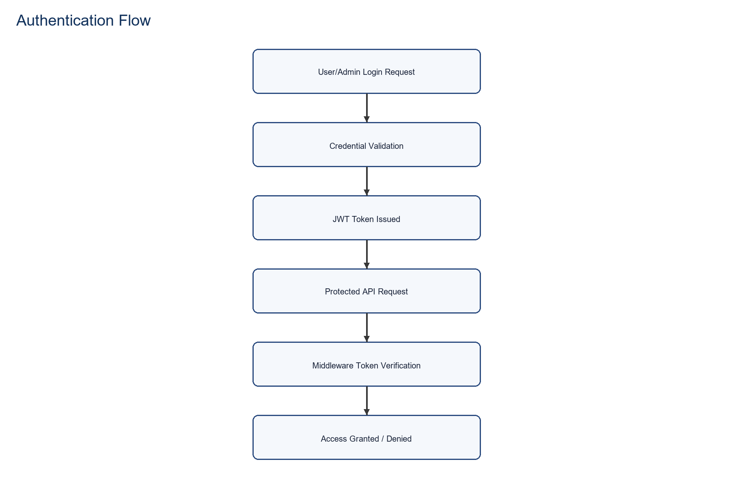
Authentication Flowchart
Credential validation, JWT issuance, and middleware-based access control

Slide 17
Cash On Delivery Flow
Step 1: Customer reviews cart items and prices
Step 2: Enter delivery address and phone number
Step 3: Confirm order submission (no payment gateway call)
Step 4: Backend validates and creates order document
Step 5: Cart cleared, order appears in history and admin dashboard

Slide 18
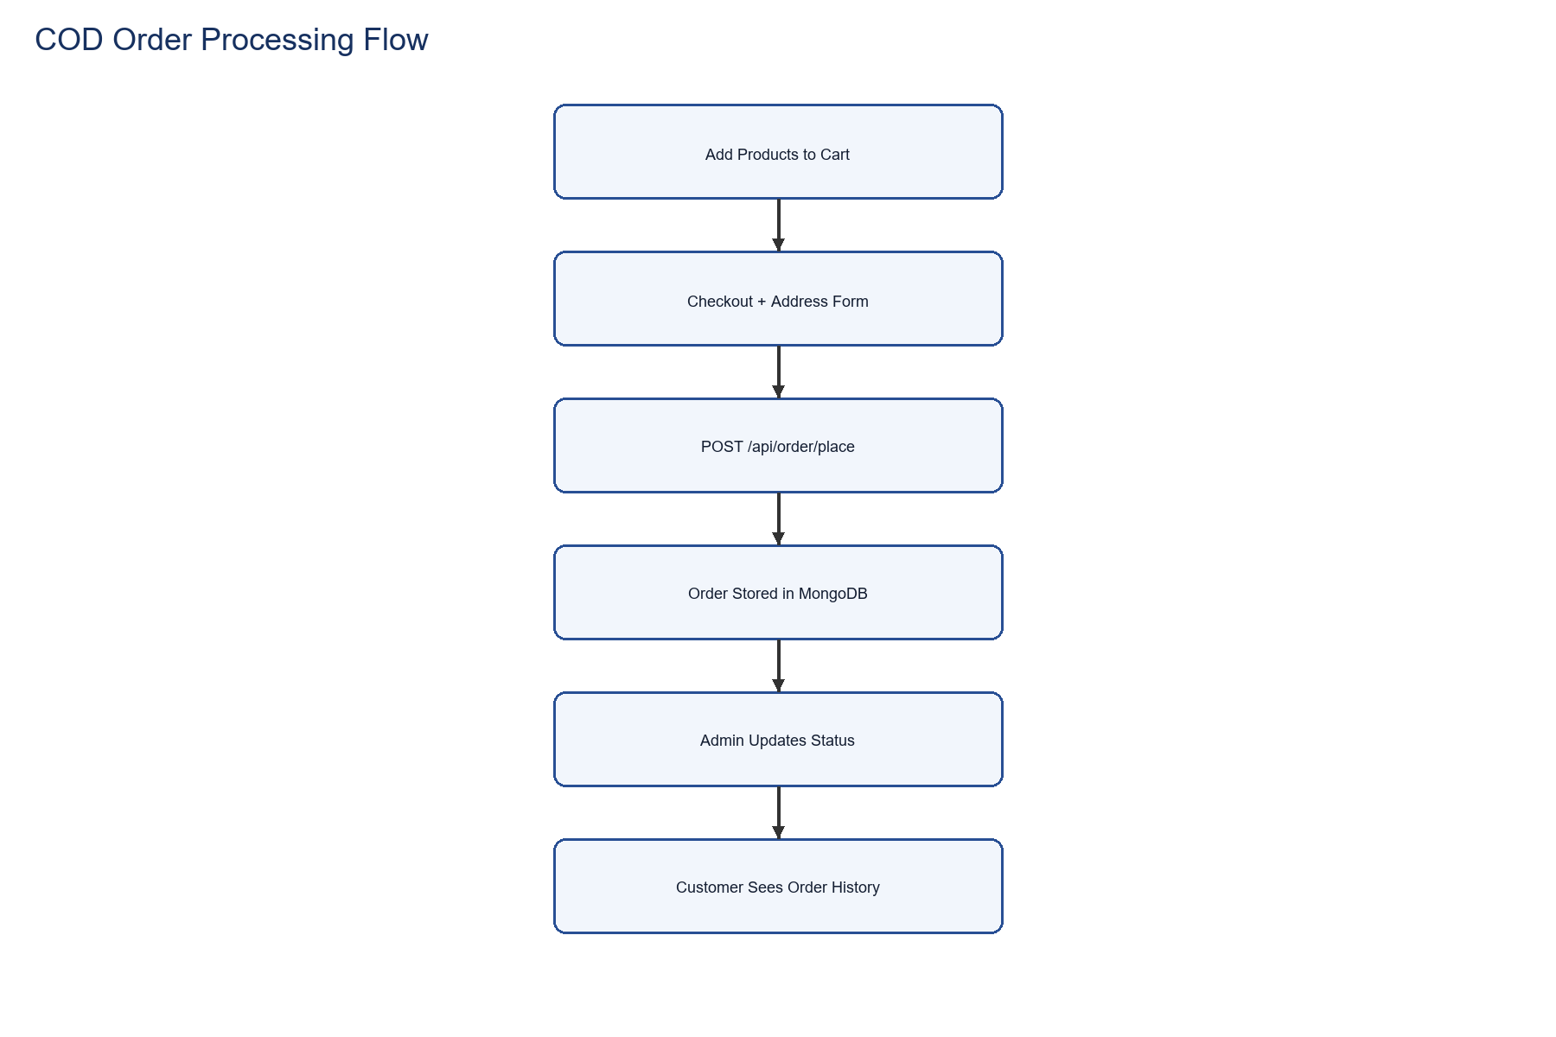
Order Processing Pipeline
COD checkout simplified: No external gateway, single backend endpoint

Slide 19
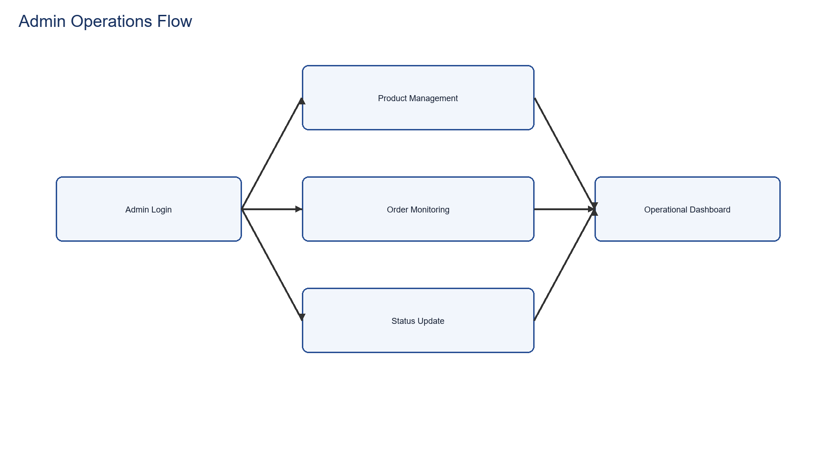
Admin Workflow
Admin authentication and operational monitoring lifecycle

Slide 20
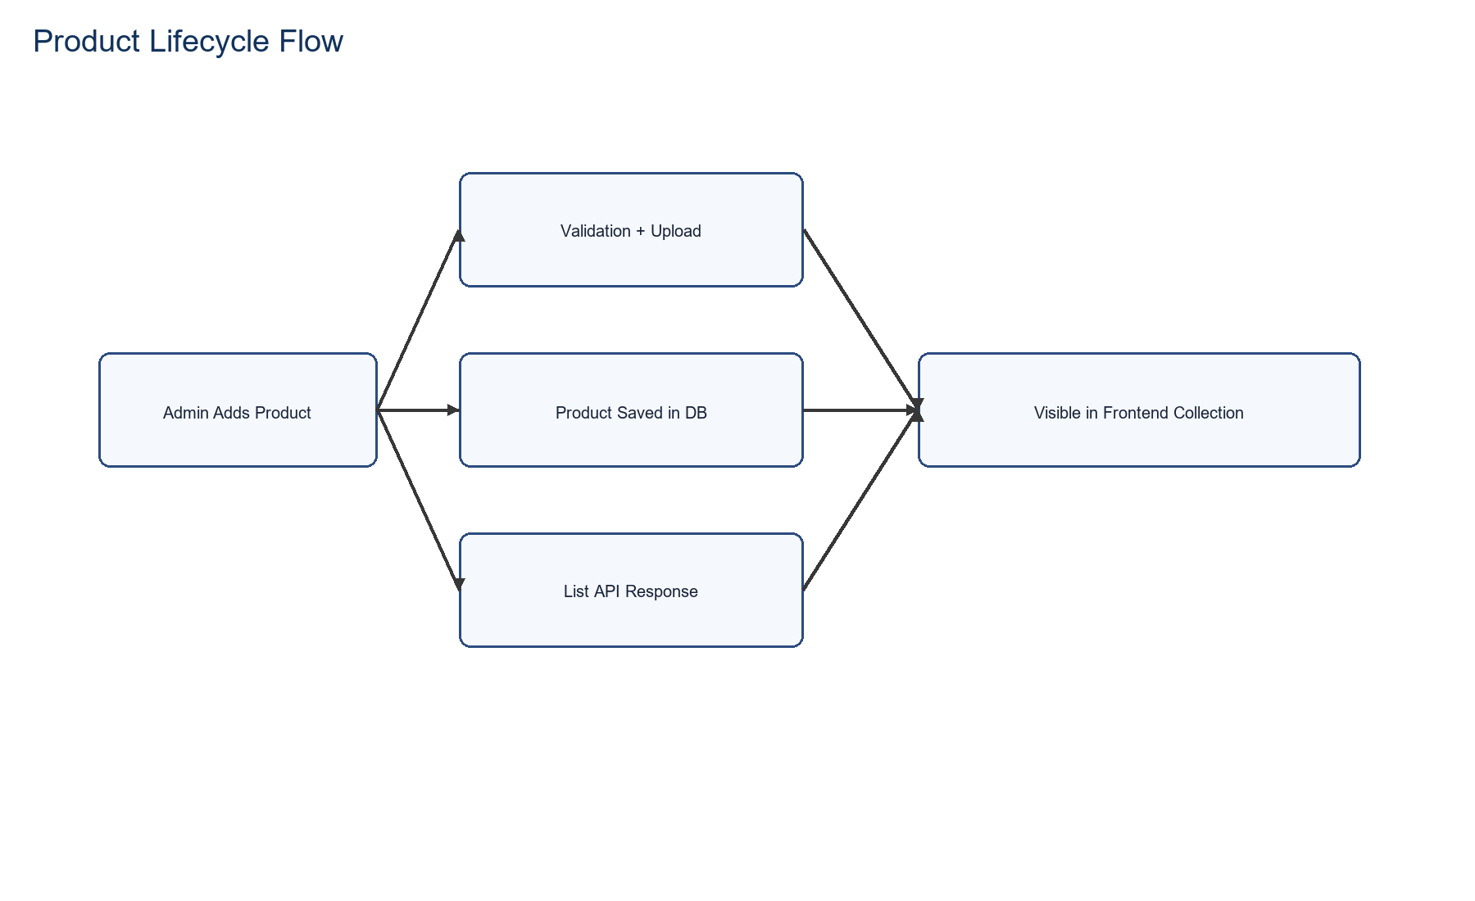
Product Lifecycle Flowchart
Admin add/update actions reflected in catalog API responses and storefront rendering

Slide 21

Application UI - Home
Home page layout used in the customer storefront

Slide 22

Application UI - Collection
Collection and filtering interface used in product browsing

Slide 23
Dataset & Metrics
Total Products: 52
Price Range: ₹250 - ₹860
Average Price: ₹547.69
Categories: Men, Women, Kids
Ready for realistic catalog simulation and viva discussion

Slide 24
Testing & Validation
Unit Testing:
• Form validation logic
• Cart calculations
• Auth token checks
• API error handling
Integration Testing:
• API smoke tests
• User registration flow
• Product listing
• Order placement

Slide 25
Security Implementation
HTTPS/TLS: Encrypted data transmission
CORS Configuration: Controlled cross-origin requests
Input Validation: Sanitize all user inputs
NoSQL Injection Mitigation: Validate and sanitize query/body payloads
Recommended Additions: Helmet.js, rate limiting, audit logging

Slide 26
Deployment & Scalability
Local Development: Separate npm processes (backend:4000, frontend/admin via Vite)
Environment Configuration: .env files per deployment stage
Database: MongoDB Atlas cloud or local community edition
Future Scale: Containerization (Docker), CI/CD pipeline, load balancing
Uptime: Monitoring and alerting infrastructure

Slide 27
Project Highlights
Complete Features:
✓ User authentication
✓ Product catalog
✓ Shopping cart
✓ Order lifecycle
Quality Marks:
✓ Clean code structure
✓ Security hardened
✓ Well documented
✓ Production-ready

Slide 28
Viva Q&A: Why COD-Only?
Simplicity: Single payment pathway reduces complexity
Stability: No dependency on third-party payment gateway
MVP Approach: Focuses on core ecommerce logic, not payment integration
Academic Clarity: Demonstrates order pipeline without payment noise
Future Ready: Payment gateways can be reintroduced in Phase 2

Slide 29
Viva Q&A: Security Model
Admin Credentials: Stored as environment variables, not in code
JWT Tokens: Issued on login, verified on protected routes
Password Storage: bcrypt hashing prevents plaintext exposure
CORS Policy: Controls which domains can access our API
Rate Limiting: (Recommended) Prevents brute-force attacks

Slide 30
Viva Q&A: Cart Synchronization
Client State: Frontend context updates cart instantly for responsive UX
Server Persistence: Cart data is synchronized through /api/cart endpoints
Authentication: Token-based calls protect user-specific cart data
Consistency: Backend remains the source of truth for order creation
Reliability: Sync after mutations prevents stale cart snapshots

Slide 31
Viva Q&A: Scaling Approach
Database: MongoDB replica sets for read scaling
Caching: Redis layer for product catalog and hot data
Microservices: Split into payment, inventory, notification services
Load Balancing: Nginx/HAProxy across multiple node instances
Monitoring: Prometheus + Grafana for performance tracking

Slide 32
Challenges Addressed
Technical:
• State management
• Real-time updates
• Data consistency
• Error handling
Solutions:
• Context API for state
• WebSocket readiness
• Transaction logs
• Graceful degradation

Slide 33
Development Timeline
Phase 1 (Backend): Database design, API development, testing
Phase 2 (Frontend): UI components, integration, cart logic
Phase 3 (Admin): Dashboard, product management, order tracking
Phase 4 (Documentation): API docs, setup guide, viva materials
Phase 5 (Deployment): Testing, security audit, launch readiness

Slide 34
Roadmap & Enhancements
Short-term:
• Payment gateway integration
• Inventory alerts
• Email notifications
• User reviews
Long-term:
• Analytics dashboard
• Coupon system
• Recommendation engine
• Mobile app

Slide 35
Project Conclusion
Complete full-stack ecommerce solution with a stable COD-first workflow
Professional documentation suitable for institutional evaluation
Security-aware implementation aligned with OWASP recommendations
Modular architecture ready for iterative enhancements
Prepared for viva presentation and guided deployment

Slide 36
Thank You
Questions & Discussion Shalini | Mohamed Sathak College of Arts & Science

