Slide 1
Ecommerce Platform
Full-Stack Demonstration | Professional Edition
College Project Demonstration
College: Mohamed Sathak College of Arts & Science
Student: Shalani | Roll No: 24MCAG001
Department: MCA

Slide 2
Presentation Outline
1. Problem Statement & Objectives
2. Technology Architecture & Design
3. Frontend Implementation Details
4. Backend & API Design
5. Database Schema & Models
6. Security & Authentication
7. Checkout & COD Flow
8. Testing, Results & Deployment

Slide 3
Problem Statement
Market Need: Lack of modular, well-documented ecommerce solutions for learning
Academic Gap: Students need real-world full-stack project with clear architecture
Business Need: Simplified COD payment model for MVP reliability
Technical Need: Clean separation of concerns (frontend, admin, backend)
Presentation Need: Professional documentation and viva-ready demonstration

Slide 4
Project Objectives
Functional Goals:
• Build responsive customer interface
• Implement admin panel
• Design secure backend APIs
• Enable complete order pipeline
Quality Goals:
• Professional architecture
• Comprehensive documentation
• Security best practices
• Ready for deployment

Slide 5
Frontend Technology Stack
Framework & Build:
• React 18+ (Hooks-based)
• Vite (Fast HMR/bundling)
• Tailwind CSS (Utility-first)
• React Router v6 (Client navigation)
Libraries & Tools:
• Axios (HTTP client)
• Context API (State mgmt)
• React Toastify (Notifications)
• npm/yarn (Package manager)

Slide 6
Backend & Database Stack
Backend Runtime:
• Node.js 18+ LTS
• Express.js (Minimal framework)
• Mongoose ODM (Schema validation)
• JWT (Token-based auth)
Infrastructure:
• MongoDB (Document database)
• Multer (File uploads)
• bcrypt (Password hashing)
• Environment variables (.env)

Slide 7
System Architecture
Three-Tier Separation: Customer Frontend | Admin Panel | Shared Backend
API-First Design: Both clients communicate via REST endpoints
Stateless Authentication: JWT tokens for session management
Database Layer: MongoDB with schema validation via Mongoose
Scalability Path: Ready for microservices, caching, and load balancing

Slide 8
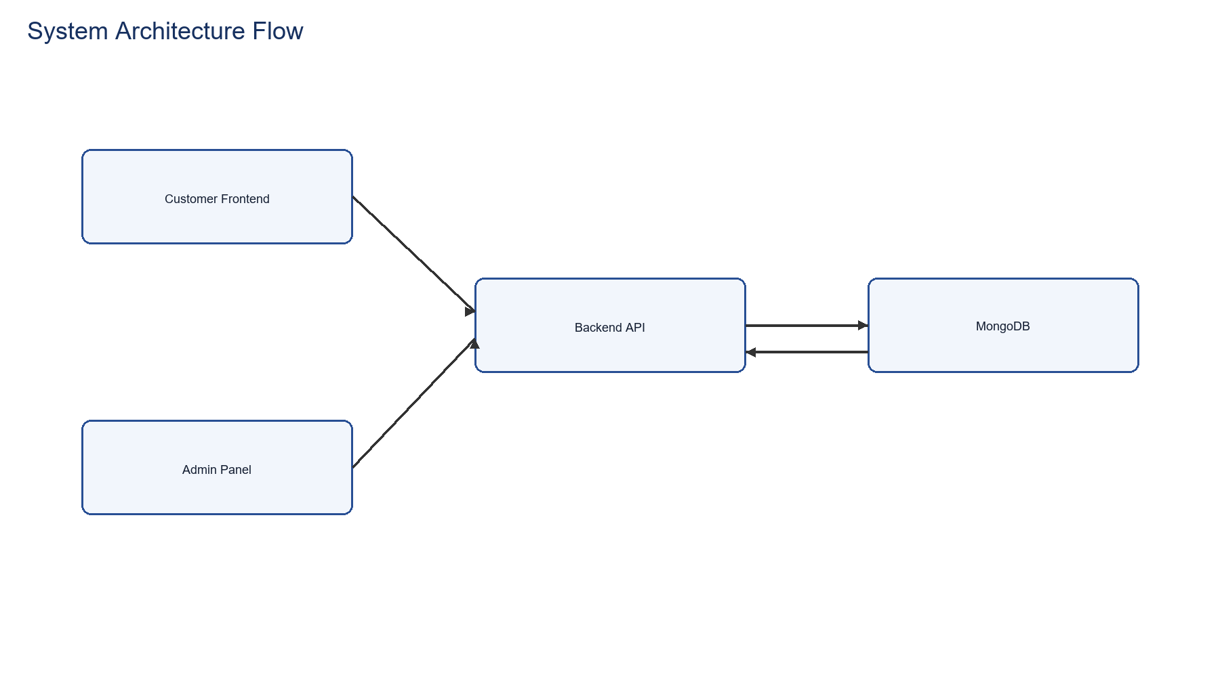
System Architecture Flowchart
Client-Service-Database model: Frontend and Admin clients consume unified backend API

Slide 9
Frontend Module Features
Product Discovery: Search, filter by category, price range sorting
Product Details: Full specs, images, size/color variants
Shopping Cart: Add/remove, quantity management, persistent storage
Checkout: Address entry, order review, COD confirmation
Order Tracking: History view, status updates, delivery confirmation

Slide 10
Admin Module Capabilities
Product Management:
• Add new products
• Edit product details
• Remove/archive
• Bulk operations
Order Management:
• View all orders
• Update status
• Track fulfillment
• Generate reports

Slide 11
Backend API Organization
User Routes: /api/user (register, login, profile)
Product Routes: /api/product (add, list, fetch, delete)
Cart Routes: /api/cart (add, remove, fetch, clear)
Order Routes: /api/order (place, list, update status, user orders)
Admin Routes: /api/admin (dashboard, analytics, reports)

Slide 12
MongoDB Collections
User Schema:
• ID, Email, Password Hash
• Name, Address, Phone
• Cart Array (Items)
• Auth Tokens, Timestamps
Product Schema:
• ID, Name, Category
• Price, Description
• Images Array
• Sizes, Stock Level

Slide 13
Order & Payment Models
Order Schema:
• User Reference
• Items Array
• Delivery Address
• Order Date & Status
Payment Flow:
• Payment Method: COD
• Status Transitions
• Date Tracking
• Admin Updates

Slide 14
Authentication & Security
JWT Implementation: Secure token generation and verification
Password Security: bcrypt hashing with salt rounds
Role-Based Access: Customer vs Admin vs Public routes
Middleware Protection: Auth middleware on protected endpoints
Environment Secrets: Credentials via .env files, never hardcoded

Slide 15
Cash On Delivery Flow
Step 1: Customer reviews cart items and prices
Step 2: Enter delivery address and phone number
Step 3: Confirm order submission (no payment gateway call)
Step 4: Backend validates and creates order document
Step 5: Cart cleared, order appears in history and admin dashboard

Slide 16
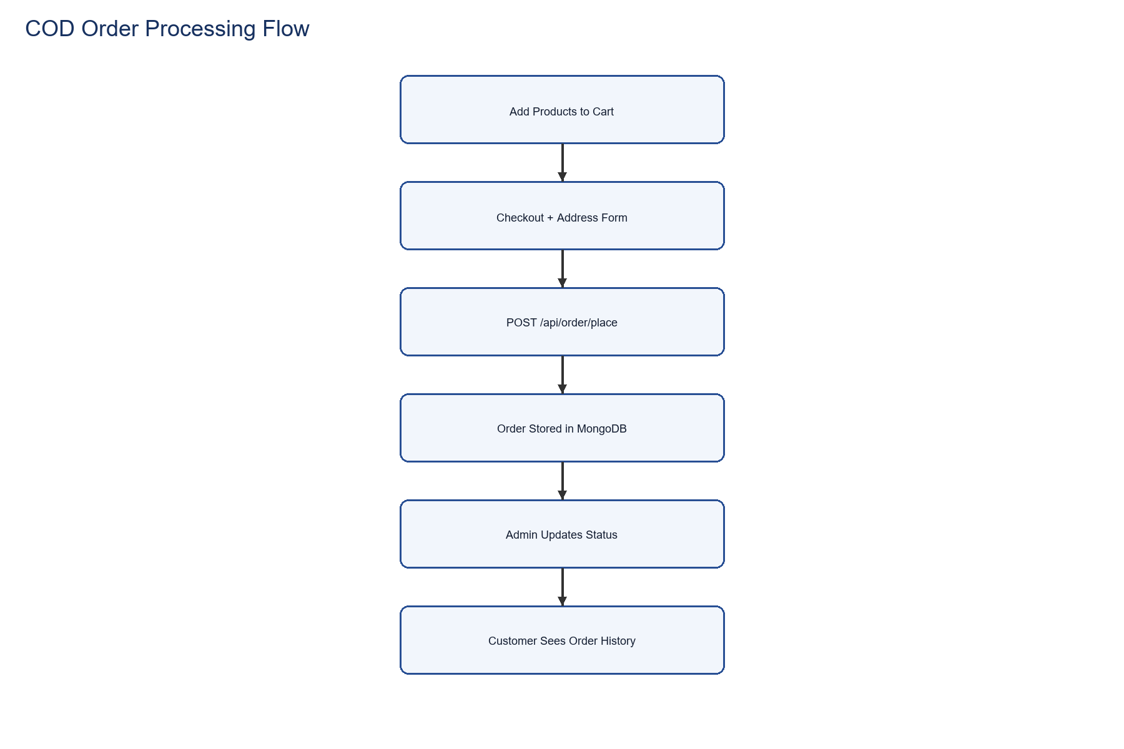
Order Processing Pipeline
COD checkout simplified: No external gateway, single backend endpoint

Slide 17
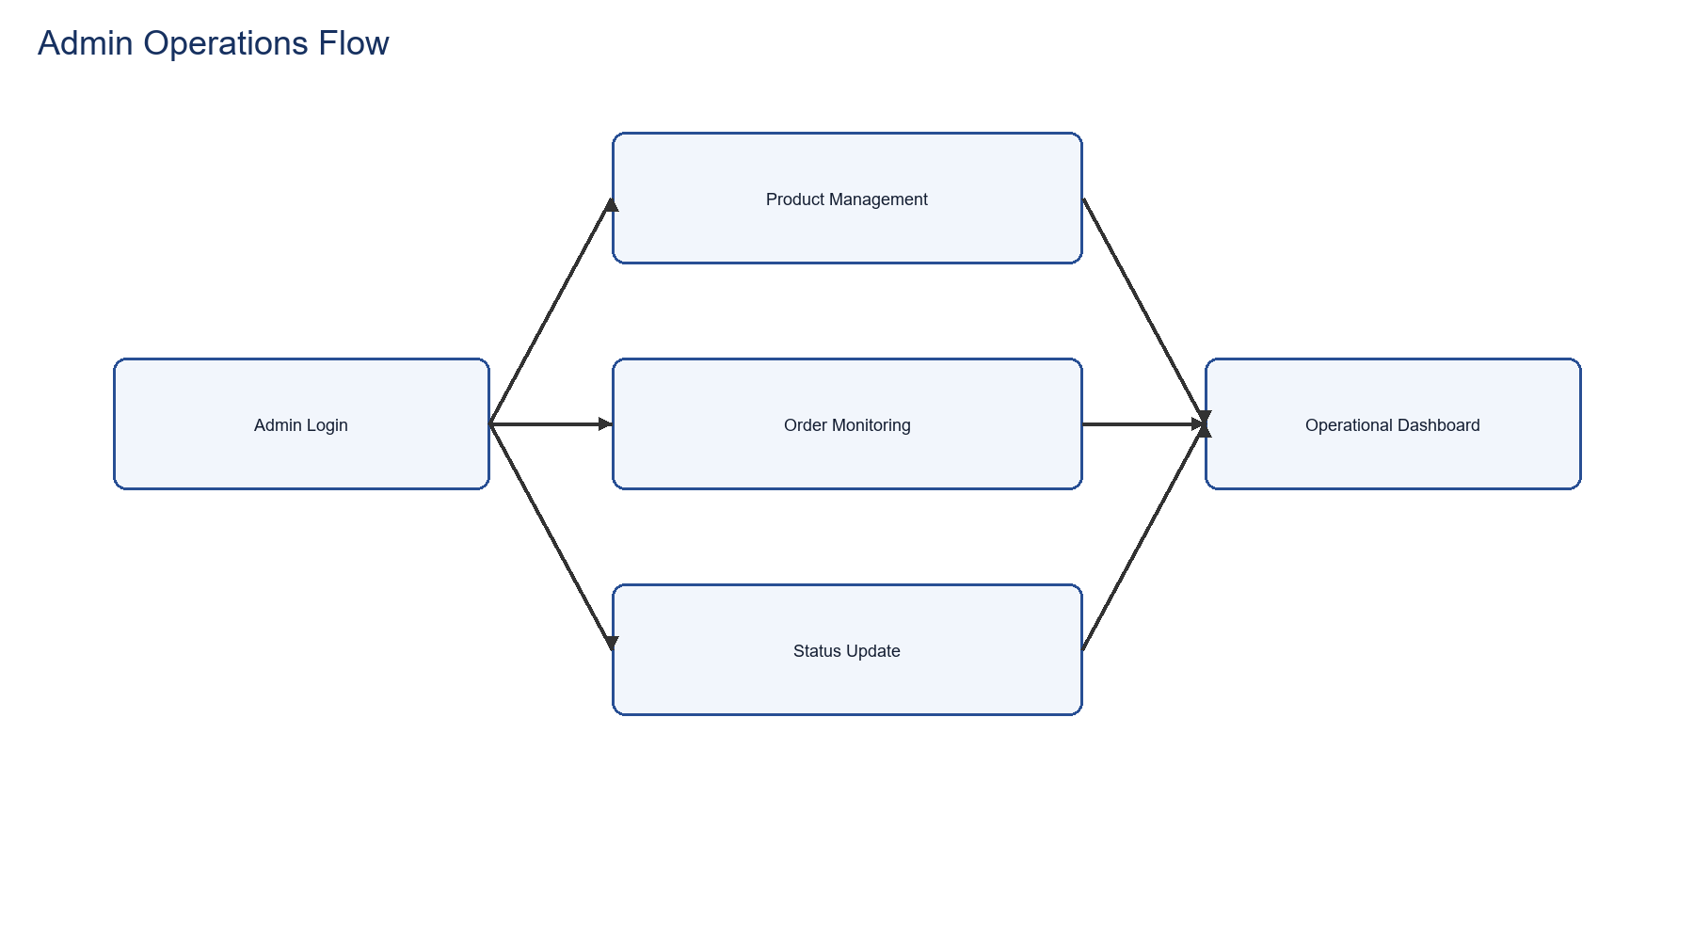
Admin Workflow
Admin authentication and operational monitoring lifecycle

Slide 18
Dataset & Metrics
Total Products: 52
Price Range: ₹250 - ₹860
Average Price: ₹547.69
Categories: Men, Women, Kids
Ready for realistic catalog simulation and viva discussion

Slide 19
Security Implementation
HTTPS/TLS: Encrypted data transmission
CORS Configuration: Controlled cross-origin requests
Input Validation: Sanitize all user inputs
SQL Injection Prevention: Mongoose parameterized queries
Recommended Additions: Helmet.js, rate limiting, audit logging

Slide 20
Deployment & Scalability
Local Development: Separate npm processes (backend:4000, frontend/admin via Vite)
Environment Configuration: .env files per deployment stage
Database: MongoDB Atlas cloud or local community edition
Future Scale: Containerization (Docker), CI/CD pipeline, load balancing
Uptime: Monitoring and alerting infrastructure

Slide 21
Project Highlights
Complete Features:
✓ User authentication
✓ Product catalog
✓ Shopping cart
✓ Order lifecycle
Quality Marks:
✓ Clean code structure
✓ Security hardened
✓ Well documented
✓ Production-ready

Slide 22
Viva Q&A: Why COD-Only?
Simplicity: Single payment pathway reduces complexity
Stability: No dependency on third-party payment gateway
MVP Approach: Focuses on core ecommerce logic, not payment integration
Academic Clarity: Demonstrates order pipeline without payment noise
Future Ready: Payment gateways can be reintroduced in Phase 2

Slide 23
Viva Q&A: Security Model
Admin Credentials: Stored as environment variables, not in code
JWT Tokens: Issued on login, verified on protected routes
Password Storage: bcrypt hashing prevents plaintext exposure
CORS Policy: Controls which domains can access our API
Rate Limiting: (Recommended) Prevents brute-force attacks

Slide 24
Viva Q&A: Cart Synchronization
Local Storage: Frontend maintains cart in browser for UI responsiveness
Database Sync: Cart array persisted in user document on backend
Authentication: Logged-in users sync via API /api/cart endpoints
Guest Checkout: Local-only cart without account required
Consistency: Backend is source of truth for finalized orders

Slide 25
Viva Q&A: Scaling Approach
Database: MongoDB replica sets for read scaling
Caching: Redis layer for product catalog and hot data
Microservices: Split into payment, inventory, notification services
Load Balancing: Nginx/HAProxy across multiple node instances
Monitoring: Prometheus + Grafana for performance tracking

Slide 26
Challenges Addressed
Technical:
• State management
• Real-time updates
• Data consistency
• Error handling
Solutions:
• Context API for state
• WebSocket readiness
• Transaction logs
• Graceful degradation

Slide 27
Development Timeline
Phase 1 (Backend): Database design, API development, testing
Phase 2 (Frontend): UI components, integration, cart logic
Phase 3 (Admin): Dashboard, product management, order tracking
Phase 4 (Documentation): API docs, setup guide, viva materials
Phase 5 (Deployment): Testing, security audit, launch readiness

Slide 28
Roadmap & Enhancements
Short-term:
• Payment gateway integration
• Inventory alerts
• Email notifications
• User reviews
Long-term:
• Analytics dashboard
• Coupon system
• Recommendation engine
• Mobile app

Slide 29
Project Conclusion
Complete full-stack ecommerce solution with production-quality code
Professional documentation suitable for academic evaluation
Security-hardened with best practices from OWASP guidelines
Scalable architecture ready for enhancement and deployment
Ready for viva presentation and real-world deployment

Slide 30
Thank You
Questions & Discussion Shalani | Mohamed Sathak College of Arts & Science

